Slide 1
Intro to Communication
Adithya Bhat
Manav Garg
Vikas Goel

Slide 2
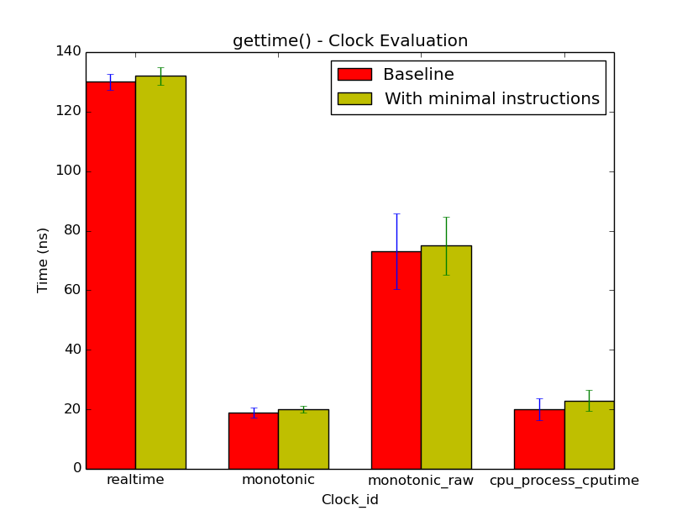
Clock Selection - Overhead and Resolution
AIM : Measure overhead of clock_gettime() call
Method : Consecutive calls Median
Error bar - StDev

Slide 3
Clock Measurement - Overhead and Resolution
 | CPU_PROCESS_CPUTIME |  | MONOTONIC |  | MONOTONIC_RAW |  | REALTIME
 | Baseline | Diff | Baseline | Diff | Baseline | Diff | Baseline | Diff
Median | 130 | 132 | 19 | 20 | 73 | 75 | 20 | 23
Average | 130.12 | 131.98 | 18.58 | 20.26 | 78.39 | 77.35 | 20.09 | 21.96
StdDev | 2.73 | 2.90 | 1.68 | 1.16 | 12.68 | 9.72 | 3.58 | 3.49
Min | 123.00 | 125.00 | 15.00 | 16.00 | 63.00 | 67.00 | 13.00 | 15.00
Max | 137.00 | 139.00 | 23.00 | 24.00 | 117.00 | 112.00 | 31.00 | 31.00
* - all time measurements are in ns

Slide 4
Options
With / without optimization
Median / average values
Remote / local machine
Choices for subsequent graphs
(Unless otherwise specified)
With optimization
Median values
Remote machine

Slide 5
Clock Measurement - Overhead and Resolution
 | Time
L1 Cache | 2.25 ns
Branch Misprediction | 80 ns
Mutex Lock | 25 ns
Mutex Unlock | 34 ns
Read 1 MB sequentially from SSD | 6.40 (MBps)
Read 1 MB sequentially from disk | 6.29 (MBps)
Send packet CA->Netherlands->CA | 168.116 (ms)
Compress 1KB with Zippy / Snappy | 776 ns

Slide 6
Overall Comparison

Slide 7
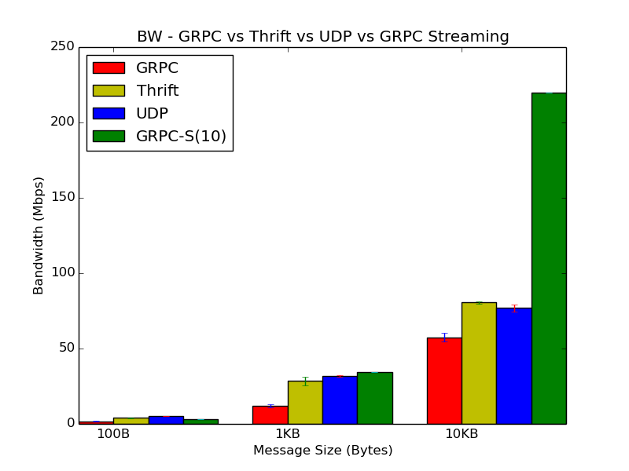
Cross comparison UDP / GRPC / Thrift
Bandwidth
With optimization
Median values
Remote machine
Note: Discuss how we measure BW, and whether it’s right to compare UDP with this.
Key point - RPC could return data, UDP returns Ack.
Also, layers below the Application Layer in RPC could be doing this internally.

Slide 8
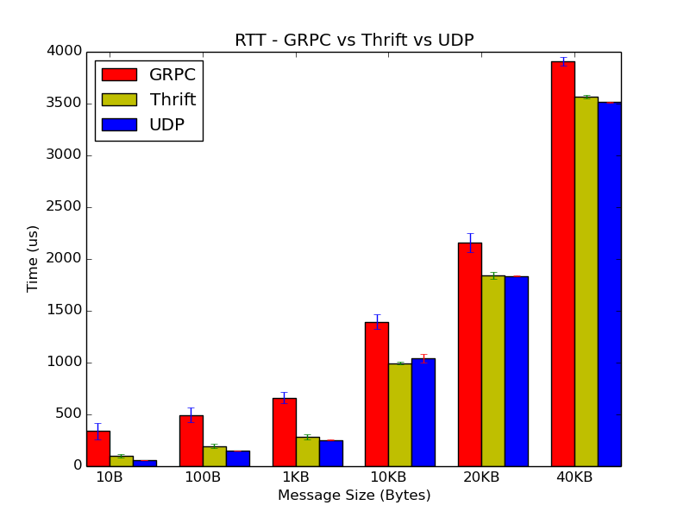
Cross comparison GRPC / Thrift
RTT
With optimization
Median values
Remote machine

Slide 9
Reliable UDP

Slide 10
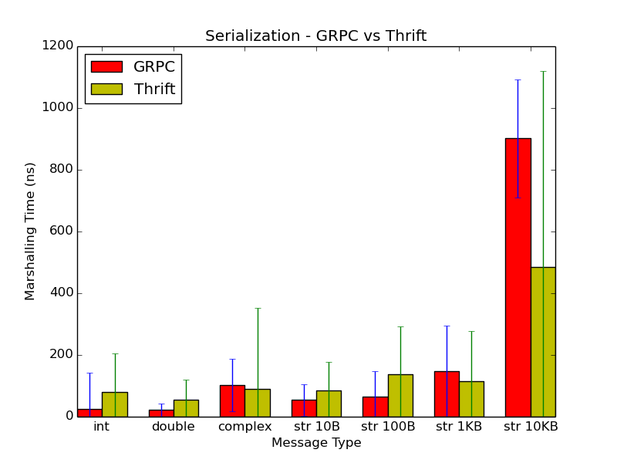
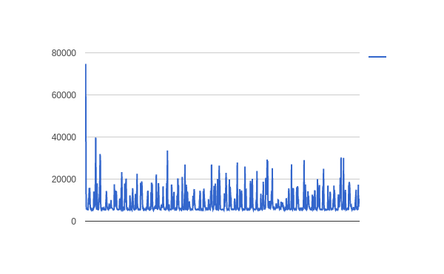
Cross comparison GRPC / Thrift
Time for Marshalling
With optimization
Median values
Remote machine

Slide 11
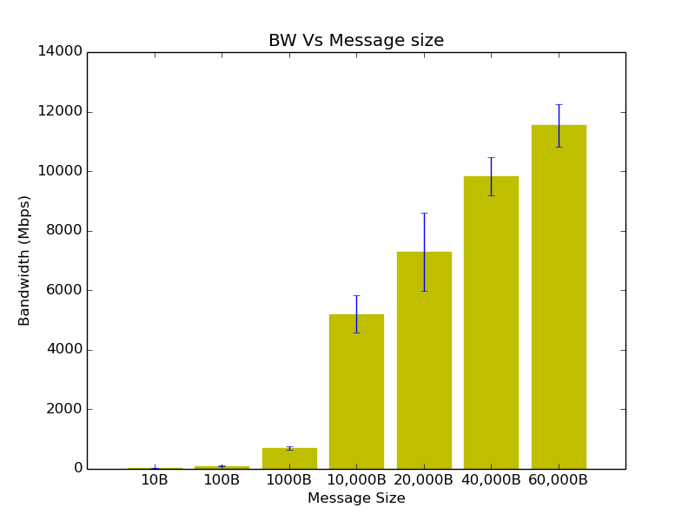
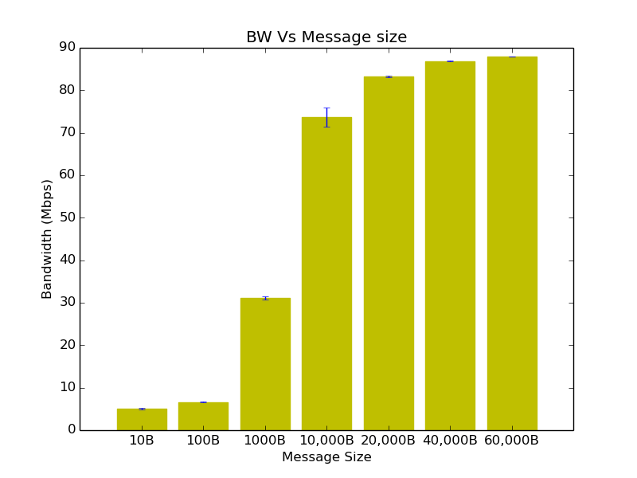
Reliable UDP
Bandwidth
Optimized
Median
Same Machine Different Machines

Slide 12
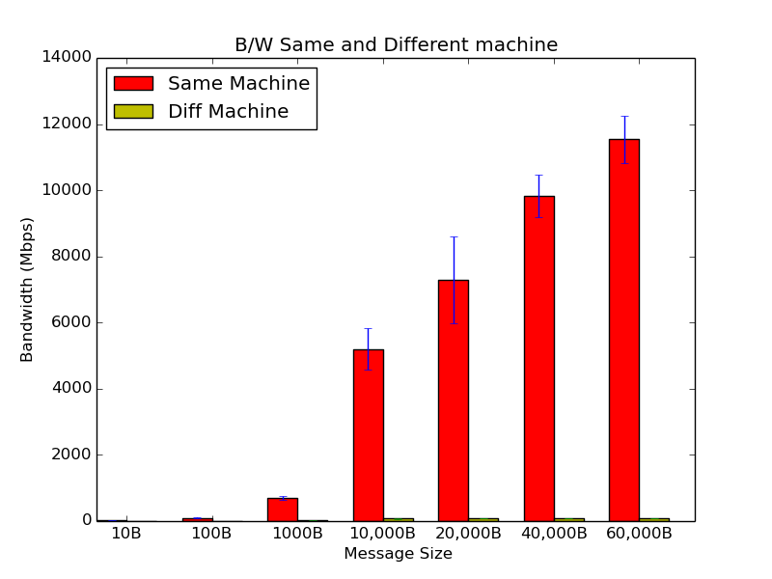
Reliable UDP
Bandwidth
Optimization
Median
Across Machine

Slide 13
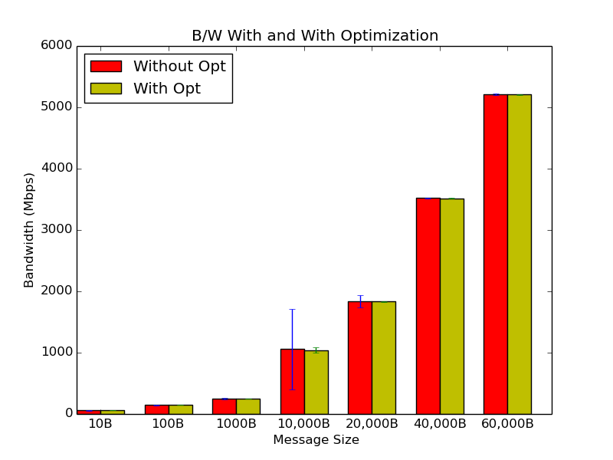
Reliable UDP
Bandwidth With Vs Without optimization
Median
Different Machine

Slide 14
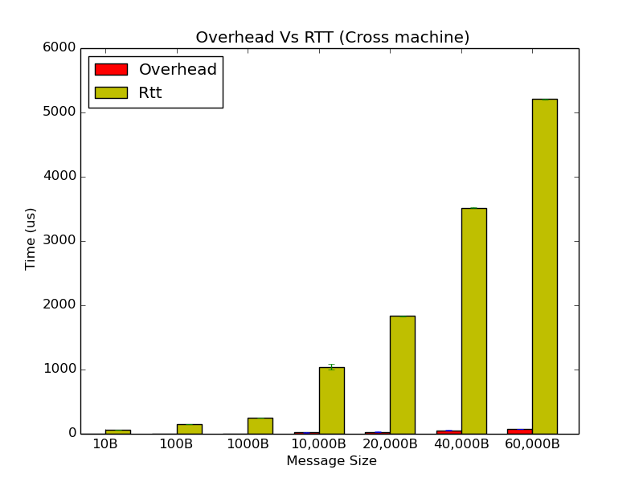
Reliable UDP
With Optimization
Median
Different machine
Overhead Vs RTT

Slide 15
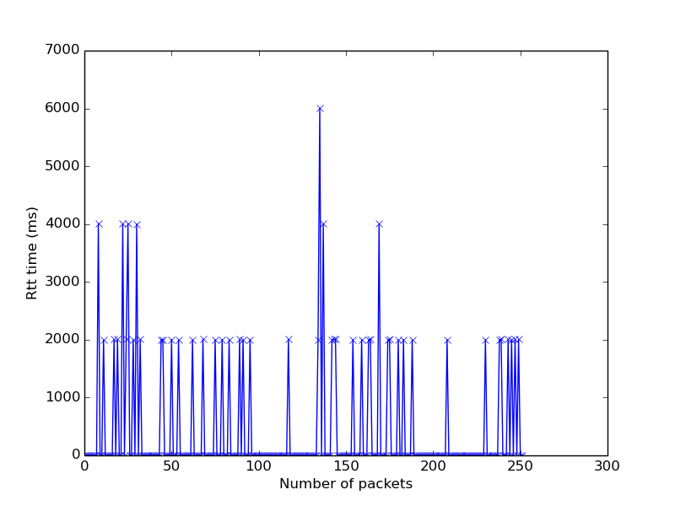
Reliable UDP
RTT with packet drop rate 20%
Timeout - 3sec
With optimization
Same machine
Median

Slide 16
GRPC

Slide 17
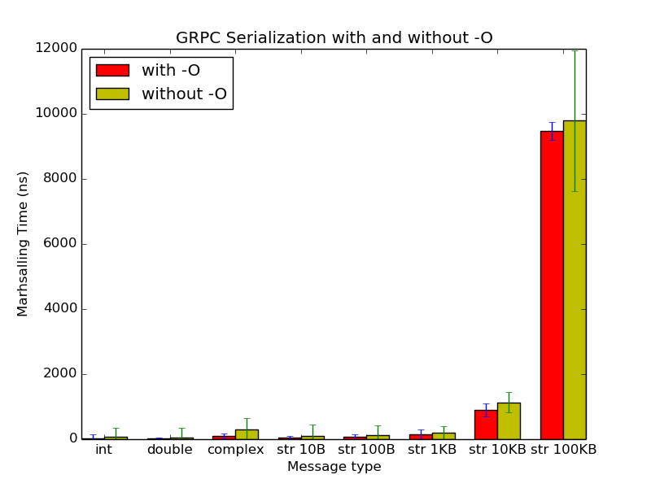
GRPC
Marshalling overhead (time)
With Vs Without optimization
Median values

Slide 18
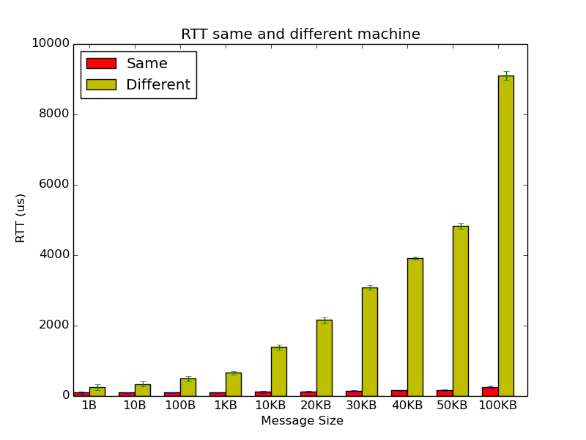
GRPC
RTT
Same and different machine
With Optimization
Median values

Slide 19
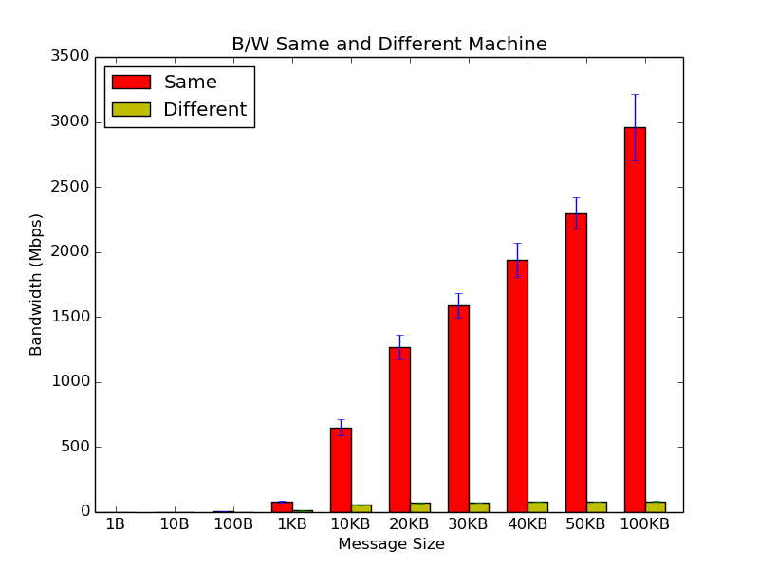
GRPC
Bandwidth
Same and different machine
With Optimization
Median values

Slide 20
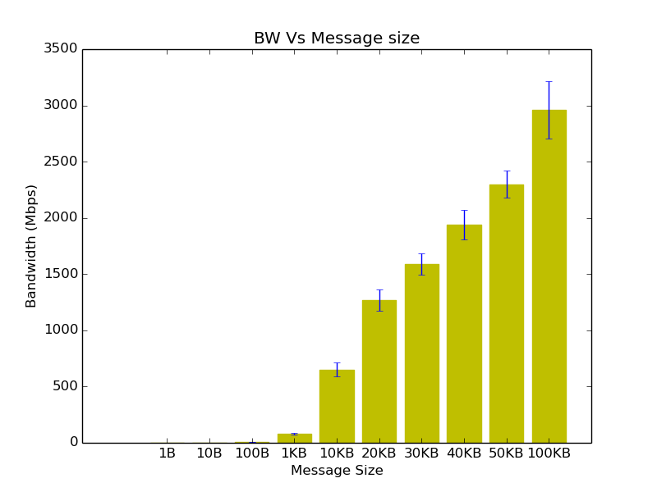
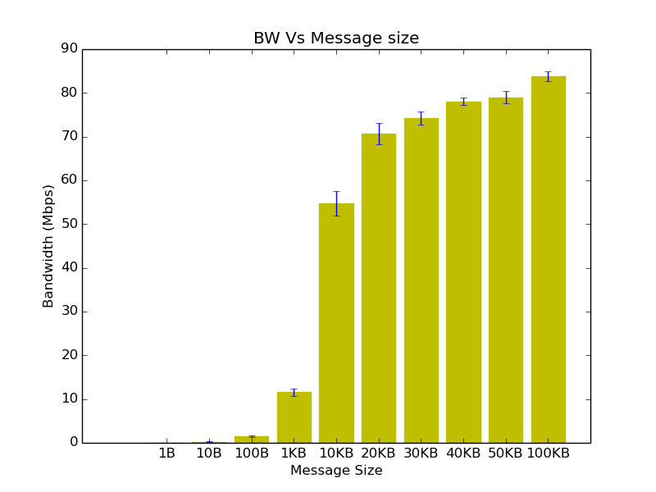
GRPC
Bandwidth - Remote hosts and Localhost
Same Machine Different Machine

Slide 21
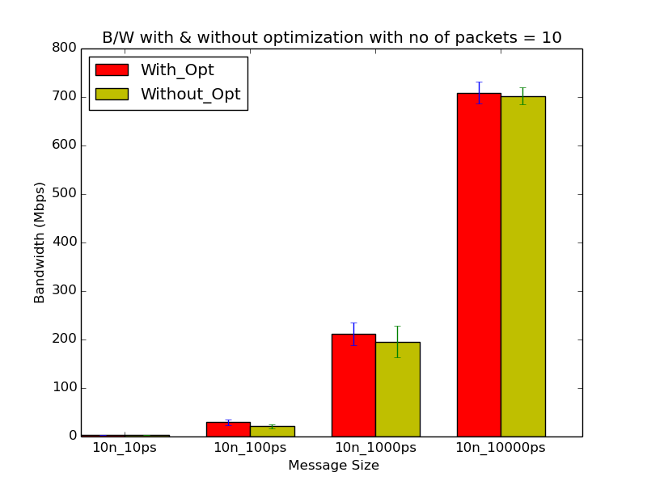
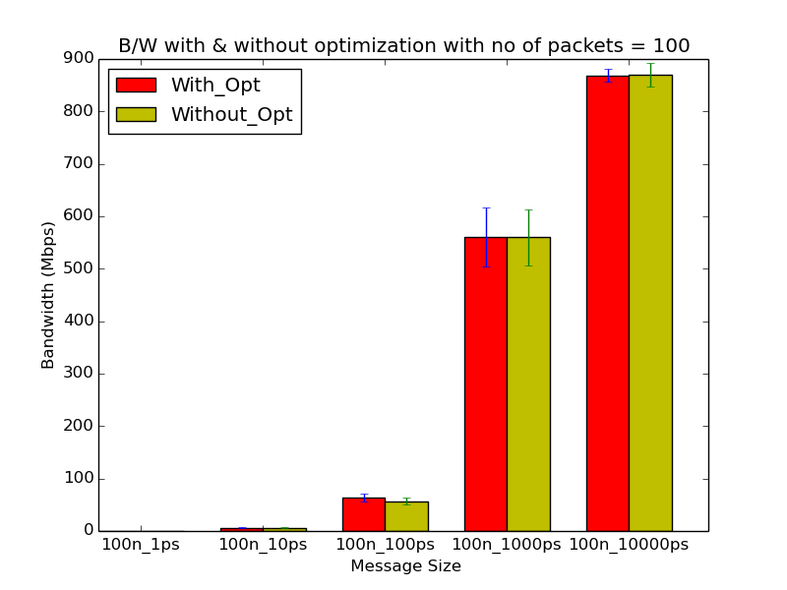
GRPC (Server Streaming)
BW in Server Streaming (with/without optimization)
No of packets = 10 Number of packets =100

Slide 22
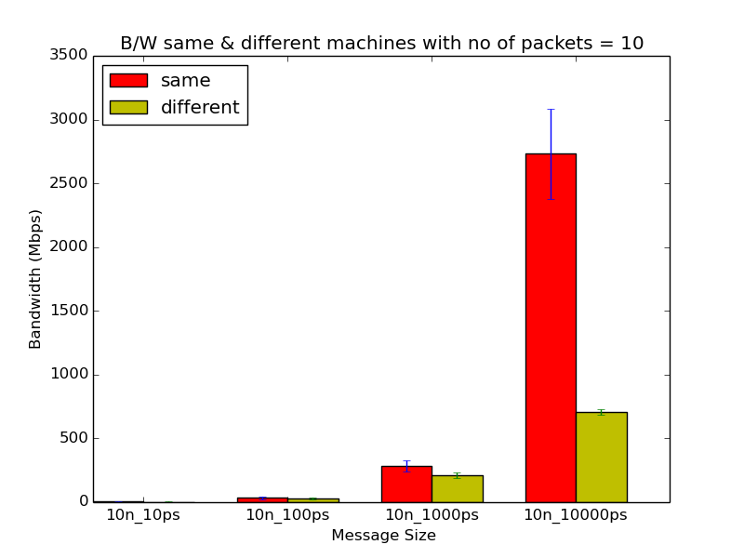
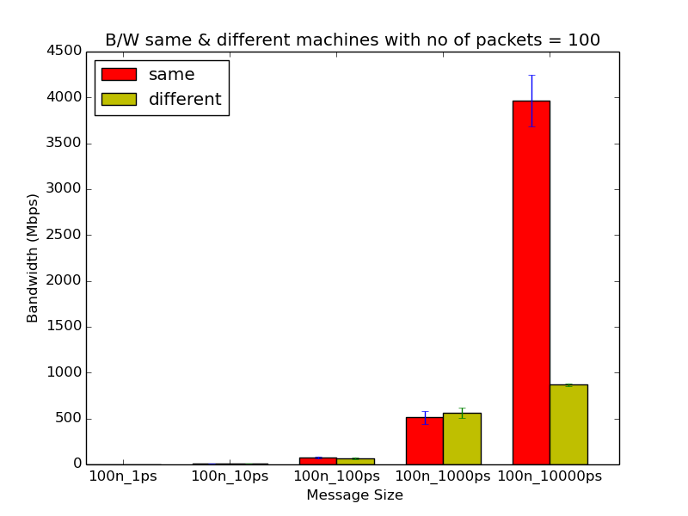
GRPC (Server Streaming)
BW in Server Streaming (same and different machine)
With Optimization
No of packets = 10 Number of packets =100

Slide 23
Thrift

Slide 24
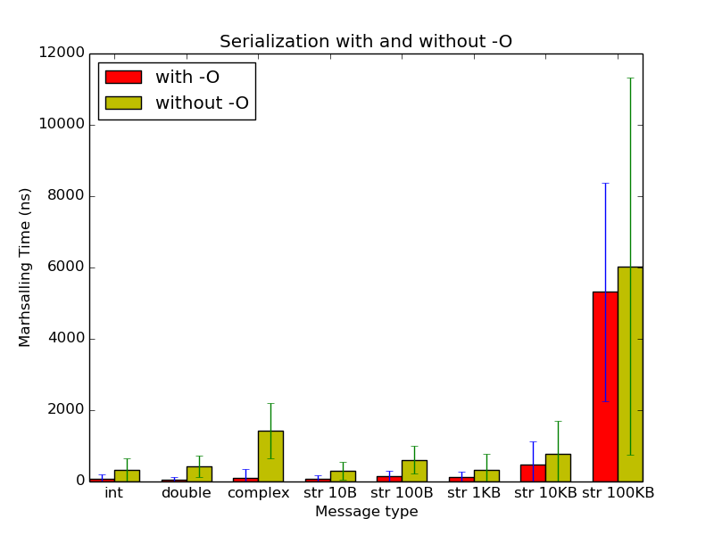
Thrift
With Vs Without optimization
Marshalling overhead (time)
Median values

Slide 25
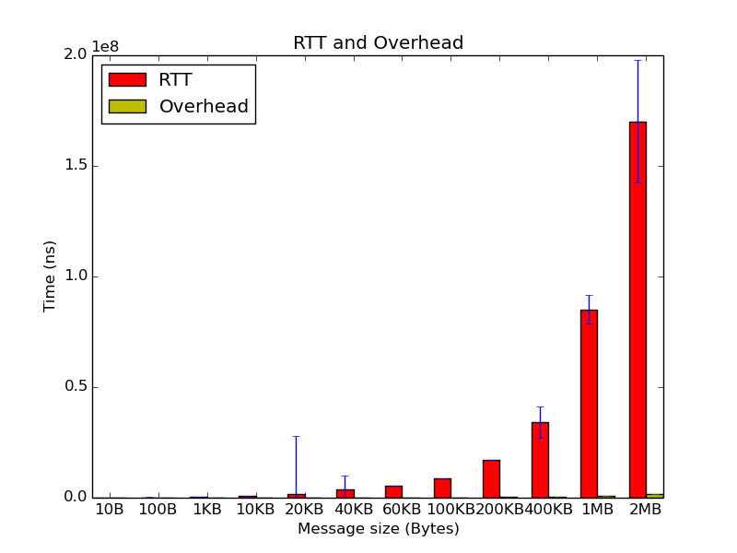
Thrift
Overhead and RTT as 2 bars
Median values
With Optimization
Remote

Slide 26
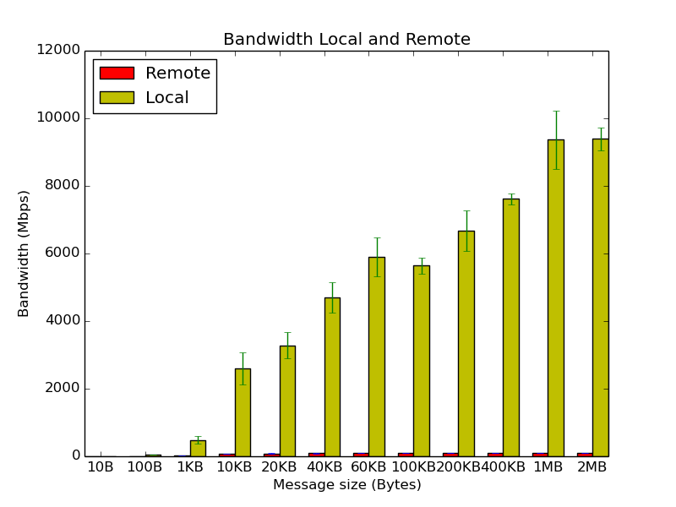
Thrift
Bandwidth: Local And Remote
Median values
With Optimization

Slide 27
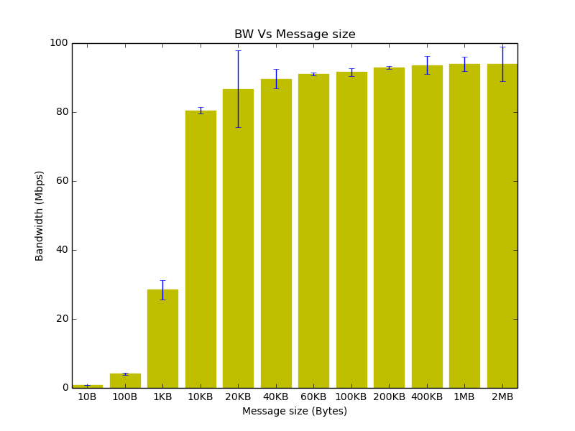
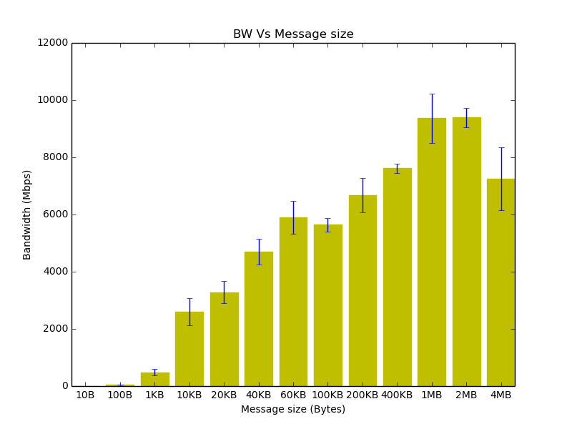
Thrift
Bandwidth - Remote hosts and Localhost
Different Machines Same Machine

Slide 28
Questions...

Slide 29
Extra Slides

