Slide 1
SECTION 0 · WELCOME & COURSE OVERVIEW
LECTURE 0.1
Your AI Agent Just Failed in Production — Now What?
Describe how a one-line prompt change can make a support agent invent policy without any error in the logs.
AI Agent Testing & Evaluation · Section 00 · Lecture 0.1
Notes:
Title card (K2). Your AI Agent Just Failed in Production — Now What?.

Slide 2
Your AI Agent Just Failed in Production
Agents fail politely: no error, wrong answer
This course: catch it before your users do
AI Agent Testing & Evaluation · Section 00 · Lecture 0.1
Notes:
By the end of this course, you'll catch failures like this before a single customer sees them. Let me show you the one we just described, running for real.
[SCREEN: Terminal in `agent-eval-framework`. Run the 0.1 demo. Let the version banner sit for a beat, then zoom on the deleted line.]
[DEMO: Output (banner trimmed)]
This is the TechCorp support agent you'll test all course. Before the edit, it searched the knowledge base and quoted the policy. Faithfulness: one point zero. After the edit, look at the tools list. Empty. It answered from memory, and every number is wrong. Faithfulness: zero. One metric, one line of output, and that deploy is blocked.

Slide 3
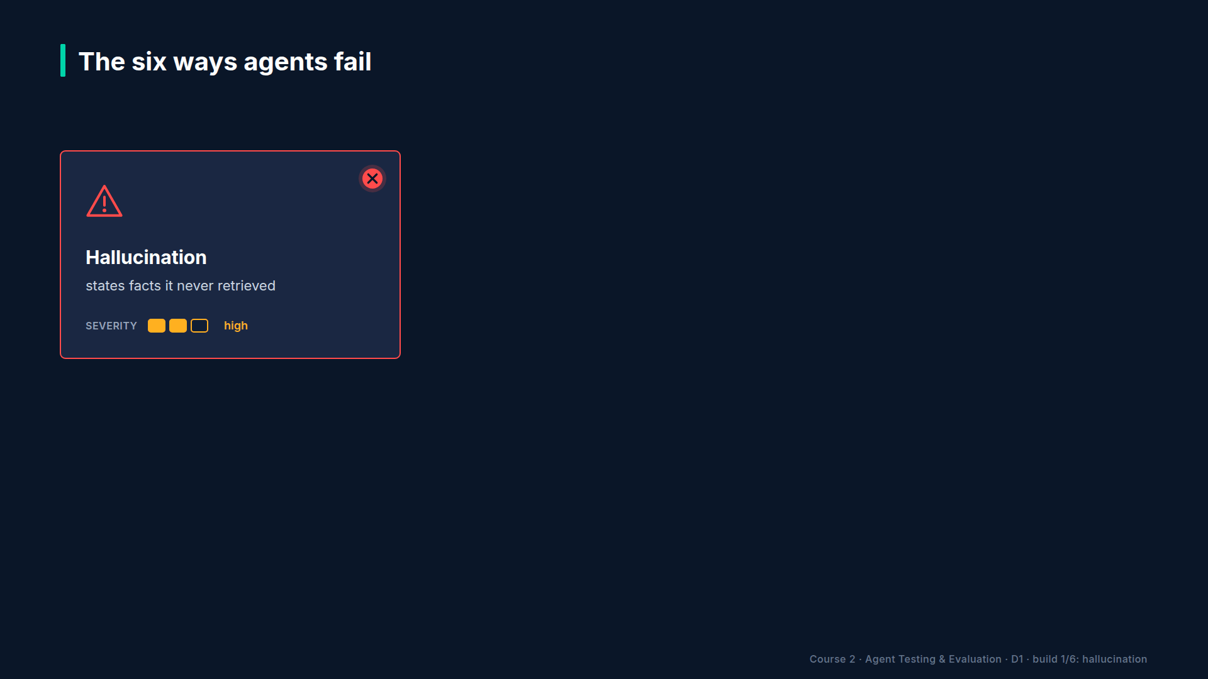
Section 00 · Lecture 0.1 · Why nobody noticed
Notes:
Why did nobody notice? Because the agent didn't crash. It answered fluently. A status-code check passes. A latency check passes. Only a check that compares the answer with the real policy fails. Now picture this at scale. Here's an illustrative scenario from the course materials: a support agent tells two hundred thirty customers their overdraft fees were waived, and the company honors forty-seven thousand dollars of mistakes. The root cause is the same: a prompt change, and no evaluation suite to run.

Slide 4
What you'll build in this course
An evaluation suite scored on five quality dimensions
A red-team report from real attacks on your agent
A monitoring dashboard for quality drift in production
A CI quality gate that blocks bad merges
AI Agent Testing & Evaluation · Section 00 · Lecture 0.1
Notes:
So what will you build? Four systems. First, an evaluation suite that scores your agent on correctness, faithfulness, relevance, safety and reliability. One command, numbers instead of opinions.
[B-ROLL: Quick cuts, two seconds each: the Project 1 report table, a promptfoo red-team results grid, the Streamlit quality dashboard, a...]
Second, a red-team report. You'll attack your own agents with prompt injections and jailbreaks, and find the holes first. Third, a monitoring dashboard, so drift shows up on a chart, not in a complaint three days later. Fourth, a CI quality gate. Every pull request runs your evals, and if quality drops, the merge is blocked. All four in Python, all yours to reuse at work.

Slide 5
RECAP
Key takeaways
✓
Agents fail silently: clean logs, wrong answers
✓
One evaluation metric caught the bad deploy
✓
You'll build four quality systems from scratch
AI Agent Testing & Evaluation · Section 00 · Lecture 0.1
Notes:
Lock it in. Agents fail silently; the logs stayed clean while the refund policy changed. One faithfulness check caught it before deploy. And over this course, you'll build the four systems that make that check routine.
Next, you'll see the full roadmap and get the course repo running on your machine. Two commands, about two hundred tests, and no API key required. Let's go.

Slide 6
→
Next up:
Course Roadmap & Environment Setup
Next: Lecture 0.2 — Course Roadmap & Environment Setup.
AI Agent Testing & Evaluation · Section 00 · Lecture 0.1

Slide 7
SECTION 0 · WELCOME & COURSE OVERVIEW
LECTURE 0.2
Course Roadmap & Environment Setup
Install the locked environment with make install and run the offline suite with make test (204 passed, 5 skipped).
AI Agent Testing & Evaluation · Section 00 · Lecture 0.2
Notes:
Title card (K2). Course Roadmap & Environment Setup.

Slide 8
Course Roadmap & Environment Setup
Install the locked environment with two commands
Know when you need an API key
Find your way around the roadmap and repo
AI Agent Testing & Evaluation · Section 00 · Lecture 0.2

Slide 9
Verified for this course
openai 2.54.0 and deepeval 4.2.7
ragas 0.4.3, langfuse 4.16.0, mcp 2.2.0
Agent gpt-4.1-mini, judge gpt-4.1
Python 3.11 or newer; Node 20+ in Module 8
AI Agent Testing & Evaluation · Section 00 · Lecture 0.2
Notes:
These are the exact versions I recorded with, pinned in the repo's lock file. If your screen ever looks different from mine, check this list first.

Slide 10
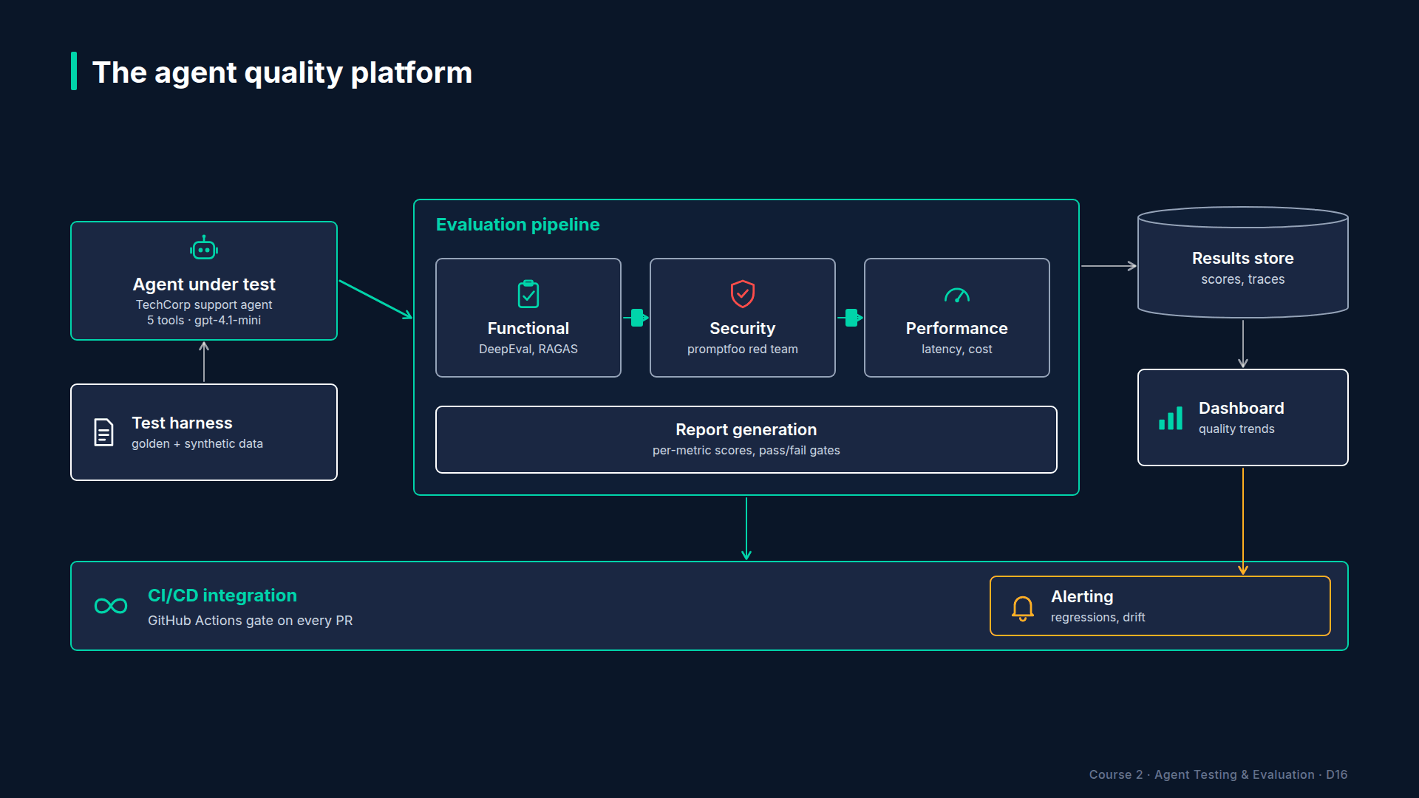
Section 00 · Lecture 0.2 · Sixteen modules, five stages
Notes:
Where are you headed? Sixteen modules in five stages. Foundations first: what agents are, and why testing them is different. Then evaluation: metrics, RAG, tool calling and multi-agent systems. Then security and red teaming. Then operations: tracing, performance, regression, CI/CD and monitoring. And a capstone that ties it all into one quality platform. Along the way you'll finish four projects plus that capstone. Every one tests a real agent in the same repo.

Slide 11
What you need
Python 3.11 or newer
uv, the Python package manager
An OpenAI key: optional, for live runs only
Node 20 or newer, only from Module 8
AI Agent Testing & Evaluation · Section 00 · Lecture 0.2
Notes:
You need Python three eleven or newer, and `uv`. That's it to start. Do you need an OpenAI key? No, it's optional. Without one, the repo runs in offline mode, and offline mode costs nothing. Live runs cost a few cents each; check the current pricing before you run a big suite. Node twenty only matters in Module 8, for promptfoo.
[SCREEN: Terminal, dark theme, large font. Open the `agent-eval-framework` folder from the course resources. Run the install.]
[DEMO: Output (tail)]
`make install` runs `uv sync` with the lock file, so you get exactly the packages I tested. On a fresh machine you'll see the install progress instead of "audited", and it takes about a minute. It also copies the example settings file to `.env`. Now the moment of truth.
[SCREEN: Same terminal. Run the test suite.]
[DEMO: Output (last lines)]
Two hundred four passed, five skipped. The five skipped tests are the live ones. They wait for a real key. Everything else ran against a deterministic stand-in model and a stand-in judge. So, why does that matter? Because you get the same numbers I do, every time.
[SCREEN: VS Code, `.env`. Highlight `OPENAI_API_KEY=` (empty), `OFFLINE=`, `OPENAI_MODEL=gpt-4.1-mini`, `OPENAI_JUDGE_MODEL=gpt-4.1`.]
Here's the settings file. The key is empty, and that's fine. `OFFLINE` one forces offline mode, zero forces live. The agent model is `gpt-4.1-mini`, and the judge is `gpt-4.1`. When you add a key later, it goes here, never in code, and `.env` is already ignored by git.
[SCREEN: Terminal. Run the setup check.]
[DEMO: Output (banner trimmed)]
What does the setup check actually check? Nine packages, two optional keys, and then it does real work. It asks the support agent a question, two LLM calls and one knowledge-base search, and scores the answer with a DeepEval metric. Relevancy: one point zero. Then the smallest eval in the course.
[SCREEN: Terminal.]
[DEMO: Output (banner trimmed)]

Slide 12
The repo you'll work in
text
agents/ support_agent.py (TechCorp, 5 tools) + 4 more agents
config/ models, prices, thresholds (eval_config.yaml)
datasets/ golden_support.json (10 cases) and friends
evaluators/ DeepEval metrics, judge, RAGAS, tool checks
security/ promptfoo, Garak, PyRIT, PII scanner
observability/ performance/ regression/ monitoring/ reports/
demos/ 61 lecture demos (mXX_*.py)
tests/ unit/ component/ trajectory/ e2e/ production/ live/
AI Agent Testing & Evaluation · Section 00 · Lecture 0.2
Notes:
A quick tour. Where does everything live? Agents holds the five agents you'll test, starting with TechCorp support. You don't build them; you test them. Config holds models, prices and every quality threshold. Datasets holds your golden test cases. Evaluators is where metrics live. Security, observability, performance, regression and monitoring each light up in their own module. Demos has one file per lecture, sixty-one of them. And tests is organized in five layers you'll meet in Lecture 2.3.

Slide 13
RECAP
Key takeaways
✓
make install, then make test: 204 passed
✓
Offline mode: no key, same numbers as mine
✓
Sixteen modules, one repo, one running agent
AI Agent Testing & Evaluation · Section 00 · Lecture 0.2
Notes:
Three things. Two commands give you a locked environment and two hundred four passing tests. Offline mode means no key and no cost, with the same numbers I get. And the whole course runs in one repo, around one agent.

Slide 14
SECTION COMPLETE
You can now
✓
Explain how a silent agent failure gets caught
✓
Install and verify the course environment
✓
Run any lecture demo offline
AI Agent Testing & Evaluation · Section 00 · Lecture 0.2
Notes:
You can now explain how a silent agent failure gets caught, and your environment is ready. Next, Module 1 starts with the three things about large language models every tester needs: tokens, context windows and temperature. Just enough to see why agents are hard to test.

Slide 15
→
Next up:
LLMs in 10 Minutes: Tokens, Context, Temperature
Next: Lecture 1.1 — LLMs in 10 Minutes: Tokens, Context, Temperature.
AI Agent Testing & Evaluation · Section 00 · Lecture 0.2

