Slide 1
SECTION 1 · AI AGENTS: WHAT YOU NEED TO KNOW FOR TESTING
LECTURE 1.1
LLMs in 10 Minutes: Tokens, Context, Temperature
Explain tokens and estimate what a test run costs from token counts.
AI Agent Testing & Evaluation · Section 01 · Lecture 1.1
Notes:
Title card (K2). LLMs in 10 Minutes: Tokens, Context, Temperature.

Slide 2
LLMs in 10 Minutes: Tokens, Context, Temperature
Tokens: what you pay for and what gets cut
Context: everything the model sees at once
Temperature: why the same question varies
AI Agent Testing & Evaluation · Section 01 · Lecture 1.1
Notes:
By the end of this lecture, you'll be able to explain how tokens, context windows and temperature shape every test you write for an agent.

Slide 3
Your testing cheat sheet
Not how transformers work
Three ideas that change how you test
Used in every module from 3 onward
AI Agent Testing & Evaluation · Section 01 · Lecture 1.1
Notes:
This isn't a machine learning course. You don't need attention mechanisms or training math. You need three ideas, because every evaluation technique from Module 3 onward leans on them. Think of this as your tester's cheat sheet for language models.

Slide 4
Tokens: the units a model reads
DIAGRAM TO BUILD
Diagram: The customer query "Hi, I was charged twice for my Pro plan this month. Can you refund one charge?" splits into coloured blocks, one per token. A counter under it reads "78 characters → 19 tokens". A small note: "rule of thumb: 100 tokens ≈ 75 English words".
AI Agent Testing & Evaluation · Section 01 · Lecture 1.1
Notes:
Language models don't read words. They read tokens. A token is a chunk of text: often a whole word, sometimes part of one, sometimes punctuation. A handy rule of thumb: a hundred tokens is roughly seventy-five English words.
Why should a tester care? Two reasons. Cost, and truncation. Every token in and out is billed. And when you cap a response with a maximum token count, you're cutting tokens, not words. A capped answer can stop mid-sentence, and your test has to notice.
[SCREEN: Terminal. Run the token demo; the version banner shows `openai 2.54.0 | tiktoken 0.14.0`.]
[DEMO: Output (banner trimmed)]
Here's a real customer message for our TechCorp agent. Nineteen tokens. But look at what the model actually receives on the first call. The system prompt is two hundred fifty-five tokens. The five tool definitions are four hundred eighty-one. The customer's words are the smallest part: nineteen out of seven hundred fifty-five.
That surprises most testers. The fixed overhead, the prompt and the tool schemas, is paid again on every single call. And an agent makes several calls per question. So when someone adds a sixth tool or a longer rule to the prompt, every test case gets more expensive, and every conversation fills its context a little faster.

Slide 5
Tokens are your test budget
755 input tokens before the agent does anything
gpt-4.1-mini: about $0.0004 per call (verify pricing)
Judge calls on gpt-4.1 cost about 5x more
500 cases × 2,000 tokens = 1M tokens per run
AI Agent Testing & Evaluation · Section 01 · Lecture 1.1
Notes:
So what does that cost? On `gpt-4.1-mini`, about four hundredths of a cent per call. Tiny. Now scale it. A suite of five hundred test cases at two thousand tokens each is a million tokens per run. Your judge model, `gpt-4.1`, is about five times the price of the agent model. Run that suite ten times a day and you can see the bill. Tokens are your testing budget, and that's why this course runs offline by default.

Slide 6
Context window: the model's desk
DIAGRAM TO BUILD
Diagram: A horizontal bar labelled "context window". Segments from left: system prompt (255), tool schemas (481), conversation history (grows every turn), retrieved knowledge-base text (varies), customer query (19), and "space for the answer" at the right. A red arrow at the right edge: "overflow: something gets dropped".
AI Agent Testing & Evaluation · Section 01 · Lecture 1.1
Notes:
The context window is everything the model can see at once. Think of it as a desk. The system prompt, the tool definitions, the conversation so far, any documents the agent retrieved, the new question, and room for the answer: all of it has to fit on the desk.
The `gpt-4.1` family has a window of about one million tokens. Our demo says that's over twelve thousand turns of this size. Sounds endless, right?
It isn't, for two reasons. Real turns carry more than a short question: every tool result the agent reads lands on the desk too, and a single knowledge-base article can be longer than the whole customer message. And the window is a hard limit only at the very edge. Long before it's full, quality can slip.

Slide 7
Big windows still fail
History grows with every turn
Retrieval can add thousands of tokens per call
Details in the middle get less attention
Test short and long conversations, both
AI Agent Testing & Evaluation · Section 01 · Lecture 1.1
Notes:
Here's the catch. Size isn't the problem; attention is. Research on long contexts found that models use information at the start and end of the context better than information buried in the middle. It's often called "lost in the middle" (verify: Liu et al., 2023). For you, that means an agent can answer perfectly in a three-turn test and forget the customer's account ID by turn thirty. Your test suite needs both lengths.

Slide 8
Temperature: the variation dial
DIAGRAM TO BUILD
Diagram: A slider from 0.0 to 2.0. At 0.0: one answer repeated ("same wording every run"). At 1.0: several different sentences fanning out ("same facts, different words"). At 2.0, greyed out: "rarely used: often incoherent".
AI Agent Testing & Evaluation · Section 01 · Lecture 1.1
Notes:
Third idea: temperature. Every time a model picks the next token, it chooses from a list of likely options. Temperature controls how adventurous that choice is. At zero, it nearly always takes the most likely token, so the wording barely changes. At one, it samples more widely. Same facts, different words. Push it toward two, and answers get strange.
Which setting would you rather test against? Here's an analogy. Ask ten people to finish "the capital of France is", and they all say Paris. That's temperature zero. Ask them to "name a city in France", and you get Paris, Lyon, Nice. All correct, all different. That's temperature one.
[SCREEN: Terminal. Run the temperature demo. Highlight the five identical lines, then the three different phrasings.]
[DEMO: Output (banner trimmed)]
Same question, "How long do refunds take?", five times at each setting. At zero: one distinct answer out of five. At one: three distinct answers out of five. Every one says five to seven business days. Every one is correct. And an exact-match assertion fails on every run that isn't word-for-word the expected sentence. That's the test from the start of this lecture.

Slide 9
What this means for your tests
Low temperature reduces variation; it doesn't remove it
Our agent uses the API's default temperature
Check meaning, not exact wording
AI Agent Testing & Evaluation · Section 01 · Lecture 1.1
Notes:
Can you just set temperature to zero for testing? It helps, but it's not a guarantee. Providers update models, and long contexts shift outputs, so even at zero you'll see some drift. And you want to test the agent the way it runs in production. Our TechCorp agent doesn't set a temperature, so it uses the API default. The fix isn't to freeze the model. It's to check meaning instead of exact words. That's exactly what you'll build in Module 3.

Slide 10
One run proves very little
Same case, several runs
Measure how often it behaves the same
Course threshold: consistency of at least 0.7
AI Agent Testing & Evaluation · Section 01 · Lecture 1.1
Notes:
There's a second habit worth starting now. When the output can vary, one run proves very little. So how many runs do you need? In Module 10 you'll run the same case several times and measure consistency: how often the agent takes the same path of tools. Our quality policy asks for at least zero point seven.

Slide 11
RECAP
Key takeaways
✓
Tokens set your cost and truncation risk
✓
Context windows fill fast; the middle fades
✓
Temperature varies wording; test meaning instead
AI Agent Testing & Evaluation · Section 01 · Lecture 1.1
Notes:
Three fundamentals. Tokens are your cost currency: seven hundred fifty-five tokens before the agent even acts, and judge calls cost more. Context windows fill with prompts, tools and history, and details in the middle fade. And temperature changes the wording from run to run, so exact-match assertions break and semantic checks win.
Now you know the engine. Next, you'll see what makes an agent different from a chatbot. Spoiler: it isn't the model. It's the loop. Agents don't just answer; they act, look at the result, and act again. That changes what you have to test.

Slide 12
→
Next up:
What Makes an Agent an Agent (Not a Chatbot)
Next: Lecture 1.2 — What Makes an Agent an Agent (Not a Chatbot).
AI Agent Testing & Evaluation · Section 01 · Lecture 1.1

Slide 13
SECTION 1 · AI AGENTS: WHAT YOU NEED TO KNOW FOR TESTING
LECTURE 1.2
What Makes an Agent an Agent (Not a Chatbot)
Distinguish a chatbot (one call, text in, text out) from an agent (LLM plus tools in a loop).
AI Agent Testing & Evaluation · Section 01 · Lecture 1.2
Notes:
Title card (K2). What Makes an Agent an Agent (Not a Chatbot).

Slide 14
What Makes an Agent an Agent (Not a Chatbot)
Tell a chatbot from an agent in one look
Read an agent's trace step by step
Know why the path matters, not just the answer
AI Agent Testing & Evaluation · Section 01 · Lecture 1.2
Notes:
By the end of this lecture, you'll be able to look at any AI system, say whether it's a chatbot or an agent, and explain why agents need a different kind of test.

Slide 15
Verified for this lecture
openai 2.54.0 and deepeval 4.2.7
Agent gpt-4.1-mini; offline mock in the demos
File: agents/support_agent.py
AI Agent Testing & Evaluation · Section 01 · Lecture 1.2
Notes:
Last lecture was about the engine: tokens, context and temperature. Now let's look at the machine built around it. People say "agent" when they mean "chatbot" all the time. If you mix them up, you'll test the wrong things.

Slide 16
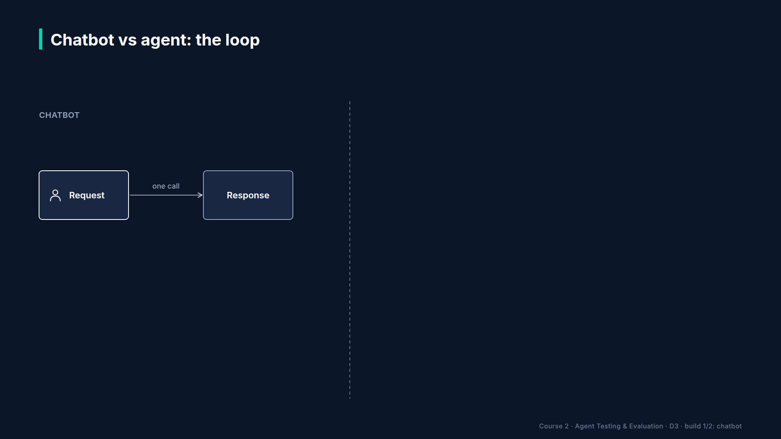
Section 01 · Lecture 1.2 · A chatbot: text in, text out
Notes:
A chatbot is the simplest thing you can build with a language model. A message goes in, one model call happens, and text comes out. No tools. No database. No second step. It can't check your account, because it has no way to reach your account.
Testing a chatbot is fairly direct. Send a prompt, judge the response. You still need to check meaning rather than exact words, as you saw last lecture, but there's one input and one output. One thing to check.
Now, what happens when you give that same model hands?

Slide 17
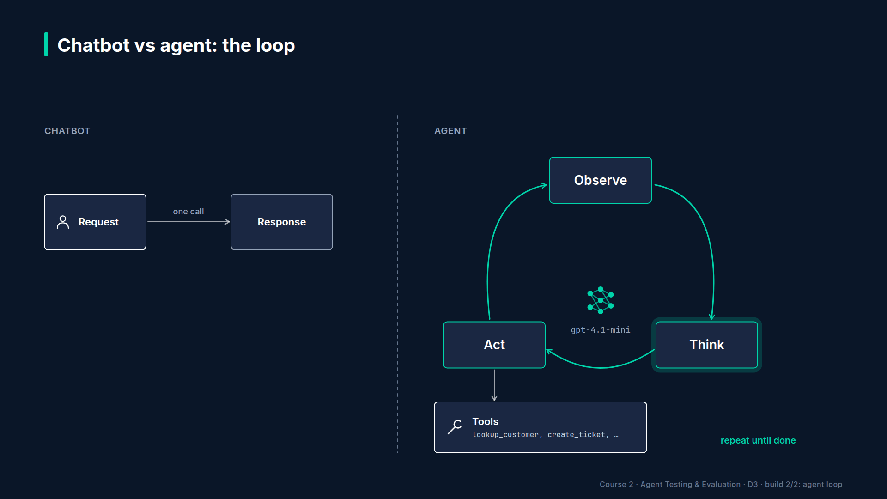
Section 01 · Lecture 1.2 · An agent: a loop with tools
Notes:
An agent runs in a loop. It observes the conversation and any tool results. It thinks: what should I do next? It acts: either it calls a tool, or it writes the final answer. If it called a tool, the result goes back into the conversation, and the loop runs again.
That's the whole difference. The same model, but now it decides which tool to call, with which arguments, how many times, and when to stop. Every one of those decisions can be wrong.
[SCREEN: Terminal. Run the side-by-side demo. Pause on the chatbot paragraph, then step through the agent's three lines.]
[DEMO: Output (banner trimmed)]
Here's the real thing. The chatbot gets one model call and no tools, so it does the honest thing: it says it can't reach the account. Polite, correct, and useless to Alice. Notice that a chatbot test would probably pass this answer. It's relevant and it's safe. It just doesn't do the job.
The agent goes to work. Step one: it calls `lookup_customer` with the email. The tool returns Alice Johnson, customer one. Step two: it calls `create_ticket` for that customer ID, with priority high. The tool returns ticket five thousand and one. Then the model writes the final answer. Three model calls, two tool calls, just under three thousand tokens.

Slide 18
Five things you can check in one run
Did it pick the right tools?
Did it pass the right arguments?
Did it use the tool results correctly?
Did it stop at the right time?
Is the final answer right and grounded?
AI Agent Testing & Evaluation · Section 01 · Lecture 1.2
Notes:
Now count what you could test in that one run. Was `lookup_customer` the right first tool? Was the email the right argument? Did the ticket use the customer ID the lookup returned, not a guess? Did the agent stop after the ticket, or wander on? And is the final answer correct and supported by what the tools said? A chatbot test checks one thing. This agent run gives you at least five.
[CODE: `agents/support_agent.py`, the loop inside `run_support_agent` (trimmed)]
Here's that loop in our agent. It's plain OpenAI tool calling, no framework. Each pass calls the model with the conversation and the five tool definitions. If the model asks for tools, the code runs them, logs the tool name, the arguments and the result, and appends the result to the conversation. Otherwise, it returns the answer.
See the line that appends `choice.message`? The agent's own tool request goes into the conversation too, so on the next pass the model can see what it asked for and what came back. That's how the loop remembers.
Notice two more things. First, `max_iterations` is five. The loop can't run forever; you'll see why that matters in Lecture 1.4. Second, `tool_calls_log`. Every step is recorded. That log is what your trajectory tests will read.

Slide 19
Four properties of an agent
Reasoning: decides what to do next
Tools: acts on real systems
Memory: carries context between steps and turns
Goal pursuit: works until the task is done
AI Agent Testing & Evaluation · Section 01 · Lecture 1.2
Notes:
Four properties separate agents from chatbots. Reasoning: it decides what to do next instead of just replying. Tools: it can change real systems, like opening a ticket or sending an email. Memory: it carries the conversation and tool results from step to step. And goal pursuit: it keeps going until the job is done, or it gives up and escalates.
A chatbot has none of these. Which ones does a basic retrieval bot have? Just one: a single tool, the search. A full agent has all four, and each is a separate thing to test. You'll take each one apart in the next lecture.

Slide 20
Trajectory: the path, not just the destination
Trajectory: every step, tool and argument, in order
Right answer, risky path: still a failure
Wrong answer: the trajectory shows where
AI Agent Testing & Evaluation · Section 01 · Lecture 1.2
Notes:
That brings us to the most important word in this course: trajectory. The trajectory is the full path: every tool call, every argument, every result, in order. Why does it matter? Because an agent can reach the right answer by a risky path, like reading an account it had no reason to open. And when the answer is wrong, the trajectory tells you which step went wrong. That's why our agent logs every step.

Slide 21
RECAP
Key takeaways
✓
Chatbots answer; agents act in a loop
✓
One run gives five things to check
✓
Test the trajectory, not just the answer
AI Agent Testing & Evaluation · Section 01 · Lecture 1.2
Notes:
Three takeaways. Chatbots take text in and give text out. Agents run a loop of observe, think and act, with tools at every step. One short agent run already gives you five things to check. So you don't just test the final answer. You test the trajectory: every tool, every argument, every step.
You've seen that agents run a loop. So what's inside that loop? Next, you'll break an agent into its four building blocks: the model, the tools, memory and planning. And, more useful for you, where each one breaks.

Slide 22
→
Next up:
Agent Architecture: The Loop, Tools, Memory, Planning
Next: Lecture 1.3 — Agent Architecture: The Loop, Tools, Memory, Planning.
AI Agent Testing & Evaluation · Section 01 · Lecture 1.2

Slide 23
SECTION 1 · AI AGENTS: WHAT YOU NEED TO KNOW FOR TESTING
LECTURE 1.3
Agent Architecture: The Loop, Tools, Memory, Planning
Map any agent to four testable components: the LLM, tools, memory, planning.
AI Agent Testing & Evaluation · Section 01 · Lecture 1.3
Notes:
Title card (K2). Agent Architecture: The Loop, Tools, Memory, Planning.

Slide 24
Agent Architecture: The Loop, Tools, Memory, Planning
Map any agent to four testable parts
Know how each part breaks
Find each part in real code
AI Agent Testing & Evaluation · Section 01 · Lecture 1.3
Notes:
By the end of this lecture, you'll be able to take any agent and map it to four components you can test one at a time.

Slide 25
Section 01 · Lecture 1.3 · The blueprint
Notes:
Every agent has the same four parts, whatever framework built it. A model that reasons. Tools that act. Memory that carries context. And planning, the strategy for getting from question to done. Each part breaks in its own way, so each needs its own tests. This blueprint is the map you'll use every time you design a test strategy.

Slide 26
Part 1: the LLM brain
Reads system prompt, history, tool results
Writes reasoning, tool calls and answers
Risks: hallucination, reasoning errors, ignored rules
AI Agent Testing & Evaluation · Section 01 · Lecture 1.3
Notes:
Part one is the model itself. In our agent, that's `gpt-4.1-mini`. It reads the system prompt, the conversation and every tool result, and it writes three kinds of output: reasoning, tool calls and the final answer.
Sound like anyone you've worked with? Think of it as a brilliant but unreliable consultant. It connects dots fast and writes beautifully. It also sometimes invents facts, sometimes draws the wrong conclusion from the right facts, and sometimes forgets a rule from the brief.
[SCREEN: VS Code, `agents/support_agent.py`, scroll `SYSTEM_PROMPT`. Highlight "Only state prices, limits and policies that appear in a k...]
Here's the brief our agent gets. Five responsibilities, six rules, four escalation rules. Every rule is a test waiting to be written. "Only state prices, limits and policies that appear in a knowledge base result." That's the line from Lecture 0.1. Delete it, and the brain starts inventing prices.

Slide 27
Part 2: tools, the agent's hands
DIAGRAM TO BUILD
Diagram: Five tool cards in a row: lookup_customer, search_knowledge_base, create_ticket, send_email, escalate_to_human. Under each, three small check boxes: selection, arguments, result use. Two cards (create_ticket, send_email) carry a red "side effect" tag.
AI Agent Testing & Evaluation · Section 01 · Lecture 1.3
Notes:
Part two: tools. These are the agent's hands. Our agent has five: look up a customer, search the knowledge base, create a ticket, send an email, and escalate to a human.
[SCREEN: VS Code, `agents/support_agent.py`, collapse `TOOLS` to show the five `"name":` lines, then expand `create_ticket` to show its f...]
Here's why tools carry the most risk. A bad sentence is embarrassing. A bad tool call opens the wrong ticket, emails the wrong person, or reads the wrong customer's account. Tools have side effects.
Every tool has three failure surfaces. Selection: did it pick the right tool? Arguments: did it pass the right values? And result use: did it read the result correctly? Five tools, three surfaces each. That's fifteen things to test before you even look at the answer. Which of the five worries you most? Look at the ones that change something: `create_ticket`, `send_email` and `escalate_to_human`. A wrong search wastes a call. A wrong email can't be unsent.
[SCREEN: Terminal. Run the Lab 1.1 demo and zoom on the third query, the unknown email.]
[DEMO: Output (third query only)]
Here's result use done right. The tool says "Customer not found." The agent tells the customer exactly that and asks for another identifier. A weaker agent might treat an empty result as success and invent an account. That's a test case: feed a tool an unknown value, check the answer admits it.

Slide 28
Part 3: memory
Short-term: the conversation history
Working: messages and tool results in this run
Long-term: knowledge base and customer records
Risks: forgotten facts, wrong retrieval, overflow
AI Agent Testing & Evaluation · Section 01 · Lecture 1.3
Notes:
Part three: memory. Three layers. Short-term memory is the conversation history; in our code, that's the `conversation_history` argument. Working memory is the message list inside one run: every tool call and result so far. Long-term memory is what the agent can look up: five knowledge-base articles and three customer records here, often a vector database in bigger systems.
What breaks? Retrieval can return the wrong article. History can grow until early details get dropped. A customer gives their email in message two; by message thirty, the agent asks for it again. Testing memory means testing at several conversation lengths. Few teams ever write that test. Will yours?

Slide 29
Part 4: planning
DIAGRAM TO BUILD
Diagram: "Cancel my subscription and refund me. I signed up 3 weeks ago." Plan: 1 lookup_customer → 2 search_knowledge_base (refund policy) → 3 create_ticket → answer. A "reflect" diamond after each step: "did that work? adjust the plan?" A side branch at step 2: "21 days < 30 days: eligible".
AI Agent Testing & Evaluation · Section 01 · Lecture 1.3
Notes:
Part four: planning. How does the agent break a task into steps, and when does it stop? Take one of our hardest golden cases: cancel my subscription and refund me, I signed up three weeks ago. The agent looks up the customer, searches the refund policy, then creates a ticket. Four model calls, three tools, in that order.
Planning failures are the hardest to test, because the right plan depends on what each step returns. You can't always hard-code the expected steps. Sometimes you check the order. Sometimes you check that the plan was sensible given what the agent knew. That's trajectory evaluation, and you'll build it in Module 6.
[SCREEN: VS Code, `run_support_agent` signature. Highlight `conversation_history: list | None = None` and `max_iterations: int = 5`.]
In code, our agent's planning is the loop itself, plus the system prompt's rules, plus one guard: at most five model calls. Hit the cap, and it apologizes and escalates. Is five the right number? For this agent, yes: its longest golden case needs four calls. Your agent might need a different cap, and testing tells you which.

Slide 30
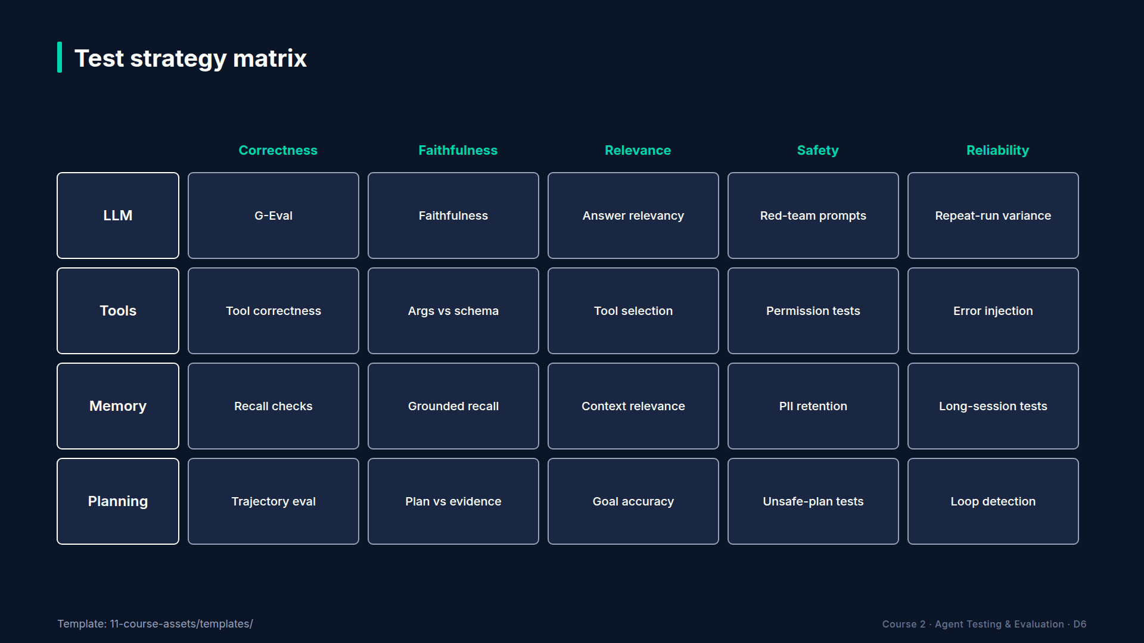
Section 01 · Lecture 1.3 · Your testing map
Notes:
Let's put it together. What does each part do, and how does it fail? The LLM reasons and writes; it can hallucinate, reason badly or drift from the brief. Tools act; they can be the wrong tool, get the wrong arguments, or have their results misread. Memory stores and retrieves; it can retrieve the wrong thing or forget. Planning sequences the steps; it can choose a bad plan or never stop. Every test you write targets one of these rows.

Slide 31
RECAP
Key takeaways
✓
Four parts: brain, tools, memory, planning
✓
Tools carry the most risk: side effects
✓
Each part fails differently; test each
AI Agent Testing & Evaluation · Section 01 · Lecture 1.3
Notes:
Lock in the blueprint. Every agent has four testable parts: the model, the tools, memory and planning. Tools carry the most risk, because they change real systems. And each part fails in its own way, so each gets its own tests.
You know the four parts. Next, the six specific ways they fail: hallucination, wrong tool selection, incorrect tool arguments, reasoning errors, goal drift and infinite loops. You'll see a real recorded example of every one.

Slide 32
→
Next up:
The 6 Ways AI Agents Fail (And Why Testing Is Hard)
Next: Lecture 1.4 — The 6 Ways AI Agents Fail (And Why Testing Is Hard).
AI Agent Testing & Evaluation · Section 01 · Lecture 1.3

Slide 33
SECTION 1 · AI AGENTS: WHAT YOU NEED TO KNOW FOR TESTING
LECTURE 1.4
The 6 Ways AI Agents Fail (And Why Testing Is Hard)
Name the six failure modes: hallucination, wrong tool selection, incorrect tool arguments, reasoning errors, goal drift, infinite loops.
AI Agent Testing & Evaluation · Section 01 · Lecture 1.4
Notes:
Title card (K2). The 6 Ways AI Agents Fail (And Why Testing Is Hard).

Slide 34
The 6 Ways AI Agents Fail
Name all six failure modes
See a real example of each
Know which check catches which
AI Agent Testing & Evaluation · Section 01 · Lecture 1.4
Notes:
By the end of this lecture, you'll be able to name the six ways agents fail, show an example of each, and say which check catches it.

Slide 35
Verified for this lecture
openai 2.54.0 and deepeval 4.2.7
Six recorded runs from failure_gallery.json
Checks run offline with the mock judge
AI Agent Testing & Evaluation · Section 01 · Lecture 1.4
Notes:
Before you can test anything, you need to know what breaks. This is your field guide. Every technique from Module 3 onward maps back to one of these six.

Slide 36

Section 01 · Lecture 1.4 · Failure 1: hallucination
Notes:
Failure one: hallucination. The agent states facts that aren't in its context, its tool results or the world. That pricing answer was hallucinated: it never searched the knowledge base, so it answered from memory. The check that catches it is faithfulness: compare every claim with the source.

Slide 37
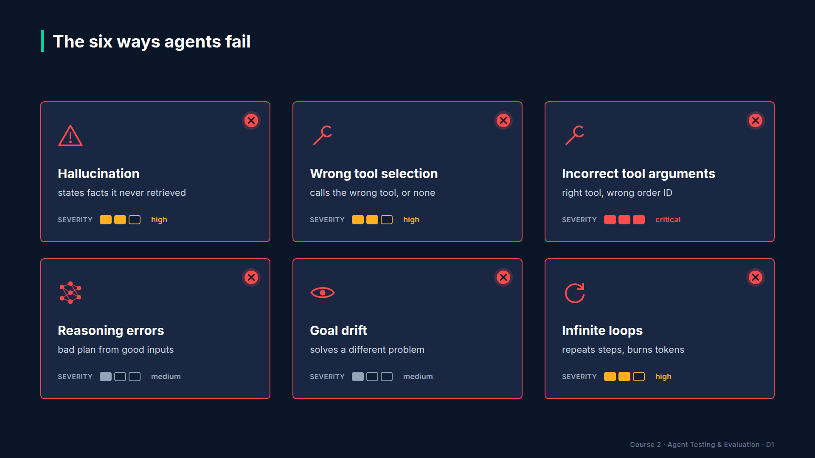
Section 01 · Lecture 1.4 · Failures 2 and 3: the hands
Notes:
Failure two: wrong tool selection. The agent calls the wrong tool, or a tool when none was needed. That's the password question from last lecture: a ticket instead of a knowledge-base search. The check: expected tools versus called tools.
Failure three: incorrect tool arguments. Right tool, wrong values. The customer gives an email, and the agent looks up the first name instead. The tool finds nothing. The check: compare the arguments with what they should be.
Which component failed in each case? Hallucination is the brain. Wrong tool and wrong arguments are the hands: the tools layer from last lecture.

Slide 38
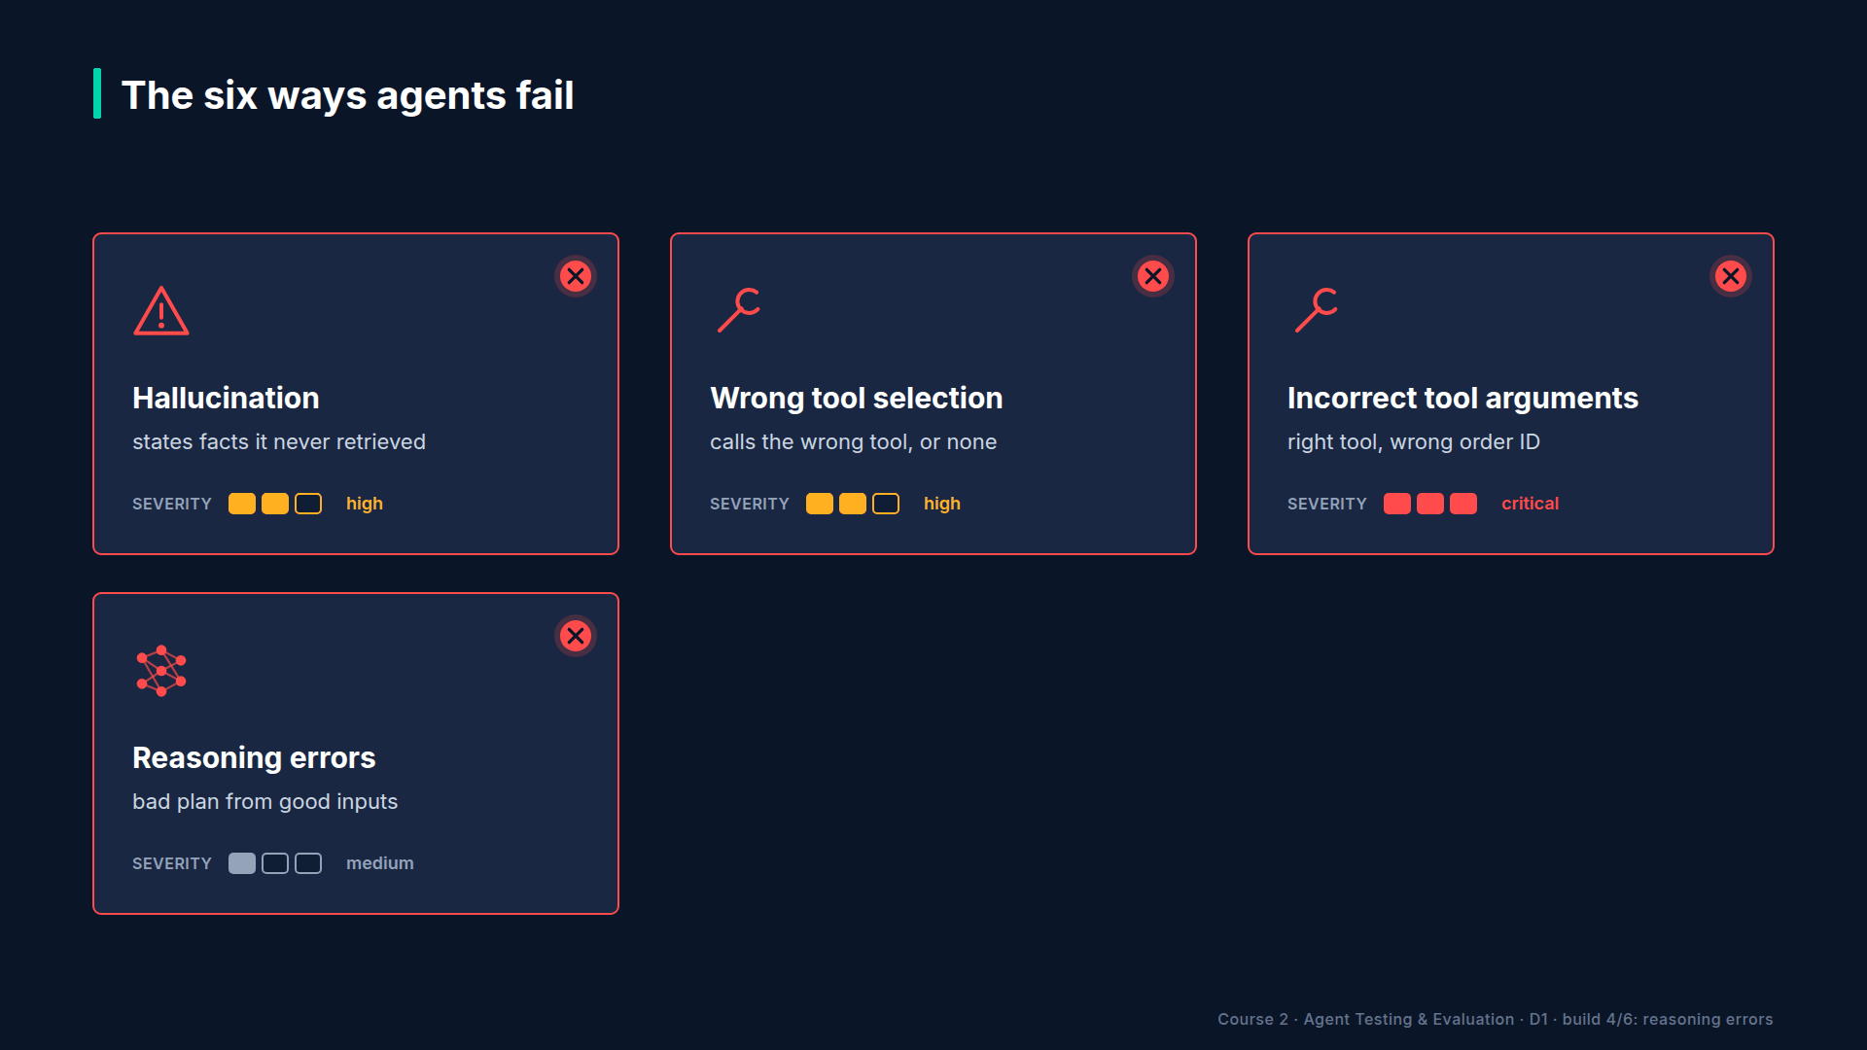
Section 01 · Lecture 1.4 · Failure 4: reasoning errors
Notes:
Failure four: reasoning errors. Correct inputs, correct tools, wrong conclusion. The agent reads the thirty-day refund policy, hears "three weeks", and says that's too late. Twenty-one days is less than thirty. The check: correctness against an expected answer.

Slide 39
Section 01 · Lecture 1.4 · Failures 5 and 6: losing the plot
Notes:
Failure five: goal drift. The agent wanders off the user's goal. Someone asks about a double charge, and the agent ends up explaining API rate limits. Prompt injection is goal drift on purpose, when an attacker hijacks the goal. The check: answer relevancy, and red teaming in Module 8.
Failure six: infinite loops. The agent repeats the same step without progress. Same search, same result, again and again. Every pass costs tokens, and the customer waits. The check: a loop detector, and a hard cap on steps.
And the components? Reasoning errors live in the brain. Goal drift and loops are planning failures: the agent lost track of where it was going. So where would you look first if your agent started looping?
[SCREEN: Terminal. Run the failure gallery. Scroll one case at a time; colour each "caught" line red.]
[DEMO: Output (banner trimmed)]
Here are all six, one recorded run each, and each one caught by a different check. Hallucination: faithfulness zero against a threshold of zero point eight. Wrong tool: we expected a search and got a ticket. Wrong argument: the check shows exactly which value was wrong. Reasoning: correctness zero point three. Drift: relevancy zero. And the loop: the same search five times, until the five-step cap stopped it. The detector flagged it at three in a row.
Notice something? Six failures, and not one exception. Every run returned a polite answer. A monitoring alert on errors would have stayed green all day. And look at the reasoning case: the agent did search, and it found the right policy. A test that only checks "did it call the knowledge base?" passes. The mistake is in what it concluded.

Slide 40
Why testing agents is hard
No crash: every failure returns a fluent answer
Each step can look fine alone
Failures compound across steps
Different failures need different checks
AI Agent Testing & Evaluation · Section 01 · Lecture 1.4
Notes:
So why is this hard? First, nothing crashes. Second, every single step can look reasonable on its own. The drifting agent's search was a sensible search. Third, failures compound: a wrong argument in step one means step two works on bad data. And fourth, there's no single check. Faithfulness misses the loop. A loop detector misses the hallucination. You need a set of checks, applied to the whole trajectory. Which of these six would hurt your users most?

Slide 41
RECAP
Key takeaways
✓
Six failure modes, each with its own check
✓
Agents fail politely, with no exceptions
✓
Test the whole trajectory, not single steps
AI Agent Testing & Evaluation · Section 01 · Lecture 1.4
Notes:
Lock it in. Six failure modes: hallucination, wrong tool selection, incorrect tool arguments, reasoning errors, goal drift and infinite loops. Agents fail politely, with no exceptions to catch. And because failures compound, you test the whole trajectory, with a different check for each mode.

Slide 42
SECTION COMPLETE
You can now
✓
Explain tokens, context windows and temperature for testing
✓
Map any agent to brain, tools, memory, planning
✓
Name the six failure modes and their checks
AI Agent Testing & Evaluation · Section 01 · Lecture 1.4
Notes:
You can now take any agent apart, and name the six ways it can fail. In Lab 1.1, you'll run the agent on five queries and fill in a failure worksheet. Then Module 2 tackles why your existing test toolkit, exact assertions, mocks and pass or fail, breaks on all of this.

Slide 43
→
Next up:
Deterministic vs. Non-Deterministic: The Testing Paradigm Shift
Next: Lecture 2.1 — Deterministic vs.
AI Agent Testing & Evaluation · Section 01 · Lecture 1.4

