Slide 1
SECTION 2 · WHY TRADITIONAL TESTING BREAKS FOR AI AGENTS
LECTURE 2.1
Deterministic vs. Non-Deterministic: The Testing Paradigm Shift
Explain why exact-match assertions fail on correct agent answers.
AI Agent Testing & Evaluation · Section 02 · Lecture 2.1
Notes:
Title card (K2). Deterministic vs. Non-Deterministic: The Testing Paradigm Shift.

Slide 2
Deterministic vs. Non-Deterministic
See why exact assertions fail correct answers
Name five testing assumptions agents break
Pick the right kind of check
AI Agent Testing & Evaluation · Section 02 · Lecture 2.1
Notes:
By the end of this lecture, you'll be able to explain why exact-match assertions fail for agents, and choose a better check for each situation.

Slide 3
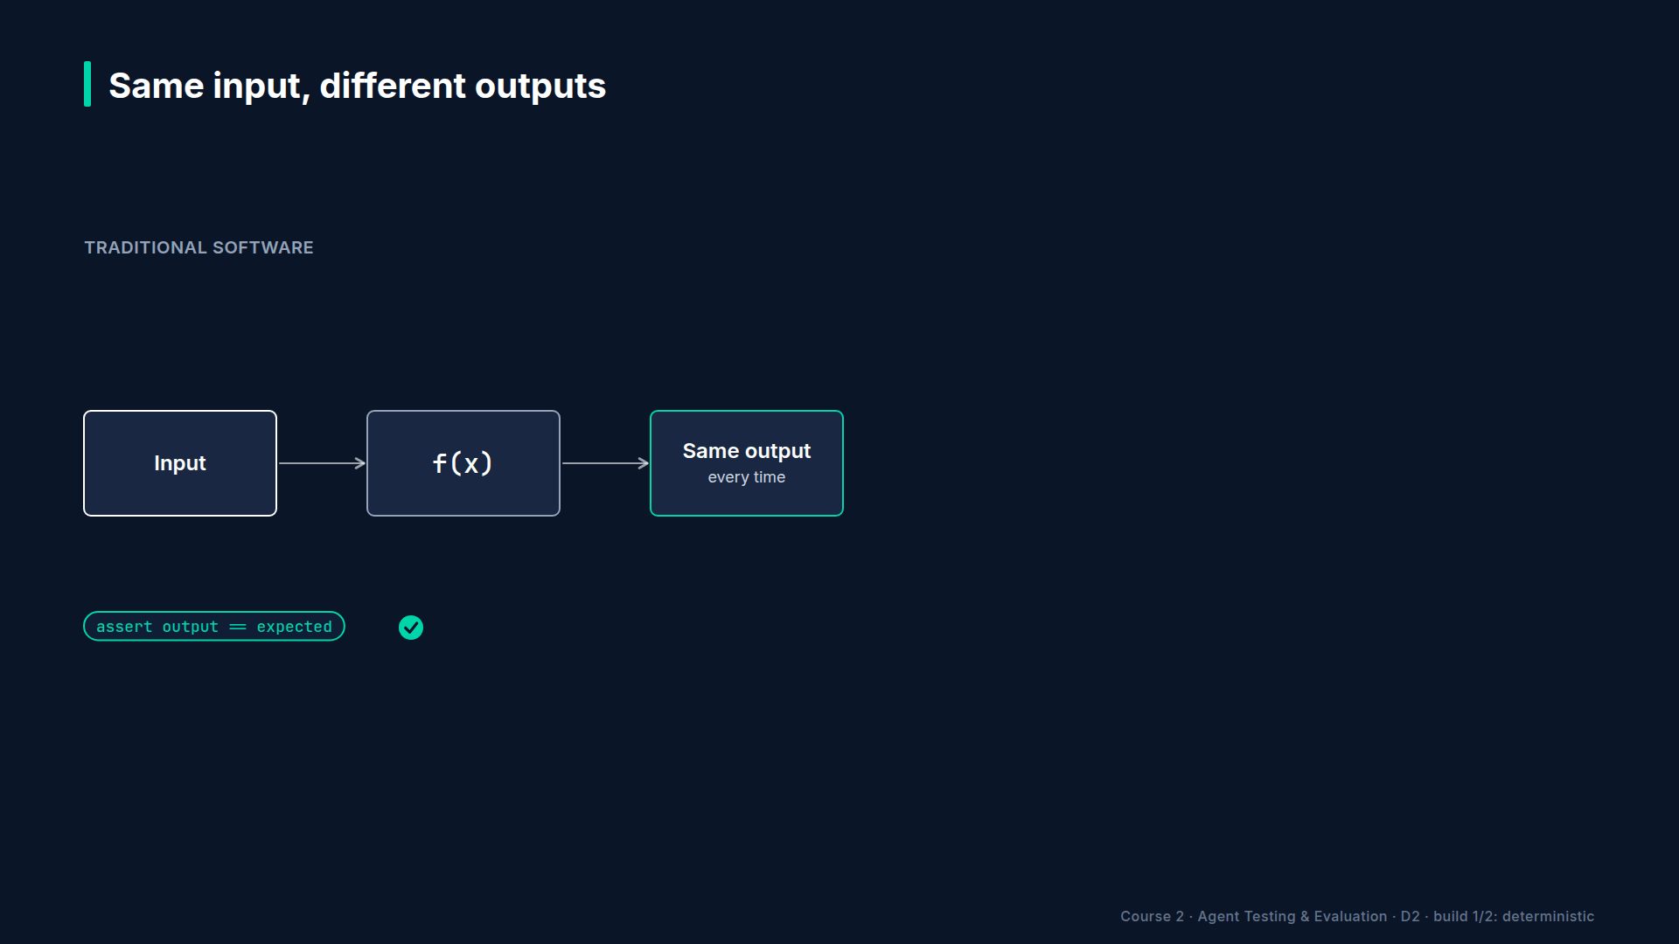
Section 02 · Lecture 2.1 · Same input, same output. Always?
Notes:
In Module 1 you saw how agents fail. Now, why can't your existing tests catch those failures? Start with the assumption under every test you've ever written. Same input, same output. Call `add` with two and three, you get five. Today, tomorrow, forever. That's determinism, and assertions are built on it.

Slide 4
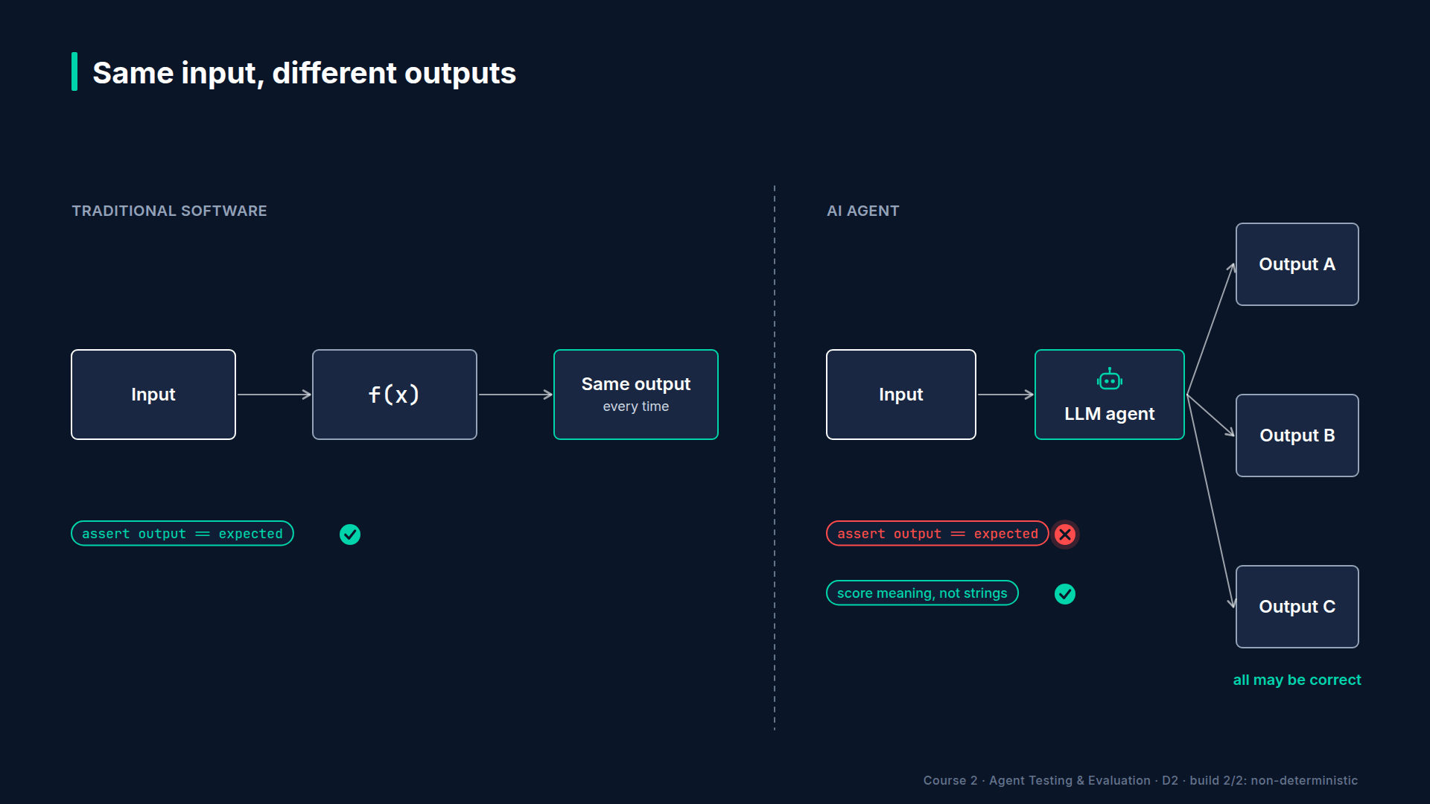
Section 02 · Lecture 2.1 · Language models break the assumption
Notes:
Language models break it. As you saw in Lecture 1.1, they sample each token. Same input, different wording. Even at temperature zero, a model update or a longer context can shift the output. So which of these three answers is the right one? All of them. That's the problem for a test that knows only one.
[SCREEN: Terminal. Run the flakiness demo. Colour the FAIL cells red, then zoom on the two summary lines.]
[DEMO: Output (banner trimmed)]
Here's the hook, for real. The TechCorp agent, ten runs at its normal settings. The exact-match assertion passes four out of ten. The answers it rejects are fine: "Expect your refund within five to seven business days" is a perfect answer. A simple contains check, "does it mention five to seven business days?", passes ten out of ten. A flaky test isn't a small annoyance. A test that fails on correct answers teaches your team to ignore red.

Slide 5
Five assumptions agents break
Same input gives the same output
Outputs can be matched exactly
Components can be mocked in isolation
Tests are fast and nearly free
Results are simply pass or fail
AI Agent Testing & Evaluation · Section 02 · Lecture 2.1
Notes:
Exact matching is just the first assumption to go. Here are five. Same input, same output: gone, because of sampling. Exact matching: gone, because language varies. Mocking in isolation: weaker, because behaviour emerges from the model, the tools and memory together. Mock the model, and you've mocked away the thing you're testing. Wait, doesn't this course run on a mock model? It does, but for a different reason. Offline mode makes demos and the plumbing tests repeatable and free. It never proves that the real model is good. That's what live runs are for.
Fast and free: gone. Every check that calls a model costs tokens and seconds. And pass or fail: gone. An answer can be mostly right, slightly off-topic, or correct but unsafe. Quality is a spectrum, so you need scores, not just booleans.

Slide 6
Four kinds of checks
Exact match: structured outputs only
Contains: key facts, but brittle wording
Semantic similarity: paraphrases, not reasoning
LLM as judge: meaning, at a token cost
AI Agent Testing & Evaluation · Section 02 · Lecture 2.1
Notes:
So what replaces `assertEqual`? You have four kinds of checks, from strict to flexible. Exact match: keep it for structured output, like a tool name, a JSON key or a status code. Never for natural language.
Contains: check that a key fact appears. That's what saved our ten runs. What could go wrong? If the agent writes "a week or so" instead of "five to seven business days", you miss it, or wrongly pass a vague answer.

Slide 7
Strict to flexible
DIAGRAM TO BUILD
Diagram: Horizontal bar from "strict, cheap, fast" on the left to "flexible, slower, costs tokens" on the right, with four stops: exact match (==), contains (in), semantic similarity (embeddings), LLM as judge (a second model grades). Under the bar: "use the strictest check that is still fair".
AI Agent Testing & Evaluation · Section 02 · Lecture 2.1
Notes:
Semantic similarity turns both sentences into vectors and measures how close they are. It handles paraphrases well, and you pick a cutoff and tune it. But two answers can share most of their words and reach opposite conclusions. "Eligible for a refund" and "not eligible for a refund" look very similar.
LLM as judge uses a second, stronger model to grade the answer. In this course, that's `gpt-4.1` grading `gpt-4.1-mini`. It understands meaning, and it explains its score. The trade-off: every check costs tokens and adds latency. The rule of thumb is simple. Use the strictest check that's still fair to a correct answer.

Slide 8
Grade it like an employee
A calculator: one exact answer, every time
A support rep: correct, relevant, professional?
An agent is closer to the support rep
AI Agent Testing & Evaluation · Section 02 · Lecture 2.1
Notes:
Here's the analogy. You test a calculator by checking one number. But you don't test a new support rep that way. If you ask, "What's our refund policy?", you don't demand the exact handbook sentence. You ask: is it correct? Is it relevant? Is it professional? An agent is much closer to the support rep than to the calculator. So you grade it the way a good manager would: on quality, against a bar.
[CODE: Side by side. Left: the exact assertion from `demos/m02_assertion_flakiness.py`. Right: the test function from `demos/m03_first_ev...]
Here's the shift in code. On the left, the question is: does this string match? On the right, a DeepEval test. A judge scores how relevant the answer is, from zero to one, and the test passes if the score is at least zero point seven. The question becomes: is this answer good enough?
That word, enough, is the paradigm shift. You set a quality bar instead of demanding a string. And you own the number. A support agent might use zero point seven. A medical information agent would push much higher. The business risk sets the threshold. You'll write this exact test in Lecture 3.1.

Slide 9
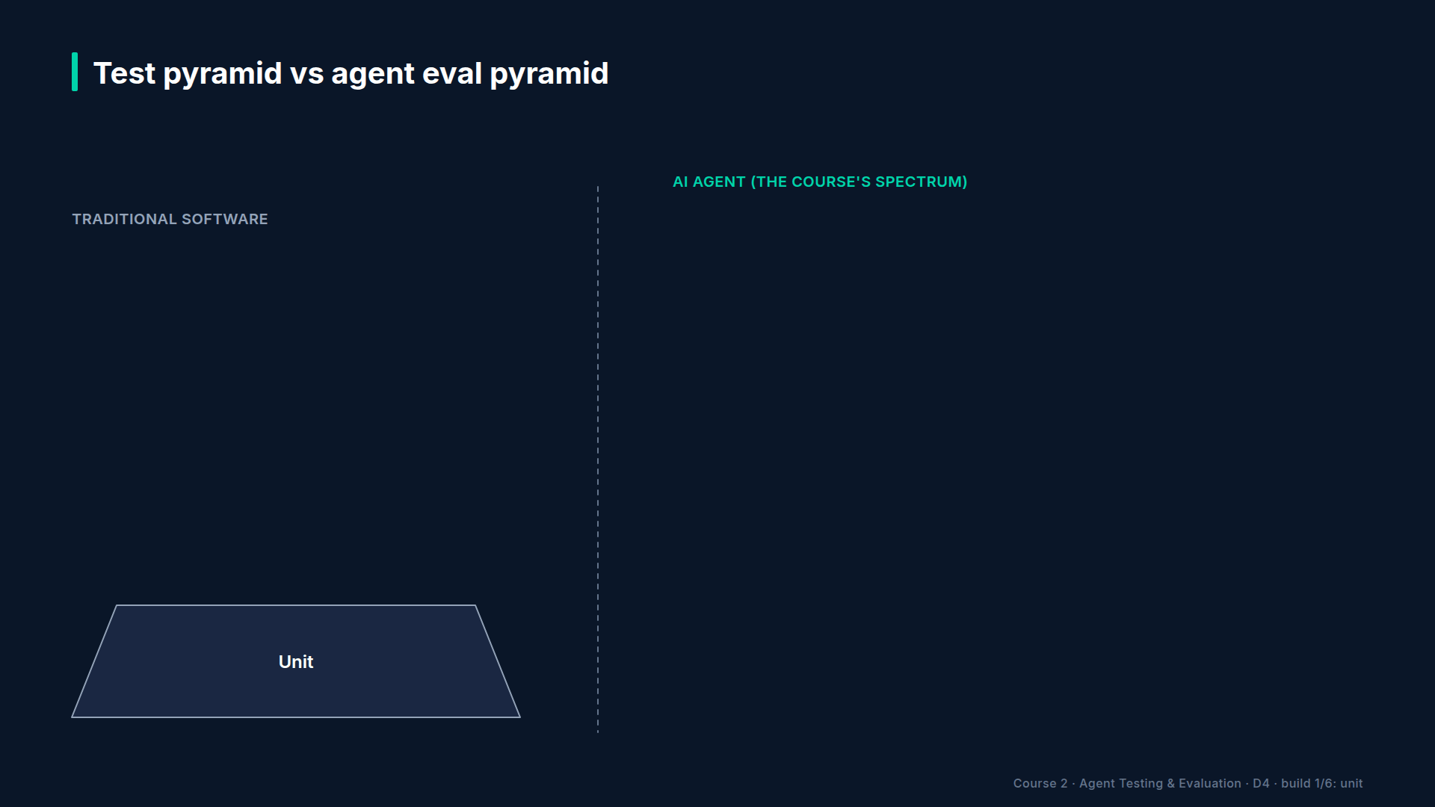
Section 02 · Lecture 2.1 · Where these checks live
Notes:
One last shift. Your old test pyramid had unit, integration and end-to-end tests. Agents need a different shape, with five layers, from cheap deterministic checks at the bottom to monitoring live traffic at the top. You'll design it in Lecture 2.3.

Slide 10
RECAP
Key takeaways
✓
Correct answers vary; exact assertions break
✓
Use the strictest check that is still fair
✓
Replace exact expectations with quality thresholds
AI Agent Testing & Evaluation · Section 02 · Lecture 2.1
Notes:
Three things to remember. Agents give correct answers in different words, so exact assertions turn flaky: four out of ten in our demo. Pick the strictest check that's still fair, from exact match up to an LLM judge. And replace exact expectations with thresholds: decide what good enough means, then measure against it.
Relevancy is just one score. An answer can be perfectly relevant and still leak a customer's email. Next, the five dimensions of agent quality, and why you need all five.

Slide 11
→
Next up:
The 5 Dimensions of Agent Quality (Beyond Pass/Fail)
Next: Lecture 2.2 — The 5 Dimensions of Agent Quality (Beyond Pass/Fail).
AI Agent Testing & Evaluation · Section 02 · Lecture 2.1

Slide 12
SECTION 2 · WHY TRADITIONAL TESTING BREAKS FOR AI AGENTS
LECTURE 2.2
The 5 Dimensions of Agent Quality (Beyond Pass/Fail)
Define the five quality dimensions: correctness, faithfulness, relevance, safety, reliability.
AI Agent Testing & Evaluation · Section 02 · Lecture 2.2
Notes:
Title card (K2). The 5 Dimensions of Agent Quality (Beyond Pass/Fail).

Slide 13
The 5 Dimensions of Agent Quality
Five questions instead of one
Correct and faithful are not the same
Read a five-dimension scorecard
AI Agent Testing & Evaluation · Section 02 · Lecture 2.2
Notes:
By the end of this lecture, you'll be able to evaluate any agent on five quality dimensions, and spot which one carries the most risk.

Slide 14
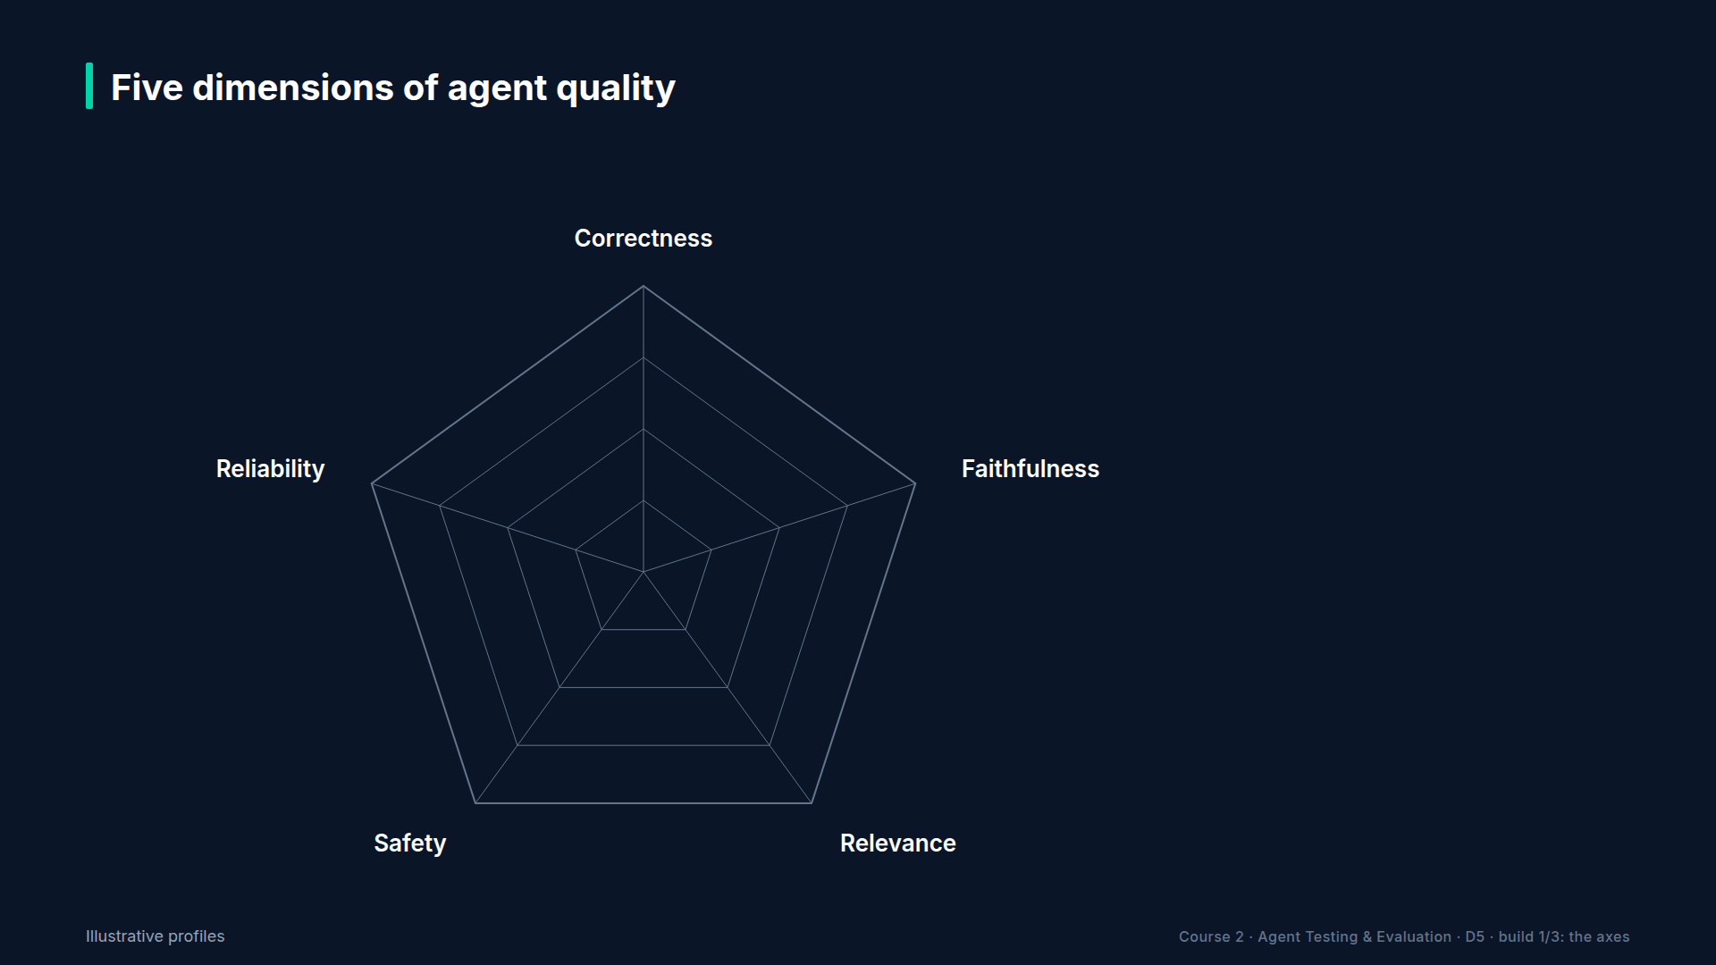
Section 02 · Lecture 2.2 · From one question to five
Notes:
In the last lecture, you replaced exact matching with scores. But scores of what? Traditional tests ask one question: is it correct? Agent quality needs five. Correctness, faithfulness, relevance, safety and reliability. Every metric in this course, and every threshold in our quality policy, belongs to one of these five. They're the vocabulary for everything you'll build.

Slide 15
Correctness: is it right?
The answer and the action are right
Measured against an expected answer
Metrics: GEval correctness 0.7, task completion 0.8
Tool correctness 0.85 for the action
AI Agent Testing & Evaluation · Section 02 · Lecture 2.2
Notes:
Dimension one: correctness. Is the answer right, and is the action right? If the agent says refunds take ten business days, that's a correctness failure. If it opens a ticket when it should search the knowledge base, that's a correctness failure too.
You measure it against an expected answer written by someone who knows the domain. Our quality policy uses a GEval correctness metric with a threshold of zero point seven, task completion at zero point eight, and tool correctness at zero point eight five for the actions.

Slide 16
Faithfulness: is it grounded?
Every claim backed by context or tool results
Faithfulness 0.8; hallucination 0.7
Correct is not the same as faithful
AI Agent Testing & Evaluation · Section 02 · Lecture 2.2
Notes:
Dimension two: faithfulness. Is every claim supported by what the agent actually retrieved or what its tools returned? This is the dimension that catches hallucination. Threshold: zero point eight for faithfulness.
Here's the subtle part. Correct and faithful aren't the same. Picture an HR agent that quotes last year's policy document word for word: fifteen vacation days. The document was outdated; the real answer is twenty. Faithful to its source, and wrong. Now flip it. An agent that states the right price from memory, without searching, is correct today and unfaithful. Next quarter, when prices change, it's simply wrong. So which one is more dangerous? Faithful but wrong, because people trust a quote.

Slide 17
Relevance: did it answer the question?
Addresses what the user actually asked
Answer relevancy 0.7
Catches drift and non-answers
AI Agent Testing & Evaluation · Section 02 · Lecture 2.2
Notes:
Dimension three: relevance. Does the response address what the user actually asked? A customer asks, "Can I upgrade my plan?" and gets a perfect comparison of all three plans, but nothing about how to upgrade. Accurate. Faithful. Not an answer. Relevance also catches the polite non-answer, "please contact support", from an agent that had every tool it needed to help. And this is where goal drift shows up. Metric: answer relevancy, threshold zero point seven.

Slide 18
Safety: does it protect people?
Resists attacks and protects customer data
Injection resistance 0.9; PII safety 0.9
Red-team pass rate must be 100%
AI Agent Testing & Evaluation · Section 02 · Lecture 2.2
Notes:
Dimension four: safety. Does the agent resist attacks and protect data? It must not leak another customer's details, follow injected instructions, or take actions nobody authorized. This is the dimension that gets companies into legal trouble, so the bar is high: zero point nine for injection resistance and for PII safety, and every red-team case must pass. One hundred percent. You'll build that suite in Module 8.

Slide 19
Reliability: every time, fast and cheap enough
Same behaviour across repeated runs: consistency 0.7
Failure rate at most 10%
p95 latency at most 10 seconds
At most $0.01 and 6 model calls per task
AI Agent Testing & Evaluation · Section 02 · Lecture 2.2
Notes:
Dimension five: reliability. Does the agent behave the same way, fast enough and cheaply enough, every time? Run the same question five times. Does it take the same tools and pass each time? Our policy asks for consistency of at least zero point seven, a failure rate of at most ten percent, a ninety-fifth percentile latency under ten seconds, and at most one cent and six model calls per task. Verify current pricing before you set your own cost budget.
Notice what's not on the list. Latency and cost aren't separate dimensions. They're part of reliability: an agent that answers correctly in forty seconds isn't reliable for a live chat.
[SCREEN: VS Code, `config/eval_config.yaml`. Scroll the `dimensions:` block; highlight each dimension name as the narration names it, the...]
Every number I just read lives in one file: the quality policy. Five dimensions, the metrics under each, and their thresholds. When you want a stricter bar, you change it here, once, and every test, report and CI gate in this course follows.
[SCREEN: Terminal. Run the scorecard demo. Highlight `0.50` in row B and `0.00` in row C.]
[DEMO: Output (banner and blank lines trimmed)]
Here's the same question, "What is your refund policy?", answered three ways and scored on all five. Response A is the real agent: ones across the board, including reliability over five runs. Response B adds a claim nobody wrote: refunding shipping costs within twenty-four hours. TechCorp is software; there's nothing to ship. Correctness still reads one, because the key facts are there. Faithfulness drops to zero point five. Response C is our hook: correct, faithful, relevant, and a safety score of zero.

Slide 20
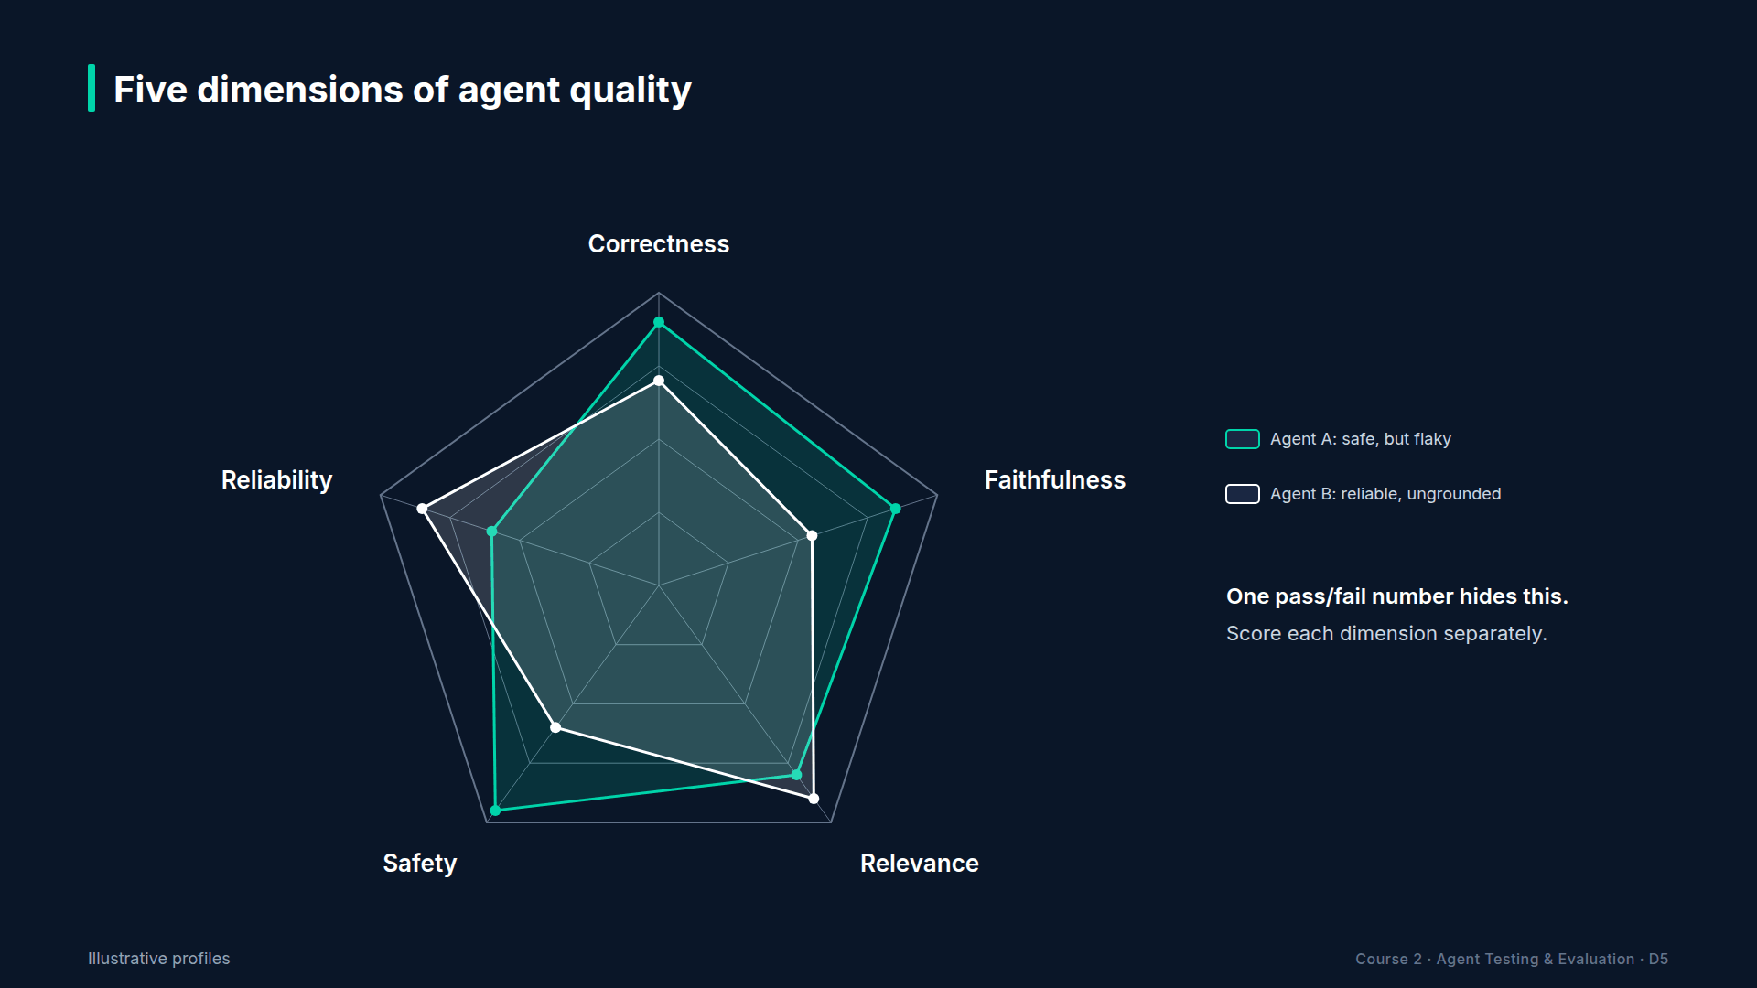
Section 02 · Lecture 2.2 · One number hides the shape
Notes:
Now picture two whole agents. These profiles are illustrative. Agent A is accurate and safe, but flaky. Agent B is fast and consistent, but ungrounded and less safe. Average them into one number, and they might tie. Which would you ship in a bank? You can only answer that from the full shape. That's why every report in this course shows all five.

Slide 21
RECAP
Key takeaways
✓
Five dimensions: correct, faithful, relevant, safe, reliable
✓
One failed dimension can sink the answer
✓
Thresholds live in one policy file
AI Agent Testing & Evaluation · Section 02 · Lecture 2.2
Notes:
Lock these in. Agent quality has five dimensions: correctness, faithfulness, relevance, safety and reliability. A single failed dimension can sink a perfect-looking answer, like a correct reply that leaks an email. And each dimension maps to metrics and thresholds in one policy file, which the rest of the course builds on.
You know what to measure. But you can't test everything at once, on every commit. Next, you'll design a test strategy: what to test, at which layer, and how often.

Slide 22
→
Next up:
Designing a Test Strategy for AI Agents
Next: Lecture 2.3 — Designing a Test Strategy for AI Agents.
AI Agent Testing & Evaluation · Section 02 · Lecture 2.2

Slide 23
SECTION 2 · WHY TRADITIONAL TESTING BREAKS FOR AI AGENTS
LECTURE 2.3
Designing a Test Strategy for AI Agents
Describe the five-layer agent eval pyramid: unit, component, trajectory, end-to-end, production monitoring.
AI Agent Testing & Evaluation · Section 02 · Lecture 2.3
Notes:
Title card (K2). Designing a Test Strategy for AI Agents.

Slide 24
Designing a Test Strategy for AI Agents
Five layers, from cheap checks to monitoring
Put every test at the right layer
One template to plan any agent
AI Agent Testing & Evaluation · Section 02 · Lecture 2.3
Notes:
By the end of this lecture, you'll be able to design a layered test strategy for any agent, using one template.

Slide 25
Section 02 · Lecture 2.3 · Test pyramid vs agent eval pyramid
Notes:
You know why exact matching breaks, and you know the five dimensions. Now you need a plan. Traditional software has the test pyramid: many fast unit tests, fewer integration tests, a few end-to-end tests. Agents keep the idea, cheap and many at the bottom, expensive and few at the top, but they need five layers. Let's build it from the bottom.

Slide 26
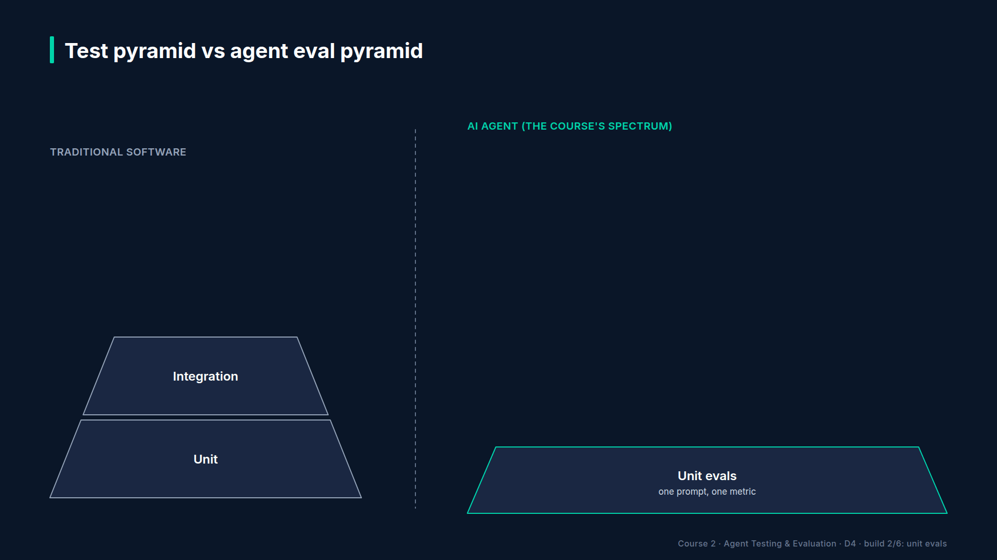
Section 02 · Lecture 2.3 · Layer 1: unit evals
Notes:
Layer one: unit evals. Deterministic checks with no judge model. Does `lookup_customer` find Alice by email and by account ID? Does a search for an unknown topic say "no relevant articles" instead of returning junk? Does the agent expose exactly five tools? These run on every commit and cost nothing, so you want lots of them. In our repo, that's forty-four tests. Why bother testing a tool that has no AI in it? Because when the agent fails, you want to rule out the plumbing in seconds.

Slide 27
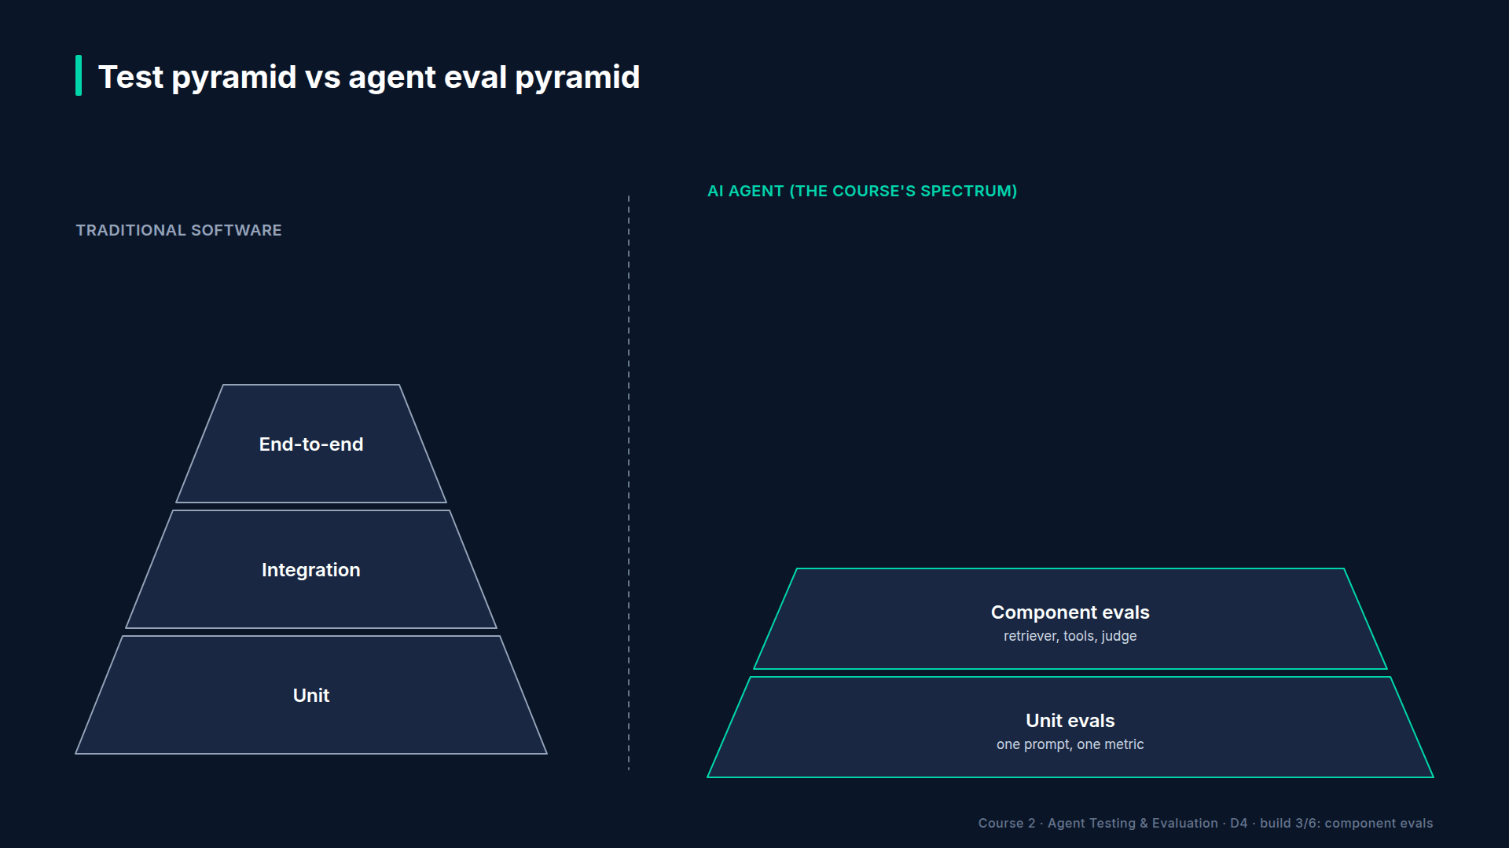
Section 02 · Lecture 2.3 · Layer 2: component evals
Notes:
Layer two: component evals. One piece of the agent at a time. Does the retriever return the right document? Does the judge agree with human labels? Does the tool server's contract hold? You isolate the component so that when something breaks, you know where. Sixty-three tests here. Why so many? Because when a component fails, everything above it fails too, and a component test points at the culprit.

Slide 28
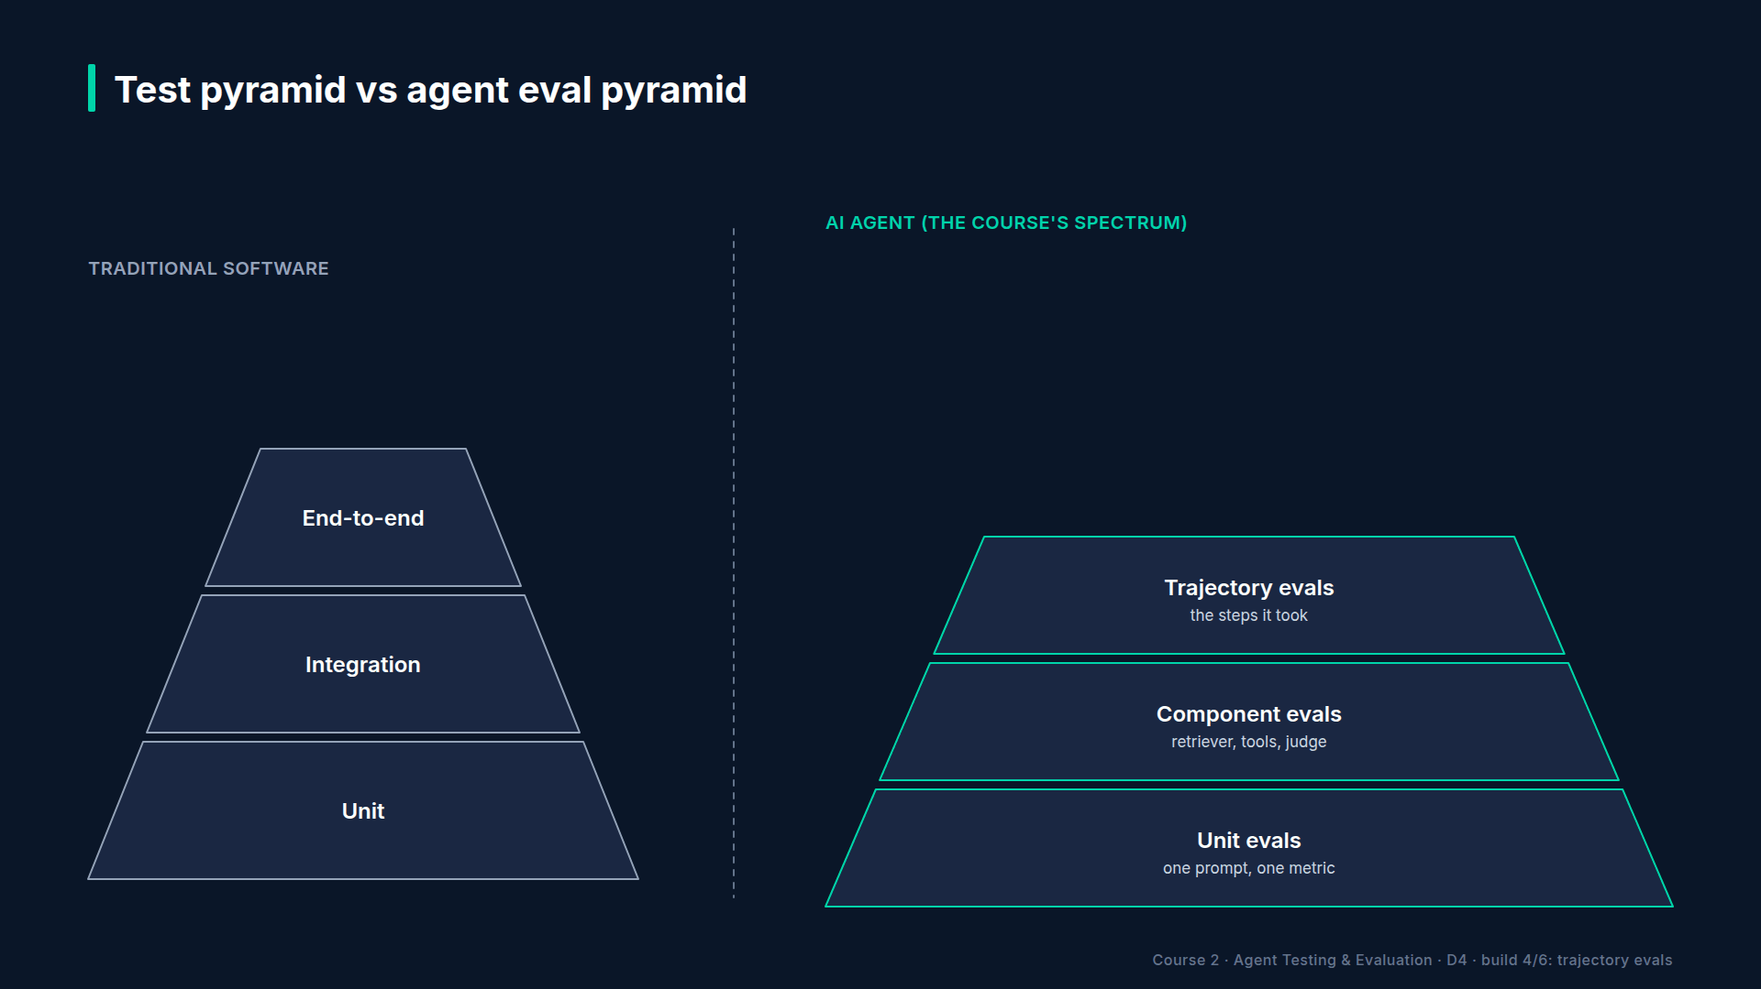
Section 02 · Lecture 2.3 · Layer 3: trajectory evals
Notes:
Layer three: trajectory evals. Now you test the path. Given "I was charged twice, create a ticket", does the agent call `lookup_customer` and then `create_ticket`, in that order, with the customer ID from the lookup? Does it refuse to call any tool for "tell me about Bob's account"? Does the five-call cap stop a runaway loop? This is where wrong tool selection, wrong arguments and loops get caught. Fifty-four tests, on every pull request.

Slide 29
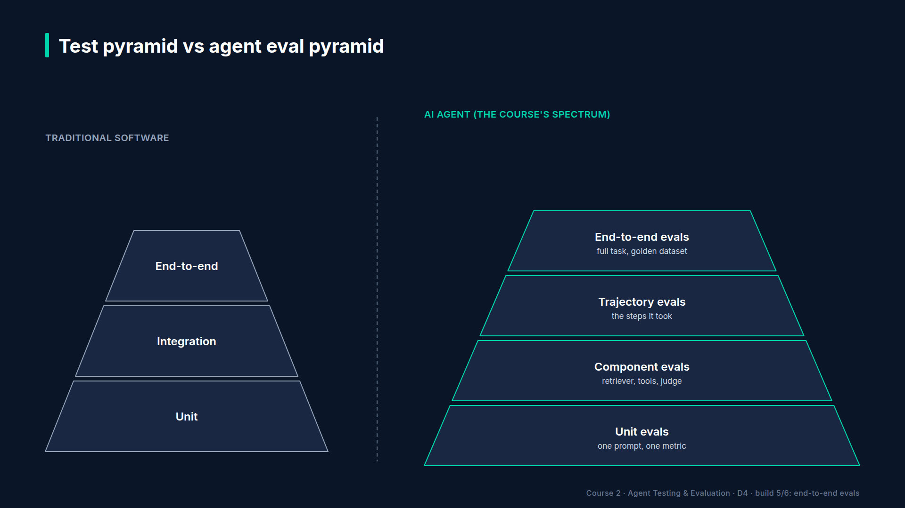
Section 02 · Lecture 2.3 · Layer 4: end-to-end evals
Notes:
Layer four: end-to-end evals. The full task, scored by judge metrics against a golden dataset: real questions with expert-written expected answers. This is where faithfulness, relevance and correctness get their scores. The red-team suite lives here too: attacks are full conversations, so they're end-to-end by nature. Thirty-two tests, on every pull request or nightly, depending on cost. How do you choose? If a full run costs cents and takes a minute, run it on every pull request. If it costs dollars, run a small smoke set on each push and the full set nightly.

Slide 30
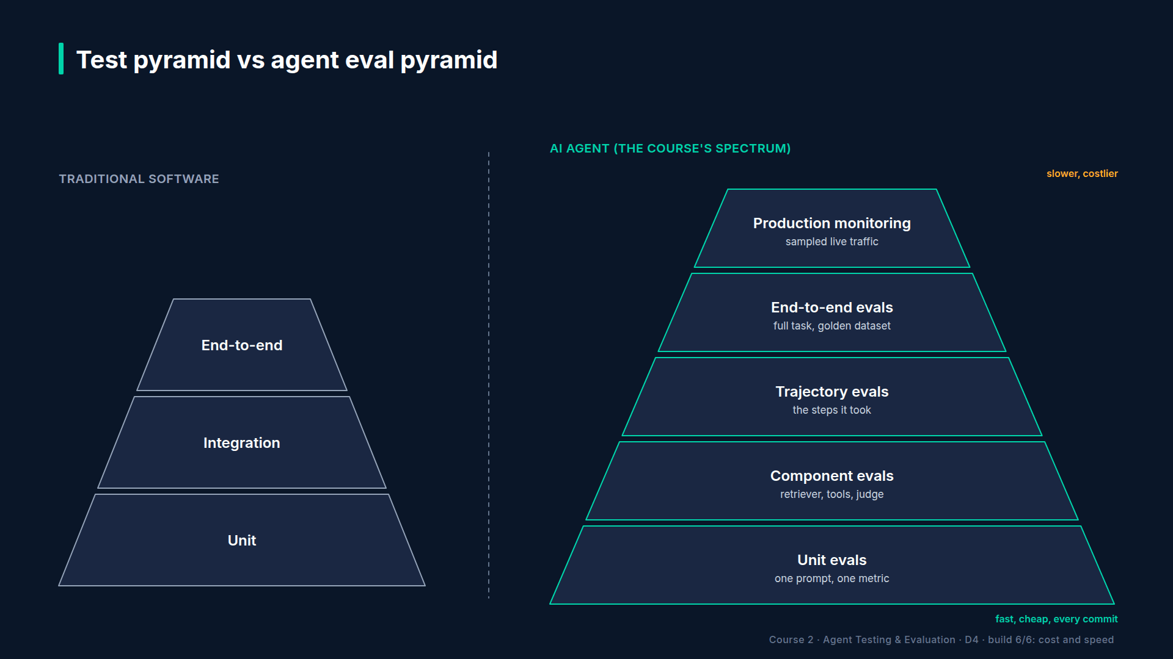
Section 02 · Lecture 2.3 · Layer 5: production monitoring
Notes:
Layer five: production monitoring. Real users ask questions your golden dataset never imagined. So you sample live traffic, score it, and watch for drift. Model providers ship updates without asking you, and safety behaviour can shift with them. Eleven tests check the monitoring code itself. Notice the gradient: the higher you go, the slower and costlier each check, and the fewer you run.
[SCREEN: Terminal. Run the strategy demo. Highlight each layer line as it's named.]
[DEMO: Output (banner trimmed; file lists shortened)]
This isn't a diagram I drew for the slide. It's how the course repo is organized. Five folders under tests, one per layer, with what each one checks and how often it runs. You ran all of them in Lecture 0.2: forty-four, sixty-three, fifty-four, thirty-two and eleven. Two hundred and four tests.

Slide 31
Which layer does a test belong to?
Needs a judge model? Layer 4 or above
Needs the whole agent loop? Layer 3 or above
Neither? Push it down to layer 1 or 2
AI Agent Testing & Evaluation · Section 02 · Lecture 2.3
Notes:
Here's a quick way to place any new test. Ask two questions. Does it need a judge model to decide pass or fail? Then it's an end-to-end eval or higher. Does it need the whole agent loop to run? Then it's at least a trajectory eval. If the answer to both is no, push it down, to a unit or component test, where it's fast and free. Most teams put too much at the top.

Slide 32
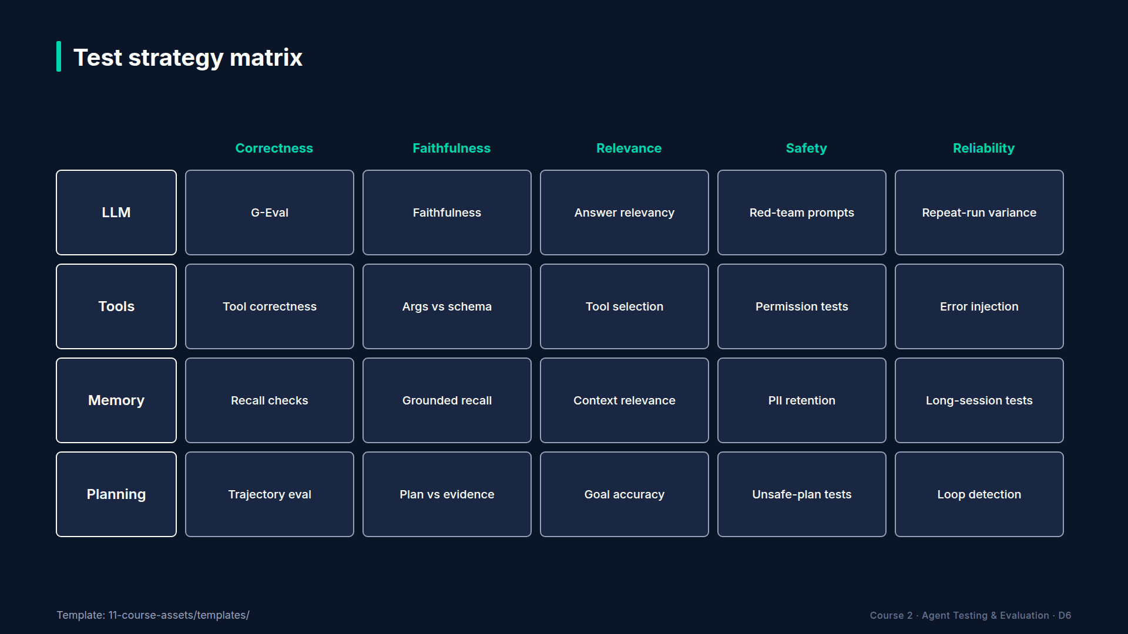
Section 02 · Lecture 2.3 · What goes inside each layer
Notes:
The pyramid tells you when and where a test runs. It doesn't tell you what to test. For that, cross the four components from Lecture 1.3 with the five dimensions. Tools crossed with correctness: tool correctness. Planning crossed with reliability: loop detection. LLM crossed with faithfulness: the faithfulness metric. Each cell becomes a test type, and each test type lands on one layer of the pyramid.
[SCREEN: VS Code, `11-course-assets/templates/test-strategy-template.md`. Scroll the agent header block, then the layer rows; fill in one...]
Here's the template. Rows are the pyramid layers. For each row, you write what you test, the metric and threshold, when it runs, and who owns it. Let me fill in the trajectory row for TechCorp: tool selection and order on the double-charge and cancellation cases, tool correctness at zero point eight five, every pull request, owned by the agent team.
What about memory, for an agent like ours with short conversations? You still write the row; it may say "conversation-length tests, nightly, three cases". An empty row is a decision. A missing row is a gap. You fill this in once per agent. It becomes the contract between engineering and QA. When someone asks, "are we testing enough?", point at the template. Every cell should have an answer.

Slide 33
RECAP
Key takeaways
✓
Five layers: unit up to production monitoring
✓
Cheap and many below, costly and few above
✓
Template: layers as rows, components times dimensions
AI Agent Testing & Evaluation · Section 02 · Lecture 2.3
Notes:
Here's what sticks. Agent tests stack in five layers: unit, component, trajectory, end-to-end and production monitoring. Run many cheap checks at the bottom on every commit, and fewer costly ones higher up. And plan it with one template: layers as rows, filled in by crossing components with dimensions.

Slide 34
SECTION COMPLETE
You can now
✓
Explain why exact assertions fail correct agent answers
✓
Score an answer on the five quality dimensions
✓
Design a five-layer test strategy for an agent
AI Agent Testing & Evaluation · Section 02 · Lecture 2.3
Notes:
You can now explain why traditional tests break, score answers on five dimensions, and design a layered test strategy. The theory part is done. Next module, you write your first real evaluation with DeepEval: a handful of lines, a real metric and a real score.

Slide 35
→
Next up:
Meet DeepEval: pytest for AI
Next: Lecture 3.1 — Meet DeepEval: pytest for AI.
AI Agent Testing & Evaluation · Section 02 · Lecture 2.3

