Slide 1
SECTION 4 · EVALUATION METRICS DEEP DIVE
LECTURE 4.1
LLM Quality Metrics: Relevance, Faithfulness, Coherence
Explain what Answer Relevancy, Faithfulness, Hallucination and GEval correctness each measure, and which test case fields each needs.
AI Agent Testing & Evaluation · Section 04 · Lecture 4.1
Notes:
Title card (K2). LLM Quality Metrics: Relevance, Faithfulness, Coherence.

Slide 2
LLM Quality Metrics
Know what each quality metric measures
Know which fields each one needs
Explain why metrics disagree
AI Agent Testing & Evaluation · Section 04 · Lecture 4.1
Notes:
By the end of this lecture, you'll be able to pick the right quality metric for a failure, and explain a table of scores that seem to contradict each other.

Slide 3
Verified for this lecture
openai 2.54.0 and deepeval 4.2.7
Judge gpt-4.1 live; mock judge offline
Demo: demos/m04_metric_comparison.py
AI Agent Testing & Evaluation · Section 04 · Lecture 4.1

Slide 4
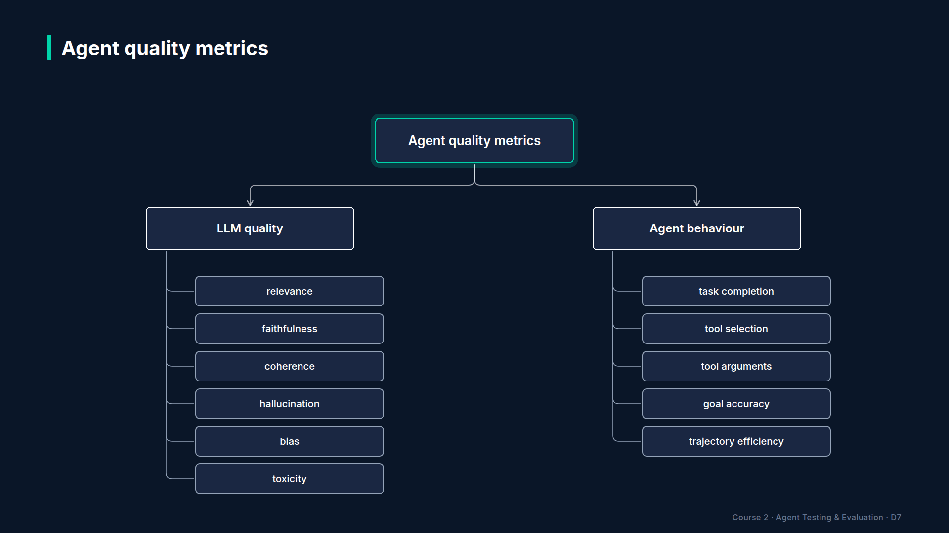
Section 04 · Lecture 4.1 · Agent quality metrics
Notes:
In Project 1, you used three metrics. Now let's look at the whole map. Agent metrics split into two families. LLM quality metrics judge the text the agent wrote. Agent behaviour metrics judge what it did: its tools and steps. This lecture is the left branch: relevance, faithfulness, coherence, hallucination, bias and toxicity. Next lecture, the right branch.

Slide 5
Answer Relevancy
Question: does it address what was asked?
Needs: input, actual output
Score: share of statements that are relevant
Our threshold: 0.7
AI Agent Testing & Evaluation · Section 04 · Lecture 4.1
Notes:
Start with answer relevancy. The judge splits the answer into statements, then asks of each one: does this help answer the question? The score is the share of relevant statements. So a focused answer scores high, and an answer padded with unrelated facts scores lower. It needs only the question and the answer, which makes it cheap to apply everywhere. It's your first defence against goal drift and non-answers. So what does a vague answer score? Somewhere in the middle, and you'll see exactly where in the demo.

Slide 6
Faithfulness
Question: is every claim backed by what it retrieved?
Needs: actual output, retrieval context
Score: share of claims not contradicted
Our threshold: 0.8
AI Agent Testing & Evaluation · Section 04 · Lecture 4.1
Notes:
Faithfulness checks grounding. The judge pulls the factual claims out of the answer, then checks each one against the retrieval context, the text the agent's tools actually returned. The score is the share of claims that hold up.
One detail that matters in DeepEval four point two. By default, a claim fails only if the context contradicts it. A claim the context simply doesn't mention counts as borderline and passes. Want unsupported extras to fail too? Set `penalize_ambiguous_claims` to true. For a policy bot, that's often the right call. Why? Because "bursts of five thousand are free" isn't contradicted by the docs. It's just invented.

Slide 7
Hallucination vs faithfulness
Faithfulness: answer vs what the agent retrieved
Hallucination: answer vs ground-truth context you supply
4.2: higher is better; our threshold 0.7
AI Agent Testing & Evaluation · Section 04 · Lecture 4.1
Notes:
The hallucination metric sounds like the same thing, so what's different? Its reference. Faithfulness compares the answer with the retrieval context, whatever the agent found. Hallucination compares it with the context field, the ground truth you wrote into the test case. The score is the share of those context passages the answer agrees with.
Careful with old tutorials. In DeepEval four point two, hallucination is higher-is-better, and it passes at or above the threshold. Our policy uses zero point seven. Older docs describe it the other way round.

Slide 8
Correctness vs faithfulness
Correctness: matches the expert's expected answer
Faithfulness: matches the agent's own sources
Outdated document: faithful but incorrect
Correct from memory: correct but unfaithful
AI Agent Testing & Evaluation · Section 04 · Lecture 4.1
Notes:
Then there's correctness, our GEval metric from Project 1. It compares the answer with the expected answer an expert wrote. This is the distinction most people get wrong in interviews. Correctness asks, "is it true?" Faithfulness asks, "did it come from the sources?" Quote an outdated document word for word, and you're faithful but incorrect. State today's price from memory, and you're correct but unfaithful, and one price change away from wrong.

Slide 9
Coherence, bias, toxicity
Coherence: no built-in metric; write a GEval criterion
Bias and Toxicity: built in, higher is better
1.0 means nothing biased or toxic found
AI Agent Testing & Evaluation · Section 04 · Lecture 4.1
Notes:
Coherence asks whether the answer is well structured and logically consistent. DeepEval four point two doesn't ship a coherence metric. You write it as a GEval criterion, in plain English, which you'll do in Lecture 4.4. Bias and toxicity are built in. In four point two they're higher-is-better too: one point zero means the judge found no biased or toxic statements. For a support agent, they're a safety net rather than a daily metric.
[CODE: `demos/m04_metric_comparison.py`, the scoring loop]
Here's the demo. One question about Pro API limits. One expected answer: a thousand requests per hour. The knowledge-base article KB-104 as both context and retrieval context. Five candidate answers, each measured by four metrics. Notice `metric.measure`: you don't need `assert_test` to get a score. Measure, then read `score` and `reason`.
[SCREEN: Terminal. Run the comparison. Highlight one cell per row as the narration reaches it.]
[DEMO: Output (banner and blank lines trimmed)]
Row one, the correct answer: ones everywhere. Good. That's your control row. If the correct answer didn't score well, you'd fix the test before reading anything else.
Row three, off-topic: "Our refund policy gives you thirty days." Relevancy zero, correctness zero point one. But faithfulness? One. Nothing in the answer contradicts the API docs, so it's perfectly grounded and perfectly useless. Faithfulness alone would wave it through.
Row four, vague: "Rate limits depend on your plan. Check the documentation." Relevancy zero point five, correctness zero point two. Not wrong, just not an answer.
Row five is our hook. Relevant, correct on the key fact, and an invented claim about free bursts. Faithfulness and hallucination both drop to zero. Here, offline, the mock judge treats an unsupported number as a failure.

Slide 10
The row that teaches the most
Row 2: "500 requests per hour", the wrong number
Relevancy, faithfulness, hallucination: all passed offline
Correctness caught it: 0.50 vs expert answer
AI Agent Testing & Evaluation · Section 04 · Lecture 4.1
Notes:
And row two, the wrong number: five hundred instead of a thousand. Only correctness caught it, at zero point five. Offline, the mock judge missed the contradiction. A live `gpt-4.1` judge usually flags it, but "usually" is the point. Every judge has blind spots, and that's why you stack metrics, and why Lecture 4.3 is about checking the judge itself. So which single metric would you trust alone? None of them.

Slide 11
A default set for a support agent
Answer Relevancy 0.7 on every case
Faithfulness 0.8 where there's retrieved text
GEval correctness 0.7 where an expert answer exists
Bias and toxicity as a safety net
AI Agent Testing & Evaluation · Section 04 · Lecture 4.1
Notes:
So what do you run day to day? For a support agent, the Project 1 set is a strong default. Relevancy on everything. Faithfulness wherever the agent retrieved text, with ambiguous claims penalized for policy answers. Correctness wherever an expert wrote the answer. Add bias and toxicity as a safety net. Then add behaviour metrics, which is next.
Why is faithfulness at zero point eight while the others sit at zero point seven? Because a wrong policy costs more than a slightly unfocused answer. Thresholds encode risk. Start from the policy file's values, then move them only with evidence, like the calibration you'll do in Lecture 4.3.

Slide 12
RECAP
Key takeaways
✓
Relevancy, faithfulness, correctness answer different questions
✓
Faithfulness checks sources; correctness checks truth
✓
Stack metrics; every judge has blind spots
AI Agent Testing & Evaluation · Section 04 · Lecture 4.1
Notes:
Three things to keep. Relevancy, faithfulness and correctness each answer a different question, so they disagree, and that's useful. Faithfulness checks the sources; correctness checks the truth. And no single metric catches everything, so you stack them.
Everything today judged the words. But an agent can write a lovely answer after calling the wrong tool. Next, the metrics that judge what the agent did: task completion, tool correctness and goal accuracy.

Slide 13
→
Next up:
Agent-Specific Metrics: Task Completion, Tool Correctness, Goal Accuracy
Next: Lecture 4.2 — Agent-Specific Metrics: Task Completion, Tool Correctness, Goal Accuracy.
AI Agent Testing & Evaluation · Section 04 · Lecture 4.1

Slide 14
SECTION 4 · EVALUATION METRICS DEEP DIVE
LECTURE 4.2
Agent-Specific Metrics: Task Completion, Tool Correctness, Goal Accuracy
Measure tool selection with ToolCorrectnessMetric (tools_called vs expected_tools) and task completion with TaskCompletionMetric.
AI Agent Testing & Evaluation · Section 04 · Lecture 4.2
Notes:
Title card (K2). Agent-Specific Metrics: Task Completion, Tool Correctness, Goal Accuracy.

Slide 15
Agent-Specific Metrics
Score what the agent did, not just said
Tool correctness and task completion in DeepEval
Arguments, goals and efficiency with simple checks
AI Agent Testing & Evaluation · Section 04 · Lecture 4.2
Notes:
By the end of this lecture, you'll be able to score an agent's actions: which tools it chose, whether it finished the task, and how efficiently it got there.

Slide 16
Verified for this lecture
openai 2.54.0 and deepeval 4.2.7
Judge gpt-4.1 live; mock judge offline
Demo: demos/m04_agent_metrics.py
AI Agent Testing & Evaluation · Section 04 · Lecture 4.2

Slide 17

Section 04 · Lecture 4.2 · The agent behaviour branch
Notes:
Last lecture was the left side of the map: metrics that judge text. Now the right side. Five behaviour metrics: task completion, tool selection, tool arguments, goal accuracy and trajectory efficiency. Remember the six failure modes? Wrong tool selection, incorrect arguments and infinite loops are invisible to text metrics. This branch is how you catch them.

Slide 18
Tool correctness
Compares tools_called with expected_tools
By name; options for order and exact match
Our threshold: 0.85
DeepEval 4.2 still needs a model=
AI Agent Testing & Evaluation · Section 04 · Lecture 4.2
Notes:
Start with tool selection. DeepEval's tool correctness metric compares two lists on the test case: the tools the agent called, and the tools it should have called. By default it matches by name. You can ask it to care about order, or to require an exact match with nothing extra.
What does order mean here? For the cancellation case, the agent must look up the customer before it creates a ticket on their account. Same tools in the wrong order is a different trajectory.
Where do the two lists come from? You built them in Lecture 3.2. `to_test_case` turns the agent's tool log into `tools_called`, and the golden case's expected tools into `expected_tools`. Our policy threshold is zero point eight five.
[CODE: `evaluators/deepeval_suite.py`, `tools_called`]
Each logged step becomes a DeepEval `ToolCall`: the name, the arguments as input parameters, and the result as output. So the arguments and results travel with the test case, ready for stricter checks later.

Slide 19
Task completion
Did the agent achieve the user's goal?
Judge reads input, output and tools called
Score 0 to 1; our threshold: 0.8
AI Agent Testing & Evaluation · Section 04 · Lecture 4.2
Notes:
Next, task completion. Did the agent actually do what the user wanted? The judge reads the request, the answer and the tools the agent called, works out what the task was and what the agent achieved, and scores how well they match. It's a judged metric, so it needs no expected answer. That makes it useful on real traffic too, where nobody wrote one. Our policy sets it at zero point eight. Can a judge really tell whether opening a ticket was the right outcome? Often, yes, because the request says what the customer wanted. When it can't, you fall back on expected tools.
[CODE: `demos/m04_agent_metrics.py`, scoring real runs and one recorded bad run]
Here's the demo. Four real agent runs from the golden set, from a one-tool lookup to the three-tool cancellation. Each gets tool correctness and task completion. Then the recorded bad run from our hook, built by hand: called `create_ticket`, expected `search_knowledge_base`.
[SCREEN: Terminal. Run the agent-metrics demo; highlight the `recorded-bad` row, then the reason block.]
[DEMO: Output (banner and blank lines trimmed)]
The four real runs score one on both metrics. The double charge, the cancellation with three tools in order, the urgent escalation: all as expected. The recorded bad run scores zero on tool correctness.
Should you be suspicious of all those ones? A little. Offline, the mock model follows the system prompt faithfully, so the golden cases come out clean. Live, `gpt-4.1-mini` occasionally takes a different path, and that's exactly when these metrics earn their place.
[SCREEN: Same terminal, zoom on the `ToolCorrectness reason` block; underline "missing tools" and "No available tools were provided".]
Now read the reason, because it tells you two things. First: missing tool, `search_knowledge_base`; called `create_ticket` instead. That's your bug report. Second: "no available tools were provided". If you also pass the list of tools the agent could have used, DeepEval adds a judged score for whether the choice was sensible. Name matching tells you that it chose wrong. The judged part helps explain why. So what would you fix first? The prompt rule that sends how-to questions to the knowledge base.

Slide 20
Tool arguments
Right tool, wrong values
Deterministic check: check_arguments in our repo
DeepEval 4.2 also has ArgumentCorrectnessMetric
AI Agent Testing & Evaluation · Section 04 · Lecture 4.2
Notes:
Third behaviour metric: arguments. Right tool, wrong values, like looking up "Alice" instead of alice@example.com. You saw our deterministic check catch that in Lecture 1.4: it compares each argument with the expected value and reports what's missing or wrong. No judge, no cost. DeepEval four point two also ships an argument correctness metric that uses a judge, which helps when the right value is a matter of judgement, like a ticket subject. Prefer the deterministic check whenever you can write down the expected value. Module 6 goes deep on this.

Slide 21
Goal accuracy
Did the final outcome match the intended outcome?
Single turn: expected tools plus expected answer
Multi-turn: DeepEval's GoalAccuracyMetric
AI Agent Testing & Evaluation · Section 04 · Lecture 4.2
Notes:
Fourth: goal accuracy. Task completion asks whether the agent finished something. Goal accuracy asks whether it finished the right thing. Opening a ticket completes a task. But if the customer only wanted the password steps, the goal was missed. For single-turn cases, you measure goal accuracy with what you already have: the expected tools plus GEval correctness against the expert answer. That's exactly what the Project 1 suite does. For multi-turn conversations, DeepEval's goal accuracy metric works on whole conversations.

Slide 22
Trajectory efficiency
Count model calls: our budget is 6
GS-05: 3 calls; GS-06: 4 calls
Loop detector: 3 identical steps in a row
AI Agent Testing & Evaluation · Section 04 · Lecture 4.2
Notes:
Fifth: trajectory efficiency. Did the agent take a reasonable number of steps? The simplest measure is a count. Our quality policy allows at most six model calls per task. The double-charge case uses three; the cancellation, our longest, uses four. Add the loop detector, three identical steps in a row, and you catch the runaway agent from Lecture 1.4 for free. DeepEval also has a step efficiency metric that reads a traced run. You'll meet tracing in Module 9.
[SCREEN: VS Code, `config/eval_config.yaml`. Highlight `task_completion: 0.8`, `tool_correctness: 0.85` under correctness and `max_llm_ca...]
All three thresholds live in the policy file. Notice where they sit. Task completion and tool correctness are part of correctness: the action is part of the answer. The step budget is part of reliability. Same five dimensions, now covering behaviour.

Slide 23
RECAP
Key takeaways
✓
Text metrics can't see actions; behaviour metrics can
✓
Tool correctness compares called and expected tools
✓
Arguments and efficiency: cheap deterministic checks first
AI Agent Testing & Evaluation · Section 04 · Lecture 4.2
Notes:
Three takeaways. Text metrics can't see actions, so agents need behaviour metrics too. Tool correctness compares the tools called with the tools expected, and its reason reads like a bug report. And for arguments and efficiency, start with cheap deterministic checks before reaching for a judge. Which of these would have caught the password ticket? Tool correctness, at zero.
Most of these metrics lean on a judge model. Task completion, faithfulness, relevancy: another model is grading yours. So who grades the grader? Next, you'll build an LLM judge from scratch, and check it against human labels.

Slide 24
→
Next up:
LLM-as-Judge: How to Use One AI to Grade Another
Next: Lecture 4.3 — LLM-as-Judge: How to Use One AI to Grade Another.
AI Agent Testing & Evaluation · Section 04 · Lecture 4.2

Slide 25
SECTION 4 · EVALUATION METRICS DEEP DIVE
LECTURE 4.3
LLM-as-Judge: How to Use One AI to Grade Another
Write a judge prompt with an anchored rubric, the context, and JSON output.
AI Agent Testing & Evaluation · Section 04 · Lecture 4.3
Notes:
Title card (K2). LLM-as-Judge: How to Use One AI to Grade Another.

Slide 26
LLM-as-Judge
Build a judge prompt and function
Know the biases judges bring
Calibrate a judge against human labels
AI Agent Testing & Evaluation · Section 04 · Lecture 4.3
Notes:
By the end of this lecture, you'll be able to build your own LLM judge, and prove whether you can trust it.

Slide 27
Verified for this lecture
openai 2.54.0 and deepeval 4.2.7
Judge gpt-4.1 grades agent gpt-4.1-mini
File: evaluators/llm_as_judge.py
AI Agent Testing & Evaluation · Section 04 · Lecture 4.3

Slide 28
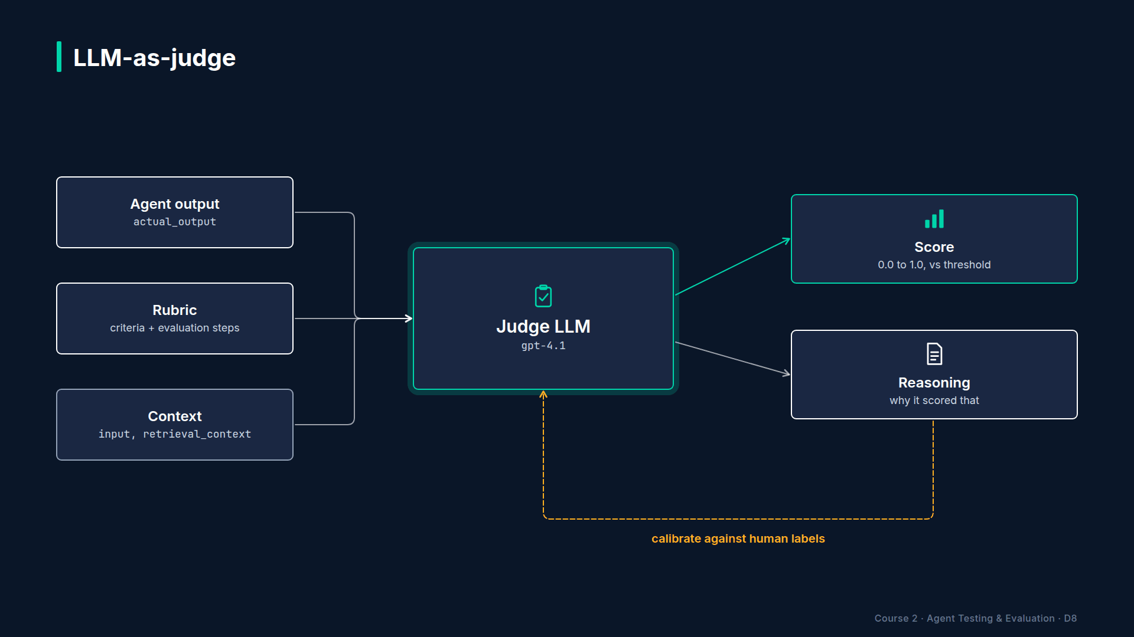
Section 04 · Lecture 4.3 · How a judge works
Notes:
Why build a judge when DeepEval has dozens of metrics? Because DeepEval's metrics are judges with good prompts. Building one yourself shows you what's inside, and when you'd want your own. The shape is simple. Three inputs: the agent's answer, a rubric, and the context the answer should match. One judge model. Two outputs: a score and a reason.
[CODE: `evaluators/llm_as_judge.py`, `JUDGE_PROMPT`]
Here's the prompt. Four design choices, and each one is there for a reason.
One: a role. "An impartial judge grading a customer-support answer." It sets the standard.
Two: an anchored rubric. Every score from one to five has a definition. What happens without anchors? One judge's four is another's three, and your scores drift.
Three: the context. The judge sees the knowledge-base text, so it grades against your policy, not against whatever it remembers. That's called reference-based judging, and it removes a whole class of judge errors.
Four: JSON output. A score you can parse, plus one sentence of reasoning. Notice the double braces: the prompt is a Python format string, so literal braces are escaped.
[CODE: `evaluators/llm_as_judge.py`, `judge`]
Now the function. Fill in the prompt. Call the judge model, `gpt-4.1` by default. Temperature zero, because you want the same grade for the same answer. JSON mode, so the reply always parses. Then return the score and the reasoning.
Why `gpt-4.1` judging `gpt-4.1-mini`? A grader should be at least as capable as the student. It costs more: about five times the price per token of the agent model, so verify current pricing before you judge thousands of answers. And if the judge fails to return a score, the code defaults to one, the lowest. A broken judge should fail loudly, not pass quietly.
[SCREEN: Terminal. Run the judge demo. Let the printed prompt sit for a beat, then highlight the judge and human columns.]
[DEMO: Output (banner and printed prompt trimmed)]
Our judge grades one answer at a time. That's called pointwise grading. The other style, pairwise, shows the judge two answers and asks which is better. It's handy for comparing two prompt versions, and it's where one of the biases you're about to see bites hardest.
Four answers to "What is your refund policy?", each graded by the judge and, separately, by a human. The full answer: five and five. The short one, thirty days but no processing time: four and four, a minor omission. The invented fourteen-day policy: one. The refusal: one, because the context answers the question. Judge and human agree on all four.

Slide 29
Three biases every judge has
Position: prefers the first of two options
Verbosity: rewards longer answers
Self-preference: favours its own model family
AI Agent Testing & Evaluation · Section 04 · Lecture 4.3
Notes:
Now, the catch. Judges have well-documented biases (verify: Zheng et al., 2023, "Judging LLM-as-a-Judge"). Position bias: when comparing two answers, judges tend to prefer the first one shown. Verbosity bias: longer answers look more thorough, so they score higher, even when they're padded. And self-preference: a model may rate text from its own family more kindly. Notice that our agent and judge share a family. Why does that matter? Because every one of these biases is a quiet, systematic error, the kind that never shows up as a crash.

Slide 30
Mitigations
Give the judge the context and an expert answer
Anchor every score level in the rubric
Temperature 0 and JSON output
Swap order when comparing two answers
Calibrate against human labels before trusting it
AI Agent Testing & Evaluation · Section 04 · Lecture 4.3
Notes:
The fixes. Ground the judge: give it the context and, when you have one, the expert answer. Anchor every score level. Run at temperature zero with JSON output. When comparing two answers, run both orders and average. Use a judge from a different provider when you can afford it. And above all: calibrate.
[CODE: `evaluators/llm_as_judge.py`, `agreement`]
Calibration in code is this small. Pair each judge score with a human score. Count how often they agree within one point, and the average gap. In our demo: four items, agreement one point zero, average gap zero.

Slide 31
How to calibrate a judge
Collect 50 to 100 human-scored answers
Include clear passes, clear fails, borderline cases
Target: at least 0.9 agreement before it gates
Re-check after changing the prompt or judge model
AI Agent Testing & Evaluation · Section 04 · Lecture 4.3
Notes:
Four items is a demo, not a calibration. For real use, have people score fifty to a hundred answers, with clear passes, clear fails, and the borderline ones that matter most. Run the judge on the same set. If it agrees at least ninety percent of the time, let it gate releases. If not, read the disagreements, fix the rubric, and run it again. And every time you change the prompt or the judge model, calibrate again. What would you do if humans disagree with each other? Then fix the criterion first. A judge can't be clearer than its instructions.

Slide 32
RECAP
Key takeaways
✓
Judge = role, anchored rubric, context, JSON
✓
Judges have biases: position, verbosity, self-preference
✓
Calibrate against humans before a judge gates
AI Agent Testing & Evaluation · Section 04 · Lecture 4.3
Notes:
Three takeaways. A good judge prompt has a role, an anchored rubric, the context, and JSON output, run at temperature zero on a stronger model. Judges have biases: position, verbosity and self-preference. And no judge gates a release until it agrees with human labels.
Your hand-built judge works, but every new criterion means a new prompt and new parsing. Next, G-Eval: DeepEval's way to turn a criterion in plain English into a reusable, calibrated metric. You'll build one for customer empathy.

Slide 33
→
Next up:
Custom Metrics: G-Eval & Building Your Own Evaluator
Next: Lecture 4.4 — Custom Metrics: G-Eval & Building Your Own Evaluator.
AI Agent Testing & Evaluation · Section 04 · Lecture 4.3

Slide 34
SECTION 4 · EVALUATION METRICS DEEP DIVE
LECTURE 4.4
Custom Metrics: G-Eval & Building Your Own Evaluator
Build a GEval metric from a name, criteria, evaluation steps and evaluation params.
AI Agent Testing & Evaluation · Section 04 · Lecture 4.4
Notes:
Title card (K2). Custom Metrics: G-Eval & Building Your Own Evaluator.

Slide 35
Custom Metrics with G-Eval
Turn a plain-English criterion into a metric
Write evaluation steps the judge follows
Calibrate it before it gates anything
AI Agent Testing & Evaluation · Section 04 · Lecture 4.4
Notes:
By the end of this lecture, you'll be able to build a custom GEval metric for any business criterion, and check it against human judgement.

Slide 36
Verified for this lecture
openai 2.54.0 and deepeval 4.2.7
Judge gpt-4.1 live; mock judge offline
File: evaluators/custom_metrics.py
AI Agent Testing & Evaluation · Section 04 · Lecture 4.4

Slide 37
Section 04 · Lecture 4.4 · What GEval does
Notes:
Last lecture, you built a judge by hand: a prompt, a call, some parsing. GEval packages that pattern. You give it a criterion in plain English and, ideally, the steps a careful grader would follow. It asks the judge to work through those steps, score from zero to ten, and normalizes the result to zero to one. When the judge model exposes token probabilities, GEval also weighs the likely scores rather than taking one number at face value, which makes scores steadier.
You've already used one GEval metric: Answer Correctness in Project 1. Now you'll write one from scratch.
[CODE: `evaluators/custom_metrics.py`, `customer_empathy`]
Let's build it piece by piece.
The name: Customer Empathy. It shows up in every report, so make it readable.
The criteria: one sentence. "Does the response show empathy for the customer's situation while still solving the problem?" Notice the second half. Without "while still solving the problem", a reply that only says sorry would score well.

Slide 38
Writing evaluation steps
One check per step, in grading order
Observable: "in the first sentence", not "warm"
Include what to penalize
Steps make scores consistent and explainable
AI Agent Testing & Evaluation · Section 04 · Lecture 4.4
Notes:
Now the evaluation steps. This is where most custom metrics succeed or fail. If you leave them out, GEval writes its own from the criteria, and they can change between runs. Writing them yourself makes the metric consistent and explainable.
Look at ours. Step two: does it acknowledge the customer's feelings in the first sentence? That's observable; "is it warm?" isn't. Step three: does it offer a concrete next step, not just sympathy? And step four says what to punish: blame, sarcasm, rudeness, heavily. Good steps read like instructions to a new grader on day one. How many steps? Keep it short: ours has four. If you need ten, you probably have two metrics hiding in one.
[CODE: Same file, highlight the last two lines of `customer_empathy`: the `evaluation_params` list (input and actual output) and the `thr...]
Then evaluation params: the judge sees the customer's message and the reply. Empathy depends on what the customer said, so the input matters. And the threshold, zero point seven, plus our usual judge.
[SCREEN: Terminal. Run the empathy demo. Highlight the three scores, then each reason.]
[DEMO: Output (banner trimmed)]
The customer wrote: "This is ridiculous! I was charged twice and nobody answers my emails!" Three replies.
The empathetic one acknowledges the frustration first, then opens a high-priority ticket. Zero point nine, pass. The flat one: "A ticket has been created." Correct, useful, and zero point six, a fail, because it never acknowledges the customer. That's the vending machine from our hook, now measurable. And the rude one scores zero.
What would correctness have said about the flat reply? It would pass. That's the point of a custom metric: it measures the thing your business cares about that nothing else does.

Slide 39
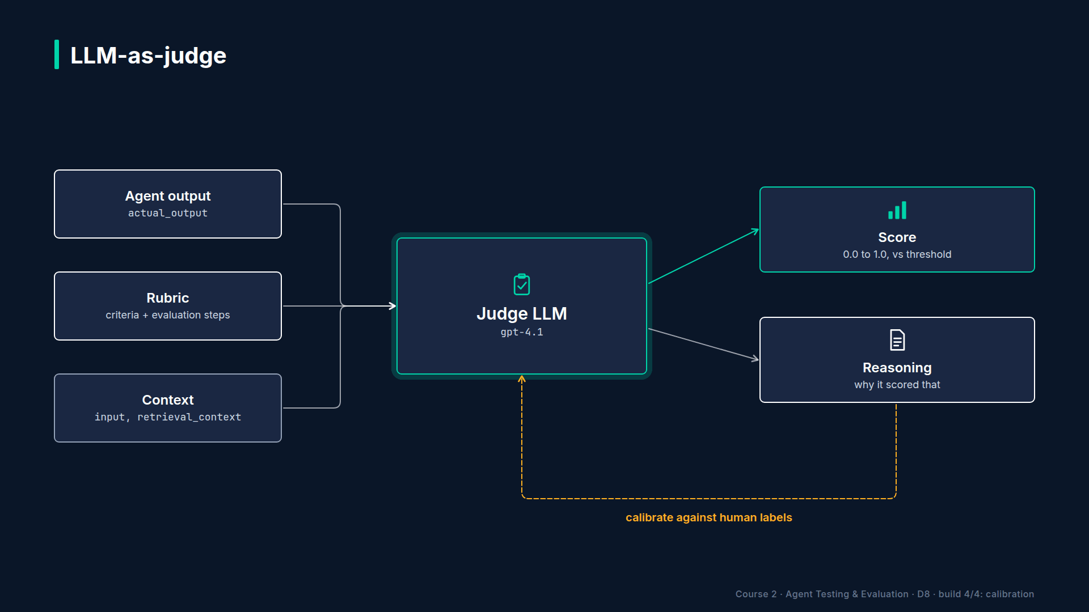
Section 04 · Lecture 4.4 · Before a custom metric gates anything
Notes:
But don't wire it into CI yet. A new metric is a hypothesis. You test it the same way you tested your judge: against human labels. That's Lab 4.1.
[SCREEN: Terminal. Run the Lab 4.1 reference solution; highlight the agree column and the summary line.]
[DEMO: Output (banner trimmed; first four rows shown)]
In the lab, you build a Regulatory Compliance metric for a financial assistant: a disclaimer must be present, no promised returns, and regulations named specifically. Then you score ten answers that a human already labelled pass or fail, and compare. Here, the metric agrees on all ten. The target is at least zero point nine before the metric is allowed to gate anything.

Slide 40
Raw judge or GEval?
Raw judge: quick experiments, custom output formats
GEval: reusable, documented, plugs into assert_test
Prototype with a judge; ship with GEval
AI Agent Testing & Evaluation · Section 04 · Lecture 4.4
Notes:
So when do you use your hand-built judge, and when GEval? Prototype with the raw judge: it's quick, and you control the output. Ship with GEval: the criteria and steps document what the metric measures, it returns a normal DeepEval score and reason, and it plugs straight into `assert_test`, your reports and CI.

Slide 41
Common mistakes
Several criteria crammed into one metric
Vague words: "good", "helpful", "appropriate"
Missing params, like context for grounding
No calibration before gating
AI Agent Testing & Evaluation · Section 04 · Lecture 4.4
Notes:
Four mistakes to avoid. Cramming several criteria into one metric: split them, so a failure tells you which one. Vague words like "good" or "appropriate": replace them with something a grader can observe. Forgetting a param: a policy metric needs the context, or the judge guesses. And skipping calibration. Which of these have you seen in a prompt at work?

Slide 42
RECAP
Key takeaways
✓
GEval: name, criteria, steps, params, threshold
✓
Write observable steps, including what to penalize
✓
Calibrate against human labels before gating
AI Agent Testing & Evaluation · Section 04 · Lecture 4.4
Notes:
Three takeaways. A GEval metric is a name, a criterion, evaluation steps, the params the judge needs, and a threshold. Write steps a new grader could follow, including what to penalize. And calibrate against human labels before the metric gates a release.

Slide 43
SECTION COMPLETE
You can now
✓
Choose quality and behaviour metrics for an agent
✓
Build and calibrate an LLM judge
✓
Create a custom GEval metric for a business rule
AI Agent Testing & Evaluation · Section 04 · Lecture 4.4
Notes:
You can now choose the right mix of metrics, build and calibrate a judge, and turn any business rule into a metric. Next module, the agents that answer from documents. When a RAG agent gets it wrong, did retrieval fail, or generation? That's where we start.

Slide 44
→
Next up:
The RAG Quality Problem: Retrieval vs. Generation
Next: Lecture 5.1 — The RAG Quality Problem: Retrieval vs.
AI Agent Testing & Evaluation · Section 04 · Lecture 4.4

