Slide 1
SECTION 5 · RAG AGENT EVALUATION
LECTURE 5.1
The RAG Quality Problem: Retrieval vs. Generation
Draw the RAG pipeline and name its two components, the retriever and the generator.
AI Agent Testing & Evaluation · Section 05 · Lecture 5.1
Notes:
Title card (K2). The RAG Quality Problem: Retrieval vs. Generation.

Slide 2
Meet the TechCorp Policy Assistant
14 internal policy documents, three domains
HR, IT security, travel and expense
Retriever returns the top 3 documents
gpt-4.1-mini answers only from those 3
Every answer cites its policy section
Verified: openai 2.54.0 | ragas 0.4.3. Offline mode: mock LLM + mock judge.
AI Agent Testing & Evaluation · Section 05 · Lecture 5.1
Notes:
Here's the agent you'll evaluate all through this module. It's an internal assistant for TechCorp employees. Fourteen policy documents in three domains. HR covers vacation, remote work and benefits. IT security covers passwords, devices and phishing. Travel and expense covers flights, meals and mileage.
Where does this sit in your test strategy? In the five-layer pyramid from Module 2, everything in this section is layer two: component evals. Instead of grading the agent as one black box, you grade its parts.

Slide 3
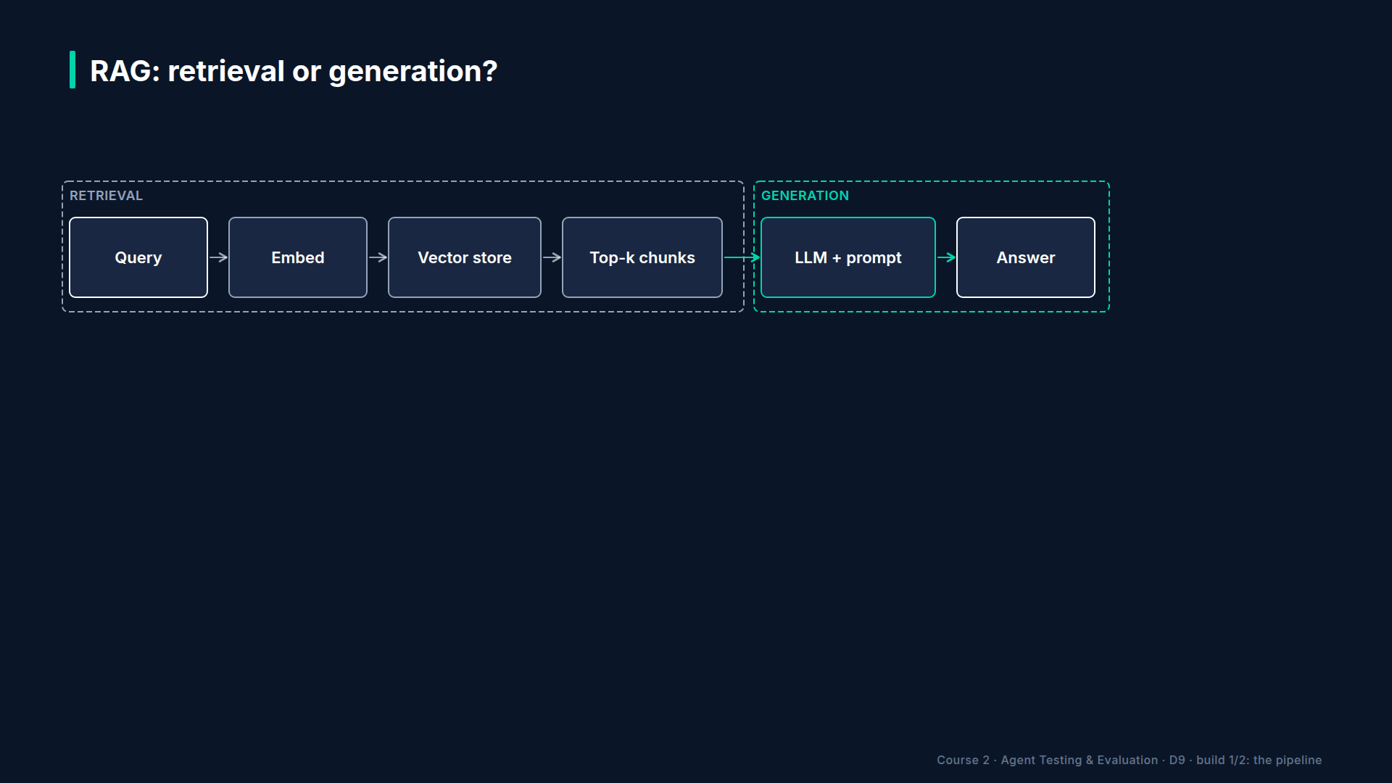
Section 05 · Lecture 5.1 · RAG: retrieval or generation?
Notes:
A RAG agent has two jobs. First, the retriever searches the documents and picks the three that look most relevant. Second, the generator, our language model, writes an answer using only those three.
Think of a research assistant and a writer. The assistant pulls folders from the filing cabinet. The writer drafts the memo from whatever lands on the desk. If the memo is wrong, was it the wrong folders, or a bad writer?

Slide 4
Four ways RAG goes wrong
Retriever returns noise: a precision problem
Retriever misses the answer: a recall problem
Generator ignores the context it was given
Generator adds facts the context doesn't contain
AI Agent Testing & Evaluation · Section 05 · Lecture 5.1
Notes:
There are four classic failures, two per half. The retriever can return noise: three documents, but only one is useful. That's a precision problem. Or it can miss the right document entirely. That's a recall problem.
The generator can ignore good context and answer from memory. Or it can embellish, adding facts that aren't in the documents. Both are the hallucination failure mode from Module 1, just with a clearer culprit.
So which of the four do you think hit our flight question? Hold that thought. The data will tell us in a minute.

Slide 5
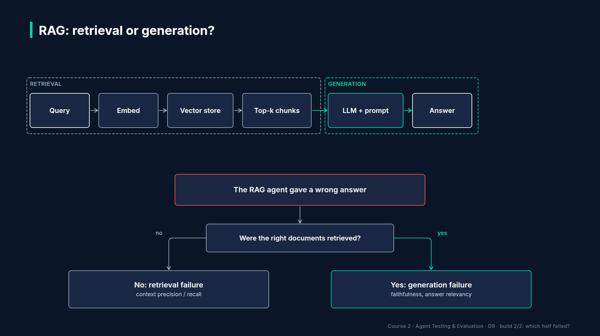
Section 05 · Lecture 5.1 · Two questions find the broken half
Notes:
Here's the whole diagnosis in two questions. Question one: were the right documents retrieved? If no, stop. Fix retrieval first, because no prompt can rescue a writer who never got the right folder. If yes, ask question two: did the generator use them faithfully, and did it answer what was asked? If no, it's a generation problem.

Slide 6
One metric per failure
Context precision: are useful chunks ranked first?
Context recall: did retrieval find everything needed?
Faithfulness: is every claim backed by context?
Answer relevancy: does it answer the question?
AI Agent Testing & Evaluation · Section 05 · Lecture 5.1
Notes:
Each question maps to metrics. Context precision and context recall grade the retriever. Faithfulness and answer relevancy grade the generator. You'll compute all four with RAGAS in the next lecture.
One trap. Why would a perfectly faithful answer still be wrong? Because faithfulness only checks the answer against what was retrieved. If the retriever hands over the vacation policy for a travel question, the generator can be one hundred percent faithful to the wrong document. That's why you never read faithfulness alone.
[CODE: `agents/rag_agent.py`, `retrieve_context`, lines with the score formula highlighted]
Here's the retriever. It's a keyword scorer standing in for a vector database, so you can see every decision it makes. A match in the title counts three times. A match in the body counts once. And by default, little words like "can", "on" and "a" count too. Can you see the problem coming?
[SCREEN: Terminal in `04-code-examples/agent-eval-framework`. Type the command, run it, then zoom on the BEFORE block, then the AFTER blo...]
[DEMO: Output (banner trimmed)]
Look at BEFORE. The retriever returned the vacation policy, the password policy and the meals policy. Travel booking, the one document with the answer, isn't there. Context recall is zero. Question one already has its answer: wrong documents.
The generation scores are zero too, which is why the diagnosis says "both". But notice what the generator actually did. With no useful context, it said it didn't know. That's honest behavior. The real cause sits upstream.
[SCREEN: Same terminal, zoom on the AFTER block; highlight `travel-001` in the retrieved list and "(Section 7.2)" in the answer.]
Now AFTER. One change, in the retriever only: stop words no longer count. Travel booking comes back, the answer is right, and it cites Section 7.2. Faithfulness, relevancy and recall all hit 1.0. Not one word of the prompt changed.
But the diagnosis still says "retrieval". Why? Context precision is 0.5. The right document came back second, behind the password policy. That's below our 0.7 threshold. The answer is right today, but a ranking that weak will bite you on the next question.
[CODE: `evaluators/ragas_suite.py`, `diagnose`]
That diagnosis is just the decision tree in code. Recall or precision under 0.7 flags retrieval. Faithfulness under 0.8, or relevancy under 0.7, flags generation. Both flags, and you fix retrieval first.
Here's the habit to take away. When a RAG answer is wrong, don't open the prompt first. Open the list of retrieved documents. It takes ten seconds, and in the flight example it would have saved the whole investigation. Then score the two halves separately. That's the plan for the next three lectures: the four metrics in 5.2, isolated component tests in 5.3, and a full diagnostic report in 5.4.

Slide 7
RECAP
Key takeaways
✓
RAG has two halves: retrieval, then generation
✓
First ask: were the right documents retrieved?
✓
Fix the half the metrics point to
AI Agent Testing & Evaluation · Section 05 · Lecture 5.1

Slide 8
→
Next up:
RAGAS Metrics: Context Precision, Recall, Faithfulness
In Lecture 5.2, you'll compute those four RAGAS metrics yourself on five policy questions, using the current RAGAS…
AI Agent Testing & Evaluation · Section 05 · Lecture 5.1

Slide 9
SECTION 5 · RAG AGENT EVALUATION
LECTURE 5.2
RAGAS Metrics: Context Precision, Recall, Faithfulness
Build RAGAS 0.4 SingleTurnSample and EvaluationDataset objects with the reference field.
AI Agent Testing & Evaluation · Section 05 · Lecture 5.2
Notes:
Title card (K2). RAGAS Metrics: Context Precision, Recall, Faithfulness.

Slide 10
RAGAS 0.4 in three objects
SingleTurnSample: one question, answer, contexts, reference
EvaluationDataset: a list of samples
Metric classes from ragas.metrics.collections
await metric.ascore(...) returns .value
Verified: openai 2.54.0 | ragas 0.4.3. Offline mode: mock LLM + mock judge.
AI Agent Testing & Evaluation · Section 05 · Lecture 5.2
Notes:
RAGAS is an open-source library built for exactly this job: scoring RAG pipelines. You need three objects. A single-turn sample holds one question, the agent's answer, the retrieved contexts and a reference answer. An evaluation dataset is a list of samples. And each metric is a class you score asynchronously.

Slide 11
Old tutorials, old API
Old: from ragas.metrics import faithfulness
Old: evaluate(Dataset.from_dict(...))
Old field name: ground_truth
Now: metric classes, ascore, and reference
AI Agent Testing & Evaluation · Section 05 · Lecture 5.2
Notes:
A warning before you search the web. Most RAGAS tutorials show the older API: lowercase metric objects, a Hugging Face dataset and a column called ground truth. In RAGAS 0.4.3, those lowercase imports are gone from `ragas.metrics`, and the ground-truth field is called reference. If you copy an old blog post, it won't run.
[CODE: `evaluators/ragas_suite.py`, `to_sample`]
Here's how one agent run becomes a sample. The user input is the employee's question. The response is the agent's answer. Retrieved contexts are the three document texts the retriever returned. And reference? Who writes that? A human does. It's the correct answer, from the golden dataset. Fifteen of those references live in `golden_rag.json`.
[CODE: `evaluators/ragas_suite.py`, `make_metrics` and the live LLM factory]
Every metric needs a judge model. Live, that's `gpt-4.1` through RAGAS's `llm_factory`. Answer relevancy also needs embeddings, so it gets `text-embedding-3-small`. Offline, the course swaps in a mock judge that implements RAGAS's own base classes, so the real metric code still runs. That's why you'll get my exact numbers without an API key.
So what does each metric actually do? Let's take them one at a time.

Slide 12
How each metric scores
Faithfulness: answer claims supported by contexts
Answer relevancy: questions regenerated from the answer
Context precision: useful chunks ranked above useless ones
Context recall: reference claims found in contexts
AI Agent Testing & Evaluation · Section 05 · Lecture 5.2
Notes:
Faithfulness splits the answer into individual claims and asks the judge whether each one can be inferred from the retrieved contexts. Five claims, four supported, gives 0.8.
Answer relevancy works backwards. The judge reads the answer and writes the questions it seems to answer, three of them when running live. Those are compared with the real question using embeddings. A vague or non-committal answer scores near zero.
Context precision asks, for each retrieved chunk, was this useful for reaching the reference? Useful chunks ranked first score high. Context recall breaks the reference into claims and checks how many appear in the retrieved contexts. Which two of these need a reference answer? Precision and recall. Faithfulness and relevancy don't.
[CODE: `evaluators/ragas_suite.py`, `ascore_sample` (each metric gets only the fields it reads)]
And here's the scoring loop. Each metric's `ascore` takes only the fields it reads, which is a nice way to remember the slide. It returns a metric result, and `.value` is the score between zero and one. One defensive line: if a judge call fails and RAGAS returns not-a-number, we record zero, so a broken judge can never look like a pass.
[SCREEN: Terminal. Run the demo; zoom on the table, then the Aggregate line.]
[DEMO: Output (banner trimmed)]
Five questions: vacation days, sick notes, lost laptops, receipts, and mileage. Four are perfect. Now RAG-TE-05: "What is the mileage reimbursement rate for using my own car?"
Read the right two columns first. Precision 1.0, recall 1.0. The retriever did its job; the mileage policy came back. Now the left two. Faithfulness zero, relevancy zero. The generator answered that the documents don't cover it, which the context it was given contradicts. RAGAS also scores a non-committal answer as irrelevant. That's a generation failure, pinned down without reading a single trace.

Slide 13
Averages hide broken rows
Faithfulness average: 0.8
Faithfulness threshold: 0.8
Aggregate passes; RAG-TE-05 scored zero
AI Agent Testing & Evaluation · Section 05 · Lecture 5.2
Notes:
Now the aggregate line. Faithfulness averages 0.8, exactly our threshold. If your gate only checks averages, this run passes, with one employee told the mileage policy doesn't exist. Would you ship that? Gate on the per-question rows as well as the average.

Slide 14
The course's RAG thresholds
Faithfulness: 0.8
Answer relevancy: 0.7
Context precision: 0.7
Context recall: 0.7
Source: RAG_THRESHOLDS and config/eval_config.yaml
AI Agent Testing & Evaluation · Section 05 · Lecture 5.2
Notes:
Where do those thresholds come from? They live in two places in the repo: `RAG_THRESHOLDS` in the RAGAS suite, and the faithfulness and relevance dimensions in `eval_config.yaml`. Faithfulness gets the strictest bar, 0.8, because an unsupported claim about a policy is the costliest mistake. Treat these as starting points. Once you have a few weeks of human-reviewed results, move them to match what your reviewers call acceptable.
One cost note before you run this live. Every metric is at least one judge call per sample, so five samples and four metrics means twenty or more `gpt-4.1` calls. That's cheap for five questions and real money for five thousand, so check current pricing and sample wisely.

Slide 15
RECAP
Key takeaways
✓
RAGAS 0.4: samples, datasets, metric classes
✓
Precision and recall grade the retriever
✓
Read rows, not just averages
AI Agent Testing & Evaluation · Section 05 · Lecture 5.2

Slide 16
→
Next up:
Evaluating Retrieval and Generation Separately
RAG-TE-05 says "generation", but that's still an end-to-end guess.
AI Agent Testing & Evaluation · Section 05 · Lecture 5.2

Slide 17
SECTION 5 · RAG AGENT EVALUATION
LECTURE 5.3
Evaluating Retrieval and Generation Separately
Test the retriever alone with a hit-at-3 and rank check that needs no LLM.
AI Agent Testing & Evaluation · Section 05 · Lecture 5.3
Notes:
Title card (K2). Evaluating Retrieval and Generation Separately.

Slide 18
Component isolation
Retriever alone: did the right document come back?
Generator alone: given perfect context, is it right?
Each test isolates exactly one component
Verified: openai 2.54.0 | ragas 0.4.3. Offline mode: mock LLM + mock judge.
AI Agent Testing & Evaluation · Section 05 · Lecture 5.3
Notes:
It's the oldest idea in testing: isolate the component. An end-to-end score blends two parts. So you test the retriever with no generator at all, and the generator with a perfect retriever. Where would a mechanic start with a car that won't start: the whole car, or the battery? The battery. One part at a time.

Slide 19
Two halves, two levers
Retriever test: query in, top-3 IDs out
Score the retriever by hit and rank
Generator test: perfect chunks in, answer out
Score the generator against the reference
AI Agent Testing & Evaluation · Section 05 · Lecture 5.3
Notes:
Here's why that matters. The two halves have different fixes. A retriever problem is fixed with chunking, ranking, metadata filters or better embeddings. A generator problem is fixed with the prompt or the model. Fixing the wrong one costs you days and changes nothing.
[CODE: `agents/rag_agent.py`, the two entry points]
The policy assistant was built for this. Retrieval and generation are separate functions. `run_rag_agent` just calls one, then the other. If your own RAG code hides both steps inside one call, that's your first refactor: you can't test what you can't call.
[CODE: `demos/m05_component_isolation.py`, the isolation loop]
Let's build it. Take the five travel and expense questions from the golden set. Each golden case knows which document holds its answer, in `reference_context_ids`.
For the retriever, call `retrieve_context` and check two things. Hit at 3: is the right document anywhere in the top three? And rank: where? No model is involved, so this test is free, instant and deterministic. You can run it on every commit.
For the generator, skip retrieval entirely. Look up the reference documents by ID and hand them straight to `generate_answer`. That's the perfect context. Then score the answer against the reference. What does it mean if the generator fails even here? It means no retriever upgrade will ever fix it.

Slide 20
Reading the two results
Hit and correct: healthy
Hit but wrong: fix the generator
Miss: fix the retriever first
Miss and wrong: retriever first, then re-test
AI Agent Testing & Evaluation · Section 05 · Lecture 5.3
Notes:
Four combinations, four actions. Retriever hits and the generator is correct: healthy. Retriever hits but the generator is wrong even with perfect context: fix the prompt or the model. Retriever misses: fix retrieval, whatever the generator did. And if both fail, retrieval first, then re-test the generator.
[SCREEN: Terminal. Run the demo; highlight the RAG-TE-05 row.]
[DEMO: Output (banner trimmed)]
All five retriever checks hit, every one at rank one. Four generator checks score 1.00. And RAG-TE-05, the mileage question: the retriever found the mileage policy at rank one, yet even with that perfect context the generator scores zero. Verdict: generator.
Why would it miss? The employee asks for the mileage rate "for using my own car". The policy says "personal car use for business is reimbursed at seventy cents per mile". Same meaning, different words, and this generator didn't connect them. That's a prompt-and-model problem. Retrieval is innocent.

Slide 21
Retriever scores you get for free
Hit at 3: answer document in the top three?
Rank: one is solid, three is fragile
No model calls: run on every commit
Generator test: one model call per case
AI Agent Testing & Evaluation · Section 05 · Lecture 5.3
Notes:
Why track rank if the hit already passed? Because a document at rank three survives today, but one more similar document in the index pushes it out of the top three. So track rank over time, not just hits. And look at cost. The retriever test makes zero model calls. The generator test makes one call per case, so fifteen calls of `gpt-4.1-mini` live, a fraction of a cent at current prices (verify current pricing). Both are cheap enough to sit in the component layer of the pyramid.
[SCREEN: VS Code, `tests/component/test_rag_components.py`. Scroll through the three test functions named below.]
[CODE: `tests/component/test_rag_components.py` (three of the tests)]
A demo is nice. A test is better. The same checks live in the component layer of the test suite. The retriever test runs once for each of the 15 golden cases. There's a regression test for the flight question from 5.1, pinning both the bug and the fix. And the generator test runs every case except RAG-TE-05, which has its own test that asserts the failure is reported.
[SCREEN: Terminal. Run the component tests.]
[DEMO: Output (trimmed)]
Thirty-six tests in under two seconds, and not one API call. That's the point of component tests: they're cheap enough to run on every commit, so retrieval regressions never sneak in behind a prompt change.
So when do you reach for which test? Retriever tests run on every commit, and always after you change chunking, the index or the embedding model. Generator tests run whenever the prompt or the model changes. And the end-to-end RAGAS run from 5.2 runs on pull requests, to confirm the two halves still work together. Three tests, three triggers, and no more guessing which half broke.

Slide 22
RECAP
Key takeaways
✓
Test the retriever alone: hit and rank
✓
Test the generator with perfect context
✓
Fix only the half that fails
AI Agent Testing & Evaluation · Section 05 · Lecture 5.3

Slide 23
→
Next up:
[PROJECT 2] Evaluate an Enterprise RAG Agent
You now have every piece.
AI Agent Testing & Evaluation · Section 05 · Lecture 5.3

Slide 24
SECTION 5 · RAG AGENT EVALUATION
LECTURE 5.4
[PROJECT 2] Evaluate an Enterprise RAG Agent
Run a 15-case RAGAS evaluation across three policy domains.
AI Agent Testing & Evaluation · Section 05 · Lecture 5.4
Notes:
Title card (K2). [PROJECT 2] Evaluate an Enterprise RAG Agent.

Slide 25
Project 2 brief
Agent: TechCorp Policy Assistant, 14 documents
Golden set: 15 questions, 5 per domain
Metrics: the four RAGAS metrics
Output: per-question and per-domain diagnosis
Deliverable: report plus your remediation advice
Verified: openai 2.54.0 | ragas 0.4.3. Offline mode: mock LLM + mock judge.
AI Agent Testing & Evaluation · Section 05 · Lecture 5.4
Notes:
Here's the brief. The agent is the policy assistant you've used all module. The golden set has fifteen questions, five each for HR, IT security, and travel and expense. Each has a human-written reference answer and the ID of the document that holds it. You'll score every question with the four RAGAS metrics, diagnose each one, roll them up by domain, and add your own recommendations. Then write at least three questions of your own, so the golden set covers something the course didn't think of.
[CODE: `demos/m05_project2_rag_eval.py`, the core]
The pipeline is everything from this module in five lines. Load the cases. Run the agent on each question. Turn each run into a RAGAS sample. Score the dataset. Then diagnose every row, and aggregate by domain. Can you name the function that turns four scores into one word? It's `diagnose`, the decision tree from 5.1.
[SCREEN: Terminal. Run the project; scroll slowly through the per-question table, then the domain table.]
[DEMO: Output (banner trimmed)]
Thirteen of fifteen rows are "ok". Two say "generation". Start with the column that answers the VP's question: context recall is 1.0 in every domain. The retriever found the needed document every single time. So the search upgrade can wait.
RAG-TE-05 you already know: the mileage paraphrase gap. Two rows show context precision of 0.833. That means the judge found two useful chunks with an irrelevant one ranked between them. It's a ranking nit, not a failure.
[SCREEN: Zoom on the domain table; draw a box around each number below 1.0 and an arrow to the row that causes it.]
Now trace every domain number back to a row. HR is perfect. IT security relevancy is 0.8: that's one zero from RAG-IT-02, averaged over five questions. Travel faithfulness is 0.8: that's RAG-TE-05. Travel precision is 0.933: the two 0.833 rows. Every average below 1.0 has a single row behind it. Which is why your report always shows both levels.
[SCREEN: Terminal. Show the full RAG-IT-02 answer with `uv run python -m agents.rag_agent "Can I use SMS codes for multi-factor authentic...]
Now the interesting one. RAG-IT-02: "Can I use SMS codes for multi-factor authentication?" Relevancy zero. But read the answer. "SMS codes are not allowed." That's correct. It just opens with a sentence about where MFA is mandatory, and the judge reconstructed the wrong question from that opening.
So is this a bug? It's a judge disagreement. In your report, it goes in a third bucket: needs human review. A flagged row is a lead, not a verdict. The engineers who earn trust are the ones who read the row before they file the ticket.

Slide 26
Your report has four parts
Scores: per question and per domain
Diagnosis: retrieval, generation, or human review
Evidence: the question, answer and retrieved IDs
Recommendation: one concrete fix per finding
AI Agent Testing & Evaluation · Section 05 · Lecture 5.4
Notes:
Here's the shape of the report. Scores, a diagnosis per finding, evidence, and one concrete recommendation each. For this run: no retrieval spend needed, recall is perfect. One generator fix: teach the prompt that "my own car" means mileage, then re-test RAG-TE-05. And one human review item. The domain averages all read "ok", yet two real issues sit underneath them. That's the 5.2 lesson again.

Slide 27
Stretch goals
Turn on noise documents: include_noise=True
Swap the keyword retriever for embeddings
Re-run live with the gpt-4.1 judge
AI Agent Testing & Evaluation · Section 05 · Lecture 5.4
Notes:
When you're done, push it. Turn on the two noise documents and watch precision fall. Swap the keyword retriever for real embeddings. Or run it live with the `gpt-4.1` judge and compare its verdict on RAG-IT-02 with the mock judge's.
How will you know your report is good? Give it to someone who hasn't seen the code. If they can tell, in under a minute, which half to fix and why, you're done. And keep it: in a job interview, "I diagnosed a policy assistant's failures to retrieval or generation, with evidence for each" is a far stronger answer than "I ran RAGAS". One more thing. Commit the golden set and the report together, so the next run has a baseline to compare against. You'll put that baseline to work in Module 11.

Slide 28
RECAP
Key takeaways
✓
Fifteen questions, three domains, four metrics
✓
Recall 1.0 everywhere: retrieval is healthy
✓
Read flagged rows before filing fixes
AI Agent Testing & Evaluation · Section 05 · Lecture 5.4

Slide 29
SECTION COMPLETE
You can now
✓
Split RAG failures into retrieval or generation
✓
Score RAG agents with RAGAS 0.4
✓
Write a per-domain RAG diagnostic report
AI Agent Testing & Evaluation · Section 05 · Lecture 5.4

Slide 30
→
Next up:
Why Tool Calling Is the Highest-Risk Part of Any Agent
Retrieval answers questions.
AI Agent Testing & Evaluation · Section 05 · Lecture 5.4

