Slide 1
SECTION 12 · CI/CD FOR AGENT EVALUATION
LECTURE 12.1
The Agent Quality Gate: Evals That Block Bad Deploys
Define a quality gate: which dataset, which metrics, which thresholds, and what happens on failure.
AI Agent Testing & Evaluation · Section 12 · Lecture 12.1
Notes:
Title card (K2). The Agent Quality Gate: Evals That Block Bad Deploys.

Slide 2
Version banner
Verified: openai 2.54.0 | deepeval 4.2.7 | Python 3.11+
Agent gpt-4.1-mini, judge gpt-4.1 | OFFLINE=1 runs without a key
AI Agent Testing & Evaluation · Section 12 · Lecture 12.1
Notes:
Two pull requests land on a Friday afternoon. One fixes typos. One "simplifies" the system prompt. Both have green unit tests. Both get approved. Only one of them makes your agent invent refund terms. Which one would your pipeline stop?

Slide 3
By the end of this lecture
Define a quality gate in four decisions
Pick hard, soft or advisory for each check
Tier your evals: every push, every PR, nightly
AI Agent Testing & Evaluation · Section 12 · Lecture 12.1
Notes:
By the end of this lecture, you'll design a quality gate for an agent: what it checks, what it blocks, and how often it runs. You'll see it make that Friday decision in about a minute, offline, at zero cost.

Slide 4
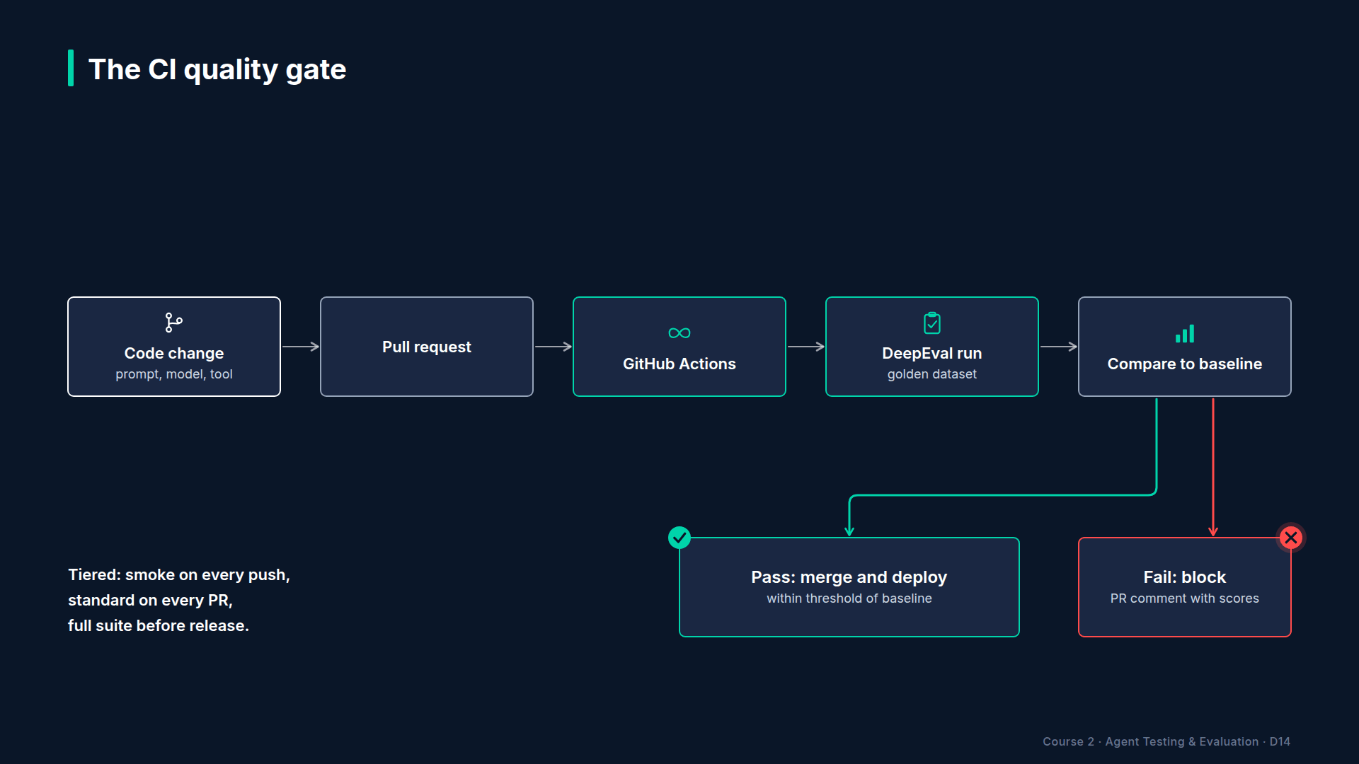
Section 12 · Lecture 12.1 · The quality gate
Notes:
A quality gate is an evaluation that can say no. A developer opens a pull request. CI runs the agent on the golden dataset, scores it, compares the scores to thresholds and to the baseline, and then either lets the merge happen or blocks it, with a report explaining why. You built every piece of this already. The gate just puts them in the merge path.

Slide 5
A gate is four decisions
Dataset: which questions? (golden_support, 10 cases)
Metrics: which scores? (correctness, relevancy, faithfulness)
Thresholds: what is good enough? (from eval_config.yaml)
Action: what happens on failure? (block, warn or report)
AI Agent Testing & Evaluation · Section 12 · Lecture 12.1
Notes:
Every gate is four decisions. Which dataset: for us, the ten-case golden support set. Which metrics: answer correctness, answer relevancy and faithfulness. Which thresholds: they live in `eval_config.yaml`, not in the CI file, so the policy is reviewed like code. And which action: block, warn or just report. Who on your team should own each of those four decisions?
[CODE: `config/eval_config.yaml`, the `gates` block.]
Here are our numbers. Smoke tests on every push must pass one hundred percent. On a pull request, at least eighty percent of golden cases must pass. No critical metric average may fall below point seven. And no metric may drop more than five points below the baseline. That last rule is the `compare` function from Lecture 11.2.
[CODE: `reports/quality_gate.py`, `evaluate_gate`.]
And here's the gate in code. It returns two things: a yes or no, and a list of reasons. The reasons matter as much as the verdict. A gate that says "failed" with no explanation gets bypassed within a week. A gate that says "Faithfulness average point two five, below point seven" gets fixed.

Slide 6
Where the numbers come from
Start from your baseline: 100% pass, metrics 0.98 to 1.00
Leave room for judge noise: 80% pass, 0.7 per metric
Tighten later, once live runs show your real variance
AI Agent Testing & Evaluation · Section 12 · Lecture 12.1
Notes:
Where do eighty percent and point seven come from? Not from a textbook. Start from your baseline. Our agent passes every case and scores between point nine eight and one point oh. Then leave room for noise, because live judges wobble a few points from run to run. Eighty and point seven are deliberately loose starting values. After a few weeks of live runs, you'll see your real variance, and you can tighten them. What would happen if you started strict and the gate failed on noise every other day?

Slide 7
Hard, soft, advisory
Hard gate: blocks the merge (pass rate, critical metrics, regression)
Soft gate: warns but allows (cost per task up, latency up)
Advisory: reports only (new metrics you are still calibrating)
AI Agent Testing & Evaluation · Section 12 · Lecture 12.1
Notes:
Not every check should block. A hard gate blocks the merge. Use it for things you'd roll back a release over: pass rate, critical metrics, regressions. A soft gate warns but allows, which suits cost and latency creep. And advisory checks only report, which is where a new metric lives while you calibrate it against human judgment, like the GEval metrics from Module 4. Promote a check to hard only when you trust it.

Slide 8
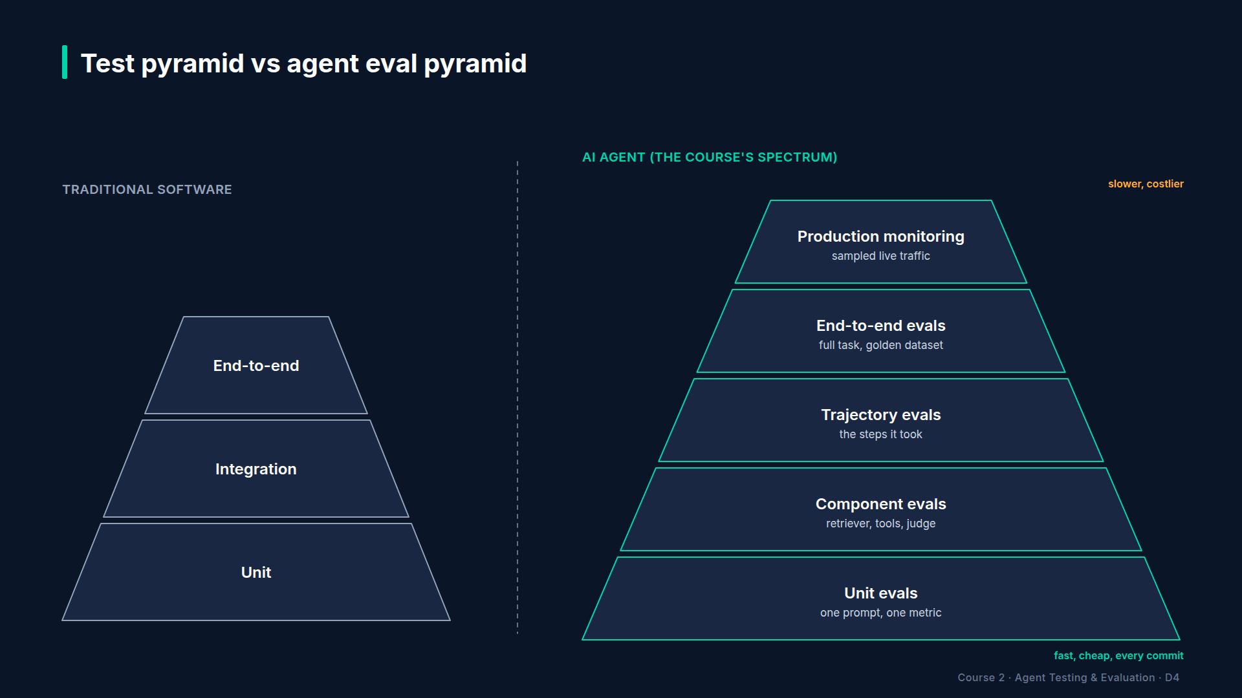
Section 12 · Lecture 12.1 · Tiered evaluation
Notes:
Running every metric on every commit is slow and costs money. So you tier it. On every push, the workflow runs the offline test suite plus a three-case smoke eval: one FAQ, one account action, one attack. About a minute, zero dollars. On every pull request, the full ten-case golden gate runs, live if the API key secret is set, plus the promptfoo red-team suite. That costs a few cents a run; verify with your first live run. And every night, the full capstone pipeline runs. Cheap and fast at the bottom. Broad and thorough at the top.

Slide 9
Spend the eval budget where it matters
Skip the live gate when no agent file changed (path filters)
Run the agent once, score with every metric
Cheaper judge for PRs, strongest judge nightly
AI Agent Testing & Evaluation · Section 12 · Lecture 12.1
Notes:
Three more ways to keep the bill small. First, a pull request that only touches the README doesn't need a live agent eval. GitHub Actions path filters can skip it. Our workflow runs on everything to keep it simple, so that's an easy upgrade. Second, run the agent once per case and score that one answer with every metric. Third, consider gpt-4.1-mini as the judge on pull requests, and keep gpt-4.1 for the nightly run, once you've checked the cheaper judge agrees with it.
[SCREEN: Terminal in `04-code-examples/agent-eval-framework`.]
[DEMO: Output after the banner (offline), the two decision lines and the blocking reasons only]
Here's the Friday afternoon, replayed. Pull request forty-one, the copy edits: ten out of ten, merge allowed. Pull request forty-two, the simplified prompt: seven out of ten, merge blocked.
[SCREEN: Same output. Zoom on the three "Blocking issues" lines, one at a time.]
And look how many rules caught it. The pass rate is below eighty percent. Faithfulness is below point seven. And it regressed against the baseline, with the three exact case IDs. Three independent reasons. Even if someone loosened one threshold, the other two would still block it.

Slide 10
When the evaluation itself fails
Agent failed the gate: red gate step, PR comment lists reasons
Eval infrastructure failed (API outage, rate limit): red eval step, no comment
Re-run infrastructure failures; never "fix" them by lowering thresholds
AI Agent Testing & Evaluation · Section 12 · Lecture 12.1
Notes:
One more design question. What if the evaluation itself breaks? An API outage, a rate limit, an expired key. In our workflow, that's a failed "run evaluation" step, and no PR comment appears. A real quality failure fails the gate step and posts its reasons. So the PR comment tells you which kind you have. Re-run infrastructure failures. Never fix them by lowering thresholds.

Slide 11
RECAP
Key takeaways
✓
A gate: dataset, metrics, thresholds, action
✓
Hard gates block; soft gates warn
✓
Tier it: push, pull request, nightly
AI Agent Testing & Evaluation · Section 12 · Lecture 12.1
Notes:
A gate is four decisions: dataset, metrics, thresholds and action. Hard gates block, soft gates warn, advisory checks report. And you tier it, so every push is cheap and every night is thorough.

Slide 12
→
Next up:
GitHub Actions Pipeline: Eval on Every PR
So far the gate ran in your terminal.
AI Agent Testing & Evaluation · Section 12 · Lecture 12.1

Slide 13
SECTION 12 · CI/CD FOR AGENT EVALUATION
LECTURE 12.2
GitHub Actions Pipeline: Eval on Every PR
Read and adapt the course workflow: jobs, triggers, permissions and the offline fallback.
AI Agent Testing & Evaluation · Section 12 · Lecture 12.2
Notes:
Title card (K2). GitHub Actions Pipeline: Eval on Every PR.

Slide 14
Version banner
Verified: openai 2.54.0 | deepeval 4.2.7 | Python 3.11+ | uv
GitHub Actions: checkout@v4, setup-uv@v6, upload-artifact@v4
AI Agent Testing & Evaluation · Section 12 · Lecture 12.2
Notes:
A gate that only runs on your laptop is a suggestion. Someone forgets to run it, or runs it on the wrong branch, and the bad prompt ships anyway. So let's make GitHub run it on every pull request, and post the verdict where the reviewer can't miss it.

Slide 15
By the end of this lecture
Read the four jobs in agent-eval.yml
Store the API key as a secret, with an offline fallback
Post the gate summary as a PR comment
AI Agent Testing & Evaluation · Section 12 · Lecture 12.2
Notes:
You'll walk through the course's real workflow file, job by job. Then you'll see the exact comment it posts on a pull request, for a good change and a bad one.
[SCREEN: VS Code, `.github/workflows/agent-eval.yml`, top of the file: the `on:` block, `permissions:` and the job names `tests`, `qualit...]
Four triggers: every push, pull requests into main, a nightly schedule at three seventeen in the morning, UTC, and a manual button. And look at permissions. Read the code, write pull-request comments. Nothing more. Always give a workflow the smallest permissions it needs. Why seventeen minutes past? Because lots of scheduled jobs start on the hour, and runners are busiest then.

Slide 16
Four jobs
Job | Trigger | What it does
tests | every push | uv sync --locked, offline pytest, 3-case smoke eval
quality-gate | PR to main, manual | golden eval → gate → PR comment → fail if gate failed
redteam | PR, schedule, manual | promptfoo 0.123.1 suite against the real agent
nightly | schedule | full capstone pipeline
AI Agent Testing & Evaluation · Section 12 · Lecture 12.2
Notes:
Four jobs. `tests` runs on every push: install with the lock file, run the offline test suite, run the smoke eval. `quality-gate` runs on pull requests, after `tests` passes. `redteam` runs the promptfoo suite from Module 8 against the real agent. And `nightly` runs the whole capstone pipeline you'll build in Module 14.
[CODE: `.github/workflows/agent-eval.yml`, the `tests` job steps.]
The `tests` job is short on purpose. `uv sync locked` installs exactly the versions in the lock file, so CI tests what you tested. Then the offline test suite, all five layers of the pyramid, in seconds. Then the smoke eval on three golden cases. No API key, no cost. If this job fails, nothing else even starts, because the gate job says `needs: tests`. Why pay for a live eval on code that doesn't install?
[CODE: `.github/workflows/agent-eval.yml`, the `quality-gate` job's evaluation and gate steps.]
Now the heart of it. Step one runs the evaluation. If the `OPENAI_API_KEY` secret exists, it runs live. If not, it runs offline. That fallback matters for forks: GitHub doesn't give secrets to pull requests from forks, so a contributor's PR still gets a gate, just an offline one. The job also prints which mode it used, so nobody mistakes an offline pass for a live one.
Step two applies the gate. Notice `set plus e`. It tells the shell not to stop on failure. The gate's exit code is saved as a step output instead. Why would you want a failing gate to keep going?
[CODE: `.github/workflows/agent-eval.yml`, the comment, artifact and final steps.]
Here's why. Step three posts the summary as a PR comment, using the GitHub CLI. `edit last` updates the bot's previous comment instead of adding a new one on every push, and the fallback after the two bars creates the first one. Step four uploads the full results as an artifact, kept for thirty days, even when things fail. And only then, step five fails the job. Comment first, fail last. A blocked PR always explains itself.

Slide 17
Secrets and safety
Add OPENAI_API_KEY under Settings → Secrets and variables → Actions (verify current UI)
Use a separate key with a spending limit for CI (verify current UI)
Make "Golden-dataset quality gate" a required check in branch protection
AI Agent Testing & Evaluation · Section 12 · Lecture 12.2
Notes:
Three setup steps on GitHub, and verify the screens, because GitHub moves them. Add the key as a repository secret. Use a separate key for CI, with a spending limit, so a runaway loop can't drain your main account. And mark the quality-gate check as required in branch protection. Without that last step, the gate turns red, and the merge button still works.
[SCREEN: Terminal. Run the same commands CI runs, through the demo.]
[DEMO: The PR comment Markdown for the bad change, exactly as `gh pr comment` posts it (offline)]
This Markdown is exactly what lands on the pull request. A verdict. A score table. The blocking reasons. A collapsible list of failing cases. And look at the failing cases: tools, empty brackets. The agent didn't even search the knowledge base. A reviewer can see the root cause without opening a terminal.
[SCREEN: GitHub pull request page, "Conversation" tab: the same comment rendered by GitHub, with the red failed check "Golden-dataset qua...]
And here it is rendered on GitHub, next to the red required check. The good change from PR forty-one gets the same comment format with "PASSED" and a green check.

Slide 18
RECAP
Key takeaways
✓
Four jobs: tests, quality gate, red team, nightly
✓
Secret for live runs, offline fallback for forks
✓
Comment first, fail last
AI Agent Testing & Evaluation · Section 12 · Lecture 12.2
Notes:
Four jobs, tiered by trigger. A secret for live runs, with an offline fallback so forks still get a gate. And comment first, fail last, so every blocked PR explains itself.

Slide 19
→
Next up:
Experiment Tracking & Quality Dashboards
Every PR now leaves a result behind.
AI Agent Testing & Evaluation · Section 12 · Lecture 12.2

Slide 20
SECTION 12 · CI/CD FOR AGENT EVALUATION
LECTURE 12.3
Experiment Tracking & Quality Dashboards
Log every evaluation run as a versioned experiment and compare two runs metric by metric.
AI Agent Testing & Evaluation · Section 12 · Lecture 12.3
Notes:
Title card (K2). Experiment Tracking & Quality Dashboards.

Slide 21
Version banner
Verified: openai 2.54.0 | deepeval 4.2.7 | streamlit 1.64.0
Python 3.11+ | OFFLINE=1 runs without a key
AI Agent Testing & Evaluation · Section 12 · Lecture 12.3
Notes:
Your manager asks: "Is version one point three better than one point two?" You open two CI logs in two tabs and start squinting at numbers. There's a better answer, and it takes one function call. Then let's give your manager a page they can open without asking you at all.

Slide 22
By the end of this lecture
Log every eval run as an experiment
Compare two versions metric by metric
Read a quality dashboard in 30 seconds
AI Agent Testing & Evaluation · Section 12 · Lecture 12.3
Notes:
You'll log evaluation runs as experiments, compare two versions side by side, and open a Streamlit quality dashboard built from the same files.
[CODE: `reports/experiments.py`, the `row` built inside `log_run`.]
An experiment is one line in a file. `log_run` appends a row to `reports/results/experiments.jsonl`: the version, a timestamp, your notes, the pass rate, the metric averages, and the pass rate per category. One JSON object per line. It's boring on purpose. You can grep it, diff it, or load it into anything.

Slide 23
Tag runs so you can find them
Version: what changed (v1.3, or v1.3 plus a short commit SHA)
Notes: why ("grounding rule restored")
Dataset: what was asked (golden_support)
AI Agent Testing & Evaluation · Section 12 · Lecture 12.3
Notes:
Tag every run so you can find it later. The version says what changed. In CI, add the short commit SHA to the version string. The notes say why. And the report already records the dataset. Six months from now, "v1.3, grounding rule restored" will save you an afternoon.
[SCREEN: Terminal in `04-code-examples/agent-eval-framework`.]
[DEMO: Output after the banner (offline)]
The demo logs two runs. Version one point two is the shorter prompt from Module 11. Version one point three restores the grounding rule. `compare_runs` answers the manager's question in five lines. Pass rate up thirty points. Faithfulness up point seven five. Correctness up point two four. Nothing regressed. Which line would you paste into the release notes?

Slide 24
Two audiences, two views
Team view: every metric, every case, the trend across versions
Leadership view: one status, one trend, one cost (Module 13.3)
Same data underneath; different questions on top
AI Agent Testing & Evaluation · Section 12 · Lecture 12.3
Notes:
Before the dashboard, a design rule. Your team and your leadership ask different questions. The team asks: which case broke, and since when? Leadership asks: is it safe to ship, and is it getting better? Same data underneath, different pages on top. Today you build the team view. In Lecture 13.3, you'll build the leadership scorecard.
[SCREEN: Terminal.]
[DEMO: Output after the banner (offline)]
This demo writes a fresh evaluation, then prints the dashboard's numbers as text: gate status, pass rate, three metric averages, and all four categories green. Now open the real app.
[SCREEN: Browser at `localhost:8501` after `make dashboard`. Pan top to bottom: the title "TechCorp Agent Quality Dashboard"; four metric...]
Here's the Streamlit dashboard. Four tiles across the top: the gate, the pass rate, faithfulness and relevancy. Below, the category table. Then the trend line across every version you've logged, which is where a slow slide becomes visible. And at the bottom, every case with its scores, so a red tile is two clicks from the answer that caused it.

Slide 25
What the trend shows that the gate can't
DIAGRAM TO BUILD
Diagram: a line chart of faithfulness across six versions, v1.0 to v1.5: 1.00, 0.97, 0.94, 0.91, 0.88, 0.85, each step labelled "−0.03, gate: pass". A dashed Teal line at the v1.0 baseline. Footnote: "illustrative".
AI Agent Testing & Evaluation · Section 12 · Lecture 12.3
Notes:
Why bother with the trend chart when the gate already blocks regressions? Here's an illustrative case. Each release drops faithfulness by three points. Three is under the five-point tolerance, so every single release passes the gate. After five releases, you've lost fifteen points. The gate compares one step. The trend shows the whole staircase. If you see this pattern, re-baseline on purpose or tighten the tolerance. Have you seen a staircase like this in any metric you track?
[CODE: `reports/quality_dashboard.py`, the four tiles.]
The whole app is about a hundred lines. It reads the files the pipeline already writes. No database, no server. And the gate tile calls the same `evaluate_gate` function CI uses, so the dashboard can never disagree with the build.
Prefer a hosted dashboard? DeepEval's Confident AI platform and the Langfuse scores from Module 9 can both show this kind of history. The principle doesn't change: one source of results, and every view reads from it.

Slide 26
RECAP
Key takeaways
✓
Log every run: version, notes, scores
✓
Compare versions with one function call
✓
One results source; dashboards only read it
AI Agent Testing & Evaluation · Section 12 · Lecture 12.3
Notes:
Log every run with a version and notes. Compare versions with one call instead of two browser tabs. And keep one source of results, with every dashboard reading from it.

Slide 27
SECTION COMPLETE
You can now
✓
Design a tiered agent quality gate
✓
Run it on every PR with a PR comment
✓
Track experiments and show them on a dashboard
AI Agent Testing & Evaluation · Section 12 · Lecture 12.3
Notes:
You can now design a quality gate, run it in GitHub Actions on every pull request, and track every result on a dashboard.

Slide 28
→
Next up:
Monitoring Agents in Production: Drift, Degradation & Alerts
Your gate protects every release.
AI Agent Testing & Evaluation · Section 12 · Lecture 12.3

