Slide 1
SECTION 1 · WELCOME: THE $4,000 WEEKEND
LECTURE 1.1
The $4,000 weekend: watch an agent burn money in real time
Watch an agent enter a retry loop and see cost climb step by step.
AI Agent Observability & Cost Control · Section 01 · Lecture 1.1
Notes:
Title card (K2). The $4,000 weekend: watch an agent burn money in real time.

Slide 2
The weekend, in numbers
Ticket system down: Friday 18:04 to Monday 07:30
Employees asking about tickets: about 1,000 conversations
Cost per stuck conversation: ≈ $3.90
Total: ≈ $3,900. Nobody noticed until the Monday invoice email.
AI Agent Observability & Cost Control · Section 01 · Lecture 1.1
Notes:
Now multiply. About a thousand employees asked about a ticket over that weekend. Each conversation looped to the timeout. Three dollars ninety, a thousand times. Roughly four thousand dollars, for zero resolved tickets, and nobody knew until Monday morning.
None of this is exotic. The tool failed, the agent was persistent, and no one was watching. That is the default behaviour of an agent loop.
Now let's run exactly the same outage against the same agent, with three things switched on. A step limit. A budget guard per tenant. And an alert.
[SCREEN: Terminal 2. Same command without the override.]
[CODE: the same scenario, guards on]
[DEMO: Same request. Terminal 1 logs `lookup_ticket` 503 twice, then "step limit 8 reached, surfacing error to user". Atlas replies: "The...]
Same question, same broken tool. This time Atlas tries, tries once more, and at step eight it stops and tells the employee the truth. Four cents. The alerts panel fired on the tool error rate within a minute, so an on-call engineer would have known Friday at 6:05, not Monday at 9.

Slide 3
Before and after
 | Friday run | Guarded run
Steps | 60 (timeout) | 8 (limit)
Cost per conversation | $3.90 | $0.04
Weekend cost | ≈ $3,900 | ≈ $40
Time to detection | 63 hours | 1 minute
Employee experience | silence, then timeout | honest answer in 6 s
AI Agent Observability & Cost Control · Section 01 · Lecture 1.1
Notes:
Three ninety versus four cents. Sixty-three hours versus one minute. And the guarded version is a better product, because the employee got an honest answer in six seconds instead of a spinner.
Here's what I want you to notice. The fix was not clever. A step limit is one integer. A budget guard is a comparison. An alert is a threshold. What was missing was the ability to see what the agent was doing, in tokens and dollars, while it was doing it.
That is this course. By Section fourteen you will have instrumented Atlas with OpenTelemetry, traced every step in Langfuse, priced every token, set budgets per department, measured latency and quality on live traffic, and built the console you just watched. And in Section eleven, you'll be handed three incidents like this one and asked to find the root cause from traces alone.
One more thing. Everything you just saw ran offline. No API key, no money spent. The token counts came from a deterministic mock, the prices came from the real price table. You'll be able to reproduce it in Lecture 2.4.

Slide 4
→
Next up:
What LLMOps means for agents (and why MLOps tools miss it)
Next, why the tools you already have for monitoring software mostly miss this, and what LLMOps for agents…
AI Agent Observability & Cost Control · Section 01 · Lecture 1.1

Slide 5
SECTION 1 · WELCOME: THE $4,000 WEEKEND
LECTURE 1.2
What LLMOps means for agents (and why MLOps tools miss it)
Name the four properties that make agents different to monitor: non-deterministic, multi-step, tool-using, token-metered.
AI Agent Observability & Cost Control · Section 01 · Lecture 1.2
Notes:
Title card (K2). What LLMOps means for agents (and why MLOps tools miss it).

Slide 6
What Northwind's dashboards showed on Friday night
HTTP 200 rate: 100%
p95 response time: within budget (requests timed out cleanly at 10 min)
CPU, memory, error logs: normal
OpenAI billing page: updates once a day
AI Agent Observability & Cost Control · Section 01 · Lecture 1.2
Notes:
Every request returned. The servers were bored. The one number that mattered, dollars per conversation, wasn't on any screen, because the billing page updates daily and nothing in the app knew what a token cost.

Slide 7
Four things that make agents different
Non-deterministic: the same input takes different paths
Multi-step: one request becomes 3, 8 or 60 model calls
Tool-using: the model decides which functions run, with what arguments
Token-metered: cost is a function of what the model saw, not of request count
AI Agent Observability & Cost Control · Section 01 · Lecture 1.2
Notes:
Four properties. First, agents are non-deterministic. The same question can take a different path on Tuesday than it did on Monday, so a passing test yesterday tells you little about production today.
Second, multi-step. A web request is one request. An agent request is a loop. Three steps if things go well. Sixty if they don't. Your request count stays flat while your model calls go up twenty times.
Third, tool use. The model decides which of your functions to call and with which arguments. That decision is invisible to the tool itself and to your HTTP logs.
Fourth, token-metered. Cost is not "requests times price." It's every token the model read and wrote, and the model reads the whole history every step. That is why the meter in the last lecture accelerated instead of climbing in a straight line.

Slide 8
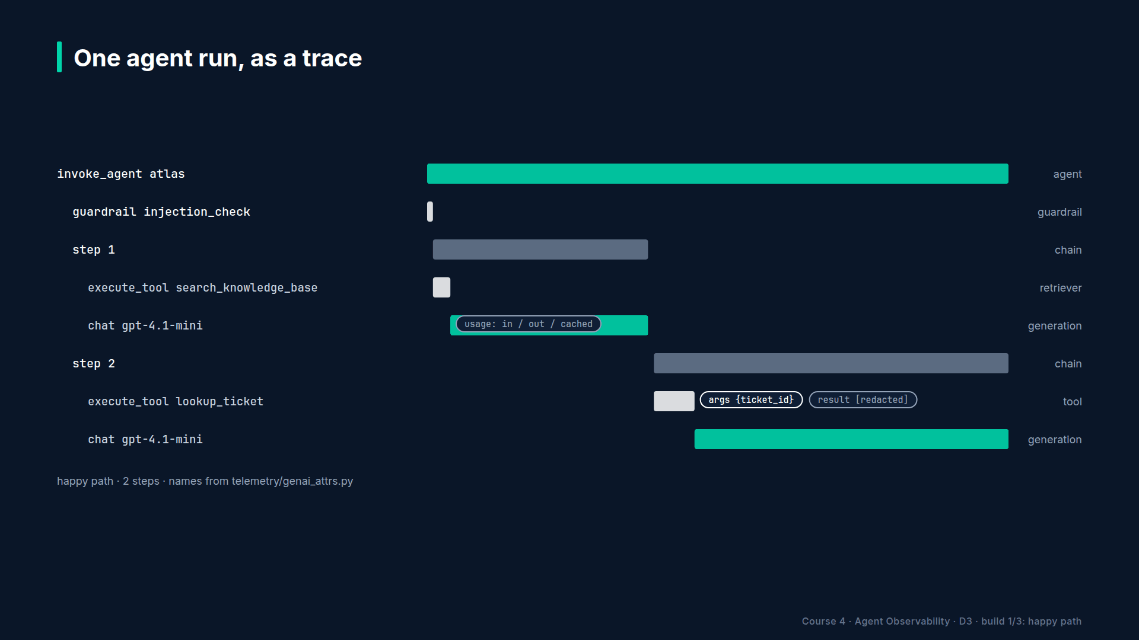
Section 01 · Lecture 1.2 · Where classic APM stops
Notes:
Classic application performance monitoring sees this. One span for the HTTP request. Nine point eight seconds, status two hundred. Everything interesting happened inside that grey box, and APM has no vocabulary for it. It doesn't know what a model call is, what a tool call is, or what a token costs.

Slide 9
Where classic MLOps stops
Built for models you train: feature drift, model registry, batch scoring
Assumes one prediction per request and a fixed schema
Cost model: GPU hours, not tokens per conversation
No concept of a tool call or a multi-step plan
AI Agent Observability & Cost Control · Section 01 · Lecture 1.2
Notes:
MLOps tools have the opposite gap. They were built for models you train and deploy yourself. Feature drift, model registries, batch scoring jobs. Valuable, and mostly irrelevant here. You didn't train the model. You call it. And your "prediction" is a sixty-step conversation, not a row of numbers.
So what do we need instead? Three things.

Slide 10
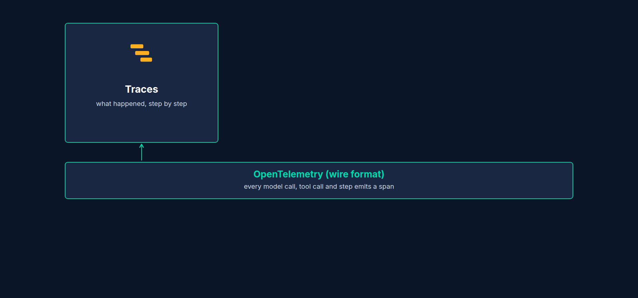
Pillar 1: Traces
Every request becomes a tree: agent → steps → model calls and tool calls
Each node carries: inputs, outputs, tokens, latency, errors
Answers: what did it do, in what order, and why?
AI Agent Observability & Cost Control · Section 01 · Lecture 1.2
Notes:
Pillar one, traces. Every request becomes a tree. The agent at the root, each step below it, and under each step the model call and any tool calls, with their inputs, outputs, token counts and timings. A trace answers the question APM couldn't: what exactly happened inside the grey box?

Slide 11
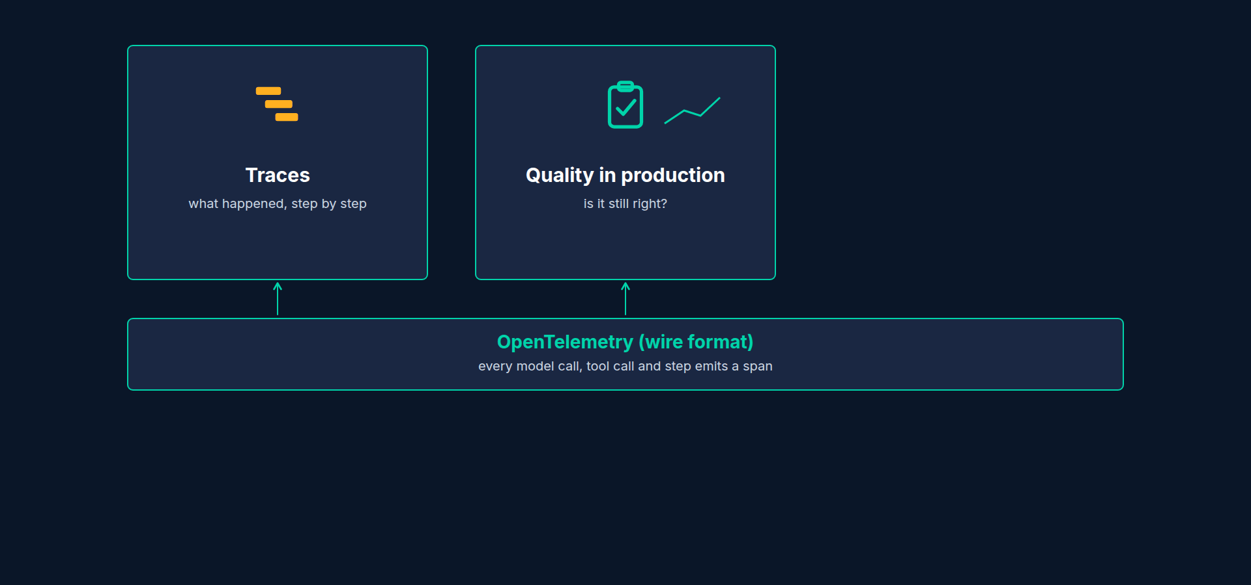
Pillar 2: Quality in production
Did the user get what they needed? Resolved, grounded, safe
Measured on live traffic: sampled LLM-as-judge, user feedback, drift vs last week
Answers: is it getting better or worse, and where?
AI Agent Observability & Cost Control · Section 01 · Lecture 1.2
Notes:
Pillar two, quality in production. Traces tell you what happened. They don't tell you whether it was any good. For that you sample live conversations and score them: was the question resolved, was the answer grounded in the knowledge base, was the escalation appropriate. You collect thumbs up and down. And you compare this week to last week, because quality drifts silently when a prompt changes or a provider updates a model.

Slide 12
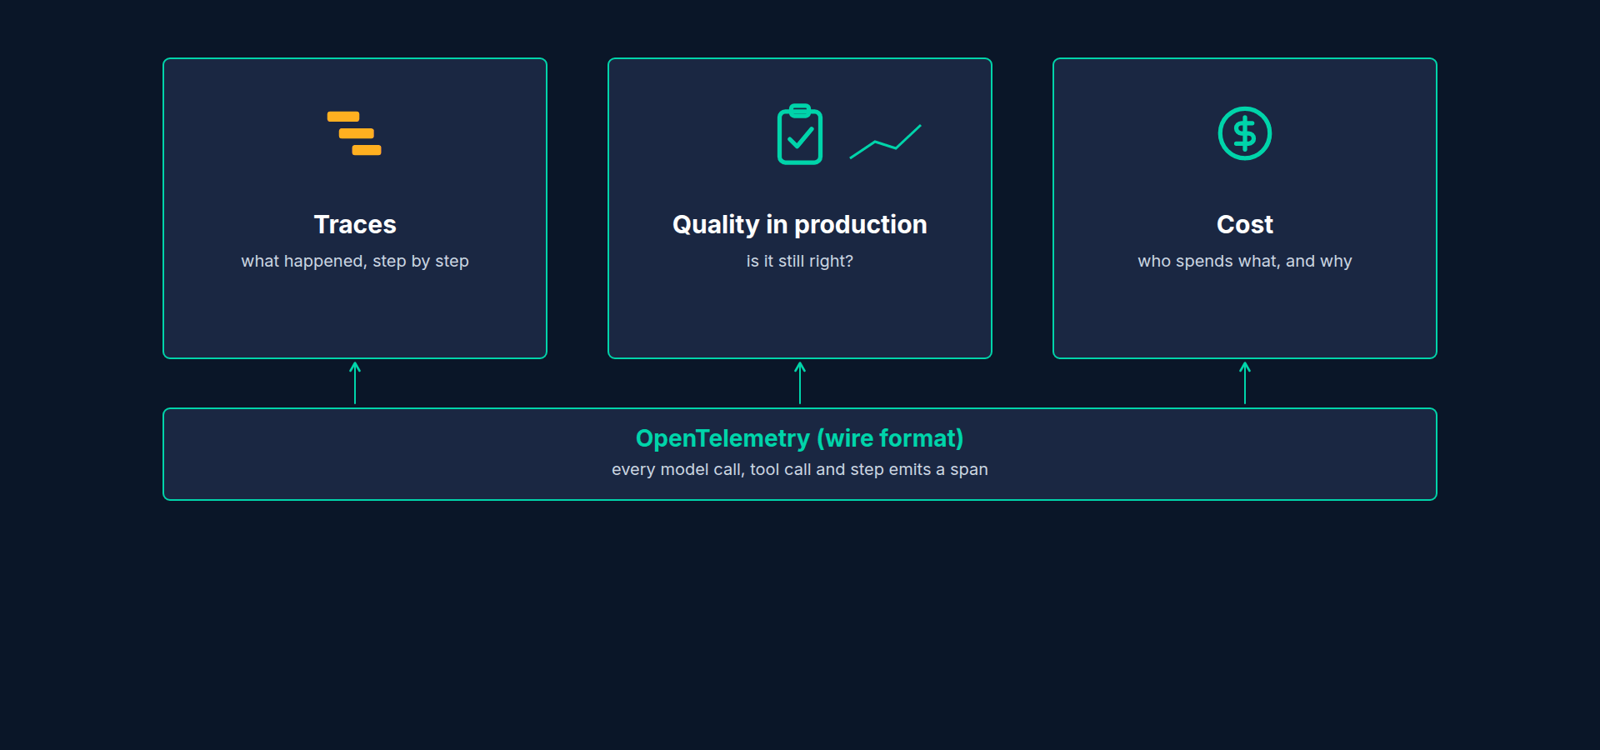
Pillar 3: Cost
Price every token on every model call: input, output, cached, reasoning
Roll up by request, session, user, tenant, feature
Budgets and anomaly alerts, not a monthly invoice
Answers: who is spending what, on which feature, and is it normal?
AI Agent Observability & Cost Control · Section 01 · Lecture 1.2
Notes:
Pillar three, cost. Price every token at the moment it's used. Roll it up by session, by user, by department, by feature. Set budgets. Alert on anomalies. The goal is that a four-thousand-dollar weekend becomes a Slack message at 6:05 on Friday.

Slide 13
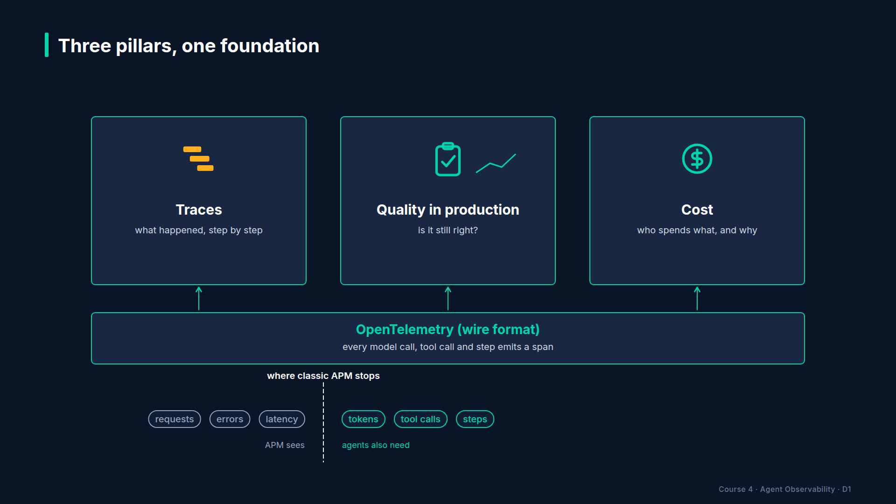
Section 01 · Lecture 1.2 · The three pillars share one foundation
Notes:
Here's the important part. All three pillars stand on one foundation: an instrumented agent. If every model call, tool call and step emits a span with the right attributes, then traces are just those spans arranged as a tree, cost is those spans multiplied by a price table, and quality scores are attached to those same spans. Instrument once, get all three. That's why Sections two through five are about instrumentation before we touch cost or quality.

Slide 14
A definition you can say out loud
LLMOps for agents = running LLM-powered, multi-step, tool-using systems in production with traces, quality measurement and cost control, so you can see, explain and stop what they do.
AI Agent Observability & Cost Control · Section 01 · Lecture 1.2
Notes:
If someone asks what LLMOps means, here's a definition that fits in one breath. Running LLM-powered, multi-step, tool-using systems in production, with traces, quality measurement and cost control, so you can see, explain and stop what they do.

Slide 15
What this looks like on Monday morning
APM: "All systems operational"
LLMOps: "ops tenant spent 40× its daily budget on 1,012 conversations that all called lookup_ticket and all failed at the same tool. Root cause: ticketing API 503 from 18:04 Friday."
AI Agent Observability & Cost Control · Section 01 · Lecture 1.2
Notes:
Same weekend, two Monday mornings. With APM alone, "all systems operational." With the three pillars, a sentence with a tenant, a count, a tool name, a root cause and a timestamp. You'll write that exact sentence yourself in Section eleven.
So, keep the four properties in mind: non-deterministic, multi-step, tool-using, token-metered. Every technique in this course exists because of one of those four. And keep the three pillars: traces, quality, cost. Every lecture belongs to one of them.

Slide 16
→
Next up:
The observability stack you will build
Next, the specific tools you'll use for each pillar, and why the stack is built so you can…
AI Agent Observability & Cost Control · Section 01 · Lecture 1.2

Slide 17
SECTION 1 · WELCOME: THE $4,000 WEEKEND
LECTURE 1.3
The observability stack you will build
Name the role of each component: OpenTelemetry as the wire format, Langfuse as the LLM-native backend, Prometheus and Grafana for metrics, LiteLLM…
AI Agent Observability & Cost Control · Section 01 · Lecture 1.3
Notes:
Title card (K2). The observability stack you will build.

Slide 18
One agent, four questions
What did it do? → traces
What did it cost? → prices × tokens
Is it healthy right now? → metrics and alerts
Is it any good? → scores
AI Agent Observability & Cost Control · Section 01 · Lecture 1.3
Notes:
Four questions we need answered about Atlas. What did it do. What did it cost. Is it healthy right now. Is it any good. Each one gets a tool, and the tools talk to each other through a standard.

Slide 19
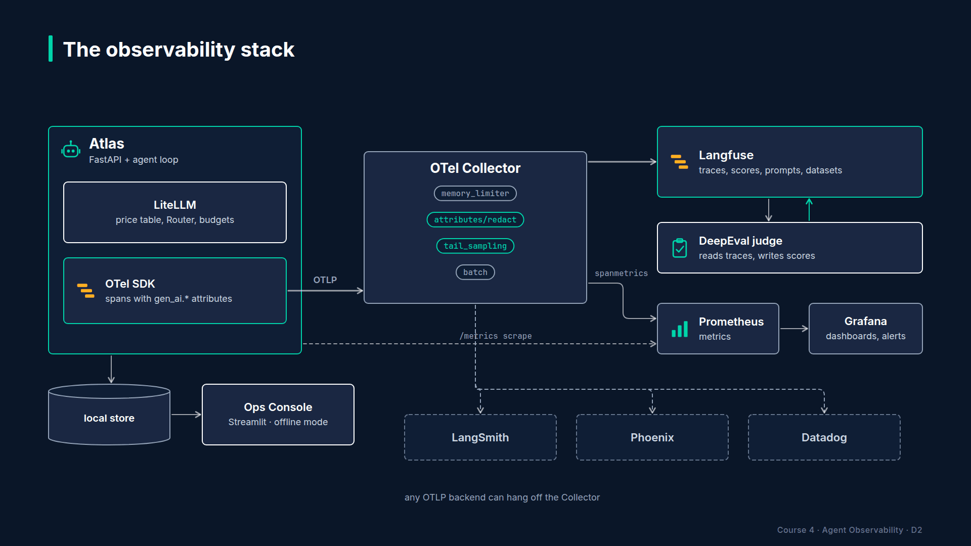
Section 01 · Lecture 1.3 · The stack
Notes:
Let's build the picture. In the middle, Atlas. It's a FastAPI service with a tool-calling loop inside.
Underneath Atlas, OpenTelemetry. Every step, model call and tool call becomes an OpenTelemetry span, and every span carries attributes from the GenAI semantic conventions. That means the model name, the token counts, the tool name and arguments all have standard names that any backend understands. OpenTelemetry is the wire format. It's a standard, maintained by the CNCF, used by every major backend.
To the right, Langfuse. This is where spans go to become traces you can click through. Langfuse also holds things OpenTelemetry has no concept of: sessions and users, prompt versions, quality scores and datasets. Version four of its Python SDK is itself built on OpenTelemetry, so the two fit together with almost no glue. You'll see that in Section four.
To the left, Prometheus and Grafana. Traces are for individual requests. When you want "tool error rate over the last five minutes" or "cost per hour by tenant," you want metrics. Atlas exposes them at slash metrics, Prometheus scrapes them, Grafana draws them and fires alerts. That's Section nine.
Inside Atlas, LiteLLM. We use it for two things. Its price table, which knows what a million tokens of each model cost, and its Router, which lets Atlas try a small model first and fall back to a bigger one or another provider. Sections six and seven.
And at the bottom, the Ops Console. A small Streamlit app over a local SQLite store. It's what you watched in Lecture 1.1, and it's how every lab works without spending money.
Slide text (drawn on the diagram): Centre: "Atlas (FastAPI + agent loop)". · Below it: "OpenTelemetry SDK: spans with GenAI semantic conventions". Label: "the wire format". · Right: arrow from OTel to "Langfuse: traces, sessions, prompts, scores, datasets". Label: "LLM-native backend". · Left: arrow from Atlas to "Prometheus → Grafana: counters, histograms, alerts". Label: "metrics". · Inside Atlas: a small box "LiteLLM: price table, Router, budgets". Label: "cost and routing". · Bottom: "Ops Console (Streamlit) over a local store" with the label "offline mode".

Slide 20
Why OpenTelemetry in the middle
Emit once, in a standard format
Point it at Langfuse today, Phoenix or Datadog tomorrow, or two at once
The GenAI semantic conventions give tokens, models and tools standard names
Your instrumentation code has zero vendor imports
AI Agent Observability & Cost Control · Section 01 · Lecture 1.3
Notes:
Now the portability argument. Because Atlas emits OpenTelemetry, the instrumentation code has zero vendor imports. If you want to try Arize Phoenix next quarter, you change an exporter endpoint. If your company mandates Datadog, same thing. If you want Langfuse and a collector feeding Grafana at the same time, an OpenTelemetry Collector fans out to both. Section twelve does exactly this: same Atlas, traced to three backends, with a one-line change each time.

Slide 21
What is not portable
Scores, prompts, datasets, dashboards live in the backend
Choose the backend for those features; the traces will follow you anywhere
Keep vendor SDK calls in one module: telemetry/langfuse_setup.py
AI Agent Observability & Cost Control · Section 01 · Lecture 1.3
Notes:
Be honest about what isn't portable. Scores, prompt versions, datasets and dashboards live in the backend. That's fine. Choose your backend for those features, and know the traces themselves will follow you anywhere. And keep the vendor-specific calls in one module. In our repo that's telemetry slash langfuse setup. When the day comes to switch, you edit one file, not four hundred.

Slide 22
Open source and cost
Component | Licence | What you pay
OpenTelemetry | Apache 2.0 | nothing
Langfuse | MIT (self-host) or Cloud free tier | nothing for this course
Prometheus, Grafana | Apache 2.0 / AGPL | nothing
LiteLLM | MIT | nothing
OpenAI API | pay as you go | ≈ $5-15 across the whole course, with a hard cap
AI Agent Observability & Cost Control · Section 01 · Lecture 1.3
Notes:
Everything in the stack is open source. Langfuse has a free cloud tier that's plenty for this course, and in Section thirteen you'll self-host it with Docker Compose. The only thing you pay for is the OpenAI API, and with offline mode and a hard cap, that's five to fifteen dollars for the entire course.

Slide 23
Alternatives you'll meet
LangSmith (Section 12.2): same Atlas, traceable and wrap_openai
Arize Phoenix (12.3): OTLP endpoint swap, OpenInference conventions
OpenLLMetry, Datadog LLM Observability (12.4): when you already have an APM
Decision matrix in 12.5
AI Agent Observability & Cost Control · Section 01 · Lecture 1.3
Notes:
You'll also meet the alternatives, hands on, in Section twelve. LangSmith, Arize Phoenix, OpenLLMetry and Datadog's LLM observability. Not to sell you on one, but so you can make the decision with a matrix instead of a gut feeling.

Slide 24
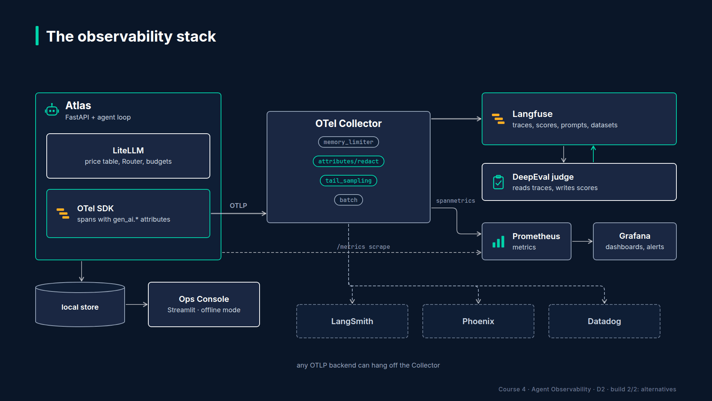
Section 01 · Lecture 1.3 · The stack, once more, with sections
Notes:
Here's the same diagram with section numbers. Section three builds the OpenTelemetry layer. Four, five and eight build out Langfuse. Six and seven are LiteLLM for cost and reliability. Nine is metrics and dashboards. Thirteen deploys it all. Fourteen assembles it into the capstone.
Four tools, one standard in the middle. If you remember one thing from this lecture: emit OpenTelemetry once, with the GenAI conventions, and every backend decision becomes reversible.

Slide 25
→
Next up:
Meet Atlas and the swarm
Time to meet the agent that will emit all of this: Atlas, and the swarm that keeps it…
AI Agent Observability & Cost Control · Section 01 · Lecture 1.3

Slide 26
SECTION 1 · WELCOME: THE $4,000 WEEKEND
LECTURE 1.4
Meet Atlas and the swarm
Describe what Atlas does: knowledge base answers, ticket lookup and creation, verified password resets, shipment checks, for four department tenants.
AI Agent Observability & Cost Control · Section 01 · Lecture 1.4
Notes:
Title card (K2). Meet Atlas and the swarm.

Slide 27
Northwind Logistics
Fictional freight company, about 2,000 employees
Four departments as tenants: ops, finance, hr, eng
Atlas: the internal IT and HR helpdesk agent
Served over HTTP so traffic can be generated
AI Agent Observability & Cost Control · Section 01 · Lecture 1.4
Notes:
Northwind Logistics is a fictional freight company with about two thousand employees in four departments: operations, finance, HR and engineering. Those four departments are our tenants. Each one gets its own budget, its own tags and its own line in every report.
Atlas is their internal helpdesk agent. Employees ask it about the VPN, laptop policy, leave, expenses, payroll dates. It looks up and creates tickets. It resets passwords, after verifying who you are. And because it's a logistics company, it checks shipment status.
[SCREEN: VS Code, repo `03-code/` open. Expand `app/`.]
Let's look at the code. Everything about the agent lives in the app folder.
[SCREEN: Open `app/agent.py`. Scroll to the `AtlasAgent` class and its `run` method. Highlight the `while` loop, the `max_steps` check an...]
Agent dot py holds the `AtlasAgent` class. At its heart is a loop. Build the messages, call the model, and if the model asked for a tool, run the tool, append the result and go around again. Two things to notice now, because you'll instrument them in Section five. There's a step limit, `max_steps`, which was switched off in the Friday run. And there's an escalation branch that swaps in the bigger model.
[SCREEN: Open `app/tools.py`. Scroll through the five function definitions.]
Tools dot py has the five tools. `search_knowledge_base`, which runs a small BM25 retriever over markdown files. `lookup_ticket` and `create_ticket`, which talk to a fake ticketing system that can be told to fail. `reset_password`, which insists on a verification step first. And `check_shipment`. Five tools is enough to be interesting and few enough to keep in your head.
[SCREEN: Open `src/northwind/data/kb/`. Show the list of markdown files: vpn.md, laptop-policy.md, leave.md, expenses.md, security.md, on...]
The knowledge base is seven markdown files. Real enough that retrieval quality is measurable, small enough to read in ten minutes.
[SCREEN: Open `app/server.py`. Highlight the `POST /chat` route and the header handling for tenant, user and session.]
Server dot py wraps the agent in FastAPI. One route matters most: post slash chat. Every request carries three headers, tenant, user and session. Those three headers become the three most important dimensions in every trace and every cost report. There's also slash feedback for thumbs up and down, slash metrics for Prometheus, and slash healthz.

Slide 28
Why an agent over HTTP?
Traffic can be generated, replayed and load-tested
Tenant, user and session arrive as headers, exactly as in production
Observability is about what happens under load, not in a notebook
AI Agent Observability & Cost Control · Section 01 · Lecture 1.4
Notes:
Why HTTP? Because observability is about what happens under load, not in a notebook. Serving Atlas over HTTP means we can generate traffic, replay it, and break it on purpose.
[SCREEN: Expand `simulator/`. Open `simulator/personas.py`, scroll through a few persona entries.]
Which brings us to the swarm. Personas dot py defines employees: a department, a set of likely questions, and a misbehaviour rate. Some personas ramble. About two percent try prompt injection, because in a company of two thousand, some people will.
[SCREEN: Open `simulator/scenarios.py`. Highlight the list of scenario names: `loop`, `context_bloat`, `retry_storm`, `slow_provider`, `p...]
Scenarios dot py defines a normal day of traffic, and five incidents you can inject into it. `loop`, which you saw. `context_bloat`. `retry_storm`. `slow_provider`. And `prompt_regression`. Each one is the seed of an incident lab in Section eleven.
[SCREEN: Open `simulator/swarm.py` briefly, then `simulator/replay.py`.]
Swarm dot py drives the FastAPI app at a configurable rate, with a fixed random seed, so a run is reproducible. Replay dot py is the shortcut: it emits the whole day of spans directly, with no HTTP and no model calls, in about forty seconds.
[SCREEN: Open `app/mock_llm.py`. Highlight the usage and latency generation.]
And the piece that makes all of this free: mock LLM dot py. When `OFFLINE=1` is set, Atlas calls this instead of OpenAI. It's deterministic, it picks tool calls the way the real model would for each persona, and it returns realistic token counts and latencies, so the traces, costs and p95s you see are shaped like production.

Slide 29
Every lab has an offline path
OFFLINE=1: mock LLM, local span store, Ops Console
Same code path, same spans, same dashboards, zero spend
Live mode: set OPENAI_API_KEY, point at Langfuse Cloud, run a few real requests
Recommended: offline for exploration, live for the screenshot
AI Agent Observability & Cost Control · Section 01 · Lecture 1.4
Notes:
Every lab in this course works offline. Same code, same spans, same dashboards, zero dollars. Use offline to explore and break things freely. Switch to live mode when you want a real trace in Langfuse Cloud for your screenshot. That's how you keep the whole course under fifteen dollars.
Atlas, four tenants, five tools, a swarm with five injectable incidents, and a mock that makes it all free. Everything you observe from here on comes from this system.

Slide 30
→
Next up:
Course roadmap and how to get the most out of it
Next, the roadmap for the fifteen sections, and three habits that will get you the most out of…
AI Agent Observability & Cost Control · Section 01 · Lecture 1.4

Slide 31
SECTION 1 · WELCOME: THE $4,000 WEEKEND
LECTURE 1.5
Course roadmap and how to get the most out of it
Map the fifteen sections onto the three pillars and the operate loop.
AI Agent Observability & Cost Control · Section 01 · Lecture 1.5
Notes:
Title card (K2). Course roadmap and how to get the most out of it.

Slide 32
Fifteen sections, three pillars
Pillar | Sections
Foundation: instrument the agent | 2 Setup · 3 OpenTelemetry · 4 Langfuse · 5 Agent patterns
Cost and reliability | 6 Cost engineering · 7 Latency and reliability
Quality and operations | 8 Online evaluation · 9 Dashboards, SLOs, alerts · 10 Governance
Prove it | 11 Incident labs · 12 Portability · 13 Deploy and CI · 14 Capstone · 15 Careers
AI Agent Observability & Cost Control · Section 01 · Lecture 1.5
Notes:
Here's the map. Sections two to five are the foundation: you instrument Atlas until every step, model call and tool call is a span with the right names, and you can read a trace fluently. Sections six and seven are money and time: pricing, caching, routing, budgets, then latency budgets, retries and fallbacks. Eight, nine and ten are quality and operations: judging live traffic, dashboards, SLOs, alerts and the privacy of your own telemetry. Then you prove it. Three incident investigations in eleven, alternative backends in twelve, deployment and CI gates in thirteen, and the capstone in fourteen.

Slide 33
The first win is in Section 2
Lecture 2.3: one curl, one trace in Langfuse, about ten minutes from clone
Lecture 2.4: a full day of traffic, offline, in the Ops Console
Everything after that is explaining and improving those two screens
AI Agent Observability & Cost Control · Section 01 · Lecture 1.5
Notes:
Your first win comes early. By the end of Lecture 2.3 you'll have a real trace in Langfuse from a real request. By 2.4 you'll have a full day of traffic in the console. Every lecture after that is explaining and improving those two screens.

Slide 34
The signature section and the centrepiece
Section 6, Cost engineering: 70 minutes, ends with a challenge to cut Atlas's daily bill by 40%
Section 11, Incident labs: you're on call; three incidents, eight minutes each to find root cause before the reveal
AI Agent Observability & Cost Control · Section 01 · Lecture 1.5
Notes:
Two sections to look forward to. Section six is the deepest: seventy minutes on cost, ending with a challenge to cut Atlas's daily bill by forty percent and prove it. And Section eleven is where the course pays off. You get the spans and a brief. You have eight minutes. Then the reveal.
[SCREEN: VS Code, `03-code/README.md`. Scroll from the top: setup, run commands, lecture-to-file map, offline mode.]
The README is your companion. Setup at the top. Then the Make targets: install, run, swarm, replay, console, test. Then a table mapping every lecture to the files it touches, so when you come back to Section seven in two weeks you know exactly where to look.
[SCREEN: Scroll to the version banner near the top of the README.]
And this banner. langfuse four, opentelemetry SDK one forty-five, semantic conventions zero sixty-six, openinference. These libraries move fast. The Langfuse SDK went from version two to version four in about a year and changed its whole API on the way. So before you report that something on screen doesn't match your machine, check the banner, check your installed versions, and check the README's updates section. Nine times out of ten, that's the answer.

Slide 35
The build log habit
One markdown file: BUILD-LOG.md in your fork
After every lecture, three lines: what I ran, what I saw, one number
Example: "2.4 replayed the day offline. 1,184 traces. ops tenant is 41% of cost. Why?"
By Section 14 it's your capstone write-up and your portfolio story
AI Agent Observability & Cost Control · Section 01 · Lecture 1.5
Notes:
Now the habit. Keep a build log. One markdown file in your fork. After every lecture, three lines: what you ran, what you saw, and one number that surprised you. "Replayed the day. Eleven hundred traces. Ops is forty-one percent of cost, why?" Those questions become your incident investigations, and by Section fourteen the log is most of your capstone write-up.

Slide 36
Getting help
Q&A: paste the command, the error, and your version banner
Offline first: if it fails offline, it's not your API key
Section 11 briefs and Project 2 are spoiler-free zones; ask without revealing root cause
Update notes live in the repo README, not in re-recorded videos
AI Agent Observability & Cost Control · Section 01 · Lecture 1.5
Notes:
When you're stuck, use the Q&A, and include three things: the command, the error, and your version banner. Try it offline first. If it fails offline, your API key isn't the problem. And in Section eleven, please keep the Q&A spoiler-free. Ask about method, not the answer.
Map, first win, build log, versions. Now let's check what you've picked up in this section with a short quiz.

Slide 37
→
Next up:
Quiz: Foundations
Six quick questions on the foundations, then Section 2 gets your keys, your repo and your first trace.
AI Agent Observability & Cost Control · Section 01 · Lecture 1.5

Slide 38
SECTION 1 · WELCOME: THE $4,000 WEEKEND
LECTURE 1.6
Quiz: Foundations
Check understanding of why agents need their own observability and what the three pillars are.
AI Agent Observability & Cost Control · Section 01 · Lecture 1.6
Notes:
Title card (K2). Quiz: Foundations.

Slide 39
Section 1 quiz: what's covered
Why the Friday run got more expensive every step
The four properties of agents and the three pillars
Which component does what: OTel, Langfuse, Prometheus/Grafana, LiteLLM
What is and isn't portable
What OFFLINE=1 changes
AI Agent Observability & Cost Control · Section 01 · Lecture 1.6
Notes:
You'll see one question on why the loop's cost accelerated rather than climbing in a straight line, two on the four properties and three pillars, one matching each stack component to its job, one on what stays portable when you switch backends, and one on offline mode.
Tip: when a question asks "which tool," ask yourself which of the four questions it answers. What did it do, what did it cost, is it healthy, is it good.
Every answer has an explanation and points to a lecture. Miss one, rewatch that lecture. Section two assumes all of it.

Slide 40
→
Next up:
Accounts, keys and spending caps
Next, Section 2: accounts, keys, a spending cap, and your first trace in about ten minutes.
AI Agent Observability & Cost Control · Section 01 · Lecture 1.6

