Slide 1
SECTION 5 · AGENT OBSERVABILITY PATTERNS
LECTURE 5.1
What an agent trace must answer
List the six questions an agent trace must answer: why that tool, with what, what came back, how many steps, where the…
AI Agent Observability & Cost Control · Section 05 · Lecture 5.1
Notes:
Title card (K2). What an agent trace must answer.

Slide 2
Six questions an agent trace must answer (1/2)
Why did it call that tool?
With what arguments?
What came back?
How many steps, and did it stop on its own?
Where did the tokens go?
AI Agent Observability & Cost Control · Section 05 · Lecture 5.1
Notes:
Why did it call that tool. With what. What came back. How many steps, and did it stop by itself or was it stopped. Where did the tokens go. Where did the time go. If a trace answers all six in ninety seconds, it's a good trace. If it answers three, you're going to be reading logs.

Slide 3
Six questions an agent trace must answer (2/2)
Where did the time go?
AI Agent Observability & Cost Control · Section 05 · Lecture 5.1
Notes:
(continued) Why did it call that tool. With what. What came back. How many steps, and did it stop by itself or was it stopped. Where did the tokens go. Where did the time go. If a trace answers all six in ninety

Slide 4
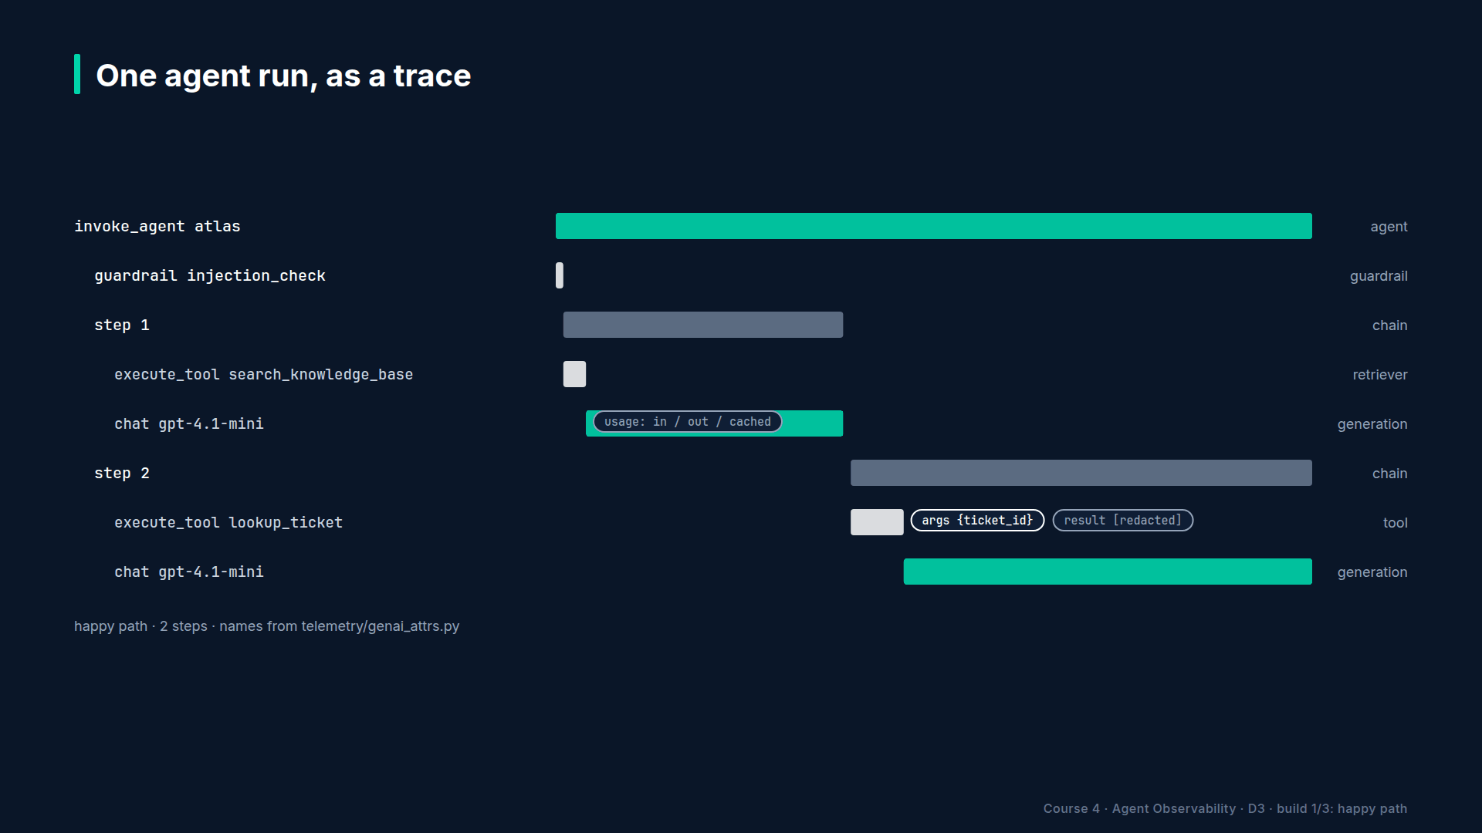
Section 05 · Lecture 5.1 · The trace we're aiming for
Notes:
Here's the trace we're building towards. Agent at the root. A guardrail first. Then one chain observation per step, and inside each step, whatever happened: a retriever, a generation, a tool. Step two's tool failed. Step three escalated to the big model. An event marks the escalation. Scores at the end. Let's take the six questions against it.

Slide 5
Q1. Why that tool? → the generation before it
The model's output message in the previous generation shows the tool call it chose and any reasoning text
gen_ai.response.finish_reasons = ["tool_calls"]
Read: what did the model see (input messages) → what did it decide (output)
AI Agent Observability & Cost Control · Section 05 · Lecture 5.1
Notes:
Why did it call that tool? Look at the generation immediately before it. Its output is the model's decision, including the tool name and arguments it chose, and its input is everything the model saw when it decided. The finish reason says `tool_calls`. Cause and effect, one click apart.

Slide 6
Q2 and Q3. With what, and what came back → the tool observation
Input: the arguments, exactly as the model produced them
Output: the result, clipped, masked
Status and level: OK, or ERROR with the message the model then saw
gen_ai.tool.call.id matches the call in the generation's output
AI Agent Observability & Cost Control · Section 05 · Lecture 5.1
Notes:
With what, and what came back: the tool observation. Input is the arguments as the model produced them, which is how you catch a model passing a ticket ID with a typo. Output is the result, clipped and masked. Level and status tell you it failed, and the message shows what the model read next. The call ID ties it back to the generation.

Slide 7
Q4. How many steps, and did it stop itself? → chain spans and events
One chain per step: count them
Event step_limit_reached or escalated when the loop intervened
Score steps and step_limit_hit on the trace
Finish reason stop on the last generation means the model chose to end
AI Agent Observability & Cost Control · Section 05 · Lecture 5.1
Notes:
How many steps? Count the chain observations. Did it stop on its own? The last generation's finish reason says `stop` if the model chose to end. If the loop intervened, there's an event: step limit reached, or escalated. And the same facts land as scores, so you can filter a week of traces by "hit the step limit."

Slide 8
Q5. Where did the tokens go? → usage per generation, per step
Each generation: input, output, cached input
Input tokens per step should be roughly flat; a rising line is context growth
Cached tokens should be high on step 2+ if caching works (Section 6.4)
Trace total = sum of generations; compare to the day's median
AI Agent Observability & Cost Control · Section 05 · Lecture 5.1
Notes:
Where did the tokens go? Every generation has usage. Read the input tokens down the steps: flat is healthy; climbing is context growth, the Friday-night signature. Cached input should be high from step two onward once caching is on. And the trace total against the day's median tells you if this conversation is an outlier.

Slide 9
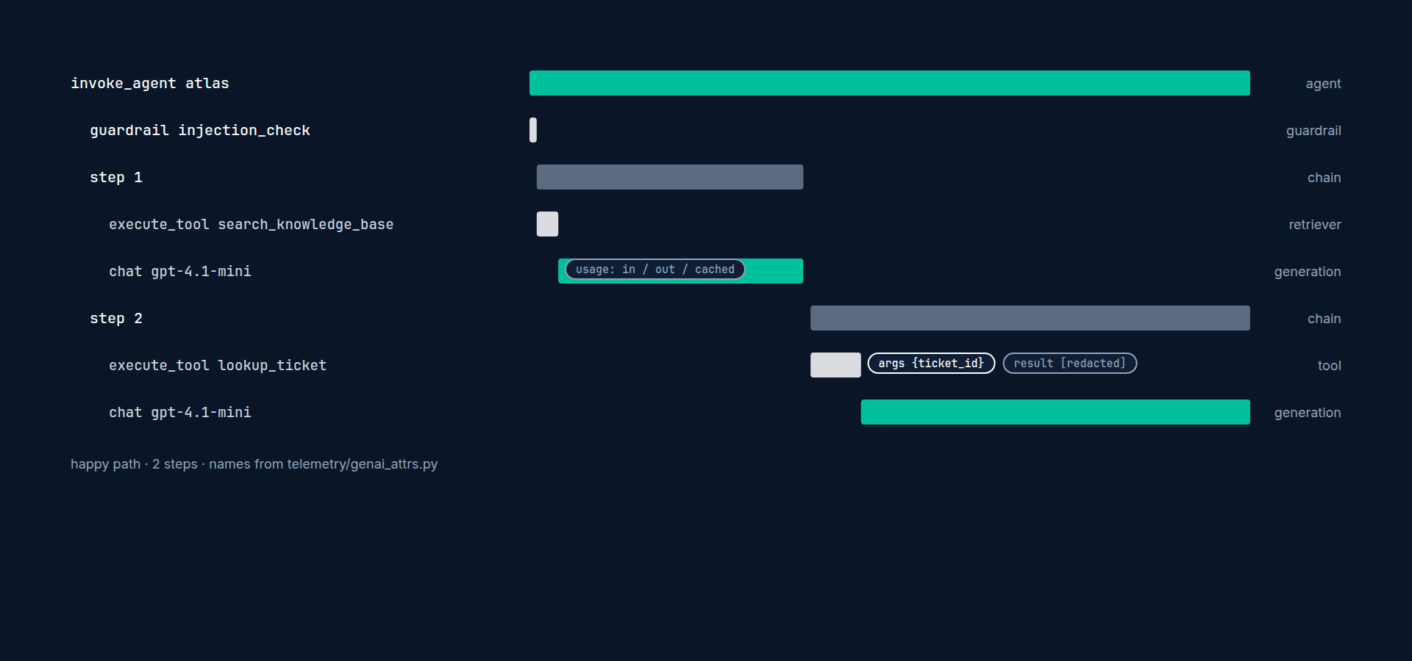
Q6. Where did the time go? → the waterfall
Generations dominate; tools should be milliseconds
Gaps between spans are your own code
Time to first token per generation (5.4)
One slow tool call at the wrong moment doubles p95 (Section 7)
AI Agent Observability & Cost Control · Section 05 · Lecture 5.1
Notes:
Where did the time go? The waterfall. Generations should dominate. Tools should be milliseconds; a tool taking two seconds is a finding. Gaps between spans are your own code. And in the next lectures, time to first token per generation.

Slide 10
What breaks readability
Flat traces: agent and twenty children, no steps → can't tell which tool followed which call
Missing arguments or results → can't answer Q2 or Q3
Silent stopping → loop ended, nothing says why
Escalation without a marker → cost jumped, no reason in the trace
Unredacted tool results the size of a web page → nobody scrolls
AI Agent Observability & Cost Control · Section 05 · Lecture 5.1
Notes:
What breaks readability? Flat traces, where the agent has twenty children and no steps. Missing arguments or results. Silent stopping. Escalation with no marker. And results the size of a web page, which nobody reads.

Slide 11
The pattern, in one slide
Agent → guardrail → step (chain) → { retriever | generation | tool } per step
Events for interventions: step_limit_reached, escalated, tool_retry_exhausted
Scores for outcomes: resolved, steps, step_limit_hit
Everything clipped, masked and typed
AI Agent Observability & Cost Control · Section 05 · Lecture 5.1
Notes:
Agent, guardrail, one chain per step, the work inside each step, events for interventions, scores for outcomes. That's the pattern. Next lecture you'll build it into the loop.

Slide 12
→
Next up:
Code-along: tracing the tool loop step by step
Next, the code-along: step spans, redacted tool results, the step limit as an event, and escalation as a…
AI Agent Observability & Cost Control · Section 05 · Lecture 5.1

Slide 13
SECTION 5 · AGENT OBSERVABILITY PATTERNS
LECTURE 5.2
Code-along: tracing the tool loop step by step
Wrap each loop iteration in a chain observation named step n.
AI Agent Observability & Cost Control · Section 05 · Lecture 5.2
Notes:
Title card (K2). Code-along: tracing the tool loop step by step.

Slide 14
What the six lines bought you
Question | Answered by
Why that tool | previous generation's output, inside the same step
With what / what came back | tool observation input and clipped output; ERROR level on failure
How many steps, who stopped it | count of step n; step_limit_reached event; steps and step_limit_hit scores
Where the tokens went | usage per generation, per step; model per generation
Where the time went | the waterfall per step
Why cost jumped | escalated event and model name on the generation
AI Agent Observability & Cost Control · Section 05 · Lecture 5.2
Notes:
Six lines: a chain per step, errors as levels, two events, one score, and a model argument. That's the whole pattern. Everything in Sections six, seven and eleven reads traces shaped like this.

Slide 15
→
Next up:
RAG spans: retrieval quality is a production metric
Next, the retriever: why "how good was the search" is a production metric, and how to record it.
AI Agent Observability & Cost Control · Section 05 · Lecture 5.2

Slide 16
SECTION 5 · AGENT OBSERVABILITY PATTERNS
LECTURE 5.3
RAG spans: retrieval quality is a production metric
Record query, top-k, document IDs and scores on the retriever observation.
AI Agent Observability & Cost Control · Section 05 · Lecture 5.3
Notes:
Title card (K2). RAG spans: retrieval quality is a production metric.

Slide 17
What to record on a retriever observation
Input: the query text and top_k
Output: document IDs and scores (not full chunk text; it's already in the generation's input)
Metadata: hits, top_score, empty, index_version
Level: WARNING when empty or below a confidence threshold
Score on the trace: grounded (boolean)
AI Agent Observability & Cost Control · Section 05 · Lecture 5.3
Notes:
Five things. The query and top-k as input. Document IDs and scores as output, not the chunk text, which already appears in the generation's input. Metadata with the hit count, top score and an empty flag. A warning level when the result is empty or weak. And a boolean `grounded` score on the trace, so a week of traces can be filtered by it.
[SCREEN: VS Code, `app/knowledge.py`.]
[CODE: the retriever, fully recorded]
The retriever. Search, then split hits into good ones above a threshold. Update the span: input with query and top-k; output with doc names and rounded scores; metadata with hits, good hits, top score, an empty flag and the index version. Warning level when nothing cleared the threshold. And return only the good hits, so the model never sees junk with a score of point one.
[SCREEN: `app/agent.py`, where the retriever is called in step 1.]
[CODE: the grounded score]
In the agent, right after retrieval, score the trace: grounded true if we had at least one good document, false otherwise. One line, and "how often do we answer ungrounded" becomes a filter.
[SCREEN: Terminal: send "What's the policy on bringing my dog to the office?" (not in the KB). Browser: the trace. Retriever at WARNING,...]
[DEMO: Warning-level retriever with low scores, grounded false, and a confident-sounding answer from the model.]
Ask something the knowledge base doesn't cover. The retriever is yellow. Three hits, all under the threshold, empty true. Grounded false. And look at the answer: the model produced two polite sentences of policy that doesn't exist. Without the retriever span, this trace looks like a success.

Slide 18
Two rates you'll track from here
Empty-result rate: retriever observations with empty = true ÷ all retrievals
Grounded rate: traces with grounded = true ÷ all traces with a retrieval
Baseline on the replayed day: empty 6.8%, grounded 93.2%
A jump in empty rate after a KB or index change is Incident 2's second cause (Section 11)
AI Agent Observability & Cost Control · Section 05 · Lecture 5.3
Notes:
Two rates. Empty-result rate, from the retriever metadata. Grounded rate, from the score. On the replayed day the baseline is six point eight percent empty, ninety-three point two grounded. Write those in your build log. In Section eleven, a change to top-k moves those numbers, and you'll be asked to notice.
[SCREEN: Terminal: `OFFLINE=1 make replay`. Ops Console → Quality page now shows "Grounded rate 93.2%" and "Empty retrievals 6.8%". Brows...]
[DEMO: Console shows the two rates; Langfuse lists ungrounded traces.]
Replay the day, and the console's quality page has its first two real numbers. In Langfuse, filter by grounded false: about eighty traces. Open a few. Pets, parking, the gym. That list is a to-do list for whoever owns the knowledge base, produced by the agent's own telemetry.

Slide 19
When top-k and thresholds change
Record top_k and index_version so a change is visible in traces
Higher top-k: more tokens per step (cost), fewer empties; lower: the reverse
Section 6.5 tunes top-k for cost; Section 11 shows what happens when someone tunes it without looking here
AI Agent Observability & Cost Control · Section 05 · Lecture 5.3
Notes:
Record the query, the documents, the scores, the emptiness. Score the trace as grounded or not. Two rates, on a dashboard, from day one. Retrieval quality is not an offline benchmark; it's a production metric, and now you have it.

Slide 20
→
Next up:
Streaming: time to first token and tokens per second
Next, streaming: measuring time to first token and tokens per second on every generation.
AI Agent Observability & Cost Control · Section 05 · Lecture 5.3

Slide 21
SECTION 5 · AGENT OBSERVABILITY PATTERNS
LECTURE 5.4
Streaming: time to first token and tokens per second
Stream a chat completion with usage included and assemble the response.
AI Agent Observability & Cost Control · Section 05 · Lecture 5.4
Notes:
Title card (K2). Streaming: time to first token and tokens per second.

Slide 22
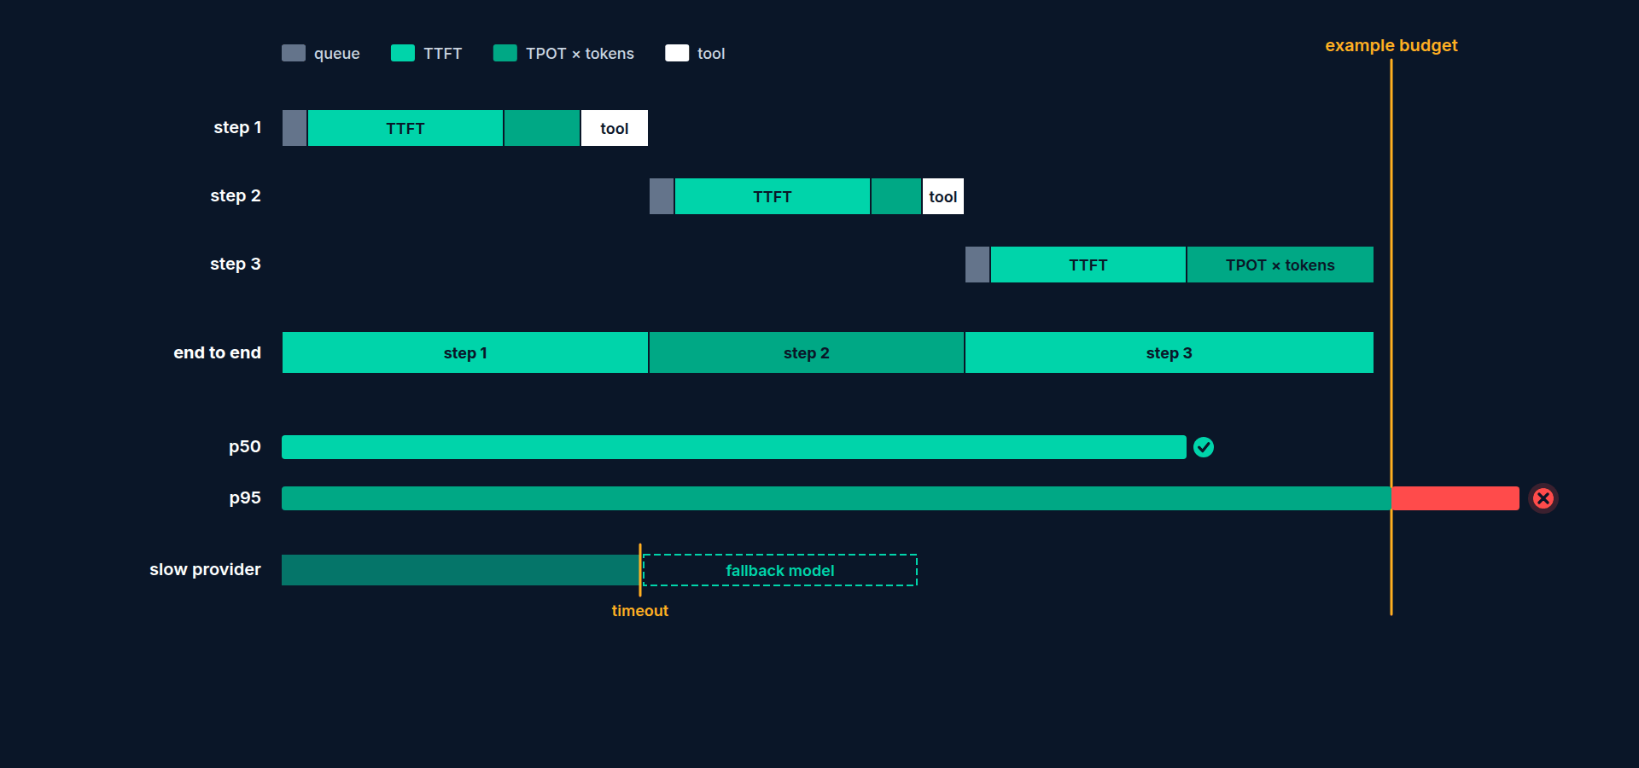
Three latency numbers per generation
TTFT: time to first token. What the user feels as "did it hear me?"
TPOT: time per output token, after the first. Reading speed.
Total: TTFT + (output_tokens − 1) × TPOT. What p95 dashboards usually show.
Same total, different TTFT = completely different experience
AI Agent Observability & Cost Control · Section 05 · Lecture 5.4
Notes:
Three numbers per generation. Time to first token, which is what the user feels as responsiveness. Time per output token after the first, which is reading speed. And total, which is what most dashboards show and which hides the difference.
[SCREEN: VS Code, `src/northwind/latency.py`. Show `ttft_ms`, `tpot_ms`, `percentile`.]
The latency module has the arithmetic: `ttft_ms` from two timestamps, `tpot_ms` from first-token time, end time and output tokens, and a percentile function you'll use in Section seven. Pure Python, unit-tested.
[SCREEN: `app/agent.py`. Add `_call_model_stream`.]
[CODE: the streaming generation]
The streaming version. Note the start time. Ask for a stream, and ask for usage to be included; without that option the final chunk has no token counts and you can't price the call. Then iterate. On the first chunk with content, record the time, and do two things with it. Tell Langfuse via `completion_start_time`, which is how its UI shows time to first token on the generation. And set the standard attribute, `gen_ai.response.time_to_first_chunk`, on the underlying OpenTelemetry span, in seconds. Incubating name, may change. Collect the text, catch the usage on the last chunk, note the end time.
[CODE: finish the generation]
After the loop, finish the generation: output, usage, cost, and the two computed numbers in metadata, so they're filterable per generation. Then assemble a response object shaped like the non-streaming one, so the loop doesn't care which path ran.

Slide 23
Where each number lives
Number | Where | Used by
completion_start_time | Langfuse generation | Langfuse latency views, "time to first token" column
gen_ai.response.time_to_first_chunk | span attribute (seconds) | any OTel backend; collector → metrics (Section 9)
ttft_ms, tpot_ms | generation metadata | Ops Console latency page, Section 7 budgets
Prometheus histogram atlas_ttft_seconds | /metrics | Grafana p95 (Section 9)
AI Agent Observability & Cost Control · Section 05 · Lecture 5.4
Notes:
The same measurement lands in four places for four audiences. Langfuse's own field for its UI. The standard attribute for any OpenTelemetry backend. Our metadata for the console. And, in Section nine, a Prometheus histogram for Grafana.
[SCREEN: Terminal: `OFFLINE=1 make run` with `ATLAS_STREAM=1`. Send a question. Browser: the generation shows "Time to first token 312 ms...]
[DEMO: The mock streams offline too, with realistic TTFT and TPOT distributions.]
Run with streaming on and send a question. The generation now shows time to first token: three hundred and twelve milliseconds, against a total of two point six seconds. TPOT sixteen milliseconds, about sixty tokens a second. The mock streams offline as well, with realistic distributions, so the day's replay has TTFT for every generation.

Slide 24
Reading TTFT across a day
p50 TTFT ≈ 350 ms, p95 ≈ 1.1 s on the replayed day
TTFT climbs with input tokens: context bloat shows here first
TPOT is mostly a property of the model; a jump means a provider change or a slow region
Section 7 sets budgets: TTFT p95 under 1.5 s, total p95 under 4 s
AI Agent Observability & Cost Control · Section 05 · Lecture 5.4
Notes:
Across the day: median TTFT about three hundred and fifty milliseconds, p95 around one point one seconds. Two patterns to remember. TTFT climbs with input size, so context bloat shows up here before it shows up in your bill. And TPOT is mostly a property of the model; if it jumps, the provider changed something. Section seven sets budgets for both.
Two timestamps and one flag on the request. Time to first token in Langfuse, the standard attribute for everyone else, and the number users actually feel, on every generation.

Slide 25
→
Next up:
Logs vs traces vs metrics for agents
Next, a slides lecture on the three signals: when an agent should log, when it should trace, and…
AI Agent Observability & Cost Control · Section 05 · Lecture 5.4

Slide 26
SECTION 5 · AGENT OBSERVABILITY PATTERNS
LECTURE 5.5
Logs vs traces vs metrics for agents
Decide, for a given fact about an agent, whether it belongs in a log, a span or a metric.
AI Agent Observability & Cost Control · Section 05 · Lecture 5.5
Notes:
Title card (K2). Logs vs traces vs metrics for agents.

Slide 27
Three signals, three questions
Signal | Answers | Shape | Cost grows with
Trace | what happened in this request, in order | tree of spans | requests × spans
Metric | how much, how often, right now | number series over time | label combinations
Log | what did the code say at this moment | line of text or JSON | lines
AI Agent Observability & Cost Control · Section 05 · Lecture 5.5
Notes:
Three signals. A trace answers what happened in one request. A metric answers how much and how often, right now, across all requests. A log answers what the code wanted to say at a moment. Their costs grow differently: traces with request volume, metrics with label combinations, logs with lines.

Slide 28
The five-second rule
Is it about one request, in sequence? → span or event on the span
Is it a number you'd graph over time or alert on? → metric
Is it a message for a human debugging later? → log, with trace_id
Is it both? → span first; derive the metric from spans or emit both
AI Agent Observability & Cost Control · Section 05 · Lecture 5.5
Notes:
The rule. If it's about one request, in sequence, it's a span or an event on one. If it's a number you'd graph or alert on, it's a metric. If it's a message for a human, it's a log, with the trace ID attached. If it's both, span first, and emit the metric alongside.

Slide 29
Agent examples
Fact | Signal
The model chose lookup_ticket with these arguments | span (tool observation)
Tool error rate for lookup_ticket, last 5 minutes | metric: atlas_tool_calls_total{tool, outcome}
Step limit reached in this conversation | event on the span + score; and metric atlas_step_limit_total{tenant}
Cost of this generation | span (generation cost_details)
Cost per hour by tenant | metric: atlas_cost_usd_total{tenant, model}
"Prompt fetched from fallback: Langfuse unreachable" | log, WARNING, with trace_id
TTFT of this generation | span (completion_start_time)
TTFT p95 today | metric: histogram atlas_ttft_seconds{model}
AI Agent Observability & Cost Control · Section 05 · Lecture 5.5
Notes:
Examples. The tool the model chose: a span. Tool error rate over five minutes: a metric. Step limit reached: an event on the span, a score, and a metric counter, because you'll alert on the rate. Cost of one generation: on the span. Cost per hour by tenant: a metric. "Prompt fetched from fallback": a log at warning level, with the trace ID. TTFT of this call: on the span. TTFT p95 today: a histogram.

Slide 30
Logs that are worth having
telemetry/logging_setup.py: JSON formatter that reads the current span context
Paste the trace_id into Langfuse: the whole request appears
No message bodies, no PII in logs; that's what masked spans are for
json
{"ts": "2026-09-28T14:02:07Z", "level": "WARNING", "logger": "atlas.prompts",
"msg": "prompt fetched from fallback", "prompt": "atlas-system",
"trace_id": "c8e0b7a1c432fda1dd0b3d28692756c3", "span_id": "21c0b128c8a0a5b9",
"tenant": "ops", "service": "atlas", "env": "dev"}
AI Agent Observability & Cost Control · Section 05 · Lecture 5.5
Notes:
A log that's worth having looks like this. JSON, one line, a level, a message, and the trace and span IDs read from the current span context by the formatter. Paste that trace ID into Langfuse and the whole request opens. Our logging setup does this for every line. Two rules for logs: no message bodies, and no personal data. Logs are usually retained longer and read by more people than traces.

Slide 31
The cardinality trap
A metric series exists for every unique combination of label values
tenant (4) × model (3) × tool (5) × outcome (2) = 120 series. Fine.
Add user_id (2,000) → 240,000 series. Prometheus memory, query time and your dashboards all suffer.
Add session_id → unbounded. This is how a metrics server dies.
Rule: labels are for dimensions with a small, fixed set of values. Users and sessions are trace dimensions, never metric labels.
AI Agent Observability & Cost Control · Section 05 · Lecture 5.5
Notes:
Now the trap. A Prometheus metric is one series per unique combination of label values. Tenant, model, tool, outcome: four times three times five times two, a hundred and twenty series. Fine. Add a user ID label, with two thousand employees: two hundred and forty thousand series. Add a session ID: unbounded, and your metrics server falls over at three in the morning. Labels are for dimensions with a small, fixed set of values. Users and sessions belong in traces, where they already are.

Slide 32
What telemetry/metrics.py exposes
text
atlas_requests_total{tenant, outcome}
atlas_tokens_total{tenant, model, kind} kind = input | output | cache_read | reasoning
atlas_cost_usd_total{tenant, model}
atlas_tool_calls_total{tenant, tool, outcome}
atlas_step_limit_total{tenant}
atlas_budget_hits_total{tenant, level} level = soft | hard
atlas_ttft_seconds{model} histogram
atlas_request_latency_seconds{tenant} histogram
AI Agent Observability & Cost Control · Section 05 · Lecture 5.5
Notes:
Here's what Atlas exposes at slash metrics, and every label set is small and fixed. Tokens by kind, so cached and reasoning tokens are visible as series. Cost by tenant and model. Tool calls by outcome. Step limits and budget hits. Two histograms. Section nine builds the dashboard and alerts on exactly these.

Slide 33
Putting it together for one request
DIAGRAM TO BUILD
Diagram: one request flows through Atlas. Three arrows out: "spans → Langfuse (what happened, cost, TTFT)", "metrics → Prometheus (rates, totals, histograms, by tenant/model/tool)", "logs → stdout JSON with trace_id (human notes)". A dotted line from a log line to the trace it names.
AI Agent Observability & Cost Control · Section 05 · Lecture 5.5
Notes:
For one request: spans to Langfuse for what happened. Metrics to Prometheus for how much and how often. Logs to standard out, in JSON, with the trace ID, for the human notes. The trace ID is the thread that ties a log line back to the request it came from.
Span for the request, metric for the number, log for the human, trace ID on everything. And never, ever, a user ID on a metric label.

Slide 34
→
Next up:
Break it: the loop you can only see in a trace
Next, a break-it demo: the Friday loop, seen from inside the trace this time, and the code that…
AI Agent Observability & Cost Control · Section 05 · Lecture 5.5

Slide 35
SECTION 5 · AGENT OBSERVABILITY PATTERNS
LECTURE 5.6
Break it: the loop you can only see in a trace
Inject the loop scenario and read the runaway trace: repeated identical tool errors, climbing input tokens, escalation.
AI Agent Observability & Cost Control · Section 05 · Lecture 5.6
Notes:
Title card (K2). Break it: the loop you can only see in a trace.

Slide 36
Where else would this have shown up?
Signal | What it showed on Friday
HTTP status | 200
Request count | 1
Error logs | 60 lines "ticketing API 503", indistinguishable from 60 different users
Tool error metric | 100% error rate for lookup_ticket: a real signal, if anyone had the alert
Trace | 61 identical steps, climbing tokens, silent escalation, no stop
AI Agent Observability & Cost Control · Section 05 · Lecture 5.6
Notes:
Where else would you have seen this? The HTTP status was 200. Request count, one. The error logs had sixty lines saying 503, which look exactly like sixty different users having a bad day. The tool error metric did spike, and that's the alert we add in Section nine. But the shape of the failure, one conversation retrying itself into the ground, only exists in the trace.
Two fixes, both in the agent, both from Lecture 5.2. A step limit, with an event. And surfacing consecutive tool errors instead of feeding them back forever.
[SCREEN: VS Code, `app/agent.py`. Highlight the `max_steps` block with `create_event("step_limit_reached")` and the new consecutive-error...]
[CODE: the second guard, consecutive identical tool errors]
The step limit you saw in 5.2. This is the second guard. After more than two consecutive errors from the same tool, stop. Emit a `tool_retry_exhausted` event with the tool, the attempt count and the last error. Score the trace. And tell the employee the truth, with the system's name in plain English. This fires long before the step limit would, on exactly the failure that caused Friday.
[SCREEN: Terminal 1: `OFFLINE=1 make run` (defaults). Terminal 2: `OFFLINE=1 make swarm SCENARIO=loop`, one conversation.]
[SCREEN: Browser: newest trace. `atlas` → `injection_check` → `step 1` { retriever, chat } → `step 2` { `lookup_ticket` ERROR, chat } → `...]
[DEMO: Short, readable trace with a warning event and an honest answer as the trace output.]
Same scenario, guards on. Four steps. Three red tool calls. Then a yellow event, `tool_retry_exhausted`, with the tool name and "ticketing API 503" in its metadata. Resolved false, so it's honest about the outcome. Two cents. Seven seconds. And the trace output is the message the employee saw.

Slide 37
Before and after, from the trace
 | Before | After
Steps | 61 | 4
Tool errors fed back to the model | 60 | 3
Escalation | silent, step 14 | never reached
Stop reason in trace | none | tool_retry_exhausted event + score
Cost | $3.90 | $0.02
User saw | timeout | honest message in 7 s
AI Agent Observability & Cost Control · Section 05 · Lecture 5.6
Notes:
Sixty-one steps to four. Three ninety to two cents. And the reason it stopped is written in the trace, as an event and a score, so a filter for `tool_retry_exhausted = true` on Monday shows every conversation the outage touched.
[SCREEN: `tests/integration/test_spans.py`, `test_loop_scenario_stops_at_step_limit`. Run `make test`.]
[CODE: the regression test]
And the test that keeps it fixed: run the loop scenario offline, assert at most four steps, an unresolved result and the event. Green.
The loop was always visible. It just wasn't visible anywhere people were looking. Now it's a four-step trace with a yellow event, and a test that fails if anyone turns the guards off again.

Slide 38
→
Next up:
Lab 3: Trace a multi-step ticket escalation
Lab 3: trace the ticket escalation path yourself and write the test for it.
AI Agent Observability & Cost Control · Section 05 · Lecture 5.6

Slide 39
SECTION 5 · AGENT OBSERVABILITY PATTERNS
LECTURE 5.7
Lab 3: Trace a multi-step ticket escalation
Trace the path lookup fails → create_ticket → escalation with steps, events and scores.
AI Agent Observability & Cost Control · Section 05 · Lecture 5.7
Notes:
Title card (K2). Lab 3: Trace a multi-step ticket escalation.

Slide 40
→
Next up:
Quiz: Agent patterns
A six-question quiz on agent patterns, then Section 6, the signature section: where the money goes, and how…
AI Agent Observability & Cost Control · Section 05 · Lecture 5.7

Slide 41
SECTION 5 · AGENT OBSERVABILITY PATTERNS
LECTURE 5.8
Quiz: Agent patterns
Check understanding of the six questions and the step-span pattern.
AI Agent Observability & Cost Control · Section 05 · Lecture 5.8
Notes:
Title card (K2). Quiz: Agent patterns.

Slide 42
Section 5 quiz: what's covered (1/2)
The six questions and which span answers each
Tool errors: level and output, not exceptions
Events vs scores for the step limit
What to record on a retriever; the grounded score
TTFT vs total latency; include_usage
AI Agent Observability & Cost Control · Section 05 · Lecture 5.8
Notes:
One on mapping questions to spans. One on how tool errors should be recorded. One on events versus scores. One on retriever spans and grounding. One on time to first token. And one that gives you a fact and asks: log, span or metric?
Tip for the last one: if the fact has a user in it, it's not a metric label.

Slide 43
Section 5 quiz: what's covered (2/2)
Log, span or metric? Cardinality
AI Agent Observability & Cost Control · Section 05 · Lecture 5.8
Notes:
(continued) One on mapping questions to spans. One on how tool errors should be recorded. One on events versus scores. One on retriever spans and grounding. One on time to first token. And one that gives you a fa

Slide 44
→
Next up:
Where the money goes: token anatomy
Next, Section 6, Cost engineering: token anatomy, a price table you can trust, and the challenge to cut…
AI Agent Observability & Cost Control · Section 05 · Lecture 5.8

