Slide 1
SECTION 1 · WELCOME AND HOW VOICE AGENTS WORK
LECTURE 1.1
Meet Riley: one call that works, one that fails, one that's fixed
Hear the difference between a production voice agent and a naive one on the same request.
Production Voice AI Agents · Section 01 · Lecture 1.1
Notes:
Title card (K2). Meet Riley: one call that works, one that fails, one that's fixed.

Slide 2
RECAP
Key takeaways
✓
Naive agents talk over, mishear and invent slots
✓
The fix is engineering, not a smarter model
✓
Your Riley will pass call three's tests
Production Voice AI Agents · Section 01 · Lecture 1.1

Slide 3
→
Next up:
What a voice agent actually is
Next, we'll open the hood and name every component inside those calls, starting with what a voice agent…
Production Voice AI Agents · Section 01 · Lecture 1.1

Slide 4
SECTION 1 · WELCOME AND HOW VOICE AGENTS WORK
LECTURE 1.2
What a voice agent actually is
Distinguish a voice agent from an IVR and from a text chatbot.
Production Voice AI Agents · Section 01 · Lecture 1.2
Notes:
Title card (K2). What a voice agent actually is.

Slide 5
IVR vs chatbot vs voice agent
IVR: fixed menu tree, keypad or keywords, no understanding
Chatbot: understands language, but text in, text out, and you wait for full replies
Voice agent: understands language, speaks in real time, takes actions, handles interruptions
Production Voice AI Agents · Section 01 · Lecture 1.2
Notes:
An IVR is a decision tree. It only understands what it was built to expect. Say "I chipped my tooth" and it has no idea what to do.
A chatbot understands language. But it lives in text. You type, you wait, you read a full paragraph. Nobody minds a two second pause in a chat window.
A voice agent understands language like a chatbot. But it has to behave like a person on the phone. It listens while you talk. It decides when you're finished. It answers in under a second. And when you interrupt, it stops talking. That last part sounds small. It's actually one of the hardest problems in this whole course.

Slide 6
A voice agent is a real-time system, not a chatbot with a speaker
Audio arrives as a continuous stream, twenty milliseconds at a time
The agent must decide when the caller has finished
Every reply is a race against silence
Production Voice AI Agents · Section 01 · Lecture 1.2
Notes:
Here's the mindset shift. A chatbot is request and response. A voice agent is a real-time system. Audio arrives in tiny frames, about fifty of them every second. The agent has to make decisions on a live stream, with a clock running.

Slide 7
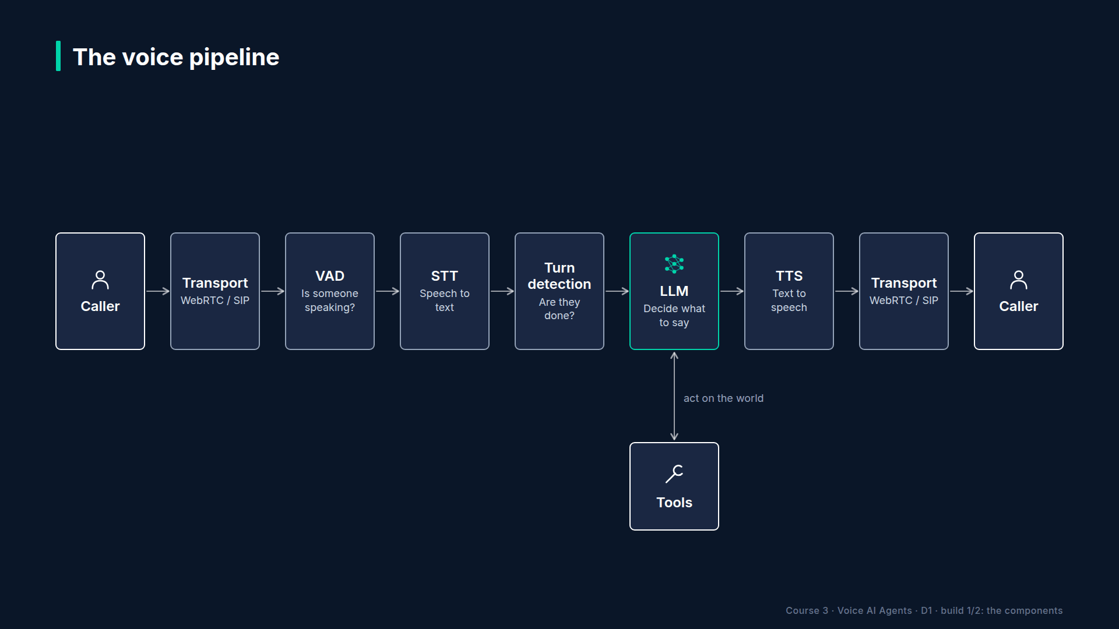
Section 01 · Lecture 1.2 · The voice pipeline, seven components
Notes:
Let's walk the pipeline one box at a time. I'll tell you what each part does, and the way it usually breaks.
Slide text (drawn on the diagram): Transport: moves audio in and out · VAD: is someone speaking right now? · STT: speech to text · Turn detection: are they done? · LLM: decide what to say or do · Tools: act on the world · TTS: text to speech

Slide 8
Transport: WebRTC and SIP
WebRTC: browsers and apps, low latency, built for real-time media
SIP: the telephone network, via a SIP trunk
Failure: packet loss, jitter, eight kilohertz phone audio
Production Voice AI Agents · Section 01 · Lecture 1.2
Notes:
Box one is transport. It moves audio between the caller and your agent. In a browser or mobile app, that's WebRTC, the same technology behind video calls. On a phone, it's SIP, the protocol that connects the phone network to the internet.
In this course, LiveKit handles transport for you. That's a big deal. You never touch a raw audio socket.
How does it fail? Bad networks. Packets arrive late or not at all. And phone audio is sampled at eight kilohertz, half the quality of a browser. That will matter when we pick a speech-to-text model in Section 8.

Slide 9
VAD: voice activity detection
Small, fast model: speech or not speech, every frame
Runs locally (Silero), in a few milliseconds
Failure: background noise triggers it, or soft speakers get missed
Production Voice AI Agents · Section 01 · Lecture 1.2
Notes:
Box two is VAD, voice activity detection. It answers one question, many times a second. Is someone speaking right now? We'll use Silero, a tiny model that runs on your CPU in a few milliseconds.
VAD fails in noisy rooms. A TV in the background, a dog barking, a car on the road. Suddenly the agent thinks the caller is talking and stops mid-sentence.

Slide 10
STT: speech-to-text
Streams partial transcripts while the caller speaks, then a final transcript
Default in this course: Deepgram Nova-3
Failure: names, drug names, numbers, accents
Production Voice AI Agents · Section 01 · Lecture 1.2
Notes:
Box three is STT, speech-to-text. It streams words as the caller speaks, then settles on a final transcript. Our default is Deepgram Nova-3.
STT fails on exactly the words that matter most. Surnames. Medication names. Phone numbers. If the caller says "Ortiz" and STT hears "or tease," your booking is wrong before the LLM even sees it.

Slide 11
Turn detection: are they done?
Silence alone is a bad signal: people pause mid-thought
Semantic turn detector reads the words, not just the silence
Failure: cutting people off, or awkward long waits
Production Voice AI Agents · Section 01 · Lecture 1.2
Notes:
Box four is turn detection. This one surprises people. How does the agent know you've finished your turn? The obvious answer is silence. But think about how you give a phone number. "Five five five... two zero one..." You pause. You haven't finished.
So we combine silence with a small model that reads the transcript and predicts whether the sentence is complete. Get this wrong in one direction and Riley interrupts people. Get it wrong the other way and there's a painful gap before every reply. Section 3 is where you'll tune it.

Slide 12
LLM and tools: the brain and the hands
LLM decides: reply, ask a question, or call a tool
Tools: find slots, book, reschedule, cancel, look up clinic info, transfer
Failure: hallucinated availability, wrong arguments, long rambling answers
Production Voice AI Agents · Section 01 · Lecture 1.2
Notes:
Boxes five and six are the LLM and its tools. The LLM reads the conversation and decides what happens next. Sometimes that's a reply. Sometimes it's a tool call, like checking the schedule or booking a slot.
Here's the scariest failure in voice. Remember call two from the first lecture? The LLM invented six Friday times without ever calling a tool. The caller hangs up happy, and shows up to a full waiting room. That's why tools, and tests for tools, get two full sections.

Slide 13
TTS: text-to-speech
Streams audio back sentence by sentence
Default in this course: Cartesia Sonic-3
Failure: reads markdown aloud, mangles numbers, mispronounces names
Production Voice AI Agents · Section 01 · Lecture 1.2
Notes:
Box seven is TTS, text-to-speech. It turns the LLM's words into audio and streams it back, starting before the full reply is written. Our default is Cartesia Sonic-3.
TTS fails in funny ways that aren't funny in production. It reads "asterisk asterisk" out loud because the LLM wrote markdown. It says a phone number as "five hundred fifty-five million." Section 4 exists to fix this.

Slide 14
Every box adds latency and a failure mode
Component | Typical failure | Where we fix it
Transport | packet loss, 8 kHz audio | S8
VAD | noise triggers | S3
STT | names and numbers | S3, S9
Turn detection | interrupts or long gaps | S3
LLM | rambling, hallucination | S4, S9
Tools | wrong args, fake availability | S5, S9
TTS | reads symbols, bad numbers | S4
Production Voice AI Agents · Section 01 · Lecture 1.2
Notes:
[SCREEN: VS Code, `03-code/agents/common.py`, scrolled to `create_session`. Highlight the `stt=`, `llm=`, `tts=`, `vad=` and `turn_handli...]
And here's that same pipeline in the code you'll use from Section four on. One function in `agents/common.py` builds Riley's session. Speech-to-text, one line. The LLM, one line. Text-to-speech, one line. VAD, one line. Turn detection, one line. Transport is LiveKit itself, so it isn't a line at all, and tools live on the agent, which you'll meet in Section five. Seven boxes on a slide, five lines of Python.
Here's the key idea. Every box adds time. And every box adds a way to fail. A voice agent isn't one model. It's a relay race of seven runners, and the caller only hears the final time.
That's also why testing voice agents is different. A wrong answer might be the LLM's fault. Or the STT misheard. Or turn detection cut the caller off halfway through. You'll learn to test each box on its own, and the whole relay together.

Slide 15
RECAP
Key takeaways
✓
Seven boxes, from transport to TTS
✓
Every box adds latency and a failure mode
✓
Test each box, then the whole relay
Production Voice AI Agents · Section 01 · Lecture 1.2

Slide 16
→
Next up:
Cascaded vs speech-to-speech architectures
Next, you'll see there are two very different ways to wire that pipeline together: cascaded and speech-to-speech.
Production Voice AI Agents · Section 01 · Lecture 1.2

Slide 17
SECTION 1 · WELCOME AND HOW VOICE AGENTS WORK
LECTURE 1.3
Cascaded vs speech-to-speech architectures
Explain the cascaded STT → LLM → TTS pipeline and the realtime speech-to-speech approach.
Production Voice AI Agents · Section 01 · Lecture 1.3
Notes:
Title card (K2). Cascaded vs speech-to-speech architectures.

Slide 18
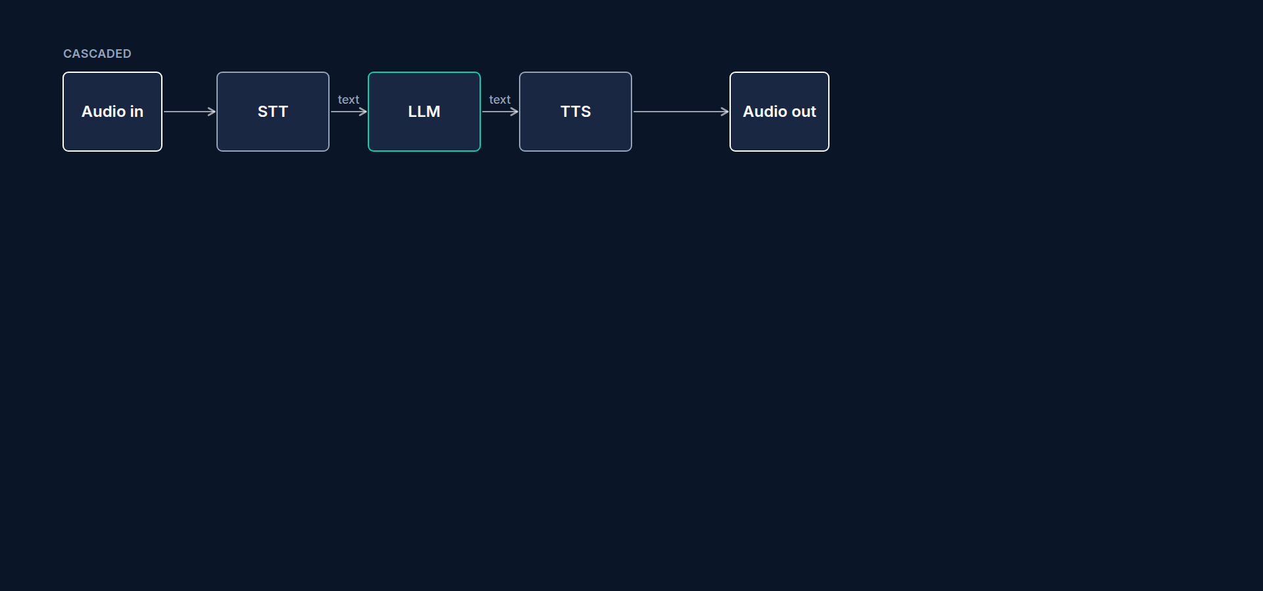
Architecture 1: cascaded
Three specialist models
Text is the handoff format between them
Production Voice AI Agents · Section 01 · Lecture 1.3
Notes:
The first design is called cascaded. Audio comes in. A speech-to-text model turns it into words. A text LLM decides what to say. A text-to-speech model turns that into audio. Three specialists in a row, passing text like a baton.
This is the pipeline you saw in the last lecture. It's also the default for Riley in Sections 3, 4 and 5.

Slide 19
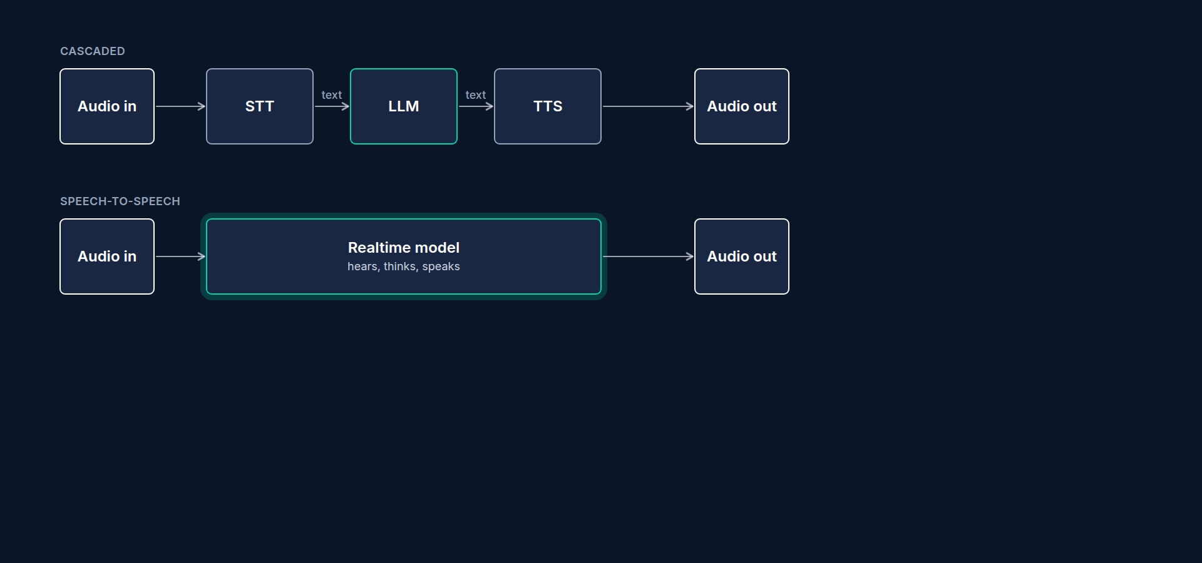
Architecture 2: speech-to-speech
One model, audio in and audio out
Example: OpenAI gpt-realtime
Transcripts produced on a side channel
Production Voice AI Agents · Section 01 · Lecture 1.3
Notes:
The second design is speech-to-speech, sometimes called realtime. One model takes audio in and produces audio out. There's no separate transcription step and no separate voice. OpenAI's gpt-realtime is the model we'll use, in Section 6.
It still gives you text transcripts. But they're a side channel for your logs, not the thing the model reasons over.

Slide 20
Why speech-to-speech sounds more human
Hears tone, hesitation, emphasis
Can respond with matching emotion
One network hop instead of three
Production Voice AI Agents · Section 01 · Lecture 1.3
Notes:
Why would you want that? Because the model hears more than words. It hears hesitation. It hears that the caller sounds stressed. A cascaded pipeline throws all of that away the moment STT turns audio into text. "I'm fine" and "I'm... fine" look identical in a transcript.
It's also simpler on the wire. One model call instead of three. That can mean lower latency, especially on the first word of a reply.

Slide 21
Why cascaded is still the production default
Swap any component: best STT, cheapest LLM, brand voice
Inspect and test the text at every step
Mature tool calling in text LLMs
Usually cheaper per minute
Production Voice AI Agents · Section 01 · Lecture 1.3
Notes:
So why doesn't everyone use speech-to-speech? Four reasons.
First, control. In a cascaded pipeline, you pick the best model for each job. A speech-to-text model tuned for phone audio. The cheapest LLM that passes your tests. A voice that matches your brand. With speech-to-speech, you get one vendor's bundle.
[SCREEN: Terminal log from a console session of `03-code/agents/s03_hello_agent.py` (the agent you'll run in Lecture 2.4). Highlight the...]
Second, visibility. Every stage produces text. You can log it, redact it, test it and diff it. When Riley books the wrong day, you can see whether STT misheard "Thursday" or the LLM misread it.
Third, tool reliability. Text LLMs have had tool calling for years. Realtime models are catching up fast, but for a system that writes to a real calendar, you want the most predictable tool calls you can get.
Fourth, cost. Audio tokens are more expensive than text tokens. For long calls, cascaded is usually cheaper per minute. We'll measure the exact difference in Section 10, with your own numbers, not mine.

Slide 22
Where cascaded hurts
Loses tone and emotion at the STT step
Three network hops can add latency
More moving parts to configure
Production Voice AI Agents · Section 01 · Lecture 1.3
Notes:
To be fair, cascaded has costs too. It's flat. It can't hear sarcasm. And three hops means three chances for a slow response. The good news is that streaming hides most of that. Each stage starts working before the previous one finishes.

Slide 23
Head-to-head comparison
Dimension | Cascaded | Speech-to-speech
Control over each model | High | Low
Voice and brand choice | Any TTS voice | Vendor voices only
Emotion and prosody | Lost at STT | Preserved
Latency to first word | Good with streaming | Often better
Tool-call reliability | Mature | Improving
Debuggability | Text at every step | Transcripts on side channel
Cost per minute | Usually lower | Usually higher
Best for | Transactions, compliance, scale | Natural conversation, coaching, companionship
Production Voice AI Agents · Section 01 · Lecture 1.3
Notes:
Here's the whole comparison on one slide. Pause the video and screenshot this one.
Read it as a trade. Cascaded wins on control, debuggability and cost. Speech-to-speech wins on naturalness and emotion. Latency is closer than people think, and it depends more on your configuration than on the architecture.
Think about Riley for a second. Riley books appointments. Riley reads back phone numbers. Riley has to get a date exactly right. Does Riley need to hear emotion? A little. Does Riley need perfectly reliable tool calls? Absolutely. That's why cascaded is our default.

Slide 24
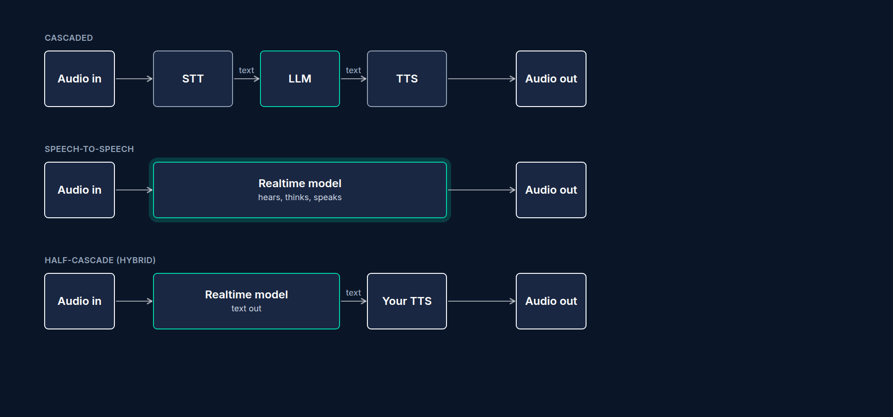
The hybrid: half-cascade
Realtime model understands audio directly
You keep your own brand voice
Code: modalities=["text"] plus a separate TTS
Production Voice AI Agents · Section 01 · Lecture 1.3
Notes:
There's a third option, and it's quietly very popular. The half-cascade. You send audio into the realtime model, so it hears tone and hesitation. But you ask it for text output only, and you speak that text with your own TTS voice.
You get better listening, and you keep your brand voice and your text logs. You'll build exactly this in Section 6.

Slide 25
Where each design spends its time
Cascaded: endpointing → STT final → LLM time-to-first-token → TTS time-to-first-byte
Speech-to-speech: endpointing (server VAD) → model time-to-first-audio
Label: "Endpointing is in both bars. Tool calls add time to both."
DIAGRAM TO BUILD
Two stacked bars.
Production Voice AI Agents · Section 01 · Lecture 1.3
Notes:
Let's look at latency a bit more carefully, because it's where the marketing claims live. In a cascaded pipeline, time goes to four places: deciding the caller has finished, the final transcript, the LLM's first token and the voice's first audio. In speech-to-speech, the middle steps collapse into one: time to the first audio from the model.
[B-ROLL: Slide 8's two bars animate. The middle segments of the cascaded bar merge into one "time to first audio" block, then the "Endpoi...]
So speech-to-speech removes a hop or two. But look at what's in both bars. Endpointing. Deciding the caller is done is the same problem in both designs, and it's usually the biggest single slice. And when the agent calls a tool, like checking the calendar, both designs wait for it the same way. We'll put real numbers on every slice in the next lecture.

Slide 26
Cost per minute, a first look (placeholder prices)
Cascaded, typical receptionist call: roughly 7 cents per minute
Speech-to-speech, same call: roughly 28 cents per minute
Source: the course's cost calculator, src/maple/costs.py, with placeholder list prices
Check current pricing; you'll recompute with real usage in Section 10
Production Voice AI Agents · Section 01 · Lecture 1.3
Notes:
[SCREEN: Terminal in the course repo. Run the cost calculator for a ten-minute call, cascaded first, then realtime. Zoom on the two "per...]
[CODE: the course's cost calculator, `src/maple/costs.py` (you'll run it yourself in Lecture 2.7)]
[DEMO: Output (excerpt: the last two lines of each report)]
And cost. The course repo includes a small cost calculator. With its placeholder list prices, a typical ten-minute receptionist call costs around seven cents a minute cascaded, and around twenty-eight cents a minute speech-to-speech. That's roughly four times more.
Those are placeholder numbers, and prices move every few months. But the shape is common: audio tokens cost more than text, and a realtime model re-reads the growing conversation as audio on every turn. For a clinic taking a thousand calls a month, that difference is real money.

Slide 27
How to decide
Transactions with strict data: cascaded
Emotion-heavy conversation: speech-to-speech
Want both: half-cascade
Always: measure latency, cost and tool accuracy on your own calls
Production Voice AI Agents · Section 01 · Lecture 1.3
Notes:
Here's my rule of thumb. If a mistake costs money or trust, like a wrong booking or a wrong dose, start cascaded. If the conversation itself is the product, like language practice or coaching, try speech-to-speech. If you're torn, try the hybrid.
And here's the most important part. Don't take anyone's word for it. Not a vendor's. Not mine. In Section 6, you'll run the same five test calls through both architectures and measure latency, cost per minute and tool accuracy yourself.
The best part? In LiveKit Agents, switching is mostly one line. The `Agent` class, the tools and the prompt stay the same. Only the model you hand to the session changes. That's a big reason we're using this framework.

Slide 28
RECAP
Key takeaways
✓
Cascaded: control, visibility, lower cost
✓
Speech-to-speech: hears tone, fewer hops
✓
Half-cascade: realtime ears, your own voice
Production Voice AI Agents · Section 01 · Lecture 1.3

Slide 29
→
Next up:
The latency budget: why 800 ms is the magic number
Both architectures live or die by one number, and in the next lecture you'll learn exactly where every…
Production Voice AI Agents · Section 01 · Lecture 1.3

Slide 30
SECTION 1 · WELCOME AND HOW VOICE AGENTS WORK
LECTURE 1.4
The latency budget: why 800 ms is the magic number
Define voice-to-voice latency and explain why the human turn gap sets the target.
Production Voice AI Agents · Section 01 · Lecture 1.4
Notes:
Title card (K2). The latency budget: why 800 ms is the magic number.

Slide 31
How fast do humans take turns?
Typical gap between speakers: about 200 to 300 milliseconds
Measured across many languages
Past about one second, the silence feels awkward
Production Voice AI Agents · Section 01 · Lecture 1.4
Notes:
Researchers who study conversation have timed this across many languages. The typical gap between one person finishing and the next person starting is around two hundred to three hundred milliseconds. That's faster than you can consciously react. We start planning our answer while the other person is still talking.
Machines can't quite hit that yet. But there's a threshold where it stops feeling broken. Somewhere around one second, silence goes from "thinking" to "is anyone there?"

Slide 32
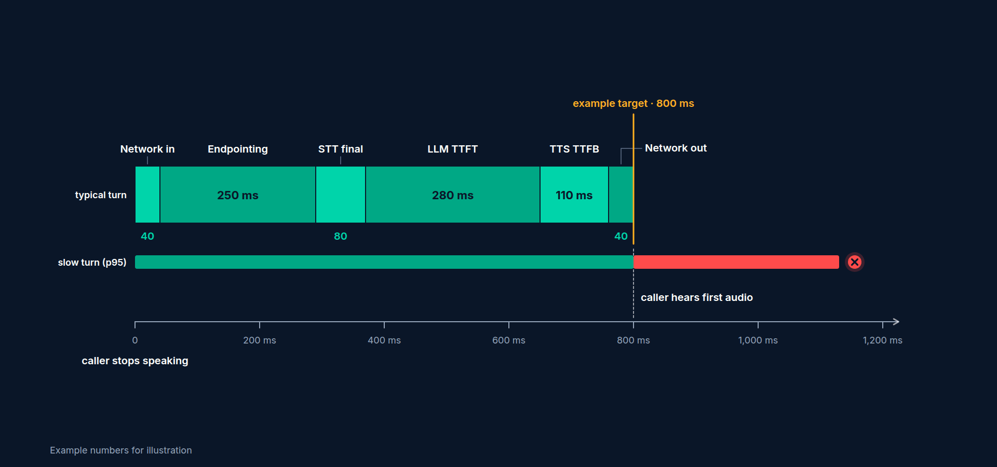
Voice-to-voice latency
Measured from the end of the caller's speech
To the first sound the caller hears
Target: under one second, aim for about 800 ms
Production Voice AI Agents · Section 01 · Lecture 1.4
Notes:
So here's the metric that matters. Voice-to-voice latency. The clock starts when the caller stops speaking. It stops when the caller hears the first sound of the reply. Not when the reply is finished. The first sound.
Our target is under one second. We'll aim for about eight hundred milliseconds, to leave headroom for the bad days.

Slide 33
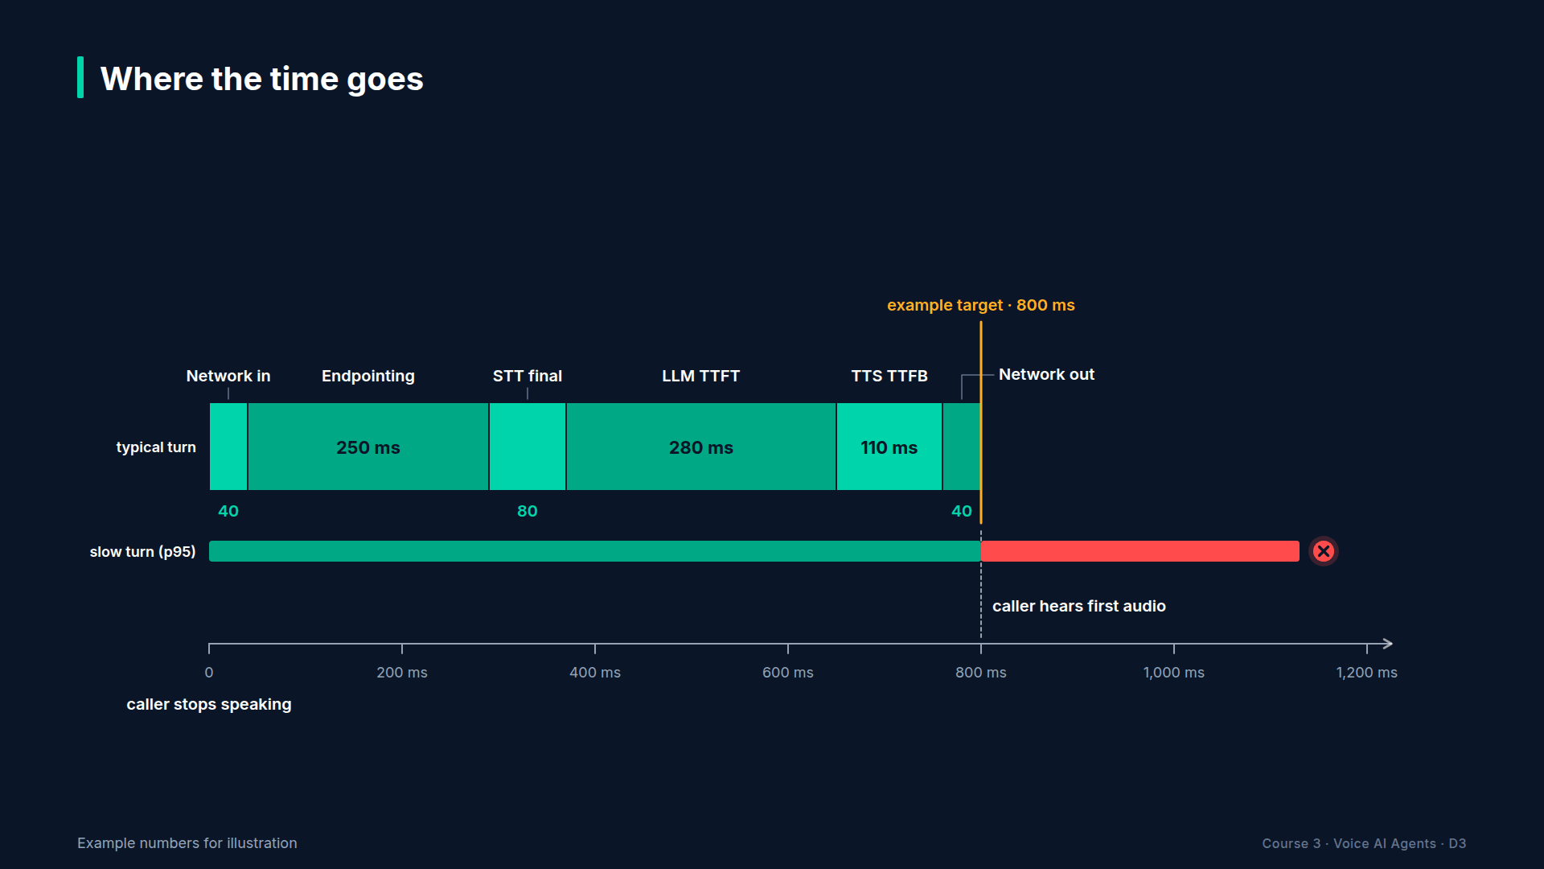
Section 01 · Lecture 1.4 · Where the time goes
Notes:
Now let's split that second into line items. Think of it like a household budget. You have one thousand milliseconds to spend. Each stage in the pipeline takes a slice.

Slide 34
Line item 1: network
Audio from the caller's device to your agent, and back
WebRTC to a nearby region: tens of milliseconds each way
Phone calls add carrier and SIP hops
Production Voice AI Agents · Section 01 · Lecture 1.4
Notes:
Line item one is network. Audio has to travel from the caller to your agent, and the reply has to travel back. Over WebRTC to a nearby data center, that's tens of milliseconds each way. Put your agent on another continent and it's a lot more. Phone calls add carrier hops on top.

Slide 35
Line item 2: endpointing
Deciding the caller has finished their turn
Silence threshold plus the turn-detector model
Usually the biggest single line item
Production Voice AI Agents · Section 01 · Lecture 1.4
Notes:
Line item two is endpointing. This is the decision "the caller is done." Remember the phone number example? Five five five, pause, two zero one. If Riley answered after every short pause, it would talk over people constantly. So we wait a little, and we ask a turn-detection model whether the sentence sounds finished.
Here's the uncomfortable truth. That waiting is usually the biggest line item in the budget. And it's the one you have the most control over. It's a setting, not a model.

Slide 36
Line item 3: STT final
Streaming STT has most of the words before the caller stops
After endpointing, we wait for the final transcript
Usually under about 100 ms with streaming
Production Voice AI Agents · Section 01 · Lecture 1.4
Notes:
Line item three is the STT final transcript. Because STT streams, it already has most of the words while the caller is still speaking. After the turn ends, we just wait for it to confirm the last few words. With a good streaming model, that's typically under a hundred milliseconds.

Slide 37
Line item 4: LLM time-to-first-token
TTFT: time until the model emits its first token
Grows with prompt size and model size
Small, fast models are your friend
Production Voice AI Agents · Section 01 · Lecture 1.4
Notes:
Line item four is LLM time-to-first-token. People shorten this to TTFT. It's how long the model takes to produce its very first word. Not the whole answer. Just the first token.
Bigger models are slower to start. Longer prompts are slower to start. A giant system prompt with forty pages of FAQ pasted in? That costs you on every single turn. This is why Riley uses a small, fast model, and why Section 7 retrieves knowledge on demand instead of stuffing it into the prompt.

Slide 38
Line item 5: TTS time-to-first-byte
TTFB: time until the first chunk of audio is ready
Streaming TTS starts on the first sentence, not the whole reply
Short first sentences start speaking sooner
Production Voice AI Agents · Section 01 · Lecture 1.4
Notes:
Line item five is TTS time-to-first-byte, or TTFB. How long until the voice model hands back the first chunk of audio. Streaming TTS doesn't wait for the full reply. It starts speaking the first sentence while the LLM is still writing the second.
And that gives you a sneaky trick. Short first sentences. "Sure, let me check." Four words. The caller hears something almost immediately.

Slide 39
An example budget under one second
Stage | Example budget
Network in (caller → agent) | 40 ms
Endpointing (turn detection) | 250 ms
STT final transcript | 80 ms
LLM time-to-first-token | 280 ms
TTS time-to-first-byte | 110 ms
Network out (agent → caller) | 40 ms
Total voice-to-voice | 800 ms
Example numbers for illustration. You'll measure your own in Sections 9 and 10.
Production Voice AI Agents · Section 01 · Lecture 1.4
Notes:
Here's a complete example budget. Let's add it up together.
Network in, forty milliseconds. Endpointing, two hundred and fifty. STT final, eighty. LLM time-to-first-token, two hundred and eighty. TTS time-to-first-byte, one hundred and ten. Network out, forty.
Forty plus two fifty is two ninety. Plus eighty is three seventy. Plus two eighty is six fifty. Plus one ten is seven sixty. Plus forty. Eight hundred milliseconds. Under one second, with two hundred to spare.
These are illustrative numbers, not a promise. Your region, your models and your prompt will change every line. But notice where the big items are. Endpointing and the LLM together are more than half the budget. That's where you tune first.

Slide 40
What blows the budget
Tool calls: +300 to +1,500 ms (fix: filler speech, Section 5)
Long prompts and big models: slower TTFT (fix: smaller model, retrieval)
Cautious endpointing: +500 ms per turn (fix: tuning, Section 3)
Far-away regions: +100 to +300 ms (fix: deploy near callers, Section 12)
Averages hide pain: watch p95, not just p50
Production Voice AI Agents · Section 01 · Lecture 1.4
Notes:
Now, what blows the budget? Tool calls are the big one. When Riley checks the calendar, that's an extra network call before it can answer. That could be three hundred milliseconds or a full second and a half. We can't make that disappear. But we can hide it, with a short filler like "One moment while I check the schedule." That's Section 5.
The other budget killers are long prompts, cautious endpointing and servers far from your callers.
And one more warning. Don't trust averages. If your median is seven hundred milliseconds but one call in twenty takes three seconds, that's a lot of confused callers. We'll track the ninety-fifth percentile, p ninety-five, not just the median.

Slide 41
How we'll measure it
LiveKit emits metrics every turn: end_of_utterance_delay, transcription_delay, LLM ttft, TTS ttfb
Section 9: fail a test if p95 exceeds the budget
Section 10: dashboards and alerts
Production Voice AI Agents · Section 01 · Lecture 1.4
Notes:
[SCREEN: Terminal in the course repo. Run the latency report on the sample call metrics that ship with the repo, with the voice-to-voice...]
[DEMO: Output]
Here's a preview of where this goes. This report reads per-turn metrics from a set of sample calls in the repo and checks each line item against a budget. Every stage on its own looks fine. But voice to voice, at the ninety-fifth percentile, is fourteen hundred and seventy-four milliseconds. Six hundred and seventy-four over our target. So what does the command do? It fails, on purpose. That's the check you'll put in your build in Section nine.
Here's the good news. You won't need a stopwatch. LiveKit Agents reports these numbers on every turn: end-of-utterance delay, transcription delay, LLM time-to-first-token and TTS time-to-first-byte. In Section 9, you'll write a test that fails the build if p ninety-five goes over budget. In Section 10, you'll put it on a dashboard.
Grab the latency budget worksheet in the resources folder. Fill in the example column now. You'll fill in your real numbers later, and it's very satisfying to compare.

Slide 42
RECAP
Key takeaways
✓
Clock runs from caller silence to first sound
✓
Five line items; endpointing is usually biggest
✓
Aim for about 800 ms, and watch p95
Production Voice AI Agents · Section 01 · Lecture 1.4

Slide 43
→
Next up:
Course roadmap, repo tour and how to get help
You now know what you're building and the number it has to hit, so next let's tour the…
Production Voice AI Agents · Section 01 · Lecture 1.4

Slide 44
SECTION 1 · WELCOME AND HOW VOICE AGENTS WORK
LECTURE 1.5
Course roadmap, repo tour and how to get help
Describe the course path from first agent to production deployment.
Production Voice AI Agents · Section 01 · Lecture 1.5
Notes:
Title card (K2). Course roadmap, repo tour and how to get help.

Slide 45
The roadmap: Build (1/2)
S1 Welcome and how voice agents work
S2 Setup: accounts, keys, dev environment
S3 Your first voice agent
S4 Prompting for the ear
S5 Tools: booking, rescheduling, cancelling
Production Voice AI Agents · Section 01 · Lecture 1.5
Notes:
The course has three phases. Build, test and operate.
The build phase is Sections one to eight. You'll set up your environment, get Riley talking in about thirty lines, teach it to speak like a receptionist instead of a chatbot, give it tools to book appointments, try the speech-to-speech version, add a knowledge base and specialist agents, and put it on a phone number.

Slide 46
The roadmap: Build (2/2)
S6 Speech-to-speech with OpenAI Realtime
S7 Knowledge and multi-agent handoffs
S8 Telephony: a real phone number
Production Voice AI Agents · Section 01 · Lecture 1.5
Notes:
(continued) The course has three phases. Build, test and operate.
The build phase is Sections one to eight. You'll set up your environment, get Riley talking in about thirty lines, teach it to speak like a recep

Slide 47
The roadmap: Test and Operate (1/2)
S9 Testing and evaluating voice agents (signature section)
S10 Observability, latency and cost
S11 Security, safety and guardrails
S12 Deploying to production
S13 Capstone: Riley, production receptionist
Production Voice AI Agents · Section 01 · Lecture 1.5
Notes:
Then the part most courses skip. Section nine is the heart of this course: behavior tests, tool-call assertions, LLM judges, word error rate, latency budgets and simulated callers. Section ten measures latency and cost. Section eleven defends Riley against prompt injection and social engineering. Section twelve deploys it.
Section thirteen is the capstone, where everything comes together. Section fourteen rebuilds Riley in Pipecat, so you can compare frameworks with real code. And Section fifteen points you to what's next.
[SCREEN: Browser on the course GitHub repo `voice-agents-course`, then switch to VS Code with the repo open. Font size 18, dark theme, fi...]
Now let's look at the code. This is the repo you'll work in for the whole course. You'll clone it in the next section. For now, just get oriented.
[SCREEN: Expand `src/maple/` in the explorer. Hover over each file.]
The first folder is `src/maple`. This is plain Python business logic. No network calls, no API keys. The scheduler that holds the clinic calendar. The prompts. The FAQ retriever. PII redaction. The cost and latency math. Word error rate.
Why keep this separate from the agent? Because you can test it in milliseconds, for free, offline. When something is pure logic, it belongs here. You'll see this pattern pay off in Section five.
[SCREEN: Open `src/maple/config.py` briefly. Highlight the environment variable names.]
One file to know now: `config.py`. Every model name comes from an environment variable with a sensible default. Speech-to-text model, LLM, voice. When a provider renames a model, and they will, you change one line in your `.env` file. Not your code.
[SCREEN: Expand `agents/`.]
Next, the `agents` folder. One file per section, numbered by section. `s03_hello_agent.py` is your first agent. `s05_booking_agent.py` adds tools. `s08_telephony_agent.py` goes on the phone. `s13_capstone_receptionist.py` is the finished Riley you heard in lecture one.
Each file is runnable on its own. If you fall behind, or something breaks, you can always open the file for the section you're on and compare.
[SCREEN: Expand `tests/`: `unit/`, `agent/`, `evals/`, `data/`.]
Then `tests`. Three layers. `unit` runs offline with no keys, and it should always be green. `agent` holds behavior tests that talk to a real LLM, so they skip automatically if you don't have an OpenAI key. And `evals` holds the heavier evaluations: conversation quality, word error rate, latency reports and simulated callers.
[SCREEN: Terminal in the repo folder. Run `make test`. Let the dots scroll, then zoom on the final "passed" line and its time.]
Want proof that the first layer is free? Watch. Make test runs every unit test, a couple of hundred of them, in about a second, with no keys and no network. You'll see that green line more than anything else in this course.
[SCREEN: Show `deploy/`, `pipecat/`, `frontend/README.md`, `.github/workflows/ci.yml`.]
The rest you'll meet later. `deploy` has the Dockerfile. `pipecat` has the comparison build. `frontend` explains how to put a web page in front of Riley. And the CI workflow runs your tests on every push.
[SCREEN: Terminal. Run `make help`, then open `Makefile` beside it.]
[CODE: `make help` output (excerpt: seven of the twenty targets)]
Last stop, the Makefile. `make help` lists every shortcut with a one-line description. These seven are the ones to know first, and `make install`, `make test`, `make console` and `make dev` are the ones you'll use every day. Under the hood they're ordinary `uv run` commands, and I'll always show you the full command the first time.
[SCREEN: Open `README.md`, scroll to the "Lecture → file map" table.]
And if you ever wonder "which file goes with this lecture?", the README has a lecture-to-file map.
Now, how to get help. Voice agents have a lot of moving parts, so you will get stuck at some point. That's normal. Here's how to get unstuck fast.

Slide 48
The roadmap: Test and Operate (2/2)
S14 Pipecat and choosing your stack
S15 Wrap-up and next steps
Production Voice AI Agents · Section 01 · Lecture 1.5
Notes:
(continued) Then the part most courses skip. Section nine is the heart of this course: behavior tests, tool-call assertions, LLM judges, word error rate, latency budgets and simulated callers. Section ten measure

Slide 49
How to ask a question that gets answered
Lecture number, for example "3.3"
The exact command you ran
The full error text, not a screenshot of half of it
Your OS, Python version and livekit-agents version (uv pip show livekit-agents)
What you already tried
Production Voice AI Agents · Section 01 · Lecture 1.5
Notes:
When you post in Q&A, include five things. The lecture number. The exact command. The full error text. Your operating system, Python version and livekit-agents version. And what you already tried. A question like that usually gets answered in one reply instead of five.
And please, never paste your API keys. If you see a key in a screenshot, rotate it.

Slide 50
How to use labs, projects and quizzes
Labs: short, guided, checklist style. Do them right after the lecture.
Projects: open-ended. Build, record a demo, share it.
Quizzes: check understanding before moving on.
Production Voice AI Agents · Section 01 · Lecture 1.5
Notes:
Finally, the practice. Labs are short and guided, and they come right after the lectures they practice. Projects are bigger and open-ended. Quizzes check the ideas before you build on them. Do the labs. The students who finish this course are the ones who ran the code, not just watched it.

Slide 51
RECAP
Key takeaways
✓
Fifteen sections: build, test, operate
✓
Repo layers: src/maple, agents, tests
✓
Good questions: lecture, command, full error, versions
Production Voice AI Agents · Section 01 · Lecture 1.5

Slide 52
SECTION COMPLETE
You can now
✓
Name the seven parts of a voice pipeline
✓
Choose cascaded, speech-to-speech or half-cascade
✓
Read a latency budget and find the biggest lever
Production Voice AI Agents · Section 01 · Lecture 1.5

Slide 53
→
Next up:
Quiz: Voice agent fundamentals
Before we set anything up, a quick quiz to lock in how voice agents work.
Production Voice AI Agents · Section 01 · Lecture 1.5

Slide 54
SECTION 1 · WELCOME AND HOW VOICE AGENTS WORK
LECTURE 1.6
Quiz: Voice agent fundamentals
Check understanding of pipeline components, architectures and the latency budget.
Production Voice AI Agents · Section 01 · Lecture 1.6
Notes:
Title card (K2). Quiz: Voice agent fundamentals.

Slide 55
Section 1 quiz: what's covered
The seven components of a voice pipeline
VAD vs turn detection
Cascaded vs speech-to-speech vs half-cascade
The five latency line items and the 800 ms target
Production Voice AI Agents · Section 01 · Lecture 1.6
Notes:
You'll see questions on the seven pipeline components, the difference between VAD and turn detection, the three architectures, and the latency budget.
Here's a tip for the latency questions. When a question asks where to tune first, think about which line items were biggest in our example budget. Endpointing and the LLM.
Every question has an explanation. If you miss one, read the explanation before you move on, and rewatch the lecture it points to. Section 3 builds directly on these ideas, especially turn detection.
No pressure. Nobody sees your score. It's there to help you, not to grade you.

Slide 56
→
Next up:
Accounts you need and what they cost
Next up, Section 2: you'll create your accounts, get your keys and set up your development environment.
Production Voice AI Agents · Section 01 · Lecture 1.6

