Slide 1
SECTION 3 · YOUR FIRST VOICE AGENT WITH LIVEKIT AGENTS
LECTURE 3.1
LiveKit mental model: rooms, participants, tracks, dispatch
Explain rooms, participants and tracks, and why the agent is "just another participant".
Production Voice AI Agents · Section 03 · Lecture 3.1
Notes:
Title card (K2). LiveKit mental model: rooms, participants, tracks, dispatch.

Slide 2
Four words to know
Room: a live session, like a meeting
Participant: anyone in the room, human or agent
Track: a stream of audio or video a participant publishes
Dispatch: how an agent gets sent into a room
Production Voice AI Agents · Section 03 · Lecture 3.1
Notes:
Four words. Room, participant, track and dispatch. If you understand these four, you understand LiveKit.

Slide 3
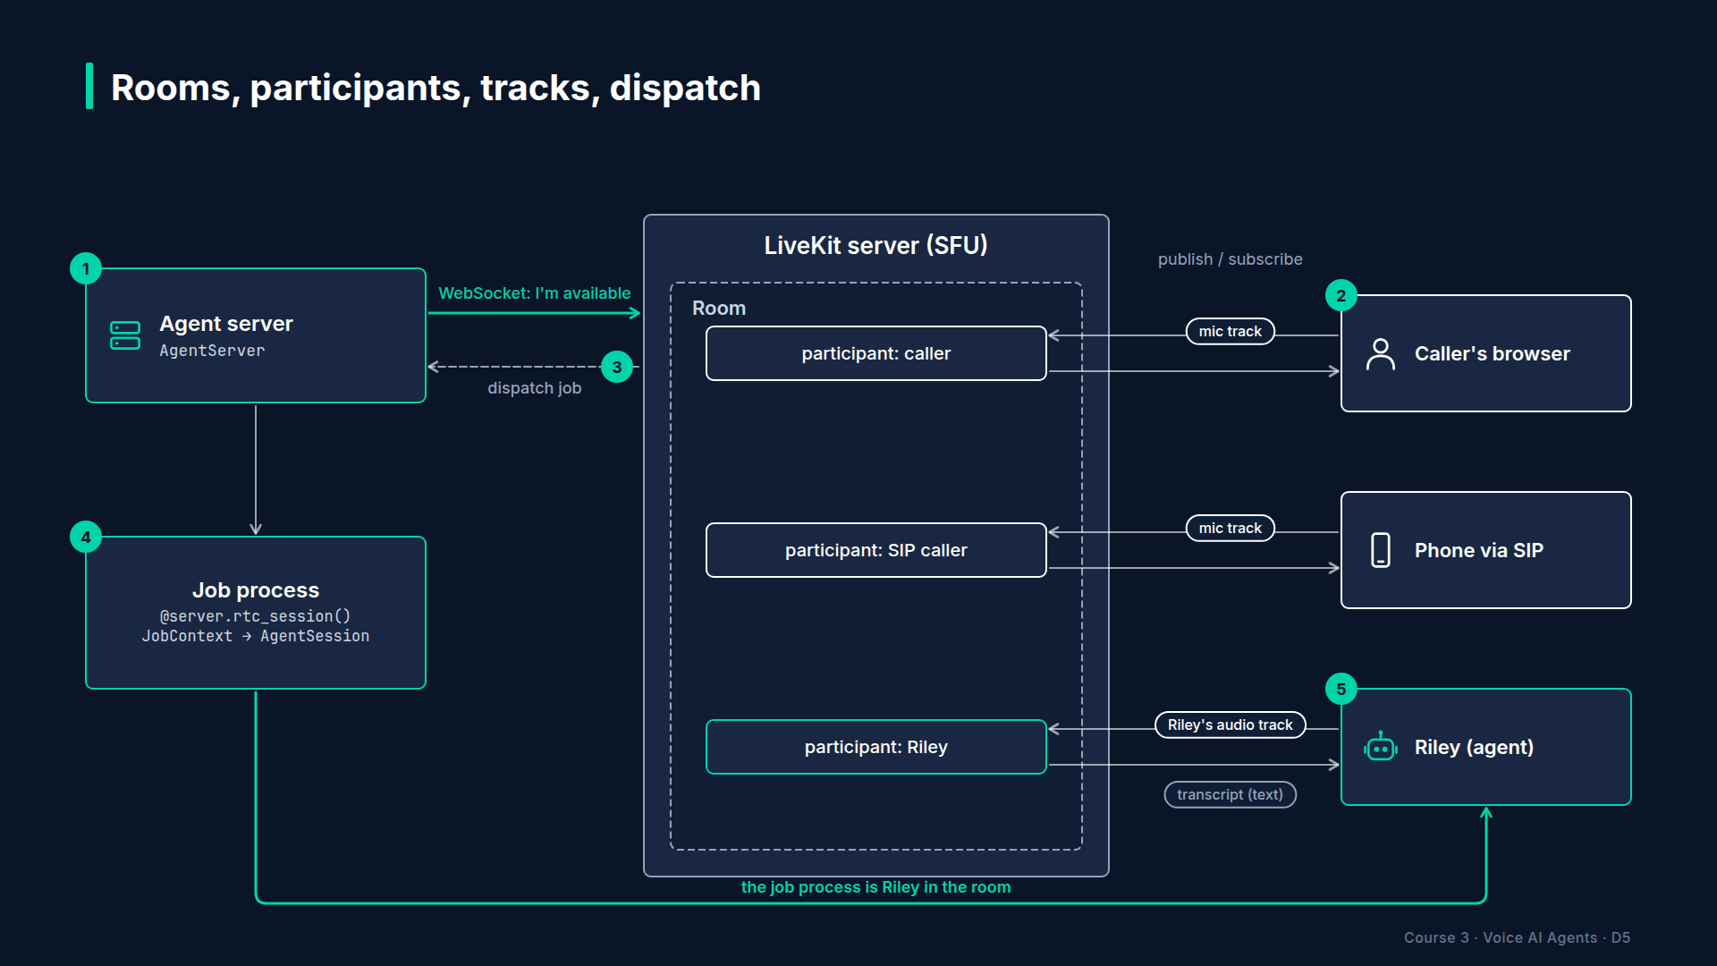
Section 03 · Lecture 3.1 · The SFU in the middle
Notes:
At the center is the LiveKit server. It's an SFU, a selective forwarding unit. That's a fancy name for a smart router for media. Every participant sends their audio to the SFU once. The SFU forwards it to whoever needs it.
Why does that matter to you? Because your agent never talks directly to the caller's device. Both of them talk to the SFU. So the caller can be on Chrome, an iPhone app or a landline, and your agent code doesn't change.

Slide 4
Rooms
A room is created when the first participant joins (or via the API)
Each call to Riley is one room
Room closes when everyone leaves
Production Voice AI Agents · Section 03 · Lecture 3.1
Notes:
A room is one live session. For Riley, one phone call is one room. When the caller hangs up and everyone leaves, the room closes. You saw this in Lecture 2.3, when `lk room list` came back empty. No calls, no rooms.

Slide 5
Participants
Caller: a human participant (browser, app, or phone via SIP)
Riley: an agent participant
Later: a human receptionist joins for transfers (Section 8)
Production Voice AI Agents · Section 03 · Lecture 3.1
Notes:
A participant is anyone in the room. The caller is a participant. Riley is a participant too. And in Section eight, when Riley transfers a call, a human receptionist is just one more participant.
That's the big insight. The agent is not special plumbing. It's a participant with a Python brain.

Slide 6
Tracks
Participants publish tracks: microphone audio, camera video, screen
Other participants subscribe to tracks
Riley subscribes to the caller's audio track and publishes its own audio track
Transcripts travel alongside as text
Production Voice AI Agents · Section 03 · Lecture 3.1
Notes:
Participants publish tracks. A track is a single stream, like microphone audio. Other participants subscribe to the tracks they care about.
So Riley subscribes to the caller's microphone track. That's what it listens to. And Riley publishes its own audio track. That's what the caller hears. Transcripts travel alongside as text, which is how the playground shows live captions. You'll see that in Lecture 3.4.

Slide 7
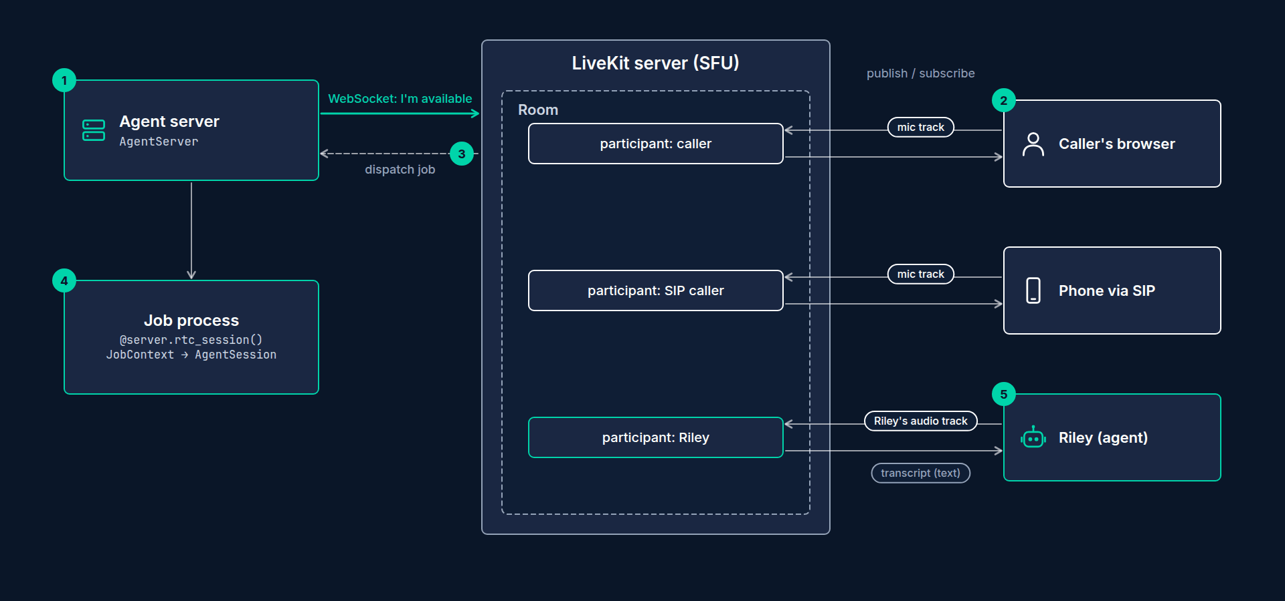
How the agent gets into the room
Agent server starts and opens a WebSocket to LiveKit Cloud: "I'm available."
Caller joins a new room.
LiveKit dispatches a job to an available agent server.
Agent server starts a job process and calls your entrypoint with a JobContext.
Your code starts an AgentSession in that room. Riley speaks.
Production Voice AI Agents · Section 03 · Lecture 3.1
Notes:
Now the fourth word, dispatch. This is where your code comes in.
Step one. You start your agent server. It opens a connection to LiveKit Cloud and says, "I'm available for work." Notice the direction. Your server connects out. You don't need to open any ports or set up a public URL. That makes local development and deployment much simpler.
Step two. A caller joins a new room.
Step three. LiveKit picks an available agent server and sends it a job. A job means "please put an agent in this room."
Step four. The agent server starts a fresh process for that job and calls your entrypoint function. It hands you a job context, which includes the room.
Step five. Your code starts a session in that room, and Riley starts talking.

Slide 8
One server, many calls
Each job runs in its own process
One slow or crashed call doesn't take down the others
Scale out by running more agent servers (Section 12)
Production Voice AI Agents · Section 03 · Lecture 3.1
Notes:
One agent server can handle many calls at once. Each job runs in its own process, so if one call crashes, the others keep going. And when you need more capacity, you run more agent servers. LiveKit spreads the jobs across them. We'll tune all of this in Section twelve.

Slide 9
When the call ends
Caller hangs up → their participant leaves the room
The session closes; your shutdown callbacks run (log the outcome, save metrics)
The job process ends; the room closes when empty
Your agent server keeps running, ready for the next job
Production Voice AI Agents · Section 03 · Lecture 3.1
Notes:
What about the end of a call? The caller hangs up, so their participant leaves the room. Riley's session notices and closes. Any shutdown callbacks you registered run, which is where you'll log how the call went in Section five, and export metrics in Section ten. Then the job's process ends, and the empty room closes.
Your agent server doesn't stop. It's still registered, still saying "I'm available," waiting for the next job. That separation, one long-lived server and many short-lived jobs, is what lets you deploy an update without dropping live calls. We'll use that in Section twelve.

Slide 10
Automatic vs explicit dispatch
Automatic: no agent name, joins every new room (great for development)
Explicit: named agent, dispatched only when asked (telephony, production, multiple agents)
Name comes from LIVEKIT_AGENT_NAME or livekit.toml
Production Voice AI Agents · Section 03 · Lecture 3.1
Notes:
There are two dispatch styles. With automatic dispatch, your agent joins every new room in the project. That's perfect while you're developing, and it's what we'll use in this section.
With explicit dispatch, you give the agent a name, and it only joins when something asks for it by name. You'll need that for phone numbers in Section eight, and whenever one project runs more than one kind of agent.
[SCREEN: VS Code, `03-code/.env.example`. Highlight the commented-out `# LIVEKIT_AGENT_NAME=riley-receptionist` line and the comment abov...]
In the repo, the name is one commented-out line in the settings template. The comment says it all: leave it unset for Sections three to seven, so the playground can reach your agent, and switch it on in Section eight.

Slide 11
How this maps to code
AgentServer: the process that registers with LiveKit
@server.rtc_session(): "call this for every new job"
JobContext: the job, including ctx.room
cli.run_app(server): adds the console, dev, start and download-files commands
python
from livekit.agents import AgentServer, JobContext, cli
server = AgentServer()
@server.rtc_session()
async def entrypoint(ctx: JobContext) -> None:
# ctx.room is the room you were dispatched into
...
if __name__ == "__main__":
cli.run_app(server)
Production Voice AI Agents · Section 03 · Lecture 3.1
Notes:
Here's how the picture maps to code. You'll type this in two lectures.
`AgentServer` is the thing that registers with LiveKit. The `rtc_session` decorator marks your entrypoint. It says, "every time a job arrives, call this function." The function receives a `JobContext`, and `ctx.room` is the room you were dispatched into. And `cli.run_app` gives the file its commands: console, dev, start and download-files.
[SCREEN: VS Code, `03-code/agents/s03_hello_agent.py`. Highlight `server = AgentServer()`, then `@server.rtc_session()` above `async def...]
Here's the same shape in the reference file you'll compare against all through this section. Server, entrypoint, run app. Every agent in this course starts exactly like this.
[SCREEN: Terminal in the repo folder. Ask the file for help and zoom on the Commands box.]
[DEMO: Output (excerpt: the Commands box)]
And here's what `cli.run_app` gave the file. Console, start, dev, connect and download-files. You've already used two of them. So which ones register with LiveKit Cloud and wait for jobs? Dev, and start in production. Console runs the whole job on your laptop instead.
So when you hear "the agent joins the room," picture it literally. A new participant walks into a meeting, subscribes to the caller's microphone, and starts publishing its own voice. Everything else in this course, including phones, handoffs and transfers, is a variation on that picture.

Slide 12
RECAP
Key takeaways
✓
A call is a room; Riley is a participant
✓
Participants publish and subscribe to tracks
✓
Servers register; LiveKit dispatches jobs to them
Production Voice AI Agents · Section 03 · Lecture 3.1

Slide 13
→
Next up:
AgentSession and Agent: the two core classes
Next, let's meet the two classes you'll use inside that entrypoint: AgentSession and Agent.
Production Voice AI Agents · Section 03 · Lecture 3.1

Slide 14
SECTION 3 · YOUR FIRST VOICE AGENT WITH LIVEKIT AGENTS
LECTURE 3.2
AgentSession and Agent: the two core classes
Explain what belongs on Agent (instructions, tools, per-agent overrides, lifecycle hooks) versus AgentSession (models, turn handling, userdata, events).
Production Voice AI Agents · Section 03 · Lecture 3.2
Notes:
Title card (K2). AgentSession and Agent: the two core classes.

Slide 15
Session = the line. Agent = who's talking.
AgentSession: the runtime for one call: audio in and out, models, turn-taking, state
Agent: a role: instructions, tools, behavior
One session can switch between agents (handoffs, Section 7)
Production Voice AI Agents · Section 03 · Lecture 3.2
Notes:
Picture Maple Street Dental's front desk phone. The phone line, the headset, the call timer and the notepad, that's the session. The person answering, with their job description and the tools on their desk, that's the agent.
Why split them? Because in Section seven, Riley hands a caller from a greeter to a booking specialist to billing. The phone line stays connected. Only the person on the line changes. Same session, different agent.

Slide 16
Agent: the role
instructions: the system prompt
tools: what this agent can do (or @function_tool methods, Section 5)
Optional per-agent overrides: stt, llm, tts, turn_handling
Lifecycle hooks: on_enter, on_exit, on_user_turn_completed
python
from livekit.agents import Agent
class Riley(Agent):
def __init__(self) -> None:
super().__init__(
instructions="You are Riley, the receptionist for Maple Street Dental...",
)
Production Voice AI Agents · Section 03 · Lecture 3.2
Notes:
Let's start with `Agent`. You create one by subclassing it. The one required argument is `instructions`, which is the system prompt.
An agent also owns its tools. In Section five, you'll add tools by decorating methods on this class. And an agent can override the session's models. For example, a billing specialist could use a bigger LLM, while the greeter uses a fast small one.
Finally, agents have lifecycle hooks. `on_enter` runs when the agent takes over the call. That's where Riley will greet the caller in Section four. `on_user_turn_completed` runs after each thing the caller says, which is handy for looking up knowledge in Section seven.

Slide 17
AgentSession: the runtime
stt, llm, tts: the three models of the cascade
vad: voice activity detection
turn_handling: turn detection, endpointing, interruptions
userdata: your own per-call state
Also: max_tool_steps, user_away_timeout, preemptive_generation
python
from livekit.agents import AgentSession, TurnHandlingOptions, inference
from livekit.plugins import silero
session = AgentSession(
stt="deepgram/nova-3",
llm="openai/gpt-4.1-mini",
tts="cartesia/sonic-3",
vad=silero.VAD.load(),
turn_handling=TurnHandlingOptions(
turn_detection=inference.TurnDetector(),
),
userdata=CallState(), # Section 5
)
Production Voice AI Agents · Section 03 · Lecture 3.2
Notes:
Now the session. This is where the models live. Speech-to-text, the LLM and text-to-speech. Here they're LiveKit Inference strings, the ones you met in Section two.
Then VAD. Silero, loaded once.
Then `turn_handling`. This groups every setting about who speaks when. The turn detector, how long to wait at the end of a turn, and how interruptions work. It gets its own lecture, 3.6.
Then `userdata`. That's a slot for your own data about this call. Caller name, phone number, the appointment being booked. Section five fills it in.
There are a few more settings you'll meet later. `max_tool_steps` limits how many tool calls the LLM can chain in one turn. `user_away_timeout` decides when a quiet caller counts as "away." And preemptive generation lets the LLM start early, which we'll talk about in 3.6.

Slide 18
Starting the session
Connects to the room and subscribes to the caller's audio
Publishes Riley's audio track and transcripts
Hands control to the agent
generate_reply: ask the LLM to speak now
python
await session.start(agent=Riley(), room=ctx.room)
await session.generate_reply(instructions="Greet the caller.")
Production Voice AI Agents · Section 03 · Lecture 3.2
Notes:
Once you have both, you connect them. `session.start` takes the agent and the room from the job context. That one line joins the room, subscribes to the caller's microphone, publishes Riley's voice, and puts Riley in charge.
The session doesn't talk first by default. It waits for the caller. So we'll ask it to speak with `generate_reply`, and give it a one-line instruction: greet the caller.

Slide 19
Two ways to speak
session.generate_reply(instructions=...): the LLM writes the words. Flexible, adds LLM latency.
session.say("..."): exact words, straight to TTS. Fast and predictable.
Production Voice AI Agents · Section 03 · Lecture 3.2
Notes:
Speaking of speaking, there are two ways to make Riley talk. `generate_reply` asks the LLM to write something, guided by an instruction. It's flexible, but it costs an LLM round trip.
`session.say` sends exact words straight to text-to-speech. It's faster and it never goes off script. That's perfect for fixed lines like a legal disclosure or a greeting. You'll use both.

Slide 20
The session tells you what's happening
Events are how you observe a live call without changing it
Handlers are plain functions; start async work with asyncio.create_task
python
@session.on("user_input_transcribed") # live speech-to-text, partial and final
@session.on("conversation_item_added") # a user or agent message was committed
@session.on("agent_state_changed") # initializing, listening, thinking, speaking
@session.on("user_state_changed") # speaking, listening, away (Section 4)
@session.on("metrics_collected") # latency and usage numbers (Sections 9 and 10)
Production Voice AI Agents · Section 03 · Lecture 3.2
Notes:
The session also tells you what's happening, through events. You subscribe with `session.on` and an event name.
User input transcribed fires as the speech-to-text hears words. Conversation item added fires when a message is committed to the history. Agent state changed tells you whether Riley is listening, thinking or speaking. User state changed tells you whether the caller is speaking, listening, or away, and you'll use that in Section four to handle silence. And metrics collected delivers latency and usage numbers after each step. That one powers Sections nine and ten.
You don't need any of these for a first agent. But when you're debugging, "what state was Riley in when the caller interrupted?" is exactly the question these events answer.

Slide 21
The agent's states, in order
initializing → listening → thinking → speaking → listening ...
"thinking" is the gap the caller hears as silence
Long "thinking" usually means a slow LLM or a slow tool
Production Voice AI Agents · Section 03 · Lecture 3.2
Notes:
Here's the loop of agent states you'll see in logs. Initializing, then listening. When the caller finishes, thinking. When audio starts, speaking. Then back to listening.
Thinking is the state the caller experiences as silence. So when someone says "Riley feels slow," the first question is: how long was it in thinking, and why? A slow LLM, or a slow tool. Section five shows how to cover a slow tool with a short filler phrase.

Slide 22
Where does a setting go?
Setting | Put it on
System prompt | Agent
Tools | Agent
Default models | AgentSession
A different model for one specialist | Agent (override)
Turn-taking defaults | AgentSession
Caller details for this call | AgentSession userdata
Greeting | Agent on_enter (Section 4)
Production Voice AI Agents · Section 03 · Lecture 3.2
Notes:
Here's a cheat sheet. Instructions and tools go on the agent. Default models and turn-taking go on the session. Per-call data goes in the session's userdata. And if one specialist needs something different, override it on that agent.
[SCREEN: VS Code, `03-code/agents/s03_hello_agent.py`. Highlight `class HelloRiley(Agent)` and its `instructions` line, then scroll to th...]
Here's the rule in a real file. The agent class holds the instructions, and nothing else yet. The session, built inside the entrypoint, holds the models, the VAD and the turn handling. You'll type your own version of this in the next lecture.
When a setting "doesn't work," the first question is always: did I put it on the session or the agent? Because agent settings override session settings. And that's usually the answer.

Slide 23
RECAP
Key takeaways
✓
Session: the line, with models, turn-taking, state
✓
Agent: the role, with instructions, tools, hooks
✓
Agent settings override session settings
Production Voice AI Agents · Section 03 · Lecture 3.2

Slide 24
→
Next up:
Code-along: hello Riley in 30 lines
Enough slides, let's write the code and hear Riley say hello in about thirty lines.
Production Voice AI Agents · Section 03 · Lecture 3.2

Slide 25
SECTION 3 · YOUR FIRST VOICE AGENT WITH LIVEKIT AGENTS
LECTURE 3.3
Code-along: hello Riley in 30 lines
Build a working cascaded voice agent from an empty file with AgentServer, @server.rtc_session(), AgentSession and Agent.
Production Voice AI Agents · Section 03 · Lecture 3.3
Notes:
Title card (K2). Code-along: hello Riley in 30 lines.

Slide 26
What each line does
Line | Job
AgentServer() | Registers with LiveKit, receives jobs
@server.rtc_session() | "Run this for every new call"
AgentSession(...) | The runtime: STT, LLM, TTS, VAD, turn handling
HelloRiley(Agent) | The role: instructions (tools later)
session.start(...) | Join the room, subscribe, publish, hand control to the agent
generate_reply(...) | Speak first
cli.run_app(server) | console, dev, start, connect, download-files
Production Voice AI Agents · Section 03 · Lecture 3.3
Notes:
Here's every line and its job on one slide. If any of these feel fuzzy, rewatch Lecture 3.2. Everything else in this course builds on this file.
One more thing. Right now the model names are hard-coded. That's fine for a first agent, but it means changing a voice means changing code. In Lecture 3.5, we'll move them into configuration.

Slide 27
RECAP
Key takeaways
✓
AgentServer plus an @server.rtc_session() entrypoint
✓
AgentSession: STT, LLM, TTS, VAD, turn detection
✓
Agent: instructions now, tools later
Production Voice AI Agents · Section 03 · Lecture 3.3

Slide 28
→
Next up:
Dev mode and the Agents Playground
Console mode works on your laptop, so next let's run Riley in dev mode and call it from…
Production Voice AI Agents · Section 03 · Lecture 3.3

Slide 29
SECTION 3 · YOUR FIRST VOICE AGENT WITH LIVEKIT AGENTS
LECTURE 3.4
Dev mode and the Agents Playground
Run the agent server in dev mode and explain how it differs from console.
Production Voice AI Agents · Section 03 · Lecture 3.4
Notes:
Title card (K2). Dev mode and the Agents Playground.

Slide 30
console vs dev vs start
console: local mic and speakers, no room, fastest feedback
dev: registers with LiveKit Cloud, joins real rooms, hot reload, debug logs
start: production mode, no reload (Section 12)
Production Voice AI Agents · Section 03 · Lecture 3.4
Notes:
Quick comparison. Console runs a simulated session with your mic and speakers, and no room. Dev registers your agent server with LiveKit Cloud, so it gets dispatched into real rooms, like the ones a browser or phone would create. It also reloads when you save a file. Start is the production version, which we'll use in Section twelve.
[SCREEN: Terminal in the repo folder.]
[CODE: run the agent server in dev mode]
[DEMO: Logs show the server starting, then a "registered" line with a worker ID and region.]
Look for the registered line. That means your agent server connected out to LiveKit Cloud and said "I'm available." Remember, you didn't open any ports. It dialed out.
It's also waiting. No room, no job. So let's make a room.
[SCREEN: Browser, open https://agents-playground.livekit.io. Choose to connect to your LiveKit Cloud project and sign in. Click "Connect".]
This is the LiveKit Agents Playground. It's a web page that creates a room in your project and joins it as a caller, with your browser's microphone. Connect it to your LiveKit Cloud project, and click connect.
[DEMO: Browser asks for mic permission. Allow. Within a second or two, the agent joins and Riley greets you. Transcript panel fills in li...]
The browser asks for the microphone. Allow it. And a moment later, Riley joins and greets me.
So where did Riley come from? Look at the terminal. You'll see a new job appear. LiveKit dispatched it to my laptop, my server started a process, and the entrypoint ran. Exactly the five steps from Lecture 3.1.
[DEMO: Ask: "Hi Riley, do you do teeth whitening?" Riley answers briefly. Point at the transcript panel.]
Now look at the playground's transcript panel. My words appear as I speak them. That's the live speech-to-text. Then Riley's reply appears, synced with the audio. This is the fastest way to spot a mishearing. If Riley's answer seems odd, check what it actually heard.
[SCREEN: New terminal tab.]
[CODE: see the live room]
[DEMO: One room listed, with two participants.]
And in a second terminal, lk room list. This time there's a room, with two participants. Me, and Riley.
[SCREEN: VS Code, `agents/my_hello_agent.py`. Change the greeting instruction to "Greet the caller as Riley from Maple Street Dental, men...]
Now, hot reload. I'll change the greeting instruction to mention that we're open on Saturday mornings. And save.
[DEMO: Terminal shows the server reloading.]
The server reloaded. But did the call that's already running change? No. It keeps the old code, because hot reload applies to new jobs. So I'll disconnect in the playground and connect again.
[DEMO: Disconnect, reconnect. Riley greets with the new Saturday line.]
New room, new job, new greeting. That's your edit loop for the rest of the course. Edit, save, reconnect.

Slide 31
Your development loop
dev running in one terminal
Playground (or console) as the caller
Edit and save → server reloads
Reconnect to get a fresh job
Read transcripts and logs
Production Voice AI Agents · Section 03 · Lecture 3.4
Notes:
Two more tips. First, keep only one dev server running. If you have two terminals both running dev, both register, and you can't predict which one gets your call. That one confuses everybody at least once.
Second, you're not limited to the playground. In Section twelve, you'll put a real web front end in front of Riley using LiveKit's React starter. And in Section eight, a phone number. The agent code won't change. Only the caller does.

Slide 32
RECAP
Key takeaways
✓
dev registers your laptop with LiveKit Cloud
✓
The playground joins as caller, with live transcripts
✓
Hot reload changes new calls, not live ones
Production Voice AI Agents · Section 03 · Lecture 3.4

Slide 33
→
Next up:
Choosing STT, LLM and TTS providers
Riley works, so now let's look at the three models inside it and how to choose them.
Production Voice AI Agents · Section 03 · Lecture 3.4

Slide 34
SECTION 3 · YOUR FIRST VOICE AGENT WITH LIVEKIT AGENTS
LECTURE 3.5
Choosing STT, LLM and TTS providers
Compare STT, LLM and TTS providers on accuracy, latency, price, voices and languages.
Production Voice AI Agents · Section 03 · Lecture 3.5
Notes:
Title card (K2). Choosing STT, LLM and TTS providers.

Slide 35
Five questions for every model
Accuracy: does it get your words right? (names, numbers, domain terms)
Latency: time-to-first-token or time-to-first-byte, at p95
Price: per minute, per token or per character
Voice and language coverage
Data handling: retention, region, compliance
Production Voice AI Agents · Section 03 · Lecture 3.5
Notes:
Ask five questions of every model. Accuracy on your words, not a benchmark's. Latency, and specifically the slow tail. Price. Voice and language coverage. And data handling, meaning where audio goes and how long it's kept. For a dental clinic, that last one matters.

Slide 36
STT: speech-to-text
What matters | Why
Streaming with fast finals | Feeds the endpointing and STT-final line items
Keyterm or keyword boosting | "Invisalign", "Doctor Alvarez", "Delta Dental"
Phone-audio accuracy | 8 kHz calls in Section 8
Default | deepgram/nova-3
Alternatives | AssemblyAI Universal-Streaming, others via LiveKit Inference
Production Voice AI Agents · Section 03 · Lecture 3.5
Notes:
For speech-to-text, you want streaming with fast final transcripts, because that feeds the latency budget. You want keyterm boosting, so it hears "Invisalign" and not "invisible line." And you want good accuracy on phone audio, which we'll test in Section eight.
Our default is Deepgram Nova-3. The repo also lists AssemblyAI's streaming model as a fallback. In Section nine, you'll measure word error rate on Maple Street's own vocabulary and decide with data.

Slide 37
LLM
What matters | Why
Time-to-first-token | Largest line item after endpointing
Reliable tool calling | Booking must be exact
Instruction following | Short answers, one question at a time
Default | openai/gpt-4.1-mini
Fallback in config | google/gemini-2.5-flash
Production Voice AI Agents · Section 03 · Lecture 3.5
Notes:
For the LLM, bigger is not better on the phone. You want fast time-to-first-token, reliable tool calls and good instruction following. A small, fast model that follows "one or two sentences" beats a giant model that writes an essay.
Our default is GPT four point one mini. The config also names a fallback from a different provider, so an outage at one vendor doesn't take Riley down. We'll wire up fallbacks in Section thirteen.

Slide 38
TTS: text-to-speech
What matters | Why
Time-to-first-byte | Caller hears something sooner
Naturalness and pacing | Trust and comprehension
Voice library and cloning policy | Brand fit (Section 4)
Pronunciation control | Names and numbers
Default | cartesia/sonic-3
Alternatives | Deepgram Aura-2, ElevenLabs, others
Production Voice AI Agents · Section 03 · Lecture 3.5
Notes:
For text-to-speech, time-to-first-byte comes first, then naturalness. Then voice choice, because the voice is your brand. And pronunciation control, for names and numbers.
Our default is Cartesia Sonic-3, chosen for fast first audio. Deepgram Aura-2 and ElevenLabs are common alternatives. Pick by listening. Record the same three sentences with each voice and play them to someone who isn't you.

Slide 39
Prices change: compare structure, not numbers
STT: billed per audio minute
LLM: billed per input and output token (short replies keep this small)
TTS: billed per character, often the largest slice of a cascaded call
Check current pricing; the repo's price table is a placeholder
Production Voice AI Agents · Section 03 · Lecture 3.5
Notes:
I'm not putting prices on this slide on purpose. They change too often. What stays stable is the structure. STT bills per minute of audio. LLMs bill per token. TTS bills per character, and it's often the largest slice of a cascaded call. So short replies save money twice: fewer output tokens and fewer characters to speak.

Slide 40
Two ways to plug a model in
python
# LiveKit Inference: a string, billed through LiveKit Cloud
stt="deepgram/nova-3"
tts="cartesia/sonic-3:f786b574-daa5-4673-aa0c-cbe3e8534c02" # model:voice
# Direct plugins: your own provider keys, every provider option
from livekit.plugins import cartesia, deepgram, openai
stt=deepgram.STT(model="nova-3", keyterm=["Invisalign", "Delta Dental"])
llm=openai.LLM(model="gpt-4.1-mini")
tts=cartesia.TTS(model="sonic-3", voice="f786b574-daa5-4673-aa0c-cbe3e8534c02")
Production Voice AI Agents · Section 03 · Lecture 3.5
Notes:
Two ways to plug in a model, which you met in Section two. Model strings through LiveKit Inference. One account, one bill. Note the colon trick for voices. "Cartesia slash sonic three colon" and then a voice ID picks the voice.
Or direct plugins, with your own keys. You get every provider option, and you pay the provider directly.
When should you switch to plugins? When you need an option LiveKit Inference doesn't expose, when you have negotiated pricing with a provider, or when compliance says audio must go straight to a specific vendor.
[SCREEN: VS Code, `src/maple/config.py`. Scroll through `Settings` fields and `load_settings()`.]
Now let's see how the repo makes swapping painless. Open `src/maple/config.py`. The Settings dataclass holds every model choice: STT model, LLM model, TTS model and voice, realtime model, and provider mode. `load_settings` reads each one from the environment, with the course defaults as fallbacks. It's pure Python, and it has its own unit tests.
[SCREEN: Scroll to `tts_model_with_voice` and `split_model`.]
Two helpers worth knowing. `tts_model_with_voice` glues the voice ID onto the TTS string, using that colon format. And `split_model` turns "openai slash gpt four point one mini" into the provider and the model name, which the plugin path needs.
[SCREEN: Terminal. Run the config unit tests.]
[DEMO: The config tests pass in well under a second.]
And because this is pure Python, it's tested like pure Python. Defaults, overrides from the environment, blank values, bad values, the colon format and `split_model`. All green in a fraction of a second, with no keys. So when a model swap misbehaves, you can rule out the config layer in one command.
[SCREEN: VS Code, `agents/my_hello_agent.py`. Replace the three hard-coded strings with settings.]
[CODE: refactor the session in `my_hello_agent.py` to read from config]
Now let's use it. In our hello agent, import get settings from common, load the settings inside the entrypoint, and replace the three hard-coded strings. Speech-to-text, the LLM, and the TTS model with its voice. This is exactly how the reference file, `s03_hello_agent.py`, does it.
[SCREEN: VS Code, `agents/common.py`. Scroll to `build_stt`, `build_llm`, `build_tts`, then `create_session`.]
From Section four onward, the agents go one step further. `agents/common.py` has three builders: build STT, build LLM and build TTS. Each one checks the provider mode. In inference mode, it returns a model string, or, for Deepgram, an inference STT with a list of dental keyterms attached, so it hears "Invisalign" and "Delta Dental." In plugins mode, it builds the provider plugin with your own key.
And `create_session` wraps all of it: models, VAD, turn handling and call state, in one call. You'll use it from Section four on, so every agent is configured the same way.

Slide 41
Swapping is now a one-line change in .env
bash
# try a different voice
TTS_VOICE=<voice-id-from-the-cartesia-library>
# try a different LLM through LiveKit Inference
LLM_MODEL=google/gemini-2.5-flash
# use your own provider keys instead (agents built with create_session, Section 4 on)
MAPLE_PROVIDER_MODE=plugins
Production Voice AI Agents · Section 03 · Lecture 3.5
Notes:
And now every experiment is a one-line change in dot env. A different voice. A different LLM. Or, for the agents that use create session, plugins mode with your own keys. No code edits, no merge conflicts, and when a provider renames a model next year, you fix it in one place.
Here's my advice for choosing. Start with the defaults. Get the whole agent working. Then measure. In Section nine, you'll measure STT accuracy on your words. In Section ten, you'll measure latency and cost per minute. Then change one model at a time, and let the numbers decide.

Slide 42
RECAP
Key takeaways
✓
Judge models on your own calls
✓
Model strings or plugins: a one-line swap
✓
Every model choice lives in .env
Production Voice AI Agents · Section 03 · Lecture 3.5

Slide 43
→
Next up:
VAD, turn detection and interruptions
Next, the settings that make Riley feel human or robotic: VAD, turn detection and interruptions.
Production Voice AI Agents · Section 03 · Lecture 3.5

Slide 44
SECTION 3 · YOUR FIRST VOICE AGENT WITH LIVEKIT AGENTS
LECTURE 3.6
VAD, turn detection and interruptions
Explain how Silero VAD, endpointing delays and the semantic turn detector work together to end a turn.
Production Voice AI Agents · Section 03 · Lecture 3.6
Notes:
Title card (K2). VAD, turn detection and interruptions.

Slide 45
Three layers decide "your turn is over"
VAD: is there speech right now? (Silero, frame by frame)
Endpointing: how long has it been quiet? (min_delay, max_delay)
Turn detector: do the words sound finished? (inference.TurnDetector())
Production Voice AI Agents · Section 03 · Lecture 3.6
Notes:
Three layers work together. VAD hears whether there's speech right now. Endpointing counts how long it's been quiet. And the turn detector reads the words and asks, does this sound like a finished thought?

Slide 46
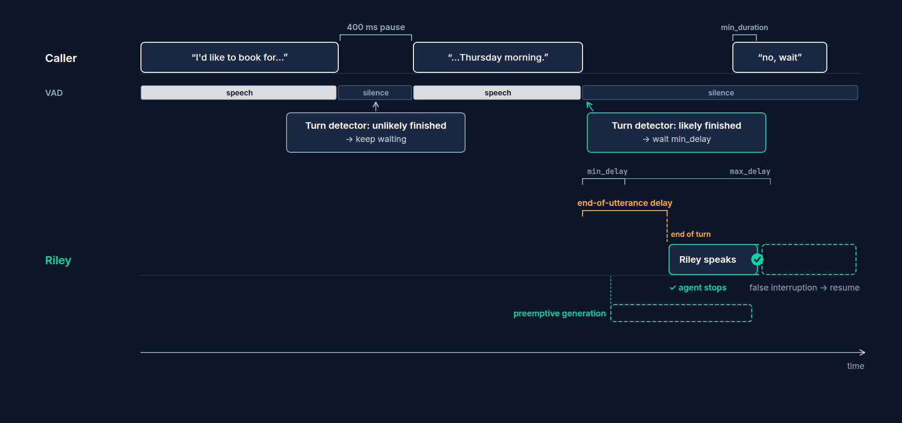
Timeline of one turn
Caller speaks: "I'd like to book for... [pause 400 ms] ...Thursday morning."
VAD: speech / silence / speech / silence
Turn detector at the first pause: "unlikely finished" → keep waiting
At the final silence: "likely finished" → wait only min_delay → end of turn
Label: "end-of-utterance delay" from last speech to end of turn
Production Voice AI Agents · Section 03 · Lecture 3.6
Notes:
Here's one turn on a timeline. The caller says "I'd like to book for..." and pauses. VAD sees silence. But the turn detector reads "I'd like to book for" and says that sentence isn't finished. So Riley keeps waiting, up to the maximum delay.
Then the caller says "Thursday morning" and stops. VAD sees silence again. This time the detector says, that's a complete thought. So Riley waits only the minimum delay, then ends the turn and starts answering.
That gap, from the last bit of speech to the end of the turn, is the end-of-utterance delay. It's the endpointing line item from our latency budget.

Slide 47
VAD: Silero settings
Defaults are good for most calls
Noisy environments: raise activation_threshold
Don't use min_silence_duration to tune turn-taking: that's endpointing's job
python
vad = silero.VAD.load(
min_speech_duration=0.05, # seconds of speech to start a speech segment
min_silence_duration=0.55, # seconds of silence to end a speech segment
activation_threshold=0.5, # higher = less sensitive to noise
)
Production Voice AI Agents · Section 03 · Lecture 3.6
Notes:
Let's take each layer's settings. VAD first. These are Silero's main knobs, shown with their defaults. Minimum speech duration, minimum silence duration and activation threshold.
My advice: leave them alone at first. The one you might change is activation threshold. If callers are in noisy places and background sounds keep triggering Riley, raise it a little. Higher means less sensitive.
And a common mistake: using VAD's silence setting to control turn-taking. Don't. That's what endpointing is for.

Slide 48
Endpointing options
min_delay: used when the turn detector is confident the caller is done
max_delay: the ceiling when it thinks they're still going
"dynamic": adapts between the two based on this caller's pause patterns
python
from livekit.agents import EndpointingOptions
endpointing=EndpointingOptions(
mode="fixed", # or "dynamic"
min_delay=0.5, # wait at least this long after speech ends
max_delay=3.0, # never wait longer than this
)
Production Voice AI Agents · Section 03 · Lecture 3.6
Notes:
Endpointing has three settings. Minimum delay is how long Riley waits after speech ends when the turn detector is confident the caller is done. The default is half a second. Maximum delay is the ceiling when the detector thinks they're still going. The default is three seconds.
Then there's mode. Fixed uses those numbers as they are. Dynamic learns from the caller's own pauses during the call and adjusts within that range. It's worth trying for callers who speak slowly, like many older patients.
Think about what each number costs. Lower the minimum, and Riley feels snappier but interrupts more. Raise the maximum, and Riley is more patient with slow speakers but has longer awkward gaps when the detector is unsure.

Slide 49
The semantic turn detector
A small language model trained on conversation
Reads the transcript so far and predicts "finished" or "not finished"
"My number is five five five..." → not finished
"Thursday morning works." → finished
Runs on LiveKit Inference, with a local fallback (that's why we ran download-files)
python
turn_detection=inference.TurnDetector()
Production Voice AI Agents · Section 03 · Lecture 3.6
Notes:
The turn detector is the clever part. It's a small language model trained on real conversations. It reads the transcript so far and predicts whether the speaker is done.
"My number is five five five..." Not finished. Keep waiting. "Thursday morning works." Finished. Answer now.
Without it, you only have silence to go on, and you'd have to pick one delay for everything. With it, Riley can be quick when the sentence is clearly done and patient when it's clearly not. That's the single biggest improvement in turn-taking you can make.
It runs on LiveKit Inference, with a local fallback model. That's one of the files you downloaded in Section two.

Slide 50
Interruptions
python
from livekit.agents import InterruptionOptions
interruption=InterruptionOptions(
enabled=True,
min_duration=0.5, # seconds of caller speech to count as an interruption
min_words=0, # also require this many transcribed words
resume_false_interruption=True, # resume if it was just a cough or "mm-hm"
false_interruption_timeout=2.0, # silence after which it counts as false
)
Production Voice AI Agents · Section 03 · Lecture 3.6
Notes:
Now the other direction. What happens when the caller talks while Riley is talking?
By default, Riley stops. That's what a polite human does. But not every sound is an interruption. A cough. A "mm-hm." Someone in the background.
So there are guards. Minimum duration means the caller must speak for at least half a second to count. Minimum words means STT must transcribe at least that many words. Set it to two, and "mm-hm" won't stop Riley, but "wait, no" will.
And there's a safety net called false interruption resume. If Riley stops, but the caller then says nothing for two seconds, Riley decides it was a false alarm and picks up where it left off.

Slide 51
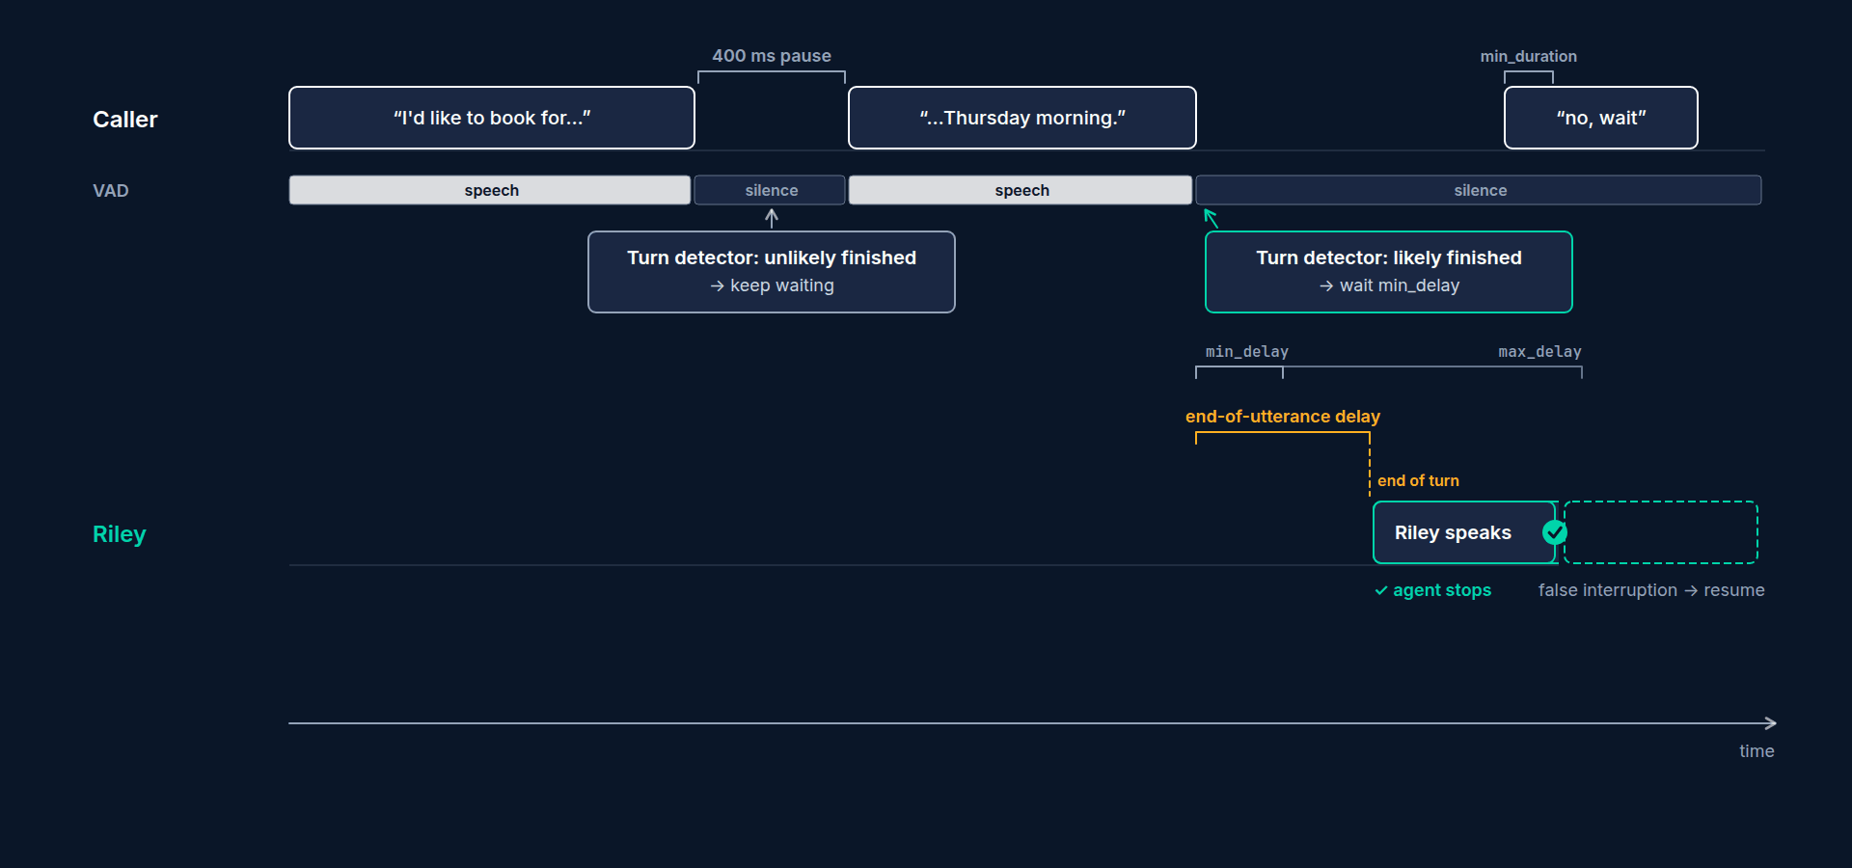
When not to allow interruptions
Legal or compliance disclosures
Reading back a booking right before committing it (Section 5)
Per-utterance: session.say(..., allow_interruptions=False)
In a tool: context.disallow_interruptions()
Production Voice AI Agents · Section 03 · Lecture 3.6
Notes:
Sometimes you don't want Riley to be interruptible at all. A required disclosure. Or the moment it commits a booking. You can switch it off for a single sentence, or from inside a tool. You'll use both in Section five.

Slide 52
Preemptive generation
The LLM starts drafting a reply before the turn is confirmed
If the caller keeps talking, the draft is thrown away
Saves time on the LLM line item; costs some extra tokens
On by default in LiveKit Agents 1.8
Production Voice AI Agents · Section 03 · Lecture 3.6
Notes:
One more setting, and it's a latency trick. Preemptive generation. As soon as the transcript looks final, the LLM starts drafting a reply, even before endpointing officially ends the turn. If the caller keeps talking, the draft is thrown away. If not, Riley's reply is already partly written.
It overlaps the LLM's time-to-first-token with the endpointing wait. That's two of our biggest line items running in parallel. The cost is some wasted tokens on drafts that get thrown away. It's on by default, and for most agents that's the right call.

Slide 53
Putting it together
python
session = AgentSession(
stt="deepgram/nova-3",
llm="openai/gpt-4.1-mini",
tts="cartesia/sonic-3",
vad=silero.VAD.load(),
turn_handling=TurnHandlingOptions(
turn_detection=inference.TurnDetector(),
endpointing=EndpointingOptions(min_delay=0.5, max_delay=3.0),
interruption=InterruptionOptions(min_duration=0.5, min_words=0),
),
)
Production Voice AI Agents · Section 03 · Lecture 3.6
Notes:
Here's everything in one place. It all lives inside turn handling options. Turn detection, endpointing and interruption. These are the defaults, written out so you can see them. In the next lecture, we'll change them and listen to the difference.
[SCREEN: VS Code, `03-code/agents/common.py`, scrolled to `build_turn_handling`. Highlight the `min_delay` line, then the three `Interrup...]
And here's what Riley actually uses from Section four on: `build_turn_handling` in `common.py`. The turn detector. Endpointing delays read from your dot env. And interruptions with a half-second minimum, false-interruption resume switched on, and a slightly shorter timeout of one and a half seconds. Notice one more line. On a phone call, the minimum delay is raised to at least point seven seconds. Why would a phone line need a longer wait? You'll find out in Section eight.
Here's the mental model to keep. The turn detector decides whether the caller is probably done. Endpointing decides how long to wait in each case. And interruption settings decide what happens when both of you talk at once. Tune them in that order.

Slide 54
RECAP
Key takeaways
✓
VAD hears speech; the detector reads the words
✓
Endpointing delays decide how long to wait
✓
Interruption options filter coughs and "mm-hm"
Production Voice AI Agents · Section 03 · Lecture 3.6

Slide 55
→
Next up:
Tuning turn-taking live
Now let's change those settings live and hear exactly what each one does to Riley.
Production Voice AI Agents · Section 03 · Lecture 3.6

Slide 56
SECTION 3 · YOUR FIRST VOICE AGENT WITH LIVEKIT AGENTS
LECTURE 3.7
Tuning turn-taking live
Change endpointing delays through .env and hear the effect on the same three test phrases.
Production Voice AI Agents · Section 03 · Lecture 3.7
Notes:
Title card (K2). Tuning turn-taking live.

Slide 57
Three test phrases (say them the same way every time)
The pause test: "My number is five one two... [pause] ...five five five... [pause] ...zero one four eight."
The hesitation test: "I'd like to book a cleaning for, um... [pause] ...Thursday."
The snap test: "Yes." (Riley should answer quickly.)
Production Voice AI Agents · Section 03 · Lecture 3.7
Notes:
Here are the three phrases. The pause test, a phone number with natural gaps. The hesitation test, with an "um" in the middle. And the snap test, a one-word answer, where Riley should respond quickly.
Say them the same way every time. Consistency is what makes the comparison fair.
[SCREEN: Terminal. Show the `.env` endpointing lines first.]
[CODE: default endpointing in `.env`]
Round one, the defaults. Half a second minimum, three seconds maximum. The reference hello agent reads these from config and passes them into its endpointing options.
[CODE: run in console mode]
[DEMO: Say all three phrases. Riley waits through the phone-number pauses, waits through the "um", and answers "Yes" promptly.]
Listen. It waited through my phone number pauses, because the turn detector knew the number wasn't finished. It waited through the "um." And on "yes," it came back fast. That's the semantic turn detector doing its job.
[CODE: round two, too snappy (edit `.env`, then restart)]
Round two. I'll make it aggressive. A tenth of a second minimum, and a ceiling of just over half a second. Save, and restart.
[DEMO: Same three phrases. Riley jumps in after "five one two" and again after "um".]
Hear that? Riley jumped in right after "five one two." Even though the turn detector said "not finished," the maximum delay of point six seconds forced the turn to end. The ceiling beat the model. That's the most common tuning mistake: a low maximum delay silently overrides the turn detector.
[CODE: round three, too patient]
Round three. The opposite. One and a half seconds minimum.
[DEMO: Same phrases. No interruptions, but a long, awkward silence after "Yes."]
No interruptions. But listen to the silence after "yes." It feels like the line dropped. That's the minimum delay applying even when the caller is obviously done.
[CODE: back to the defaults]
Back to the defaults. For most callers on a laptop, these are a good starting point. In Section eight, phones get a slightly longer minimum, because phone lines add their own delay.
[SCREEN: VS Code, `agents/my_hello_agent.py`. Expand the `TurnHandlingOptions` to include endpointing and interruption settings.]
Now interruptions. In my hello agent, I'll spell out the full turn handling options, the same way the reference file does, and add one new setting.
[CODE: update `turn_handling` in `my_hello_agent.py`]
Endpointing now reads the two values from dot env, so the rounds we just did work in your file too. And for interruptions, I'm setting min words to two. Now a single "mm-hm" shouldn't stop Riley, but "wait, stop" should.
[DEMO: Ask Riley "What services do you offer?" While it answers, say "mm-hm". Riley keeps going. Ask again, and say "wait, stop" mid-answ...]
"Mm-hm." Riley keeps going. "Wait, stop." Riley stops. That's the behavior you want on a phone call.
Keep min words at two if you like it. It's a good default for phone calls, and you'll see it again in Section eight.

Slide 58
Three tuning mistakes
A low max_delay that overrides the turn detector
Changing several settings at once
Tuning on speakers instead of headphones (echo looks like interruptions)
Production Voice AI Agents · Section 03 · Lecture 3.7
Notes:
Three mistakes to avoid. A low maximum delay that overrides the turn detector. Changing several settings at once, so you can't tell what helped. And tuning with speakers instead of headphones, where Riley hears its own voice and "interrupts" itself.

Slide 59
RECAP
Key takeaways
✓
Same three phrases, one change per run
✓
A low max_delay overrides the turn detector
✓
min_words=2 lets backchannels pass
Production Voice AI Agents · Section 03 · Lecture 3.7

Slide 60
→
Next up:
Lab 2: Customise your first agent
Next is Lab 2, where you'll run these experiments yourself with your own voice, model and turn settings.
Production Voice AI Agents · Section 03 · Lecture 3.7

Slide 61
SECTION 3 · YOUR FIRST VOICE AGENT WITH LIVEKIT AGENTS
LECTURE 3.8
Lab 2: Customise your first agent
Change Riley's voice, LLM and turn-taking settings through .env without editing code.
Production Voice AI Agents · Section 03 · Lecture 3.8
Notes:
Title card (K2). Lab 2: Customise your first agent.

Slide 62
→
Next up:
Break it: five ways your first agent fails, and what each sounds like
Next, you'll break your agent on purpose, five ways, so you can recognise each failure by ear.
Production Voice AI Agents · Section 03 · Lecture 3.8

Slide 63
SECTION 3 · YOUR FIRST VOICE AGENT WITH LIVEKIT AGENTS
LECTURE 3.9
Break it: five ways your first agent fails, and what each sounds like
Recognise five common voice-agent failures by ear.
Production Voice AI Agents · Section 03 · Lecture 3.9
Notes:
Title card (K2). Break it: five ways your first agent fails, and what each sounds like.

Slide 64
How the toggles work
Cases: short_endpointing, long_endpointing, no_interruptions, markdown, wrong_stt
One environment variable, one failure
No code edits, so "before" and "after" are identical except for the toggle
You'll reuse these in Section 9 to prove your tests catch each failure
bash
BROKEN=short_endpointing uv run python agents/s03_hello_agent.py console
Production Voice AI Agents · Section 03 · Lecture 3.9
Notes:
The reference hello agent, `s03_hello_agent.py`, has a built-in switch. Set BROKEN to a case name, and it deliberately misconfigures one thing. Leave it unset, and you get the healthy agent. Same code, same prompt, one variable.
[SCREEN: Terminal. Run `BROKEN=short_endpointing ...console`.]
Failure one. Endpointing too short.
[DEMO: Before. Caller: "My number is five one two... [pause] ...five five five..." Riley: "Thanks! And what's the rest of your..." Caller...]
The caller pauses after the area code, and Riley pounces. Now they're talking over each other, and the transcript is split into fragments.
[DEMO: After, with `BROKEN` unset. Riley waits through the pauses and reads back the full number.]
The broken version turned off the semantic turn detector and used VAD silence alone, with a ceiling of three tenths of a second. Any breath ended the turn. The fix is the default: the turn detector on, half a second minimum, three seconds maximum.
[SCREEN: Terminal. `BROKEN=long_endpointing`.]
Failure two. Endpointing too long.
[DEMO: Before. Caller: "Yes." Two and a half seconds of silence. Caller: "Hello?" Riley starts answering at the same moment.]
The caller says "yes," and then nothing. The caller says "hello?" just as Riley starts talking. Now they collide. A long delay doesn't just feel slow. It causes talk-over too, because callers fill the silence.
[DEMO: After. "Yes." Riley replies promptly.]
The fix is a sensible minimum delay. If you have slow speakers, try dynamic endpointing rather than a big fixed number.
[SCREEN: Terminal. `BROKEN=no_interruptions`.]
Failure three. Interruptions disabled.
[DEMO: Before. Riley reads a long answer about services. Caller: "Sorry, I just need the hours." Riley keeps talking to the end.]
The caller tries to redirect. Riley ignores them and finishes its speech. Every caller has met this bot, and every caller hates it.
[DEMO: After. Caller says "Sorry, I just need the hours." Riley stops and answers the hours.]
The fix: interruptions on, with min words set to two, so "mm-hm" doesn't stop Riley but "sorry, I just need the hours" does. Keep "uninterruptible" for the few moments that truly need it, like committing a booking in Section five.
[SCREEN: Terminal. `BROKEN=markdown`.]
Failure four. The chat prompt, with the text filters turned off.
[DEMO: Before. Caller: "What are your hours?" Riley: "Here are our hours, asterisk asterisk Monday to Thursday asterisk asterisk, eight A...]
Asterisk, asterisk. This is what happens with a chatbot prompt and no safety net. The model writes markdown, and the voice reads the symbols.
[DEMO: After. "We're open eight to five Monday through Thursday, and eight to two on Fridays."]
Two fixes, in order. The voice output rules in the prompt, which you'll write in Section four. And the default text filters, which strip markdown and emojis before speech. The broken case had both removed.
[SCREEN: Terminal. `BROKEN=wrong_stt`.]
Failure five. The wrong speech-to-text model.
[DEMO: Before. Caller: "Do you take Delta Dental? I'm due for Invisalign." Transcript panel shows "Do you take delta dinner? I'm due for...]
Look at the transcript. "Delta dinner." "Invisible line." Riley's answer is perfectly sensible, for the words it received. This is the failure people blame on the LLM, and it's not the LLM's fault at all.
[DEMO: After. Transcript shows "Delta Dental" and "Invisalign" correctly. Riley answers correctly.]
The broken case swapped in an older, general-purpose model. The fix is a current model suited to the audio. From Section four on, our build STT helper also adds keyterms: a list of dental terms and clinic names the model should listen for. Phone audio is harder still, and Section eight tunes for it. Section nine measures it with word error rate.

Slide 65
Symptom → setting
What the caller says | Likely cause | First setting to check
"It kept cutting me off" | Endpointing too short | max_delay, turn detector on
"It was so slow to answer" | Endpointing too long | min_delay
"It wouldn't let me talk" | Interruptions off | InterruptionOptions(enabled=True)
"It said weird symbols" | Chat prompt, filters off | Output rules, tts_text_transforms
"It didn't understand me" | Wrong or outdated STT | STT model, keyterms; check the transcript first
Production Voice AI Agents · Section 03 · Lecture 3.9
Notes:
Here's the cheat sheet. Symptom, cause and the first setting to check. Screenshot it. When you get a complaint, start at the matching row, and always read the transcript before blaming the LLM.

Slide 66
RECAP
Key takeaways
✓
Every failure has a sound and a setting
✓
BROKEN=<case> reproduces each one on demand
✓
Read the transcript before blaming the LLM
Production Voice AI Agents · Section 03 · Lecture 3.9

Slide 67
SECTION COMPLETE
You can now
✓
Build and run a voice agent from scratch
✓
Tune turn-taking by ear, one setting at a time
✓
Trace a caller's complaint to one setting
Production Voice AI Agents · Section 03 · Lecture 3.9

Slide 68
→
Next up:
Quiz: First agent and turn-taking
Let's lock this in with a short quiz on your first agent and turn-taking.
Production Voice AI Agents · Section 03 · Lecture 3.9

Slide 69
SECTION 3 · YOUR FIRST VOICE AGENT WITH LIVEKIT AGENTS
LECTURE 3.10
Quiz: First agent and turn-taking
Check understanding of dispatch, AgentSession vs Agent, and turn-taking settings.
Production Voice AI Agents · Section 03 · Lecture 3.10
Notes:
Title card (K2). Quiz: First agent and turn-taking.

Slide 70
Section 3 quiz: what's covered
Rooms, participants, tracks and dispatch
What belongs on Agent vs AgentSession
min_delay, max_delay and the turn detector
Interruptions and backchannels
Matching a symptom to a setting
Production Voice AI Agents · Section 03 · Lecture 3.10
Notes:
You'll see questions on dispatch, on where settings belong, on endpointing and the turn detector, on interruptions, and one that gives you a caller complaint and asks which setting to check first.
Tip: if you're torn on a turn-taking question, picture the timeline from Lecture 3.6. Where is the caller in the timeline, and which setting is the clock running on?
Every answer has an explanation. If you miss one, rewatch the lecture it points to. Section four builds on all of it.

Slide 71
→
Next up:
Why chat prompts fail on voice
Next, Section 4: why chat prompts fail on voice, and how to write prompts for the ear.
Production Voice AI Agents · Section 03 · Lecture 3.10

