Slide 1
SECTION 6 · SPEECH-TO-SPEECH WITH OPENAI REALTIME
LECTURE 6.1
How realtime speech models work
A speech-to-speech model hears audio and speaks audio in one model, which removes two hops but changes what you can control.
Production Voice AI Agents · Section 06 · Lecture 6.1
Notes:
Title card (K2). How realtime speech models work.

Slide 2
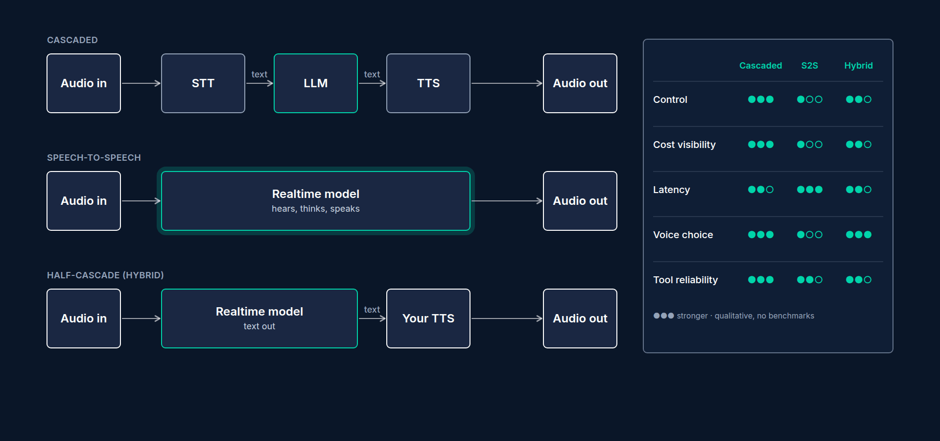
Two ways to build Riley
Cascaded: audio → STT → text → LLM → text → TTS → audio
Speech-to-speech: audio → realtime model → audio
Same tools, same prompt, different plumbing
Production Voice AI Agents · Section 06 · Lecture 6.1
Notes:
Here's the picture. On the top, the cascaded pipeline you've been building. Three models, each one replaceable. On the bottom, the realtime pipeline. One model. Audio goes in. Audio comes out. The good news is that almost nothing else changes. Riley keeps its instructions. Riley keeps its four booking tools. Riley keeps its `CallState` userdata. LiveKit's `AgentSession` hides the difference behind one parameter. You'll see that in the next lecture. Right now, let's understand what's happening inside the box.

Slide 3
What "audio in, audio out" really means
Caller audio is streamed to the model as audio tokens, roughly every 20 to 100 milliseconds
The model reasons over audio directly: tone, hesitation, emphasis
It generates audio tokens back, streamed as it speaks
Text is optional output, not an intermediate step
Production Voice AI Agents · Section 06 · Lecture 6.1
Notes:
A realtime model doesn't convert your words to text first. It turns the audio into tokens, the same way a text model turns words into tokens. Then it reasons over those audio tokens. That's why it can hear things a transcript throws away. A rising tone on "Tuesday?" A sigh before "I guess that works." A caller who sounds rushed. The reply is generated as audio tokens and streamed back to the caller while the model is still thinking about the rest of the sentence.
[B-ROLL: Animation. The caller's waveform is chopped into small audio-token blocks that flow into one "realtime model" box; reply blocks...]
This is where the speed comes from. There's no waiting for a final transcript. There's no waiting for the first sentence of text before speech synthesis can start. In my own tests, a realtime Riley usually starts speaking somewhere between half a second and eight hundred milliseconds after the caller stops. A well-tuned cascaded Riley lands closer to eight hundred milliseconds to one point two seconds. We'll measure both properly in lecture 6.4, so don't take my word for it yet.

Slide 4
Where the transcript comes from
The model does NOT need a transcript to answer
A separate transcription model runs on the side channel
LiveKit default: gpt-4o-mini-transcribe
The transcript is for you: logs, tests, UI captions, compliance
Production Voice AI Agents · Section 06 · Lecture 6.1
Notes:
Here's the part that surprises people. If the model reasons over audio, where does the transcript in your logs come from? From a second model. The realtime API runs a transcription model on the side, in parallel. In LiveKit Agents 1.8 the default is `gpt-4o-mini-transcribe`. That side-channel transcript powers your captions, your logs, and every test in Section 9.
And that creates a subtle trap. The transcript and the model's understanding can disagree. The caller says "Dr. Okafor." The transcript says "Dr. O'Connor." But the model heard the audio and answered correctly. Or the reverse. When you debug a realtime agent, remember that the transcript is a witness, not the source of truth.

Slide 5
Server-side turn detection
Server VAD: silence threshold, for example 500 ms of quiet ends the turn
Semantic VAD: a classifier judges whether the caller sounds finished
Eagerness: low, medium, high, auto (LiveKit default: medium; our code: auto)
The model decides when to reply, and whether a barge-in cancels its answer
Production Voice AI Agents · Section 06 · Lecture 6.1
Notes:
Next, turn-taking. In Section 3, Riley used Silero VAD plus LiveKit's turn detector model to decide when you'd finished talking. With a realtime model, the provider does that on their server. There are two flavors.
Server VAD is the simple one. It waits for a fixed stretch of silence, say five hundred milliseconds, and then declares the turn over. It's fast, but it cuts off people who pause to think.
[B-ROLL: animated waveform of a caller saying "my number is five five five... uh... two one two..." with a server-VAD cutoff marker firin...]
Semantic VAD is smarter. A classifier listens to the words and the intonation and asks: does this person sound finished? "My phone number is five five five..." Not finished. Semantic VAD waits. You tune it with one knob called eagerness. Low waits longer. High jumps in sooner. LiveKit's default for OpenAI is semantic VAD at medium eagerness. In our code we'll set it to auto, which lets the model adapt, and I'll show you when to switch to low: a dental clinic, where callers read out phone numbers and insurance IDs, is exactly that case.

Slide 6
Voices
Voices are baked into the model, chosen per session
marin and cedar are the newest, most natural options
You get the provider's voice, not your brand's cloned voice
Voice can't change mid-session once the model has spoken
Production Voice AI Agents · Section 06 · Lecture 6.1
Notes:
Now voices. In a cascaded pipeline, the voice belongs to your TTS provider. You can pick from hundreds of voices or clone your own. In a realtime model, the voice belongs to the model. OpenAI ships a small set. We'll use `marin`, which is one of the two newest and most natural. That's a real trade-off for a business. If Maple Street Dental already has a brand voice on their phone menu, a realtime model can't match it. Lecture 6.3 shows the hybrid fix for exactly that.

Slide 7
Session limits you must design for
Max session length: OpenAI caps a realtime session (60 minutes at time of recording; verify in OpenAI's docs)
LiveKit's plugin recycles the connection every 20 minutes by default (max_session_duration, 1,200 s in livekit-agents 1.8.3)
Context grows every turn: long calls cost more per minute
Audio tokens are priced far higher than text tokens
Production Voice AI Agents · Section 06 · Lecture 6.1
Notes:
Limits. A realtime connection is a long-lived session with the provider. OpenAI caps how long it can live. When I recorded this, the cap was sixty minutes. LiveKit's plugin quietly recycles the connection every twenty minutes by default, and carries the chat history across. You'll almost never hit this on a receptionist call. But you will hit it if a caller is put on hold and forgets to hang up.
[SCREEN: VS Code, `03-code/agents/s06_realtime_agent.py`. Go to Definition on `openai.realtime.RealtimeModel`, then open `.venv/lib/pytho...]
I don't want you to take those defaults on trust, so here's where they live. From the realtime agent file, go to the definition of `RealtimeModel` and follow it to this module in livekit-agents one point eight point three. Three constants. Semantic VAD at medium eagerness. The side-channel transcription model. And a maximum session duration of twenty times sixty seconds. Pass `max_session_duration` yourself to change it. And when you upgrade the library, check this file again.
The bigger limit is money. Every turn, the whole conversation so far is fed back into the model. On a realtime model that history includes audio tokens. Audio tokens cost many times more than text tokens. So a ten-minute call doesn't cost ten times a one-minute call. It costs more. We'll put real numbers on this in lecture 10.4.

Slide 8
What you trade for speed
Less control: no text step to filter, rewrite or pronounce-fix before speech
Tool calling works, but is harder to observe and test
Harder to swap one piece: model, voice and ears come as a bundle
Test framework runs in text mode either way (Section 9)
Production Voice AI Agents · Section 06 · Lecture 6.1
Notes:
So what do you give up? Control. In the cascaded pipeline, there's a moment where Riley's reply exists as plain text. You can check it for a phone number that shouldn't be there. You can rewrite "Dr." to "Doctor". You can add pronunciation hints. With pure speech-to-speech, that moment doesn't exist. The words go straight to audio.
You also give up modularity. If a better speech-to-text model comes out tomorrow, a cascaded Riley swaps one string. A realtime Riley waits for the provider.
The good news for this course is testing. LiveKit's test framework drives the agent with text either way. So the behavior tests you write in Section 9 cover both architectures.

Slide 9
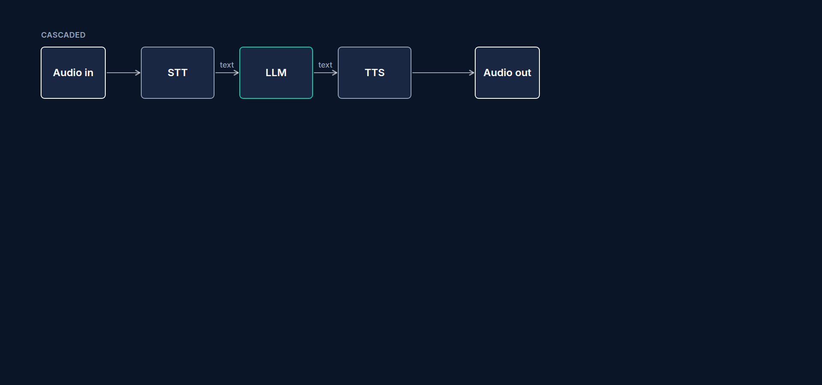
When realtime wins, when cascaded wins
Realtime: lowest latency, natural prosody, emotional or casual conversations
Cascaded: strict wording, compliance review, brand voice, lowest cost per minute
Hybrid: realtime brain, your TTS voice (lecture 6.3)
Decide with data, not vibes (lecture 6.4)
Production Voice AI Agents · Section 06 · Lecture 6.1
Notes:
Here's my rule of thumb. If the conversation is casual and speed is everything, realtime wins. If every word has to be controlled, like a clinic reading back appointment times and cancellation policies, cascaded usually wins. And there's a middle path that we'll build in lecture 6.3. But rules of thumb are just opinions. By the end of this section you'll have your own latency and cost numbers for both versions of Riley.

Slide 10
→
Next up:
Code-along: Riley on gpt-realtime
In the next lecture, we'll put Riley on gpt-realtime with one changed line, and find out which of…
Production Voice AI Agents · Section 06 · Lecture 6.1

Slide 11
SECTION 6 · SPEECH-TO-SPEECH WITH OPENAI REALTIME
LECTURE 6.2
Code-along: Riley on gpt-realtime
Swapping Riley to speech-to-speech is one changed argument on AgentSession, plus one habit change: without a TTS, Riley can't say() fixed text.
Production Voice AI Agents · Section 06 · Lecture 6.2
Notes:
Title card (K2). Code-along: Riley on `gpt-realtime`.

Slide 12
say() needs a TTS
session.say(text) → spoken by the TTS → needs tts= on the session
Pure realtime: no TTS → RuntimeError: trying to generate speech from text without a TTS model...
Use session.generate_reply(instructions="Say ...") instead
String fillers use say too: the mixin's _filler skips them here (can_say)
Production Voice AI Agents · Section 06 · Lecture 6.2
Notes:
The same rule applies to filler speech from lecture 5.5. When you pass `with_filler` a string, LiveKit speaks it with `say`. So do Riley's booking tools crash here when the calendar is slow? No. Remember the `_filler` helper from lecture 5.7? It asks `can_say` first, and on a pure realtime session it skips string fillers. The tool still runs. The caller just hears a little more silence.
[SCREEN: VS Code, `agents/common.py`: `can_say`, then `BookingToolsMixin._filler`. Then `tests/agent/test_mock_mode.py`, scrolled to `tes...]
And that behaviour has a test. String fillers are skipped only in pure realtime mode, and still play in cascaded and hybrid sessions. If you want a filler on pure realtime anyway, use the hybrid setup from the next lecture, which has a TTS again, or pass `with_filler` a function that calls `generate_reply`. There's a snippet in the lecture notes.
[CODE: step 3: the realtime model]
Model: `gpt-realtime`. Voice: `marin`. Ignore `modalities` and `hybrid` for now; that's next lecture. For pure speech-to-speech, the model returns audio.
Then turn detection. We use semantic VAD, from lecture 6.1. `create_response=True` means the model answers automatically when it decides the caller is done. `interrupt_response=True` means a caller can barge in and cut Riley off. And `eagerness`. We use `auto`, which lets the model adapt. If your callers read out phone numbers and insurance IDs and get cut off, try `low`, which waits longer. If Riley feels sluggish on short yes-and-no answers, try `high`.
We don't set the transcription model. LiveKit's default side-channel transcript is `gpt-4o-mini-transcribe`, which is fine here. You can override it with `input_audio_transcription` if clinic-specific words keep coming out wrong in your logs.
[CODE: step 4: the entrypoint]
Here's the whole switch. In Section 5, `AgentSession` took `stt`, `llm`, `tts`, `vad` and `turn_handling`. Here it takes one `llm`, and that `llm` happens to be a realtime model. LiveKit sees that and uses the model's server-side turn detection automatically. Riley's userdata, `CallState`, and `max_tool_steps=5` are the same as before.
Two branches you can ignore for now. `MOCK_MODE` swaps in the scripted fake LLM from Section 2 for zero-cost practice. And `REALTIME_HYBRID` is next lecture.
Let's run it.
[SCREEN: terminal]
[DEMO: console mode. Riley greets in the `marin` voice. Speak: "Hi, I'd like to book a cleaning next Tuesday morning." Riley answers quic...]
Listen to how fast that first reply lands. And look at the log. There's the `find_available_slots` call, with the day and part of day the model chose. Same tool. Different brain.
[DEMO: pick a time, give name and number "Alex Kim, 512 555 0188". Riley reads back and asks for confirmation. Say "yes". `book_appointme...]
The booking goes through. And listen to the read-back. Riley still confirms the name, day and time before calling `book_appointment`, because that rule lives in its instructions, and instructions travel with the agent.
One more check. Interrupt it.
[DEMO: while Riley reads back, say "No, Thursday." Riley stops mid-sentence and re-checks Thursday.]
The barge-in worked, because of `interrupt_response=True`. OpenAI's server heard me, cancelled the reply, and handled "No, Thursday" as a new turn.
[SCREEN: terminal log from the booking demo, scrolled back to the start of the call.]
Before we move on, let's read the log together, because realtime sessions log differently from cascaded ones. At the top, the realtime session connects to OpenAI. There's no "STT connected" line and no "TTS connected" line, because there's no separate STT or TTS. Then each of your turns shows up twice: once as the side-channel transcript of what you said, and once as the model's response. Notice the transcript line sometimes arrives after Riley has already started speaking. That's normal. The model answered from the audio, and the transcription model finished a moment later. It's lecture 6.1's "the transcript is a witness" in action.
[SCREEN: Zoom on the `find_available_slots` call in the log and its JSON arguments.]
Look at the tool call too. The arguments are JSON, exactly like the cascaded version: a `day` and a `part_of_day`. The model chose "2026-10-06" for next Tuesday, because Riley's instructions include today's date through `build_instructions`. If you ever see a realtime Riley book the wrong week, check that line of the prompt first.
And one habit to keep from Section 5: run the booking twice. Realtime models vary more between runs in how they phrase things, and sometimes in which details they collect first. The tools and the scheduler keep the outcome correct either way. That's the architecture doing its job.
Let's review. Changed: one argument on `AgentSession`, and the greeting now uses `generate_reply` instead of `say`. Unchanged: the tools, the prompt, the userdata, and the scheduler logic in `src/maple/scheduler.py`. That's the payoff of keeping business logic out of the agent. You swapped the entire speech stack without touching the code that books appointments.

Slide 13
→
Next up:
Hybrid: realtime LLM with your own TTS
Next, we'll keep the realtime brain but give Riley back a voice you choose, with the hybrid setup.
Production Voice AI Agents · Section 06 · Lecture 6.2

Slide 14
SECTION 6 · SPEECH-TO-SPEECH WITH OPENAI REALTIME
LECTURE 6.3
Hybrid: realtime LLM with your own TTS
Run the realtime model with text output and your own TTS to get audio understanding plus brand voice and text-level control.
Production Voice AI Agents · Section 06 · Lecture 6.3
Notes:
Title card (K2). Hybrid: realtime LLM with your own TTS.

Slide 15
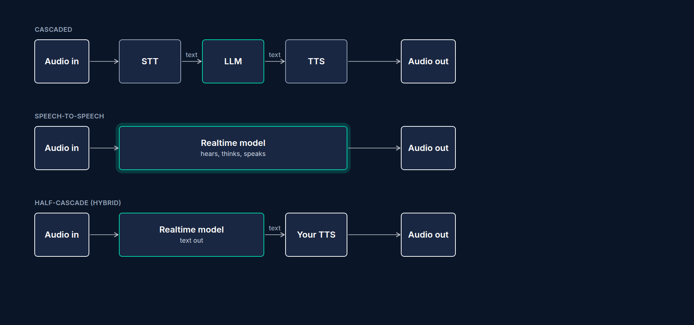
The hybrid pipeline
Caller audio → realtime model (hears tone, pauses; semantic VAD)
Realtime model → text reply (modalities=["text"])
Text → your TTS (cartesia/sonic-3 with Riley's voice) → caller
Adds one TTS hop, typically 100 to 250 ms to first audio
Production Voice AI Agents · Section 06 · Lecture 6.3
Notes:
Here's the shape. The input side is identical to lecture 6.2. Audio goes straight into `gpt-realtime`, so you keep semantic turn detection and the model still hears hesitation and tone. The output side changes. The model returns text, and Cartesia speaks it in Riley's Section 3 voice.
You pay for that with one extra hop. A good streaming TTS adds roughly a hundred to two hundred and fifty milliseconds before the first sound. You'll measure the real number in 6.4.

Slide 16
What you get back
Brand voice or cloned voice
session.say(...) and string fillers work again
Text transforms and pronunciation fixes from Section 4
A text checkpoint for guardrails (Section 11)
Production Voice AI Agents · Section 06 · Lecture 6.3
Notes:
And here's what you get back. Your brand voice. `session.say` and plain string fillers work again, because there's a TTS. The pronunciation fixes from Section 4 apply again, because there's text to transform. And in Section 11, when we add output guardrails, there's a text checkpoint where you can catch a reply before anybody hears it.
[SCREEN: `agents/s06_realtime_agent.py`, highlight the `modalities` line and the `hybrid` branch in the entrypoint.]
The code is already in the file from last lecture. Two lines make the hybrid.
[CODE: the two hybrid lines]
First, `modalities`. For pure speech-to-speech it's `["audio"]`: the model returns audio. For the hybrid it's `["text"]`: the model returns only text.
Second, the session. In hybrid mode we add `tts=build_tts(settings)`, the same helper every cascaded agent uses. It returns `cartesia/sonic-3` with Riley's voice ID, through LiveKit Inference. No STT. No VAD. The realtime model still does the listening and the turn detection. LiveKit sees a text-only realtime model plus a TTS, and routes the text into the TTS for you.
`REALTIME_HYBRID=1` switches it on. Run both. First, hybrid.
[SCREEN: terminal]
[DEMO: say "Hi, do you have anything Thursday afternoon for a filling?" Riley answers in the Cartesia voice from Section 3.]
That's Riley's Section 3 voice again, with a realtime brain behind it.
Now pure realtime, same question.
[DEMO: same question. Riley answers in `marin`.]
Can you hear the difference? The realtime voice is a bit more expressive. The hybrid is a bit more consistent with the brand. Neither is wrong. It depends on what Maple Street Dental cares about more.

Slide 17
Hybrid gotchas
Use modalities=["text"], not the default ["text", "audio"], or you pay for audio you throw away
The voice= argument is ignored in text mode
Latency = realtime text TTFT + TTS TTFB
Transcripts: caller side from the transcription model, Riley's side is its exact text
Production Voice AI Agents · Section 06 · Lecture 6.3
Notes:
Four gotchas. One: set modalities to text only. The plugin's default is text and audio, and if you add a TTS on top, you pay for audio output tokens you never play. Two: the voice argument does nothing in text mode. Three: your latency is now the realtime model's time to first text token plus the TTS time to first byte. Four, a bonus: Riley's side of the transcript is now exact, because it's the text Riley actually spoke. That makes the judge tests in Section 9 more trustworthy.

Slide 18
When to choose the hybrid
The voice is part of the brand
You need exact wording: policies, read-backs
You want a text checkpoint for guardrails
Skip it when every millisecond counts
Production Voice AI Agents · Section 06 · Lecture 6.3
Notes:
So when should you choose the hybrid? Here's how I think about it. Pick it when the voice is part of the brand, when you need exact wording for things like policies and read-backs, or when you want the text checkpoint for guardrails, but you still want realtime's natural turn-taking and its ear for tone. Skip it when every millisecond counts and a built-in voice is acceptable, because pure realtime is still faster.

Slide 19
Hybrid latency, a worked example
Pure realtime: about 650 ms to first audio
Hybrid: the same listening, then first text instead of first audio
Plus one TTS hop: about 150 to 200 ms
About 800 to 850 ms: still under the 1-second target
Illustrative numbers. You'll measure your own in 6.4.
Production Voice AI Agents · Section 06 · Lecture 6.3
Notes:
Let's put numbers on that trade. Say pure realtime starts speaking about six hundred and fifty milliseconds after the caller stops. The hybrid listens the same way, but waits for the first text tokens instead of the first audio, and then Cartesia needs another hundred and fifty to two hundred milliseconds to start speaking. So add roughly one TTS hop: around eight hundred to eight hundred and fifty milliseconds. Still under our one-second target from lecture 1.4, and still faster than a typical cascaded turn on a phone line. For Maple Street Dental, that's a very reasonable price for keeping their brand voice. In the next lecture, we'll check whether my guesses survive real measurement.

Slide 20
→
Next up:
Head-to-head: cascaded vs realtime
Now we have three Rileys: cascaded, realtime and hybrid.
Production Voice AI Agents · Section 06 · Lecture 6.3

Slide 21
SECTION 6 · SPEECH-TO-SPEECH WITH OPENAI REALTIME
LECTURE 6.4
Head-to-head: cascaded vs realtime
Choose an architecture by running the same five calls through each version, hearing them side by side, and comparing latency, cost per…
Production Voice AI Agents · Section 06 · Lecture 6.4
Notes:
Title card (K2). Head-to-head: cascaded vs realtime.

Slide 22
The five test calls
Simple FAQ: "What time do you close on Friday?"
Book: "Cleaning next Tuesday morning, name Alex Kim, 512-555-0188"
Correction: "Actually, make that Thursday"
Barge-in: interrupt Riley mid read-back with "No, the afternoon"
Cancel: "Cancel my appointment on the 14th"
Production Voice AI Agents · Section 06 · Lecture 6.4
Notes:
Here's the script. Five calls that cover what a receptionist actually does. A quick question. A booking with a name and phone number. A correction. An interruption in the middle of a read-back. And a cancellation. I say the exact same words each time, from this card, at the same pace. That's the only way the comparison is fair.

Slide 23
The four numbers
Latency: end of caller speech → first Riley audio (median of 5 turns)
Cost per minute: from usage summary × price table
Tool accuracy: right tool, right arguments, first try (out of 5)
Interruptions: did it stop within half a second and handle the new request? (out of 5)
Production Voice AI Agents · Section 06 · Lecture 6.4
Notes:
And here's what we measure. Latency is the gap between the moment I stop talking and the moment Riley starts. Cost per minute comes from the usage LiveKit reports, multiplied by a price table. Tool accuracy asks: did Riley call the right tool with the right arguments on the first try? And interruptions asks: when I cut Riley off, did it actually stop, and did it handle what I said?
For latency today, I've pasted a three-line metrics logger into each entrypoint, right after the session is created. It's a preview of Section 10, where we'll do this properly and export to a file. For now, it just prints each metric as it arrives.
[CODE: temporary metrics logger, added after `session = ...` in both entrypoints]
[SCREEN: terminal split in three panes: cascaded, realtime, hybrid. Each started with metrics logging on.]
[DEMO: Cascaded Riley, calls 1 to 5 from the card. Point out log lines for end-of-utterance delay, LLM time to first token and TTS time t...]
Cascaded first. Call one, the Friday hours. Watch the log. End of utterance delay around half a second, because of the turn detector's minimum delay. LLM time to first token a bit under half a second. TTS time to first byte around a hundred and fifty milliseconds. Add them up and we're a little over a second. You can feel that small gap.
[SCREEN: Cascaded pane, zoom on the `book_appointment` line in the log and its four arguments.]
Call two, the booking. Riley asks for anything missing, reads back "Tuesday, October sixth at nine in the morning, Alex Kim," and then calls `book_appointment`. Look at the arguments in the log. Name, phone, reason, start time. All correct. That's one for one on tool accuracy.
Call four, the barge-in. I cut Riley off during the read-back. It stops. It re-checks the afternoon. Good.
[DEMO: Realtime Riley, same five calls.]
Now pure realtime. Same card. Call one. Did you hear that? The answer started noticeably sooner. There's no STT final and no TTS hop. The realtime metrics log a time to first token for the whole speech-to-speech response, and it's sitting around six hundred milliseconds on my connection.
[SCREEN: Realtime pane, zoom on the two `book_appointment` calls in the log: the phone number with dashes in one, without in the other.]
Call two, the booking. The read-back is more natural. Listen to the phone number. "Five one two, five five five, zero one eight eight." It grouped the digits without our Section 4 text transforms. But look at the tool call. On this run, it passed the phone number with dashes in one call and without in another. Our scheduler normalizes phone numbers, so the booking still worked. But if it didn't, that's the kind of drift you'd only catch with the tool-argument tests in Section 9.
Call four, the barge-in. Realtime is excellent here. It stops almost instantly, because the provider's server hears me while it's speaking.
[DEMO: Hybrid Riley, same five calls.]
Finally, hybrid. The answers start a little later than pure realtime, because of the Cartesia hop, but earlier than cascaded. The voice is the brand voice. And because there's a TTS again, `session.say` and string fillers would work here too. Tool calls look the same as pure realtime, because it's the same brain.
[DEMO: SIDE-BY-SIDE PLAYBACK. Pre-recorded audio of calls 2 and 4 from each architecture (captured with LiveKit session recording or OBS...]
Numbers are easy to skim, so let's listen instead. Here's call two, the booking, from all three versions, lined up so the moment I stop talking sits on the same vertical line. Cascaded. Realtime. Hybrid. Hear how the realtime answer lands almost on top of my last word? And how cascaded leaves a small breath first? That breath is the gap you saw in the logs.
[SCREEN: The call-4 lanes, stacked, with a red marker on each lane where Riley stops talking after the caller starts.]
Now call four, the barge-in. Watch the red markers. Cascaded stops a beat after I start talking. Realtime stops almost instantly. Hybrid is close to realtime, because the same server is listening. Also listen to the voices. Realtime's `marin` is more expressive. Hybrid and cascaded share the Cartesia brand voice. That difference doesn't show up in any metric, and it might matter more to the clinic than a hundred milliseconds. And one more thing about those red markers. The gap you can see on a waveform is the fairest latency number of all. Cascaded Riley reports separate stages, while realtime Riley mostly reports one time to first token, so their log numbers aren't directly comparable. What the caller hears is.
[SCREEN: `10-resources/architecture-decision-matrix.md` open, with a filled table. Numbers typed in live.]

Slide 24
My results (illustrative; yours will differ)
 | Cascaded | Realtime | Hybrid
Median latency | about 1.1 s | about 0.65 s | about 0.85 s
Cost per minute (3-min call) | about 6.5 cents | about 16 cents | about 10 to 13 cents
Tool accuracy | 5 / 5 | 4 / 5 | 4 / 5
Clean interruptions | 4 / 5 | 5 / 5 | 5 / 5
Production Voice AI Agents · Section 06 · Lecture 6.4
Notes:
Here's my sheet. Treat these numbers as illustrative. Prices move, networks differ, and five calls is a small sample. Cascaded was the slowest at about one point one seconds, but the cheapest, at roughly six and a half cents a minute, and it went five for five on tool calls. Realtime was the fastest at about six hundred and fifty milliseconds, and the best at interruptions, but it cost roughly two and a half times as much per minute. Hybrid landed in the middle on both.
[SCREEN: `10-resources/architecture-decision-matrix.md`, the cost row. Type in the three cost-per-minute numbers.]
Why is realtime so much more expensive? Remember lecture 6.1. Audio tokens cost far more than text tokens, and every turn re-sends the conversation so far. Longer calls make that gap wider, not narrower. Lecture 10.4 turns this into an exact calculation in `src/maple/costs.py`.

Slide 25
Decision matrix for Maple Street Dental
Must read back dates, times and names exactly → favors cascaded or hybrid
Brand voice on the phone line → rules out pure realtime
Budget: about 400 calls a day, 3 minutes each → cost per minute matters
Callers are often older, pause mid-sentence → semantic VAD helps
Decision: cascaded as default, hybrid as an A/B candidate
Production Voice AI Agents · Section 06 · Lecture 6.4
Notes:
Now apply it to a real business. Maple Street Dental takes about four hundred calls a day, three minutes each. That's twelve hundred minutes a day. At six and a half cents a minute, that's about seventy-eight dollars a day. At sixteen cents a minute, it's about a hundred and ninety-two. Over a month, that difference is around three thousand four hundred dollars. They also want their brand voice, and they want dates and names read back precisely.
[SCREEN: `10-resources/architecture-decision-matrix.md`, scrolled to the "Decision record template". Fill it in live: "Decision: cascaded...]
So my decision for Riley is: cascaded as the default, which is what the rest of this course builds on. Hybrid is an A/B candidate for later, if callers complain about speed. Pure realtime is a great fit for a different business, like a casual language-practice app where expressiveness beats everything.
Your decision might differ. That's fine. What matters is that you made it with your numbers.

Slide 26
→
Next up:
Lab 4: Measure both architectures
Your turn: in Lab 4 you'll run the same five calls and fill in your own comparison sheet.
Production Voice AI Agents · Section 06 · Lecture 6.4

Slide 27
SECTION 6 · SPEECH-TO-SPEECH WITH OPENAI REALTIME
LECTURE 6.5
Lab 4: Measure both architectures
Produce your own architecture comparison with real numbers and a written recommendation.
Production Voice AI Agents · Section 06 · Lecture 6.5
Notes:
Title card (K2). Lab 4: Measure both architectures.

Slide 28
SECTION COMPLETE
You can now
✓
Put Riley on a speech-to-speech model
✓
Keep a brand voice with the hybrid
✓
Choose an architecture with your own numbers
Production Voice AI Agents · Section 06 · Lecture 6.5

Slide 29
→
Next up:
Quiz: Architectures and tools
When your sheet is done, take the short quiz to lock in the section.
Production Voice AI Agents · Section 06 · Lecture 6.5

Slide 30
SECTION 6 · SPEECH-TO-SPEECH WITH OPENAI REALTIME
LECTURE 6.6
Quiz: Architectures and tools
Check you can choose and configure an architecture, and that your tools survive the switch.
Production Voice AI Agents · Section 06 · Lecture 6.6
Notes:
Title card (K2). Quiz: Architectures and tools.

Slide 31
Quiz: 8 questions
Tools: descriptions, ToolError, fillers, userdata
Realtime session configuration and transcripts
Hybrid, and picking an architecture from numbers
Production Voice AI Agents · Section 06 · Lecture 6.6
Notes:
A tip before you start: question eight gives you head-to-head numbers. Decide with what the clinic cares about most, not with the fastest number.
If you miss one, the feedback points to the exact lecture to revisit. No time limit. Take it now while the lab numbers are fresh.

Slide 32
→
Next up:
RAG for voice: short, speakable, grounded
Next up is Section 7, where Riley learns to answer clinic questions from a knowledge base and hand…
Production Voice AI Agents · Section 06 · Lecture 6.6

