Slide 1
SECTION 8 · TELEPHONY: PUT RILEY ON A PHONE NUMBER
LECTURE 8.1
PSTN, SIP and trunks in plain English
A phone call reaches Riley through a chain: phone network, SIP trunk, LiveKit SIP, a room, and a dispatched agent; each link…
Production Voice AI Agents · Section 08 · Lecture 8.1
Notes:
Title card (K2). PSTN, SIP and trunks in plain English.

Slide 2
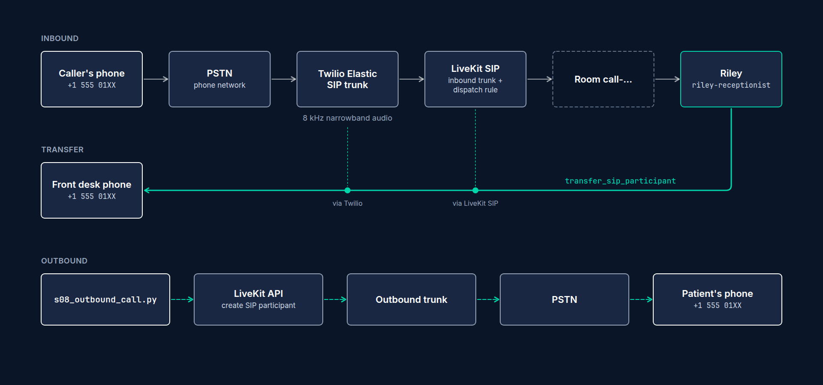
The call path
Caller's phone → PSTN (the public phone network)
PSTN → SIP trunk provider (Twilio Elastic SIP Trunking)
Twilio → LiveKit SIP service (your project's SIP URI)
LiveKit SIP → a new room with the caller as a SIP participant
Dispatch rule → Riley's agent joins the room
Production Voice AI Agents · Section 08 · Lecture 8.1
Notes:
[B-ROLL: animated call path. A phone icon rings; a line travels through a "PSTN" cloud, into a Twilio box, into a LiveKit box, into a "ro...]
Here's the path. A caller dials the clinic's number. That call travels over the PSTN, the public switched telephone network. That's the same network your grandparents' landline used. It's run by carriers, and it speaks old telephone protocols.
Our software doesn't speak those. It speaks SIP, the Session Initiation Protocol, which is how internet phone systems set up calls. So we need a bridge. That bridge is a SIP trunk. Twilio owns the phone number, receives the call from the carrier, and forwards it over SIP to LiveKit.
[B-ROLL: the call-path animation continues: a SIP INVITE leaves the Twilio box, reaches the LiveKit box, and a new "room" circle opens wi...]
LiveKit's SIP service receives it and does something very familiar. It creates a room, and puts the caller into it as a participant. A special kind of participant, a SIP participant, but still a participant with an audio track. And then a dispatch rule tells LiveKit which agent to send into that room. Riley joins, exactly like it joins a browser room today.
[SCREEN: `agents/s08_telephony_agent.py`, the entrypoint. Highlight `if participant.kind == rtc.ParticipantKind.PARTICIPANT_KIND_SIP:`, t...]
That's the key insight of this whole section. From Riley's point of view, a phone caller is just another participant. Almost none of its code changes.

Slide 3
Four things you'll configure
Twilio Elastic SIP trunk: owns the number; origination points to LiveKit, termination accepts calls from LiveKit
LiveKit inbound trunk: "accept calls for +1 512 555 0100"
LiveKit dispatch rule: "put each caller in a new room and dispatch riley-receptionist"
LiveKit outbound trunk: "place calls through Twilio" (for reminders, lecture 8.5)
Production Voice AI Agents · Section 08 · Lecture 8.1
Notes:
You'll configure four things. First, a Twilio Elastic SIP trunk. It owns the number. Its "origination" settings say where inbound calls go, which is LiveKit. Its "termination" settings let LiveKit place outbound calls through Twilio.
Second, a LiveKit inbound trunk. It tells LiveKit which numbers to accept calls for.
Third, a dispatch rule. It says what to do with each call: create a new room per caller, and dispatch the agent named `riley-receptionist`.
Fourth, for outbound calls, a LiveKit outbound trunk that points back at Twilio.

Slide 4
Explicit dispatch and agent names
Browser rooms in dev: an unnamed agent is auto-dispatched to every room
Telephony: a named agent (riley-receptionist) is dispatched only when asked
Name comes from LIVEKIT_AGENT_NAME (dev) or [agent] name in livekit.toml (production)
The dispatch rule and the outbound script both use this name
Production Voice AI Agents · Section 08 · Lecture 8.1
Notes:
One idea from Section 3 becomes important now: agent names. In dev, Riley had no name, so LiveKit dispatched it into every room automatically. That's handy for a playground and dangerous for a phone system. With a name, like `riley-receptionist`, the agent is only dispatched when something asks for it by name. The dispatch rule asks for it. The outbound reminder script asks for it. Nothing else does. In LiveKit Agents 1.8, the name comes from the `LIVEKIT_AGENT_NAME` environment variable, or from the `[agent]` section of `livekit.toml` when you deploy.

Slide 5
Phone audio is not laptop audio
Phone networks carry 8 kHz narrowband audio (G.711); your laptop mic gives 48 kHz
Consonants blur: "fifteen" vs "fifty", "B" vs "D"
Background noise: cars, kitchens, speakerphones
Extra network delay: often 100 to 300 ms more round trip
Production Voice AI Agents · Section 08 · Lecture 8.1
Notes:
Now the part that bites people. Phone audio is terrible. A traditional phone call carries audio sampled at eight kilohertz. Your laptop mic records at forty-eight. The phone network throws away most of the high frequencies, and that's exactly where consonants live. "Fifteen" and "fifty" start to sound alike. So do "B" and "D." For a receptionist reading back appointment times, that's a real problem.
Callers also call from cars, kitchens and speakerphones. And the phone network adds its own delay, often a hundred to three hundred milliseconds of extra round trip on top of everything we've already budgeted.

Slide 6
What this means for Riley
STT: pick a model that's strong on telephony audio; add keyterms (lecture 8.3, measured in 9.7)
Turn-taking: slightly longer endpointing; callers pause more on phones
Read-backs matter more: always confirm dates, times and numbers
Latency budget: phone adds delay you can't remove, so save it elsewhere
Production Voice AI Agents · Section 08 · Lecture 8.1
Notes:
So we'll tune for it. A speech-to-text model that's strong on phone audio, with a keyterm list for dental words and dentists' names. A slightly longer endpointing delay, because phone callers pause more. Read-backs become non-negotiable. And we'll protect the latency budget, because the phone network just spent some of it for us. Lecture 8.3 does all of that, and in Section 9 we'll measure it.

Slide 7
Where calls fail
Twilio: number not attached to trunk, wrong origination URI
LiveKit inbound trunk: number format wrong (must be E.164: +15125550100)
Dispatch rule: agent name typo, so the caller hears silence
Agent: not running, or running without the name set
Production Voice AI Agents · Section 08 · Lecture 8.1
Notes:
Last slide, and keep it handy. When a test call fails, it fails at one of these links. Twilio rejects it because the number isn't attached to the trunk. LiveKit rejects it because the number isn't in E.164 format, which means plus, country code, then the number, with no spaces. The dispatch rule has a typo in the agent name, so the call connects and the caller hears nothing. Or the agent simply isn't running with its name set. Nine out of ten "my phone agent doesn't work" questions in the Q&A are one of these four.

Slide 8
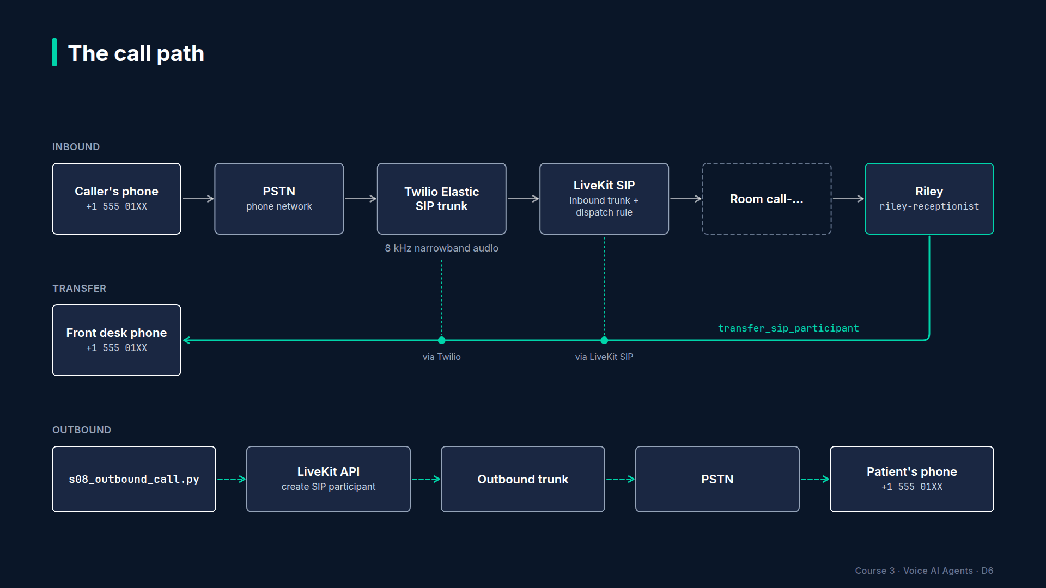
Section 08 · Lecture 8.1 · One inbound call, second by second
Notes:
Here's the chain again, as a timeline, so you know what "fast" looks like. The caller dials. The carrier hands the call to Twilio. Twilio sends a SIP INVITE, which is SIP's way of saying "incoming call," to your LiveKit SIP address. LiveKit checks the number against your inbound trunk, applies the dispatch rule, creates a fresh room, and dispatches Riley. With prewarmed agent processes, that's all well under a second. Then Riley greets, and the caller hears it within a second or two of the call connecting.
[B-ROLL: two waveforms side by side. Left: laptop mic, full 48 kHz spectrum. Right: the same sentence at 8 kHz G.711, the high frequencie...]
On the audio side, the phone network typically uses a codec called G.711 at eight kilohertz. LiveKit converts it for the agent, so your code doesn't change. But the audio quality is still eight kilohertz. Conversion doesn't bring back the frequencies the phone network threw away. That's why the tuning in lecture 8.3 matters.
A question from the Q&A: "Why not just use WebRTC in the browser and skip all this?" For many products you should. Web and app callers get wideband audio, no per-minute phone charges and simpler setup. But a dental clinic's patients call a phone number. So does almost every small business's. Meeting callers where they already are is the whole point of this section.
Slide text (drawn on the diagram): 0.0 s: caller dials; carrier routes to Twilio · ~0.3 s: Twilio sends a SIP INVITE to your LiveKit SIP URI · ~0.4 s: LiveKit matches the inbound trunk and the dispatch rule, creates room `call-...` · ~0.5 s: `riley-receptionist` is dispatched; the job starts (faster with prewarmed processes) · ~1 to 2 s: caller hears Riley's greeting · Audio: G.711 at 8 kHz on the phone side; LiveKit converts for the agent

Slide 9
RECAP
Key takeaways
✓
Phone, Twilio trunk, LiveKit SIP, room, named agent
✓
A phone caller is just another room participant
✓
8 kHz phone audio needs its own tuning
Production Voice AI Agents · Section 08 · Lecture 8.1

Slide 10
→
Next up:
Inbound calls: Twilio trunk + LiveKit dispatch rule
Next, we'll set up every link in that chain and make the first real call to Riley.
Production Voice AI Agents · Section 08 · Lecture 8.1

Slide 11
SECTION 8 · TELEPHONY: PUT RILEY ON A PHONE NUMBER
LECTURE 8.2
Inbound calls: Twilio trunk + LiveKit dispatch rule
Four configuration steps and one environment variable put Riley on a real phone number.
Production Voice AI Agents · Section 08 · Lecture 8.2
Notes:
Title card (K2). Inbound calls: Twilio trunk + LiveKit dispatch rule.

Slide 12
The plan
LiveKit: find your project's SIP URI
Twilio: buy a number, create an Elastic SIP trunk, point origination at LiveKit, attach the number
LiveKit: create an inbound trunk for that number (lk sip inbound create)
LiveKit: create a dispatch rule to riley-receptionist (lk sip dispatch create)
Run the named agent and call it
Production Voice AI Agents · Section 08 · Lecture 8.2
Notes:
[SCREEN: LiveKit Cloud dashboard → project Settings. Highlight the "SIP URI" field. On-screen banner: "Verify in current LiveKit/Twilio c...]
Step one. In the LiveKit Cloud dashboard, open your project's settings. Find the SIP URI. It looks like `sip:` followed by a project-specific host ending in `sip.livekit.cloud`. Copy it. This is the address Twilio will send calls to.
[SCREEN: Twilio Console → Phone Numbers → Buy a number. Search a local area code, buy a voice-capable number.]
Step two, in Twilio. Buy a phone number with voice capability. On a trial account, you get one free, and you can only call it from numbers you've verified in Twilio. For this demo, my clinic number is plus one, five one two, five five five, zero one zero zero. Yours will be different.
[SCREEN: Twilio Console → Elastic SIP Trunking → Trunks → Create new SIP Trunk. Name it "maple-dental-livekit".]
Now create an Elastic SIP trunk. I'll call it `maple-dental-livekit`.
[SCREEN: Trunk → Origination → Add new Origination URI. Paste `sip:<your-project>.sip.livekit.cloud;transport=tcp`. Priority 10, weight 10.]
Open the trunk's Origination section. Origination is Twilio's word for "calls coming in from the phone network, going out to you." Add an origination URI: your LiveKit SIP URI, with `;transport=tcp` on the end. TCP is more reliable than UDP for SIP signaling across the internet.
[SCREEN: Trunk → Phone Numbers → Add an existing number → select the clinic number.]
Then open the trunk's Phone Numbers section and attach your number. This is the step people forget. If the number isn't attached to the trunk, Twilio sends the call to its default voice webhook instead, and you'll hear a Twilio demo message, not Riley.
We'll configure Termination, the outbound direction, in lecture 8.5. For now, inbound is enough.
[SCREEN: VS Code. Create folder `telephony/` in the repo root. New file `telephony/inbound-trunk.json`.]
Step three, back in LiveKit. We'll use the `lk` CLI, because JSON files in your repo are easier to review and repeat than console clicks. Create `telephony/inbound-trunk.json`.
[CODE: `telephony/inbound-trunk.json`]
Three fields. A name for humans. The numbers this trunk accepts, in E.164 format. And `krispEnabled`, which turns on LiveKit's noise cancellation for callers on this trunk. Phone callers in cars and kitchens will thank you.
[SCREEN: terminal]
[DEMO: CLI prints the new trunk with an ID starting `ST_`.]
The CLI prints the new trunk and its ID, which starts with `ST_`. Copy that ID.
Step four: the dispatch rule. Create `telephony/dispatch-rule.json`.
[CODE: `telephony/dispatch-rule.json`]
Let's read it. `trunk_ids` limits the rule to our inbound trunk. `dispatchRuleIndividual` means every caller gets their own brand-new room. The room names start with `call-`, so they're easy to spot in the dashboard. That matters. You never want two callers in the same room with Riley. And `roomConfig.agents` says which agent to dispatch into each new room: `riley-receptionist`.
[DEMO: both list commands show the trunk and rule.]
Create it, and list both to double-check. Trunk, number, rule, agent name. Everything is there.
Now the agent side. Two places carry the agent name. For local development, your `.env`.
[CODE: `.env` (add one line)]
And for deployment, `livekit.toml`. Copy the example file.
[CODE: `livekit.toml.example` → `livekit.toml`]
Why both? In LiveKit Agents 1.8, `dev` and `console` read the environment variable. The `livekit.toml` name is used when the agent runs in production, which we'll do in Section 12. Setting the name in the decorator is deprecated, so we don't.
Now the phone-ready agent file, `agents/s08_telephony_agent.py`. We'll dig into its phone-specific parts in the next two lectures, but let's read it once and run it.
[CODE: `agents/s08_telephony_agent.py` (imports and module docstring trimmed)]
This is the same Riley you've built all along, assembled from mixins. `BookingToolsMixin` from Section 5. `KnowledgeToolsMixin` from Section 7. And a new one, `TelephonyToolsMixin`, which adds `transfer_to_human` and `end_call`; we'll open it in lecture 8.4. `PHONE_RULES` adds three lines to its prompt: ask again when the line is unclear, announce a transfer before doing it, and say goodbye before hanging up.
`on_enter` answers immediately with the fixed greeting, AI disclosure included. On the phone, silence after pickup makes callers think the line is dead.
The entrypoint waits for the caller, reads caller ID, which is next lecture's topic, and builds the session with `create_session(..., telephony=True)`. That flag switches on the phone tuning we'll look at in 8.3.
[SCREEN: terminal, repo root, `.env` open in a split pane with `LIVEKIT_AGENT_NAME=riley-receptionist` highlighted.]
Run it in dev mode. Not console. Console mode uses your laptop mic and never registers with LiveKit, so phone calls can't reach it.
[DEMO: terminal shows the agent registering with agent name `riley-receptionist`. Then pick up a mobile phone, dial the clinic number. Ca...]
Look at the log first: "registered worker," with our agent name. Now I'll call from my mobile.
There it is. Riley, on a real phone line. And it answered the Friday hours question from the FAQ, in one sentence.
[SCREEN: LiveKit Cloud dashboard → Sessions / Rooms. A room named `call-...` with two participants: a SIP participant and the agent.]
In the LiveKit dashboard, you can see the room the dispatch rule created. Its name starts with `call-`, and it has two participants: the SIP participant, which is me on my mobile, and Riley.
If your call didn't connect, go back to the "Where calls fail" slide in lecture 8.1 and walk the chain in order. Number attached to the trunk. Origination URI correct. Number in E.164 on the inbound trunk. Agent name identical in the dispatch rule and your `.env`. Agent running in `dev`, not `console`.

Slide 13
Debugging an inbound call, in order
lk sip inbound list: is the number there, in E.164?
lk sip dispatch list: right trunk ID, right agent name?
Agent log: "registered worker" with riley-receptionist?
LiveKit dashboard: was a call-... room created?
Twilio call log: did the call reach the trunk, and what SIP response came back?
Production Voice AI Agents · Section 08 · Lecture 8.2
Notes:
Here's the checklist I use when a test call fails, in order. Each step rules out one link in the chain. First, the inbound trunk: is the number there, in E.164? Second, the dispatch rule: does it point at the right trunk ID and the exact agent name? Third, the agent log: did the worker register with that name? Fourth, the LiveKit dashboard: was a `call-` room created at all? If yes, the phone side worked and the problem is dispatch or the agent. If no, the problem is before LiveKit. Fifth, Twilio's call log, which shows whether the call reached your trunk and what SIP response came back. Five checks, about two minutes, and you'll find almost every inbound problem.
One more thing about the files we just created: they belong in version control, secrets removed. The inbound trunk and dispatch rule JSON are your phone system's configuration. When someone asks in six months "why do calls go to room names starting with call-?", the answer is in `telephony/dispatch-rule.json`, with a commit message. Console clicks leave no history. Files do.

Slide 14
RECAP
Key takeaways
✓
Twilio trunk origination points at your LiveKit SIP URI
✓
Inbound trunk plus dispatch rule name riley-receptionist
✓
Run the named agent in dev, never console
Production Voice AI Agents · Section 08 · Lecture 8.2

Slide 15
→
Next up:
Phone-specific tuning
It works, but it's tuned for a laptop microphone.
Production Voice AI Agents · Section 08 · Lecture 8.2

Slide 16
SECTION 8 · TELEPHONY: PUT RILEY ON A PHONE NUMBER
LECTURE 8.3
Phone-specific tuning
Phone callers need a phone-tuned STT with keyterms, a slightly longer endpointing delay, noise handling, and caller ID from SIP attributes.
Production Voice AI Agents · Section 08 · Lecture 8.3
Notes:
Title card (K2). Phone-specific tuning.

Slide 17
RECAP
Key takeaways
✓
Deepgram keyterms fix names and dental words
✓
Phone endpointing waits at least 0.7 seconds
✓
Caller ID from sip.phoneNumber is confirmed, not trusted
Production Voice AI Agents · Section 08 · Lecture 8.3

Slide 18
→
Next up:
Transfer to a human and ending calls
Next: the two tools every phone agent needs, handing a caller to a human and hanging up cleanly.
Production Voice AI Agents · Section 08 · Lecture 8.3

Slide 19
SECTION 8 · TELEPHONY: PUT RILEY ON A PHONE NUMBER
LECTURE 8.4
Transfer to a human and ending calls
A phone agent must know when to hand a caller to a person and how to hang up, and both tools must…
Production Voice AI Agents · Section 08 · Lecture 8.4
Notes:
Title card (K2). Transfer to a human and ending calls.

Slide 20
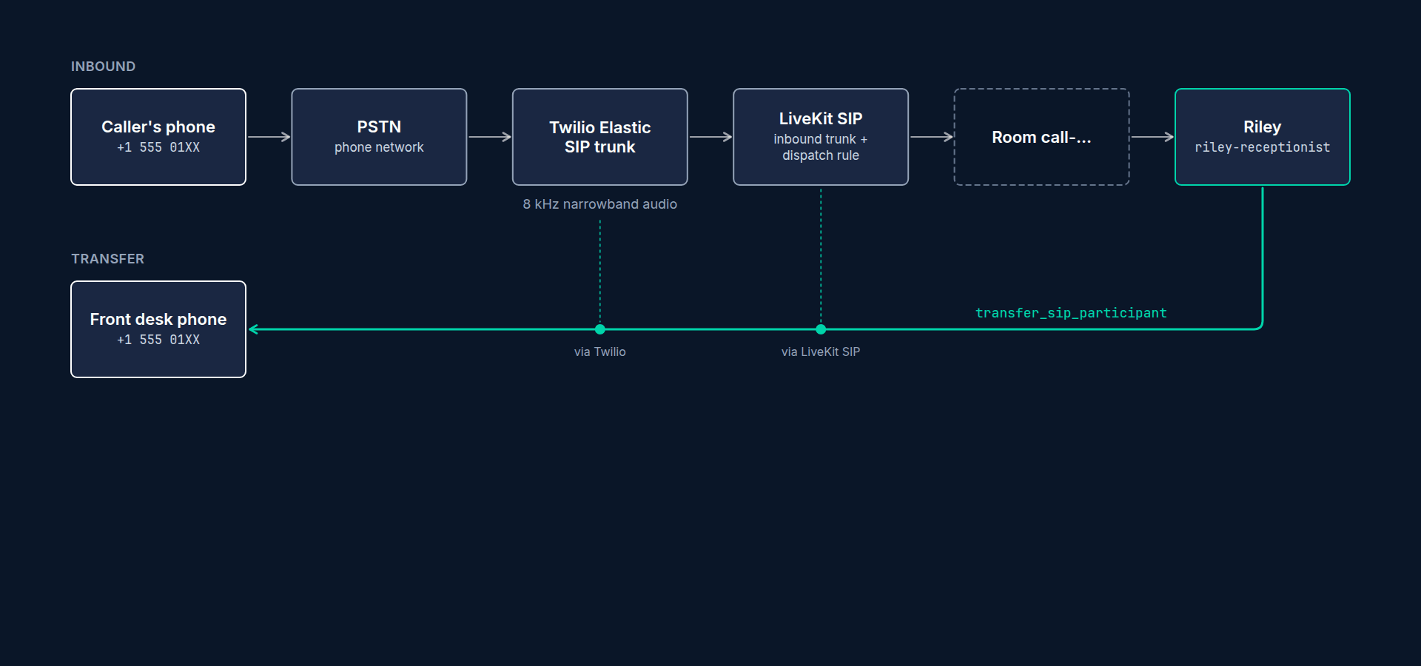
Cold vs warm transfer
Cold (blind) transfer: agent announces, then hands the call over; the human starts fresh
Warm transfer: agent puts caller on hold, briefs the human, then connects them
Cold: simple, one API call, SIP REFER on the trunk
Warm: better experience, more moving parts (LiveKit ships a beta WarmTransferTask)
Production Voice AI Agents · Section 08 · Lecture 8.4
Notes:
Two kinds of transfer. A cold transfer is what most phone systems do. Riley says "I'm transferring you now," and the call is handed to the front desk number. The human picks up with no context. It's one API call.
A warm transfer is what a great human receptionist does. Put the caller on hold, call the colleague, say "I've got Priya, she's asking about a charge on her last visit," and then connect them. It's a better experience with more moving parts. LiveKit Agents 1.8 includes a beta building block for it called `WarmTransferTask`. We'll build the cold transfer here, because it's what most clinics need first.
[SCREEN: Twilio Console → Elastic SIP Trunking → your trunk → General. Enable "Call Transfer (SIP REFER)". Banner: "Verify in current Liv...]
One console step first. A cold transfer uses a SIP message called REFER, which asks Twilio to move the call. Twilio only honors it if call transfer is enabled on the trunk. In your trunk's general settings, turn on call transfer. If you're transferring to a regular phone number, also allow transfers to the PSTN. Without this, the transfer fails silently and the caller stays with Riley.
[CODE: `.env` (add)]
Then tell Riley where to transfer. That's the front desk's number, in E.164. `get_settings()` turns it into a `tel:` URI for us, as `settings.transfer_sip_uri`.
[SCREEN: `agents/common.py`, scroll to `class TelephonyToolsMixin`.]
Now the tool. It lives in `agents/common.py`, in `TelephonyToolsMixin`, so the capstone can reuse it. Let's build it up.
[CODE: `transfer_to_human`, step 1: signature and docstring]
The docstring does two jobs. It tells the model what the tool does. And it tells the model to announce the transfer first. The `reason` argument forces the model to say why, in one sentence. We store it, so the front desk dashboard and our tests can see it.
When does Riley use it? That's in its prompt already, in the `ESCALATION_RULES` block from `prompts.py`: offer a human if the caller asks for one, is upset, has a billing dispute, or Riley has failed twice. And transfer immediately, without arguing, if they ask a second time.
[CODE: step 2: guard rails]
Before we transfer anything, three checks. Is there a job context at all? In a test, there isn't. Is there a phone caller in the room? In a browser session, there isn't. Is a transfer number configured? If any answer is no, we raise a `ToolError` with a speakable instruction: apologize and offer to take a message. The failure path is part of the feature. A transfer tool that crashes leaves the caller in silence, which is the worst possible outcome.
[CODE: step 3: announce, transfer, handle failure]
`context.wait_for_playout()` waits for whatever Riley said just before calling this tool, like "Of course, I'm transferring you to the front desk now," to finish playing. Without it, the transfer can cut Riley off mid-sentence.
The transfer itself lives in a small shared helper, `transfer_sip_caller`, a few lines above the mixin. Why a helper? Because in lecture 13.3, the capstone's error handler needs exactly the same transfer.
[CODE: `transfer_sip_caller` in `agents/common.py`]
Here's the one line that does the work: `transfer_sip_participant`, with the caller and the `tel:` URI. It returns once the phone system accepts the transfer. If it fails, say because REFER isn't enabled, the helper logs it, records the outcome and returns `False`, and the tool turns that into a speakable fallback for Riley.
Now `end_call`.
[CODE: `end_call`]
Why does Riley need a hang-up tool at all? Because on a phone, if the agent never hangs up, the line stays open. You pay per minute for silence, and the caller hears nothing until they give up.
The pattern is the same. Say goodbye, wait for playout, then act. We also record the call outcome. That field becomes one of our dashboard metrics in Section 10. And the hang-up itself is another small shared helper.
[CODE: `hang_up` in `agents/common.py`]
On a real call, deleting the room disconnects every participant, including the SIP caller, which ends the phone call. In console mode or tests there's no room to delete, so it just shuts the session down.
LiveKit also ships a ready-made `EndCallTool` in `livekit.agents.beta`. It's a good option. We wrote our own so you can see exactly what happens and set the outcome field.
[SCREEN: `agents/s08_telephony_agent.py`; the class line already includes `TelephonyToolsMixin`, and `PHONE_RULES` tells Riley to announc...]
`PhoneRiley` already inherits both tools through `TelephonyToolsMixin`, and its `PHONE_RULES` tell it to announce a transfer and say goodbye before acting. Let's test.
[DEMO: call Riley. "I have a question about a charge on my bill, can I talk to someone?" Riley: "Of course. I'm transferring you to a mem...]
"Can I talk to someone about a charge on my bill?" Riley announces the transfer, and there's the front desk phone ringing. Second call. "That's all, thanks, bye." Riley says goodbye, and the line drops. In the dashboard, the room is gone.
One more production habit. Test the failure path on purpose. The cheapest way costs no phone minutes at all: console mode, where there's no SIP caller to transfer.
[SCREEN: terminal]
[DEMO: type "Can I talk to a person, please?" The log shows `ToolError while executing tool: Transfers aren't available on this line. Apo...]
There's the `ToolError` in the log, and Riley apologizes and offers to take a message. On a real phone line, unset `TRANSFER_PHONE_NUMBER` and you hit the same path. If Riley went silent instead, your caller would too.

Slide 21
When to upgrade to a warm transfer
Callers complain about repeating themselves to staff
Transfers are for complex issues (billing disputes, clinical questions)
Staff are busy: the agent can hold, brief and connect when someone's free
Building block: WarmTransferTask (beta) in livekit.agents.beta.workflows
Production Voice AI Agents · Section 08 · Lecture 8.4
Notes:
When is it worth moving from cold to warm transfers? When callers complain about repeating themselves. When transfers are mostly complex issues, like billing disputes, where a thirty-second briefing saves five minutes of the staff member's time. And when staff are busy, so the agent can keep the caller company on hold instead of dropping them into a ringing line.
A warm transfer has more moving parts: put the caller on hold, dial the staff member into a separate conversation, summarise the call for them, then connect the two and leave. LiveKit Agents 1.8 ships a beta building block for this, `WarmTransferTask`, in `livekit.agents.beta.workflows`. It's beta, so check its current API before you build on it. For most clinics, a cold transfer with a clear reason logged in `CallState` is the right first step.

Slide 22
RECAP
Key takeaways
✓
Announce, wait for playout, then transfer or hang up
✓
No SIP caller or number: a speakable ToolError
✓
Shared helpers: transfer_sip_caller and hang_up
Production Voice AI Agents · Section 08 · Lecture 8.4

Slide 23
→
Next up:
Outbound calls: appointment reminders
So far callers have called Riley.
Production Voice AI Agents · Section 08 · Lecture 8.4

Slide 24
SECTION 8 · TELEPHONY: PUT RILEY ON A PHONE NUMBER
LECTURE 8.5
Outbound calls: appointment reminders
An outbound call is an explicit dispatch with metadata, then a CreateSIPParticipantRequest that dials the patient into the agent's room.
Production Voice AI Agents · Section 08 · Lecture 8.5
Notes:
Title card (K2). Outbound calls: appointment reminders.

Slide 25
How an outbound call works
A script asks LiveKit to dispatch a named agent into a new room, with metadata: who to call
The agent starts in that room and reads ctx.job.metadata
The agent asks LiveKit SIP to dial the patient into its room (CreateSIPParticipantRequest)
The patient answers → they're a participant → conversation as usual
Production Voice AI Agents · Section 08 · Lecture 8.5
Notes:
Outbound is inbound in reverse. Instead of a dispatch rule creating a room when someone calls, a small script creates the dispatch itself. It gives the agent's job some metadata: the phone number and the patient's name. The agent starts, reads that metadata, and asks LiveKit's SIP service to dial the patient into its own room. When they pick up, they're a participant, and Riley talks to them like any caller.
[SCREEN: Twilio Console → your trunk → Termination. Set a Termination SIP URI like `maple-dental.pstn.twilio.com`. Under Authentication,...]
First, Twilio. Open your trunk's Termination section. Termination is Twilio's word for "calls coming from you, going out to the phone network." Pick a termination SIP URI. Mine is `maple-dental.pstn.twilio.com`. Then add a credential list: a username and a strong password. LiveKit will use those to authenticate.
[CODE: `telephony/outbound-trunk.json`]
Now the LiveKit side. The outbound trunk points at Twilio's termination address. `numbers` is the caller ID the patient will see, which should be the clinic's own number, so they recognize it. And the credentials match the Twilio credential list. Don't commit the real password. Keep this file out of git, or template it from your secrets.
[DEMO: CLI prints the outbound trunk ID, starting `ST_`.]
Copy the trunk ID into `.env`.
[SCREEN: `agents/s08_outbound_call.py`]
Now open `agents/s08_outbound_call.py`. It has two halves: the agent, and a small dispatcher you run from the command line. Let's start with the dispatcher.
[CODE: the dispatcher]
`api.LiveKitAPI()` reads your LiveKit URL and keys from the environment. We make a unique room name that starts with `reminder-`. Then `create_dispatch` with a `CreateAgentDispatchRequest`: the agent's name, the room, and the metadata as a JSON string, with the phone number and the patient's name. That's explicit dispatch. It starts one job for that agent, in that room. The rest of the file wires this function to a `dispatch` sub-command with `--to`, `--name` and `--agent-name` flags.
Now the agent. First, the reminder persona.
[CODE: `ReminderRiley`]
`ReminderRiley` has the booking tools, so a patient can reschedule on the spot, and the telephony tools, so it can hang up or transfer. Its prompt adds `REMINDER_CALL_EXTRA` from `prompts.py`. It says: this is an outbound call you placed, say who you are and why you're calling in the first sentence, confirm the appointment, help them reschedule if needed, and if you reach voicemail, leave a short message with the day, time and clinic number, then end the call. The appointment itself is looked up from the scheduler by phone number, so the metadata only carries a number and a name, never medical details.
[CODE: the entrypoint]
Let's walk through it. The entrypoint reads `ctx.job.metadata`, the JSON the dispatcher sent, and builds `ReminderRiley` with the patient's name and appointment. If there's no phone number, we're in console or playground testing, so it just starts the conversation. If there's no outbound trunk configured, it logs a clear error and shuts down.
[CODE: same entrypoint, highlight `await session.start(agent=agent, room=ctx.room)`, then the `create_sip_participant(...)` call and `wai...]
Then the order matters. We start the session first, so Riley is already listening when the patient answers. Then `ctx.api.sip.create_sip_participant` with a `CreateSIPParticipantRequest`: our room, our outbound trunk, the number to call, an identity for the patient, and `wait_until_answered=True`, which means this line doesn't return until they pick up or the call fails.

Slide 26
When the outbound call fails
create_sip_participant raises api.TwirpError
exc.metadata["sip_status_code"] says why
486: busy · 480: unavailable or no answer
Log it, then ctx.shutdown(...): never leave Riley in an empty room
Production Voice AI Agents · Section 08 · Lecture 8.5
Notes:
If it fails, LiveKit raises a `TwirpError`. The SIP status code tells you why: four eighty-six means busy, four eighty means unavailable or no answer. We log it and shut the job down, so Riley isn't left alone in an empty room.
Once answered, a short `generate_reply` has Riley introduce itself and the reason for the call. There's a shortcut you'll see in LiveKit's docs: `ctx.add_sip_participant(call_to=..., trunk_id=..., participant_identity=...)`. It sends the same request, but it doesn't wait for an answer, so we use the API directly here.
Let's call my own mobile. On a Twilio trial, the destination must be a verified number. The reminder worker runs under its own agent name, so it can't be confused with the inbound receptionist.
[SCREEN: terminal, two panes]
[DEMO: pane 2 prints "Dispatched riley-outbound to room reminder-...; the agent will dial +15125550142." The phone rings. Answer: "Hello?...]
The phone rings. I answer, and Riley introduces itself as an AI assistant, says why it's calling, names the appointment from the demo calendar, and asks one question. I ask to move it. It uses the same `find_available_slots` and `reschedule_appointment` tools as inbound calls. And on the second call, which goes to voicemail, it leaves a short message and hangs up.

Slide 27
Answering machines and failed calls
Voicemail picks up a large share of reminder calls
Prompt-level handling: recognise a greeting, leave a 15-second message, end_call
LiveKit Agents 1.8 also includes AMD (answering-machine detection): start it before dialing so it hears the first words
Retry policy: no answer → retry once, later in the day; never loop
Production Voice AI Agents · Section 08 · Lecture 8.5
Notes:
Now the messy part. Many reminder calls reach voicemail. Riley's prompt already handles the simple case. For higher volumes, LiveKit Agents 1.8 includes an answering-machine detection helper, `AMD`, which classifies the greeting as a human, a voicemail or a phone menu. Start it before you dial, so it hears the first words. And whatever you do, retry at most once, later in the day. A system that redials an unanswered number five times in an hour is exactly what the rules in the next lecture are designed to stop.
One design decision worth pointing out. We run the reminder agent as a separate worker, with its own agent name, `riley-outbound`, instead of adding reminder logic to the inbound receptionist. That keeps each agent simple, it means a bug in reminder calls can never affect inbound callers, and it lets you scale them separately: inbound needs capacity at nine in the morning, reminders can run in a quiet afternoon batch. In production, the `dispatch` step usually isn't a person at a terminal. It's a scheduled job that reads tomorrow's appointments, checks consent and do-not-call lists, and dispatches one reminder per patient, a few at a time.

Slide 28
RECAP
Key takeaways
✓
Explicit dispatch carries who to call as metadata
✓
Agent dials with CreateSIPParticipantRequest(wait_until_answered=True)
✓
Separate riley-outbound worker; retry once, never loop
Production Voice AI Agents · Section 08 · Lecture 8.5

Slide 29
→
Next up:
Compliance: disclosure, consent and recording
Riley can now call real people.
Production Voice AI Agents · Section 08 · Lecture 8.5

Slide 30
SECTION 8 · TELEPHONY: PUT RILEY ON A PHONE NUMBER
LECTURE 8.6
Compliance: disclosure, consent and recording
Before a voice agent takes or places real calls, check five compliance areas: AI disclosure, recording consent, outbound calling rules, do-not-call, and…
Production Voice AI Agents · Section 08 · Lecture 8.6
Notes:
Title card (K2). Compliance: disclosure, consent and recording.

Slide 31
Not legal advice
This lecture is general information, not legal advice
Laws vary by country, state and industry, and change often
Use the checklist to prepare questions for a qualified lawyer
10-resources/telephony-compliance-checklist.md
Production Voice AI Agents · Section 08 · Lecture 8.6

Slide 32
Five areas to check
AI disclosure
Call-recording consent
Outbound calling rules (TCPA in the US)
Do-not-call lists
Data retention and health privacy
Production Voice AI Agents · Section 08 · Lecture 8.6
Notes:
Five areas. Let's take them one at a time.
One: AI disclosure. More and more jurisdictions require, or strongly expect, that a caller is told when they're talking to an AI. Even where it isn't required, it's the right default. Riley's first sentence already does it: "This is Riley, the clinic's AI assistant." And its prompt says that if anyone asks whether it's a person, it says plainly that it's an AI. Don't let a persona tweak remove that sentence. In Section 9, we'll write a test that fails if it disappears.

Slide 33
Recording consent
One-party consent: one participant may consent (many US states)
Two-party / all-party consent: everyone must consent (some US states, many countries)
Your agent is recording if you store audio or transcripts
Safe default: announce recording at the start of every call
Production Voice AI Agents · Section 08 · Lecture 8.6
Notes:
Two: recording consent. If you store call audio, or even full transcripts, you're probably recording. In the US, some states only need one party's consent. Others need everyone's. Many other countries also require all parties to be told. You can't always know where your caller is standing. So the safe engineering default is simple: announce it. "This call may be recorded for quality and training." Put it in the greeting, and make recording a setting you can switch off per region.

Slide 34
Outbound calls: stricter rules
US TCPA: AI-generated voices count as "artificial" voices for robocall rules (FCC, 2024)
Prior express consent needed; written consent for marketing calls
Calling-hour limits, caller ID must be accurate, easy opt-out
Appointment reminders are generally treated differently from marketing, but still need consent
Production Voice AI Agents · Section 08 · Lecture 8.6
Notes:
Three: outbound calls. This is where the rules get strict. In the US, the Telephone Consumer Protection Act, the TCPA, governs automated and artificial-voice calls. In 2024 the FCC clarified that AI-generated voices count as artificial voices under those rules. In practice, that means you need the patient's prior consent to call them with Riley. Marketing calls need even stronger, written consent. There are limits on calling hours, your caller ID must be accurate, and the person must be able to opt out easily.
Appointment reminders to your own patients are generally treated more leniently than sales calls. But "more leniently" isn't "no rules." Collect consent at booking time, store it, and have your lawyer check the wording.

Slide 35
Do-not-call and opt-out
Check national and internal do-not-call lists before dialing
"Stop calling me" → record it and never call again
Opt-out must work by voice, on the call itself
Test it (Section 9): simulated caller says "take me off your list"
Production Voice AI Agents · Section 08 · Lecture 8.6
Notes:
Four: do-not-call. Before any outbound call, check the relevant do-not-call lists and your own internal opt-out list. And when someone says "stop calling me," Riley must record it and the system must honor it, on the call, by voice. That's a behavior you can test. We'll add it to the simulated-caller personas in lecture 9.9.

Slide 36
Data retention and health privacy
Health providers: HIPAA in the US; GDPR special-category data in the EU/UK
Business associate agreements (BAAs) with every vendor that touches patient data
Minimize: redact PII in logs and traces (Section 11)
Retention: define how long transcripts and audio live, then delete them
Production Voice AI Agents · Section 08 · Lecture 8.6
Notes:
Five: data. Maple Street Dental is a health provider. In the US, that likely means HIPAA applies, and every vendor that handles patient information, your telephony provider, your speech-to-text and LLM providers, your tracing tool, may need a business associate agreement. In Europe and the UK, health data is special-category data under GDPR. Engineering can help a lot here. Collect less. Redact personal data before it reaches logs and traces, which we'll build in Section 11. And set a retention period, then actually delete old transcripts and recordings.

Slide 37
Compliance you can build into code
Disclosure: in GREETING, protected by a behavior test (9.3)
Recording: a per-region setting, off unless you've announced it
Consent: a stored consent flag checked before any outbound dispatch
Opt-out: "stop calling me" writes to a do-not-call list the dispatcher checks
Retention: a scheduled job that deletes transcripts and recordings past your retention period
Production Voice AI Agents · Section 08 · Lecture 8.6
Notes:
Here's the good news for engineers. Most of these items turn into small, testable pieces of code. Disclosure lives in the greeting, and a behavior test in Section 9 fails if anyone removes it. Recording is a setting you can switch per region. Consent is a stored flag that the outbound dispatcher checks before it ever dials. Opt-out is a list that "stop calling me" writes to and the dispatcher reads. And retention is a scheduled job that deletes old transcripts and recordings. Your lawyer tells you the rules. Your code makes sure they're followed every time, not just when someone remembers.
[SCREEN: `10-resources/telephony-compliance-checklist.md` scrolled slowly; each item has a checkbox and a "question for counsel" column.]
The checklist in the resources folder turns all of this into boxes to tick and questions for your lawyer. Use it before your first real caller, and again before your first outbound campaign. Once more, because it matters: this is not legal advice. It's a list of things to get proper advice on.

Slide 38
RECAP
Key takeaways
✓
Disclose AI, announce recording, honor opt-outs
✓
Outbound AI calls need consent (TCPA)
✓
Not legal advice: take the checklist to counsel
Production Voice AI Agents · Section 08 · Lecture 8.6

Slide 39
→
Next up:
Project 2: Phone receptionist
Now it's your turn to put all of Section 8 together: Project 2, your own phone receptionist.
Production Voice AI Agents · Section 08 · Lecture 8.6

Slide 40
SECTION 8 · TELEPHONY: PUT RILEY ON A PHONE NUMBER
LECTURE 8.7
Project 2: Phone receptionist
Ship a receptionist that answers, books and transfers on a real call, by phone number or, where that isn't possible, by web…
Production Voice AI Agents · Section 08 · Lecture 8.7
Notes:
Title card (K2). Project 2: Phone receptionist.

Slide 41
Two paths, same requirements
Path A: Twilio number, Elastic SIP trunk, LiveKit inbound trunk and dispatch rule
Path B: web client with explicit dispatch, plus a softphone call to your LiveKit SIP URI
Both: AI disclosure, a booking with read-back, a transfer, a clean end_call
Production Voice AI Agents · Section 08 · Lecture 8.7
Notes:
There are two ways to do it. Path A is what we did in this section: a Twilio number, an Elastic SIP trunk, and a LiveKit inbound trunk and dispatch rule.
[SCREEN: `05-projects/project-2-phone-receptionist.md`, scrolled to the Path B steps: the softphone settings and the `sip:` address.]
Path B is for you if you can't get a Twilio number. Some countries require identity documents or a local business address, and some students simply don't want to pay for one. Path B has two parts. First, a web client: connect to your named agent from the Agents Playground or the React starter, and dispatch it explicitly with `lk dispatch create`. Second, a SIP test: use a free softphone app such as Linphone to call your LiveKit SIP URI directly, so the call still goes through your inbound trunk, your dispatch rule and the `sip.phoneNumber` caller ID path. The project file has the exact steps, and a note to verify them in the current LiveKit console. For the transfer requirement on Path B, transfer to a second SIP address instead of a phone number.

Slide 42
Deliverables
2-minute recording of a real call, with captions (phone or softphone)
telephony/ JSON files with secrets removed, plus a short README
Completed compliance checklist, with the "question for counsel" column filled in
One failure path shown: transfer unset, withheld caller ID, or 20 seconds of silence
Production Voice AI Agents · Section 08 · Lecture 8.7
Notes:
The rubric rewards the failure paths. What happens when the transfer number is unset? When caller ID is withheld? When the caller says nothing for twenty seconds? Show at least one of those in your recording. Both paths earn full marks. Post your recording in the Q&A. I'd love to hear your receptionist.

Slide 43
SECTION COMPLETE
You can now
✓
Put a voice agent on a real phone number, inbound and outbound
✓
Tune speech-to-text and turn-taking for 8 kHz phone audio
✓
Transfer callers to a human and hang up safely
Production Voice AI Agents · Section 08 · Lecture 8.7

Slide 44
→
Next up:
Quiz: Telephony
Before Section 9, a five-question quiz to check the telephony essentials.
Production Voice AI Agents · Section 08 · Lecture 8.7

Slide 45
SECTION 8 · TELEPHONY: PUT RILEY ON A PHONE NUMBER
LECTURE 8.8
Quiz: Telephony
Check you can trace a call path and choose the right telephony tool for each job.
Production Voice AI Agents · Section 08 · Lecture 8.8
Notes:
Title card (K2). Quiz: Telephony.

Slide 46
Quiz: 5 questions
Call path and dispatch
Transfer and end call
Outbound calls and compliance basics
Production Voice AI Agents · Section 08 · Lecture 8.8
Notes:
A tip for the call-path question: walk the chain from the caller to the agent, in order, and ask at each link whether the call could have got this far. The first link where the answer is "no" is where to look.
[SCREEN: terminal in `03-code`: `grep -n "riley-receptionist" .env.example livekit.toml.example`. Two hits: `# LIVEKIT_AGENT_NAME=riley-r...]
And when it's silence, the agent name is the usual suspect. It lives in two files, and both must match the dispatch rule.
Every answer links back to its lecture. About five minutes, and the compliance question tests what to check, not legal advice.

Slide 47
→
Next up:
How voice agents fail in production
Riley is now live on a phone.
Production Voice AI Agents · Section 08 · Lecture 8.8

