Slide 1
SECTION 10 · OBSERVABILITY, LATENCY AND COST
LECTURE 10.1
What to measure on every call
Measure every call on three levels: pipeline timing, model usage, and business outcome.
Production Voice AI Agents · Section 10 · Lecture 10.1
Notes:
Title card (K2). What to measure on every call.

Slide 2
Three levels of measurement
Pipeline timing: how fast each stage is, per turn
Usage: how much of each model each call consumes (the cost drivers)
Outcome: what actually happened on the call
Production Voice AI Agents · Section 10 · Lecture 10.1
Notes:
Three levels. Timing tells you how the call felt. Usage tells you what it cost. Outcome tells you whether it worked. Most teams collect the first, estimate the second, and forget the third.

Slide 3
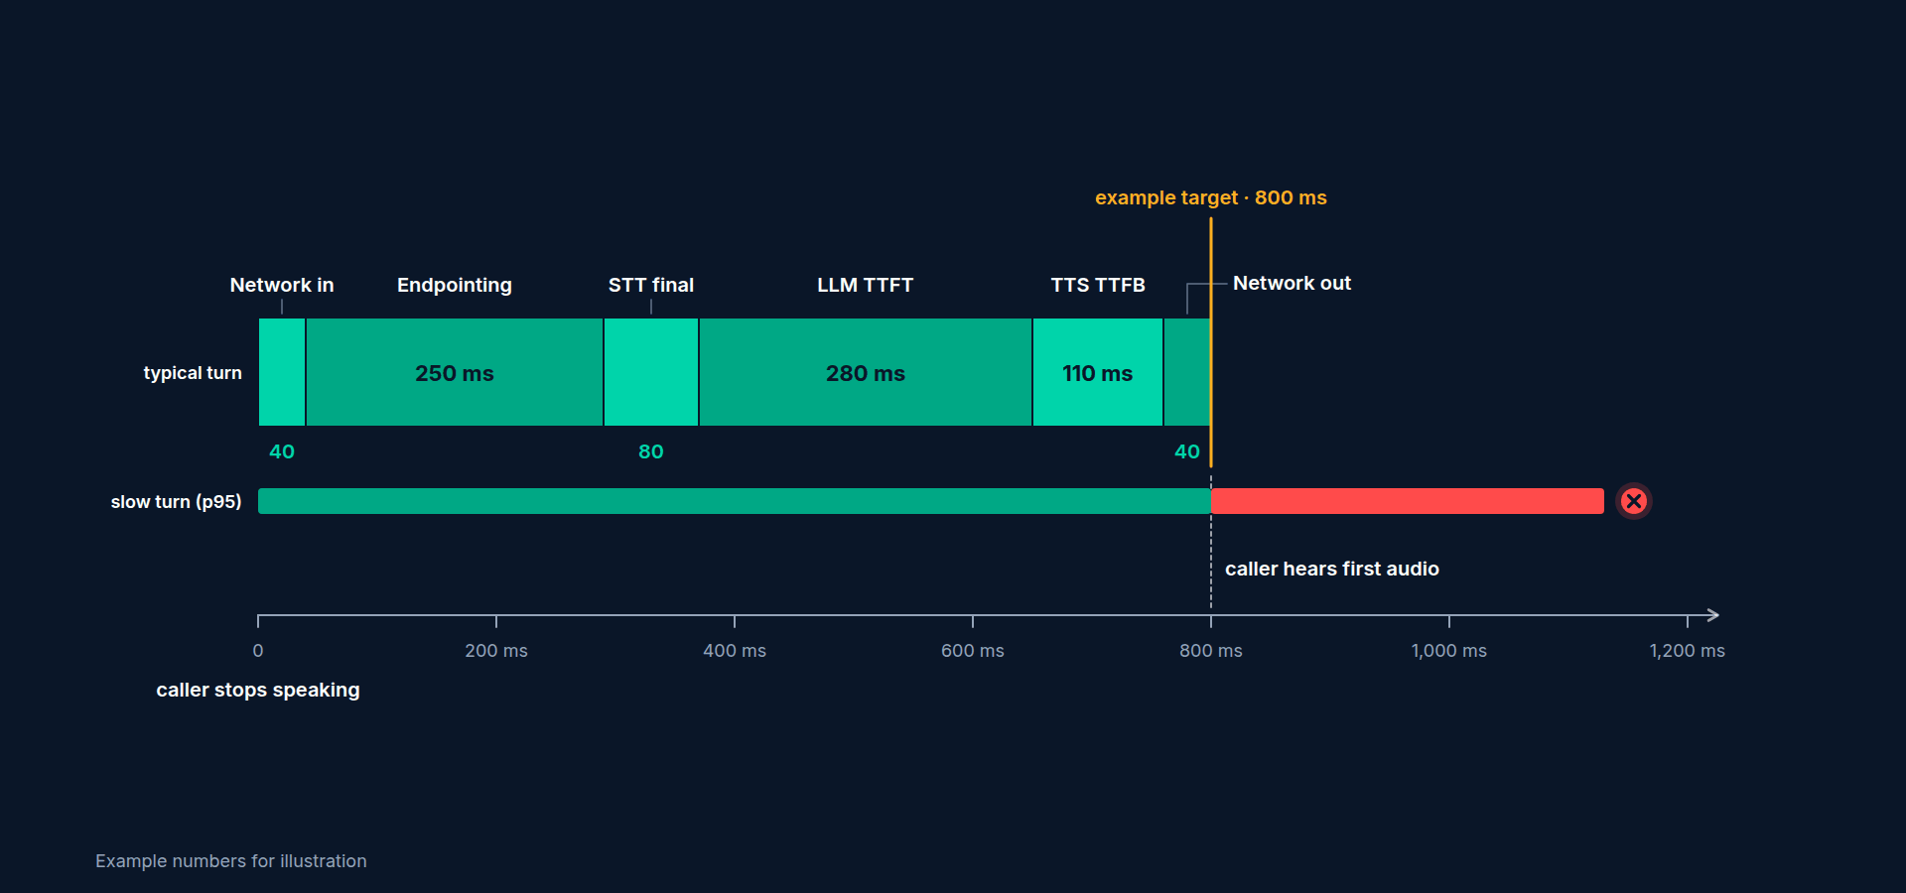
One turn, timed
end_of_utterance_delay: caller stops → turn declared over (VAD, endpointing, turn detector)
transcription_delay: caller stops → final transcript
LLM ttft: request → first token (plus prompt_tokens, completion_tokens)
TTS ttfb: first text → first audio byte (plus characters_count)
Per-turn e2e_latency on each assistant message (ChatMessage.metrics)
Production Voice AI Agents · Section 10 · Lecture 10.1
Notes:
[B-ROLL: animated timeline of one turn. Caller waveform ends; a bracket labelled "EOU delay 560 ms"; then "LLM TTFT 470 ms"; then "TTS TT...]
Here's one turn, timed. The caller stops speaking. The end-of-utterance delay is how long Riley waits before deciding the caller is done. That's VAD, endpointing and the turn detector together. On a phone line it's often the biggest single piece. The transcription delay is when the final transcript arrives. Then the LLM's time to first token, and the TTS's time to first byte. Add those up and you get voice-to-voice latency, the silence the caller actually hears.
[SCREEN: terminal in `03-code`: `sed -n '2,3p' tests/data/sample_metrics.jsonl`. An `eou_metrics` line with `"end_of_utterance_delay": 0....]
LiveKit reports all of these for you. In Section 9 we turned them into a budget. In this section we'll collect them on every call, not just in tests.

Slide 4
Usage: the cost drivers
STT: audio seconds sent
LLM: prompt tokens (and cached tokens), completion tokens
TTS: characters synthesized
Realtime models: audio input and output tokens
Plus: call minutes (platform) and telephony minutes
Production Voice AI Agents · Section 10 · Lecture 10.1
Notes:
Usage is the second level. Each provider bills on its own unit. Speech-to-text bills audio seconds. The LLM bills tokens, and cached prompt tokens are much cheaper. Text-to-speech bills characters. A realtime model bills audio tokens, which are expensive. And on top of that, you pay per minute for the agent platform and the phone line. If you don't capture usage per call, you can't answer the question from lecture 10.4: "what does one minute of Riley cost?"

Slide 5
Outcome: what happened on the call
call_outcome: booked, rescheduled, cancelled, waitlisted, transferred, completed, error
Tool calls: count, failures (ToolError), and tool latency
Interruptions and false interruptions
Transfers requested vs completed; calls that ended in silence
Call duration
Production Voice AI Agents · Section 10 · Lecture 10.1
Notes:
The third level is the one most dashboards miss. What happened? Riley already records a `call_outcome` in `CallState`: booked, cancelled, transferred, completed, error. Add tool calls and tool failures. Add interruptions, because a caller who interrupts five times is a caller who's frustrated. Add transfers requested versus transfers completed. And calls that ended in silence. Our "robot kept hanging up" complaint? That showed up in outcomes: a spike in calls ending in `end_call` less than twenty seconds in. Timing was fine. The outcome wasn't.

Slide 6
Where each metric comes from
metrics_collected events: EOU, STT, LLM, TTS, VAD metrics, per stage (still works in 1.8; we export these)
ChatMessage.metrics: per-turn latency (newer)
session.usage.model_usage: usage per model and provider (newer)
CallState: outcome, transfers, notes (your code)
OpenTelemetry spans: the story of each turn (lecture 10.3)
Production Voice AI Agents · Section 10 · Lecture 10.1
Notes:
And here's where each one comes from in LiveKit Agents 1.8. The `metrics_collected` event, which we used in Section 9, still works. Newer versions add per-turn metrics on each chat message, and usage per model on `session.usage`. Outcomes come from your own `CallState`. And traces come from OpenTelemetry. Next lecture, we wire up all of them.

Slide 7
One call, one record
call_summary: room, call seconds, model usage, cost components, cost per minute, outcome
Plus every per-stage metric line for that call
Plus events worth counting: agent_false_interruption, user_state_changed (away), function_tools_executed
One file per call: easy to find, easy to aggregate
Production Voice AI Agents · Section 10 · Lecture 10.1
Notes:
Here's what "measure every call" becomes in practice: one record per call. A summary line with the room name, how long the call lasted, usage per model, the cost of each component, the cost per minute, and the outcome. Above it, every per-stage metric for that call. That's what we'll build in the next lecture.
And a few session events are worth counting too. LiveKit emits `agent_false_interruption` when Riley paused for what turned out not to be a real interruption, like a cough. A spike means your interruption settings are too sensitive for phone lines. `user_state_changed` tells you when a caller went quiet for a long time, which often means confusion. And `function_tools_executed` tells you which tools ran on each turn.

Slide 8
If you only had one minute a day
p95 voice-to-voice latency
Cost per minute
Share of calls handled without a human
Production Voice AI Agents · Section 10 · Lecture 10.1
Notes:
Last thought for this lecture. Decide now which three numbers you'd look at if you only had one minute a day. For Maple Street Dental, mine are p95 voice-to-voice latency, cost per minute, and the share of calls that ended booked or answered without a human. Everything else is there for when one of those three looks wrong.
A question I often get: "Isn't all this measurement expensive?" Not really. The metrics are already computed by LiveKit. Writing a few lines of JSON per turn costs almost nothing, and the traces are sent in the background. The expensive part is not having the data on the day a patient complains, and having to guess. Collect everything numeric by default. Be careful with content, like transcripts, which we'll handle in Section 11.
Here's what "everything numeric" means for Riley. Per turn: four timings and two token counts. Per call: usage per model, cost, duration and outcome. Per day: those rolled up into the five dashboard numbers you'll meet in lecture 10.5. That's it. It fits on one slide, and it answers almost every question anyone will ask you about Riley in production.

Slide 9
RECAP
Key takeaways
✓
Timing: per-stage delays on every turn
✓
Usage: seconds, tokens and characters drive cost
✓
Outcome: what actually happened on the call
Production Voice AI Agents · Section 10 · Lecture 10.1

Slide 10
→
Next up:
Collecting metrics and usage
Next, we'll collect metrics and usage from a live Riley and write them to a file on every…
Production Voice AI Agents · Section 10 · Lecture 10.1

Slide 11
SECTION 10 · OBSERVABILITY, LATENCY AND COST
LECTURE 10.2
Collecting metrics and usage
Attach observers to the session, not the agent: log and export every metric, record per-turn latency, and write a usage and cost…
Production Voice AI Agents · Section 10 · Lecture 10.2
Notes:
Title card (K2). Collecting metrics and usage.

Slide 12
RECAP
Key takeaways
✓
Observers wrap the session, not the agent
✓
One JSONL file per call, ending in call_summary
✓
session.usage replaces the deprecated UsageCollector
Production Voice AI Agents · Section 10 · Lecture 10.2

Slide 13
→
Next up:
Tracing with OpenTelemetry and Langfuse
Numbers tell you something is slow.
Production Voice AI Agents · Section 10 · Lecture 10.2

Slide 14
SECTION 10 · OBSERVABILITY, LATENCY AND COST
LECTURE 10.3
Tracing with OpenTelemetry and Langfuse
Point LiveKit's built-in OpenTelemetry spans at Langfuse, and every call becomes a readable trace of turns, LLM requests and tool calls, with…
Production Voice AI Agents · Section 10 · Lecture 10.3
Notes:
Title card (K2). Tracing with OpenTelemetry and Langfuse.

Slide 15
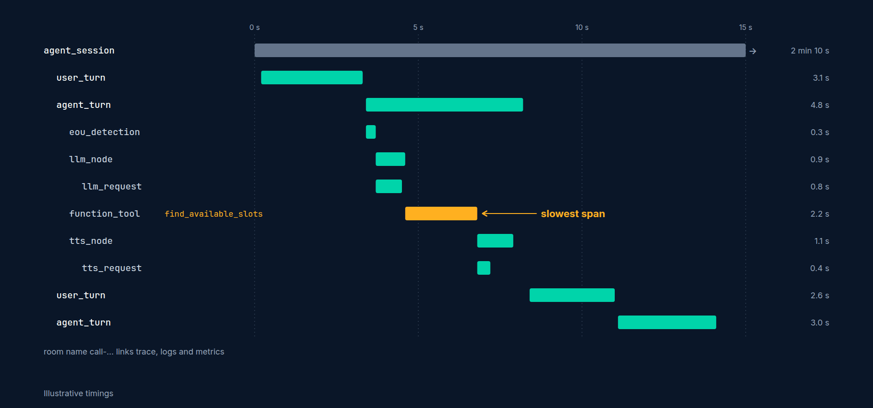
What LiveKit traces for you
agent_session: the whole call
user_turn / agent_turn: each side of the conversation
eou_detection, llm_node, llm_request, function_tool, tts_node, tts_request
Attributes: model names, token counts, timings, tool arguments (when allowed)
Span names can change between versions; check your trace viewer
Production Voice AI Agents · Section 10 · Lecture 10.3
Notes:
Here's what you get for free. A span for the whole session. Spans for each user turn and agent turn. Inside those, end-of-utterance detection, the LLM node and the actual LLM request, every function tool call, and the TTS work. Each span carries attributes: model names, token counts, timings, and, if you allow it, the text and tool arguments.
[SCREEN: Langfuse cloud → Settings → API keys → create key pair. Copy public and secret keys.]
First, Langfuse keys. In Langfuse, open your project's settings and create an API key pair. You get a public key and a secret key. Put them in `.env`.
[CODE: `.env` (add)]
And install the observability extra, which brings in the OpenTelemetry SDK and OTLP exporter.
[SCREEN: `agents/s10_observed_agent.py`, `setup_observability`]
[CODE: `setup_observability`, step 1: pointing OTLP at Langfuse]
Langfuse accepts OpenTelemetry traces at `/api/public/otel` on your Langfuse host, authenticated with HTTP basic auth: your public key and secret key, joined with a colon and base64-encoded. We set the two standard OpenTelemetry environment variables, the endpoint and the headers, and the exporter picks them up. The `%20` is a URL-encoded space, which the OTLP headers format expects. If there are no Langfuse keys but a generic OTLP endpoint is set, we use that instead, so the same code works with Grafana, Honeycomb or any other OpenTelemetry backend. And if neither is set, tracing is off and the agent runs normally.
[CODE: step 2: the tracer provider]
Standard OpenTelemetry setup. A `TracerProvider` named after our service. A `BatchSpanProcessor`, which sends spans in the background in batches, so tracing never slows down a turn. An `OTLPSpanExporter` over HTTP, which reads the environment variables we just set.
[CODE: same block, highlight `set_tracer_provider(provider, metadata={...}, allow_pii=False)`.]
Then the LiveKit-specific line: `set_tracer_provider` from `livekit.agents.telemetry`. It tells LiveKit Agents to send its spans through our provider. Two arguments matter. `metadata` adds attributes to every span, here the clinic name. And `allow_pii`. With `allow_pii=False`, LiveKit strips conversational content, tool payloads and other user data from spans before they reach Langfuse, and keeps the timings, models and token counts. For a dental clinic, that's the right default. Patients say their names, birthdays and symptoms out loud. If your data-retention policy and your vendor agreement with Langfuse allow transcripts in traces, you can flip it to `True` and see full conversations. That's a policy decision, not a coding one, and we'll come back to it in Section 11.
We call `setup_observability()` at the top of the entrypoint, as you saw last lecture. Run a call.
[DEMO: a call: ask about parking, then book a cleaning. End the call. Switch to Langfuse → Traces. Open the newest trace: a tree with `ag...]
The startup log says "tracing enabled via langfuse." After the call, open Langfuse. Here's the trace. At the top, the whole session. Inside, each turn. Open this agent turn: the LLM request, with the model and the token counts. The `function_tool` span for `lookup_clinic_info`. Here's the booking turn: `find_available_slots`, then `book_appointment`.
Now the question we started with. Which turn was slow? Sort by duration. This one. Open it. The LLM request took most of it, and look at the prompt token count: nearly four thousand. It's the turn after the FAQ lookup, when the conversation plus the retrieved section made the prompt big. That's a concrete fix: trim what the tool returns. Metrics said "slow." The trace said "why."

Slide 16
Linking traces, logs and metrics
One key everywhere: the room name (call-...)
ctx.log_context_fields = {"room": ctx.room.name} on every log line
Metrics file: metrics/<room>.jsonl
Trace attributes: add metadata={...} for search (clinic, environment)
With allow_pii=False, use the room name to find a transcript in your own, access-controlled store
Production Voice AI Agents · Section 10 · Lecture 10.3
Notes:
Last piece: linking. When the clinic manager says "a patient called at 2:14 and Riley was weird," you need to jump from that call to its trace, logs and metrics. Use one key everywhere: the room name. It's on every log line through `log_context_fields`, it's the metrics file name, and it's on the trace. And because we keep transcripts out of traces, the room name is also how an authorized person finds the transcript in your own, access-controlled store.
If you've taken *AI Agent Testing & Evaluation*, you've used Langfuse there for scoring traces. The same idea applies here: you can attach evaluation scores from Section 9, like a DeepEval metric, to production traces. It's optional, and a great next step.
A quick tour of how I actually use traces day to day. I don't browse them. I search them. When the latency report flags a slow hour, I filter traces to that hour and sort by duration. When a tool starts failing, I filter for `function_tool` spans with errors. When the clinic reports a strange call, I search by room name. Traces are an index into your calls. You go to them with a question, and they give you the one call that answers it.
And if you don't want Langfuse, you don't need to change any code. Point `OTEL_EXPORTER_OTLP_ENDPOINT` at any OpenTelemetry-compatible backend, like Grafana Tempo, Honeycomb or Datadog, and `setup_observability` sends spans there instead. That's the value of an open standard: the tracing code you write today outlives whichever vendor you pick.

Slide 17
RECAP
Key takeaways
✓
LiveKit already emits OpenTelemetry spans per turn
✓
Point OTLP at Langfuse with basic auth
✓
allow_pii=False keeps transcripts out of traces
Production Voice AI Agents · Section 10 · Lecture 10.3

Slide 18
→
Next up:
Cost per minute: the number your boss will ask for
We know how fast Riley is and why.
Production Voice AI Agents · Section 10 · Lecture 10.3

Slide 19
SECTION 10 · OBSERVABILITY, LATENCY AND COST
LECTURE 10.4
Cost per minute: the number your boss will ask for
Cost per minute is usage times a price table divided by call minutes, and the breakdown shows where the money goes and…
Production Voice AI Agents · Section 10 · Lecture 10.4
Notes:
Title card (K2). Cost per minute: the number your boss will ask for.

Slide 20
The formula
Cost = Σ (usage × unit price) for STT, LLM, TTS, realtime, platform, telephony
Cost per minute = total ÷ call minutes
Usage comes from session.usage (lecture 10.2)
Prices come from YOUR invoices: every default is a placeholder
Production Voice AI Agents · Section 10 · Lecture 10.4
Notes:
The formula is simple. For each component, usage times its unit price. Add them up. Divide by call minutes. The hard parts are getting accurate usage, which we did last lecture, and getting accurate prices. Which brings me to the most important warning in this lecture.
[SCREEN: `src/maple/costs.py`, the module docstring warning and `PRICES_LAST_CHECKED`.]
Every price in `DEFAULT_PRICES` is a placeholder. It says so in capital letters at the top of `src/maple/costs.py`, and in `PRICES_LAST_CHECKED`. Providers change prices constantly, and LiveKit Inference, direct provider plugins and enterprise contracts all differ. Copy the table, fill it in from your own invoices, and pass it in.
[CODE: `src/maple/costs.py`, `PriceTable` (highlight; the docstring's attribute list is trimmed)]
Each field is a unit price in the unit the provider bills. STT per audio minute. LLM per million tokens, with cached input much cheaper. TTS per million characters. Realtime audio per million tokens, and look at the size of those two numbers compared with text. Platform per minute. Telephony per minute, zero for web calls, and about one and a quarter cents in `PHONE_PRICES`.
[CODE: `cost_breakdown` (the LLM line, highlight)]
`cost_breakdown` is exactly the formula. The one subtle line is the LLM: uncached prompt tokens at full price, cached ones at the cached price, plus output. It returns a `CostBreakdown` with each component, the total, cost per minute, and `largest_component()`, which answers "where does the money go?"
Let's use it. First, a real call from last lecture's metrics file.
[CODE: a quick script in the terminal]
[DEMO: `uv run python` with the snippet; prints the component table for the recorded call and its per-minute cost, plus the phone-priced...]
That's one real call. Now the bigger question: how do cascaded and realtime compare, and how does call length change things? `costs.py` includes two helpers with typical usage for a receptionist call, so we can compare shapes without making a hundred calls.
[CODE: comparing architectures]
[DEMO: output:
]
Read the numbers. With these placeholder prices, a three-minute cascaded call costs about six and a half cents a minute. And the biggest line isn't the LLM. It's text-to-speech: thirteen and a half cents of the nineteen-cent call. That surprises almost everyone. The LLM, `gpt-4.1-mini` with prompt caching, is under two cents for the whole call. So if the clinic wants Riley cheaper, the first conversation is with the TTS provider, or about shorter replies, not about the LLM.
[SCREEN: zoom on the three per-minute lines: cascaded 6.35, 6.46, 6.84; realtime 12.97, 16.23, 27.67.]
Now realtime. About thirteen cents a minute for a one-minute call, sixteen for three minutes, and nearly twenty-eight for ten minutes. It grows, because every turn re-sends the conversation history as audio tokens. Cascaded barely moves, from six point three five to six point eight four. That's the shape I promised in lecture 6.4, now as numbers you can put in a spreadsheet.

Slide 21
What moves the number
Shorter replies: fewer TTS characters (the biggest cascaded lever)
Prompt caching: keep the system prompt stable so it caches
Smaller prompts: trim tool results and old history
Phone adds telephony per minute (about 1.25 cents in PHONE_PRICES)
Realtime: keep calls short, or use the hybrid; compare with your own prices
Production Voice AI Agents · Section 10 · Lecture 10.4
Notes:
What moves the number? Shorter replies, which also make Riley sound better on the phone. A stable system prompt, so it caches. Trimming tool results, which we found in the trace last lecture. And for Maple Street Dental's twelve hundred minutes a day, the difference between six and a half and sixteen cents is about a hundred and fourteen dollars a day. Roughly three thousand four hundred a month. That's why the architecture decision in Section 6 mattered.

Slide 22
Presenting cost to a non-engineer
One number: cost per minute, web and phone
One sentence: where the money goes ("70 percent is the voice")
One comparison: cost of a human-answered minute
One lever: what you'd change to reduce it, and the trade-off
Production Voice AI Agents · Section 10 · Lecture 10.4
Notes:
Finally, how to present this to the person who asked. Give them one number: cost per minute, for web and for phone. One sentence about where the money goes. One comparison they already understand. A front-desk person costs the clinic something like thirty to fifty cents per minute of phone time when you include wages and overhead, so seven or eight cents is a very different conversation. And one lever: "If we shorten Riley's replies by a third, cost drops by about a fifth, and callers probably prefer it." That's a two-minute conversation that ends with a decision, which is the whole point of measuring.
One more sanity check before you share numbers: reconcile with your invoices. At the end of the month, add up the `cost_total` of every `call_summary` line and compare it with what your providers actually billed. If they're within ten or fifteen percent, your price table is right. If not, something's missing: a platform fee, a minimum charge, or a model you forgot to price. Do it once a month, and your cost-per-minute number becomes one people trust.

Slide 23
RECAP
Key takeaways
✓
Cost per minute: usage times price over minutes
✓
Cascaded Riley: text-to-speech is the biggest line
✓
Realtime cost per minute grows with call length
Production Voice AI Agents · Section 10 · Lecture 10.4

Slide 24
→
Next up:
Dashboards and alerts that matter
Now let's turn these numbers into dashboards and alerts that tell you when something's wrong.
Production Voice AI Agents · Section 10 · Lecture 10.4

Slide 25
SECTION 10 · OBSERVABILITY, LATENCY AND COST
LECTURE 10.5
Dashboards and alerts that matter
A voice agent dashboard needs five numbers, p95 latency, cost per minute, transfer rate, containment rate and failed tool calls, each with…
Production Voice AI Agents · Section 10 · Lecture 10.5
Notes:
Title card (K2). Dashboards and alerts that matter.

Slide 26
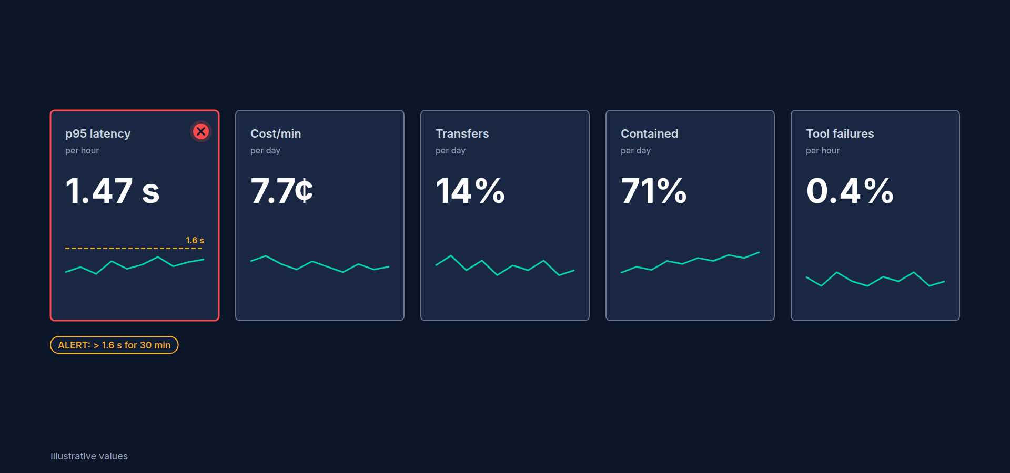
The five numbers
p95 voice-to-voice latency (per hour)
Cost per minute (per day)
Transfer rate (per day)
Containment rate (per day)
Failed tool calls (per hour)
Production Voice AI Agents · Section 10 · Lecture 10.5
Notes:
[B-ROLL: mock dashboard with five big tiles: "p95 latency 1.47 s", "Cost/min 7.7¢", "Transfers 14%", "Contained 71%", "Tool failures 0.4%...]
Number one, p95 voice-to-voice latency, per hour. Not the average. The ninety-fifth percentile, the same number our Section 9 budget checks. For Riley on the phone: alert if it's over one point six seconds for thirty minutes. First check: open the slowest traces and see which stage grew. Usually it's the LLM provider having a bad hour, or a prompt that got bigger.
[SCREEN: terminal in `03-code`: `uv run python tests/evals/latency_report.py`, the `voice_to_voice` row highlighted: p95 `1474` against `...]
Number two, cost per minute, per day, from the `call_summary` records. Alert if it's twenty percent above your baseline for a day. First check: the largest component. A prompt change that doubled the reply length shows up here before it shows up on the invoice.

Slide 27
Outcome rates
Containment rate = calls resolved without a human ÷ all calls (booked, rescheduled, cancelled, answered)
Transfer rate = transferred ÷ all calls
Healthy receptionist range (illustrative): containment 60 to 80 percent, transfers 10 to 25 percent
Both too high or too low is a signal
Production Voice AI Agents · Section 10 · Lecture 10.5
Notes:
Numbers three and four come from `call_outcome`. Transfer rate is the share of calls handed to a human. Containment rate is the share resolved without one: booked, rescheduled, cancelled, or question answered.
Here's the subtle part. Both directions are bad. If transfers jump from fifteen to forty percent, Riley is failing at something. Open the transcripts of transferred calls. If transfers drop to near zero, that's also suspicious. Maybe Riley stopped offering humans when it should, which is the "missed escalation" failure from lecture 9.1. The illustrative healthy range for a receptionist is something like sixty to eighty percent containment, and ten to twenty-five percent transfers. Your clinic will set its own.
[B-ROLL: the mock dashboard's "Tool failures" tile jumps from 0.4% to 6% with a red alert badge; the other four tiles stay green.]
Number five, failed tool calls per hour: any `ToolError` or exception in a tool. Alert at about two percent of tool calls. First check: the scheduler backend. If your practice-management system is down, this is the first number that moves, and it's how you learn before the patients tell you.

Slide 28
Alert hygiene
Every alert has a threshold, a time window, and an owner
Every alert links to a runbook step and a trace search
Page a human only for things that hurt callers now (latency, tool failures)
Everything else goes to a daily report
Review thresholds monthly; delete alerts nobody acts on
Production Voice AI Agents · Section 10 · Lecture 10.5
Notes:
Some alert hygiene. Every alert has a threshold, a time window, and an owner. Every alert links to its first diagnostic step: a trace search, or a test to run. Only page a human for things that hurt callers right now, like latency and tool failures. Cost and outcome rates go in a daily report. And once a month, delete any alert nobody acted on. An ignored alert is worse than no alert.

Slide 29
From alert to fix
Alert fires → trace shows the stage → reproduce with a behavior test (9.3) or simulated caller (9.9)
Fix → the new test stays in the suite → CI (9.10) prevents the regression
Production is the top of the testing pyramid
Production Voice AI Agents · Section 10 · Lecture 10.5
Notes:
And here's how it all connects. An alert fires. The trace shows the stage that broke. You reproduce it with a behavior test or a simulated caller. You fix it. The new test stays in the suite, and CI makes sure it never comes back. Production monitoring isn't separate from testing. It's the top of the pyramid.

Slide 30
A weekly review, 15 minutes
Read the five numbers for the week, and their trend
Listen to three calls: one transferred, one contained, one slow
Pick one fix, add one test for it
Review alert thresholds once a month
Production Voice AI Agents · Section 10 · Lecture 10.5
Notes:
Dashboards only help if someone looks at them. So here's the ritual I recommend: fifteen minutes, once a week. Read the five numbers and their trend. Then listen to three calls: one that was transferred, one that Riley handled alone, and the slowest one. You'll learn more from those three recordings than from any chart. Then pick one fix, and add one test for it, so the fix sticks. Once a month, review your alert thresholds. In a quarter, that's twelve fixes, twelve new tests, and a Riley that's measurably better than the one you launched.
Let me show you how the five numbers told a real story at a clinic like Maple Street Dental. One Monday, containment dropped from seventy-two to fifty-eight percent, and transfers doubled. Latency and cost were normal. The failed-tool-call tile was flat. So nothing was broken, technically. Listening to three transferred calls explained it: the clinic had changed its insurance list over the weekend, the FAQ hadn't been updated, and callers asking about the new plan got "I'm not sure" and asked for a person. One FAQ edit, one new golden conversation, and containment was back the next day. No single chart would have told that story. The five together did.

Slide 31
RECAP
Key takeaways
✓
Five numbers, each with threshold, owner and first check
✓
Transfers too high or too low: both signal trouble
✓
Page only for caller pain; report the rest daily
Production Voice AI Agents · Section 10 · Lecture 10.5

Slide 32
→
Next up:
Lab 6: Build a call-quality report
Time to build it yourself: Lab 6, a call-quality report from ten real calls.
Production Voice AI Agents · Section 10 · Lecture 10.5

Slide 33
SECTION 10 · OBSERVABILITY, LATENCY AND COST
LECTURE 10.6
Lab 6: Build a call-quality report
Turn ten real calls into a one-page report with latency, cost and outcomes.
Production Voice AI Agents · Section 10 · Lecture 10.6
Notes:
Title card (K2). Lab 6: Build a call-quality report.

Slide 34
Your one-page report
Headline numbers: p95 latency, cost per minute, containment, transfers
Three findings, each with evidence (a number, a trace, or a transcript)
One alert you'd set up, with threshold and first diagnostic step
One next experiment
Production Voice AI Agents · Section 10 · Lecture 10.6
Notes:
Step six is the deliverable: one page. Headline numbers. Three findings with evidence. One alert. One experiment you'd run next. Keep it to one page. That constraint is the skill.
A word on the slow calls. When you open their traces in step five, don't stop at "the tool was slow." Look at what Riley did while it was slow: did the filler speech play, and did the caller interrupt? That's the difference between a slow backend and a bad experience, and it's exactly the kind of finding that belongs in your report.

Slide 35
SECTION COMPLETE
You can now
✓
Export per-turn metrics and usage on every call
✓
Trace calls in Langfuse with patient data kept out
✓
Compute cost per minute and explain where it goes
Production Voice AI Agents · Section 10 · Lecture 10.6

Slide 36
→
Next up:
Quiz: Observability and cost
Then take the short quiz to wrap up Section 10.
Production Voice AI Agents · Section 10 · Lecture 10.6

Slide 37
SECTION 10 · OBSERVABILITY, LATENCY AND COST
LECTURE 10.7
Quiz: Observability and cost
Check you can choose metrics, read a trace, and compute and explain cost per minute.
Production Voice AI Agents · Section 10 · Lecture 10.7
Notes:
Title card (K2). Quiz: Observability and cost.

Slide 38
Quiz: 5 questions
Metrics and traces
Cost per minute
Dashboards and alerts
Production Voice AI Agents · Section 10 · Lecture 10.7
Notes:
For the cost question, write the formula down first: usage times unit price, summed, divided by call minutes. Then plug in the numbers.
[SCREEN: the 10.4 terminal output for a three-minute cascaded call: component lines, `total $0.1938`, `per minute $0.0646 (3.00 min)`.]
Here's the formula worked once, from lecture 10.4. Nineteen cents over three minutes is about six and a half cents a minute.
Each answer links back to its lecture. About five minutes, and a calculator helps for one question.

Slide 39
→
Next up:
Threat model for voice agents
Next up is Section 11, where we harden Riley against prompt injection, PII leakage and unsafe tool use.
Production Voice AI Agents · Section 10 · Lecture 10.7

