Slide 1
SECTION 14 ·
LECTURE 14.1
Pipecat's frame pipeline model
Explain frames, frame processors, transports and the direction frames flow.
Production Voice AI Agents · Section 14 · Lecture 14.1
Notes:
Title card (K2). Pipecat's frame pipeline model.

Slide 2
This section is optional
Nothing in Section 15 depends on it
Short on time? Jump to 14.3, the comparison
Choosing a stack for a real project? Watch all three
Production Voice AI Agents · Section 14 · Lecture 14.1
Notes:
One thing first. This section is optional. Nothing in Section 15 depends on it, and your capstone is complete without it. If you're short on time, you can skip to Lecture 14.3, the comparison, which is useful even if you never write a line of Pipecat. But if you're choosing a stack for a real project, the full section is worth your thirty minutes.
So in this lecture, the mental model. Next lecture, Riley's booking flow in Pipecat. Then we compare everything, including the managed platforms.

Slide 3
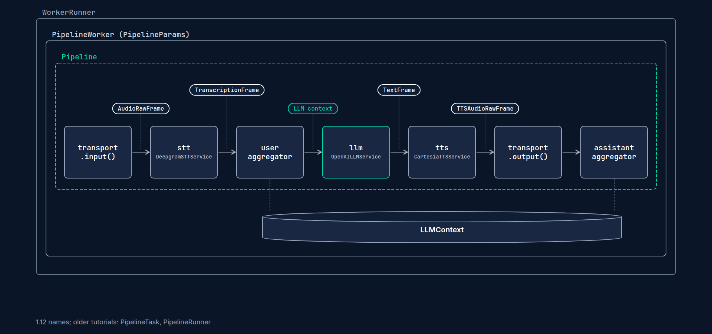
Pipecat in one sentence
An open-source Python framework for real-time voice and multimodal agents
Created by Daily, BSD-licensed, large contributor community
Everything is a frame, flowing through a pipeline of processors
Production Voice AI Agents · Section 14 · Lecture 14.1
Notes:
Pipecat is an open-source Python framework for real-time voice and multimodal agents. It started at Daily, the WebRTC company, and it has a big community around it.
And its core idea fits in one sentence. Everything is a frame, flowing through a pipeline of processors.

Slide 4
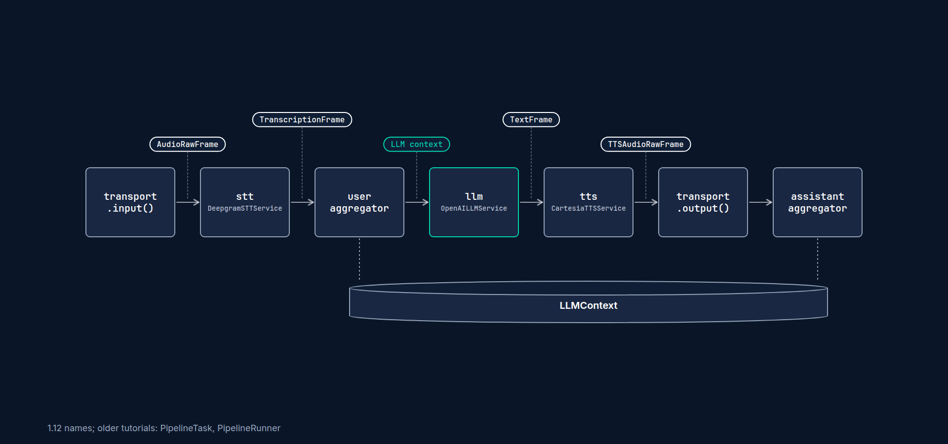
Frames
A frame is a small typed message
Audio frames: raw caller audio, synthesized speech
Text frames: transcriptions, LLM tokens
Control frames: start, end, interruptions, "user started speaking"
Production Voice AI Agents · Section 14 · Lecture 14.1
Notes:
Let's unpack that. A frame is a small, typed message. Some frames carry data. An audio frame carries twenty milliseconds or so of sound. A transcription frame carries text from the speech-to-text service. An LLM text frame carries a few tokens.
Other frames carry signals. "The user started speaking." "The user stopped speaking." "Interrupt now." "End of the pipeline." Those control frames are how Pipecat does turn-taking and barge-in.

Slide 5
Processors and the pipeline
Each box is a frame processor
Frames flow downstream (left to right) and upstream (right to left)
A processor handles frames it knows and passes the rest along
Production Voice AI Agents · Section 14 · Lecture 14.1
Notes:
A frame processor is a box that receives frames, does something, and pushes frames on. The speech-to-text service is a processor. It eats audio frames and emits transcription frames. The LLM service is a processor. It eats a context and emits text frames. The TTS service eats text and emits audio.
[SCREEN: `pipecat/s14_pipecat_bot.py`, scrolled to `pipeline = Pipeline([...])`: the seven boxes from the slide, as real code.]
Chain those boxes in a list, and you have a pipeline. Here's Riley's pipeline. Transport input, STT, user aggregator, LLM, TTS, transport output, assistant aggregator.
Frames flow both ways. Most go downstream, left to right. Some go upstream. For example, when the caller interrupts, a signal travels back so the TTS stops talking.
And each processor only handles the frames it cares about. Everything else passes straight through. That's what makes it easy to drop a custom processor anywhere in the chain.

Slide 6
Transports
Transport = how audio gets in and out
WebRTC in the browser (SmallWebRTC, Daily), LiveKit rooms, telephony WebSockets (Twilio, Telnyx, Plivo, Exotel)
transport.input() starts the pipeline, transport.output() ends it
Production Voice AI Agents · Section 14 · Lecture 14.1
Notes:
The first and last boxes are the transport. The transport is how audio gets in and out. Pipecat supports several. Peer-to-peer WebRTC for local development. Daily rooms. LiveKit rooms. And telephony providers over WebSockets, like Twilio.
That's one big design difference from LiveKit Agents. In LiveKit, the transport is LiveKit. In Pipecat, the transport is a plug-in.

Slide 7
Context and aggregators
LLMContext: the conversation history and the tools
User aggregator: collects transcription frames into a user message
Assistant aggregator: collects spoken text into an assistant message
LLMContextAggregatorPair(context) gives you both
Production Voice AI Agents · Section 14 · Lecture 14.1
Notes:
Now, the conversation memory. Pipecat keeps it in an `LLMContext` object. It holds the messages and the tools.
Two processors keep that context up to date. The user aggregator sits after STT. It collects transcription frames until the caller finishes their turn, then adds one user message and triggers the LLM. The assistant aggregator sits at the very end. It collects what Riley actually said and adds that as the assistant message.
[B-ROLL: an interrupted reply. Riley's sentence is cut at "nine thirty or"; only the spoken words drop into the assistant aggregator's bo...]
Why at the very end? Because if the caller interrupts, only the words that were actually spoken should go into history. Same idea as LiveKit truncating an interrupted reply.
And there's one more benefit of frames that's easy to miss. Because everything flows as frames, you can observe everything. Pipecat has observers that watch frames go by without changing them. That's how its metrics and tracing work: time to first byte, token usage, turn timing. The same numbers we collected in Section 10, from a different angle.
[CODE: from `pipecat/s14_pipecat_bot.py`]
You create both with one line. `LLMContextAggregatorPair`, passing in the context. In Pipecat 1.12, these live in `pipecat.processors.aggregators.llm_response_universal`. They're called universal because they work with any LLM service.

Slide 8
Worker and runner
Pipeline([...]): the list of processors
PipelineWorker(pipeline, params=PipelineParams(...)): runs one conversation
WorkerRunner(): add the worker, run() it, handles signals and shutdown
Older names (pre-1.3): PipelineTask and PipelineRunner. They still work in 1.12, with deprecation warnings
Production Voice AI Agents · Section 14 · Lecture 14.1
Notes:
Three objects run the show. `Pipeline` is the list of processors. `PipelineWorker` runs one conversation through that pipeline. It takes `PipelineParams` for things like metrics. And `WorkerRunner` manages the lifecycle, like stopping cleanly on Control-C.
A quick warning, because you will hit this. Almost every Pipecat tutorial online says `PipelineTask` and `PipelineRunner`. Those were the names before version 1.3. In 1.12 they still work, but you get deprecation warnings. We'll use the new names.

Slide 9
LiveKit to Pipecat translation
LiveKit Agents | Pipecat
AgentSession(stt, llm, tts, vad) | Pipeline([...]) + services
Agent(instructions=...) | system_instruction in LLM settings + LLMContext
@function_tool | FunctionSchema + llm.register_function(...)
RunContext | FunctionCallParams
session.generate_reply() | queue an LLMRunFrame
AgentServer + cli.run_app | bot() + pipecat.runner.run.main(), WorkerRunner
llm_node / tts_node override | a custom frame processor
Production Voice AI Agents · Section 14 · Lecture 14.1
Notes:
Here's the translation table you'll want next to you in the code-along.
An `AgentSession` becomes a pipeline plus services. An `Agent`'s instructions become the LLM's system instruction. A `@function_tool` becomes a `FunctionSchema` plus a registered handler function. `RunContext` becomes `FunctionCallParams`. Generating a reply becomes queuing an `LLMRunFrame`. And the agent server becomes a `bot` function, started by Pipecat's development runner.
Notice the last row. In LiveKit, we overrode `llm_node` in Section 11 to guard Riley's output. In Pipecat, you'd write a small frame processor and put it between the LLM and TTS. Different shape, same idea.
So here's the mental model to take into the next lecture. LiveKit gives you an agent and a session, and you customize through hooks. Pipecat gives you the pipeline itself, and you customize by adding boxes. Neither is better. They're different levels of abstraction. Let's feel the difference by typing it.

Slide 10
RECAP
Key takeaways
✓
Everything is a frame, flowing through processors
✓
Transports are plug-ins at both ends of the pipeline
✓
PipelineWorker and WorkerRunner replace Task and Runner
Production Voice AI Agents · Section 14 · Lecture 14.1

Slide 11
→
Next up:
Code-along: Riley booking flow in Pipecat
Next, we'll rebuild Riley's booking flow in Pipecat 1.12, line by line.
Production Voice AI Agents · Section 14 · Lecture 14.1

Slide 12
SECTION 14 ·
LECTURE 14.2
Code-along: Riley booking flow in Pipecat
Build a Pipecat 1.12 bot with Deepgram STT, OpenAI LLM, Cartesia TTS and Silero VAD.
Production Voice AI Agents · Section 14 · Lecture 14.2
Notes:
Title card (K2). Code-along: Riley booking flow in Pipecat.

Slide 13
RECAP
Key takeaways
✓
Explicit FunctionSchemas plus handlers that call back
✓
Seven processors in one visible pipeline list
✓
Same src/maple business logic, unchanged
Production Voice AI Agents · Section 14 · Lecture 14.2

Slide 14
→
Next up:
LiveKit Agents vs Pipecat vs managed platforms
Next, we'll put LiveKit Agents, Pipecat and the managed platforms side by side, and build a decision matrix.
Production Voice AI Agents · Section 14 · Lecture 14.2

Slide 15
SECTION 14 ·
LECTURE 14.3
LiveKit Agents vs Pipecat vs managed platforms
Compare LiveKit Agents, Pipecat and managed platforms (Vapi, Retell, ElevenLabs Agents, Bland) on control, cost, compliance and lock-in.
Production Voice AI Agents · Section 14 · Lecture 14.3
Notes:
Title card (K2). LiveKit Agents vs Pipecat vs managed platforms.

Slide 16
Three ways to ship a voice agent
Framework on your infrastructure: LiveKit Agents or Pipecat, self-hosted
Framework with managed hosting: LiveKit Cloud, Pipecat Cloud
Managed voice platform: Vapi, Retell, ElevenLabs Agents, Bland
Production Voice AI Agents · Section 14 · Lecture 14.3
Notes:
There are really three ways to ship a voice agent.
One. An open-source framework on your own infrastructure. LiveKit Agents or Pipecat, running in your containers.
Two. The same frameworks, with managed hosting from the framework vendor. That's what we did with LiveKit Cloud in Section 12. Pipecat has a similar hosted option.
Three. A managed voice platform. Vapi, Retell, ElevenLabs Agents, Bland, and others. You configure an agent through a dashboard or an API, and they run the whole pipeline.

Slide 17
LiveKit Agents vs Pipecat
 | LiveKit Agents | Pipecat
Abstraction | Agent + session; customize via hooks and nodes | Explicit pipeline; customize by adding processors
Transport | LiveKit rooms (WebRTC) and LiveKit SIP | Pluggable: WebRTC, Daily, LiveKit, telephony WebSockets
Tools | @function_tool from signatures | Explicit FunctionSchema + handlers
Testing | Built-in text-session test framework | Bring more of your own harness
Scaling | Agent server with dispatch and load balancing | Your process model or Pipecat Cloud
Languages | Python and Node.js | Python
Production Voice AI Agents · Section 14 · Lecture 14.3
Notes:
Let's start with the two frameworks. You've now built Riley in both.
Abstraction. LiveKit gives you an agent and a session. You customize through hooks, like `on_user_turn_completed` and `llm_node`. Pipecat gives you the pipeline itself. You customize by adding processors.
Transport. LiveKit is built on LiveKit's own WebRTC infrastructure, with SIP for phones. Pipecat treats transport as a plug-in. That matters if you're already on a specific telephony or WebRTC provider.
Tools. LiveKit builds schemas from your Python signatures. Pipecat has you write them explicitly.
[SCREEN: `tests/agent/test_greeting.py`, the `session.run(user_input=...)` line and the `.judge(...)` call: the built-in harness this who...]
Testing. This one mattered a lot in this course. LiveKit's built-in test framework gave us `session.run`, `expect` and judges in Section 9. With Pipecat, you'll build more of that harness yourself.
And scaling. LiveKit's agent server handles dispatch and load balancing across workers, which we used in Section 12. With Pipecat, you design the process model, or use their hosted service.

Slide 18
Managed platforms: what you get
Fastest path to a first working call
Dashboard configuration, built-in phone numbers and analytics
Hosting, scaling and provider integrations handled for you
Often a no-code or low-code editor for non-engineers
Production Voice AI Agents · Section 14 · Lecture 14.3
Notes:
Now the managed platforms. Here's what they do really well. Speed. You can have a working phone agent in an afternoon. They handle hosting, scaling, phone numbers and provider integrations. Many have dashboards where a non-engineer can edit the prompt. For a small business validating an idea, that's powerful.
They're not all the same, either. Some started as developer APIs, and expect you to call them from code. Some lean toward no-code builders for business users. Some grew out of a speech company, so their own voices and speech models are the centre of the product. Before you compare prices, figure out which kind you need.

Slide 19
Managed platforms: what you give up
Control: less access to the pipeline internals and turn-taking
Cost: usually a platform fee on top of model and telephony costs
Compliance: depends on the vendor's certifications, contracts and data handling
Lock-in: prompts, tools and call flows live in their format
Production Voice AI Agents · Section 14 · Lecture 14.3
Notes:
And here's what you trade. Four things.
Control. You get the knobs they expose. If you need a custom guardrail in the middle of the pipeline, like our streaming output check from Section 11, you may not be able to add it.
[SCREEN: terminal in `03-code`, the 10.4 snippet: `print(cost_breakdown(typical_cascaded_usage(3)).format())` ends in `per minute $0.0646...]
Cost. Most platforms charge a platform fee per minute, on top of the model and telephony costs. At low volume, that's usually worth it for the time saved. At high volume, it can become the biggest line on your bill. Run the numbers with your own call volumes. Our `costs.py` from Section 10 is a good starting point for the build side.
Compliance. If you handle health or payment data, you need to know where audio and transcripts go, how long they're kept, and what contracts the vendor will sign, like a HIPAA business associate agreement in the US. Some vendors offer this. Check the current terms. With a framework, you control that answer yourself, but you also own the work.
[B-ROLL: the `src/maple/` folder icon slides from a "LiveKit Agents" box into a "Pipecat" box, unchanged; a third "Platform" box shows th...]
Lock-in. On a platform, your prompts, tools and flows live in their format. Moving means rebuilding. With a framework, they live in your repo, and our `src/maple` logic moved from LiveKit to Pipecat without a single change.

Slide 20
Questions to ask any vendor
Can I bring my own STT, LLM and TTS providers?
Can I call my own APIs as tools, with timeouts I control?
Where are audio and transcripts stored, and for how long?
Can I export prompts, tools, transcripts and metrics?
Can I test it automatically, before changes go live?
Production Voice AI Agents · Section 14 · Lecture 14.3
Notes:
If you're evaluating a platform, here are five questions to ask. Can I bring my own models? Can I call my own APIs as tools, with my own timeouts? Where is audio stored, and for how long? Can I export everything, including transcripts and metrics? And can I test changes automatically before they go live?
The last one matters most for this course. If a platform can't run your tests, you're back to "click around and hope."

Slide 21
Build vs buy decision matrix
Criterion | Framework, self-hosted | Framework, managed hosting | Managed platform
Time to first call | Slowest | Medium | Fastest
Pipeline control | Full | Full | Limited to exposed options
Cost at low volume | Engineering time dominates | Engineering time dominates | Usually lowest total
Cost at high volume | Usually lowest per minute | Low to medium | Platform fee adds up
Compliance control | You own it all | Shared with the host | Depends on the vendor
Lock-in | Lowest | Low | Highest
Testing depth | Anything you build | Anything you build | Limited to what the platform exposes
Production Voice AI Agents · Section 14 · Lecture 14.3
Notes:
Here's the whole thing as a matrix. It's in the resources folder as `architecture-decision-matrix.md`, so you can fill it in for your own project.
Read it row by row. Time to first call favors platforms. Control favors frameworks. Cost flips with volume. Low volume, platforms usually win, because engineering time is expensive. High volume, frameworks usually win, because there's no platform fee. Compliance and lock-in both favor owning the code.

Slide 22
Three quick scenarios
Solo dental clinic, 20 calls a day: start with a managed platform, measure, revisit
Dental group with 40 clinics and a compliance team: framework + managed hosting
Voice AI startup selling to many clinics: framework, with deep testing as your moat
Production Voice AI Agents · Section 14 · Lecture 14.3
Notes:
Let's try three scenarios.
A single dental clinic, twenty calls a day. Start with a managed platform. Validate that callers actually like it. Measure containment and cost. Revisit in six months.
A dental group with forty clinics and a compliance team. A framework with managed hosting. They need control over data, custom integrations with their practice management system, and predictable costs at volume.
A startup selling voice receptionists to many clinics. A framework, no question. Their product *is* the pipeline. And their testing suite is their moat. Everything you built in Section 9 becomes a competitive advantage.
And here's the most important point in this lecture. Whatever you choose, the skills from this course transfer. Voice prompting transfers. Read-backs and confirmation gates transfer. Latency budgets, WER, LLM judges, simulated callers, cost per minute. All of it. Even on a managed platform, you can run simulated callers against its phone number and judge the transcripts.
The framework is a choice. The discipline is what makes it production.

Slide 23
RECAP
Key takeaways
✓
Frameworks: control, low lock-in, your compliance
✓
Platforms: fastest start, platform fee, less control
✓
Decide with a matrix and your real volumes
Production Voice AI Agents · Section 14 · Lecture 14.3

Slide 24
SECTION COMPLETE
You can now
✓
Explain Pipecat's frames, processors and transports
✓
Port a LiveKit agent's tools and pipeline to Pipecat
✓
Choose build or buy with a decision matrix
Production Voice AI Agents · Section 14 · Lecture 14.3

Slide 25
→
Next up:
Quiz: Choosing a stack
Lock in these trade-offs with the Section 14 quiz.
Production Voice AI Agents · Section 14 · Lecture 14.3

Slide 26
SECTION 14 ·
LECTURE 14.4
Quiz: Choosing a stack
Check understanding of Pipecat's pipeline model and its LiveKit equivalents.
Production Voice AI Agents · Section 14 · Lecture 14.4
Notes:
Title card (K2). Quiz: Choosing a stack.

Slide 27
Section 14 quiz: what's covered
Frames, processors, transports and aggregators
LiveKit to Pipecat translation
Control, cost, compliance and lock-in trade-offs
Build-vs-buy scenarios
Production Voice AI Agents · Section 14 · Lecture 14.4
Notes:
Two questions are about Pipecat's model: what a frame is, and where the aggregators go in the pipeline. Two are translations from LiveKit to Pipecat. And two are short scenarios where you pick a stack.
A tip for the scenarios. Look for the one detail that decides it. Call volume. A compliance requirement. Or how much the team needs to customize the pipeline.
[SCREEN: `pipecat/s14_pipecat_bot.py`, the `Pipeline([...])` list, with `assistant_aggregator` last, after `transport.output()`.]
And for the aggregator question, here's the real pipeline. Note which box comes last.
Read the explanations. They're short, and they point back to the right lecture.

Slide 28
→
Next up:
What you built and where to go next
Next, Section 15: what you built, and where to go from here.
Production Voice AI Agents · Section 14 · Lecture 14.4

