Slide 1
SECTION 9 · DASHBOARDS, SLOS AND ALERTING
LECTURE 9.1
SLIs for agents that leadership understands
Pick six SLIs that a director can read, set an SLO for each with a window, and use error budgets and burn…
AI Agent Observability & Cost Control · Section 09 · Lecture 9.1
Notes:
Title card (K2). SLIs for agents that leadership understands.

Slide 2
Six SLIs for Atlas (northwind.slo.compute_slis)
SLI | What it means to a director | Good events / all events
Task success | "Did requests end well?" | resolved or escalated to a human / all requests
Containment | "How often did it manage alone?" | resolved / all requests
Tool success | "Are the systems it talks to healthy?" | tool calls without error / all tool calls
Latency | "Is it fast?" | requests under 4 s / all requests
Cost | "Is it within budget?" | sessions under $0.05 / all sessions
Quality | "Are the answers good?" | judged answers scoring ≥ 0.7 / all judged
AI Agent Observability & Cost Control · Section 09 · Lecture 9.1
Notes:
Six. Task success: did requests end well, answered or handed cleanly to a person. Containment: how often Atlas managed alone. Tool success: are the systems it talks to healthy. Latency: the share of requests under four seconds. Cost: the share of sessions under five cents. And quality: the share of judged answers the judge rated at least point seven. Each one is a sentence a director can say back to you. That's the test of a good SLI. If you have to explain it, it's a metric, not an SLI. And every one is a ratio of good events to all events, which is what makes the arithmetic that follows work.
[SCREEN: terminal, `make console-text`, scrolled to the SLOs block]
Here they are on the replayed day, straight from `slo.py`. Task success ninety-nine point three percent against a target of ninety-five. Containment ninety-nine against eighty. Latency ninety-nine point three against ninety-five. All green. Two columns you haven't met yet: budget left, and burn. That's the rest of this lecture.

Slide 3
The SLOs (DEFAULT_SLOS, 28-day window)
SLI | Replayed day | SLO
Task success | 0.993 | ≥ 0.95
Containment | 0.989 | ≥ 0.80
Tool success | 1.000 | ≥ 0.99
Latency (under 4 s) | 0.993 | ≥ 0.95
Cost (sessions under $0.05) | 1.000 | ≥ 0.90
Quality (judged ≥ 0.7) | 0.986 | ≥ 0.90
AI Agent Observability & Cost Control · Section 09 · Lecture 9.1
Notes:
An SLO is a target and a window. Task success at least ninety-five percent. Latency: ninety-five percent of requests under four seconds. All over a rolling twenty-eight days in `slo.py`. Notice the targets sit below normal. An SLO at your current performance is a promise you'll break on the first bad Tuesday. Leave room. The room is called the error budget.

Slide 4
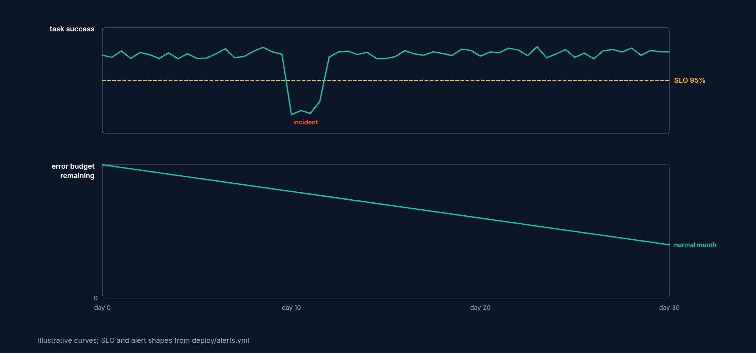
Error budget (latency SLO)
SLO: 95% of requests under 4 s over 28 days
Traffic: 10,184 a day; 5% of that is about 509 slow requests a day you may spend
Normal day: 0.7% slow, about 68 requests; budget_left 0.866 means 87% of the day's allowance unspent
The budget is a spending account: incidents draw it down; when it's empty, you stop shipping risk
AI Agent Observability & Cost Control · Section 09 · Lecture 9.1
Notes:
Take the latency SLO. Ninety-five percent under four seconds means five percent may be slower. Ten thousand requests a day, so about five hundred slow ones a day are allowed. On the replayed day, sixty-eight were slow, and that's the `budget_left` of point eight seven: eighty-seven percent of the allowance unspent. Here's the rule that makes the budget useful. When it's spent, you stop shipping risk: no prompt rollouts, no model swaps, until the window rolls forward. It's the number that ends the argument between "ship it" and "make it reliable."

Slide 5
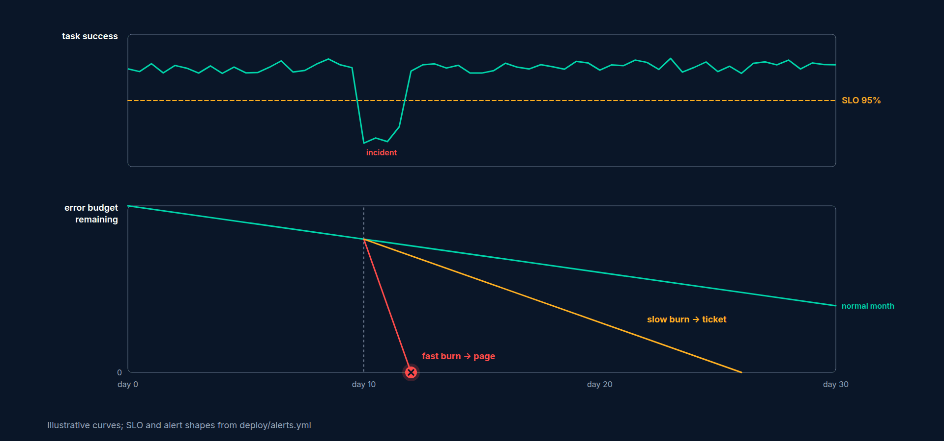
Burn rate
Burn rate = (fraction of bad events now) ÷ (fraction the SLO allows)
Allowed: 5%. Observed 5% → burn rate 1: exactly the budget over the window
Baseline day: latency burn 0.13, task success 0.14
The slow provider from 7.6: 74% of requests in the afternoon window over 4 s → burn 14.8× for four hours
Page on burn rate over a window, not on a single reading
AI Agent Observability & Cost Control · Section 09 · Lecture 9.1
Notes:
Burn rate is how fast you're spending the budget. Divide the fraction of bad events now by the fraction the SLO allows. Five percent bad against five percent allowed is a burn rate of one: you'll use exactly the budget, no more. The normal day burns at about a seventh of that. Now the slow provider from 7.6: three in four requests in the afternoon window were over four seconds. That's a burn rate of almost fifteen, for four hours. That number is why you page. Not because p95 crossed a line for one minute, but because at this rate, the promise breaks.

Slide 6
The burn-rate alerts Atlas ships (deploy/alerts.yml, task-success SLO 95%)
Bad = outcome error, step_limit, tool_error or timeout; guardrail and budget refusals are excluded on purpose
Latency pages on its own threshold rule: AtlasLatencyP95High, p95 > 4 s for 10 minutes
The multipliers come from the Google SRE workbook, where they were written for 99.9% SLOs
Rule | Burn rate | Window | for | Bad fraction it takes at 95% | Severity
AtlasTaskSuccessBurnRateFast | 14.4× | 1 h | 5 m | 72% of requests failing | page
AtlasTaskSuccessBurnRateSlow | 6× | 6 h | 30 m | 30% failing | ticket
AI Agent Observability & Cost Control · Section 09 · Lecture 9.1
Notes:
Now the rules Atlas actually ships. Two burn-rate alerts on task success. Fast burn: fourteen point four times the allowed rate over an hour, held for five minutes, pages. Slow burn: six times over six hours, held for thirty minutes, opens a ticket. "Bad" means a request ended in an error, a step limit, a tool error or a timeout; a guardrail refusal or a budget refusal is Atlas doing its job, so it's excluded.
[B-ROLL: D8 build 3, the error-budget line falling steeply during an incident, the fast-burn threshold crossed, then a gentle slope cross...]
[SCREEN: VS Code, `src/northwind/slo.py`]
[CODE: `src/northwind/slo.py` (excerpt)]
Three small pieces, so the CI gate, the console and the report compute the same thing Prometheus does. `error_budget_remaining` gives the fraction of the budget left. `burn_rate` is the division from the slide. And `DEFAULT_SLOS`, just below, pins the targets in code, next to the tests, so a change to a promise is a pull request.

Slide 7
Presenting to leadership
One page: six SLIs, target, this week, trend arrow, budget remaining
Green, amber, red; no charts on the summary page
Cost per resolved session and task success on the same line: quality and cost together
"We have 40% of our latency budget left this month; we're pausing the model swap until it rolls over"
The dashboard in 9.3 has the SLIs as its top row
AI Agent Observability & Cost Control · Section 09 · Lecture 9.1
Notes:
And the meeting. One page. Six rows, target, this week, a trend arrow, budget remaining. Colours, no charts. Cost per resolved session and task success on the same line, so nobody optimises one by breaking the other. And the sentence that makes you sound like an operator: "We have forty percent of our latency budget left this month, so we're pausing the model swap until it rolls over." That sentence is the entire point of SLOs. It turns reliability from a feeling into a budget line, and budgets are a language leadership already speaks.

Slide 8
RECAP
Key takeaways
✓
Six SLIs, each a good-over-all ratio
✓
Error budget: the failure you may spend
✓
Atlas pages on 14.4× fast burn
AI Agent Observability & Cost Control · Section 09 · Lecture 9.1

Slide 9
→
Next up:
Code-along: Prometheus metrics from Atlas
The SLIs need live numbers.
AI Agent Observability & Cost Control · Section 09 · Lecture 9.1

Slide 10
SECTION 9 · DASHBOARDS, SLOS AND ALERTING
LECTURE 9.2
Code-along: Prometheus metrics from Atlas
Mount /metrics, define every counter and histogram with low-cardinality labels in one file, and scrape it with the compose stack.
AI Agent Observability & Cost Control · Section 09 · Lecture 9.2
Notes:
Title card (K2). Code-along: Prometheus metrics from Atlas.

Slide 11
One file, one convention
All metrics in telemetry/metrics.py; nothing defines a metric anywhere else
Names: atlas_<thing>total for counters, atlas<thing>_seconds for histograms, _usd when it's money
Label allow-list (ALLOWED_LABELS): tenant, model, tool, outcome, kind, decision, feature, name, from_model, to_model, reason, version, prompt_version
Forbidden (FORBIDDEN_LABELS): user_id, session_id, trace_id, user, email; a unit test enforces both lists
Every label value comes from a small fixed set
AI Agent Observability & Cost Control · Section 09 · Lecture 9.2
Notes:
One file, one convention. Counters end in `_total`. Histograms end in `_seconds`. Money says `_usd`. And a label allow-list: tenant, model, tool, outcome, feature, and a handful of fixed enumerations. A unit test, `test_metrics_label_allowlist`, fails the build if anyone adds a label outside the list. Never a user, session or trace id. A metric with tenant, feature and model has a few hundred series at most. A metric with user id has eighty today and eight thousand next year, and Prometheus keeps every one in memory. Those ids live in the span store, where they belong.
[SCREEN: VS Code, `telemetry/metrics.py`]
[CODE: `telemetry/metrics.py` (excerpt; the full file has 20 metrics)]
You've met most of these already. `REQUESTS` with `outcome` and `feature`, which is the denominator for almost everything and the numerator for task success and containment. The latency histogram with `tenant` and `feature`, so you can ask for policy questions' p95 for finance. Tokens by kind, cost by tenant, model and feature.
[SCREEN: zoom on `INFLIGHT`, `QUEUE_WAIT`, `SHED` and `BUILD_INFO`]
The concurrency trio from 7.5. And `BUILD_INFO`, a gauge that's always one, whose labels carry the version, the default model and the prompt version; that's how Grafana can mark a release. Count the labels on each line. None has more than four, and every value is from a fixed set.
Why is cost a counter and not a gauge? Because a counter only goes up, and Prometheus can take its rate. `increase(atlas_cost_usd_total[1h])` is spend per hour, `[1d]` is spend per day, all from one series, and a restart doesn't corrupt it because `increase` understands resets. Counters for anything you add up; gauges for anything you read off, like in-flight requests; histograms for anything you take a percentile of.
Now the endpoint.
[SCREEN: `app/server.py`]
[CODE: `app/server.py` (excerpt)]
One line mounts it: `metrics_app` wraps `prometheus_client.make_asgi_app` over Atlas's own `REGISTRY`, and FastAPI serves it at `/metrics`. `set_build_info` runs once at startup. One security note. The metrics endpoint has no PII, but it shows your traffic, your spend and your model names, on the same port as the chat API. In production, bind it to an internal interface or put it behind a network policy that only Prometheus can reach.
[SCREEN: terminal]
[DEMO: output (after four requests: three policy questions and one ticket lookup):]
That's the format Prometheus scrapes. Three policy questions and a ticket lookup, all resolved. A cent and a third of spend on the policy questions. And all three policy questions in the four-second bucket. That `le="4.0"` bucket is the whole latency SLO: requests under four seconds over all requests, straight from the histogram, because we put a bucket edge at the budget in 7.2. The `-L` is habit, not a workaround: `/metrics` and `/metrics/` both answer 200.
Now the stack.
[SCREEN: `deploy/prometheus.yml` and `deploy/docker-compose.observability.yml`]
[CODE: `deploy/prometheus.yml` (excerpt) and the compose file (excerpt)]
Prometheus scrapes the `atlas` service every fifteen seconds and loads the alert rules from 9.5. Atlas itself runs in the stack, so the target is the service name, `atlas:8000`, not your laptop. Retention is forty-five days, longer than the twenty-eight-day SLO window, so a month of `increase` actually has a month of data. Grafana provisions its dashboard from the folder, so `atlas-ops.json` is loaded, not clicked. Images are pinned.
[DEMO: Prometheus at localhost:9091, Status → Targets: `atlas` UP. Graph tab: `sum(rate(atlas_requests_total[1m]))` climbing to about 2....]
Target up, two requests a second, and every SLI is now a query away. Next lecture, we put them on a dashboard.

Slide 12
RECAP
Key takeaways
✓
One file, an allow-list of labels
✓
/metrics mounted; build info at startup
✓
make stack plus make swarm feed Prometheus
AI Agent Observability & Cost Control · Section 09 · Lecture 9.2

Slide 13
→
Next up:
Grafana: the Atlas Ops dashboard
Next, Grafana: the Atlas Ops dashboard, one panel per question, tenant and feature variables, and a release marker…
AI Agent Observability & Cost Control · Section 09 · Lecture 9.2

Slide 14
SECTION 9 · DASHBOARDS, SLOS AND ALERTING
LECTURE 9.3
Grafana: the Atlas Ops dashboard
Open the provisioned atlas-ops.json, read the PromQL behind each row, filter by tenant and feature, and mark releases with a query that…
AI Agent Observability & Cost Control · Section 09 · Lecture 9.3
Notes:
Title card (K2). Grafana: the Atlas Ops dashboard.

Slide 15
Row 1: SLIs (the leadership row)
Task success: (resolved + escalated) ÷ all requests, stat
Containment: resolved ÷ all requests, stat
p95 latency, stat with a red threshold at 4 s
Cost per resolved session (1 h): cost ÷ resolved requests, labelled as an approximation
Every panel filters on tenant=~"$tenant" and feature=~"$feature"
DIAGRAM TO BUILD
Diagram: D11 build 1, the SLI row.
AI Agent Observability & Cost Control · Section 09 · Lecture 9.3
Notes:
[SCREEN: zoom on the p95 panel; open Edit; the query is visible]
[CODE: PromQL behind row 1 (from `atlas-ops.json`), plus two you add]
Five queries. Task success is a ratio of two rates of the same counter, filtered by outcome. The p95 is `histogram_quantile` over the rate of the bucket counters, summed by `le`; the `feature` filter works because the latency histogram carries a `feature` label since Section 7. Cost per resolved session is an approximation: Prometheus has no sessions, so the shipped panel divides by resolved requests and says so in its title. Honesty on the dashboard is a feature.
[SCREEN: Dashboard → Add → Visualization; paste the two added queries as stat panels: "Latency SLO (28 d)" with a threshold at 0.95, and...]

Slide 16
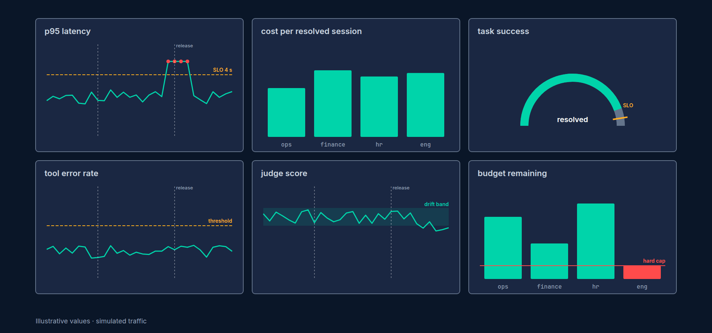
Rows 2 to 4
Traffic and latency: requests per second by tenant, p50 / p95 / p99, TTFT p95 by model, outcomes, agent steps p95, tool error rate by tool
Cost: dollars per hour by tenant and by feature, tokens by kind, cache hit ratio, LLM retries and fallbacks, budget decisions
Quality and safety: judge score mean, feedback per hour, guardrail events per hour, telemetry export failures
A table of atlas_build_info at the bottom
AI Agent Observability & Cost Control · Section 09 · Lecture 9.3
Notes:
[SCREEN: scroll through rows 2 to 4; pause on "Cost USD / hour by tenant", "Cache hit ratio" and "LLM retries and fallbacks / s"]
[CODE: PromQL behind rows 2 and 3 (from `atlas-ops.json`)]
Dollars per hour by tenant is the showback as a stacked chart. The cache hit ratio divides cached tokens by input tokens, not by input plus cached, because the input count already includes the cached ones, exactly the 6.1 rule. If this line drops, someone put a date at the front of the prompt. Retries and fallbacks sit on one panel. And the refused share is what the budget guard is doing to users right now; degraded requests are the `decision="degrade"` line on the budget-decisions panel.

Slide 17
Reading the shapes
Slow provider (7.6): p95 red; retries, fallbacks and cost flat; in-flight and queue wait climbing on a live server
Retry storm (7.3): retries up, cost per hour up, p95 barely moves
Cost spike (Incident 1): cost per hour up for one tenant, cache ratio unchanged, tokens per second up
Quality drift (8.5): nothing on rows 1 to 3 turns red; the judge lives in the span store, not here
AI Agent Observability & Cost Control · Section 09 · Lecture 9.3
Notes:
Here's how you read the dashboard during an incident. The slow provider from 7.6: p95 red, retries and fallbacks flat, cost flat. That combination has exactly one meaning: the provider is slow and nothing is timing out. You knew the fix before you opened a trace. A retry storm looks different: retries up, cost per hour up, p95 barely moving. And a quality drift doesn't show up here at all. Look at the quality row: the judge-score panel is empty, because the judge runs as a batch job over the span store and never feeds this histogram. That's not a bug in your reading. It's where Prometheus stops and the span store and Langfuse take over, and 9.5 comes back to it.
Now the two features that make this a working dashboard instead of a pretty one.
[SCREEN: Dashboard settings → Variables: `$tenant` and `$feature`; then Annotations: "Releases"]
[CODE: dashboard variables and the release annotation]
The variables are `label_values` queries, so they fill themselves; pick finance and the whole dashboard becomes finance's dashboard. Now the annotation, and a lesson in testing your dashboards. The obvious query asks for `changes()` on `atlas_build_info`, and an earlier version of this dashboard shipped with it. But that gauge is always one. A new release doesn't change a value; it creates a new series whose value is also one, so `changes()` stays at zero forever and the annotation never draws. The query in the JSON now asks for a build-info series that didn't exist five minutes ago, and that's true for five minutes after every deploy. I checked both with `promtool test rules` against a synthetic release: the `changes()` version returns nothing, the shipped one returns `{version="v1.1.0",prompt_version="v2"} 1` for five minutes after the deploy and nothing before or after.
[SCREEN: edit `.env` to `ATLAS_PROMPT_VERSION=v2`, then `docker compose -f deploy/docker-compose.observability.yml up -d atlas`; the dash...]
Restart Atlas with a different prompt version and the line appears, labelled with the version and the prompt. Nobody has to correlate a deploy log with a chart. The chart correlates itself.

Slide 18
Dashboard hygiene
Every panel has a unit and a threshold, or it's a diagnostic and lives in a collapsed row
Top row is stats, not time series: red or green at a glance
The JSON is in git: edit in the UI, export, commit to deploy/grafana/dashboards/atlas-ops.json
One dashboard per audience: Ops (this one), Finance (cost row only, weekly), Leadership (row 1 only)
Test what you can: queries and alerts with promtool, before you trust a colour
AI Agent Observability & Cost Control · Section 09 · Lecture 9.3
Notes:
Thresholds and colours come from the SLOs in 9.1, not from taste: the p95 stat turns red at four seconds, task success turns red under ninety-five percent. When a threshold changes, it changes in `slo.py` and in the JSON in the same pull request. A dashboard that disagrees with the SLO document is worse than no dashboard, because people trust the colours. And the JSON lives in git: edit in the UI, export, commit, so a dashboard change is a pull request. One dashboard per audience. And test what you can, because the `changes()` annotation looked perfectly reasonable for months before anyone noticed it had never drawn a line.

Slide 19
RECAP
Key takeaways
✓
Four rows: SLIs, latency, cost, quality
✓
Every query filters by tenant and feature
✓
Test the release annotation with promtool; changes() on a constant gauge never fires
AI Agent Observability & Cost Control · Section 09 · Lecture 9.3

Slide 20
→
Next up:
Langfuse dashboards and saved views
Grafana sees metrics.
AI Agent Observability & Cost Control · Section 09 · Lecture 9.3

Slide 21
SECTION 9 · DASHBOARDS, SLOS AND ALERTING
LECTURE 9.4
Langfuse dashboards and saved views
Use Langfuse for the questions metrics can't answer, which sessions, which users, which prompt version, and save the views so stakeholders can…
AI Agent Observability & Cost Control · Section 09 · Lecture 9.4
Notes:
Title card (K2). Langfuse dashboards and saved views.

Slide 22
Grafana vs Langfuse
Grafana: rates, percentiles, budgets, alerts. Aggregates over time. No ids
Langfuse: traces, sessions, users, scores, prompts, datasets. Individual things. Every id
Question starts with "how much" or "how often": Grafana
Question starts with "which" or "show me": Langfuse
Both fed by the same spans and the same numbers (6.3)
AI Agent Observability & Cost Control · Section 09 · Lecture 9.4
Notes:
The split. Grafana for how much and how often. Langfuse for which and show me. Same spans, same cost numbers, different questions.
[SCREEN: terminal: Langfuse keys in `.env`; `make prompts` registers prompt versions v1 and v2 (label `production` on v1); `make run`, th...]
The data first. With Langfuse keys in `.env`, `make run` exports every live trace to Langfuse as well as to the local store, with the tags from Section 4: tenant, feature, intent and prompt version. `make prompts` registers the two prompt versions. Then ten minutes of swarm traffic.
[SCREEN: Langfuse project. Dashboards (or Metrics) view: cost over time grouped by the `tenant:` tags, then by `feature:`.]
View one: cost by tag. Group cost by the tenant tag, and it has the same shape as the Grafana stacked chart, which it should, because both came from the `cost_details` and the counter written in the same moment in 6.3. Switch the grouping to feature, and policy questions dominate, as the showback said. Where this beats Grafana: click a bar and you're looking at the generations behind it.
[SCREEN: Scores view: `user_feedback` and the judge's scores over time, filtered by the `feature:policy_question` tag; then the score fil...]
View two: scores. Feedback from `/feedback` and the judge's scores from `make judge` land on the same traces. Filter to policy questions and to scores below point five. That's the low cluster from the drift report, as a list of traces. Open one: the input, the retrieved passages, the answer and the scores, two clicks from the chart to the sentence that's wrong.
[SCREEN: Sessions view: filter `feature:policy_question`, sort by number of traces; open a four-turn session.]
View three: the session explorer. Sessions are conversations. Filter to policy questions, sort by length, open a long one, and read it top to bottom: the question, the follow-ups, where the employee pushed back, whether they got there. Metrics said ninety-nine percent contained on the replayed day. This shows you what the other one percent feels like.
[SCREEN: Prompts view: `atlas-system`, versions 1 and 2 side by side, the diff highlighted, the `production` label on version 1.]
View four: prompts. Version one and version two side by side, with the diff highlighted. And because traces are tagged with the prompt version, you can filter scores per version. On the drift day from 8.1, the judge put version one at point nine one and version two at point seven one. That's the evidence for a rollback, and in Section 11 you'll do the rollback by moving the label.
[SCREEN: Save the scores view as "Policy quality, 14 d"; share the link; the project settings page showing a Viewer role.]
Now save it. Name the view, share the link, and give your stakeholder a viewer role, which is read-only. Your HR partner opens "Policy quality, fourteen days" every Monday, sees the same chart you see, and never needs Grafana or a Prometheus query.

Slide 23
The weekly review, in views
Cost by tenant and feature (Langfuse) against the showback (make report)
Scores by feature, 14 days, with the low-score filter saved
Longest sessions this week, by feature
Prompt versions, with scores per version
Grafana row 1 for the SLOs; this for the "which"
AI Agent Observability & Cost Control · Section 09 · Lecture 9.4
Notes:
That's the weekly review. Cost by tenant against the report. Scores by feature with the low-score filter. The longest sessions. Prompt versions with their scores. And Grafana's top row for the SLOs. Fifteen minutes, every Monday, and nothing drifts for a month without someone noticing.

Slide 24
RECAP
Key takeaways
✓
Grafana answers how much; Langfuse answers which
✓
Four views: cost, scores, sessions, prompts
✓
Share saved views with a read-only role
AI Agent Observability & Cost Control · Section 09 · Lecture 9.4

Slide 25
→
Next up:
Alert rules and the runbook
Dashboards are for when you're looking.
AI Agent Observability & Cost Control · Section 09 · Lecture 9.4

Slide 26
SECTION 9 · DASHBOARDS, SLOS AND ALERTING
LECTURE 9.5
Alert rules and the runbook
Read the ten shipped alert rules in three groups, SLO, cost and quality, each with a severity and a runbook entry, test…
AI Agent Observability & Cost Control · Section 09 · Lecture 9.5
Notes:
Title card (K2). Alert rules and the runbook.

Slide 27
The cost and quality groups
Rule | Fires when | Severity
AtlasTenantCostAnomaly | a tenant's last hour > 2.5× its average hour of the previous day, and > $1, for 15m | ticket
AtlasBudgetHardCapHit | any decision="refuse" in 15 minutes | page
AtlasRetryStorm | more than 0.2 LLM retries per request, for 10m | page
AtlasJudgeScoreLow | mean judge_grounded < 0.75 over 2 h, for 30m | ticket
AtlasNegativeFeedbackSpike | > 40% of feedback negative over 2 h, for 30m | ticket
AtlasTelemetryExportFailures | > 20 span export failures in 10 minutes | ticket
AI Agent Observability & Cost Control · Section 09 · Lecture 9.5
Notes:
Cost: a tenant whose last hour is two and a half times its average hour of the previous day, and more than a dollar, is a ticket, because one hour can be a lunch rush and the guard from 6.7 is already degrading it. A hard-cap refusal pages, because users are being turned away. More than a fifth of a retry per request is a retry storm, a cost event before it's a latency one. Quality: negative feedback over forty percent, and the exporter failing, are tickets. And one rule in this file will never fire.

Slide 28
AtlasJudgeScoreLow cannot fire as shipped
It reads atlas_judge_score_sum and _count
atlas_judge_score is defined in metrics.py, but nothing observes it: the judge is a batch CLI writing to the span store and Langfuse
No series, no alert. It stays "inactive" forever, which looks exactly like "healthy"
To wire it: observe metrics.JUDGE_SCORE.labels(f"judge_{name}").observe(value) in a process Prometheus scrapes, or push the judge's means through a Pushgateway after each run
Until then, quality drift is caught by the drift report (8.5) in CI, not by Prometheus
AI Agent Observability & Cost Control · Section 09 · Lecture 9.5
Notes:
`AtlasJudgeScoreLow` reads the judge-score histogram. That histogram is defined, and nothing ever writes to it, because the judge runs as a batch job over the span store, not inside the server Prometheus scrapes. No series, no alert. It sits in the rules page as "inactive" forever, which looks exactly like healthy. That's the most dangerous kind of alert: one that can't fail. Two ways to wire it: observe the scores in a process Prometheus scrapes, or push the judge's means to a Pushgateway after each run. Until you do, quality drift is caught by the drift report from 8.5, failing a CI job, not by a page.
Which brings us to the habit that would have caught it: test every rule.
[SCREEN: VS Code, a new file `deploy/alerts_test.yml`; then terminal]
[CODE: `deploy/alerts_test.yml` (you write this file)]
[DEMO: output ` SUCCESS`. Then change `21m` to `20m` and run again:]
A synthetic slow provider: from minute ten, every request is slower than four seconds. Four minutes in, the rule is pending, not firing. At minute twenty-one, it fires: one minute for p95 to cross the line, ten minutes of `for:`. Change twenty-one to twenty and the test fails, which tells you exactly how long you'll wait for the page. The same file can hold a test for `AtlasJudgeScoreLow`. Feed it judge scores, and it passes; feed it what Atlas actually exports, and there's nothing to feed. That's the gap, found in CI instead of during an incident.
[SCREEN: `10-resources/runbook-template.md`, then the `#latency` entry you write from it]
[CODE: the `latency` runbook entry, filled in from the template (excerpt)]
Owner, severity, and a two-minute first look: three panels to open. Then a decision tree keyed on what those panels show, with the setting to change and the lecture that explains it. Then how to verify it's fixed, and when a postmortem is required. The whole entry fits on one screen, because at three in the morning nobody scrolls.
[SCREEN: Prometheus at localhost:9091 → Alerts, with `make stack` running and `make swarm RPS=2 DURATION=5400 SCENARIO=slow_provider` in...]
On the live stack, the swarm compresses the replayed day into ninety minutes, so the slow afternoon lasts about fifteen minutes. `AtlasLatencyP95High` goes pending shortly after it starts, and fires ten minutes later, with the summary and the runbook link. Nothing in the cost group moves, because nothing about cost changed. Record the timings from your own run.

Slide 29
Alert fatigue rules
Page only on user-facing symptoms and budget burn; everything else is a ticket
Every alert has a runbook entry with an owner, or it doesn't ship
Two windows or a for: clause on anything rate-based
Review the alert log weekly: any alert that fired 3× with no action gets deleted or demoted
Unit-test every rule with promtool before it goes live, including that it can fire
AI Agent Observability & Cost Control · Section 09 · Lecture 9.5
Notes:
Five rules against fatigue. Page only for symptoms users feel and for budget burn. Every alert has a runbook and an owner, or it doesn't merge. Windows or a `for:` clause on everything rate-based. Review the alert log weekly, and delete anything that fired three times without anyone acting. And test every rule, including that it can fire at all. An alert you've never seen fire is an alert you can't trust, the same way as a test.

Slide 30
RECAP
Key takeaways
✓
Ten rules: SLO, cost and quality groups
✓
AtlasJudgeScoreLow has no data: it can't fire
✓
Test rules with promtool; runbook for each
AI Agent Observability & Cost Control · Section 09 · Lecture 9.5

Slide 31
→
Next up:
Lab 6: Ship the dashboard and one alert
Lab 6 puts it together: stack up, dashboard live, and one alert that fires and clears.
AI Agent Observability & Cost Control · Section 09 · Lecture 9.5

Slide 32
SECTION 9 · DASHBOARDS, SLOS AND ALERTING
LECTURE 9.6
Lab 6: Ship the dashboard and one alert
Bring up the compose stack, get the Atlas Ops dashboard live on swarm traffic, and make one alert fire and clear with…
AI Agent Observability & Cost Control · Section 09 · Lecture 9.6
Notes:
Title card (K2). Lab 6: Ship the dashboard and one alert.

Slide 33
Lab 6 checklist (1/2)
make stack; Prometheus target atlas UP
make swarm; top row populated
One new panel with unit and threshold, exported to atlas-ops.json
One alert pending, firing, then cleared: three screenshots
Stretch: an alert for the refused share (outcome="refused") with its runbook entry and a promtool test
AI Agent Observability & Cost Control · Section 09 · Lecture 9.6
Notes:
The stretch goal is a new alert, for the share of requests the budget guard refuses, with its runbook entry and a `promtool` test. Write the runbook first. If you can't say what someone should do when it fires, it isn't ready to fire.

Slide 34
Lab 6 checklist (2/2)
Submit: the screenshots and the exported JSON diff
AI Agent Observability & Cost Control · Section 09 · Lecture 9.6
Notes:
(continued) The stretch goal is a new alert, for the share of requests the budget guard refuses, with its runbook entry and a `promtool` test. Write the runbook first. If you can't say what someone should do when

Slide 35
SECTION COMPLETE
You can now
✓
Turn Atlas's numbers into six SLOs with budgets
✓
Read and fix the PromQL behind a live dashboard
✓
Ship alerts you've tested, each with a runbook
AI Agent Observability & Cost Control · Section 09 · Lecture 9.6

Slide 36
→
Next up:
Quiz: SLOs and alerting
Before the lab, the Section 9 quiz.
AI Agent Observability & Cost Control · Section 09 · Lecture 9.6

Slide 37
SECTION 9 · DASHBOARDS, SLOS AND ALERTING
LECTURE 9.7
Quiz: SLOs and alerting
Check you can compute an error budget and a burn rate, read PromQL for an SLI, and choose page versus ticket.
AI Agent Observability & Cost Control · Section 09 · Lecture 9.7
Notes:
Title card (K2). Quiz: SLOs and alerting.

Slide 38
Quiz: 6 questions
Error budget and burn rate arithmetic
Reading PromQL
Page vs ticket
Label cardinality
AI Agent Observability & Cost Control · Section 09 · Lecture 9.7
Notes:
A tip: burn rate is just observed bad fraction over allowed bad fraction. Write both fractions down first.

Slide 39
→
Next up:
Your traces are a data breach waiting to happen
Atlas is observable end to end.
AI Agent Observability & Cost Control · Section 09 · Lecture 9.7

