Slide 1
COMPUTER NETWORKS PROJECT
DNS Client Application
A client-server system for domain name to IP address resolution
Narne Adithya Hanuman | G Sreemanth | V. Umika
Slot: F1 | Team: Team 13

Slide 2
PROJECT OVERVIEW
Introduction
The Domain Name System (DNS) is a vital component of the internet which enables domain names to be resolved into their IP addresses. This allows users to browse through websites without memorizing the complex numerical IP addresses.
The DNS Client Application is a relatively easy project that explains the above process by utilizing the client-server architecture, whereby the client passes a domain name to the server, and the server resolves the IP address from the database present locally on the server.

Slide 3
PROJECT OVERVIEW
Abstract
The DNS Client Application is a basic networking application designed to help learn about the Domain Name System. The application is made up of the DNS client and the DNS server. The user types the domain name using the client, which forwards the request to the server. The server looks up the domain in its local database and gives out the IP address if it finds the domain name. In case there is no such domain, an error message is shown. The project helps learn the basics of DNS and domain name resolution.

Slide 4
RELATED WORK
Literature Survey
Title | Author(s) · Year | Summary
1. Addressing the Challenges of Modern DNS: A Comprehensive Tutorial | van der Toorn, van Rijswijk-Deij, Sperotto · 2022 | Reviews DNS architecture, resolution, caching & security challenges.
2. A Survey on DNS Encryption: Development, Malware Misuse, and Inference Techniques | Lyu, Gharakheili, Sivaraman · 2022 | Surveys DoH/DoT/DoQ; encrypted traffic hard to inspect.
3. Security of the Domain Name System (DNS) | OECD · 2022 | Analyzes DNS security threats & deployment practices.
4. Study on Domain Name System (DNS) Abuse: Technical Report | Bayer et al. · 2022 | Examines DNS abuse types: phishing, malware, domain misuse.
5. Domain Name System Security and Privacy: A Contemporary Survey | Khormali, Park, Alasmary, Anwar, Mohaisen · 2021 | Surveys DNS vulnerabilities, attacks & security mechanisms.
6. Secure Domain Name System (DNS) Deployment Guide | NIST · 2021 | Best practices for secure DNS deployment using DNSSEC.
7. Secure and Efficient DNS Resolution in Cloud Environments | Various Researchers · 2023 | Optimizes cloud DNS resolvers for scalability & speed.
8. DNS Performance Optimization Using Intelligent Caching Techniques | Various Researchers · 2023 | Studies adaptive caching & TTL to cut lookup delay.
9. Survey on DNS Recursive Resolution Service Security Technology | Li, Wu, Wang, Li · 2025 | Reviews recursive resolver security threats & defenses.
10. A Survey and Evaluation Framework for Secure DNS Resolution | Sadeghi Jahromi, Abdou, van Oorschot · 2025 | Compares secure DNS resolution methods & frameworks.

Slide 5
BACKGROUND
Existing System
The current DNS is a client–server system that resolves domain names to IP addresses. A query travels up a hierarchy — Root, TLD, and Authoritative servers — until the correct address is found, with caching used along the way to improve performance.
LIMITATIONS
Complex, multi-tier hierarchy of servers
Queries are unencrypted — vulnerable to spoofing and eavesdropping
Latency when a record isn't in the local cache
Global DNS database is hard to maintain and manage
Too heavy an architecture for small academic projects
2

Slide 6
RESEARCH GAP · 1 OF 2
Security & Privacy Loopholes
Encrypted DNS vs. Corporate Visibility
DoH/DoT protect user privacy but blind enterprise SOC teams — encrypted C2 traffic can't be inspected without intrusive MITM decryption.
Dangling & DNS Drift
Cloud, multi-tenant scaling leaves dangling CNAME/A/MX records and lifecycle drift that perimeter firewalls don't track — exposing orphaned namespace.
DNSSEC Validation Burden
Cryptographic validation adds overhead; resource-limited clients like IoT and edge nodes often disable it to save power.
3

Slide 7
RESEARCH GAP · 2 OF 2
Performance, Caching & Scalability
PERFORMANCE & CACHING
CLOUD-NATIVE SCALABILITY
Static vs. Adaptive TTLs
Service Discovery Redundancy
Fixed TTLs cause stale records and query storms with microservices/CDN backends that change frequently.
Kubernetes-style API discovery (etcd/Consul) duplicates traditional hierarchical DNS — an unoptimized penalty on flat lookups.
Stub Resolver Shortcomings
Telemetry Normalization
OS resolvers fall back with simple round-robin — no intelligent multi-path routing around congestion or compromised recursive resolvers.
High-QPS, hybrid cloud environments generate fragmented logs that are hard to normalize without straining local client storage.
4

Slide 8
SOLUTION
Proposed System
A simple DNS Client–Server application that converts a domain name into an IP address. The client sends the domain name to the server; the server checks its local database and returns the matching IP address, or a “Domain Not Found” message.
DNS Server
DNS Client
The core of the application. Listens on a port, looks up the requested domain in its local database, and returns the IP address — or an error if it isn't found.
A simple interface that takes the domain name as input, forwards the request to the server, and displays the returned IP address or error message.
5

Slide 9
HOW IT WORKS
Communication Flow
1
2
3
4
5
6
User enters the domain name
DNS Client sends the domain name to the DNS Server
DNS Server searches the domain in its local database
If the domain exists server returns the IP address
If not server returns “Domain Not Found”
DNS Client displays the result to the user
→
→
→
→
→
6

Slide 10
WHY THIS APPROACH
Advantages
Very easy to understand and implement
Illustrates the basic concepts of DNS
Uses simple client–server communication
Performs quick lookups via a local database
7

Slide 11
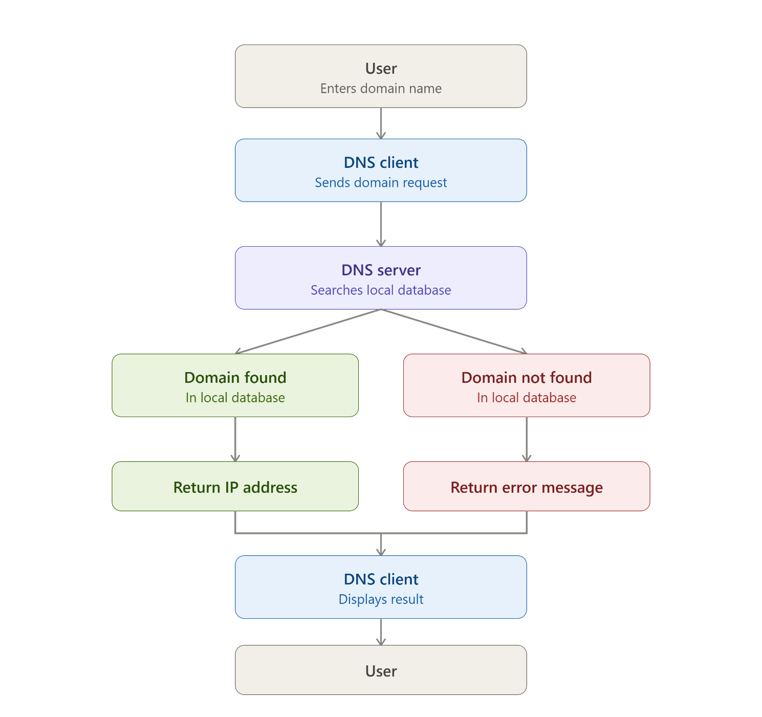
SYSTEM DESIGN
Architecture Diagram
8

Slide 12
SDG MAPPING
Alignment with UN SDGs
This DNS Client–Server project connects to two UN Sustainable Development Goals:
SDG 9
SDG 4
Industry, Innovation & Infrastructure
Quality Education
TARGET 9.C
TARGET 4.4
Expand access to information and communications technology, working toward affordable, universal internet access.
Grow the number of youth and adults with relevant technical and vocational skills for employment.
OUTCOME
OUTCOME
The client–server model built here performs domain name resolution — a core function of the addressing infrastructure that makes the internet usable.
Designing the client and server from scratch builds hands-on skills in sockets, protocols, and system design — direct preparation for a networking career.
9

Slide 13
TECHNOLOGY READINESS
TRL Assessment
The project is assessed against the standard 9-point Technology Readiness Level (TRL) scale used to gauge the maturity of a technology, from basic research through to full deployment.
TRL 4 — Validated in a Lab
Why TRL 4
Technology validated in a lab: the client and server have been built and demonstrated in a lab/development setting, not yet in a live or operational environment.
The client and server were integrated and tested end-to-end on a local machine, successfully resolving domain names to IP addresses — meeting the bar of lab-based validation, ahead of field or operational testing.
10

Slide 14
DISSEMINATION
Journal Paper Summary: DNS Client-Server Application
Journal Paper — Planned
Introduction & Objective: The project explores the fundamental mechanics of the Domain Name System (DNS) by implementing a lightweight, educational client-server application that resolves domain names into their corresponding IP addresses.
Architecture & Methodology: Built using direct socket communication, the system features a client interface that accepts user domain queries, and a core server that processes incoming requests against a local database to return matching IP addresses or a "Domain Not Found" message.
Academic Relevance & Significance: Grounded in core internet standards (RFC 1034/1035) and networking principles, the application provides a simplified alternative to complex multi-tier global DNS hierarchies, making it ideal for academic study and foundational skill-building.
11

Slide 15
SOURCES
References
RFC 1034 — Mockapetris, P. (1987). Domain Names: Concepts and Facilities. IETF.
RFC 1035 — Mockapetris, P. (1987). Domain Names: Implementation and Specification. IETF.
Kurose, J. F., & Ross, K. W. — Computer Networking: A Top-Down Approach.
Tanenbaum, A. S., & Wetherall, D. J. — Computer Networks, 5th Edition, Pearson Education.
12

