Slide 1
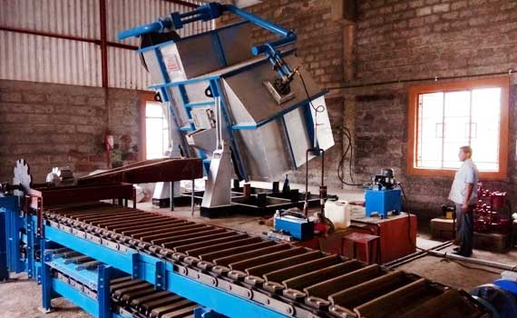
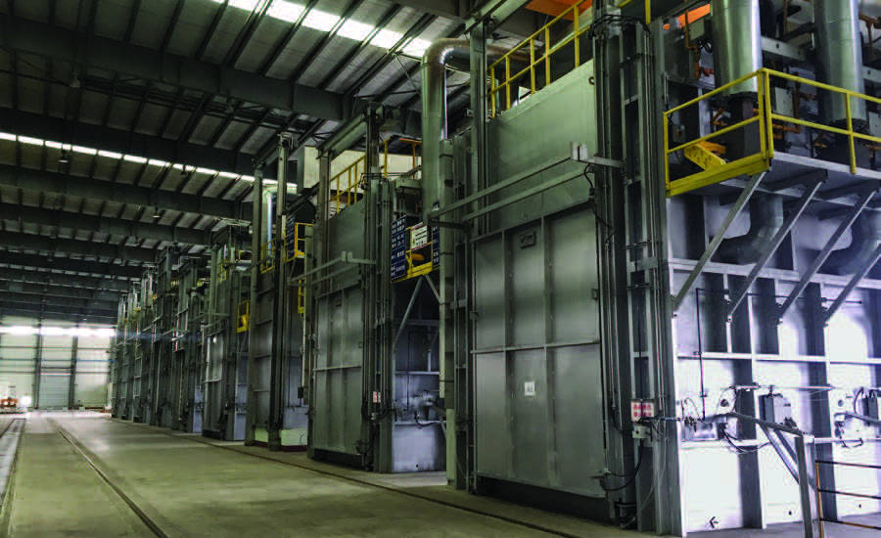
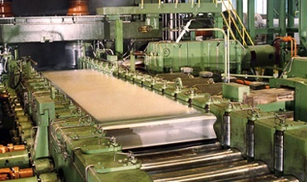
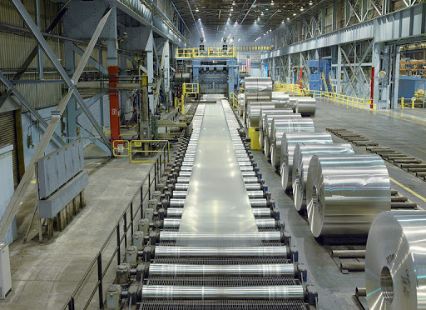
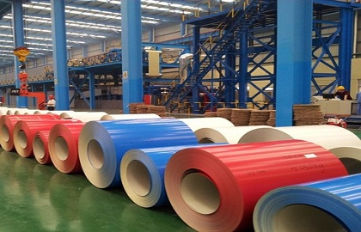
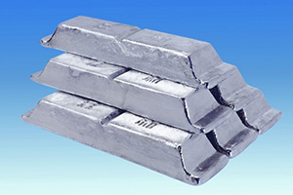
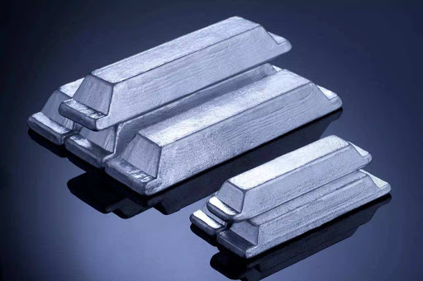
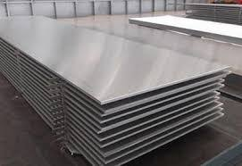
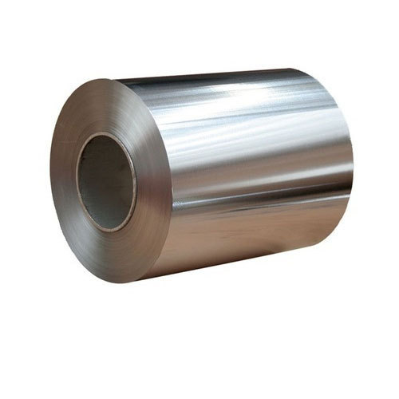
Sheet Formation in a nutshell
Ingot Casting
Homogenization
Cold Rolling
Color Coating
Hot Rolling

Slide 2
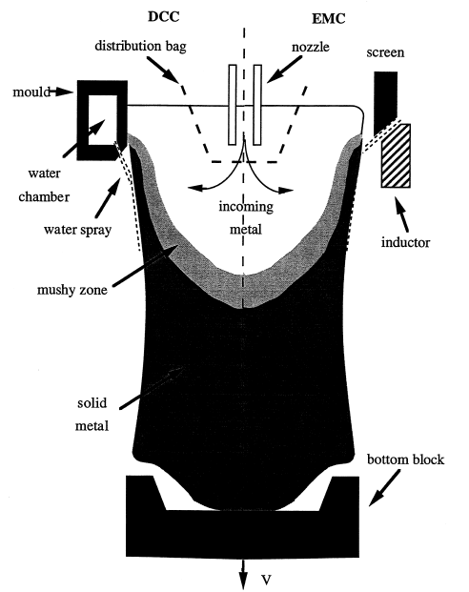
Ingot Casting
Direct Chill (DC) Casting
Open rectangular furnace with movable bottom block
Addition of liquid input and removal of solid output at a steady rate
Primary cooling via water-cooled mould
Key parameters: Superheat in liquid, Cooling spray configuration, casting speed and melt level
Electromagnetic (EM) casting
Developed by Z.N. Getselev. Avoids contact of metal and mould
High current of up to 6000 A
Screen ensures water-cooling and attenuation of the upper magnetic field

Slide 3
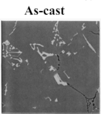
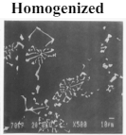
Homogenization
Also called pre-heat or heat treatment process
Primarily used to reduce microscopic deficiencies in the cast product
Key process parameter:
Heating rate: 45 – 70 ⁰C/hour
Cooling rate: Air cooled
Temperature: 550 – 610 ⁰C
Soaking Time: 15 – 25 hours
Raises temperature for the next step
Influences strength, formability and texture
Soaking time
Cooling
Temperature (⁰C)
Heating
Time (hours)
Heat treatment cycle

Slide 4
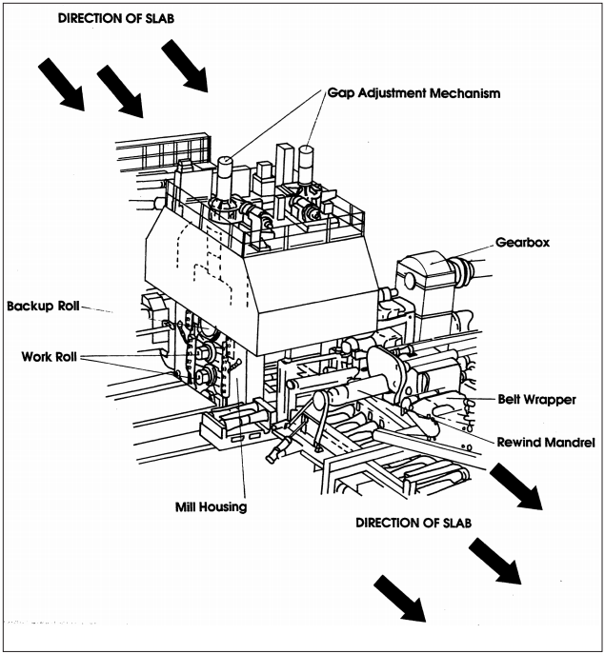
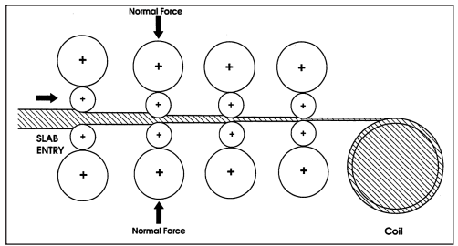
The Rolling Mill
Main Components
Mill stand
Backup rolls
Drive motors
Gearbox
Drive spindles
Rolling bend machinery
Cooling system
Key Process Parameters
Roll gap
Roll force
Sheet tension
Roll torque
Roll force
Roll cooling
Roll tilting and bending
Features of a 4 high roll mill
A four stand tandem roll mill

Slide 5
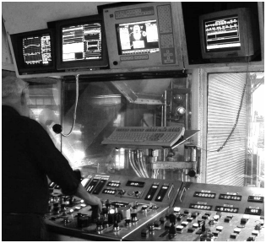
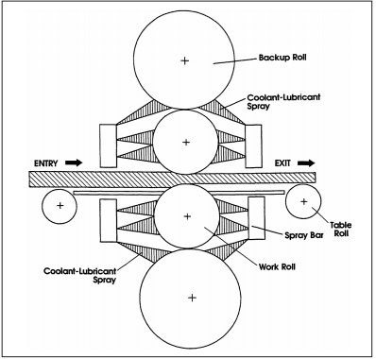
Hot Rolling
Reversible milling (up to 25 mm thickness) followed by tandem milling (up to 2.5 mm thickness)
Can roll sheets at the rate of 600 m/min
Metallurgical effects:
Welds pores left during casting
Converts brittle cast alloy into a ductile wrought alloy
Temperature kept 50 ⁰C below the solidus temperature of Al alloy
Operator in the rolling mill control pulpit
Cold Rolling
Milling up to 0.3 mm (88% reduction) by multiple passes
Can roll sheets at the rate of 1800 m/min
Work hardening increases with each pass
Cooling/lubricant system

Slide 6
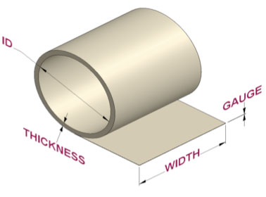
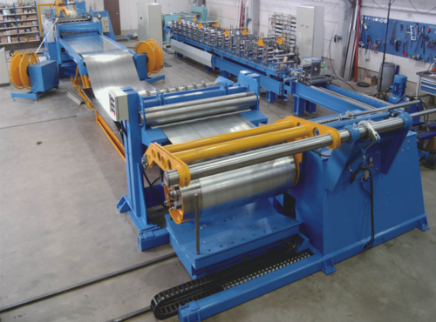
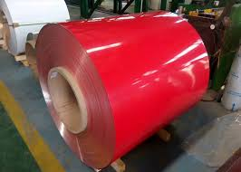
Sheet finishing
Coiling
Slitting
Oiling & degreasing
Coating and marking
Sheets from rolling mills are coiled up to a diameter of 2.4 m
High speed slitter is used to trim the edges of the sheet
Paint or enamel can be sprayed or rolled on the sheets
Oil coating prevents scratching during handling, storage and shipping of sheets
Degreasing is just opposite of oiling, when sheets are ready to process further

