Slide 1
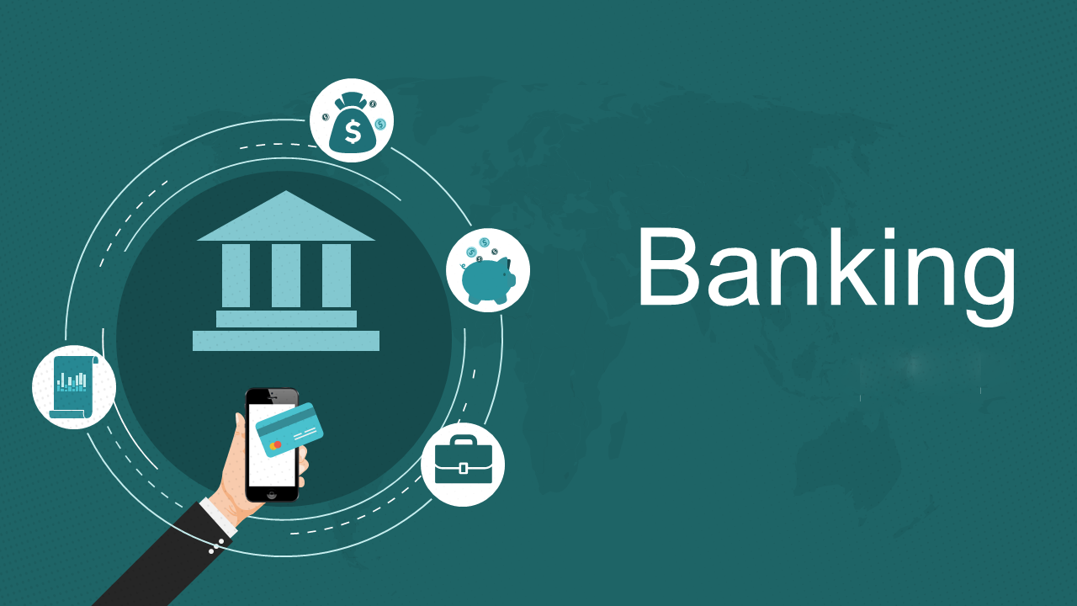
BANK MANAGEMENT SYSTEM
Under the supervision of :
Benny Jacob
Presented by:
Jagarlamudi Adithya

Slide 2
TABLE OF CONTENTS
Introduction
User Interface
Project Overview
Technology Used
Conclusion and future Enhancements

Slide 3
Introduction
The Bank Management System is a robust software application that empowers banks to effectively manage accounts , transactions and customer information.
This project is a replica of Banking system in c++.
The main objective of this project is performing functionalities such as Account creations and authenticaton, transation handling,customer information handling.

Slide 4
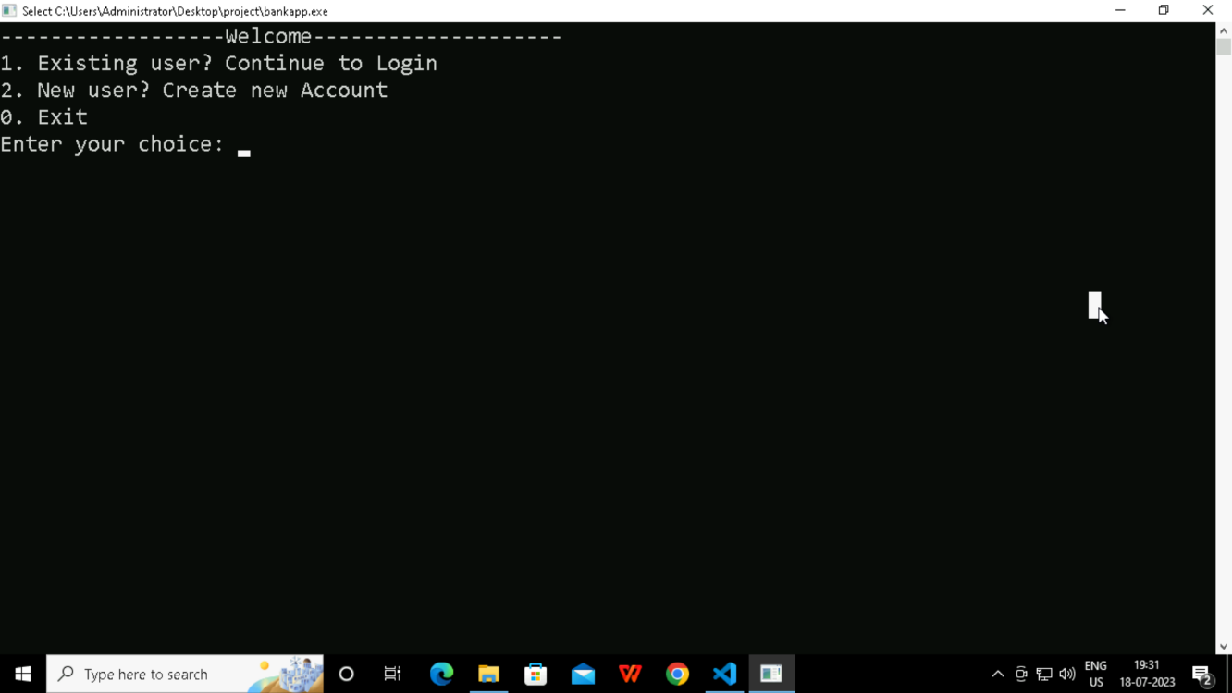
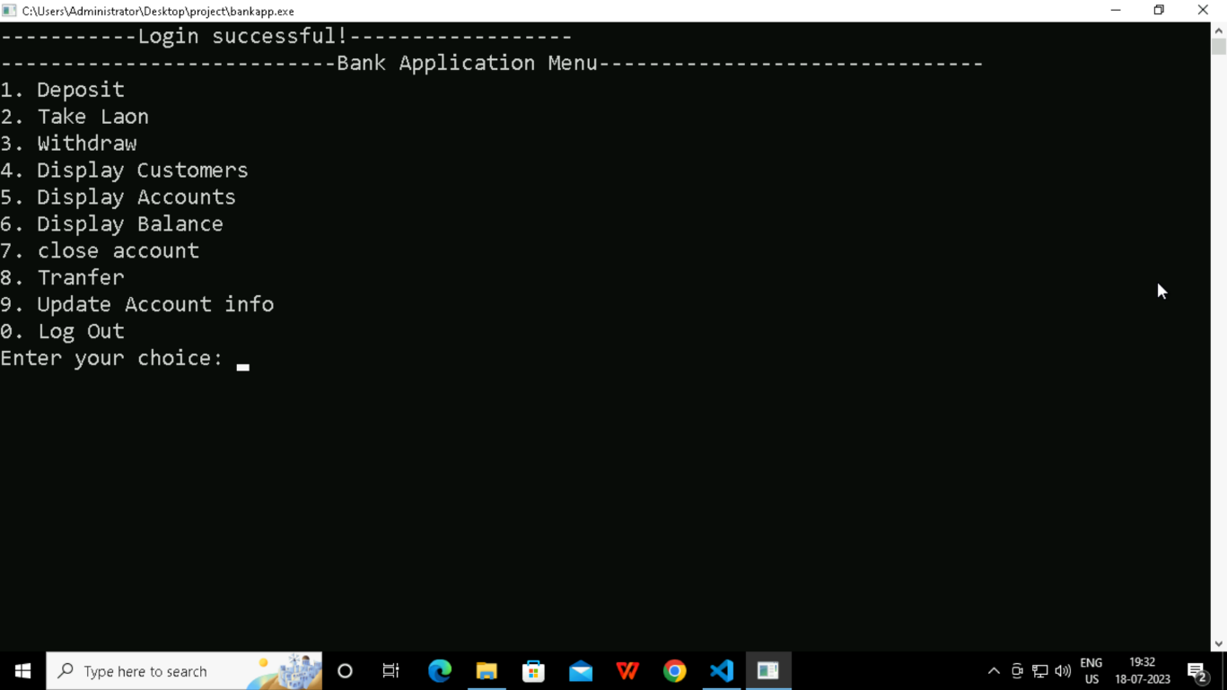
User Interface
Sceenshots of a welcome page and Main menu Interface

Slide 5
project Overview
This project consists following classes and Methods.
Account Class:
It represents individual bank accounts and stores relevant information related to the account.
It contains the attributes such as account number, account type, balance, user name and password.
Customer Class:
It stores the customer details such as name, address and contact information.

Slide 6
Cont’d…
Methods:
addCustomer(const string& accountNumber): By calling this function, a user can add a new customer to the system and associate them with an existing account.
bool login() :This function is responsible for authenticating the user by verifying their username and password.
void displayBalance(const string& accountNumber): By calling this function and passing the account number as an argument, the user can view the current balance of the specified account.
void deposit() : This function allows customers to add funds to their accounts, and it ensures that the deposit is correctly processed and reflected in the account's balance.
void withdraw():This function allows customers to withdraw funds from their accounts, taking into consideration the availability of funds in the account. It ensures that the withdrawal is processed correctly and updates the account's balance accordingly.
void displayCustomers(), void displayAccounts():Both the functions serve the purpose of displaying the list of customers and the list of accounts, respectively.

Slide 7
Cont’d
void takeLoan(): This function provides a way for customers to request and receive a loan. It ensures that the loan amount is added to the appropriate account and updates the account balance accordingly.
void updateAccount(const string& accountNumber): It allows users to modify the details of an existing account. It provides a convenient way to update account-related information, ensuring that the changes are accurately reflected in the system.
void transfer(): It enables users to transfer funds between accounts within the system. It ensures the necessary validations are performed and provides feedback to the user regarding the success or failure of the transfer operation and also about the balance amount.
void closeAccount():This function provides a way for users to terminate their accounts if they no longer wish to use them. It ensures that the account is removed from the system, preventing any further transactions or operations associated with that account.
void createAccount():It combines the process of creating a new account, gathering customer information, and facilitating the login process, providing users with a streamlined account creation experience.

Slide 8
Tools and Technologies Used
Programming Language: C++ - The project is developed using the C++ programming language, which is known for its efficiency and versatility.
Integrated Development Environment (IDE): Visual Studio - Visual Studio is used as the IDE for writing, compiling, and debugging the C++ code. It provides a comprehensive development environment with features like code editor, debugger, and project management.
Operating System: Windows - The project is designed to run on the Windows operating system, taking advantage of Windows-specific libraries and functions for console handling and system calls.

Slide 9
Future Enhancements
Improved User Interface.
Database Integration.
Multi-User Support.
Transaction History.
Integration with Third-Party APIs.

Slide 10
Thank you

