Slide 1
DEEP LEARNING OF FACIAL DEPTH MAPS FOR OBSTRUCTIVE SLEEP APNEA PREDICTION
GROUP – 22
B. Veera Chary - 21N31A6626
J. Adithya - 21N31A6666
G. Shiva Kumar - 21N31A6654
Internal Guide:
Ms. P. Swapna(Assistant Professor)

Slide 2
INTRODUCTION :-
Poor sleep negatively affects social and personal activities.
Sleep disorders impose significant economic costs, with Australia alone facing a $5.1 billion annual burden.
Obstructive Sleep Apnea (OSA) is the most common sleep disorder, caused by repeated upper airway blockages..
OSA leads to oxygen deprivation and frequent awakenings, with diagnosis confirmed if more than 15 apneas occur per hour.
Diagnosis methods include patient history, physical exams, imaging, and polysomnography (PSG), the gold standard sleep study.

Slide 3
ABSTRACT :-
Obstructive Sleep Apnea (OSA) occurs due to repeated airway obstruction during sleep, often caused by tongue and muscle relaxation.
Common symptoms include snoring, gasping for air, and unrefreshing sleep, but diagnosis is often delayed due to high costs and time constraints.
Facial morphology has been linked to OSA, providing a potential non-invasive diagnostic approach.
This study explores deep learning techniques using depth maps from facial scans to detect OSA more effectively than traditional 2D images.
Using transfer learning, the model achieves approximately 90% validation accuracy in predicting OSA severity (>15 or ≤15 apneas per hour) with limited data.

Slide 4
DATASET :-
The performance of the deep learning model for predicting OSA depends on the quality and diversity of the dataset used for training and evaluation.
The dataset is uploaded through a module that allows the application to access and process OSH facial images.
A preprocessing module resizes all images to a uniform size and normalizes pixel values for consistent input.
The VGG-19 model is trained on the processed images to learn patterns for OSA detection.
The system includes a test module for prediction and an accuracy comparison graph to visualize model performance.

Slide 5
SYSTEM REQUIREMENTS :-
Software Requirements :-
Operating System: Windows 7 or above.
Programing language : Python.
Supporting libraries : TensorFlow, PyTorch, Keras, CNN.
Hardware Requirements :-
Processor: i5 and above
RAM: 8 GB and above
Hard Disk: 25 GB in local drive

Slide 6
EXISTING SYSTEM :-
Polysomnography(PSG) is the standard test for diagnosing OSA, requiring an overnight stay in a sleep clinic or hospital.
It monitors brain activity, breathing patterns, heart rate, muscle tone, and oxygen levels to detect sleep disruptions.
Home Sleep Apnea Tests (HSAT) offer a more convenient alternative but are less accurate, often missing mild to moderate cases.
High costs make PSG inaccessible for many patients, especially in low-resource settings.
Time-consuming process, requiring overnight monitoring and specialized equipment, results in long waiting times.

Slide 7
PROPOSED SYSTEM :-
Uses 3D facial depth maps to analyze facial structures linked to OSA, providing a non-invasive alternative.
Deep learning (CNN model) is applied to detect patterns in facial features that correlate with OSA severity.
Classifies OSA severity into two categories: moderate-to-severe (AHI > 15) and mild/no OSA (AHI ≤ 15).
Cost-effective and time-efficient, as it eliminates the need for expensive overnight sleep studies.
More accessible and comfortable, requiring only a quick facial scan, leading to better patient compliance.

Slide 8
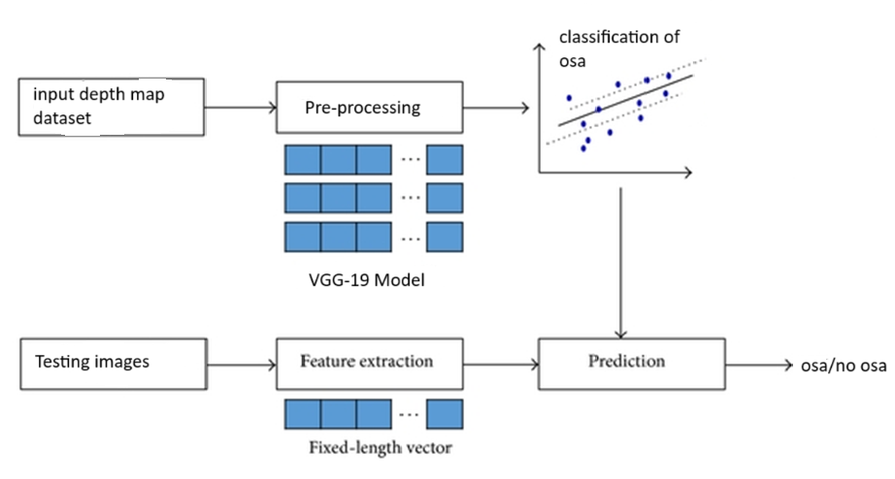
PROPOSED SYSTEM ARCHITECTURE :-

Slide 9
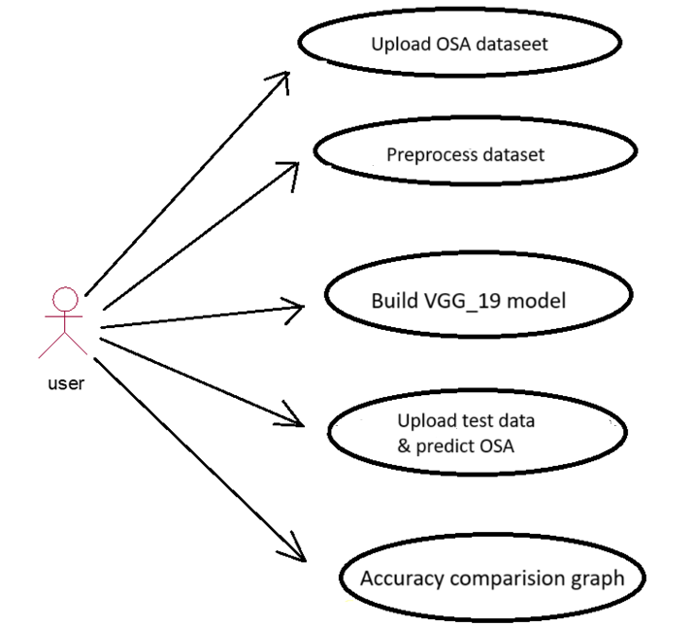
UML DIAGRAMS :-
USECASE Diagram :-

Slide 10
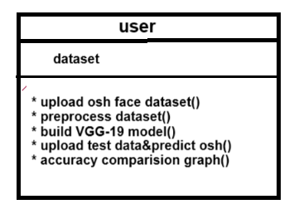
CLASS DIAGRAM :-

Slide 11
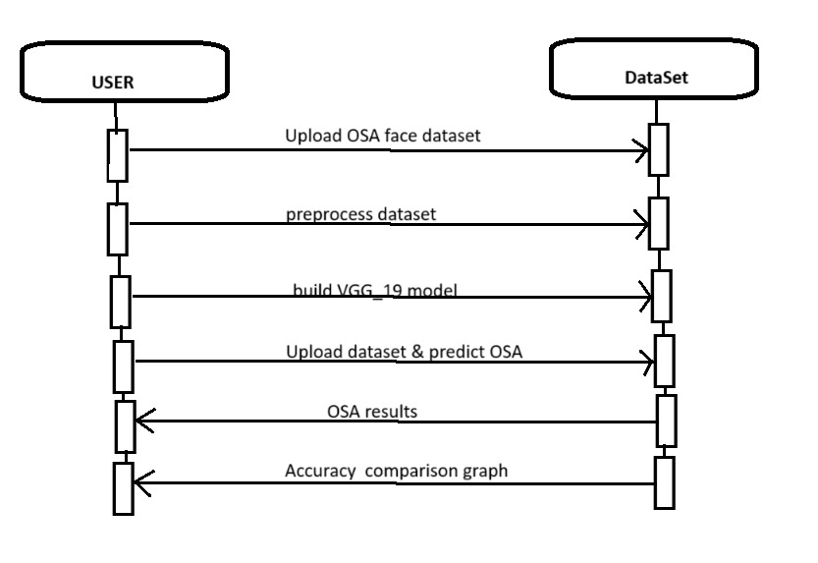
SEQUENCE DIAGRAM :-

Slide 12
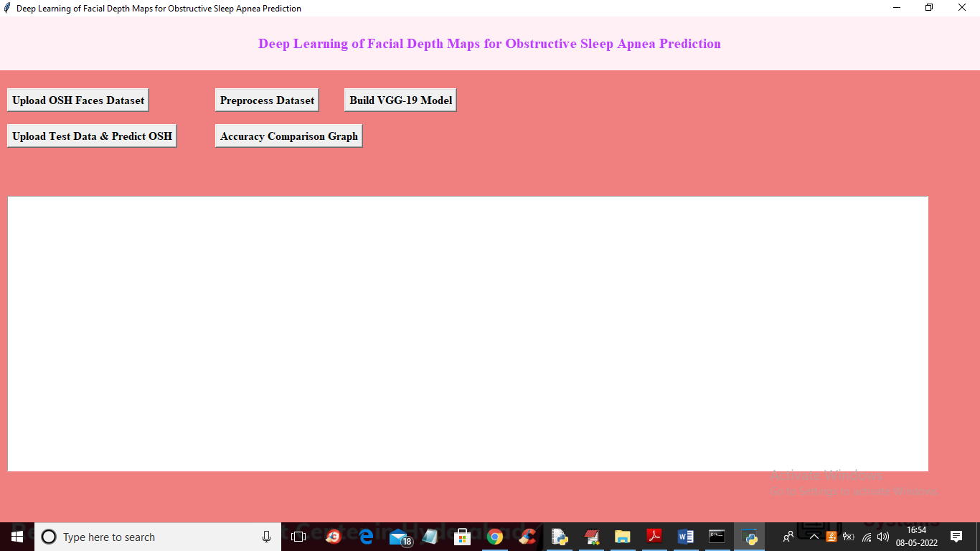
OUTPUT SCREENS:

Slide 13
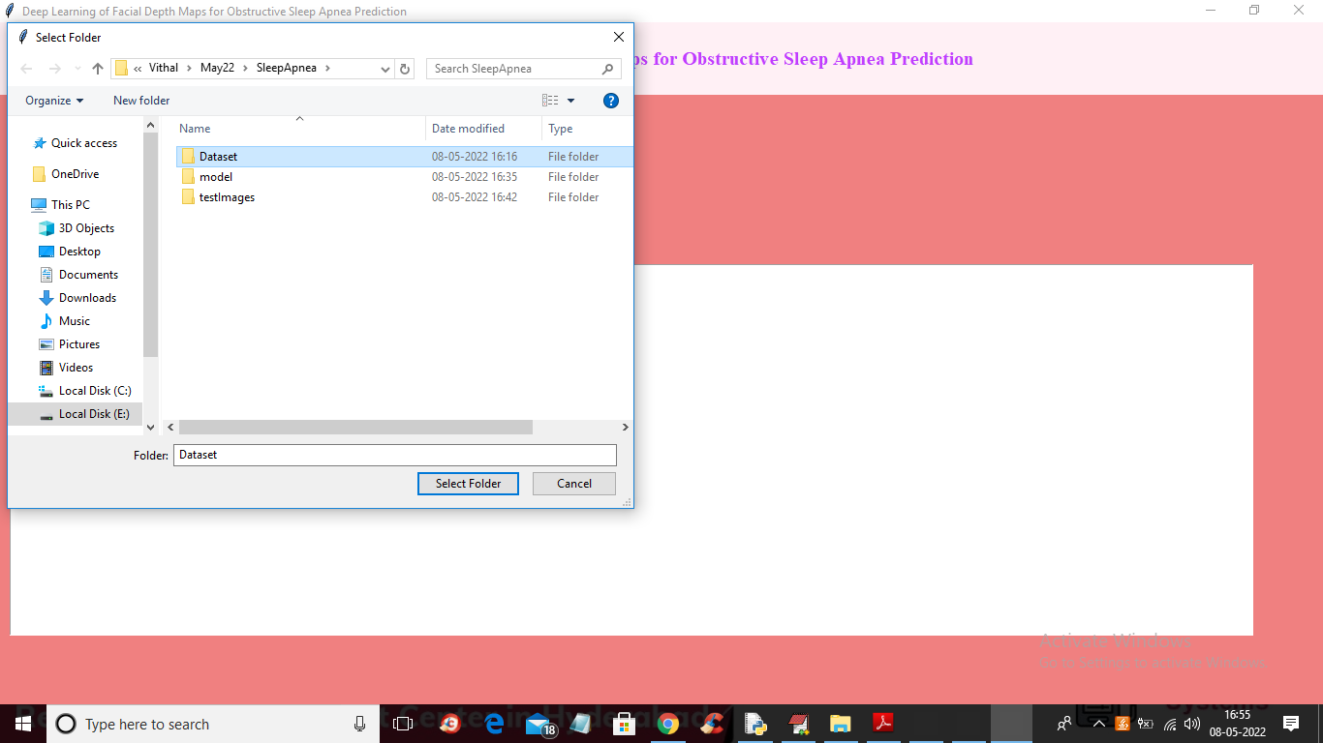

Slide 14


Slide 15
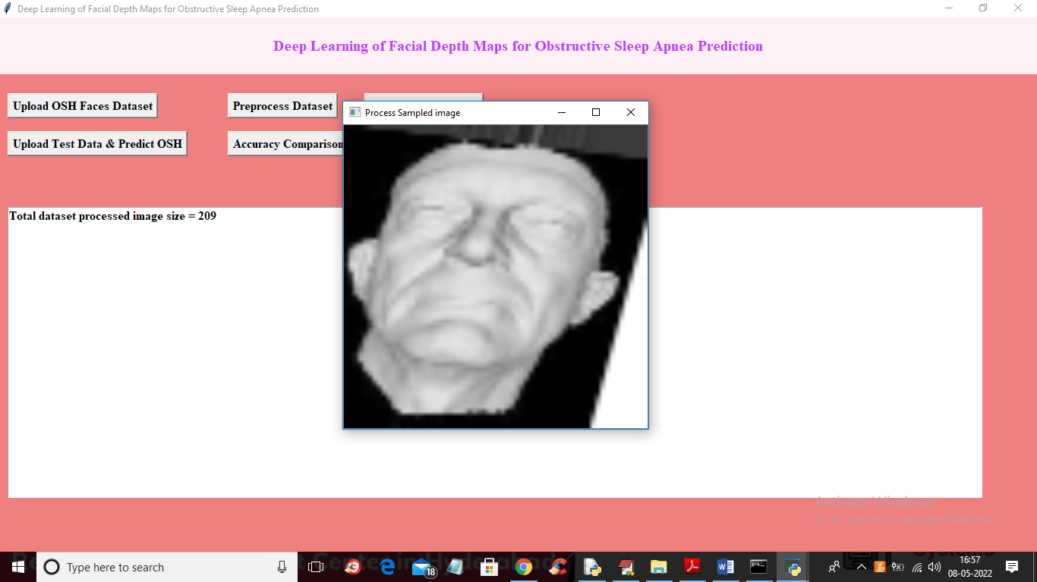

Slide 16


Slide 17
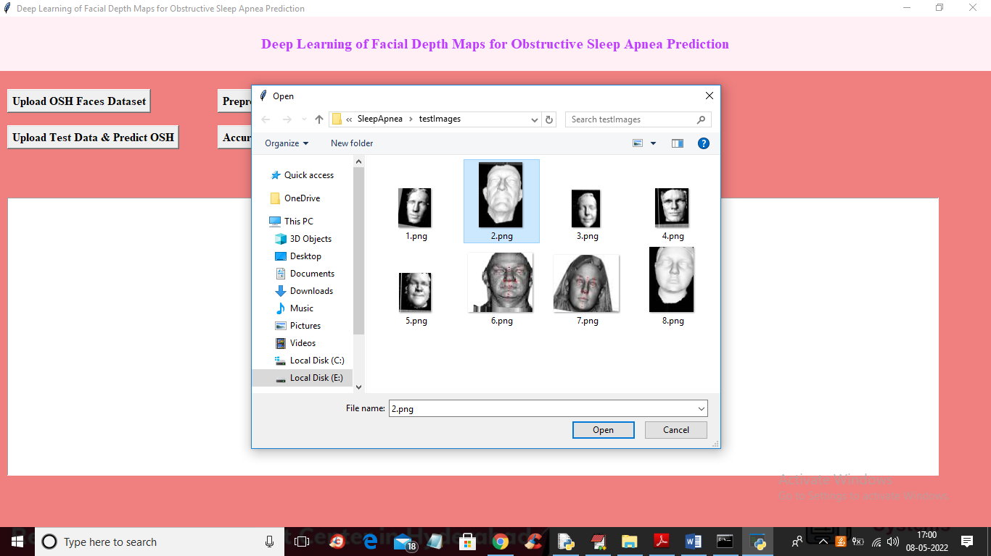

Slide 18
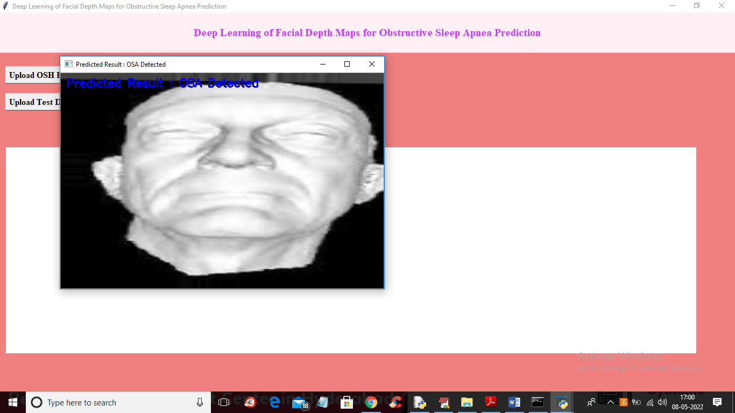

Slide 19
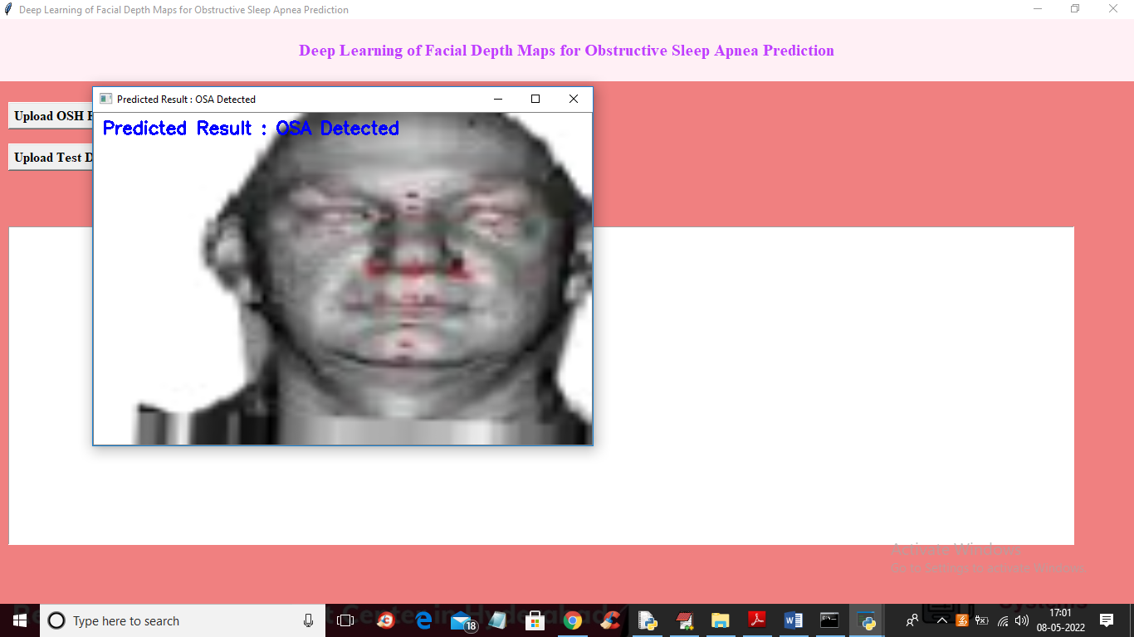

Slide 20
CONCLUSION :-
This study introduces the first facial depth map-based approach for detecting sleep apnea.
Transfer learning is used to overcome the challenge of a small patient dataset.
Among tested models, VGGFace performs best in predicting OSA from depth facial data.
The method achieves results comparable to state-of-the-art techniques using end-to-end deep learning.
Future improvements include pose correction using a 3D morphable model and automated hole-filled depth maps to enhance diagnostic accuracy.

Slide 21
THANK YOU

