Slide 1
Edge Computing
Overview of Key Concepts and Benefits

Slide 2
Introduction to Edge Computing
Edge computing is a distributed computing model that processes data closer to the data source rather than sending it to centralized cloud servers.
This allows for faster real-time processing, reduced latency, and optimized bandwidth.

Slide 3
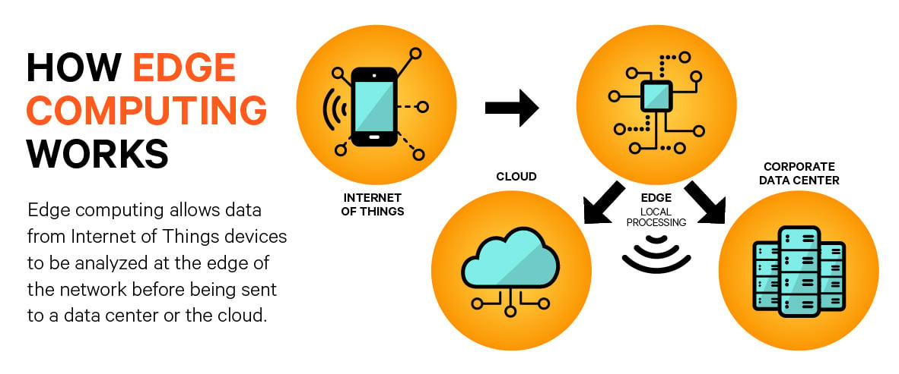

Slide 4
Key Components
1. Edge Devices: Devices such as sensors and smartphones that process data locally.
2. Edge Nodes: Intermediary devices for data processing between cloud and devices.
3. Edge Data Centers: Smaller data centers that handle more complex processing near the network edge.
4. Edge Gateway: A bridge between devices and the cloud.

Slide 5
Why Use Edge Computing Over Other Paradigms?
There are many more types of computing like :
Cloud Computing
Fog Computing
On-Premises Computing
Distributed Computing
Mobile Computing
Quantum Computing

Slide 6
Why Use Edge Computing Over Other Paradigms?
Low Latency
Bandwidth Optimization
Data Privacy & Security
Real-Time Analytics
Scalability for Iot

Slide 7
Advantages of Edge Computing
1. Reduced Latency
2. Bandwidth Optimization
3. Enhanced Privacy and Security
4. Reliability and Resilience
5. Scalability

Slide 8
Use Cases of Edge Computing
1. IoT
2. Autonomous Vehicles
3. Smart Cities
4. Healthcare
5. Industrial IoT

Slide 9
Challenges in Edge Computing
1. Infrastructure Complexity
2. Limited Resources
3. Security Risks
4. Data Synchronization

Slide 10
The Future of Edge Computing
With the expansion of 5G networks, edge computing is set to become more prominent, enhancing real-time applications and device connectivity.

