Slide 1
Internet of Things – Workshop on RaspberryPi
Speakers
Adithya B, Vadiraja A
Jyothy Institute of Technology

Slide 2
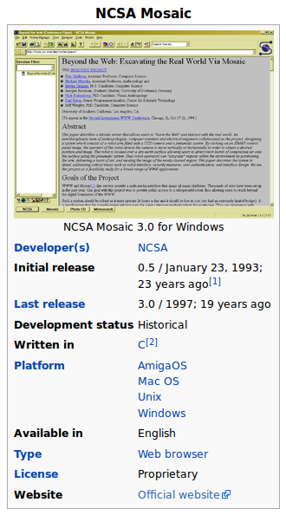

Slide 3
Will It Change the world?

Slide 4


Slide 5
Five Things Happened That Day !!!
1. They under-estimated the huge influx of web traffic.
2. Five Thousand servers deployed for this event. None were properly configured to automatically scale to handle giant traffic spikes.
3. DNS failure to share the load.
4. The Load Balancer which implements failover

Slide 6
Last Things Happened That Day !!!
Someone
[I don't mean Amazon or Snapdeal :)] launched massive attacks against Flipkart by directing a giant traffic surge to the Flipkart`s website.
That's called a DDoS attack

Slide 7

Where Does All These Data Reside
4000 Exabytes

Slide 8
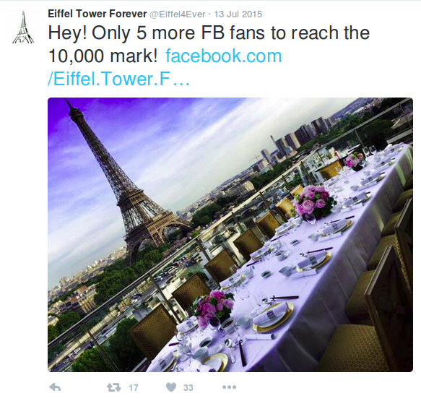
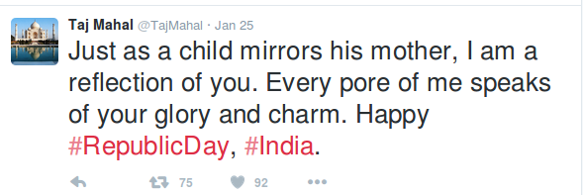
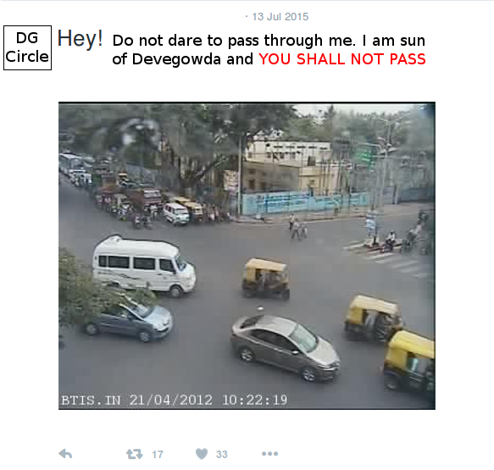

Slide 9
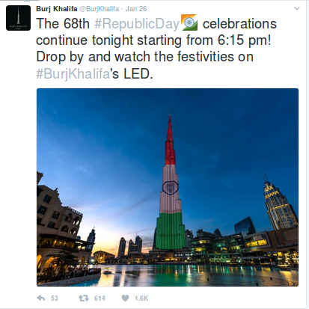

Slide 10
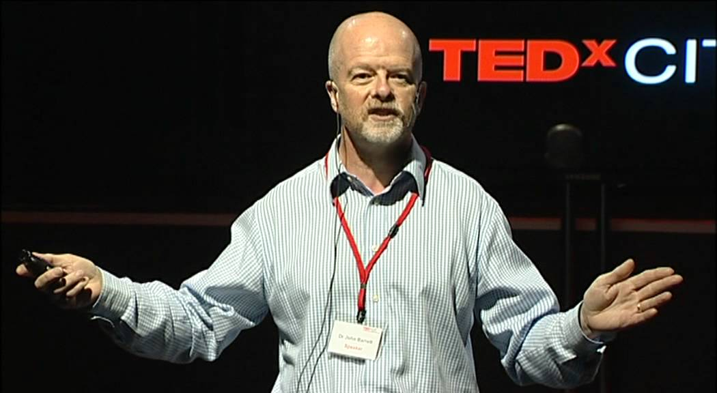
Dr. John Berret
English Methodist and chairman and elected president of the World Methodist Council

Slide 11
What do we Do with it?
CONNECT WITH THINGS

Slide 12
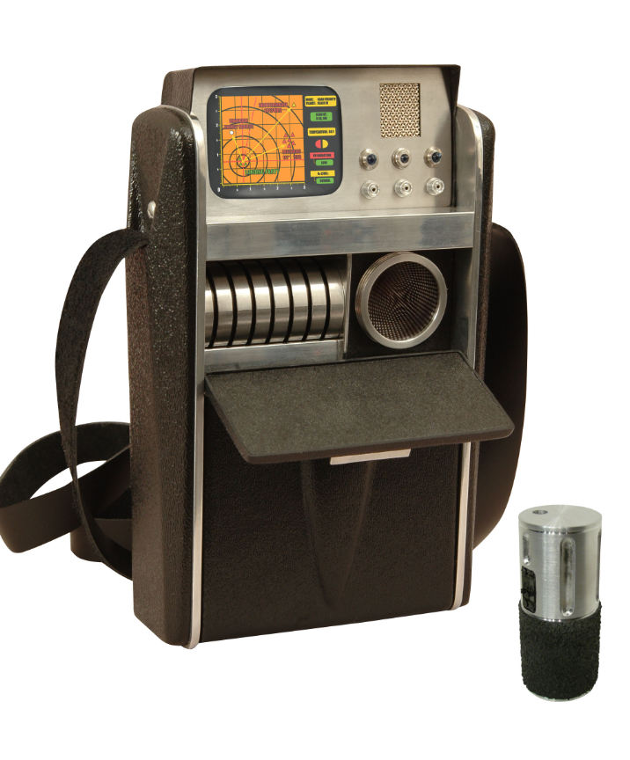
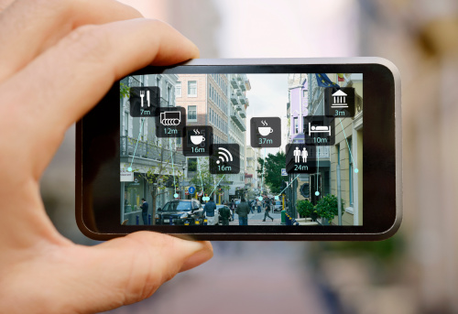

Slide 13
Monitoring

Slide 14
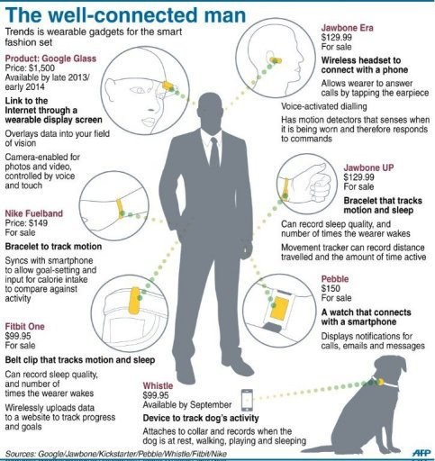

Slide 15
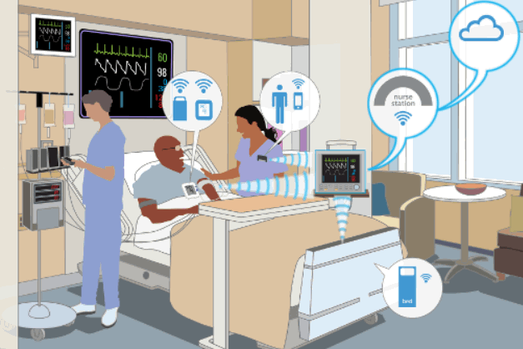

Slide 16
Search For Things

Slide 17
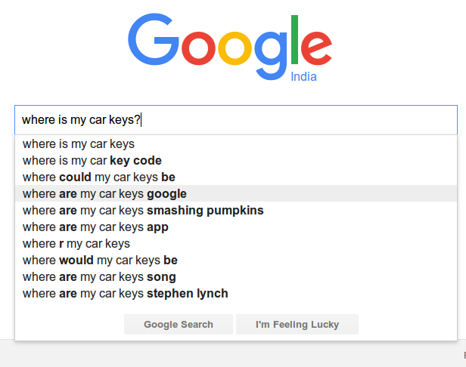
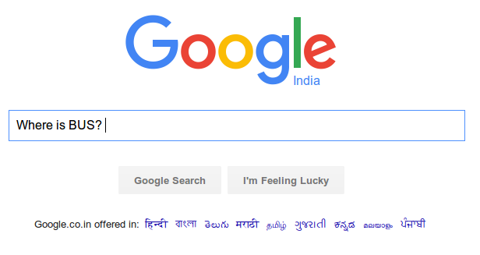
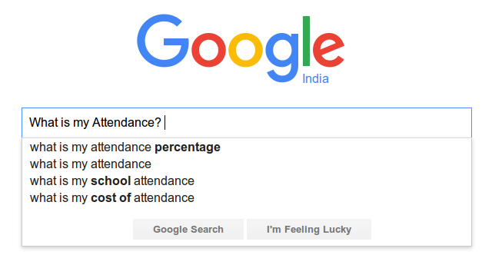

Slide 18
Manage Things

Slide 19
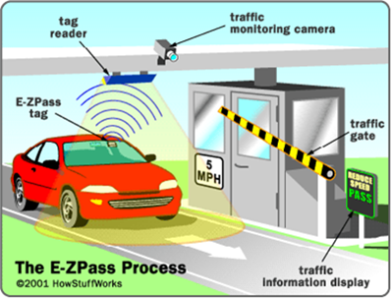

Slide 20
Control Things

Slide 21
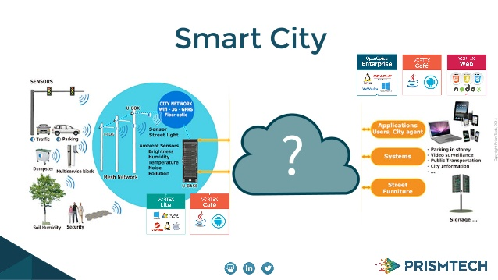

Slide 22
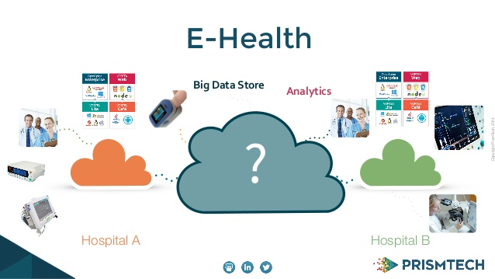

Slide 23
Play with Things

Slide 24
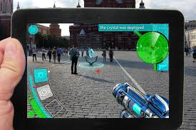

Slide 25
Each Indivisual will be sourounded by 3000 to 5000 devices
Managing
Controlling
Monitoring
Searching
Connecting
Playing
By 2032

Slide 26
Will It Change the world?

Slide 27
How Will This Work?

Slide 28
Return Journey
On ward Journey
Applciation
Mobile, Web, messaging
Cloud
Google, Microsoft, Amazon ...
Network
Ethernet, WiFi, Zigbee, Blootooth, IR
Controllers, Micro Computers
Sensors, Actuaors, Motors, Electrical Appliences

Slide 29
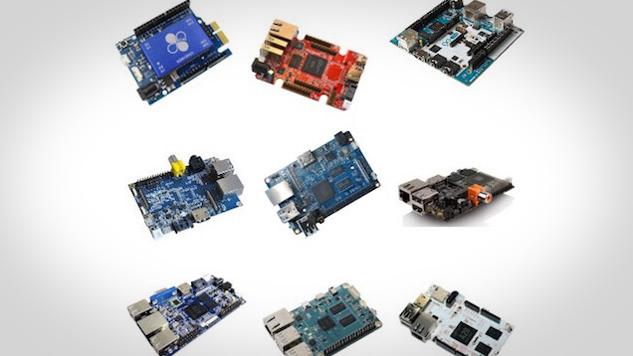
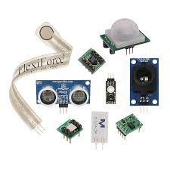
Sensors, Actuaors, Motors, Electrical Appliences
Micro Controllers and Micro Computers

Slide 30
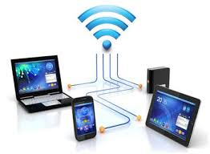
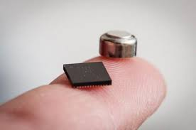
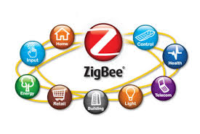
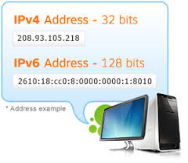
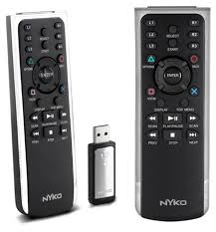
Networking

Slide 31
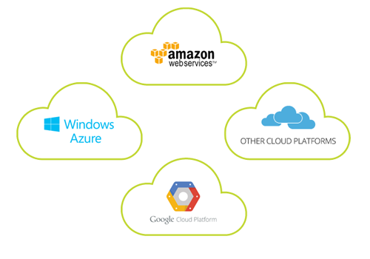
Cloud Platforms

Slide 32
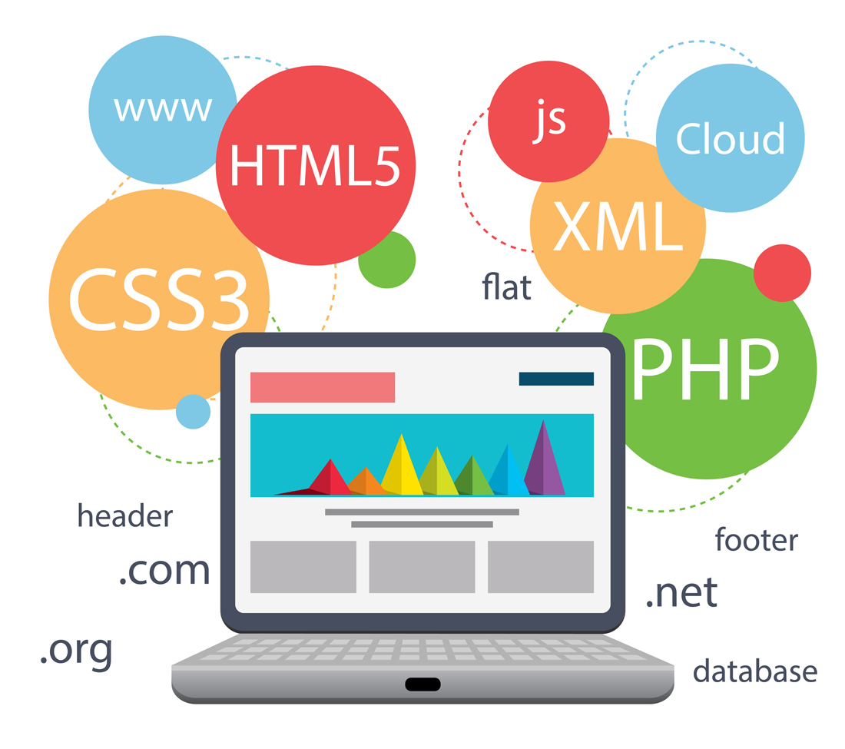
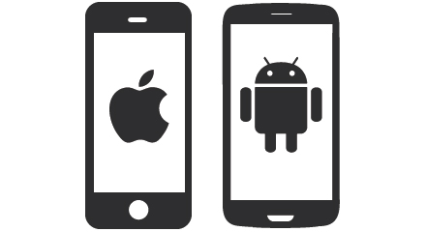

Applications

Slide 33
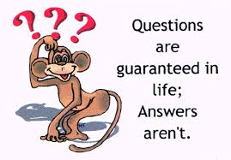
adithya.b@jyothyit.org
vadiraja.a@jyothyit.org

