Slide 1
Internet of Things – Workshop on RaspberryPi
Speakers
Adithya B, Vadiraja A
Jyothy Institute of Technology

Slide 2
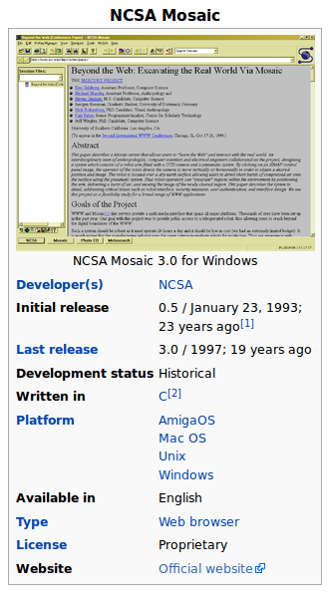

Slide 3
Will It Change the world?

Slide 4


Slide 5
Five Things Happened That Day !!!
1. They under-estimated the huge influx of web traffic.
2. Five Thousand servers deployed for this event. None were properly configured to automatically scale to handle giant traffic spikes.
3. DNS failure to share the load.
4. The Load Balancer which implements failover

Slide 6
Last Things Happened That Day !!!
Someone
[I don't mean Amazon or Snapdeal :)] launched massive attacks against Flipkart by directing a giant traffic surge to the Flipkart`s website.
That's called a DDoS attack

Slide 7
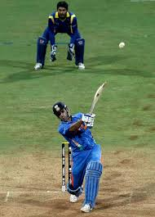

Mumbai

Slide 8
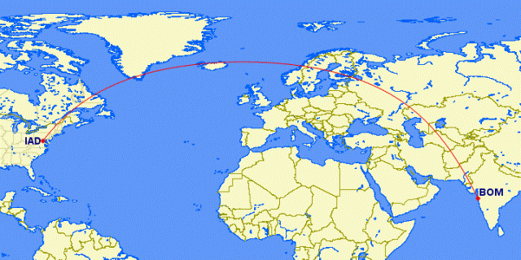
13,568 km

Slide 9
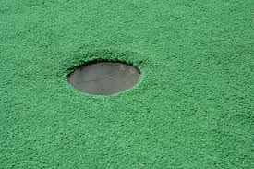
US: New York
Hole
10 inches

Slide 11

Where Does All These Data Reside
4000 Exabytes

Slide 12


What does 4000 Exabytes Mean
7.5 Billion Km
7,500,000,000 Km

Slide 13
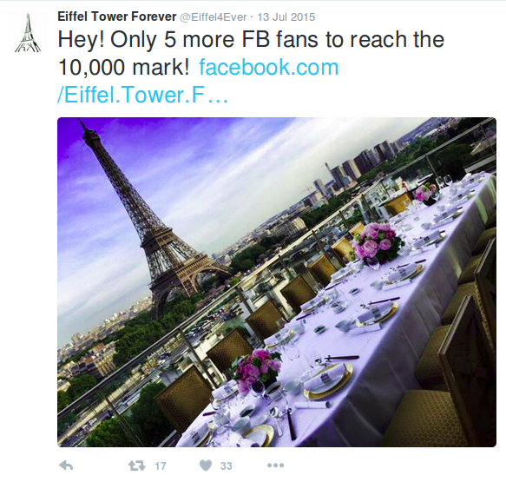
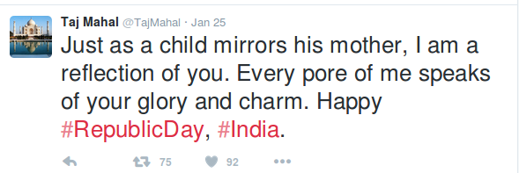
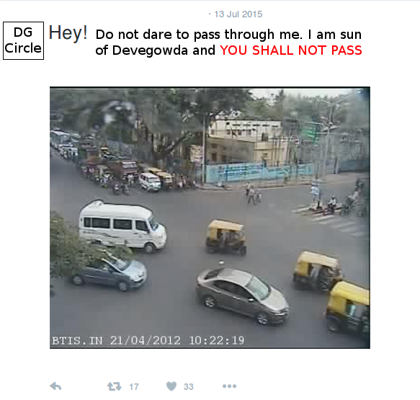

Slide 14
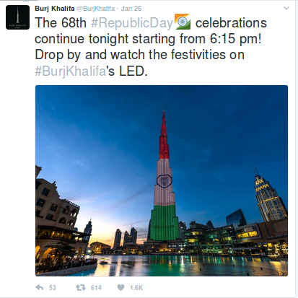

Slide 15
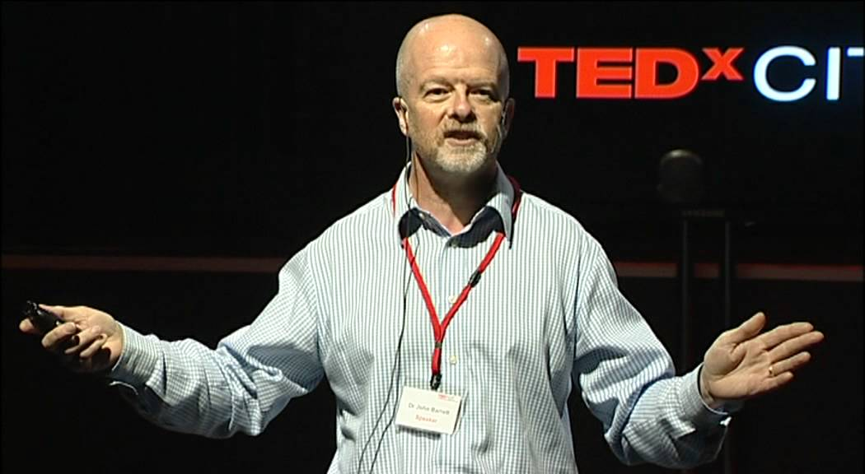
Dr. John Berret
English Methodist and chairman and elected president of the World Methodist Council

Slide 16
What do we Do with it?
CONNECT WITH THINGS

Slide 17
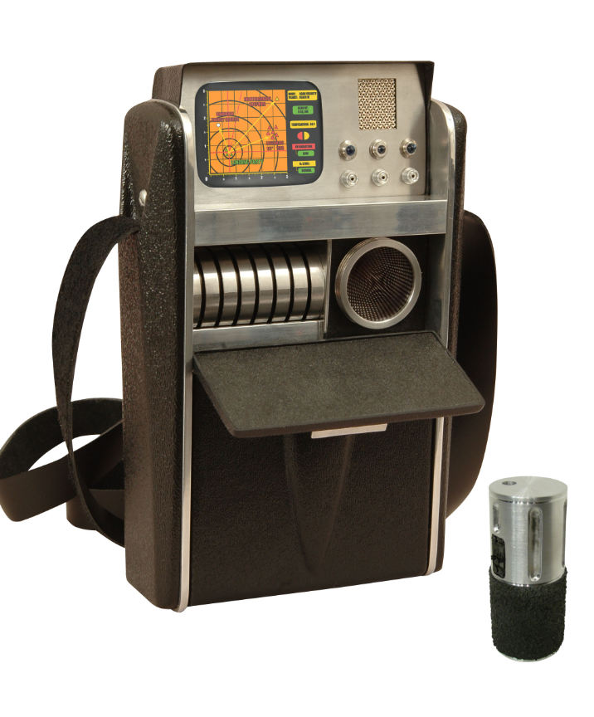
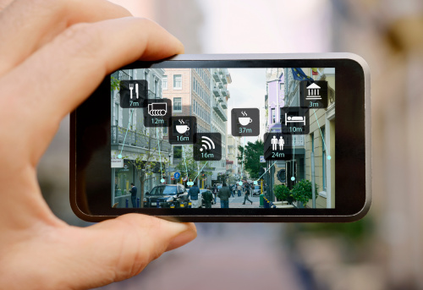

Slide 18
Monitoring

Slide 19
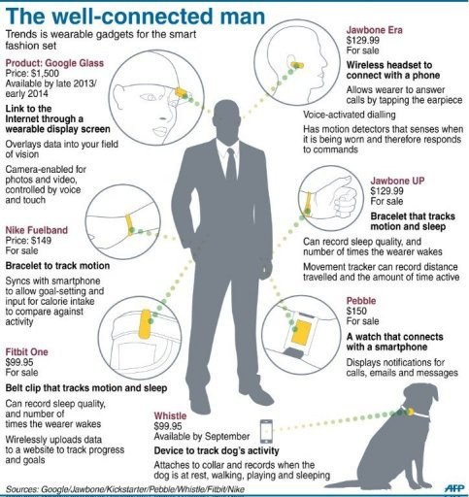

Slide 20
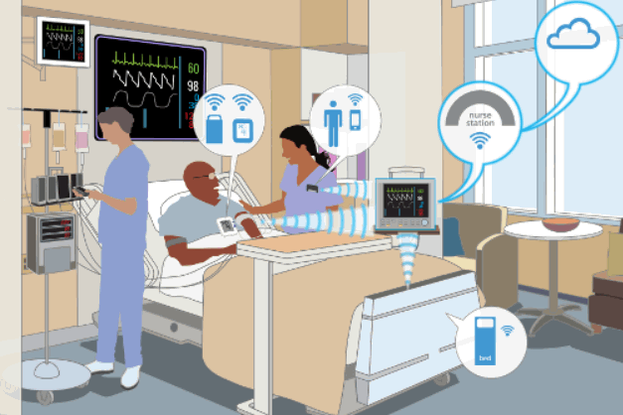

Slide 21
Search For Things

Slide 22
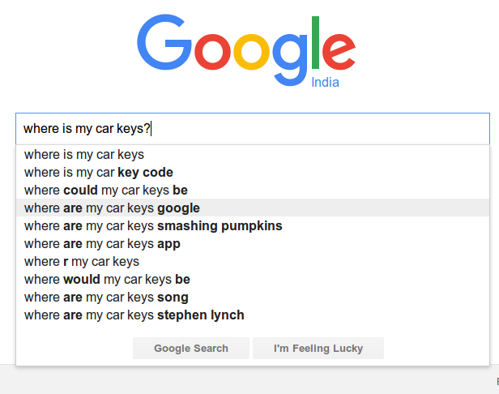
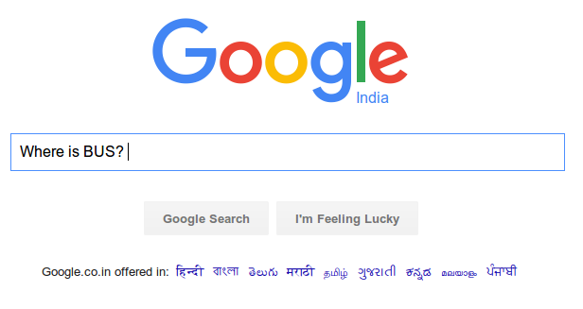
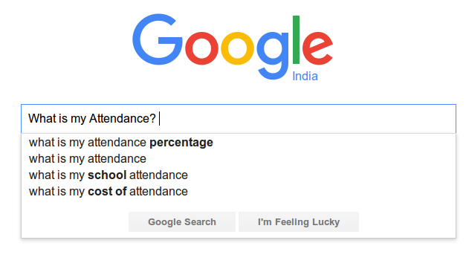

Slide 23
Manage Things

Slide 24
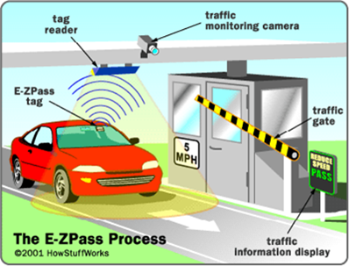

Slide 25
Control Things

Slide 26
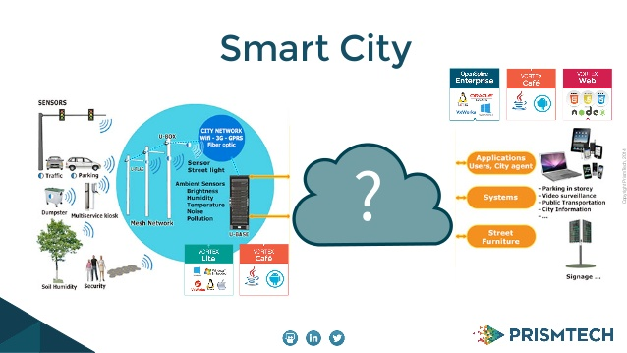

Slide 27
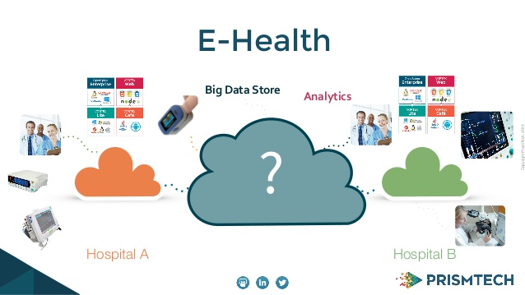

Slide 28
Play with Things

Slide 29
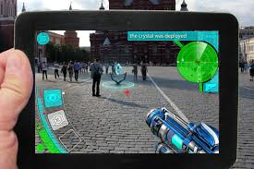

Slide 30
Each Indivisual will be sourounded by 3000 to 5000 devices
Managing
Controlling
Monitoring
Searching
Connecting
Playing
By 2032

Slide 31
Will It Change the world?

Slide 32
How Will This Work?

Slide 33
Return Journey
On ward Journey
Applciation
Mobile, Web, messaging
Cloud
Google, Microsoft, Amazon ...
Network
Ethernet, WiFi, Zigbee, Blootooth, IR
Controllers, Micro Computers
Sensors, Actuaors, Motors, Electrical Appliences

Slide 34
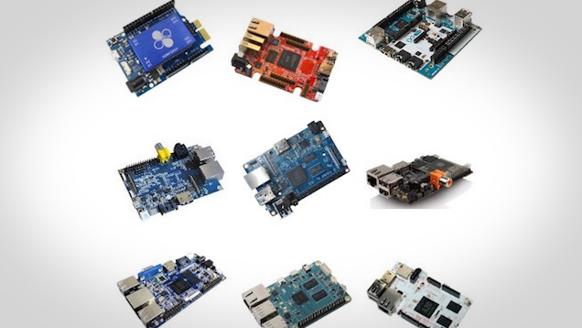
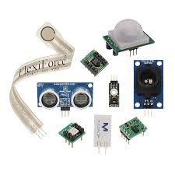
Sensors, Actuaors, Motors, Electrical Appliences
Micro Controllers and Micro Computers

Slide 35
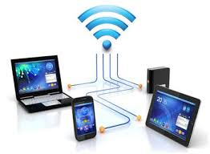
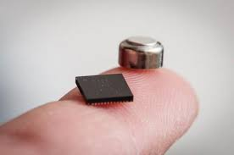
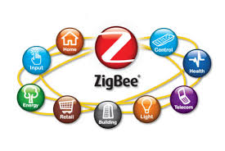
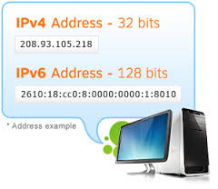
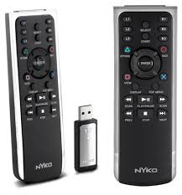
Networking

Slide 36
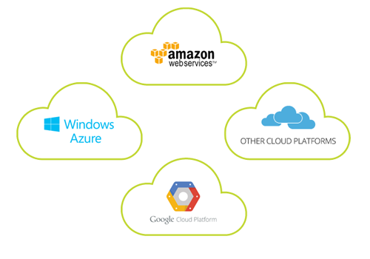
Cloud Platforms

Slide 37
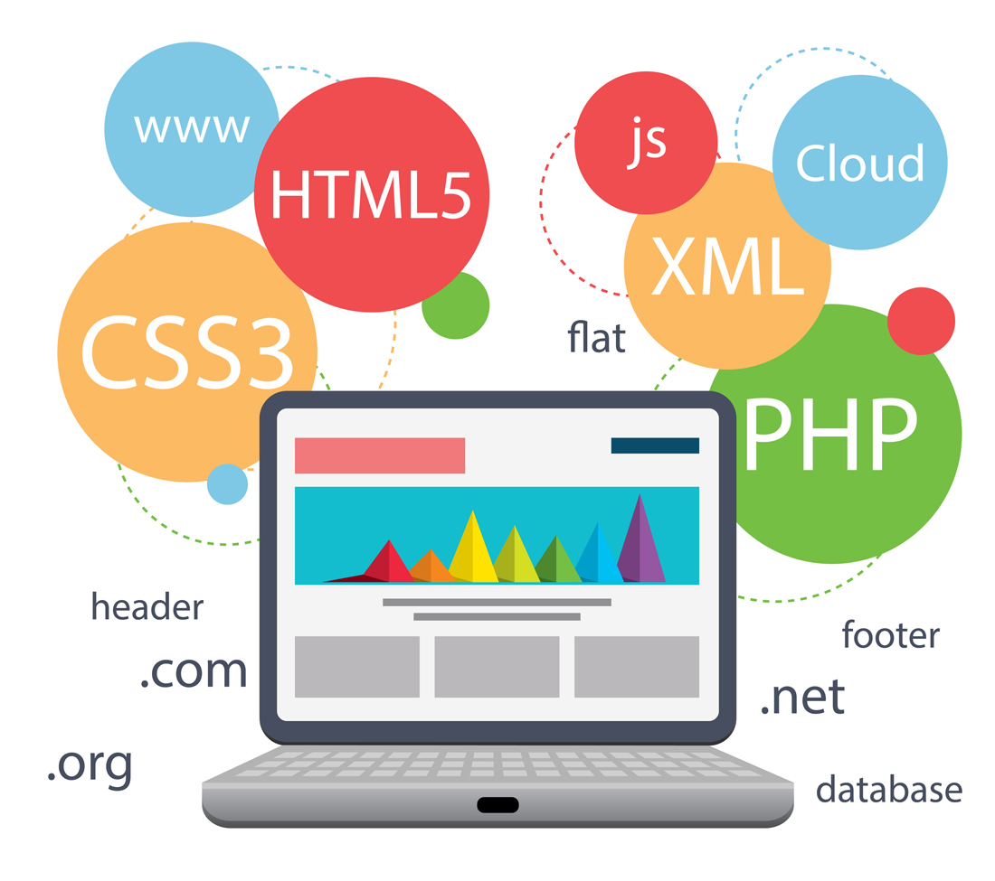
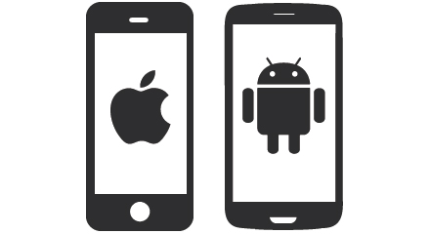

Applications

Slide 38

adithya.b@jyothyit.org
vadiraja.a@jyothyit.org

