Slide 1
WELCOME

Slide 2
Introducing new iPhone
First iPhone with apple intelligence

Slide 3
IPhone 16 Mobile Cost and Discount Calculation
Introduction to iPhone 16 Mobile Pricing
Discount Structure Based on Quantity
GST Calculation on Mobile Cost
Computation of Total Cost with Taxes and Discounts
Summary and Billing Output

Slide 4
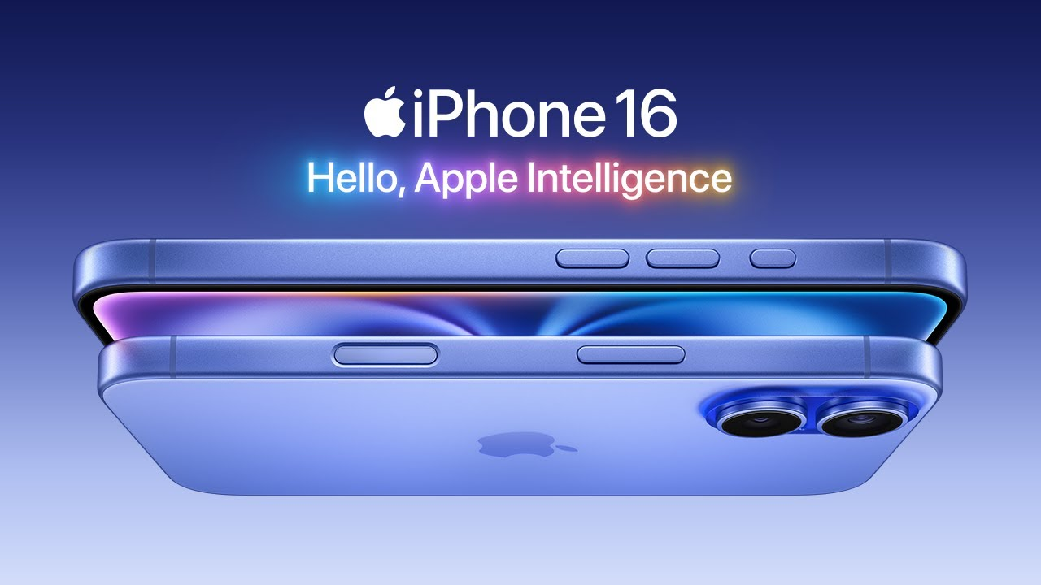
Introduction to iPhone 16 Mobile Pricing
Base Price Specification: The iPhone 16 is priced at ₹90,000 before taxes and discounts are applied to purchases.
GST Tax Components: Integrated GST is split equally into SGST and CGST, each charged at 18% of the base price.
Pricing Objective: Aim to determine total payable amount by applying quantity-based discounts and GST taxes precisely.

Slide 5
Discount Structure Based on Quantity
Tiered Discount Percentages: Discounts escalate from 5% for 1 item up to 33% for 41 or more, rewarding increased order volume.
Encouragement of Bulk Purchases: Higher discounts incentivize customers to increase quantity, boosting overall sales volume effectively.
Strategic Pricing Implication: Graduated discounts strategically balance profit margins with consumer purchase motivation enhancing revenue.

Slide 6
GST Calculation on Mobile Cost
SGST and CGST Rates: Both SGST and CGST are levied at 18% each, calculated on the mobile's base price of ₹90,000.
SGST Amount per Unit: SGST for each unit equals 18% of ₹90,000, resulting in ₹16,200 added to the cost separately.
CGST Amount per Unit: Similarly, CGST per unit is ₹16,200, making total tax ₹32,400 by summing SGST and CGST equally.

Slide 7
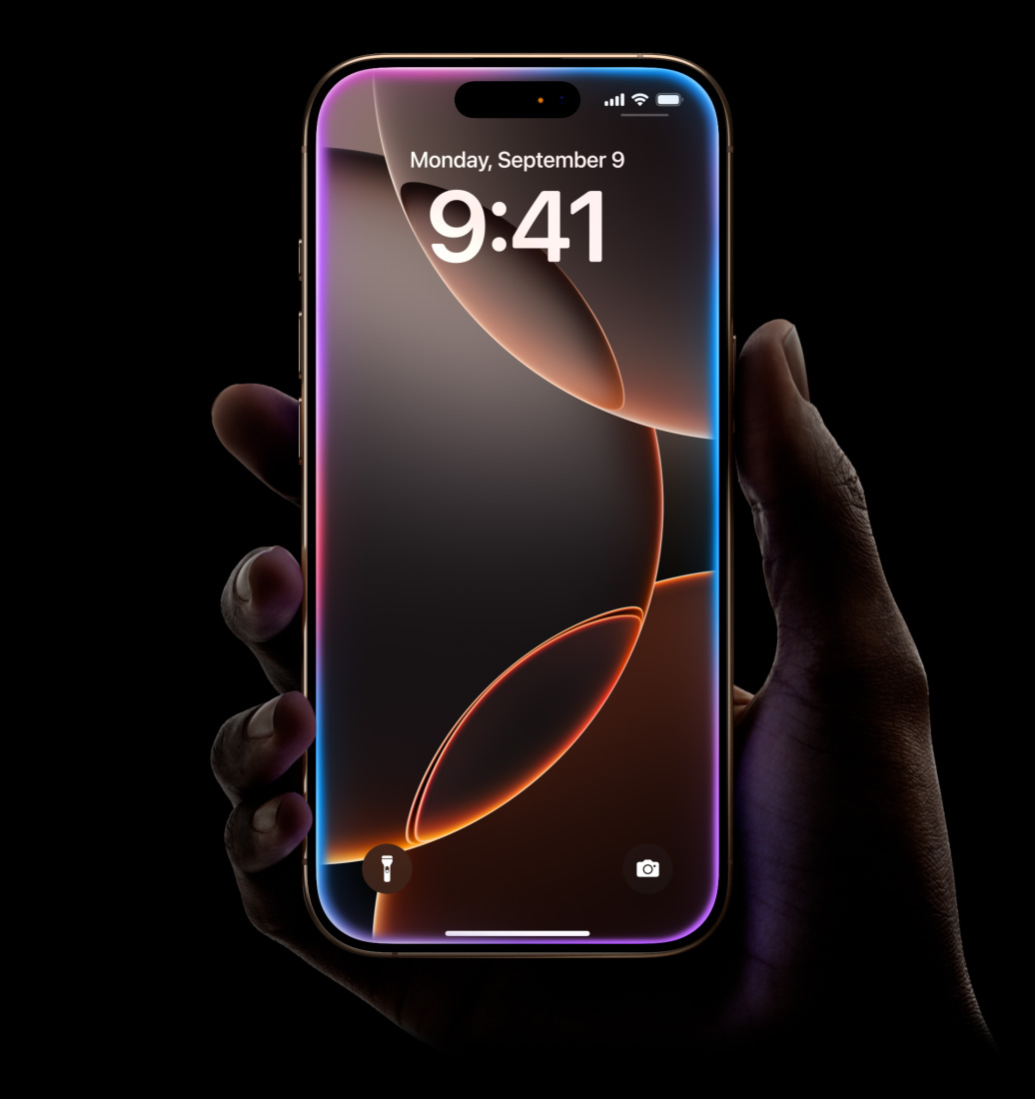
Computation of Total Cost with Taxes and Discounts
Total Base Cost Calculation: Multiply the iPhone base price by quantity to get the total pre-tax, pre-discount cost.
Tax Computation Methodology: Calculate SGST and CGST as 18% each on total base cost, summing taxes to total tax cost.
Discount and Payable Amount Formula: Subtract discount (discount rate times total base cost) from base cost plus taxes for net payment.

Slide 8
Summary and Billing Output
Sample Billing Summary: For 5 iPhones: Total cost ₹450,000, SGST ₹81,000, CGST ₹81,000, discount 10% ₹45,000.
Final Amount Payable: Payable amount is calculated by adding taxes to base cost then subtracting applicable discount precisely.
Customer Appreciation: Thank you for choosing us; your preference drives our commitment to quality and service excellence.

Slide 9


