Slide 1
Andrea Doria

Slide 2
What was the Andrea Doria
She was named after 16th centuary admiral ‘Andrea Doria’
She was like a smaller and slower version of titanic
The Andrea Doria was a
Italian ship that sank a little after
world war 2

Slide 3
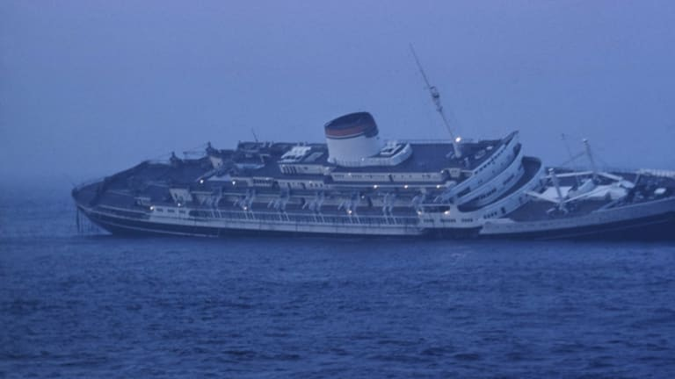
The sinking
At the end of the rescue the ilde France had rescued 735 passengers (more than the others)
It was a nice and comfortable trip. On25 July the Stockholm hit with Andrea Doria and many people were killed soon a distress call was sent out
A few small boats came to help and the Stockholm even sent life boats.
On July 17 1956 Andrea Doria departed from Genoa to New York
The il de France (which was pretty big) was a little far away but got the S.O.S and came to scene and helped
These are few links that tells the story more precisely
https://www.youtube.com/watch?time_continue=2&v=3Wjgj7M_7kA&feature=emb_logo
In the end about 50 people died
https://www.youtube.com/watch?v=rTpGjeqKtSw

Slide 4
Thank you

