Slide 1
titanic

Slide 2
What is titanic
She was owned by the company White Star Line
Titanic was the
Largest ship of her time and the most
Luxurious
She stood at 175 feet tall (about 15 stories) and 269 meters (882 feet) in length

Slide 3
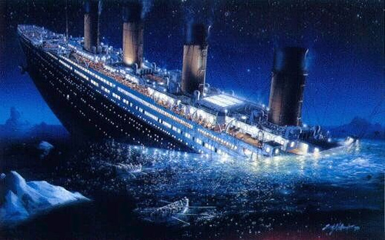
The sinking
On titanic the passengers were happy and comfortable
But on April 14 1912
At 11:50 pm Titanic struck an iceberg and sank 2 and a half hours later at 2:20 am on 15 April 1912.
1500 people died and only 700 hundred survived

Slide 4
Aftermath
There were also movies telling the story of titanic)
First was saved from titanic (can’t see the movie now)then a night to remember (on YouTube)
And Titanic a romance film that took place on titanic(on Hotstar premium account needed
2.All radio operators must be awake all day and all night
After the sinking of Titanic the rules of marine travel were changed.
1.All ships must have enough life boats for all the passengers on board

Slide 5
Thank you

