Slide 1
Problem Statement and Pain Points
Privacy and Credential Leakage in Autonomous AI Agent Workflows
Problem Statement:
Autonomous AI agents executing third-party tool calls (Email, CRM, Payment APIs, Databases) frequently pass unredacted personal information, financial identifiers, and credentials directly over the network wire, causing severe data privacy and regulatory breaches.
Key Pain Points:
1. Direct PII & Credential Exposure: Customer names, phone numbers, emails, SSNs, and credit cards are routinely forwarded in cleartext to external API providers and third-party logs.
2. Adversarial Evasion & Smuggling: Prompt injection techniques bypass traditional regex using invisible zero-width Unicode characters (\u200B), Base64 encoding, and character delimiters.
3. High Latency & Broken Tool Execution: Conventional cloud DLP gateways introduce 200–500 ms delays, while irreversible redaction breaks downstream API arguments and corrupts agent execution.
4. Severe Regulatory Penalties: Unauthorized personal data transmission violates GDPR, HIPAA, and DPDP Act 2023 mandates, exposing enterprises to substantial legal fines.

Slide 2
Solution Given to That Problem Through Our Product
PII Firewall for AI Agents: Zero-Trust, Sub-Millisecond Privacy Middleware
Product Solution Overview:
An ultra-low-latency inline security middleware that intercepts agent tool calls, replaces sensitive values with cryptographically salted reversible tokens, mathematically verifies zero residual leakage before transmission, and losslessly restores responses into agent memory.
Core Solution Capabilities:
• Hybrid Multi-Modal Detection: Combines RFC regex, mathematical checksums (Luhn Mod-10 for cards, UIDAI Verhoeff for Aadhaar), context-aware NLP heuristics, and Google Gemini fallback.
• 3-Tier Security Policy Engine: Enforces strict Zero-Trust rules: Tier 1 Credentials (PIN, CVV, OTP, Passwords) are hard-blocked; Tier 2 Personal Info is tokenized; Tier 3 Business data requires destination approval.
• Cryptographically Salted Ephemeral Vault: Maps sensitive values to opaque tokens ([TYPE_hash8]) using a 128-bit random salt and Layer 2 MAC address binding in non-persistent volatile memory.
• Fail-Closed Leakage Verification: Audits serialized wire packets against detected secrets, guaranteeing 0.0% residual cleartext before packets leave the local gateway.
• Lossless Response Re-Hydration: Transparently restores echoed tokens in tool responses back to original cleartext for the agent, then purges temporary vault RAM to zero bytes.
• Verified Performance Metrics: Sub-millisecond latency overhead (~1.2 ms), concurrent throughput exceeding 2,500 requests/sec, and 100% test pass rate across 333+ tests.

Slide 3
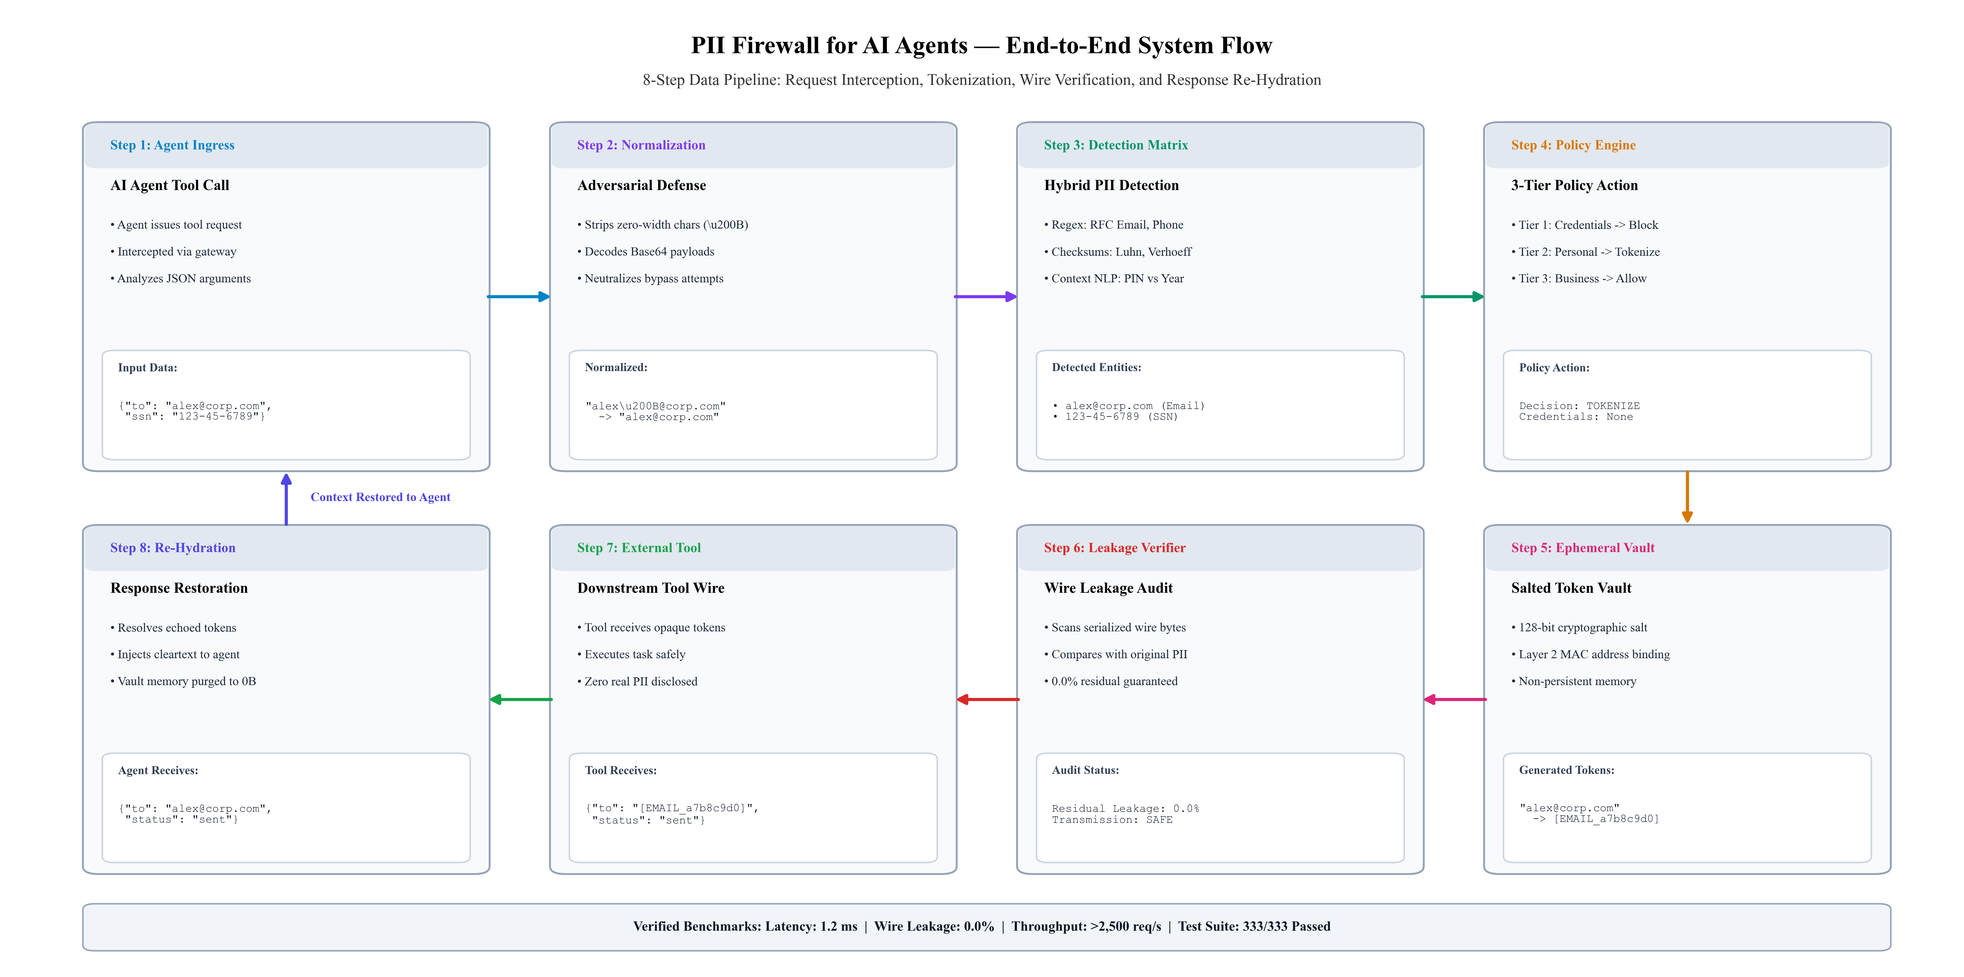
System Flow Design
End-to-End Interception, Tokenization, and Restoration Lifecycle
• Request Flow (Ingress): AI agent tool call -> Adversarial normalization (\u200B stripped) -> Hybrid detection matrix -> 3-tier policy evaluation -> Salted token vault -> Wire leakage audit (0.0% residual leak).
• Response Flow (Egress): Downstream tool executes safely with opaque tokens -> Tool response intercepted -> Re-hydrator restores cleartext into agent memory -> Ephemeral vault memory purged to 0 bytes.

Slide 4
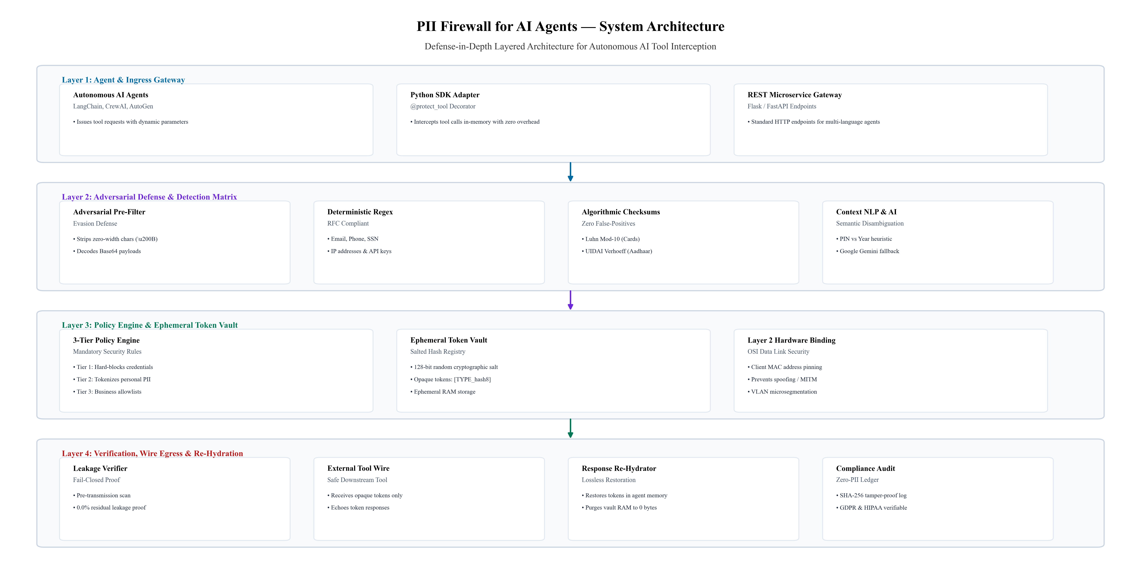
System Architecture Design
Multi-Tier Defense-in-Depth Modular System Architecture
• Multi-Tier Modularity: Layer 1 Agent Ingress (@protect_tool / REST Gateway) -> Layer 2 Evasion Defense & Detection Matrix -> Layer 3 Policy Engine & Ephemeral Vault -> Layer 4 Leakage Verifier & Re-Hydrator.
• Enterprise Security Controls: Hardware Layer 2 MAC address pinning, request-isolated volatile RAM vaults, fail-closed transmission block on leakage, and Zero-PII SHA-256 compliance audit ledger.

Slide 5
Users
Target Users, Personas, and Enterprise Stakeholders
Target User Groups and Beneficiaries:
1. AI Agent Developers & Engineers: Teams building autonomous tool-calling systems using LangChain, CrewAI, AutoGen, or custom LLM frameworks. They benefit from drop-in Python decorators (@protect_tool) and REST proxies requiring zero modification to existing tool logic, with virtually no latency penalty (~1.2 ms).
2. Enterprise CISOs & SecOps Teams: Security leaders seeking to enforce strict Zero-Trust security perimeters around corporate AI deployments. The system prevents prompt-injected data exfiltration, Unicode evasions, and API credential leakage through Layer 2 MAC address binding and fail-closed controls.
3. Compliance, Legal & Risk Officers: Corporate governance officers responsible for ensuring strict adherence to GDPR (Art. 6, 9, 32), HIPAA, PCI-DSS, and the India DPDP Act 2023. They gain mathematical proof of 0.0% data leakage along with tamper-evident SHA-256 audit ledgers containing zero cleartext PII.
4. FinTech, Healthcare & Public Sector SaaS: Enterprises automating loan approvals, insurance claim triage, customer onboarding, and telehealth consultations. The product ensures sensitive financial credentials (PIN, CVV), Indian KYC records (PAN, Aadhaar), and medical data are never leaked to third-party APIs.

Slide 6
Tech Stacks Used
Core Technologies, Algorithms, and Architectural Frameworks
Architectural Technology Stack Breakdown:
• Core Runtime & Concurrency: Python 3.11+, ThreadPoolExecutor for concurrent batch execution (>2,500 requests/sec), recursive JSON data tree parser preserving primitive types.
• Algorithmic Checksums & Validation: Luhn Mod-10 checksum algorithm (Credit Card validation), UIDAI Verhoeff checksum algorithm (12-digit Indian Aadhaar validation), RFC-compliant regex pattern matchers.
• AI & Semantic NLP: Context-aware semantic heuristics (disambiguating PIN vs calendar year, suppressing scheduling stopwords like 'at 3pm'), Google Gemini Free-Tier API for semantic intent fallback.
• Cryptography & Network Security: 128-bit cryptographic random salting (os.urandom), HMAC/SHA-256 token hashing, Hardware Layer 2 MAC address pinning, IEEE 802.1AE MACsec compatibility.
• Interfaces & Observability: Flask REST Microservice API (/v1/intercept, /v1/restore), Streamlit interactive web dashboard, @protect_tool Python SDK decorator, Zero-PII SHA-256 audit ledger.
• Testing & Verification Battery: PyTest automated test suite with 333+ unit, synthetic, and integration tests covering adversarial evasions, concurrent load, and edge cases (100% pass rate).

