Slide 1
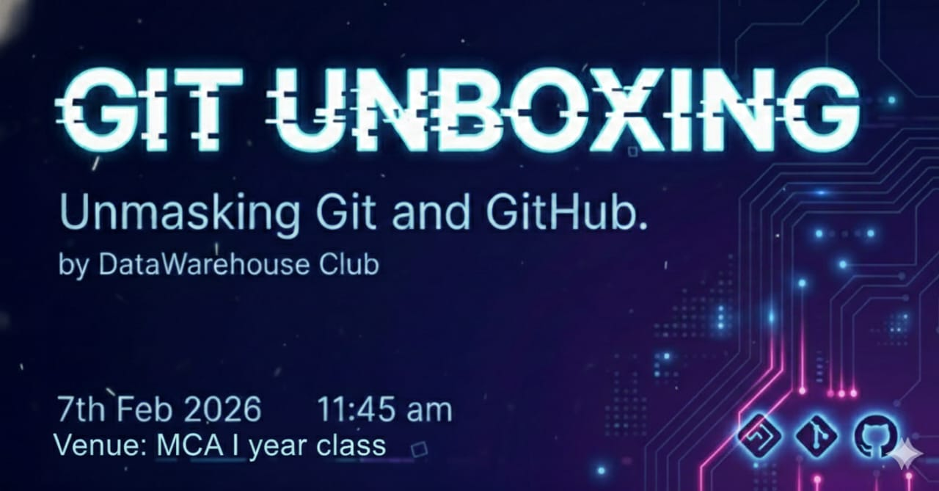

Slide 2

Introduction
Git - is a free, open-source version control system
Started in the year 2005, it was created by LinusTarvalds ,He Created Git to manage the “Linux” “Kernal” Source code.
GitHub - Web-based platform for Git repositories
Started in the year 2008,it was Tom Preston-werner and team ,He Created to share code online.

Slide 3

Git
Git is a free, open-source version control system that helps
you manage changes to code, documents, or any other digital content over time.
Key Characteristics
Version Control System (VCS)
Distributed
Command-line interface

Slide 4
Key Features
Distributed version control
Fast and Efficient
Branching and merging
Data integrity and security

Slide 5
How Git works
Make changes
Save snapshots
Go back if needed
Benefits
Tracks changes
Helps collaboration
Keeps work safe

Slide 6

GitHub
GitHub is a web-based platform that provides hosting for Git
repositories, making it easy to collaborate with others on code and
projects.
Key Characteristics
Web-based platform
Collaboration tools
Version control
Community features

Slide 7
Key Features
Repositories
Pull Requests
Issue Tracking
Code Review

Slide 8
How GitHub Works
Create repository
Collaborate with others
Track issues and projects
Review and merge changes
Benefits
Improved Collaboration
Increased Productivity
Enhanced Community
Better Version Control

Slide 9
Difference between Git And GitHub
Git | GitHub
A software tool. | A web-based service.
A distributed version control system (DVCS). | A repository hosting and collaboration platform.
Primarily used through a command-line interface. | Provides a web-based graphical interface.
Focuses on version control and change tracking. | Focuses on code hosting and collaboration.
Manages source code history. | Hosts version-controlled repositories

Slide 10
What are the Contents in Git & GitHub?
1. Repository (Repo)
2. Commit
3. Branch
4. README.md
5. Pull Request (PR)
6. Issues
7. Fork
8. Clone
9. Push & Pull

Slide 11
Workflow of Git and GitHub
Write code ⇒ Add ⇒ Commit ⇒ Push ⇒ Github ⇒ Pull ⇒ Merge

Slide 12
Demonstration
Using Command Line Interface

Slide 13
Demonstration
Using GU Interface

Slide 14
Project Demonstration and pushing to GitHub

Slide 15


Slide 16


Slide 17


