Slide 1
Linear Regression
Pritam Prakash Shete
Computer Division, BARC
Centre for Excellence in Basic Sciences

Slide 2
Topics
Supervised learning – Regression
Linear regression
Algorithm
Applications
Advantages
Disadvantages

Slide 3
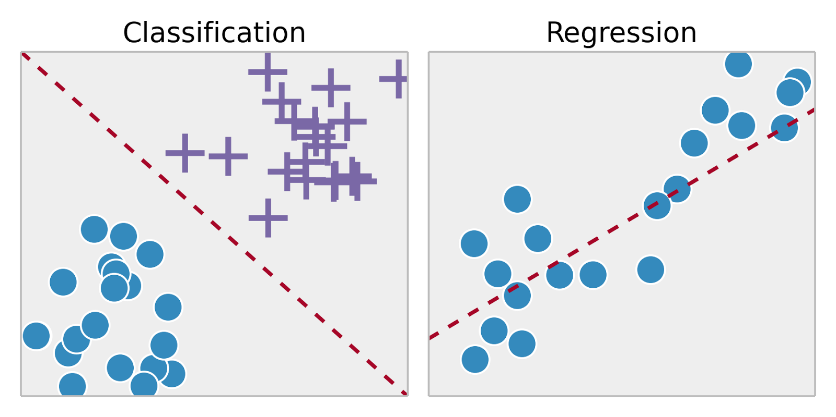
Supervised Learning
Training set – { (x⁽¹⁾,y⁽¹⁾), (x⁽²⁾,y⁽²⁾), …, (x^{(m)},y^{(m)})}
Labeled dataset
Image ack – Google

Slide 4
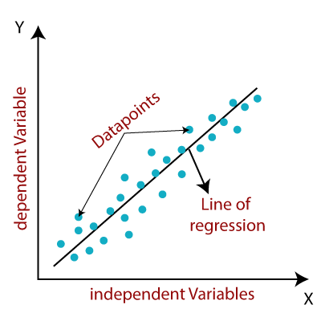
Linear Regression
Independent variable – X axis
Dependent variable – Y axis
Data points – Samples
Relationship
Line of regression
Image ack – Google

Slide 5
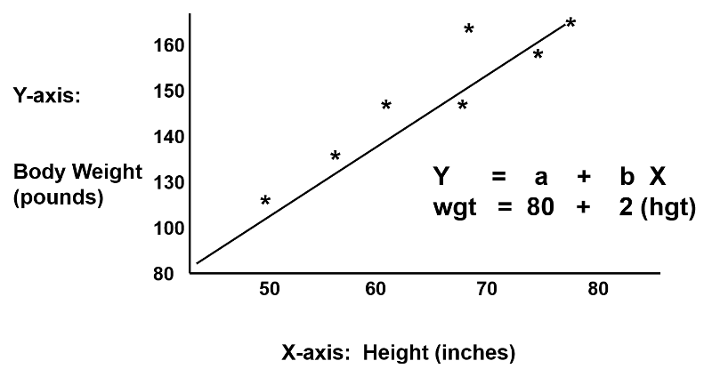
Linear Regression
Image ack – Google

Slide 6
Linear Regression
Input – X
Vector
X ε R
Dimension – n_{X}
Output – y
Scalar
y ε R

Slide 7
Linear Regression
Weights – W – (W₁, W₂, W₃, …, W_{nx})
Vector
W ε R
Dimension – n_{X}
Bias – b – W₀
Scalar
b ε R
y = W^{T}X + b

Slide 8
Linear Regression
Positive correlation
Independent variable increases
Dependent variable increases
Negative correlation
Independent variable increases
Dependent variable decreases
No correlation
Independent variable increases
Dependent variable no change

Slide 9
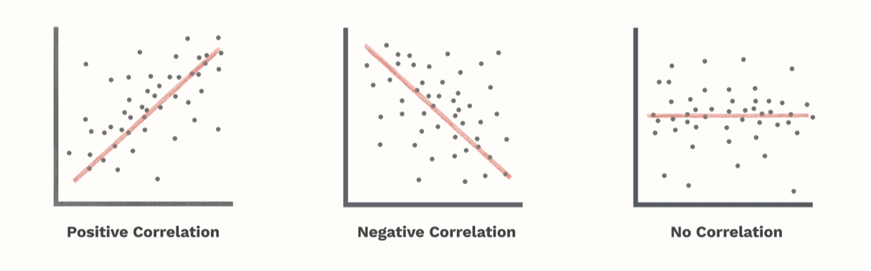
Linear Regression
Image ack – Google

Slide 10
Linear Regression – Types
Simple linear regression
Single independent variable
Multiple linear regression
More than one independent variable

Slide 11
Algorithm
Fit line to dataset
Compute slope of line
Compute Y axis intercept
Calculate R² value
Calculate p-value for R² value

Slide 12
Least Squares
Linear regression – Least squares
Actual value – Observed value
Estimated value – Predicted value
Error value
Sum of squared residuals
Minimize error value
Generic equation of line

Slide 13
Least Squares
X_{i} – Independent variable
y_{i} – Dependent variable
W₀ – Y axis intercept
W₁ – Slope of line
ŷ_{i} – Estimated value
Ɛ_{i} – Random error
Mean squared error – MSE
J – Cost function – Minimize cost function

Slide 14
R² Value
SS – Sum of squared differences
Var – Variation around variable
n_{x} – Number of samples
Var(mean) – Variation around mean
Var(fit) – Variation around fit

Slide 15
R² Value
SS – Sum of squared differences
SS(mean) – Sum of squared differences around mean
SS(fit) – Sum of squared differences around fit

Slide 16
R² Value
Coefficient of determination
Coefficient of multiple determination
Strength of relationship
Value between 0.0 – 1.0
Percentage value
Independent variable explains p percent of variation in dependent variable
Independent variable reduces p percent of variation in dependent variable

Slide 17
p Value
Statistical significance

Slide 18
Applications
Inputs to response mapping
Error reduction
Prediction
House price prediction from observed dataset
Forecasting
Weather forecasting from observed dataset

Slide 19
Advantages
Good for linearly separable data
Easier to implement and interpret
Efficient to train
Handle over-fitting
Dimensionality reduction techniques
Cross validation
Regularization
Extrapolation of dataset

Slide 20
Disadvantages
Assumption of linearity
Independent variables
Dependent variables
Prone to noise
Sensitive to outliers
Prone to multicollinearity

Slide 21
Multicollinearity
Correlated independent variables
Example
Independent variables
Radius of a circle
Circumference of a circle
Radius and circumference – Correlated

Slide 22
Questions?
Thank you

