Slide 1
Linear Regression
Pritam Prakash Shete
Centre for Excellence in Basic Sciences
& Computer Division, BARC

Slide 2
Topics
Introduction
Supervised learning
Linear regression
Optimization objective
Advantages and disadvantages

Slide 3
Introduction

Slide 4
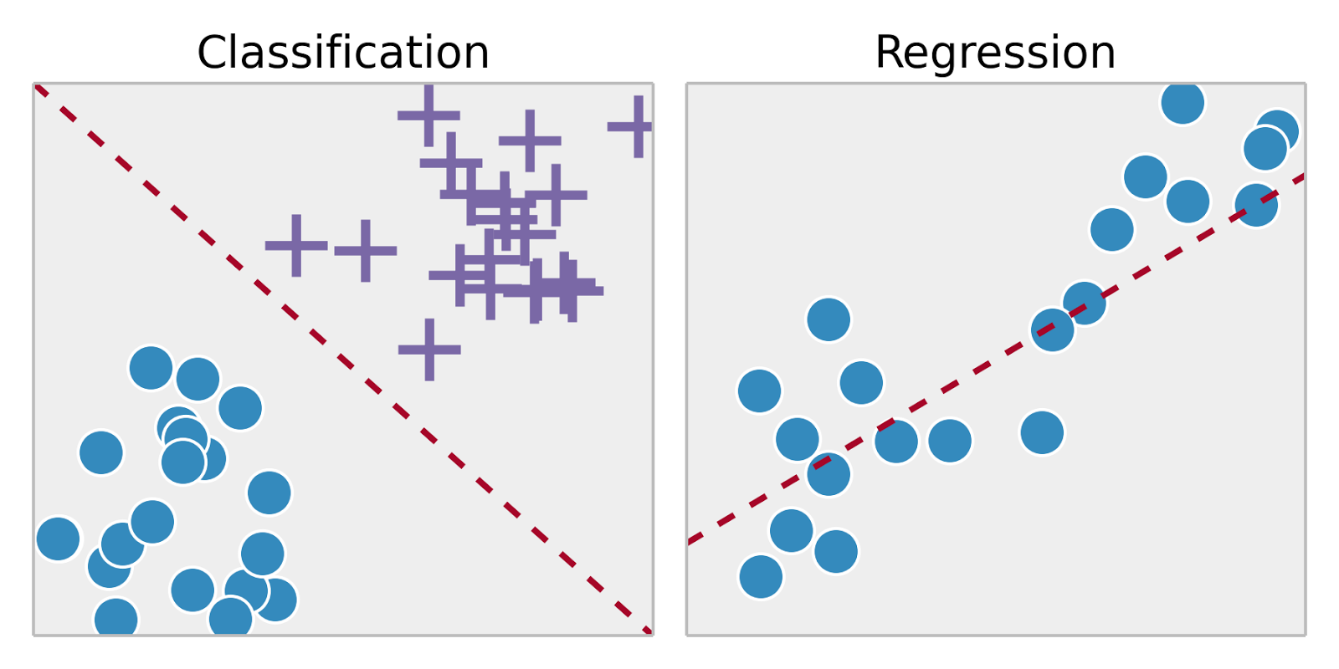
Supervised Learning
Training set – { (x⁽¹⁾,y⁽¹⁾), (x⁽²⁾,y⁽²⁾), …, (x^{(m)},y^{(m)})}
Labeled dataset
Image ack – Google

Slide 5
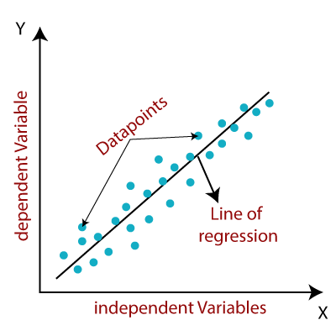
Linear Regression
Independent variable – X axis
Dependent variable – Y axis
Data points – Samples
Relationship
Line of regression
Least squares method
Image ack – Google

Slide 6
Linear Regression
Positive correlation
Independent variable increases
Dependent variable increases
Negative correlation
Independent variable increases
Dependent variable decreases
No correlation
Independent variable increases
Dependent variable no change

Slide 7
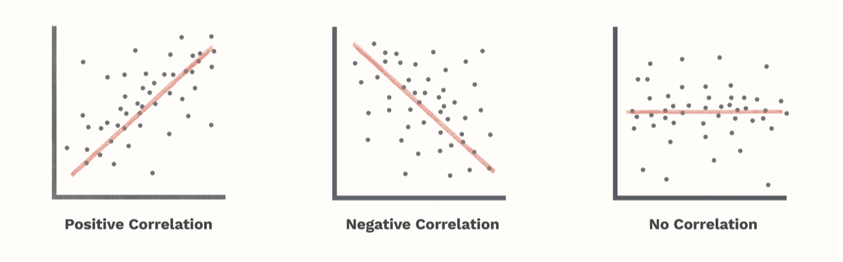
Linear Regression
Image ack – Google

Slide 8
Advantages

Slide 9
Disadvantages

Slide 10
Questions?
Thank you

