Slide 1
Naive Bayes
Pritam Prakash Shete
Computer Division, BARC
Centre for Excellence in Basic Sciences

Slide 2
Topics
Supervised learning
Conditional probability
Bayes’ rule
Naive Bayes
Laplacian smoothing
Applications
Advantages
Disadvantages

Slide 3
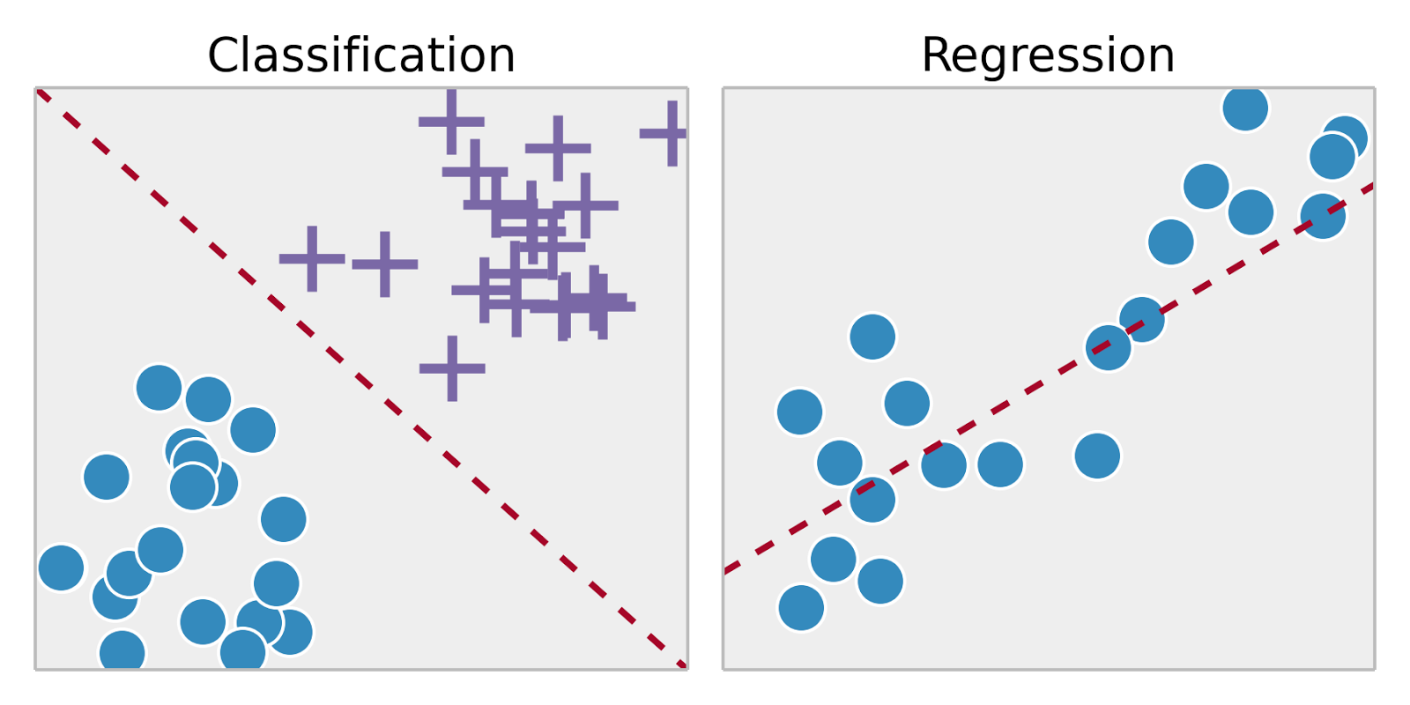
Supervised Learning
Training set – { (x⁽¹⁾,y⁽¹⁾), (x⁽²⁾,y⁽²⁾), …, (x^{(m)},y^{(m)})}
Labeled dataset
Image ack – Google

Slide 4
Probability
Application – SMS spam detection
Corpus of SMSs
Events – Ham or Spam SMS
Name | Value
N_{Total} | 1000
N_{Ham} | 800
N_{Spam} | 200
P(Ham) | 0.8 (80%)
P(Spam) | 0.2 (20 %)

Slide 5
Probability
Application – SMS spam detection
Corpus of SMSs
Event – SMS contains word ‘discount’
Name | Value
N_{Total} | 1000
N_{discount} | 20
P(discount) | 0.02 (2 %)

Slide 6
Conditional Probability
Corpus
Ham
Spam
discount

Slide 7
Conditional Probability
Event – SMS – Spam
Event – SMS – ‘discount’
Intersection – Spam and ‘discount’
Probability that SMS is Spam given SMS contains word ‘discount’.
Probability that SMS is Spam and SMS contains word ‘discount’.

Slide 8
Bayes’ Rule
Event – SMS – Spam
Event – SMS – ‘discount’
Intersection – Spam and ‘discount’

Slide 9
Bayes’ Rule
Event – SMS – Spam
Event – SMS – ‘discount’
Intersection – Spam and ‘discount’

Slide 10
Bayes’ Rule
Event – SMS – Spam
Event – SMS – ‘discount’
Intersection – Spam and ‘discount’

Slide 11
Naive Bayes

Slide 12
Laplacian Smoothing

Slide 13
Applications

Slide 14
Advantages

Slide 15
Disadvantages

Slide 16
Questions?
Thank you

