Slide 1
Edge Artificial Intelligence
Pritam Prakash Shete
Bhabha Atomic Research Centre &
Centre for Excellence in Basic Sciences

Slide 2
Topics
Edge AI – What ?
Edge AI – Why ?
Edge AI v/s Cloud AI
Edge AI – Benefits
Edge AI – How ?
Edge AI – Applications

Slide 3
Edge AI – What ?
Edge AI – AI on the edge
Edge computing
Compute and storage closer to user
Device at Edge of Network
Process data closer to source of data
Deploy AI algorithms and models at source
With or without network connection

Slide 4
Edge AI – Why ?
Real time feedback
Localized decision making
Low or reduce latency
No bandwidth limitations
No network disruptions
No need for constant network connectivity

Slide 5
Edge AI v/s Cloud AI
 | Cloud AI | Edge AI
Computing power | More | Less
Latency | More | Less
Network bandwidth | More | Less
Security | Less | More

Slide 6
Edge AI – Benefits
Diminished latency
Decreased bandwidth
Real time analytics
Data privacy
Scalability
Reduced costs

Slide 7
Edge AI – How ?
Edge devices
Sensor devices
Internet of Things (IoT) devices

Slide 8
Edge AI – How ?
Focus on
Small model size
Memory requirements
Optimal performance
Low power consumption

Slide 9
Edge Devices
NVIDIA Jetson
Raspberry Pi
Intel Movidius
Google Coral

Slide 10
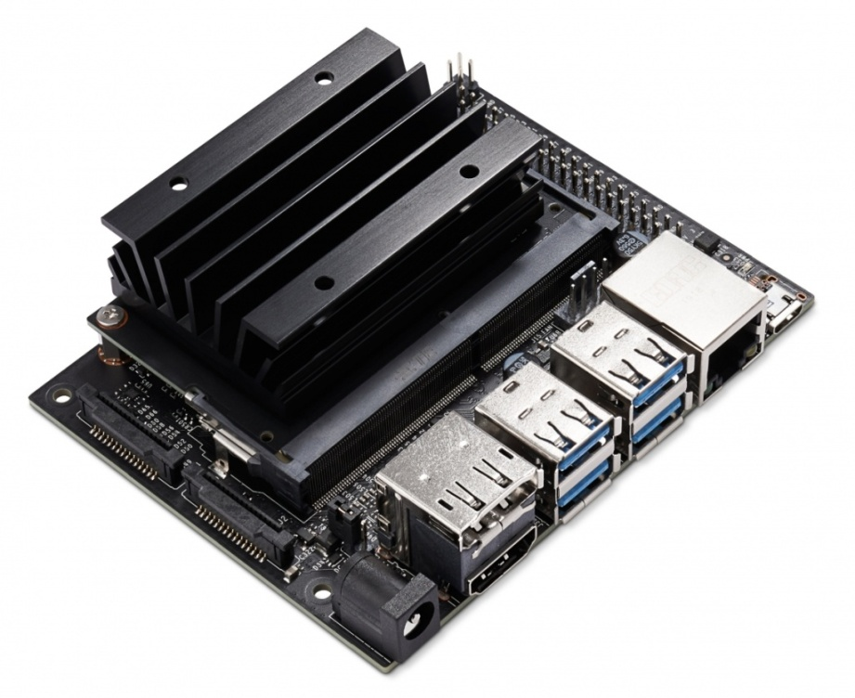
NVIDIA Jetson Nano
GPU
NVIDIA Maxwell architecture
128 NVIDIA CUDA cores
CPU
Quad core ARM Cortex
Memory
2 GB or 4 GB
Image ack – Google

Slide 11
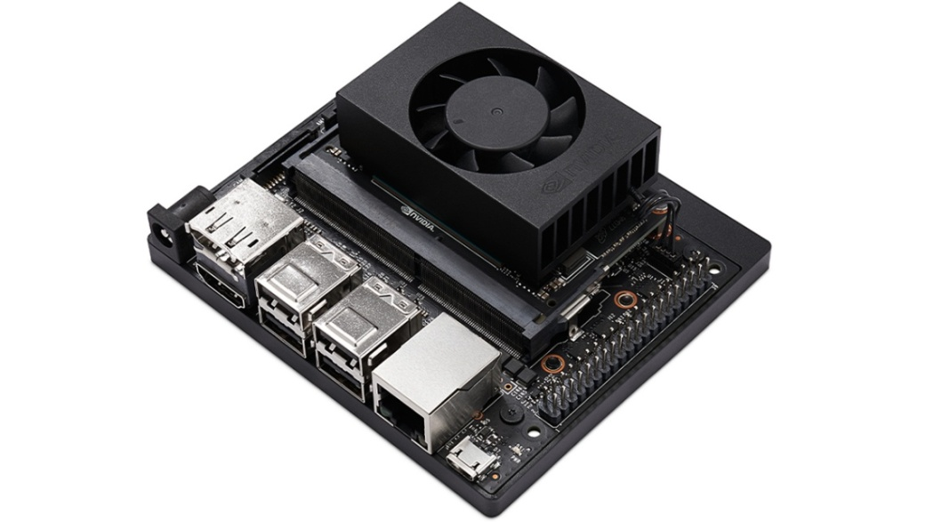
NVIDIA Jetson Xavier
GPU
NVIDIA Volta architecture
384 or 512 NVIDIA CUDA cores
CPU
6 or 8 core ARM Cortex
Memory
8, 16, 32, 64 GB
Image ack – Google

Slide 12
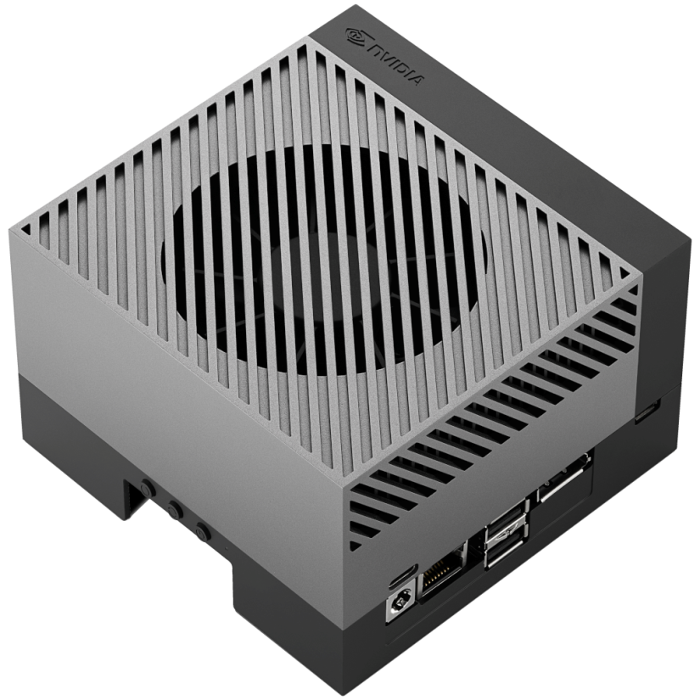
NVIDIA Jetson Orin
GPU
NVIDIA Ampere architecture
512, 1024, 2048 NVIDIA CUDA cores
CPU
8 or 12 core Arm Cortex
Memory
8, 16, 32, 64 GB
Image ack – Google

Slide 13
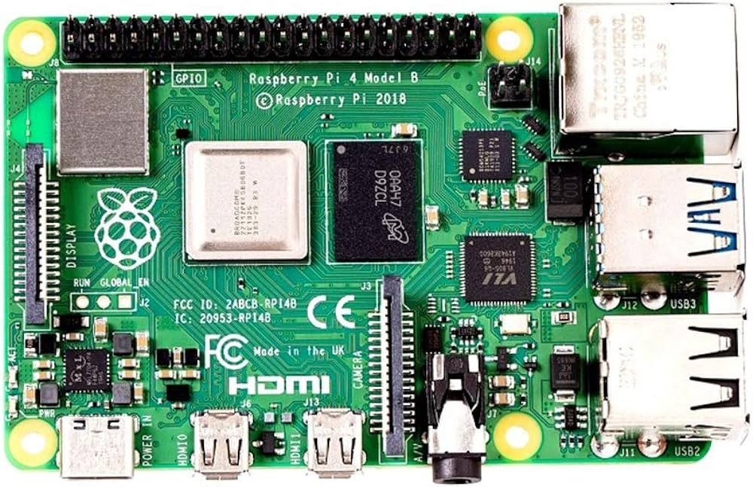
Raspberry Pi 4
CPU
Quad core ARM Cortex A72
GPU
Broadcom VideoCore VI
Memory
1, 2, 4, 8 GB

Slide 14
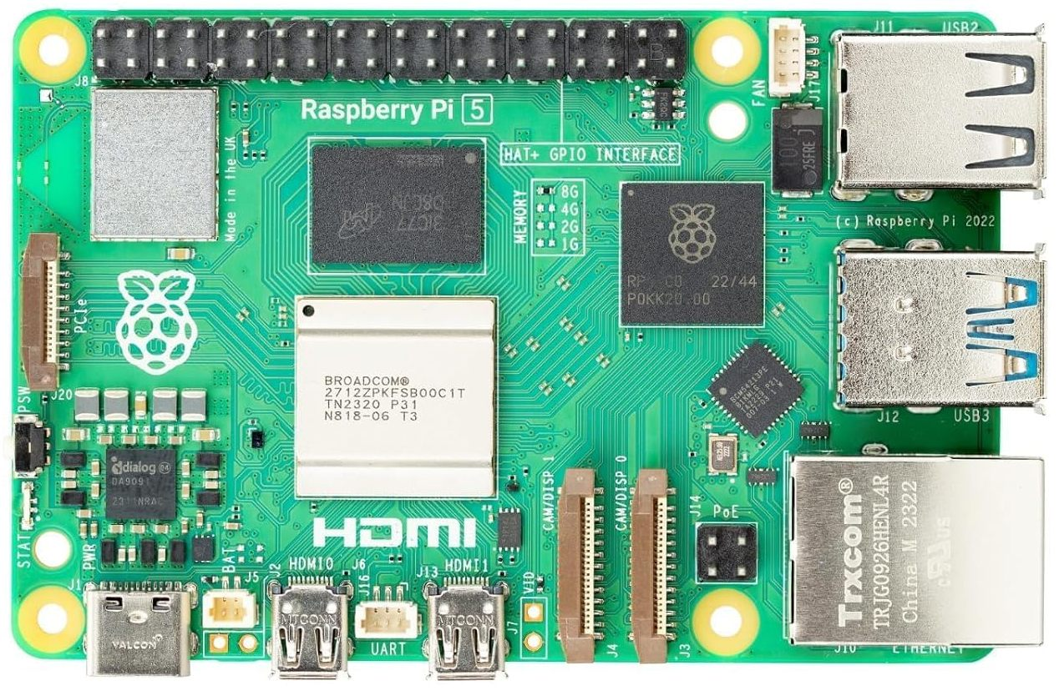
Raspberry Pi 5
CPU
Quad core ARM Cortex A76
GPU
Broadcom VideoCore VII
Memory
1, 2, 4, 8 GB

Slide 15
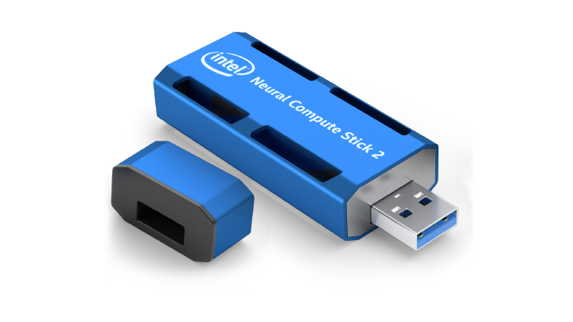
Intel Movidius
Vision Processing Units
Intel Neural Compute Stick 2
Supported frameworks
TensorFlow, Caffe, Apache MXNet, PaddlePaddle
Open Neural Network Exchange, PyTorch
Connectivity – USB 3.0 (Type-A)
Plug and Play AI

Slide 16
Google Coral
Google Edge TPU
System on Module

Slide 17
Edge AI – Healthcare
Wearable edge AI devices
Wearable health monitors
Heart rate, blood pressure
Glucose levels, respiration rate
Real time monitoring
Reduce response time
Patient privacy

Slide 18
Edge AI – Manufacturing
Sensor devices & IoT devices
Predictive maintenance
Prevent operational downtime
Enhance efficiency and productivity
Supply chain analytics
Quality control

Slide 19
Edge AI – Retail
Pick-and-go stores
Smart shopping carts
Smart check outs
Sensor devices & IoT devices

Slide 20
Edge AI – Smart Homes
Smart devices
Smart doorbells, thermostats, refrigerators
Start entertainment systems
Smart controlled light bulbs
Edge computing
Real time monitoring
Resident's privacy

Slide 21
Edge AI – Security & Surveillance
Security video analytics
Real time analysis
Reduce latency
Stronger sense of safety

Slide 22
Edge AI – Security & Surveillance
Autonomous vehicles
Autonomous drones

Slide 23
Questions?
Thank you

