Slide 1
Artificial Neural Network
Pritam Prakash Shete
Scientific Officer F,
Computer Division, BARC

Slide 2
Topics
Linear regression
Logistic regression
Gradient descent
Gradient descent for logistic regression
Artificial neural network
Back propagation for neural network
Activation functions

Slide 3
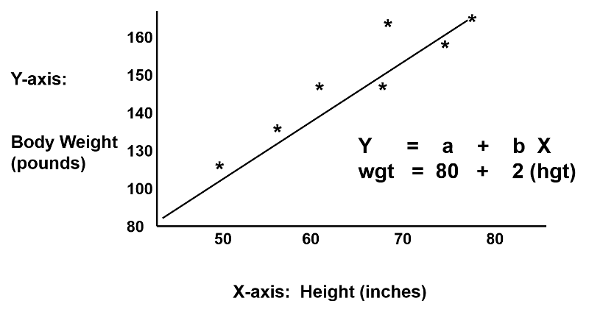
Linear regression – Overview
Image ack – Google

Slide 4
Linear regression – Input & output
Input – X
Vector
X ε R
Dimension – n_{X}
Output – y
Scalar
y ε R

Slide 5
Linear regression – Equation
Weights – W
Vector
W ε R
Dimension – n_{X}
Bias – b
Scalar
b ε R
y = W^{T}X + b

Slide 6
Linear regression – Applications
Fit predictive model to observed dataset
Variables – Response
Prediction
House price prediction from observed dataset
Forecasting
Weather forecasting from observed dataset
Error reduction

Slide 7


Binary classification
Classify elements of given set into two groups
Classify dog and non-dog images
Dog
Non-dog
Image ack – Google

Slide 8
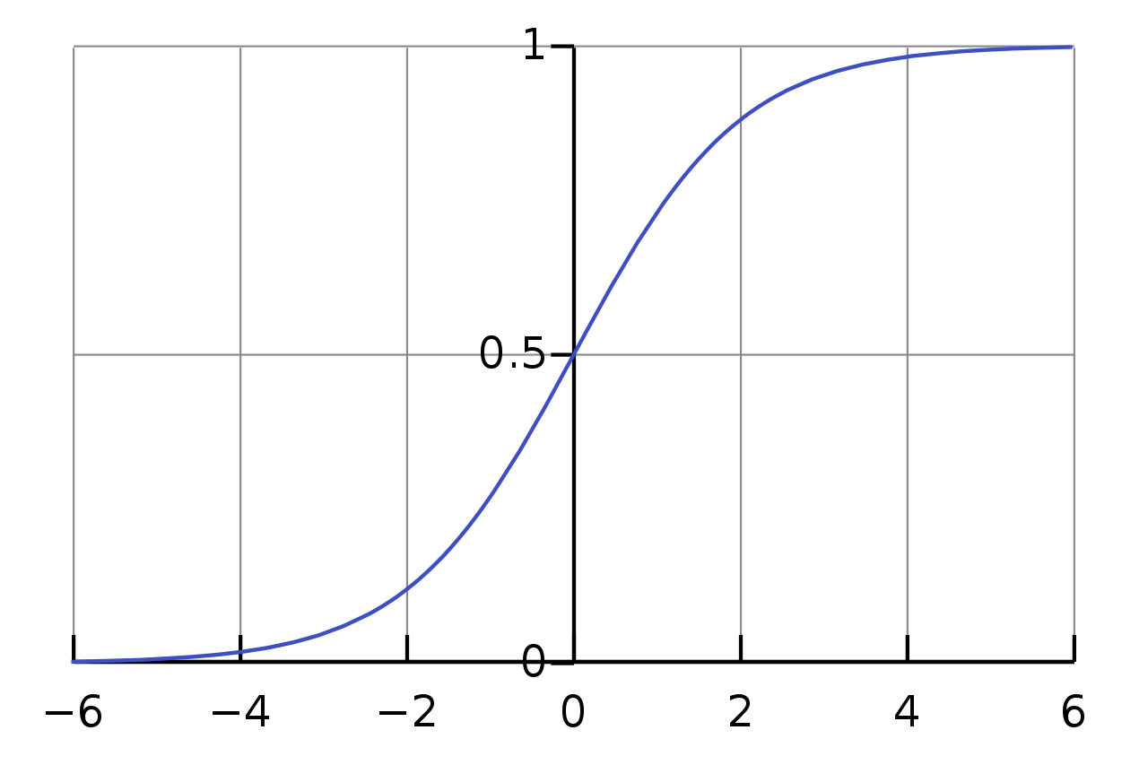
Sigmoid function – Equation

Slide 9
Sigmoid function – Interpretation
σ(Z) ~ 1 – For Z >> 0
σ(Z) ~ 0 – For Z << 0
σ(Z) = 0.5 – For Z = 0
Z | σ(Z)
-2 | 0.12
-1.5 | 0.18
-1 | 0.27
-0.5 | 0.38
0 | 0.50
0.5 | 0.62
1 | 0.73
1.5 | 0.82
2 | 0.88

Slide 10
Logistic regression – Input & output
Input – X
Vector
X ε R
Dimension – n_{X}
Output – ŷ
Scalar
0 <= ŷ <= 1.0

Slide 11
Linear regression – Equation
Weights – W
Vector
W ε R
Dimension – n_{X}
Bias – b
Scalar
b ε R
y = W^{T}X + b

Slide 12
Logistic regression – Equation
Weights – W
Vector
W ε R
Dimension – n_{X}
Bias – b
Scalar
b ε R
y = W^{T}X + b

Slide 13
Logistic regression – Equation
Weights – W
Vector
W ε R
Dimension – n_{X}
Bias – b
Scalar
b ε R
Z = W^{T}X + b
ŷ = σ(Z) – Activation (sigmoid) function
x₁
W₁
+b
W₂
x₂
ŷ
activation
x₃
W₃

Slide 14
Logistic regression – Equation
Weights – W
Vector
W ε R
Dimension – n_{X}
Bias – b
Scalar
b ε R
Z = W^{T}X + b
ŷ = P( y=1 | X)

Slide 15
Logistic regression loss function
Input dataset
{ (x⁽¹⁾,y⁽¹⁾), (x⁽²⁾,y⁽²⁾), …, (x^{(m)},y^{(m)})}
Equations
Z = W^{T}X + b
ŷ = σ(Z) = y_{p}
Output
ŷ^{(i)} ~ y^{(i)}
W and b

Slide 16
Logistic regression loss function
L(ŷ, y) = – y * log(ŷ) – (1 – y) * log(1 – ŷ)

Slide 17
Logistic regression loss function
L(ŷ, y) = – y * log(ŷ) – (1 – y) * log(1 – ŷ)
y = 1
L(ŷ, y) = – log(ŷ)
– log(ŷ) – Minimize
log(ŷ) – Maximize
ŷ – Maximize
ŷ – 1.0

Slide 18
Logistic regression loss function
L(ŷ, y) = – y * log(ŷ) – (1 – y) * log(1 – ŷ)
y = 0
L(ŷ, y) = – log(1 – ŷ)
– log(1 – ŷ) – Minimize
log(1 – ŷ) – Maximize
1 – ŷ – Maximize
ŷ – Minimize
ŷ – 0.0

Slide 19
Logistic regression cost function
Loss function
One sample – i^{th} sample
L(ŷ^{(i)}, y^{(i)}) = – y^{(i)} * log(ŷ^{(i)}) – (1 – y^{(i)}) * log(1 – ŷ^{(i)})
Cost function
Average of loss function for all samples

Slide 20
Logistic regression – Gradient descent
Input dataset – { (x⁽¹⁾,y⁽¹⁾), (x⁽²⁾,y⁽²⁾), …, (x^{(m)},y^{(m)}) }
Equations – Z = W^{T}X + b and ŷ = σ(Z) = y_{p}
Loss function – L(ŷ, y) = – y*log(ŷ) – (1–y)*log(1–ŷ)
Cost function –
Output
ŷ^{(i)} ~ y^{(i)}
W and b – Minimize J(W, b)

Slide 21
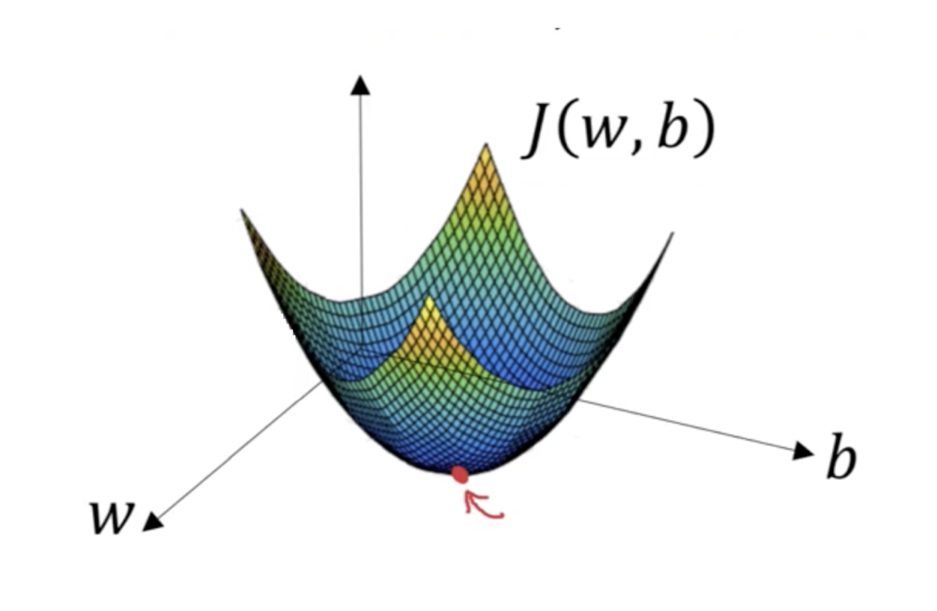
Gradient descent – Cost function
Convex function
Global optimum

Slide 22
Logistic regression – Gradient descent
Forward pass
Z^{[1]}= W^{[1]}a^{[0]} + b^{[1]}
ŷ = a^{[1]} = σ(Z^{[1]})
L(ŷ^{(i)}, y^{(i)})
J(W^{[1]}, b^{[1]})
Backward pass

Slide 23
Logistic regression – Gradient descent
Forward pass
Z^{[1]}= W^{[1]}a^{[0]} + b^{[1]}
ŷ = a^{[1]} = σ(Z^{[1]})
L(ŷ^{(i)}, y^{(i)})
J(W^{[1]}, b^{[1]})
Backward pass

Slide 24
Logistic regression – Gradient descent
Forward pass
Z^{[1]}= W^{[1]}a^{[0]} + b^{[1]}
ŷ = a^{[1]} = σ(Z^{[1]})
L(ŷ^{(i)}, y^{(i)})
J(W^{[1]}, b^{[1]})
Backward pass

Slide 25
Logistic regression – Gradient descent
Forward pass
Z^{[1]}= W^{[1]}a^{[0]} + b^{[1]}
ŷ = a^{[1]} = σ(Z^{[1]})
L(ŷ^{(i)}, y^{(i)})
J(W^{[1]}, b^{[1]})
Backward pass

Slide 26
Logistic regression – Gradient descent
Forward pass
Z^{[1]}= W^{[1]}a^{[0]} + b^{[1]}
ŷ = a^{[1]} = σ(Z^{[1]})
L(ŷ^{(i)}, y^{(i)})
J(W^{[1]}, b^{[1]})
Backward pass

Slide 27
Logistic regression – Gradient descent
Forward pass
Z^{[1]}= W^{[1]}a^{[0]} + b^{[1]}
ŷ = a^{[1]} = σ(Z^{[1]})
L(ŷ^{(i)}, y^{(i)})
J(W^{[1]}, b^{[1]})
Backward pass

Slide 28
Logistic regression – Gradient descent
Forward pass
Z^{[1]}= W^{[1]}a^{[0]} + b^{[1]}
ŷ = a^{[1]} = σ(Z^{[1]})
L(ŷ^{(i)}, y^{(i)})
J(W^{[1]}, b^{[1]})
Backward pass

Slide 29
Logistic regression – Gradient descent
Forward pass
Z^{[1]}= W^{[1]}a^{[0]} + b^{[1]}
ŷ = a^{[1]} = σ(Z^{[1]})
L(ŷ^{(i)}, y^{(i)})
J(W^{[1]}, b^{[1]})
Backward pass

Slide 30
Logistic regression – Gradient descent
Forward pass
Z^{[1]}= W^{[1]}a^{[0]} + b^{[1]}
ŷ = a^{[1]} = σ(Z^{[1]})
L(ŷ^{(i)}, y^{(i)})
J(W^{[1]}, b^{[1]})
Backward pass

Slide 31
Logistic regression – Gradient descent
Forward pass
Z^{[1]}= W^{[1]}a^{[0]} + b^{[1]}
ŷ = a^{[1]} = σ(Z^{[1]})
L(ŷ^{(i)}, y^{(i)})
J(W^{[1]}, b^{[1]})
Backward pass

Slide 32
Logistic regression – Gradient descent
Forward pass
Z^{[1]}= W^{[1]}a^{[0]} + b^{[1]}
ŷ = a^{[1]} = σ(Z^{[1]})
L(ŷ^{(i)}, y^{(i)})
J(W^{[1]}, b^{[1]})
Backward pass

Slide 33
Artificial neural network
Z = W^{T}X + b
Linear regression
x₁
W₁
+b
W₂
x₂
a = ŷ
activation
x₃
W₃

Slide 34
Artificial neural network
Z = W^{T}X + b
Linear regression
ŷ = σ(Z) = a
Activation function
e.g. sigmoid function
x₁
W₁
+b
W₂
x₂
a = ŷ
activation
x₃
W₃

Slide 35
Artificial neural network
Z = W^{T}X + b
Linear regression
ŷ = σ(Z) = a
Activation function
e.g. sigmoid function
L(ŷ, y)
Loss function
x₁
W₁
+b
W₂
x₂
a = ŷ
activation
x₃
W₃

Slide 36
Artificial neural network
Z = W^{T}X + b
Linear regression
ŷ = σ(Z) = a
Activation function
e.g. sigmoid function
Loss function
L(ŷ^{(i)}, y^{(i)}) – One i^{th} sample
Cost function
J(W, b) – Average of loss function for all samples
x₁
W₁
+b
W₂
x₂
a = ŷ
activation
x₃
W₃

Slide 37
Two layer neural network
Input layer
Hidden layer – Layer 1
Output layer – Layer 2
x₁
x₂
ŷ
x₃

Slide 38
Two layer neural network
Layer 1
Z^{[1]} = W^{[1]}X + b^{[1]}
x₁
x₂
ŷ
x₃

Slide 39
Two layer neural network
Layer 1
Z^{[1]} = W^{[1]}a^{[0]} + b^{[1]}
x₁
x₂
ŷ
x₃

Slide 40
Two layer neural network
Layer 1
Z^{[1]} = W^{[1]}a^{[0]} + b^{[1]}
a^{[1]} = σ(Z^{[1]})
x₁
x₂
ŷ
x₃

Slide 41
Two layer neural network
Layer 1
Z^{[1]} = W^{[1]}a^{[0]} + b^{[1]}
a^{[1]} = σ(Z^{[1]})
Layer 2
Z^{[2]} = W^{[2]}a^{[1]} + b^{[2]}
x₁
x₂
ŷ
x₃

Slide 42
Two layer neural network
Layer 1
Z^{[1]} = W^{[1]}a^{[0]} + b^{[1]}
a^{[1]} = σ(Z^{[1]})
Layer 2
Z^{[2]} = W^{[2]}a^{[1]} + b^{[2]}
a^{[2]} = σ(Z^{[2]})
x₁
x₂
ŷ
x₃

Slide 43
Two layer neural network
Layer 1
Z^{[1]} = W^{[1]}a^{[0]} + b^{[1]}
a^{[1]} = σ(Z^{[1]})
Layer 2
Z^{[2]} = W^{[2]}a^{[1]} + b^{[2]}
ŷ = a^{[2]} = σ(Z^{[2]})
Loss function
L(ŷ, y)
x₁
x₂
ŷ
x₃

Slide 44
Two layer neural network
Layer 1
Z^{[1]} = W^{[1]}a^{[0]} + b^{[1]}
a^{[1]} = σ(Z^{[1]})
Layer 2
Z^{[2]} = W^{[2]}a^{[1]} + b^{[2]}
ŷ = a^{[2]} = σ(Z^{[2]})
Loss function
L(ŷ^{(i)}, y^{(i)})
x₁
x₂
ŷ
x₃

Slide 45
Two layer neural network
Layer 1
Z^{[1]} = W^{[1]}a^{[0]} + b^{[1]}
a^{[1]} = σ(Z^{[1]})
Layer 2
Z^{[2]} = W^{[2]}a^{[1]} + b^{[2]}
ŷ = a^{[2]} = σ(Z^{[2]})
Cost function
J(W, b)
x₁
x₂
ŷ
x₃

Slide 46
Back propagation for neural networks
Parameters
W^{[1]}, b^{[1]}, W^{[2]}, b^{[2]}
Cost function
J(W^{[1]}, b^{[1]}, W^{[2]}, b^{[2]})
Forward pass
Z^{[1]}= W^{[1]}a^{[0]} + b^{[1]}
a^{[1]} = σ(Z^{[1]})

Slide 47
Back propagation for neural networks
Parameters
W^{[1]}, b^{[1]}, W^{[2]}, b^{[2]}
Cost function
J(W^{[1]}, b^{[1]}, W^{[2]}, b^{[2]})
Forward pass
Z^{[1]}= W^{[1]}a^{[0]} + b^{[1]}
a^{[1]} = σ(Z^{[1]})
Z^{[2]}= W^{[2]}a^{[1]} + b^{[2]}
ŷ = a^{[2]} = σ(Z^{[2]})

Slide 48
Back propagation for neural networks
Parameters
W^{[1]}, b^{[1]}, W^{[2]}, b^{[2]}
Cost function
J(W^{[1]}, b^{[1]}, W^{[2]}, b^{[2]})
Forward pass
Z^{[1]}= W^{[1]}a^{[0]} + b^{[1]}
a^{[1]} = σ(Z^{[1]})
Z^{[2]}= W^{[2]}a^{[1]} + b^{[2]}
ŷ = a^{[2]} = σ(Z^{[2]})
L(ŷ^{(i)}, y^{(i)})
J(W^{[1]}, b^{[1]}, W^{[2]}, b^{[2]})

Slide 49
Back propagation for neural networks
Parameters
W^{[1]}, b^{[1]}, W^{[2]}, b^{[2]}
Cost function
J(W^{[1]}, b^{[1]}, W^{[2]}, b^{[2]})
Backward pass

Slide 50
Back propagation for neural networks
Parameters
W^{[1]}, b^{[1]}, W^{[2]}, b^{[2]}
Cost function
J(W^{[1]}, b^{[1]}, W^{[2]}, b^{[2]})
Backward pass

Slide 51
Back propagation for neural networks
Parameters
W^{[1]}, b^{[1]}, W^{[2]}, b^{[2]}
Cost function
J(W^{[1]}, b^{[1]}, W^{[2]}, b^{[2]})
Backward pass

Slide 52
Back propagation for neural networks
Parameters
W^{[1]}, b^{[1]}, W^{[2]}, b^{[2]}
Cost function
J(W^{[1]}, b^{[1]}, W^{[2]}, b^{[2]})
Backward pass

Slide 53
Activation functions
Sigmoid activation
tanh activation
ReLU – Rectified Linear Units
Leaky ReLU

Slide 54
Sigmoid activation – Equation

Slide 55
Sigmoid activation – Applications
0 <= ŷ <= 1.0
Binary classification

Slide 56
Sigmoid activation – Derivative

Slide 57
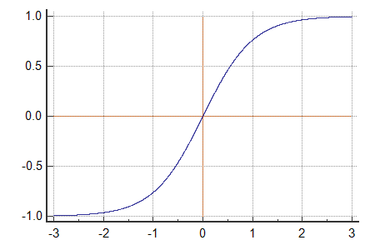
tanh activation – Equation

Slide 58
tanh activation – Interpretation
tanh(Z) ~ 1 – For Z >> 0
tanh(Z) ~ -1 – For Z << 0
tanh(Z) = 0 – For Z = 0

Slide 59
tanh activation - Applications
Zero mean
Range – -1.0 to +1.0
Scaled and zero mean Sigmoid function
Better than Sigmoid activation function
Neural network
Recurrent neural network

Slide 60
tanh activation – Derivative

Slide 61
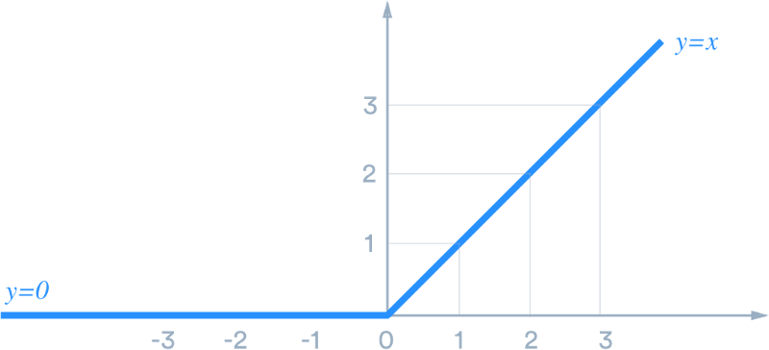
ReLU activation – Equation

Slide 62
ReLU activation – Interpretation
ReLU(Z) ~ Z – For Z > 0
ReLU(Z) ~ 0 – For Z < 0
ReLU(Z) = ? – For Z = 0

Slide 63
ReLU activation - Applications
Neural network
Convolutional neural network

Slide 64
ReLU activation – Derivative

Slide 65
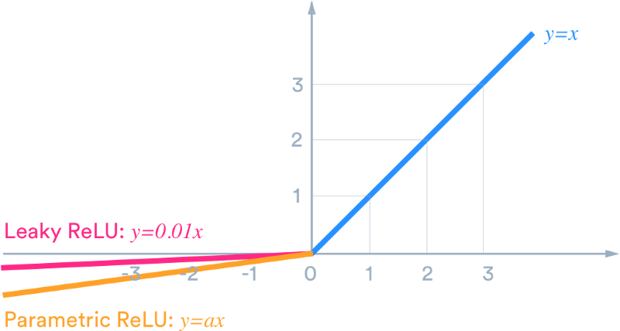
Leaky ReLU activation – Equation

Slide 66
Leaky ReLU activation – Interpretation
Leaky ReLU(Z) ~ Z – For Z > 0
Leaky ReLU(Z) ~ 0.01 * Z – For Z < 0
Leaky ReLU(Z) = ? – For Z = 0

Slide 67
Leaky ReLU activation - Applications
Neural network
Convolutional neural network

Slide 68
Leaky ReLU activation – Derivative

Slide 69
Questions?
Thank you

