Slide 1
Decision Tree
Computer Division
Bhabha Atomic Research Centre

Slide 2
Topics
Introduction
Supervised learning
Decision tree
Optimization objective
Advantages and disadvantages

Slide 3
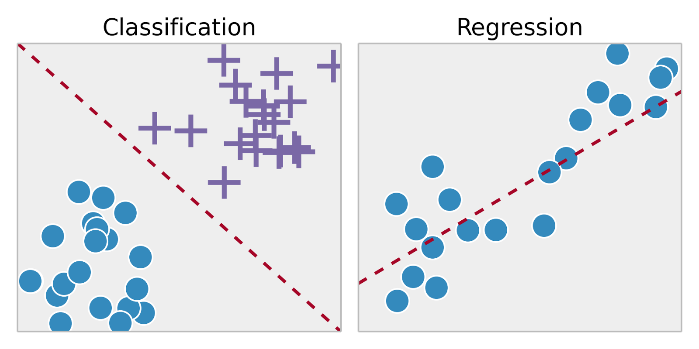
Supervised Learning
Training set – { (x⁽¹⁾,y⁽¹⁾), (x⁽²⁾,y⁽²⁾), …, (x^{(m)},y^{(m)})}
Labeled dataset
Image ack – Google

Slide 4

Decision Tree
Binary tree
Recursively split dataset
Root node
Decision nodes
Split dataset
Select feature
Select split condition
Pure leaf nodes
Class of dataset sample – Classification tree
Value of dataset sample – Regression tree
Image ack – Google

Slide 5
Decision Tree
Greedy algorithm
Select best solution in the current state
No back tracking
No optimal solution
Faster implementation

Slide 6
Optimization objective
Entropy
Information gain
Gini index or Gini impurity
Gain Ratio
Reduction in Variance
Chi-Square

Slide 7
Entropy
Measure of information contained in a state
High entropy – High uncertainty – More info
Less entropy – Less uncertainty – Less info
Root node – Highest entropy – 1
Leaf node – Low entropy
Pure node – Lowest entropy – 0

Slide 8
Information Gain
Maximize information gain
Information gain
Entropy
Parent entropy
Weighted child entropy
Weight – Relative size

Slide 9
Gini Index
Gini Impurity
Evaluate accuracy of a split
Value between 0 and 1
Value 0
All observations belong to one class
Value 1
Random distribution of classes

Slide 10
Decision Tree Algorithm
Create root node with complete dataset
Find best attribute and value in dataset
Generate decision node
Divide current dataset into subsets
Repeat Steps 2 to 3 until
All nodes are leaf nodes
Further division is not possible

Slide 11
Advantages
Generate understandable rules
Interpretable AI
Classification with less computation
Handle continuous and categorical variables
Indicate feature importance

Slide 12
Disadvantages
Less appropriate for regression task
Over-fitting
Less accurate
Solution – Use random forest algorithm

Slide 13
Questions?
Thank you

