Slide 1
Naive Bayes
Pritam Prakash Shete
Computer Division, BARC
Centre for Excellence in Basic Sciences

Slide 2
Topics
Supervised learning
Conditional probability
Bayes’ rule
Naive Bayes
Laplacian smoothing
Applications
Advantages
Disadvantages

Slide 3
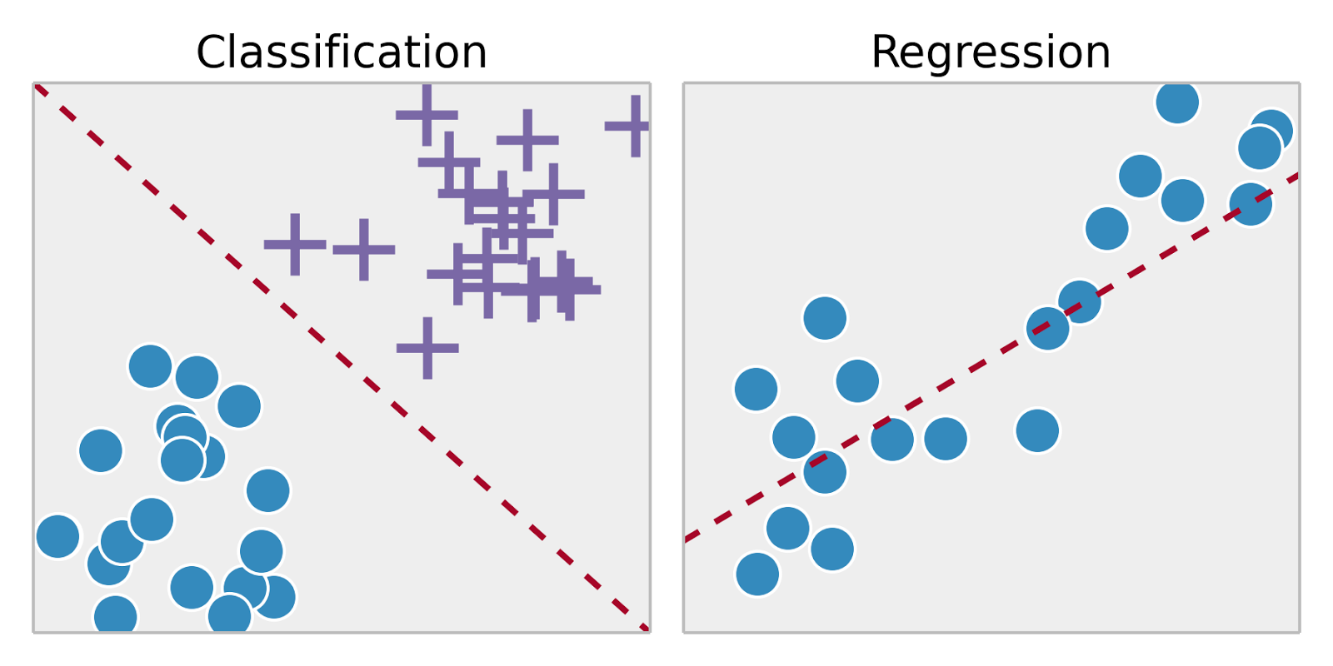
Supervised Learning
Training set – { (x⁽¹⁾,y⁽¹⁾), (x⁽²⁾,y⁽²⁾), …, (x^{(m)},y^{(m)})}
Labeled dataset
Image ack – Google

Slide 4
Probability
Application – SMS spam detection
Corpus of SMSs
Events – Ham or Spam SMS
Name | Value
N_{Total} | 1000
N_{Ham} | 800
N_{Spam} | 200
P(Ham) | 0.8 (80%)
P(Spam) | 0.2 (20 %)

Slide 5
Probability
Application – SMS spam detection
Corpus of SMSs
Event – SMS contains word ‘discount’
Name | Value
N_{Total} | 1000
N_{discount} | 20
P(discount) | 0.02 (2 %)

Slide 6
Conditional Probability
Corpus
Ham
Spam
discount

Slide 7
Conditional Probability
Event – SMS – Spam
Event – SMS – ‘discount’
Intersection – Spam and ‘discount’
Probability that SMS is Spam given SMS contains word ‘discount’.
Probability that SMS is Spam and SMS contains word ‘discount’.

Slide 8
Bayes’ Rule
Event – SMS – Spam
Event – SMS – ‘discount’
Intersection – Spam and ‘discount’

Slide 9
Bayes’ Rule
Event – SMS – Spam
Event – SMS – ‘discount’
Intersection – Spam and ‘discount’

Slide 10
Bayes’ Rule
Event – SMS – Spam
Event – SMS – ‘discount’
Intersection – Spam and ‘discount’

Slide 11
Naive Bayes
SMS spam detection
Corpus
Spam corpus
Ham corpus
Vocabulary
All words
Spam and Ham corpus

Slide 12
Laplacian Smoothing

Slide 13
Applications

Slide 14
Advantages

Slide 15
Disadvantages

Slide 16
Questions?
Thank you

