Slide 1
Naive Bayes
Pritam Prakash Shete
Computer Division, BARC
Centre for Excellence in Basic Sciences

Slide 2
Topics
Supervised learning
Conditional probability
Bayes’ rule
Naive Bayes
Laplacian smoothing
Prior ratio
Log likelihood
Applications
Advantages
Disadvantages

Slide 3
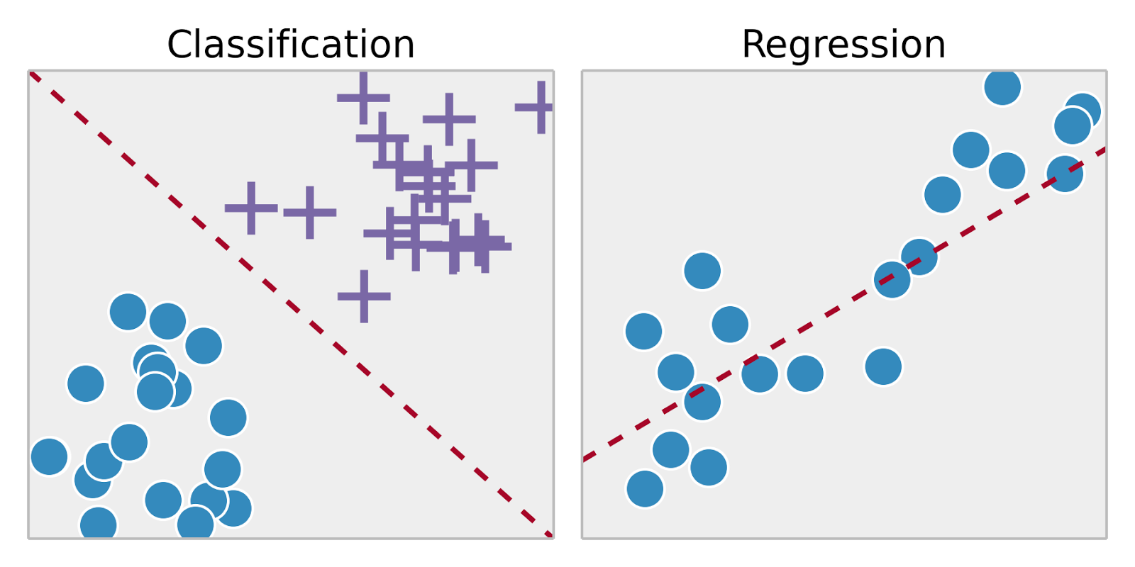
Supervised Learning
Training set – { (x⁽¹⁾,y⁽¹⁾), (x⁽²⁾,y⁽²⁾), …, (x^{(m)},y^{(m)})}
Labeled dataset
Image ack – Google

Slide 4
Probability
SMS spam detection
Corpus of SMSs
Events – Ham SMS or Spam SMS
Name | Value
N_{Total} | 1000
N_{Ham} | 800
N_{Spam} | 200
P(Ham) | 0.8 (80%)
P(Spam) | 0.2 (20 %)

Slide 5
Probability
SMS spam detection
Corpus of SMSs
Event – SMS contains word ‘discount’
Name | Value
N_{Total} | 1000
N_{discount} | 20
P(discount) | 0.02 (2 %)

Slide 6
Conditional Probability
Corpus
Ham
Spam
discount

Slide 7
Conditional Probability
Event – SMS – Spam
Event – SMS – ‘discount’
Intersection – Spam and ‘discount’
Probability that SMS is Spam, given SMS contains word ‘discount’.
Probability that SMS is Spam and SMS contains word ‘discount’.

Slide 8
Bayes’ Rule
Event – SMS – Spam
Event – SMS – ‘discount’
Intersection – Spam and ‘discount’

Slide 9
Bayes’ Rule
Event – SMS – Spam
Event – SMS – ‘discount’
Intersection – Spam and ‘discount’

Slide 10
Bayes’ Rule
Event – SMS – Spam
Event – SMS – ‘discount’
Intersection – Spam and ‘discount’

Slide 11
Naive Bayes
SMS spam detection
Corpus
Ham corpus
Spam corpus
Vocabulary
All words
Ham and Spam corpus
Word | Ham | Spam
I | 400 | 400
am | 400 | 400
because | 50 | 0
meeting | 200 | 100
company | 350 | 100
discount | 100 | 200
lottery | 100 | 400
1600 | 1600

Slide 12
Naive Bayes
SMS spam detection
Corpus
Ham corpus
Spam corpus
Vocabulary
All words
Ham and Spam corpus
Word | Ham | Spam
I | 0.25 | 0.25
am | 0.25 | 0.25
because | 0.03125 | 0
meeting | 0.125 | 0.0625
company | 0.21875 | 0.0625
discount | 0.0625 | 0.125
lottery | 0.0625 | 0.25
1600 | 1600

Slide 13
Naive Bayes
SMS spam detection
Corpus
Ham corpus
Spam corpus
Vocabulary
All words
Ham and Spam corpus
Word | Ham | Spam
I | 400 | 400
am | 400 | 400
because | 50 | 0
meeting | 200 | 100
company | 350 | 100
discount | 100 | 200
lottery | 100 | 400
1600 | 1600

Slide 14
Naive Bayes
SMS spam detection
Corpus
Ham corpus
Spam corpus
Vocabulary
All words
Ham and Spam corpus
Word | Ham | Spam
I | 0.25 | 0.25
am | 0.25 | 0.25
because | 0.03125 | 0
meeting | 0.125 | 0.0625
company | 0.21875 | 0.0625
discount | 0.0625 | 0.125
lottery | 0.0625 | 0.25

Slide 15
Naive Bayes
Identical probabilities
Neutral words
I, am
Significant words
Power words
meeting, company
discount, lottery
Table of probabilities
Word | Ham | Spam
I | 0.25 | 0.25
am | 0.25 | 0.25
because | 0.03125 | 0
meeting | 0.125 | 0.0625
company | 0.21875 | 0.0625
discount | 0.0625 | 0.125
lottery | 0.0625 | 0.25

Slide 16
Naive Bayes
Word | Ham | Spam
I | 0.25 | 0.25
am | 0.25 | 0.25
because | 0.03125 | 0
meeting | 0.125 | 0.0625
company | 0.21875 | 0.0625
discount | 0.0625 | 0.125
lottery | 0.0625 | 0.25
I am in meeting.
Ham

Slide 17
Naive Bayes
Word | Ham | Spam
I | 0.25 | 0.25
am | 0.25 | 0.25
because | 0.03125 | 0
meeting | 0.125 | 0.0625
company | 0.21875 | 0.0625
discount | 0.0625 | 0.125
lottery | 0.0625 | 0.25
You got discount.
Spam

Slide 18
Laplacian Smoothing
Word count – 0
Probability of word – 0
Probability of sentence – 0
e.g.
Word ‘because’ – Spam

Slide 19
Laplacian Smoothing
Word | Ham | Spam
I | 0.2495 | 0.2495
am | 0.2495 | 0.2495
because | 0.0317 | 6.2e-4
meeting | 0.125 | 0.0628
company | 0.2184 | 0.0628
discount | 0.0628 | 0.125
lottery | 0.0628 | 0.2495

Slide 20
Prior Ratio
Number of Ham (positive) SMSs
Number of Spam (negative) SMSs
Ratio of number of Ham and Spam SMSs

Slide 21
Likelihood
Ratio of probabilities
Neutral words
~1.
Positive words
> 1 – Larger than 1
Negative words
< 1 – Less than 1
Multiplication
Numerical underflow

Slide 22
Log Likelihood
Logarithm of ratio of probability
Log likelihood
Addition of logarithms
No numerical underflow
Neutral words – ~0
Positive words – > 0
Negative words – < 0
Logprior

Slide 23
Applications
Spam detection
Sentiment analysis
Author identification
Text classification
Word disambiguation

Slide 24
Advantages
Simple
Easy to implement
Real-time predictions
Work with less training dataset
Continuous and discrete data
Not sensitive to irrelevant features

Slide 25
Disadvantages
Assume independent features
Relative frequencies in corpus

Slide 26
Questions?
Thank you

