Slide 1
Random Forest
Pritam Prakash Shete
Computer Division, BARC
Centre for Excellence in Basic Sciences

Slide 2
Topics
Supervised learning
Decision tree
Random forest
Advantages
Disadvantages

Slide 3
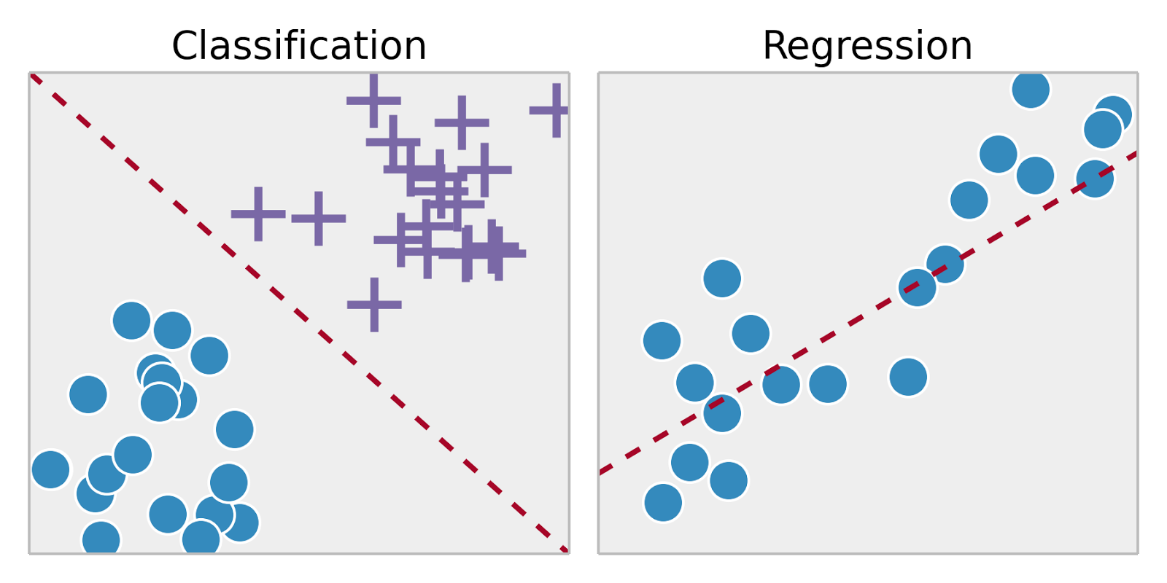
Supervised Learning
Training set – { (x⁽¹⁾,y⁽¹⁾), (x⁽²⁾,y⁽²⁾), …, (x^{(m)},y^{(m)})}
Labeled dataset
Image ack – Google

Slide 4

Decision Tree
Binary tree
Recursively split dataset
Root node
Decision nodes
Split dataset
Select feature
Select split condition
Pure leaf nodes
Class of dataset sample – Classification tree
Value of dataset sample – Regression tree
Image ack – Google

Slide 5
Decision Tree – Disadvantages
Over-fitting
Less accurate
Solution – Use random forest algorithm

Slide 6
Random Forest
Subset of dataset
Bootstrapped dataset
Subset of features
Bagging approach
Ensemble learning
Improve performance
Number of decision trees
More number
Less over-fitting
Higher accuracy

Slide 7
Random Forest Algorithm
Create bootstrapped dataset
Select subset of features
Bagging approach
Create decision tree using selected features
Repeat Steps 1 to 3
Number of decision trees

Slide 8
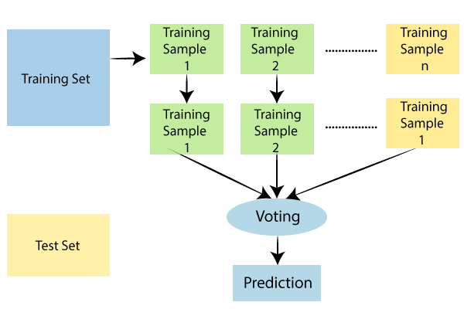
Random Forest
Image ack – Google

Slide 9
Advantages
Less over-fitting by using multiple trees
More accurate as compared to single tree

Slide 10
Disadvantages
Computationally expensive
Less interpretable than decision tree

Slide 11
Questions?
Thank you

