Slide 1
Graphics Processing Unit
Pritam Prakash Shete
Computer Division
Bhabha Atomic Research Centre

Slide 2
Topics
CPU v/s GPU
Heterogeneous Computing
GPU Architecture
Streaming Multiprocessor
Memory Hierarchy
Thread Hierarchy

Slide 3
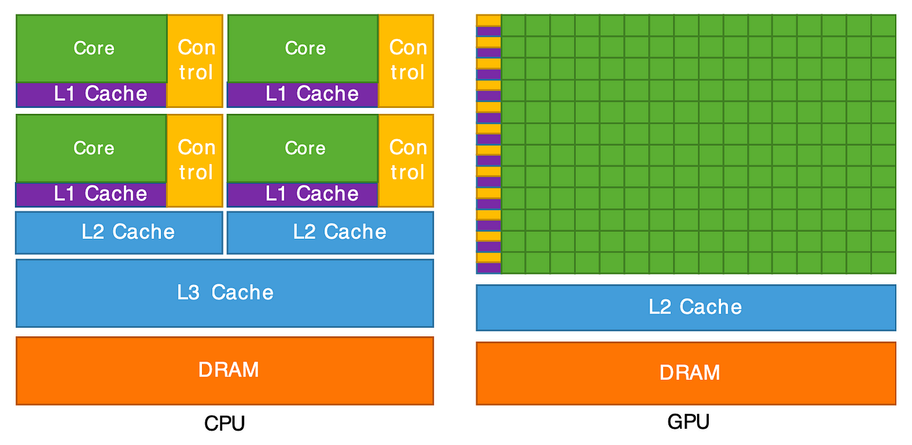
CPU v/s GPU
Image ack – Google

Slide 4
CPU v/s GPU
Central Processing Unit
Less number of cores (~100)
Low compute density
Low latency
Higher clock speed
Powerful cores
Serial instruction processing
Handful of operations at once
Graphics Processing Unit
Large number of cores (~1000)
High compute density
High throughput
Lower clock speed
Weak cores
Parallel instruction processing
Thousands of operations at once

Slide 5
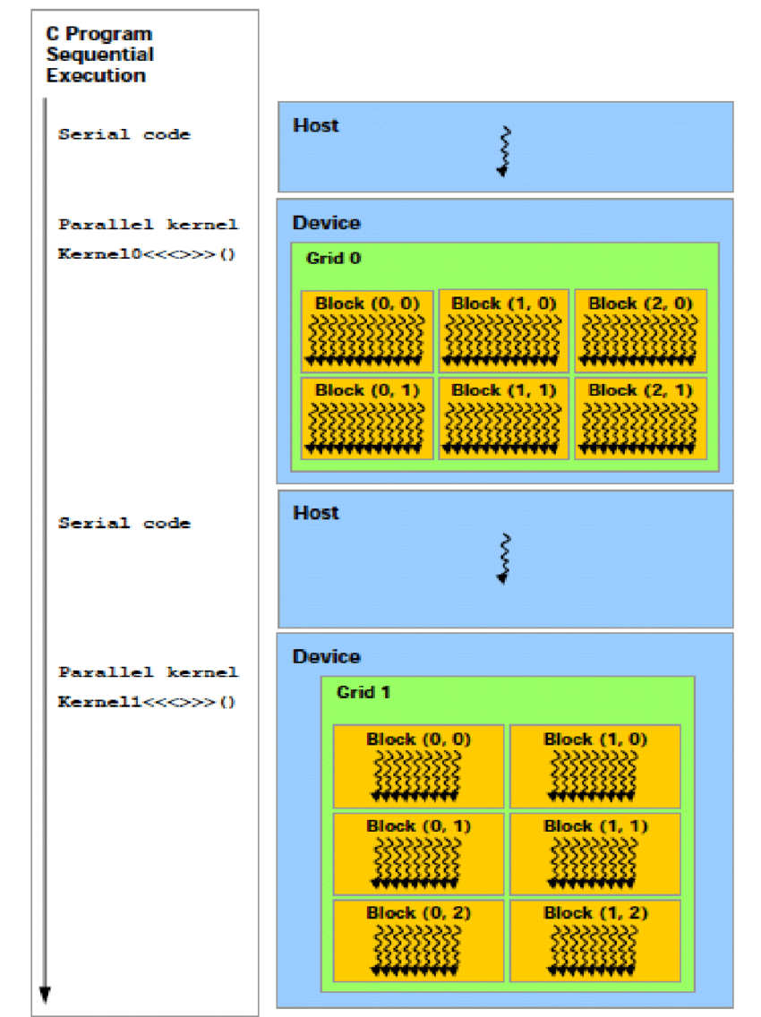
Heterogeneous Computing
Image ack – Google

Slide 6
Heterogeneous Computing
Step 1: Initialize the memories on both CPU and GPU.
Step 2: Transfer the data to a GPU.
Step 3: Do the computation on a GPU.
Step 4: Transfer the data back to a CPU.
Step 5: Delete the memories on both CPU and GPU.

Slide 7
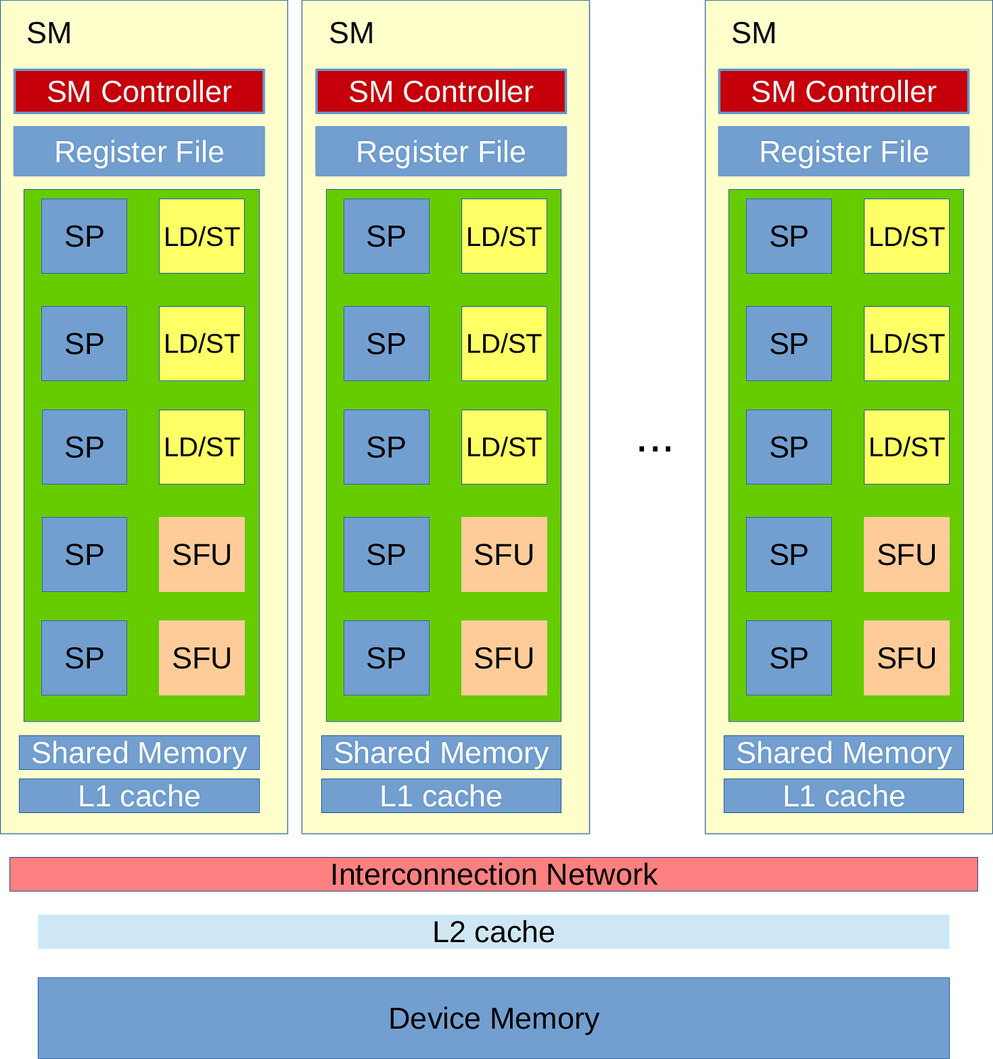
GPU Architecture
Image ack – Google

Slide 8
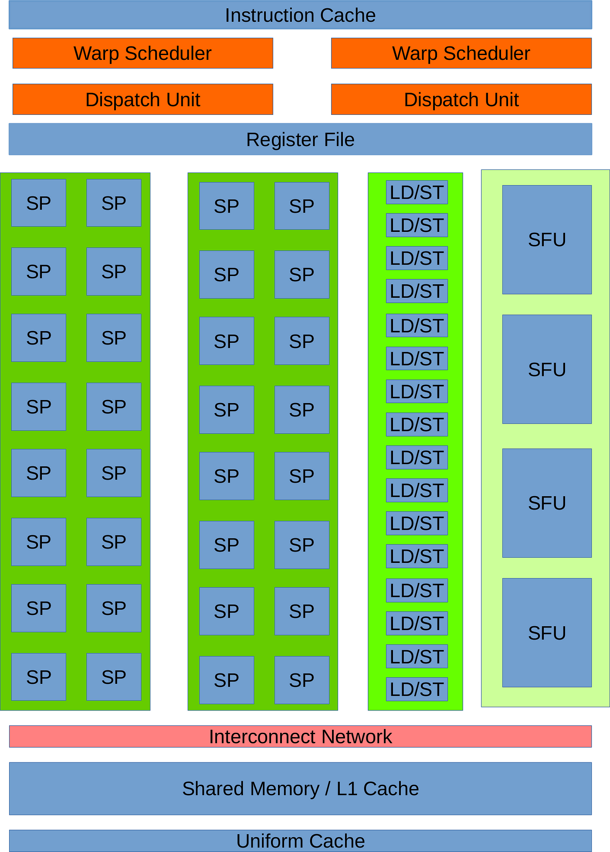
Streaming Multiprocessor
Image ack – Google

Slide 9
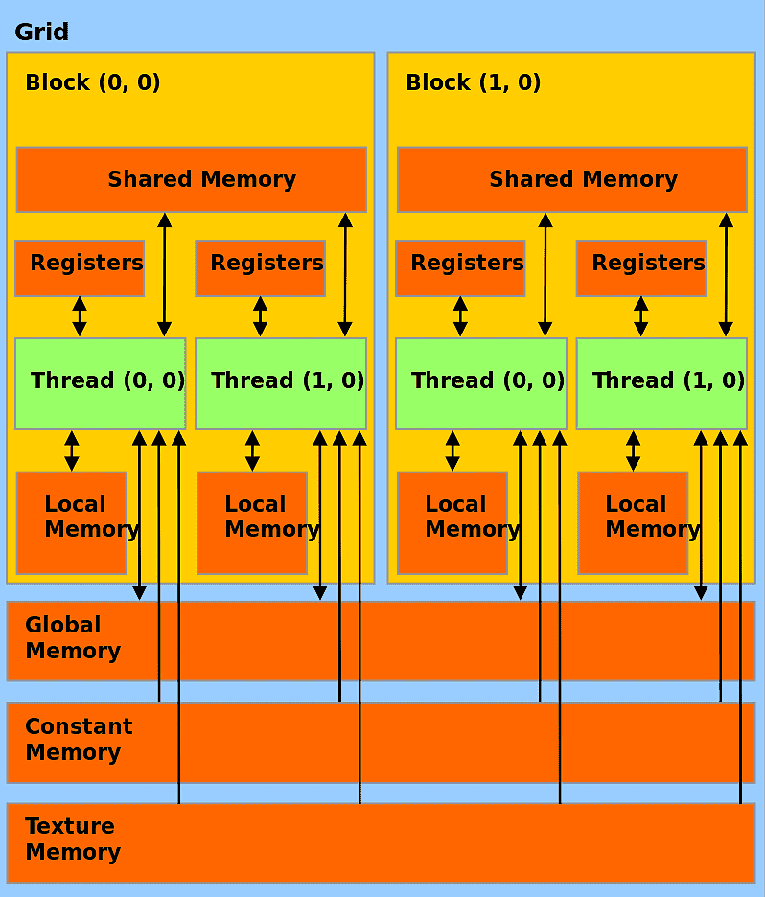
Memory Hierarchy
Image ack – Google

Slide 10
Memory Hierarchy
Local memory
Register memory
Shared memory
Global memory
Constant memory
Texture memory

Slide 11
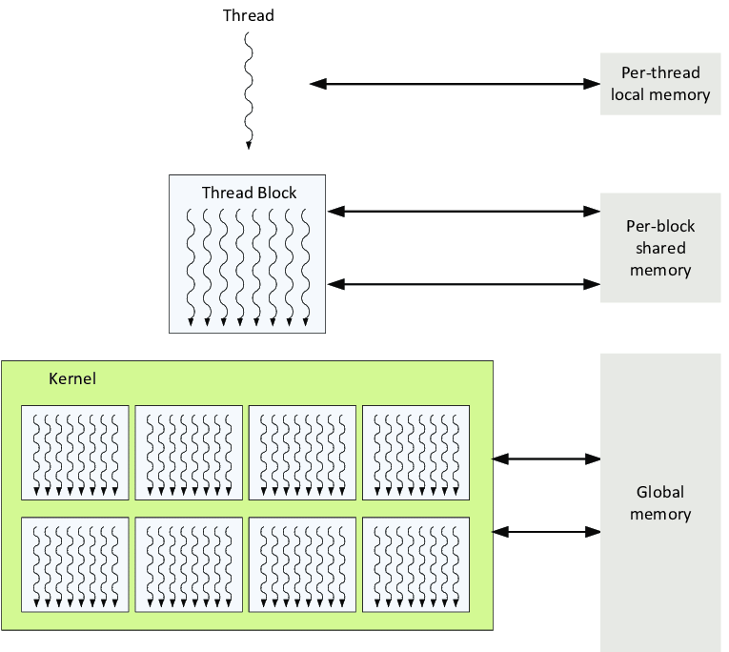
Thread Hierarchy
Image ack – Google

Slide 12
Questions?
Thank you

