Slide 1
OpenACC
Pritam Prakash Shete
Computer Division
Bhabha Atomic Research Centre

Slide 2
Topics
Heterogeneous Computing
OpenACC

Slide 3
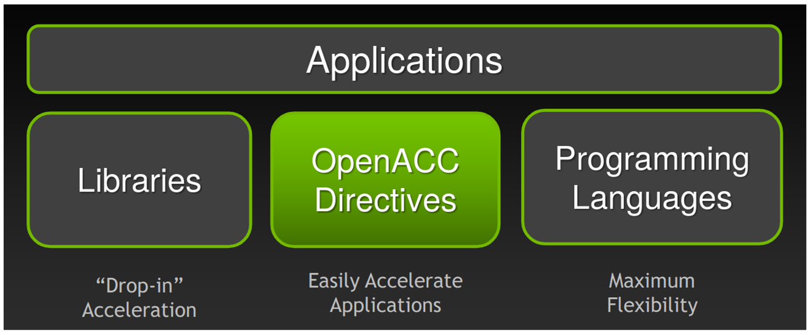
Heterogeneous Computing
Image ack – Google

Slide 4
Heterogeneous Computing
Libraries
cuBLAS, cuFFT, CUDA Math
Directive based
OpenACC
Programming languages
CUDA – NVIDIA
OpenCL – NVIDIA, ATI, FPGA

Slide 5
OpenACC
Incremental
Single Source
Low Learning Curve

Slide 6
OpenACC – Incremental
Maintain existing sequential code
Add annotations to expose parallelism
Verifying correctness
Annotate more of the code

Slide 7
OpenACC – Incremental
Begin with a working sequential code.
Parallelize it with OpenACC.
Rerun the code to verify correctness and performance.
/// Sequential code
for( i=0; i <N; i++)
{
c[i] = a[i] + b[i]
}
/// OpenACC code
#pragma acc parallel loop
for( i=0; i <N; i++)
{
c[i] = a[i] + b[i]
}

Slide 8
OpenACC – Single Source
Rebuild same code on multiple architectures
Compiler based parallelization for desired machine
Maintained sequential code

Slide 9
OpenACC – Single Source
Supported platforms
POWER, Sunway, x86 CPU, AMD GPU, NVIDIA GPU
Optional OpenACC code additions
Same code for parallel or sequential execution
/// Sequential code
#pragma acc parallel loop
for( i=0; i <N; i++)
{
c[i] = a[i] + b[i]
}
/// OpenACC code
#pragma acc parallel loop
for( i=0; i <N; i++)
{
c[i] = a[i] + b[i]
}

Slide 10
OpenACC – Low Learning Curve
Easy to use
Easy to learn
Programming languages – C, C++, or Fortran
No need to learn low level hardware details

Slide 11
OpenACC – Low Learning Curve
Hints to compiler
Parallelization by compiler
int main(int argc, char *[] argv)
{
/// Sequential code
#pragma acc kernel
for( i=0; i <N; i++)
{
/// Parallel code
}
}

Slide 12
Questions?
Thank you

