Slide 1
Artificial Intelligence
Pritam Prakash Shete
Computer Division, BARC
Centre for Excellence in Basic Sciences

Slide 2
Topics
Artificial Intelligence – What ?
AI Classification
Machine Learning – What ?
ML Classification
Deep Learning – What ?

Slide 3
Artificial Intelligence – What ?
AI – Artificial Intelligence
Wikipedia – Intelligence demonstrated by machines as opposed to natural intelligence displayed by humans and animals

Slide 4
AI Classification (1)
Artificial Narrow Intelligence
ANI
Stage 1
Artificial General Intelligence
AGI
Stage 2
Artificial Super Intelligence
ASI
Stage 3

Slide 5
Artificial Narrow Intelligence
Solve one specific problem
Narrow capabilities
Controlled environments
Surpass human level performance

Slide 6
Artificial Narrow Intelligence
Digital voice assistants – Siri, Alexa
Recommendation engines
Search engines
Chat bots
Image and speech recognition
Predictive maintenance

Slide 7
Artificial General Intelligence
Theoretical concept
Ability to solve arbitrary problem
Do anything a human can do
Collection of many ANI systems

Slide 8
Artificial Super Intelligence
Theoretical concept
Surpass all human capabilities
Do even more things than any human can do
Relatively narrow gap between AGI and ASI
A nanosecond from AGI to ASI

Slide 9
AI Classification (2)
Weak AI
Artificial Narrow Intelligence
Strong AI
Artificial General Intelligence
Artificial Super Intelligence

Slide 10
Machine Learning – What ?
Improve through experience using data
A machine is said to learn from experience E with respect to some class of tasks T and performance measure P.
If its performance at tasks in T, as measured by P, improves with experience E.

Slide 11
ML Classification
Supervised learning
Unsupervised learning
Reinforcement learning
Semi supervised learning
Self supervised learning

Slide 12
Supervised Learning – What ?
Labeled dataset
Annotated dataset
Paired input variables and output variables
Compute mapping from input variables to output variables

Slide 13
Supervised Learning – Classification
Regression model
Assign continuous numerical values to dataset inputs
Example – House price prediction
Classification model
Assign discrete label or labels from predefined set of categories to dataset inputs
Example – Image classification

Slide 14
Supervised Learning – Example (1)
House price prediction – Regression model
Input variables
Number of bedrooms
Area of house
Locality of house and so on
Output variable
Price of house
Optimization function
Reduce error between predicted and actual price of house

Slide 15
Supervised Learning – Example (2)
Image classification – Classification model
Input variables
Input cropped images
Output variable
Classify image
Optimization function
Reduce classification error

Slide 16
Unsupervised Learning – What ?
Unlabeled dataset
No annotations
Only input variables
No output variables or output annotations

Slide 17
Unsupervised Learning – Classification
Clustering
Cluster or group input variables
Feature learning
Learn features or patterns from input variables
Association rules learning
Find relationships between input variables

Slide 18
Unsupervised Learning – Examples
Association rule learning
Apriori algorithm
If a person buys Bread then he also buys Jam.
Bread and Jam are bought together
If a person buys Laptop then he also buys laptop bag.
Laptop and laptop bag are bought together

Slide 19
Unsupervised Learning – Examples
Clustering
Customer segmentation for different shirt sizes
Input variables
Number of size measurements for customers
Output
Clustered number of shirt sizes (small, medium, and large)
Optimization function
No accuracy
Decrease distance between samples from same cluster
Increase distance between samples from different clusters

Slide 20
Unsupervised Learning – Examples
Feature learning
Anomaly detection
Use auto-encoder for feature learning
Compute reconstruction error
Set appropriate threshold for error
Detect anomaly using error and threshold

Slide 21
Reinforcement Learning – What ?
Learn from experience
Take suitable action
Maximize reward in particular situation

Slide 22
Reinforcement Learning – Terms
Dynamic system or environment
Agent interactions – Episodes
Feedback – Rewards or penalties
Objective – Maximize rewards
Exploration v/s Exploitation

Slide 23
Reinforcement Learning – Examples
AlphaGo
Super Mario game
Autonomous drones – Stanford University

Slide 24
Semi Supervised Learning – What ?
Supervised learning + Unsupervised learning
Small – Labeled dataset
Large – Unlabeled dataset
Labeled dataset – More weightage
Unlabeled dataset – Less weightage

Slide 25
Semi Supervised Learning – What ?
Train model using labeled dataset.
Pseudo labeling
Use trained model to label unlabeled dataset.
Train model using composite dataset.
Improve model performance.

Slide 26
Semi Supervised Learning – Examples
Vehicle number plate detection
Large open dataset
Small Indian dataset
Train model using open dataset
Label Indian dataset using trained model
Generate composite dataset
Improve performance using composite dataset

Slide 27
Semi Supervised Learning – Examples
Vehicle number plate recognition
Generate synthetic dataset
Collect unlabeled real dataset
Train model using synthetic dataset
Label real dataset using trained model
Improve performance using composite dataset

Slide 28
Self Supervised Learning – What ?
Automatic annotations
Generate labelled dataset using large amount of dataset
Train model using labelled dataset

Slide 29
Self Supervised Learning – Examples
Gray images to colour images
Use colour images
Generate corresponding gray images
Labelled dataset
Train model using labelled dataset

Slide 30
Self Supervised Learning – Examples
Predict next word – Language model
Collect text dataset using internet web pages
Use text dataset for predicting next word
Generate labelled dataset
Train model using labelled dataset

Slide 31
Supervised Learning – Classification
Artificial neural network – ANN
Decision tree
Random forest
Support vector machine – SVM

Slide 32
ANN – Classification
Linear networks
Linear function
One input and one output layer
Feed forward neural network
Convolutional neural network
Recurrent neural network
Deep neural networks
More than one hidden layer

Slide 33
Deep Learning – What ?
Input layer
Output layer
More than one hidden layer

Slide 34
Deep Learning – Why ?
Large amount of data
Internet of Things – IoT
Faster hardware
GPU
TPU
Better algorithms
Residual networks
ReLU activation

Slide 35
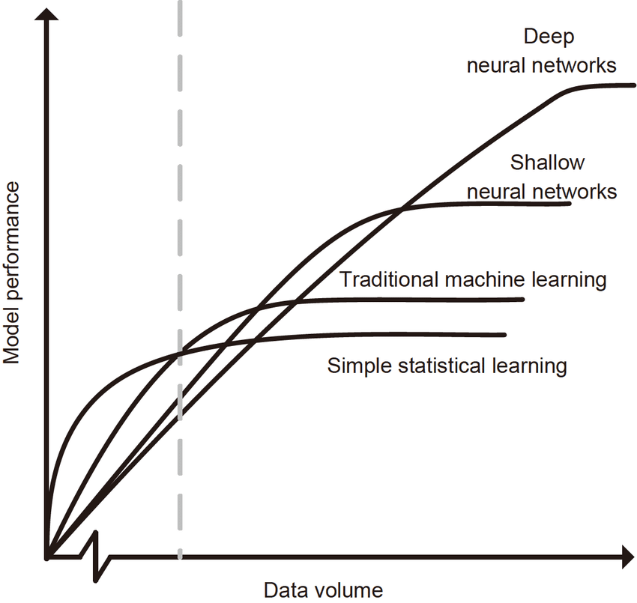
Deep Learning – Why ?
Image ack – Google

Slide 36
Machine Learning v/s Deep Learning
Training time
Machine learning
Less number of parameters
Less time
Deep learning
Large number of parameters
Large time

Slide 37
Machine Learning v/s Deep Learning
Feature extraction
Machine learning
Domain expert
Reduce data complexity
Deep learning
Learn high level features
No need of domain expert

Slide 38
Machine Learning v/s Deep Learning
Interpretability
Machine learning
Inherent interpretable
Deep learning
Black box
Explainable AI

Slide 39
Machine Learning v/s Deep Learning
Accuracy
Machine learning
Less parameters
Less complexity
Less accuracy for large datasets
Deep learning
More layers – More parameters
More complexity
More accuracy for large datasets

Slide 40
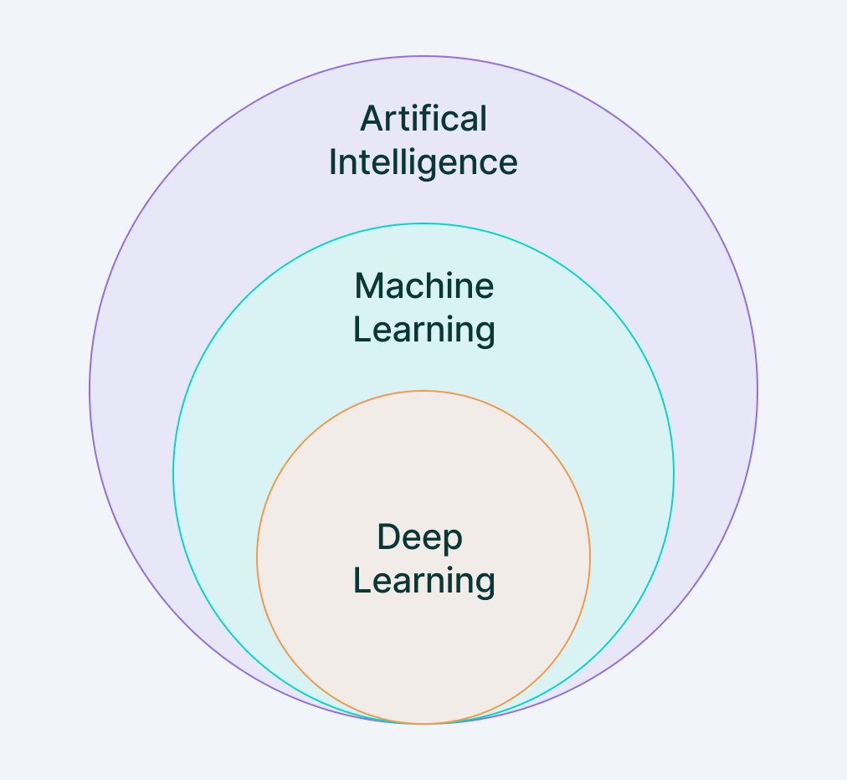
AI v/s ML v/s DL
Image ack – Google

Slide 41
ANN v/s DNN
Artificial Neural Network
One hidden layer
Deep Neural Network
More than one hidden layer

Slide 42
Questions?
Thank you

