Slide 1
Naive Bayes
Pritam Prakash Shete
Computer Division, BARC
Centre for Excellence in Basic Sciences

Slide 2
Topics
Supervised learning
Naive Bayes
Advantages
Disadvantages

Slide 3
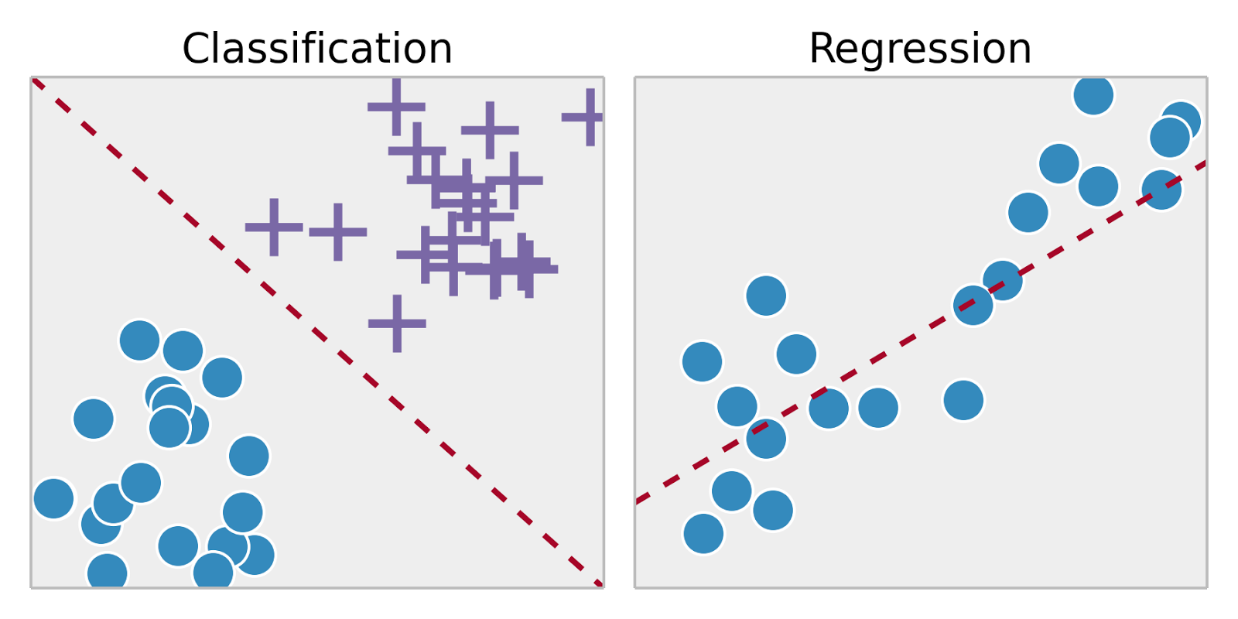
Supervised Learning
Training set – { (x⁽¹⁾,y⁽¹⁾), (x⁽²⁾,y⁽²⁾), …, (x^{(m)},y^{(m)})}
Labeled dataset
Image ack – Google

Slide 4
Advantages

Slide 5
Disadvantages

Slide 6
Questions?
Thank you

