Slide 1
Decision Tree
Computer Division
Bhabha Atomic Research Centre

Slide 2
Topics
Introduction
Supervised learning
Decision tree
Optimization objective
Advantages and disadvantages

Slide 3
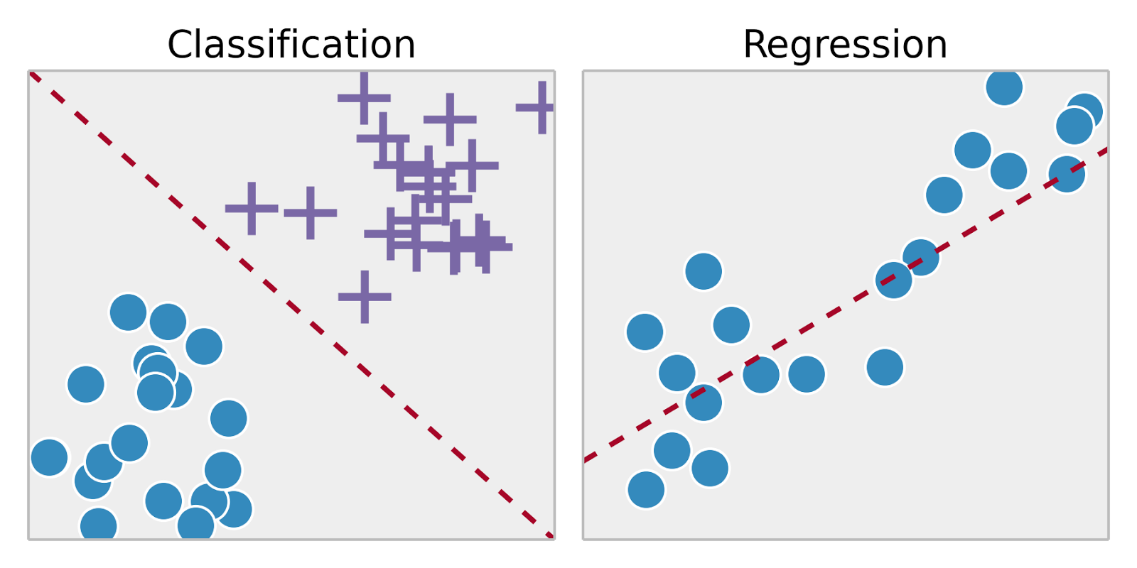
Supervised Learning
Training set – { (x⁽¹⁾,y⁽¹⁾), (x⁽²⁾,y⁽²⁾), …, (x^{(m)},y^{(m)})}
Labeled dataset
Image ack – Google

Slide 4

Decision Tree
Binary tree
Recursively split dataset
Root node
Decision nodes
Split dataset
Select feature
Select split condition
Pure leaf nodes
Class of dataset sample – Classification tree
Value of dataset sample – Regression tree
Image ack – Google

Slide 5
Decision Tree
Greedy algorithm
Select best solution in the current state
No back tracking
No optimal solution
Faster implementation

Slide 6
Optimization objective
Entropy
Measure of information contained in a state
High entropy – High uncertainty – More info
Less entropy – Less uncertainty – Less info
Root node – Highest entropy – 1
Leaf node – Low entropy
Pure node – Lowest entropy – 0

Slide 7
Optimization objective
Maximize information gain
Information gain
Entropy
Parent entropy
Weighted child entropy
Weight – Relative size

Slide 8
Optimization objective
Gini index
Evaluate accuracy of a split
Value between 0 and 1
Value 0
All observations belong to one class
Value 1
Random distribution of classes

Slide 9
Decision Tree Algorithm
Select number of clusters – K
Select random K points as centroids
Cluster assignment
Assign each data point to closest centroid
Centroid movement
Compute centroids for new clusters
Repeat Steps 3 to 5 until
Maximum number of iterations
Minimum variation in cluster centers
No change in cluster centers

Slide 10
Advantages

Slide 11
Disadvantages

Slide 12
Questions?
Thank you

