Slide 1
Bagging
Pritam Prakash Shete
Computer Division, BARC
Centre for Excellence in Basic Sciences

Slide 2
Topics
Bootstrapping
Aggregating
Parallel execution

Slide 3
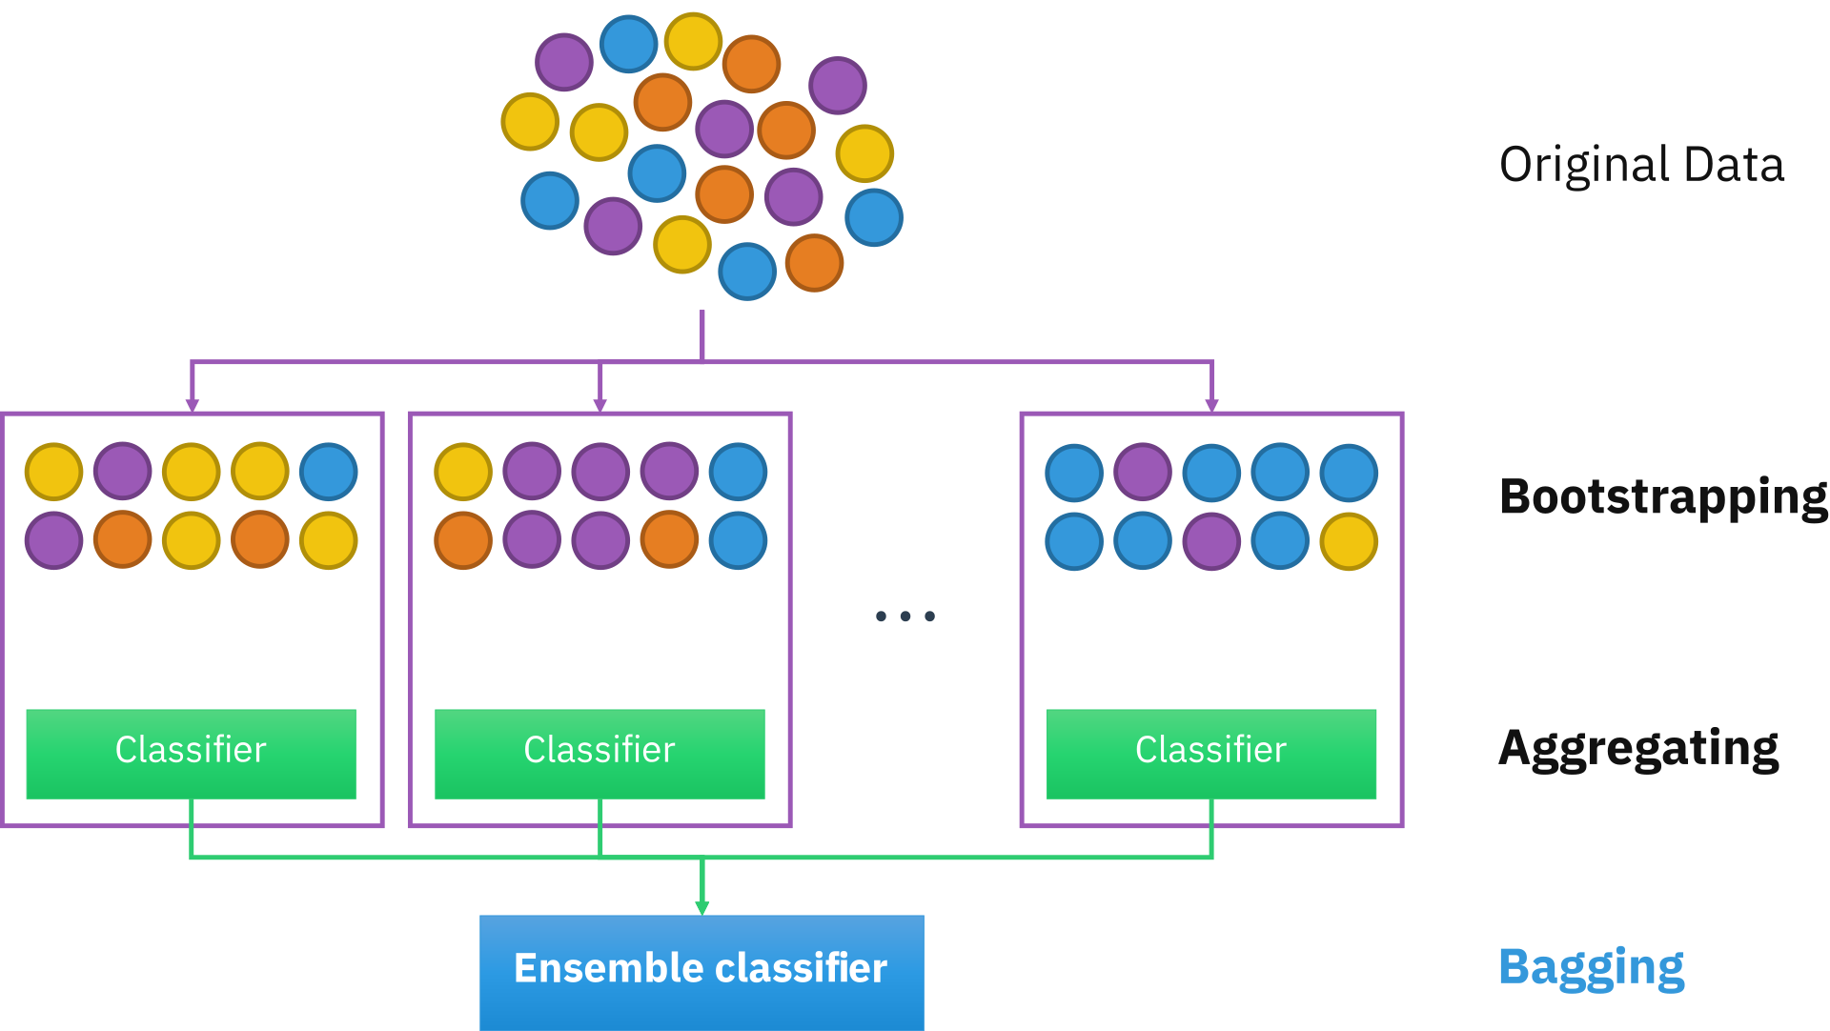
Bootstrap aggregating – Bagging
Image ack – Google

Slide 4
Questions?
Thank you

