Slide 1

UNSUPERVISED LEARNING
Pritam Prakash Shete
Scientific Officer F
Computer Division, BARC

Slide 2
Topics
Introduction
Supervised Learning and its types
Unsupervised Learning and its types
Pros & Cons of Unsupervised Learning
Unsupervised Learning-Clustering
Applications
K-Means Clustering Algorithm in detail
Unsupervised Learning- Dimensionality Reduction
Background
PCA Algorithm overview
Applications
Unsupervised Learning- Association Rule Learning
Background
Apriori Algorithm overview
Applications

Slide 3
Supervised Learning
Training set – { (x⁽¹⁾,y⁽¹⁾), (x⁽²⁾,y⁽²⁾), …, (x^{(m)},y^{(m)})}
Learn mapping function from input to output.
Y = f(X)
Predict output y for new input x.
Process of algorithm learning from training dataset can be thought of as a teacher supervising learning process.
Algorithm iteratively makes predictions on the training data and is corrected by teacher.
Learning stops when algorithm receives an acceptable level of performance.

Slide 4
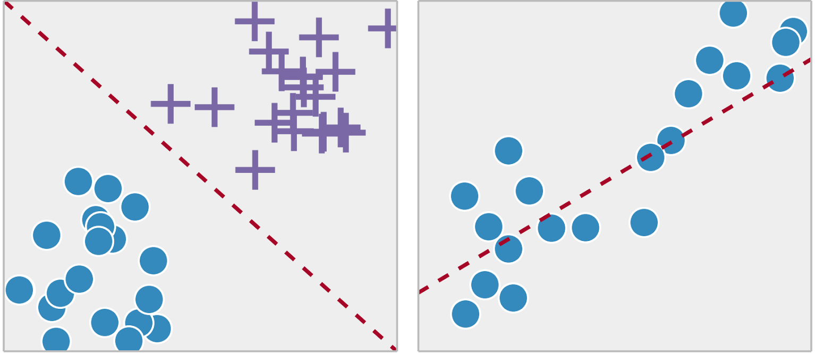
Supervised Learning Types
Classification: Output is a category like “red”, “blue”
Regression: Output is a real value like “dollars”, “weight”.
Classification
Regression

Slide 5
Unsupervised Learning
Non Labelled data.
Only input data X given and no output variable Y.
Training set – { x⁽¹⁾, x⁽²⁾, …, x^{(m)}}
Goal is to model the underlying structure or distribution in data.
Unsupervised as no correct answers and no teacher.

Slide 6
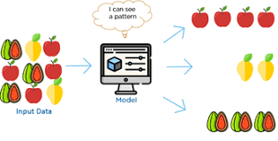
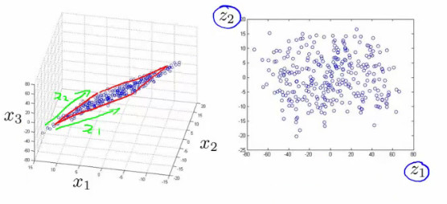
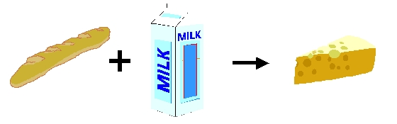
Unsupervised Learning Types
Clustering: Discover inherent groupings in data such as grouping customers by purchasing behaviour.
Dimensionality Reduction: Converting data having vast dimensions into data with lesser dimensions ensuring it conveys similar information concisely.
Association: Rule learning problem where you discover rules describing large portions of data like people that buy X also tend to buy Y.

Slide 7
Pros & Cons of Unsupervised Learning
Less complexity: No one is required to understand and label data inputs.
Result cannot be ascertained: There is no prior knowledge of data, also number of classes of data not known which leads to inability to ascertain results.

Slide 8
CLUSTERING

Slide 9
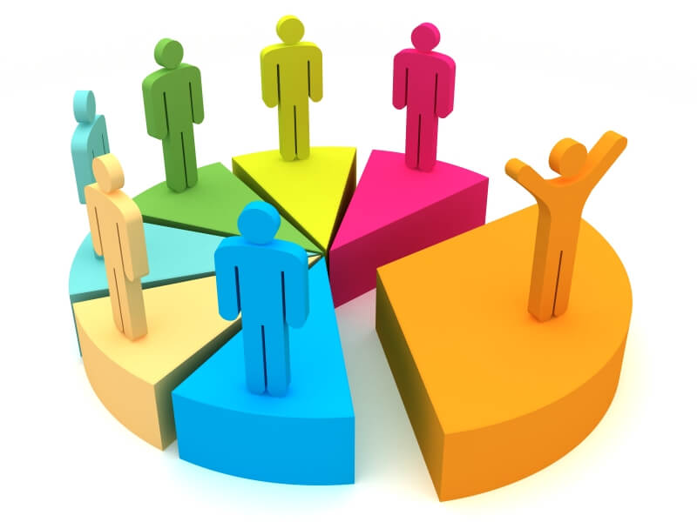
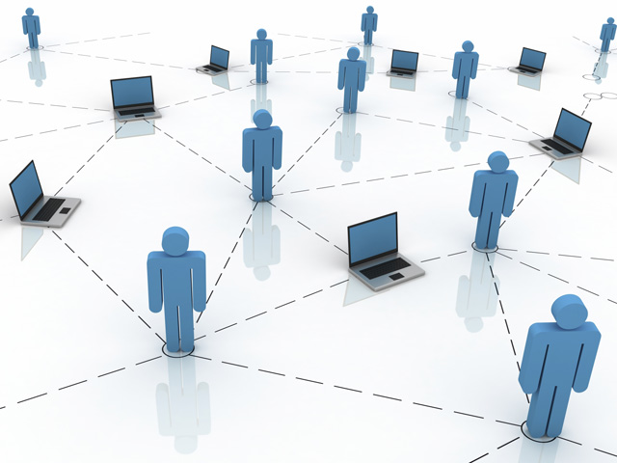

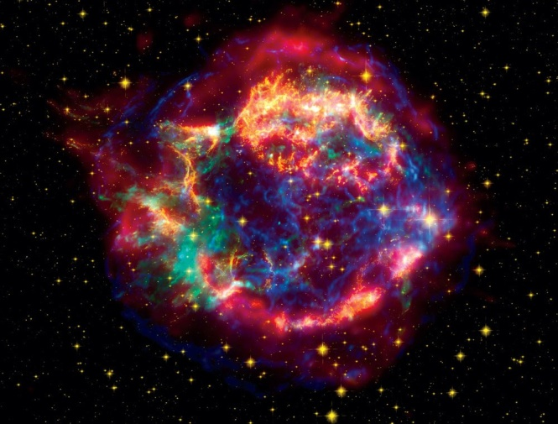
Applications
Market segmentation
Social network analysis
Organize computing clusters
Astronomical data analysis
Notes:
All type + examples + GAN

Slide 10
K-Means Clustering Algorithm
Pictorial Illustration

Slide 11
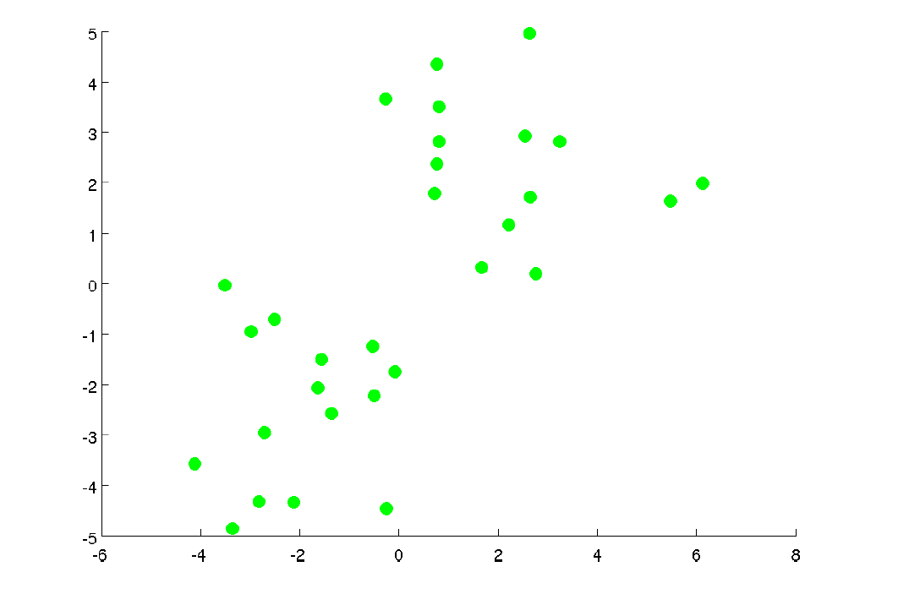

Slide 12
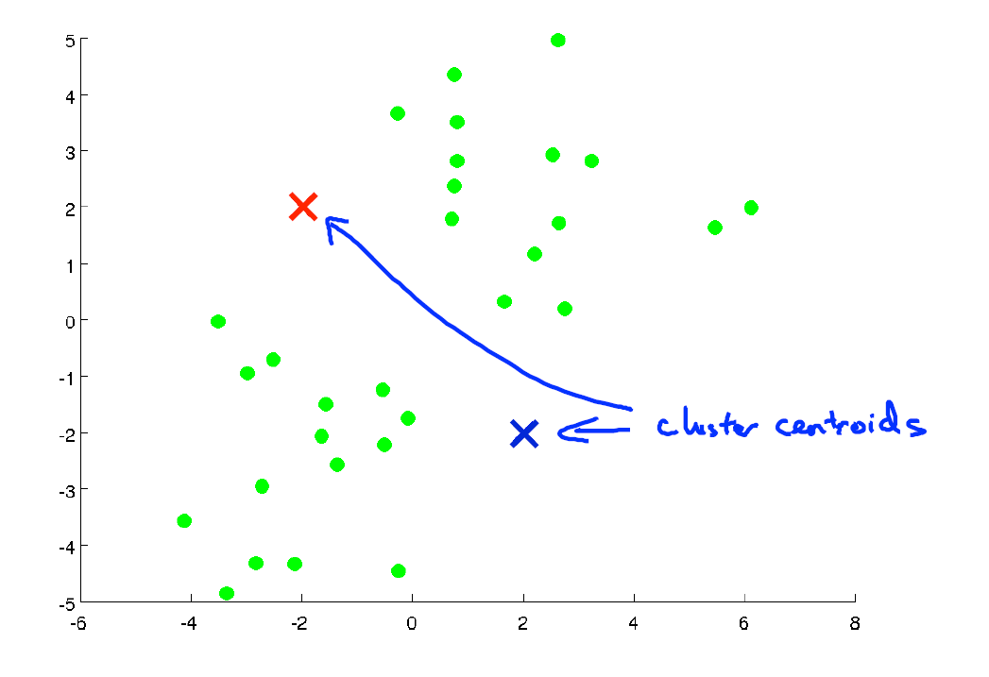

Slide 13
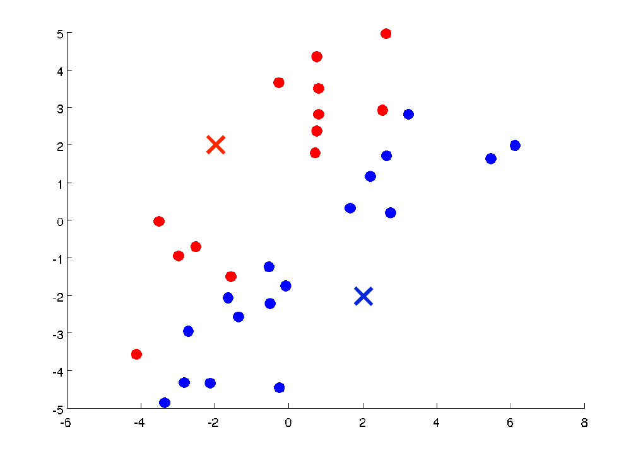

Slide 14
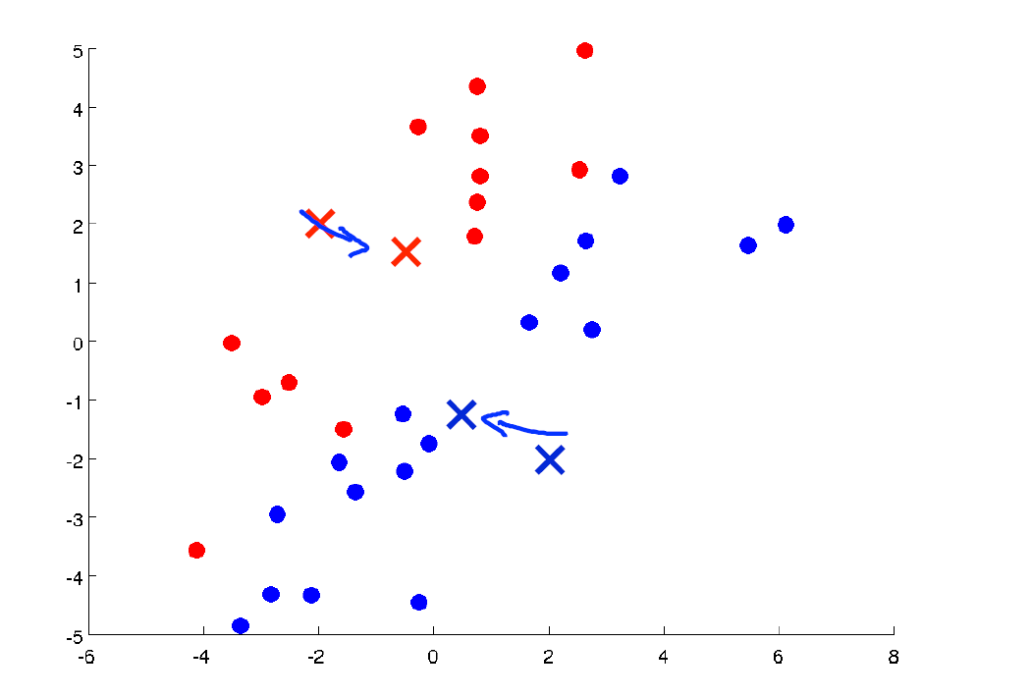

Slide 15
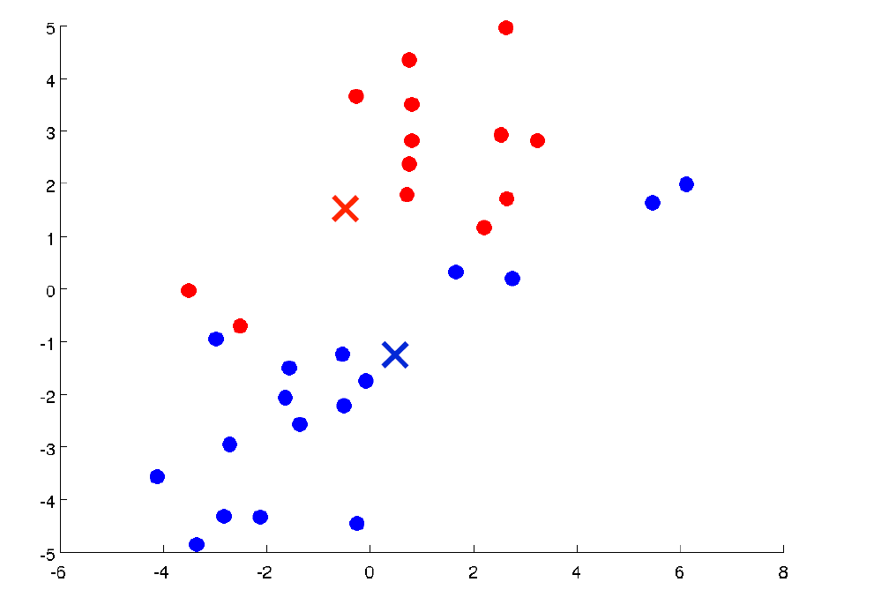

Slide 16
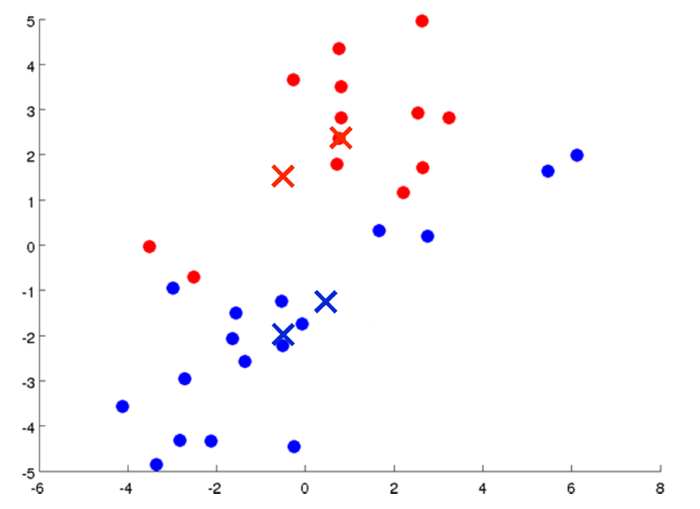

Slide 17
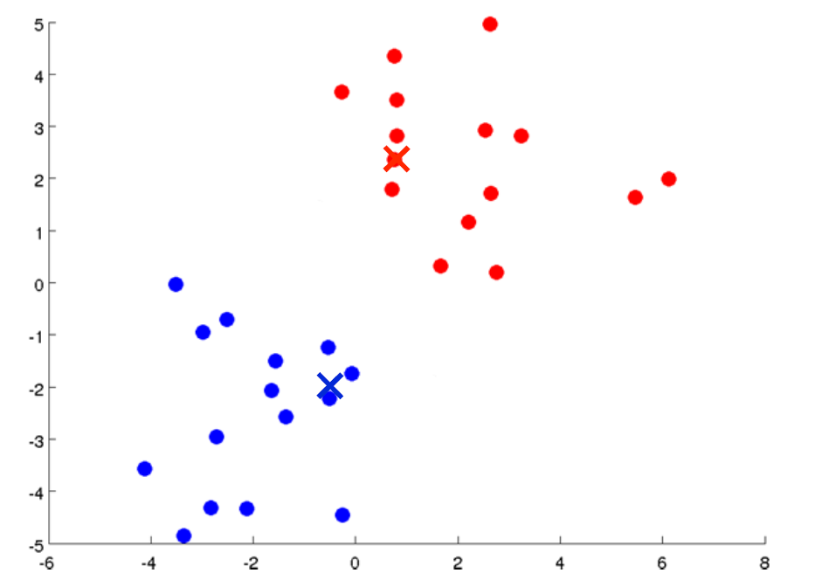

Slide 18
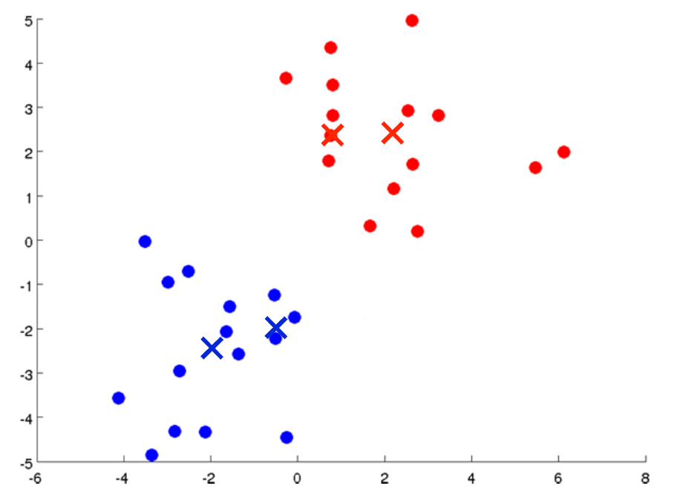

Slide 19
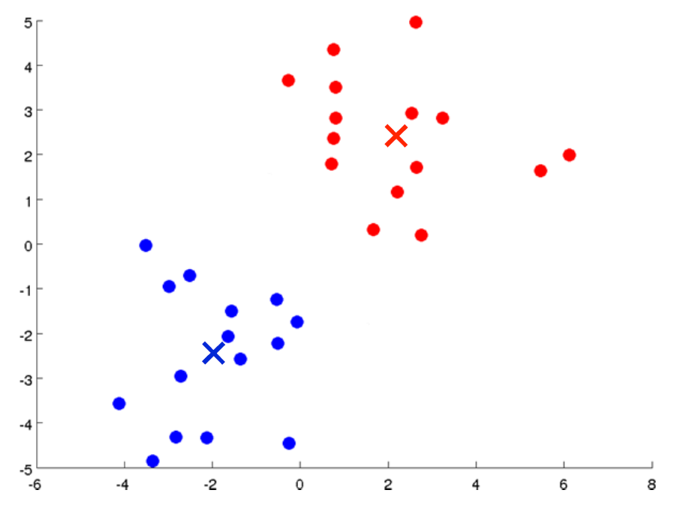

Slide 20
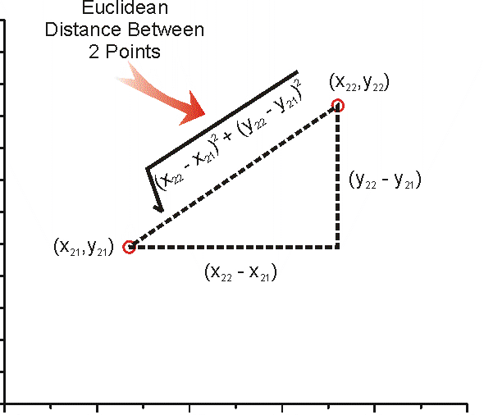

Slide 21
K-means clustering algorithm
Formal Definition

Slide 22
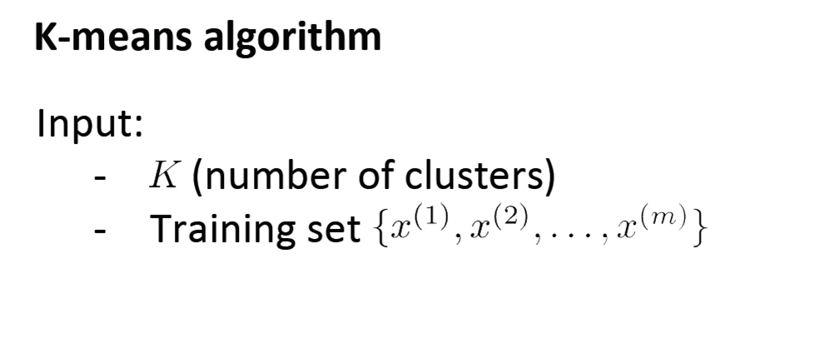

Slide 23
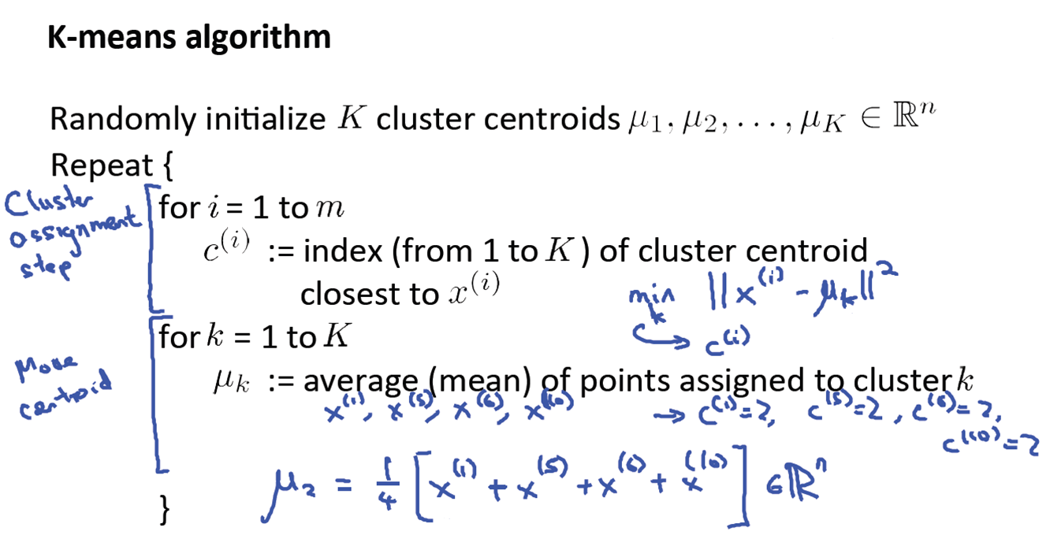

Slide 24
Optimization objective

Slide 25
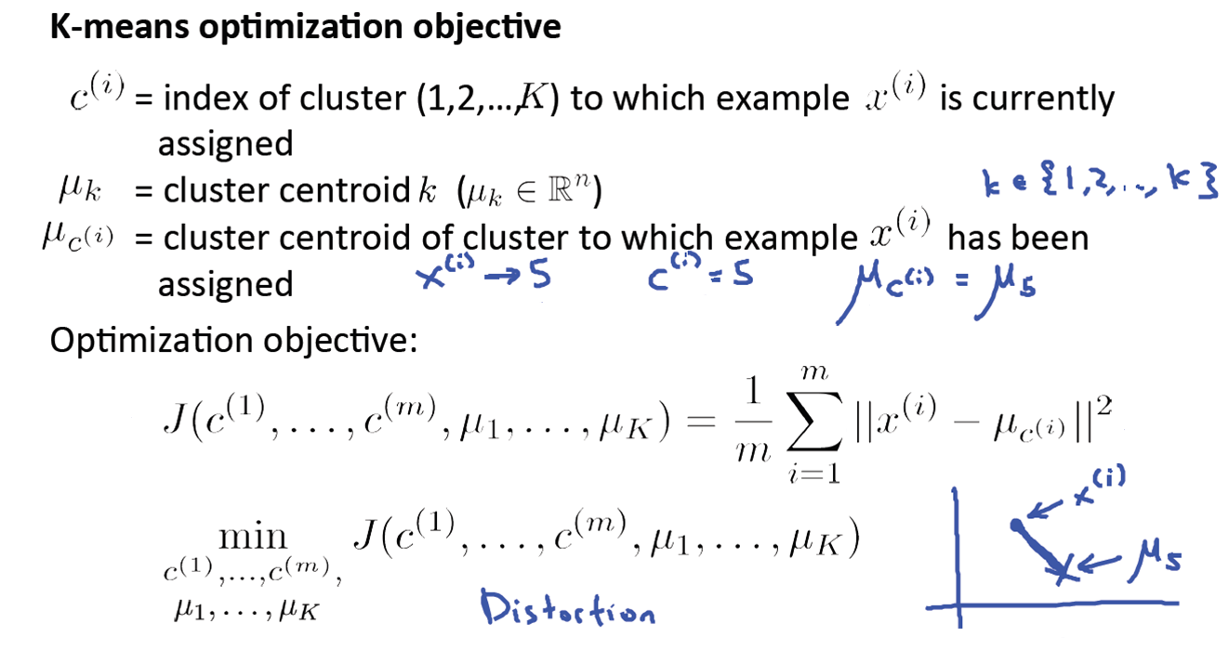

Slide 26
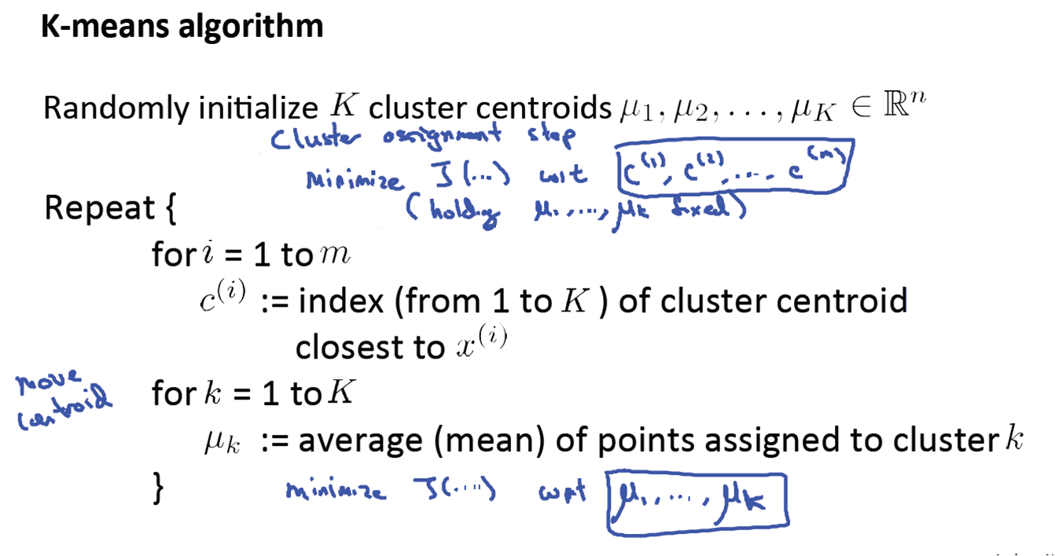

Slide 27
Random initialization

Slide 28
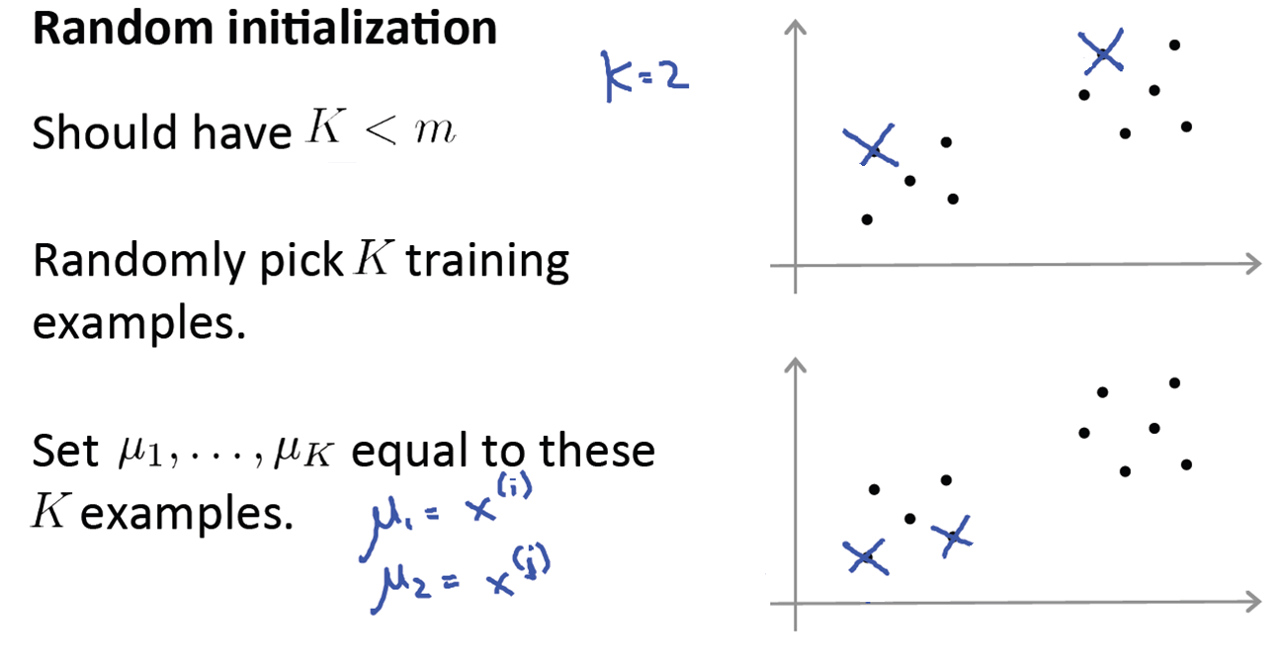

Slide 29
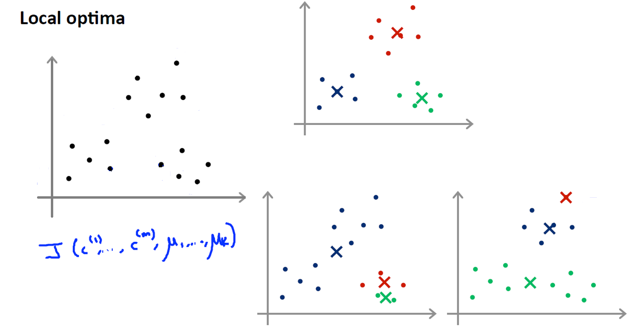

Slide 30
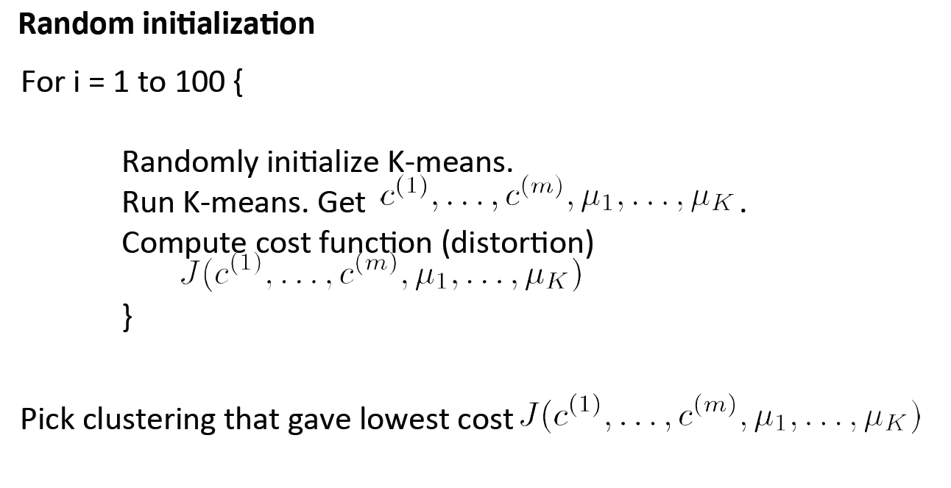

Slide 31
Choosing number of clusters

Slide 32
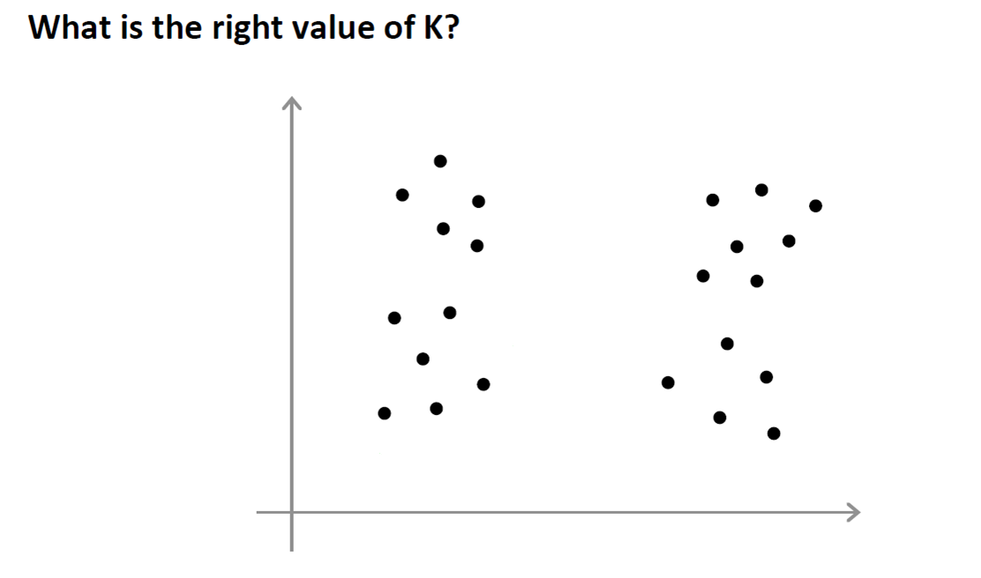

Slide 33
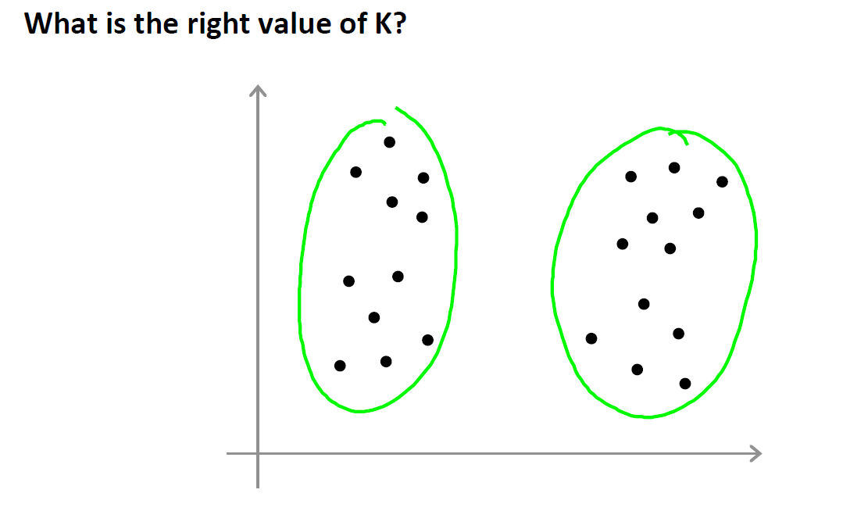

Slide 34
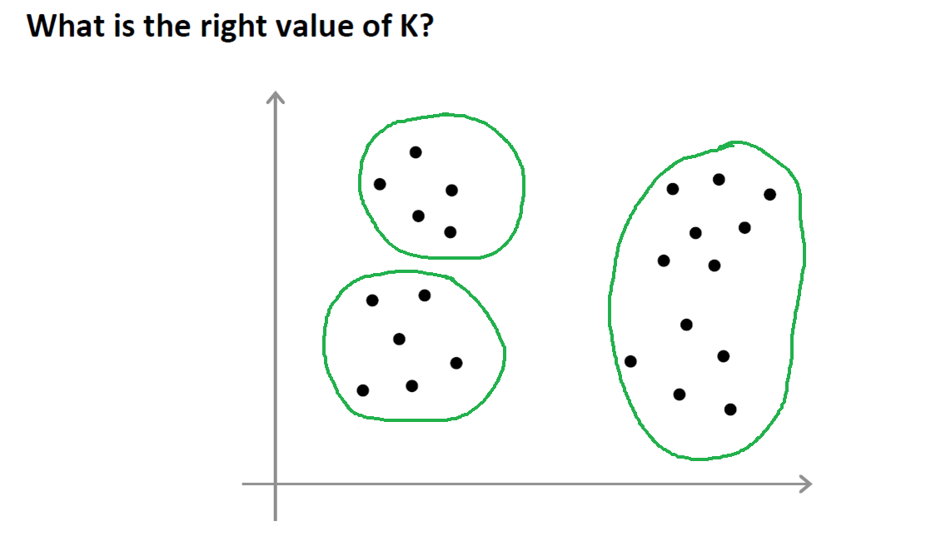

Slide 35
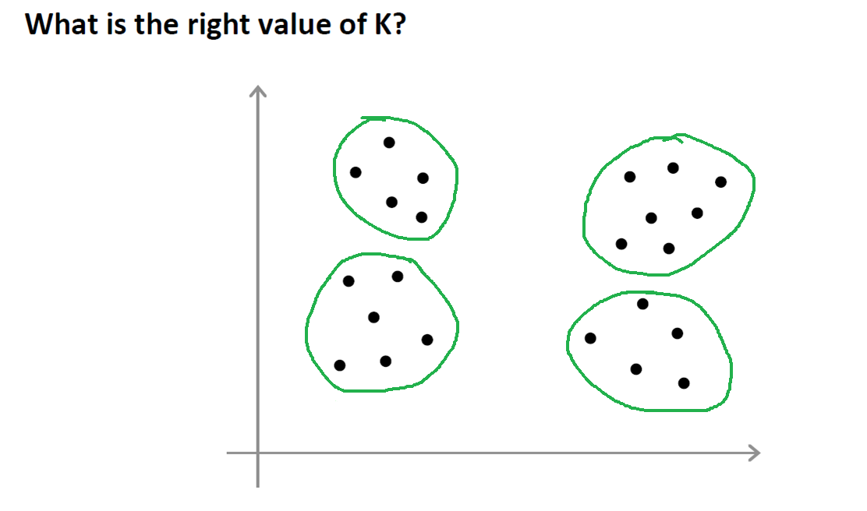

Slide 36
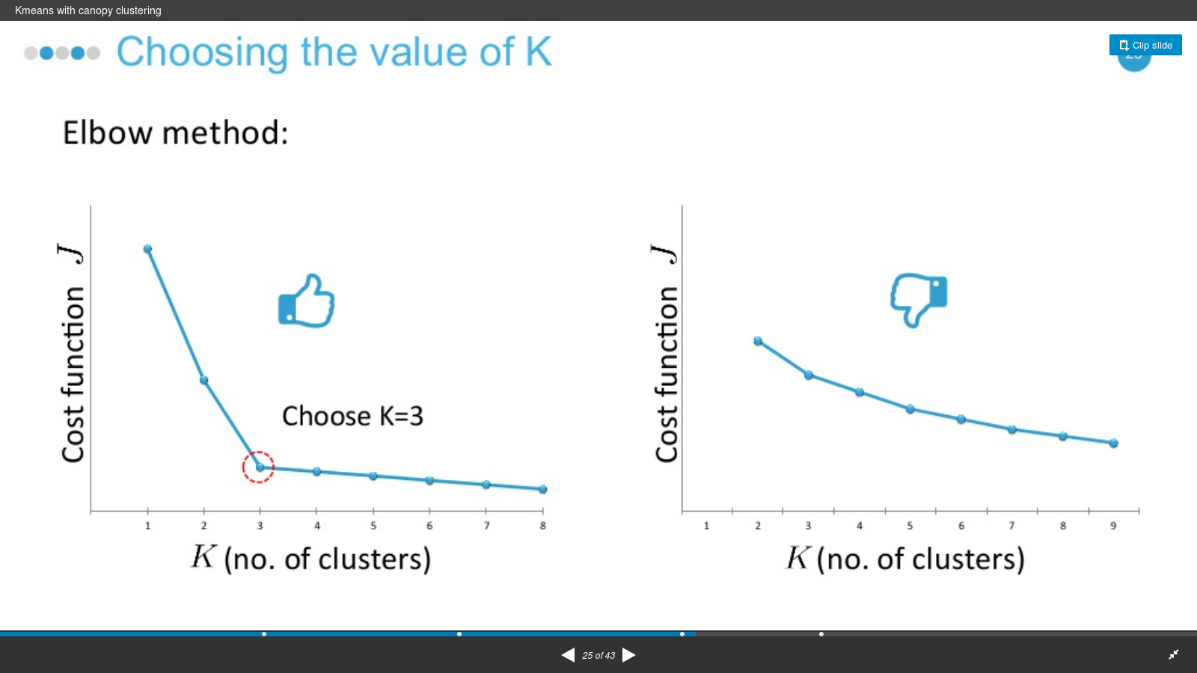

Slide 37
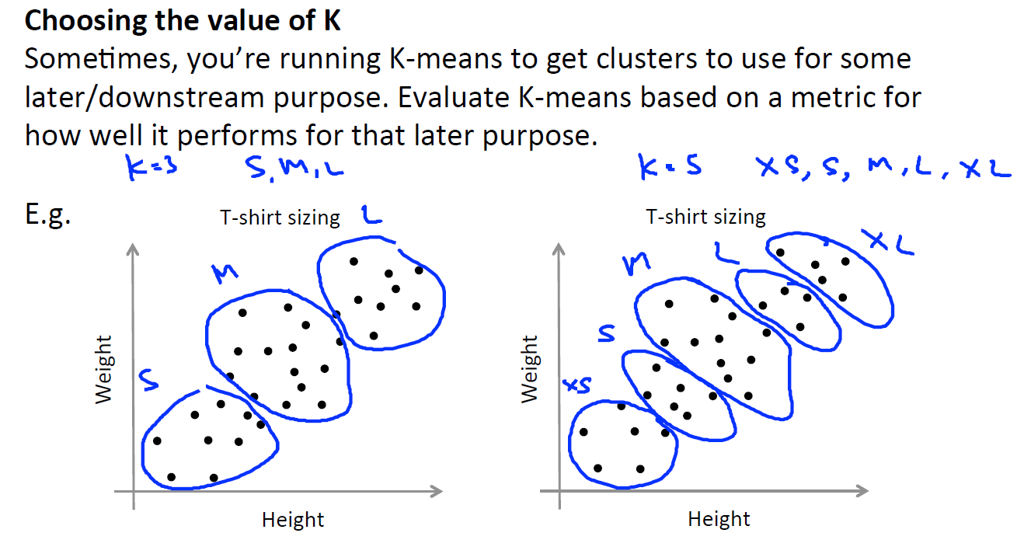

Slide 38
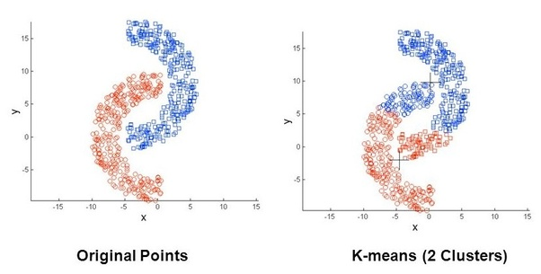
Drawbacks
Difficult to predict the number of clusters k
Initial seeds have strong impact on final results
Forms spherical clusters only, fails in other cases.

Slide 39
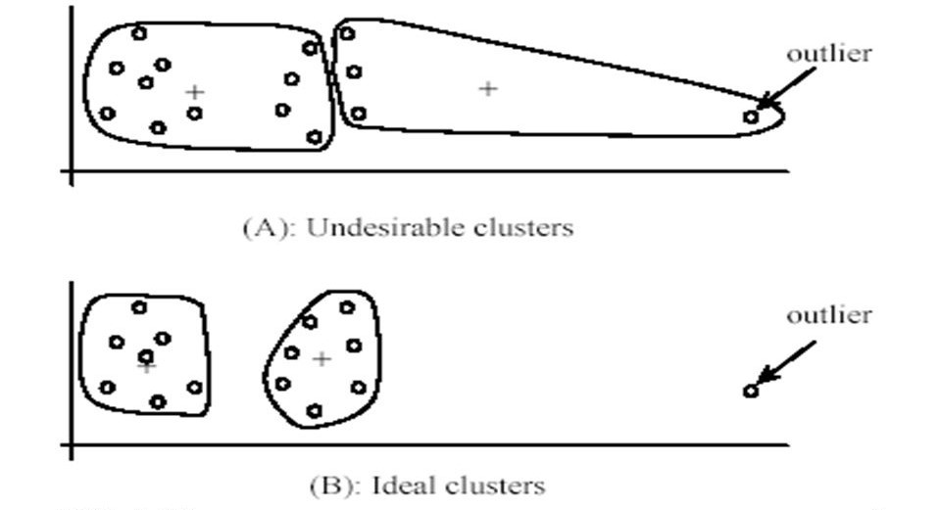
Drawbacks
Cluster are not symmetric, there can be 1 cluster with million rows and another has only 100 records
Sensitive to outliers
Notes:
Imagine we have a dataset containing 2 clusters that are nice, Gaussian point clouds. We want to find 2 clusters in the data using K-means. However, say there's also a single outlier, located very far from either of the 'true' clusters. Maybe millions of times further away from any other point than any other points are to each other. If we chose the centroids to be the centers of the true clusters (the best 'representative' configuration), the value of the loss function would be very high. The loss function is the sum of squared distances from each point to its assigned cluster centroid. It would be high because the outlier is so far from the nearest centroid. Therefore, K-means would reduce the loss function by choosing the outlier itself to be one of centroids, and placing the other centroid somewhere in the middle of the remaining data. This configuration is clearly not representative of the the underlying distribution, but a pathological situation caused by the presence of a single outlier.

Slide 40
Advantages of K-means
Easy to implement
Computationally faster
Works well with spherical clusters

Slide 41
Thank You!!
Questions?

