Slide 1
Decision Tree
Pritam Prakash Shete
Computer Division, BARC
Centre for Excellence in Basic Sciences

Slide 2
Topics
Supervised learning
Decision tree
Optimization functions
Advantages
Disadvantages

Slide 3
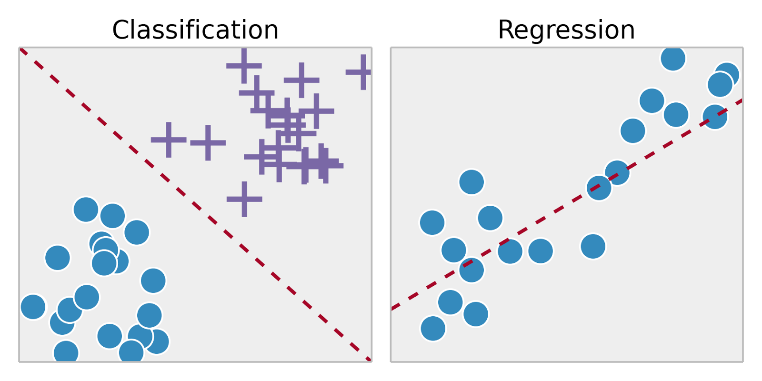
Supervised Learning
Training set – { (x⁽¹⁾,y⁽¹⁾), (x⁽²⁾,y⁽²⁾), …, (x^{(m)},y^{(m)})}
Labeled dataset
Image ack – Google

Slide 4

Decision Tree
Binary tree
Recursively split dataset
Root node
Decision nodes
Select feature
Select split condition
Split dataset
Pure leaf nodes
Class of dataset sample – Classification tree
Value of dataset sample – Regression tree
Image ack – Google

Slide 5
Decision Tree
Greedy algorithm
Select best solution in the current state
No back tracking
No optimal solution
Faster implementation

Slide 6
Decision Tree Types
Classification tree
Regression tree
Classification + Regression tree

Slide 7
Decision Tree Algorithm
Create root node with complete dataset
Find best attribute and value in dataset
Generate decision node
Divide current dataset into subsets
Repeat Steps 2 to 3 until
All nodes are leaf nodes
Further division is not possible

Slide 8
Optimization Functions
Entropy + Information gain
Gini index or Gini impurity
Gain Ratio
Reduction in Variance
Chi-Square

Slide 9
Entropy
Measure of information contained
High entropy – High uncertainty – More info
Less entropy – Less uncertainty – Less info

Slide 10
Entropy
Root node – Highest entropy – 1
Leaf node – Low entropy
Pure node – Lowest entropy – 0

Slide 11
Information Gain
Maximize information gain
Information gain
Entropy
Parent entropy
Weighted child entropy
Weight – Relative size

Slide 12
Gini Index
Gini Impurity
Evaluate accuracy of a split
Value between 0 and 1
Value 0
All observations belong to one class
Value 1
Random distribution of classes

Slide 13
Advantages
Generate understandable rules
Interpretable AI
Classification with less computation
Handle continuous and categorical variables
Indicate feature importance

Slide 14
Disadvantages
Less appropriate for regression task
Over-fitting
Less accurate
Solution – Use random forest algorithm

Slide 15
Questions?
Thank you

