Slide 1
Naive Bayes
Pritam Prakash Shete
Computer Division, BARC
Centre for Excellence in Basic Sciences

Slide 2
Topics
Supervised learning
Conditional probability
Bayes’ rule
Naive Bayes
Laplacian smoothing
Applications
Advantages
Disadvantages

Slide 3
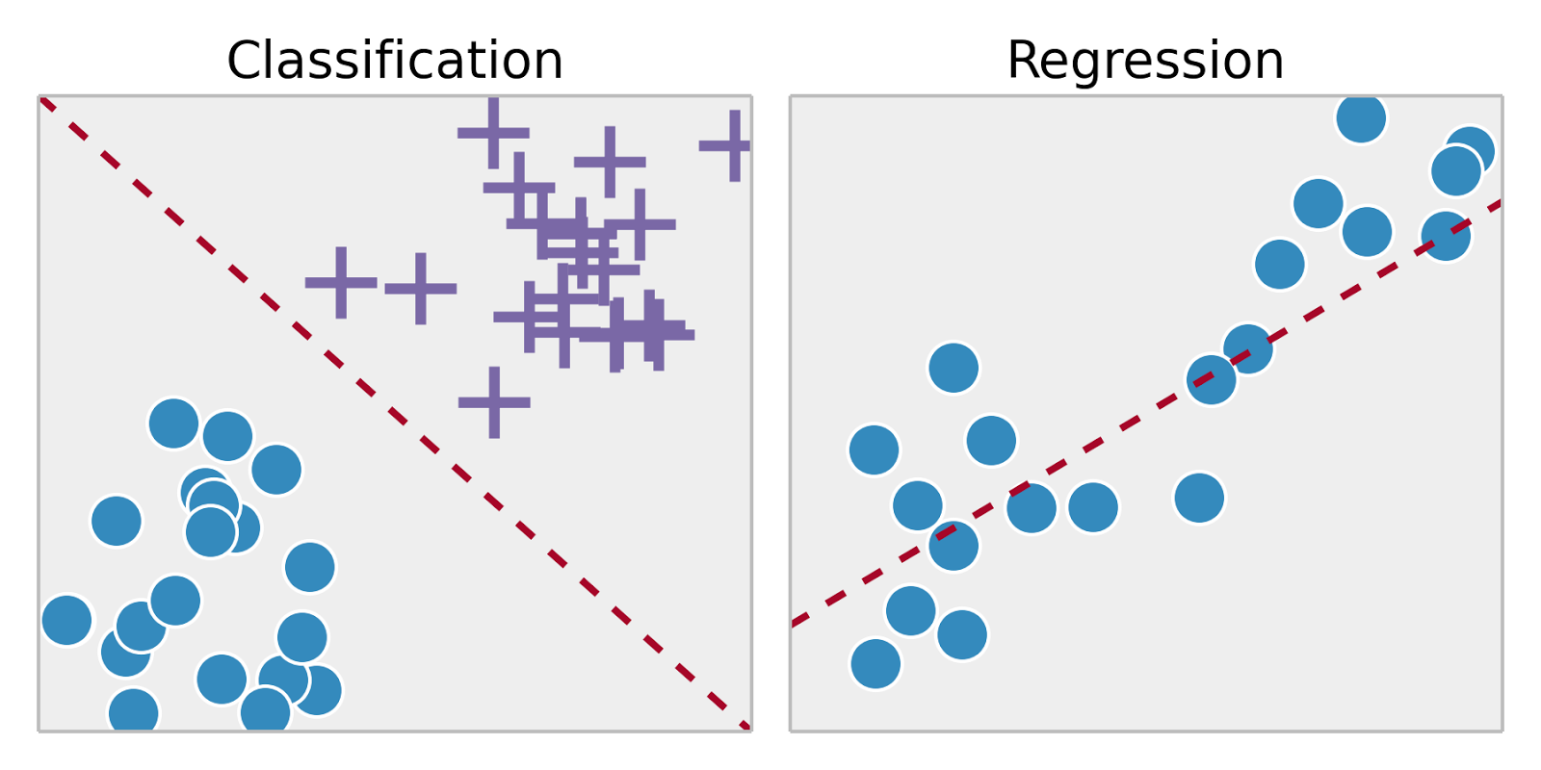
Supervised Learning
Training set – { (x⁽¹⁾,y⁽¹⁾), (x⁽²⁾,y⁽²⁾), …, (x^{(m)},y^{(m)})}
Labeled dataset
Image ack – Google

Slide 4
Probability

Slide 5
Conditional Probability

Slide 6
Bayes’ Rule

Slide 7
Naive Bayes

Slide 8
Laplacian Smoothing

Slide 9
Applications

Slide 10
Advantages

Slide 11
Disadvantages

Slide 12
Questions?
Thank you

