Slide 1
Logistic Regression
Pritam Prakash Shete
Computer Division, BARC
Centre for Excellence in Basic Sciences

Slide 2
Topics
Supervised learning – Binary classification
Sigmoid function
Logistic regression
Gradient descent
Regularization
Confusion matrix
Applications
Advantages
Disadvantages

Slide 3
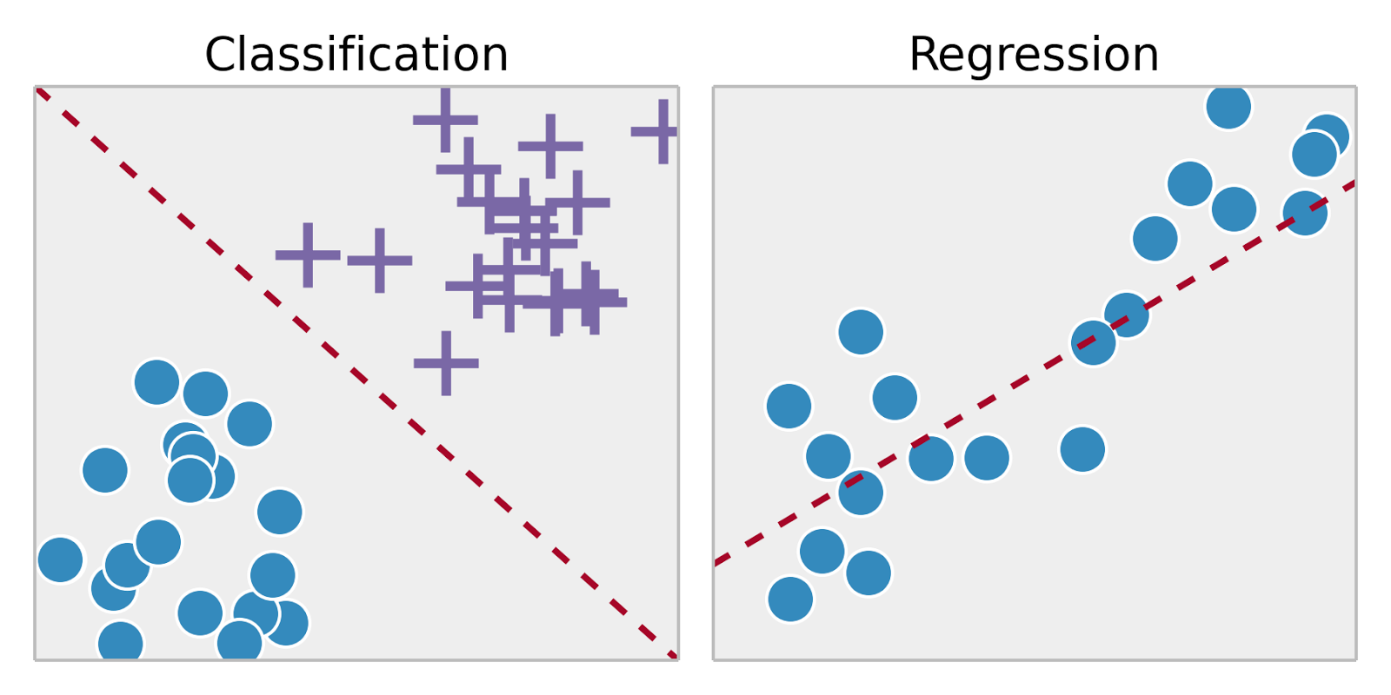
Supervised Learning
Training set – { (x⁽¹⁾,y⁽¹⁾), (x⁽²⁾,y⁽²⁾), …, (x^{(m)},y^{(m)})}
Labeled dataset
Image ack – Google

Slide 4


Binary Classification
Classify elements of given set into two groups
Classify dog and non-dog images
Dog
Non-dog
Image ack – Google

Slide 5
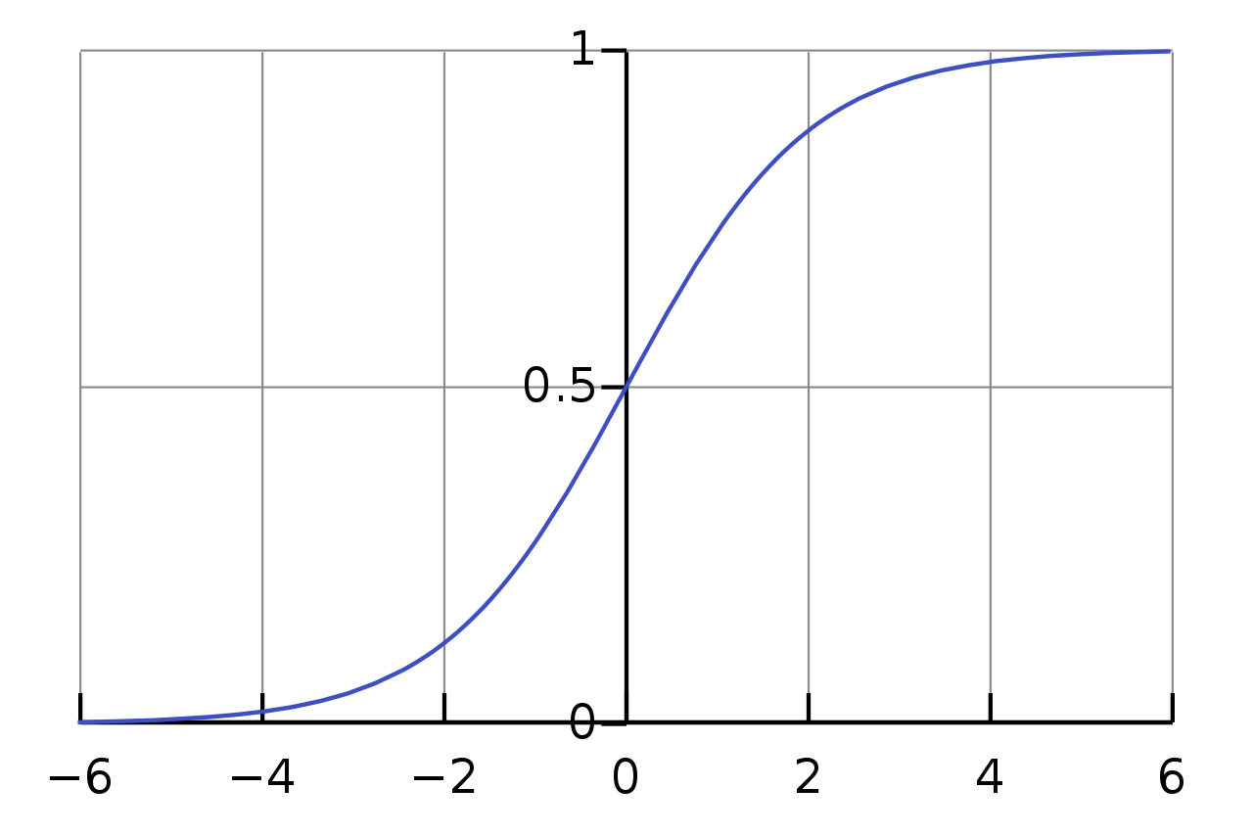
Sigmoid Function

Slide 6
Sigmoid Function
σ(Z) ~ 1 – For Z >> 0
σ(Z) ~ 0 – For Z << 0
σ(Z) = 0.5 – For Z = 0
Z | σ(Z)
-2 | 0.12
-1.5 | 0.18
-1 | 0.27
-0.5 | 0.38
0 | 0.50
0.5 | 0.62
1 | 0.73
1.5 | 0.82
2 | 0.88

Slide 7
Logistic Regression
Input – X
Vector
X ε R
Dimension – n_{X}
Output – ŷ
Scalar
0 <= ŷ <= 1.0

Slide 8
Linear Regression
Weights – W
Vector
W ε R
Dimension – n_{X}
Bias – b
Scalar
b ε R
y = W^{T}X + b

Slide 9
Logistic Regression
Weights – W
Vector
W ε R
Dimension – n_{X}
Bias – b
Scalar
b ε R
y = W^{T}X + b

Slide 10
Logistic Regression
Weights – W
Vector
W ε R
Dimension – n_{X}
Bias – b
Scalar
b ε R
Z = W^{T}X + b
ŷ = σ(Z) – Activation (sigmoid) function
x₁
W₁
+b
W₂
x₂
ŷ
activation
x₃
W₃

Slide 11
Logistic Regression
Weights – W
Vector
W ε R
Dimension – n_{X}
Bias – b
Scalar
b ε R
Z = W^{T}X + b
ŷ = P( y=1 | X)

Slide 12
Loss Function
Input dataset
{ (x⁽¹⁾,y⁽¹⁾), (x⁽²⁾,y⁽²⁾), …, (x^{(m)},y^{(m)})}
Equations
Z = W^{T}X + b
ŷ = σ(Z) = y_{p}
Output
ŷ^{(i)} ~ y^{(i)}
W and b

Slide 13
Loss Function
L(ŷ, y) = – y * log(ŷ) – (1 – y) * log(1 – ŷ)

Slide 14
Loss Function
L(ŷ, y) = – y * log(ŷ) – (1 – y) * log(1 – ŷ)
y = 1
L(ŷ, y) = – log(ŷ)
– log(ŷ) – Minimize
log(ŷ) – Maximize
ŷ – Maximize
ŷ – 1.0

Slide 15
Loss Function
L(ŷ, y) = – y * log(ŷ) – (1 – y) * log(1 – ŷ)
y = 0
L(ŷ, y) = – log(1 – ŷ)
– log(1 – ŷ) – Minimize
log(1 – ŷ) – Maximize
1 – ŷ – Maximize
ŷ – Minimize
ŷ – 0.0

Slide 16
Loss Function
Loss function
One sample – i^{th} sample
L(ŷ^{(i)}, y^{(i)}) = – y^{(i)} * log(ŷ^{(i)}) – (1 – y^{(i)}) * log(1 – ŷ^{(i)})
Cost function
Average of loss function for all samples

Slide 17
Gradient Descent
Input dataset – { (x⁽¹⁾,y⁽¹⁾), (x⁽²⁾,y⁽²⁾), …, (x^{(m)},y^{(m)}) }
Equations – Z = W^{T}X + b and ŷ = σ(Z) = y_{p}
Loss function – L(ŷ, y) = – y*log(ŷ) – (1–y)*log(1–ŷ)
Cost function –
Output
ŷ^{(i)} ~ y^{(i)}
W and b – Minimize J(W, b)

Slide 18
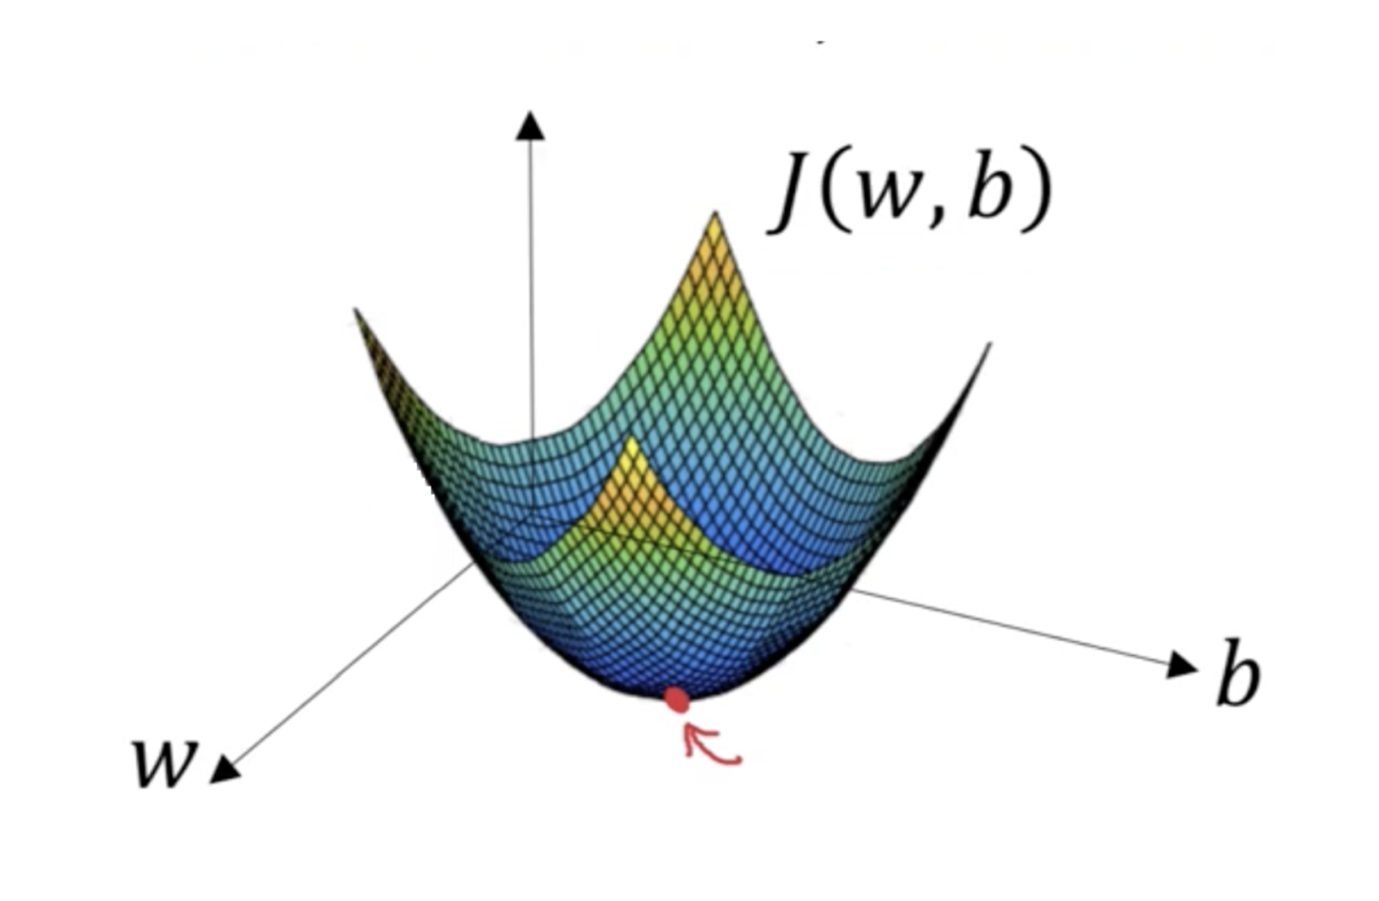
Gradient Descent
Convex function
Global optimum

Slide 19
Gradient Descent
Forward pass
Z^{[1]}= W^{[1]}a^{[0]} + b^{[1]}
ŷ = a^{[1]} = σ(Z^{[1]})
L(ŷ^{(i)}, y^{(i)})
J(W^{[1]}, b^{[1]})
Backward pass

Slide 20
Gradient Descent
Forward pass
Z^{[1]}= W^{[1]}a^{[0]} + b^{[1]}
ŷ = a^{[1]} = σ(Z^{[1]})
L(ŷ^{(i)}, y^{(i)})
J(W^{[1]}, b^{[1]})
Backward pass

Slide 21
Gradient Descent
Forward pass
Z^{[1]}= W^{[1]}a^{[0]} + b^{[1]}
ŷ = a^{[1]} = σ(Z^{[1]})
L(ŷ^{(i)}, y^{(i)})
J(W^{[1]}, b^{[1]})
Backward pass

Slide 22
Gradient Descent
Forward pass
Z^{[1]}= W^{[1]}a^{[0]} + b^{[1]}
ŷ = a^{[1]} = σ(Z^{[1]})
L(ŷ^{(i)}, y^{(i)})
J(W^{[1]}, b^{[1]})
Backward pass

Slide 23
Gradient Descent
Forward pass
Z^{[1]}= W^{[1]}a^{[0]} + b^{[1]}
ŷ = a^{[1]} = σ(Z^{[1]})
L(ŷ^{(i)}, y^{(i)})
J(W^{[1]}, b^{[1]})
Backward pass

Slide 24
Gradient Descent
Forward pass
Z^{[1]}= W^{[1]}a^{[0]} + b^{[1]}
ŷ = a^{[1]} = σ(Z^{[1]})
L(ŷ^{(i)}, y^{(i)})
J(W^{[1]}, b^{[1]})
Backward pass

Slide 25
Gradient Descent
Forward pass
Z^{[1]}= W^{[1]}a^{[0]} + b^{[1]}
ŷ = a^{[1]} = σ(Z^{[1]})
L(ŷ^{(i)}, y^{(i)})
J(W^{[1]}, b^{[1]})
Backward pass

Slide 26
Gradient Descent
Forward pass
Z^{[1]}= W^{[1]}a^{[0]} + b^{[1]}
ŷ = a^{[1]} = σ(Z^{[1]})
L(ŷ^{(i)}, y^{(i)})
J(W^{[1]}, b^{[1]})
Backward pass

Slide 27
Gradient Descent
Forward pass
Z^{[1]}= W^{[1]}a^{[0]} + b^{[1]}
ŷ = a^{[1]} = σ(Z^{[1]})
L(ŷ^{(i)}, y^{(i)})
J(W^{[1]}, b^{[1]})
Backward pass

Slide 28
Gradient Descent
Forward pass
Z^{[1]}= W^{[1]}a^{[0]} + b^{[1]}
ŷ = a^{[1]} = σ(Z^{[1]})
L(ŷ^{(i)}, y^{(i)})
J(W^{[1]}, b^{[1]})
Backward pass

Slide 29
Gradient Descent
Forward pass
Z^{[1]}= W^{[1]}a^{[0]} + b^{[1]}
ŷ = a^{[1]} = σ(Z^{[1]})
L(ŷ^{(i)}, y^{(i)})
J(W^{[1]}, b^{[1]})
Backward pass

Slide 30
Regularization
Lasso regression
Ridge Regression
Elastic Net Regression

Slide 31
Lasso Regression
Least Absolute Shrinkage Selector Operator
L1 regularization technique
Reduce coefficients
Feature selection
Select important features
Reduce coefficients of others to zero
Suitable for more number of features

Slide 32
Ridge Regression
L2 regularization technique
Reduce coefficients
Reduce model complexity
Prevent multicollinearity

Slide 33
Elastic Net Regression
L1 and L2 regularization technique

Slide 34
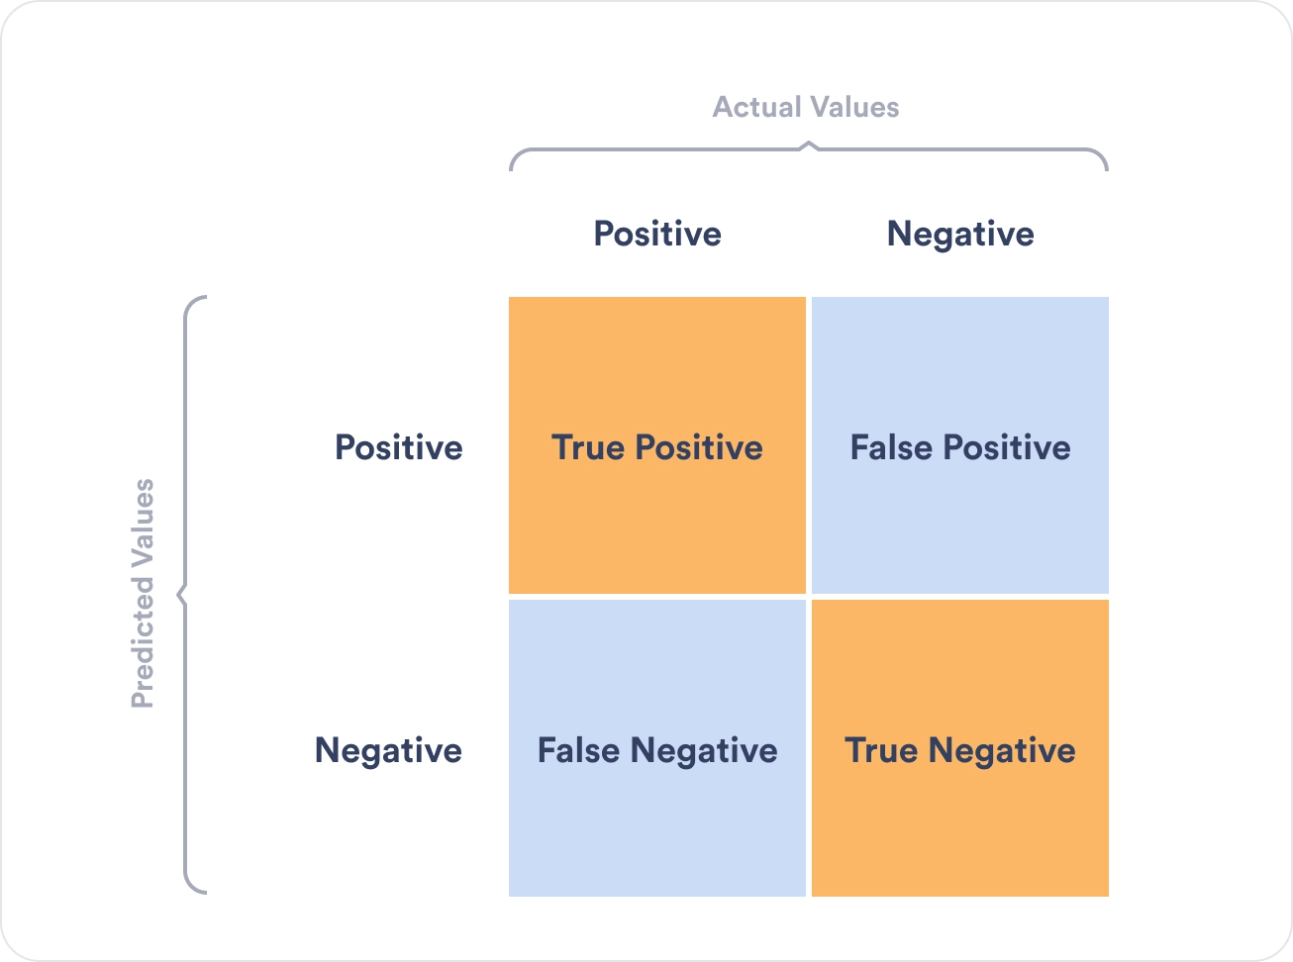
Confusion Matrix
Image ack – Google

Slide 35
Confusion Matrix
True positive
Actual positive
Predicted positive
False positive – Type 1 error
Actual negative
Predicted positive
False negative – Type 2 error
Actual positive
Predicted negative
True negative
Actual negative
Predicted negative

Slide 36
Confusion Matrix
Accuracy
(TP + TN) /(TP + TN + FP + FN)
Recall
(TP) / (TP + FN)
Precision
(TP) / (TP + FP)
F1 score
(2 × Recall × Precision) / ( Recall + Precision)

Slide 37
Applications
Binary classification
Positive class and negative class

Slide 38
Advantages
Easy to implement and interpret
Efficient to train
No assumptions about distributions of classes
Can be extended to multiple classes
Good accuracy for linearly separable dataset

Slide 39
Disadvantages
Overfit for small dataset
Construct linear boundaries
Assumption of linearity
Independent variables
Dependent variables
Cannot solve non linear problems

Slide 40
Questions?
Thank you

