Slide 1
Support Vector Machine
Pritam Prakash Shete
Computer Division, BARC
Centre for Excellence in Basic Sciences

Slide 2
Topics
Supervised learning – Classification model
Maximal Margin Classifier
Cross Validation
Support Vector Classifier
Support Vector Machine
Kernel Functions
Applications
Advantages
Disadvantages

Slide 3
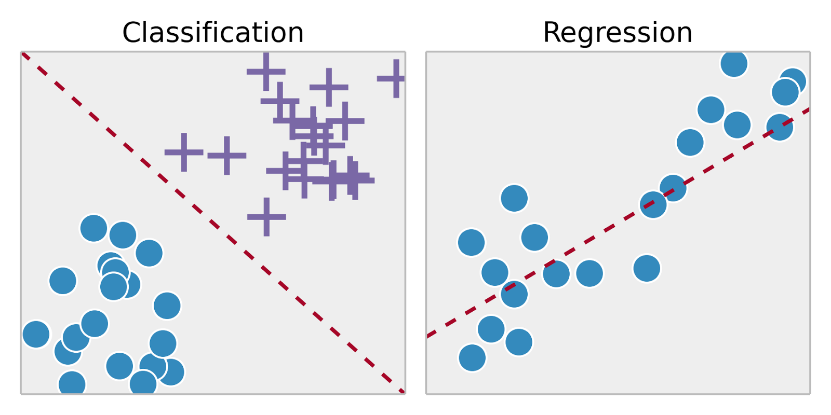
Supervised Learning
Training set – { (x⁽¹⁾,y⁽¹⁾), (x⁽²⁾,y⁽²⁾), …, (x^{(m)},y^{(m)})}
Labeled dataset
Image ack – Google

Slide 4
Maximal Margin Classifier

Slide 5
Cross Validation

Slide 6
Support Vector Classifier
Soft Margin

Slide 7
Support Vector Machine

Slide 8
Kernel Functions

Slide 9
Applications

Slide 10
Advantages

Slide 11
Disadvantages

Slide 12
Questions?
Thank you

