Slide 1
Naive Bayes
Pritam Prakash Shete
Computer Division, BARC
Centre for Excellence in Basic Sciences

Slide 2
Topics
Supervised learning
Conditional probability
Bayes’ rule
Naive Bayes
Laplacian smoothing
Prior ratio
Log likelihood
Applications
Advantages
Disadvantages

Slide 3
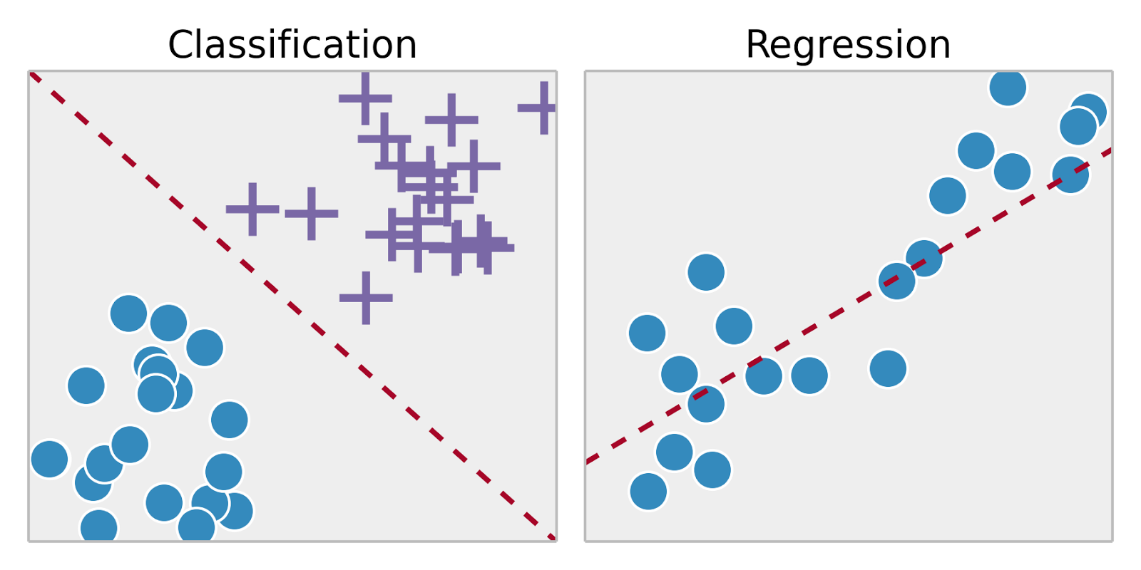
Supervised Learning
Training set – { (x⁽¹⁾,y⁽¹⁾), (x⁽²⁾,y⁽²⁾), …, (x^{(m)},y^{(m)})}
Labeled dataset
Image ack – Google

Slide 4
Probability
SMS spam detection
Corpus of SMSs
Events – Ham SMS or Spam SMS
Name | Value
N_{Total} | 1000
N_{Ham} | 800
N_{Spam} | 200
P(Ham) | 0.8 (80%)
P(Spam) | 0.2 (20 %)

Slide 5
Probability
SMS spam detection
Corpus of SMSs
Event – SMS contains word ‘discount’
Name | Value
N_{Total} | 1000
N_{discount} | 20
P(discount) | 0.02 (2 %)

Slide 6
Conditional Probability
Corpus
Ham
Spam
discount

Slide 7
Conditional Probability
Event – SMS – Spam
Event – SMS – ‘discount’
Intersection – Spam and ‘discount’
Probability that SMS is Spam, given SMS contains word ‘discount’.
Probability that SMS is Spam and SMS contains word ‘discount’.

Slide 8
Bayes’ Rule
Event – SMS – Spam
Event – SMS – ‘discount’
Intersection – Spam and ‘discount’

Slide 9
Bayes’ Rule
Event – SMS – Spam
Event – SMS – ‘discount’
Intersection – Spam and ‘discount’

Slide 10
Bayes’ Rule
Event – SMS – Spam
Event – SMS – ‘discount’
Intersection – Spam and ‘discount’

Slide 11
Naive Bayes
SMS spam detection
Corpus
Ham corpus
Spam corpus
Vocabulary
All words
Ham and Spam corpus
Word | Ham | Spam
I | 400 | 400
am | 400 | 400
because | 50 | 0
meeting | 200 | 100
company | 350 | 100
discount | 100 | 200
lottery | 100 | 400
1600 | 1600

Slide 12
Naive Bayes
SMS spam detection
Corpus
Ham corpus
Spam corpus
Vocabulary
All words
Ham and Spam corpus
Word | Ham | Spam
I | 0.25 | 0.25
am | 0.25 | 0.25
because | 0.03125 | 0
meeting | 0.125 | 0.0625
company | 0.21875 | 0.0625
discount | 0.0625 | 0.125
lottery | 0.0625 | 0.25
1600 | 1600

Slide 13
Naive Bayes
SMS spam detection
Corpus
Ham corpus
Spam corpus
Vocabulary
All words
Ham and Spam corpus
Word | Ham | Spam
I | 400 | 400
am | 400 | 400
because | 50 | 0
meeting | 200 | 100
company | 350 | 100
discount | 100 | 200
lottery | 100 | 400
1600 | 1600

Slide 14
Naive Bayes
SMS spam detection
Corpus
Ham corpus
Spam corpus
Vocabulary
All words
Ham and Spam corpus
Word | Ham | Spam
I | 0.25 | 0.25
am | 0.25 | 0.25
because | 0.03125 | 0
meeting | 0.125 | 0.0625
company | 0.21875 | 0.0625
discount | 0.0625 | 0.125
lottery | 0.0625 | 0.25

Slide 15
Naive Bayes
Identical probabilities
Neutral words
I, am
Significant words
Power words
meeting, company
discount, lottery
Table of probabilities
Word | Ham | Spam
I | 0.25 | 0.25
am | 0.25 | 0.25
because | 0.03125 | 0
meeting | 0.125 | 0.0625
company | 0.21875 | 0.0625
discount | 0.0625 | 0.125
lottery | 0.0625 | 0.25

Slide 16
Naive Bayes
Word | Ham | Spam
I | 0.25 | 0.25
am | 0.25 | 0.25
because | 0.03125 | 0
meeting | 0.125 | 0.0625
company | 0.21875 | 0.0625
discount | 0.0625 | 0.125
lottery | 0.0625 | 0.25
I am in meeting.
Ham

Slide 17
Naive Bayes
Word | Ham | Spam
I | 0.25 | 0.25
am | 0.25 | 0.25
because | 0.03125 | 0
meeting | 0.125 | 0.0625
company | 0.21875 | 0.0625
discount | 0.0625 | 0.125
lottery | 0.0625 | 0.25
You got discount.
Spam

Slide 18
Laplacian Smoothing
Word count – 0
Probability of word – 0
Probability of sentence – 0
e.g.
Word ‘because’ – Spam

Slide 19
Laplacian Smoothing
Word | Ham | Spam
I | 0.2495 | 0.2495
am | 0.2495 | 0.2495
because | 0.0317 | 6.2e-4
meeting | 0.125 | 0.0628
company | 0.2184 | 0.0628
discount | 0.0628 | 0.125
lottery | 0.0628 | 0.2495

Slide 20
Prior Ratio
Number of Ham (positive) SMSs
Number of Spam (negative) SMSs
Ratio of number of Ham and Spam SMSs

Slide 21
Log Likelihood – Why ?
Ratio of probabilities
Neutral words
~1.
Positive words
> 1 – Larger than 1
Negative words
< 1 – Less than 1
Multiplication
Numerical underflow

Slide 22
Log Likelihood – How ?
Logarithm of ratio of probability
Log likelihood
Addition of logarithms
No numerical underflow
Word classification
Neutral words – ~0
Positive words – > 0
Negative words – < 0
Logprior

Slide 23
Applications
Spam detection
Text classification
Author identification
Word disambiguation
Sentiment analysis

Slide 24
Advantages
Simple
Easy to implement
Real-time predictions
Work with less training dataset
Continuous and discrete data
Not sensitive to irrelevant features

Slide 25
Disadvantages
Assume independent features

Slide 26
Questions?
Thank you

