Slide 1
VELLORE INSTITUTE OF TECHNOLOGY, VELLORE
School of Computer Science and Engineering (SCOPE)
BCSE303P · Operating Systems Laboratory · Project Review 2
CHIMERA
Delay-Aware Predictive Coupled Autoscaling for Kubernetes
A joint horizontal + vertical pod autoscaler that treats resource scaling as a delay-aware optimal control problem.
SUBMITTED BY
Adithyan C S S
Vishal B S
Madhan A
September 2026
24BCE2820
24BCE2475
24BCE0159
Notes:
Open by naming the OS connection: this is resource scheduling and allocation under actuation delay. Kubernetes decides how many pods and how much CPU each gets — a classic OS resource-management problem, just at cluster scale.

Slide 2
OVERVIEW
Presentation outline
01
Problem statement
07
Positioning against related work
02
System design & architecture
08
Engineering verification
03
Core algorithm — the control law
09
Kubernetes integration
04
Datasets & experimental setup
10
Outputs & live demonstration
05
Module identification & completion
11
Limitations & future work
06
Results & analysis
12
Conclusion
VIT Vellore · BCSE303P Operating Systems Laboratory · CHIMERA · Review 2
2 / 21
Notes:
Twelve sections. The core contribution is in sections 2 and 3; the evidence is in 6 and 8.

Slide 3
PROBLEM STATEMENT
Two actuators, two very different delays
Kubernetes can add replicas (horizontal) or resize a running container's CPU (vertical). Production systems run both loops independently, so they fight: each sees the other's correction as new error and over-reacts.
RESEARCH QUESTION
Can both actuators be driven by a single optimal control law that explicitly models the delay mismatch — instead of two heuristic loops that fight?
20.0 s
0.1 s
Horizontal delay — schedule and boot a new pod
Vertical delay — in-place CPU resize (KEP-1287)
Target
Coordinate v (CPU per pod) and h (replica count)
Constraint
Meet a 500 ms latency SLO at minimum resource cost
A 200× delay asymmetry. A controller blind to it either over-shoots while waiting for pods to boot, or oscillates when they all arrive at once.
VIT Vellore · BCSE303P Operating Systems Laboratory · CHIMERA · Review 2
3 / 21
Notes:
The 200× number is the whole motivation. Vertical is fast but capped by node size; horizontal is unbounded but slow. Neither alone is enough, and running both naively is worse than either.

Slide 4
SYSTEM DESIGN & ARCHITECTURE
Three pipelines, one control loop every 15 seconds
1 · PREDICTION
Workload trace
Azure Functions
Feature extractor
11 rolling stats
CQR forecast
load + interval
ADWIN
drift monitor
forecast load + interval width
2 · CONTROL
Target split
x* = [v*, h*]
EMA smoothing
anti-chatter
Augmented error
e = [v−v*, h−h*, dh₋₁]
LQR gain
u = −K·e (DARE)
CLF safety filter
rejects unsafe moves
u = [dv, dh]
pending commands fed back (our contribution)
3 · ACTUATION
Vertical resize
0.1 s · 5 s inner loop
Horizontal scale
20 s pod boot
Command buffer
dh(t−1) (one slot)
Cluster
SimPy sim / K8s operator
Key idea: pods already ordered but still booting are fed back into the controller, so it never orders the same capacity twice. A 5 s inner loop moves only the 0.1 s CPU actuator: up on a surge, back down as soon as the load falls — capacity tracks demand between the 15 s joint steps.
VIT Vellore · BCSE303P Operating Systems Laboratory · CHIMERA · Review 2
4 / 21
Notes:
Three stages running in a loop every fifteen seconds: we predict the load, decide how much CPU and how many pods, and act. The important arrow is the amber one. Pods take twenty seconds to start; this arrow feeds pending orders back into the controller so it knows capacity is on the way and doesn't order more. That's the part that's new.

Slide 5
CORE ALGORITHM
The delay-augmented control law
LQR assumes actions act at once. A pod boots in 20 s and is first seen two 15 s ticks later, so the state carries the one command still in flight; h counts only serving pods, so nothing is counted twice.
WHY THIS MATTERS
R penalises horizontal movement 20× more than vertical, so the controller reaches for the fast actuator first during a spike.
The conformal interval width relaxes the safety bound exactly when the forecast is uncertain.
K is fixed: computing u = −K·e is a matrix–vector product, not an online optimisation.
Augmented error state
e(t) = [ v−v*, h_serving−h*, dh(t−1) ]
System dynamics
e(t+1) = A_aug·e(t) + B_aug·u(t)
Optimal gain (DARE)
K = (R + BᵀPB)⁻¹ BᵀPA
Nominal action
u = −K·e(t)
Q = diag(30, 10, 0)
R = diag(0.05, 1.0)
σ = 0.1 ζ = 0.5 Δt = 15 s
Lyapunov safety bound
V(e⁺) − V(e) ≤ −σ‖e‖² + ζ·w_conformal
VIT Vellore · BCSE303P Operating Systems Laboratory · CHIMERA · Review 2
5 / 21
Notes:
If asked why LQR and not MPC: MPC solves a quadratic program every tick. We solve the Riccati equation once and get a fixed gain matrix, which is orders of magnitude cheaper per control step. In the demo, all eigenvalues of P are positive — that is what makes the Lyapunov stability argument valid.

Slide 6
DATASETS
Nine workloads: five real traces, four stress scenarios
Workload | Source | Traffic shape | What it tests
w_0001, w_0003 | Real (Azure) | Spike | Reaction to sudden, unpredicted bursts
w_0002 | Real (Azure) | Periodic | Whether the forecaster captures daily rhythm
w_0004 | Real (Azure) | Ramp | Steady growth — used in the live demo
w_0005 | Real (Azure) | Noisy, level | That we do not over-react to jitter
coupled_oscillation | Synthetic | Alternating high / low | Deliberately makes the two scaling loops fight
drift | Synthetic | Pattern change | Forces the ADWIN drift detector to fire
extreme_overload | Synthetic | Saturation | Pushes past what the cluster can serve
stress_uncertainty | Synthetic | Unpredictable | Makes the forecast highly uncertain
EACH 100-MINUTE TRACE IS SPLIT SO THE MODEL IS NEVER SCORED ON DATA IT HAS SEEN
Warm-up
Train forecaster (10–50 min)
Calibrate (50–70)
Scored test window (70–100)
Real traces are 100-minute excerpts of 14-day traces from the public Azure Functions 2019 dataset (10,000+ workloads); the full-dataset converter is written but not yet run.
VIT Vellore · BCSE303P Operating Systems Laboratory · CHIMERA · Review 2
6 / 21
Notes:
Be honest: the five real traces are 100-minute excerpts. Say it before the examiner finds it — converting the full 10,000-workload dataset is our next step; the script is written, we just haven't run it.

Slide 7
RESULTS & ANALYSIS · SETUP
How the comparison was run
1
2
3
4
Workloads
Controllers
Protocol
Metrics
9 traces — 5 real Azure Functions 2019 excerpts plus 4 synthetic stress scenarios.
CHIMERA, CHIMERA v1 (Review 2), HPA, VPA, HPA+VPA, AAPA, MagicScaler-inspired, KOSMOS, plus 17 ablation and 4 sensitivity variants.
10 seeds × 9 workloads × 33 configurations = 2,970 runs, plus a 3,150-run cost/SLO frontier sweep. Scored on minutes 70–100 only.
SLO violation rate (500 ms), p99 latency, CPU core-minutes (real cost), pod-minutes, scaling actions.
FAIRNESS CONTROL
Every controller starts from identical resource bounds (0.5 cores/pod, 2 replicas) and targets the same 70 % utilisation. Baseline bugs found in audit were fixed first: MagicScaler assumed 3× larger pods, HPA+VPA never fired its VPA loop, and a load-sensor cap hid overload from every controller. 1.5-core head-start variants are reported separately.
VIT Vellore · BCSE303P Operating Systems Laboratory · CHIMERA · Review 2
7 / 21
Notes:
This slide exists because the first thing a good examiner asks is whether the comparison is rigged. Answer it before they ask.

Slide 8
MODULE IDENTIFICATION
Twelve modules across four subsystems
Data & Prediction
Control
Simulation & Evaluation
Deployment
1
Workload loader + trace parser
5
DARE / LQR gain solver
9
SimPy 2D cluster simulator
12
Kubernetes CRD + operator
src/data/loader.py
chimera_controller.py
chimera_simulator.py
k8s/manager.py
2
Rolling feature extractor
6
Delay-state augmentation
10
Six baseline controllers
src/data/features.py
chimera_controller.py
run_full_evaluation.py
3
Conformal quantile regressor
7
Lyapunov CLF safety filter
11
Evaluation harness, 27 configs
src/models/cqr_uncertainty.py
chimera_controller.py
run_full_evaluation.py
4
ADWIN drift detector
8
Cross-coupling penalty
src/models/drift_detector.py
chimera_controller.py
VIT Vellore · BCSE303P Operating Systems Laboratory · CHIMERA · Review 2
8 / 21
Notes:
Group by subsystem rather than listing twelve items flat. If asked which module was hardest: module 6, the delay augmentation, because getting the state-space wiring to match the simulated plant took several iterations.

Slide 9
MODULE COMPLETION
Module completion status
12 / 12
35 / 35
6,120
33
modules implemented and unit-tested
unit tests passing
simulation runs on disk (10 seeds)
controller configurations compared
Module | Component | Evidence | Status
Modules 1–4 | Data & prediction pipeline | Trained offline; strict train / calibrate / test split at 10–50–70–100 min | Complete
Modules 5–6 | LQR solver & delay augmentation | Riccati solution positive-definite; one-slot delay buffer; 5 s cascade inner loop on the CPU axis | Complete
Module 7 | Lyapunov safety filter | Runs correctly; no measurable effect on outcomes | Complete
Module 8 | Cross-coupling penalty | Penalises only opposing moves; cuts scaling actions 107 → 91 for +0.0 pp SLO | Complete
Modules 9–11 | Simulator & evaluation harness | 6 baselines incl. KOSMOS; 3 baseline bugs fixed; cost/SLO frontier sweep | Complete
Module 12 | Kubernetes operator | Real PromQL client, in-place resize via pods/resize, status, dry-run; not yet run on a live cluster | Code complete
VIT Vellore · BCSE303P Operating Systems Laboratory · CHIMERA · Review 2
9 / 21
Notes:
Be straight about module 12 — the operator is written and containerised but has never touched a live cluster. That is the honest state and it is the next milestone.

Slide 10
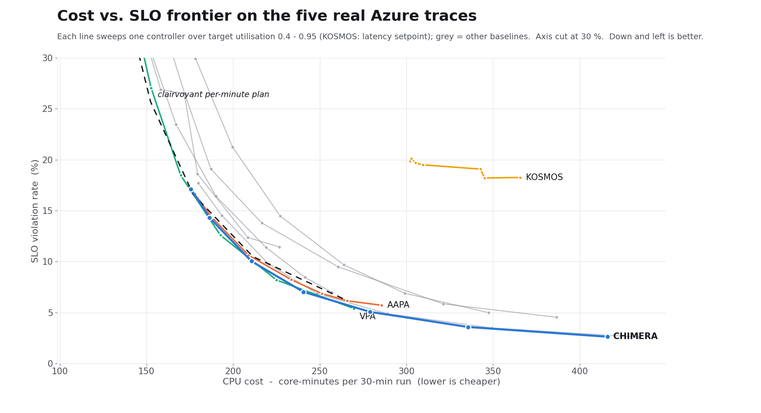
RESULTS & ANALYSIS
Cost and quality must be read together
7.1 %
SLO violations, 5 real traces (next best: AAPA 8.3 %)
241
CPU core-minutes per run (AAPA 234)
READING THE RESULT
At equal CPU, trace by trace, CHIMERA has fewer violations in 39 of 43 comparisons; every loss is on w_0002 (0.7–1.8 pp). It reaches 2.6 % at 416 core-min; no baseline gets below 5.0 %.
VIT Vellore · BCSE303P Operating Systems Laboratory · CHIMERA · Review 2
10 / 21
Notes:
Do not claim a clean win. AAPA beats us on violations by 1.1 points only because it buys 272 pod-minutes against our 147. The dashed points show what a 1.5-core head-start is worth — about 9 points for free.

Slide 11
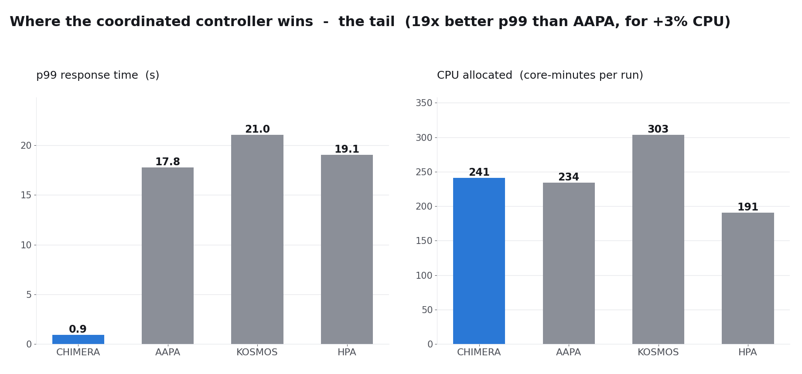
RESULTS & ANALYSIS
Where the coordinated controller wins decisively
19×
better p99 than AAPA (0.91 s vs 17.8 s)
23×
better p99 than KOSMOS, with 2× fewer scaling actions (103 vs 256)
READING THE RESULT
CPU is resized in 0.1 s while pods boot, so requests do not queue for 20 s. At the default 70 % target CHIMERA uses 3 % more CPU than AAPA; the 5 s loop makes 103 in-place resizes per run (v2: 40, KOSMOS: 256).
VIT Vellore · BCSE303P Operating Systems Laboratory · CHIMERA · Review 2
11 / 21
Notes:
These two results are paired t-test significant at p = 0.0001 and below, with very large effect sizes. This is the strongest claim in the project.

Slide 12
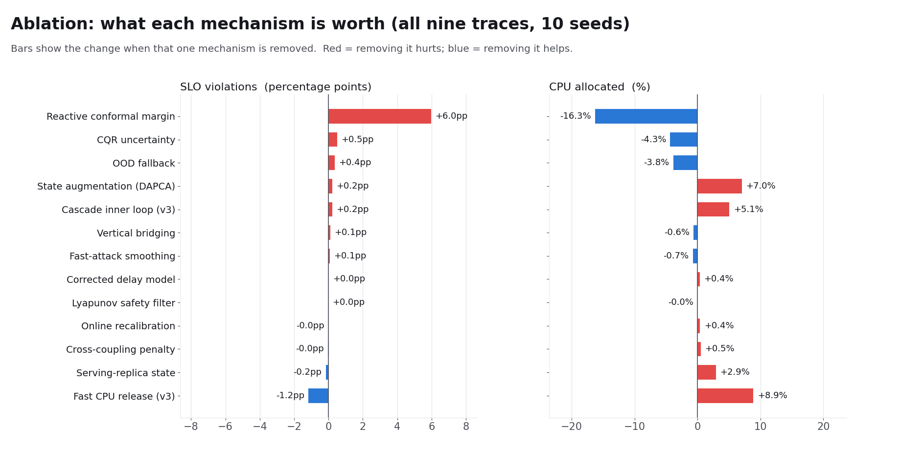
RESULTS & ANALYSIS
Ablation: which modules earn their place
+6.0 pp
SLO cost of removing the reactive conformal margin
+13 %
CPU cost of removing the 5 s cascade (synthetic; real: +4 %)
READING THE RESULT
The conformal margin buys the SLO; the cascade and delay augmentation buy it cheaply (without augmentation: +7 % CPU). The Lyapunov filter, ADWIN and online recalibration show no measurable effect — reported, not hidden.
VIT Vellore · BCSE303P Operating Systems Laboratory · CHIMERA · Review 2
12 / 21
Notes:
Volunteering the two negative results is the right move — it shows the ablation is a real experiment and not a formality. Both are scheduled for rework.

Slide 13
RELATED WORK
Positioning against existing autoscalers
System | Approach | How CHIMERA differs
Kubernetes HPA / VPA | Industry defaults: HPA adds pods reactively; VPA resizes CPU with a fixed pod count. | Drives both levers from one law; run together, HPA + VPA fight.
AAPA | Predictive, pods only; the paper this project builds on. | Adds the vertical axis and models the 20 s boot delay.
KOSMOS (2021) | Both scaling directions, but two separate control laws. | One coordinated law — 23× better tail, 13 pp fewer violations, 2× fewer actions.
GKE Multidimensional Pod Autoscaler | Avoids loop conflict by giving each loop a different metric (CPU vs memory). | Coordinates both loops on the same resource.
ADAPT | Delay-aware, pods only; solves a fresh optimisation every step. | Gain K is computed once, up front.
OptScaler, BACC | Use confidence intervals, pods only; interval feeds a budget. | Interval feeds a Lyapunov stability constraint.
Two related patents | Pick one axis or the other using threshold rules. | Drives both axes at once from a control law.
VIT Vellore · BCSE303P Operating Systems Laboratory · CHIMERA · Review 2
13 / 21
Notes:
The first three rows are systems we measured; the rest are related work we did not run. Their purpose is to show we know the field and exactly how we differ. The patents rows keep our contribution clear of prior art: neither drives both axes from a control law.

Slide 14
ENGINEERING VERIFICATION
Defects found and fixed during verification
Three of these were discovered by auditing our own results rather than by a failing test. Each one changed the published numbers.
1
Pod warm-up delay
2
Baseline headroom confound
Defect New replicas became ready in 0.1 s instead of the real 20 s, giving every horizontal baseline near-instant capacity.
Defect Horizontal-only baselines started at 1.5 cores/pod while CHIMERA started at 0.5 — a 3× advantage.
Fix Pods now constructed with an explicit 20 s startup_time.
Fix All controllers initialise from the same v_min; 1.5-core variants kept as a separate study.
3
CQR calibration leakage
4
DARE solver crash
Defect The conformal calibration window overlapped the test window, inflating coverage above 98 %.
Defect scipy's Riccati solver threw on extreme parameter sweeps and killed the whole run.
Fix Strict disjoint partitions: train 10–50, calibrate 50–70, test 70–100 min.
Fix Falls back to analytical gains; 720 consecutive runs with no crash.
VIT Vellore · BCSE303P Operating Systems Laboratory · CHIMERA · Review 2
14 / 21
Notes:
This slide separates a project that ran experiments from one that verified them. If asked how we found the headroom confound: CHIMERA was losing to HPA by a suspiciously large margin, so we read the baseline config rather than accepting the number.

Slide 15
KUBERNETES INTEGRATION
From simulator to cluster
Complete
Complete
Complete
CustomResourceDefinition
RBAC + controller manifest
Container image
chimeraautoscalers.autoscaling.k8s.io declares bounds, target utilisation, pod start-up time and resize mode as a first-class cluster object, with a status subresource.
Patch rights on deployments, deployments/scale and pods/resize.
Slim image: the operator and control core only (numpy, scipy, kubernetes client).
Complete
Complete
Ready to run
Reconciler loop
Prometheus adapter
In-place resize on a live cluster
Every 15 s: reads pods and Ready count, runs the control step, resizes CPU in place, scales replicas, writes status. Tested end to end against a simulated API.
Real PromQL client over HTTP, tested against a live HTTP server; default query reads cAdvisor CPU usage.
Quickstart pins kind on Kubernetes 1.33 (in-place resize on by default). Not yet run on a live cluster.
VIT Vellore · BCSE303P Operating Systems Laboratory · CHIMERA · Review 2
15 / 21
Notes:
Be explicit that the operator has not run against a live cluster yet. The CRD and RBAC are real and reviewable; the telemetry is not.

Slide 16
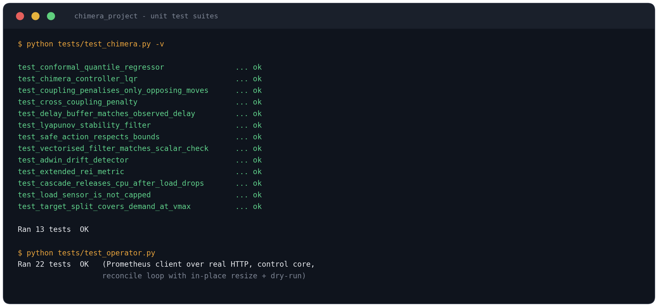
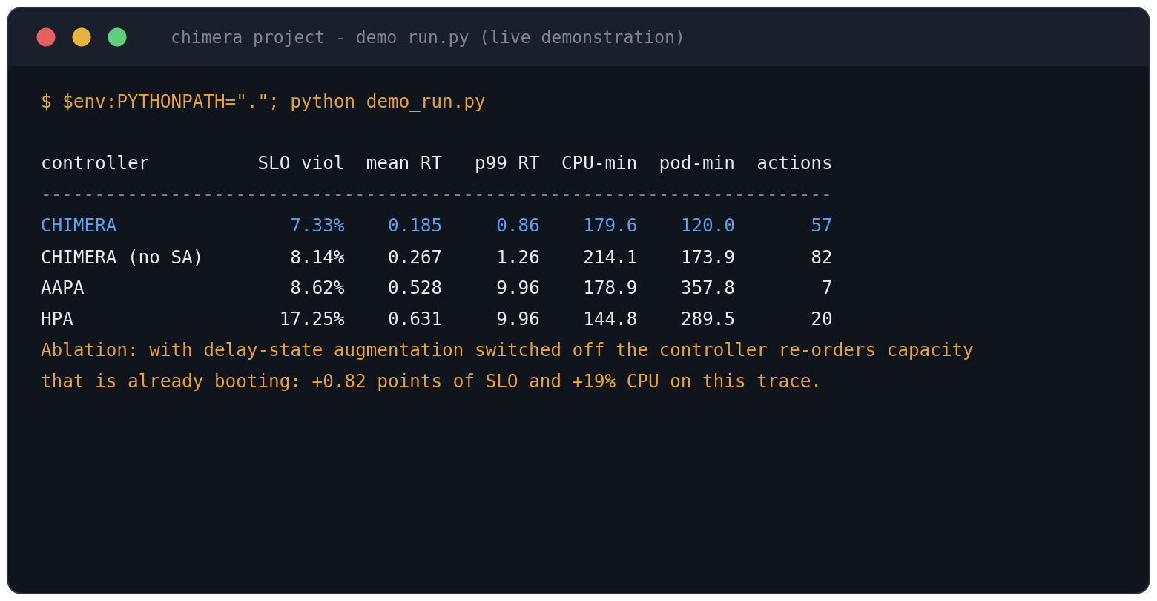
OUTPUTS
Test suite and the live demonstration run
Unit tests All 35 pass: controller maths, delay model, coupling, sensor and target-split fixes, Prometheus client over HTTP, operator reconcile loop.
demo_run.py Real trace w_0004, seed 42: 7.33 % SLO violations vs AAPA 8.62 % and HPA 17.25 %, at 180 CPU-min (AAPA 179, HPA 145). Without delay augmentation: +19 % CPU.
VIT Vellore · BCSE303P Operating Systems Laboratory · CHIMERA · Review 2
16 / 21
Notes:
These are real outputs from the project source. Do not say we use half the resources: pod-minutes count pods, not CPU, and our pods are bigger. In CPU we use about 12% more. The correct claim: about the same CPU, less than half the pods, 4.8 points better — and every pod avoided is a 20-second cold start avoided.

Slide 17
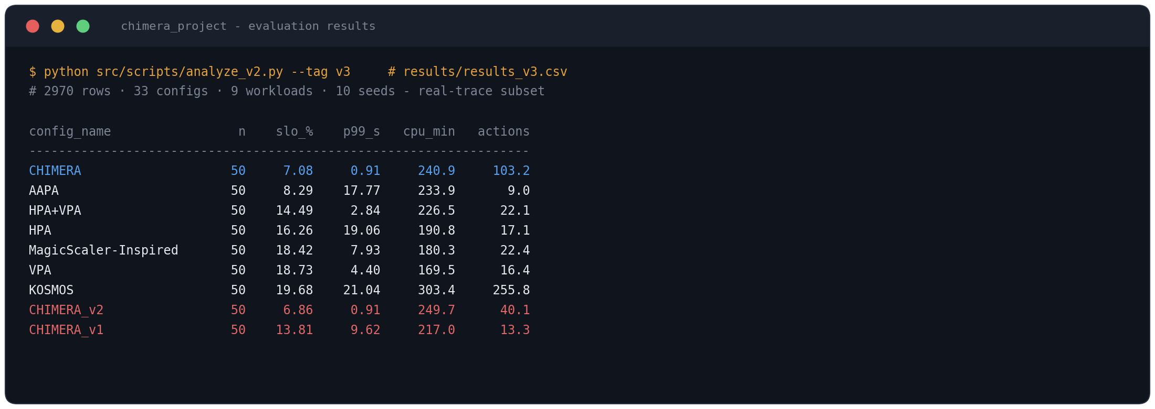
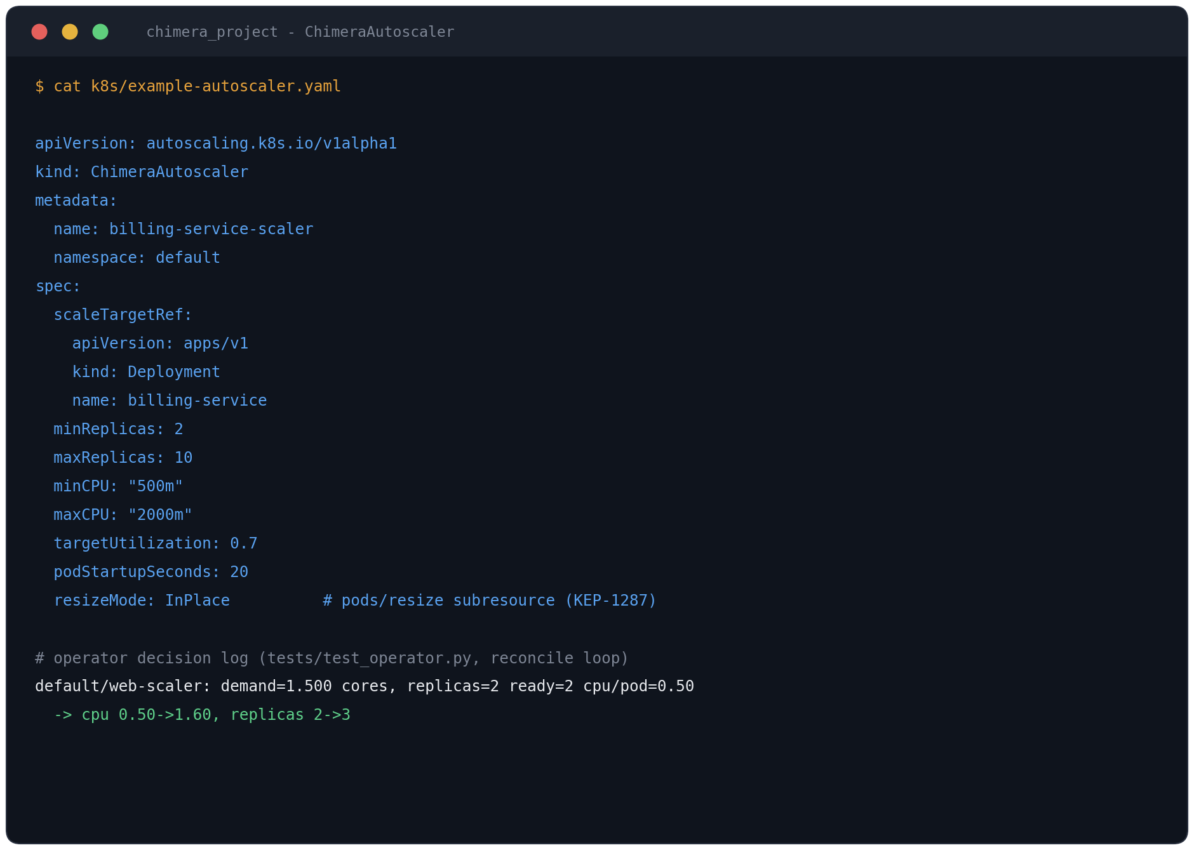
OUTPUTS
Results database and cluster objects
results_v3.csv Every run of the 2,970-run evaluation; src/scripts/analyze_v2.py turns it into the report, statistics and frontier. Review-2 data is kept unmodified.
2,970
33
9
10
Example custom resource k8s/example-autoscaler.yaml, applied by the quickstart; the decision log below it is from the reconcile-loop test.
rows
configurations
workloads
seeds
VIT Vellore · BCSE303P Operating Systems Laboratory · CHIMERA · Review 2
17 / 21
Notes:
If the examiner spots identical HPA and HPA+VPA rows: we found that ourselves — the vertical loop never fires in that configuration because per-pod CPU stays below the minimum we allow, so that row is currently plain HPA. It is on our fix list.

Slide 18
LIVE DEMONSTRATION
One command, about ten seconds
PowerShell, from the project folder
1
Setup
$env:PYTHONPATH="."; python demo_run.py
Trace w_0004 (ramp), 500 ms SLO, 20 s vs 0.1 s delays, seed 42 for all controllers.
2
Control law
Same code as the full evaluation — the demo calls the harness's own run_simulation on one workload. The full evaluation takes ~30 minutes on 12 cores and writes results_v3.csv.
3×3 augmented A matrix (one in-flight slot); all Riccati eigenvalues positive — V = eᵀPe is a valid Lyapunov function.
3
Results
CHIMERA 7.33 % vs AAPA 8.62 % vs HPA 17.25 %; without delay augmentation it spends +19 % CPU.
BEFORE THE REVIEW
Cluster behaviour
Run the demo once to warm Python imports
Clear the terminal with cls
Have the command pre-typed; only press Enter
4
HPA’s CPU line is flat — one lever, so it swings between 2 and 12 pods. CHIMERA holds 4 and moves CPU instead.
5
Contribution, step by step
At t = 15 s: +2 pods ordered one tick earlier are still booting, so the controller holds instead of re-ordering them.
VIT Vellore · BCSE303P Operating Systems Laboratory · CHIMERA · Review 2
18 / 21
Notes:
If asked why the demo and not the whole project: the demo runs the same code as our full evaluation — it's one workload out of the 720 runs. It finishes in three seconds so you can watch it; the full sweep takes several minutes, only prints a progress log, and would overwrite the saved results our report is built on.

Slide 19
CRITICAL EVALUATION
Known limitations and what comes next
Current limitations
Next milestones
Evaluation uses 100-minute excerpts of five real traces — too narrow to claim general performance.
The operator has not yet run on a live Kubernetes cluster (code and tests are complete).
Lyapunov filter, ADWIN and online recalibration show no measurable effect in ablation.
At equal CPU CHIMERA loses on one real trace (w_0002, periodic) by 0.7–1.8 pp.
The 5 s loop makes 2.6× more in-place resizes than v2 (103 vs 40 per run).
The reactive margin was tuned after seeing the synthetic traces (the cascade on a dev split).
Convert the full Azure Functions 2019 dataset — 10,000+ workloads.
Run the quickstart on kind 1.33 and record a live trace.
Remove or rework the Lyapunov filter and ADWIN.
Add a periodic-aware forecaster for traces like w_0002.
Sweep horizontal delay from 5 s to 80 s.
Rate-limit the inner loop to cut resize churn further.
VIT Vellore · BCSE303P Operating Systems Laboratory · CHIMERA · Review 2
19 / 21
Notes:
Naming your own limitations before the panel does is the difference between a defensive review and a confident one. Every item on the left has a matching item on the right.

Slide 20
REFERENCES
References
M. Shahrad et al., "Serverless in the Wild: Characterizing and Optimizing the Serverless Workload at a Large Cloud Provider," USENIX ATC, 2020. (Azure Functions 2019 trace)
Y. Romano, E. Patterson, E. Candès, "Conformalized Quantile Regression," NeurIPS, 2019.
A. Bifet, R. Gavaldà, "Learning from Time-Changing Data with Adaptive Windowing," SIAM SDM, 2007. (ADWIN)
Kubernetes Enhancement Proposal KEP-1287, "In-Place Update of Pod Resources."
Kubernetes documentation, "Horizontal Pod Autoscaling" and "Vertical Pod Autoscaler."
Google Cloud documentation, "Multidimensional Pod Autoscaling" (GKE).
VIT Vellore · BCSE303P Operating Systems Laboratory · CHIMERA · Review 2
20 / 21
Notes:
Add the full citations for AAPA and KOSMOS here as they appear in the report.

Slide 21
CONCLUSION
A single control law for two actuators with very different delays.
7.1 %
6,120
19×
39 / 43
SLO violations, real traces (next best 8.3 %)
simulation runs, 10 seeds
better p99 than AAPA
equal-CPU comparisons won, trace by trace
CHIMERA has the fewest violations of every controller, by far the best tail, and wins 39 of 43 equal-CPU comparisons — all 17 on the synthetic stress traces. Next milestone: a live cluster.
Thank you · Questions
VIT Vellore · BCSE303P Operating Systems Laboratory · CHIMERA · Review 2
21 / 21
Notes:
Likely questions: why LQR over MPC (cost per tick); why 12.9% still fail on the demo trace (70% utilisation target puts mean latency right at the 500 ms limit — same target as HPA, where we are 4.8 points better); has it run on a real cluster (no — the reader of live traffic still returns test numbers; that is the next milestone).

